Slide 1






Future Circular Collider Study and EuroCirCol Design Study
Overview and Status, M. Benedikt
gratefully acknowledging input from FCC coordination group,
global FCC and EuroCirCol design study team and all other contributors
LHC
HE-LHC
PS
SPS
FCC
http://cern.ch/fcc
Work supported by the European Commission under the HORIZON 2020 projects EuroCirCol, grant agreement 654305; EASITrain, grant agreement no. 764879; ARIES, grant agreement 730871; and E-JADE, contract no. 645479
photo: J. Wenninger
photo: J. Wenninger

Slide 2


FCC-pp collider parameters
parameter | FCC-hh |  |  | HE-LHC | HL-LHC | LHC
collision energy cms [TeV] | 100 |  |  | 27 | 14 | 14
dipole field [T] | 16 |  |  | 16 | 8.33 | 8.33
circumference [km] | 97.75 |  |  | 26.7 | 26.7 | 26.7
beam current [A] | 0.5 |  |  | 1.1 | 1.1 | 0.58
bunch intensity [10¹¹] | 1 |  | 1 | 2.2 | 2.2 | 1.15
bunch spacing [ns] | 25 |  | 25 | 25 | 25 | 25
synchr. rad. power / ring [kW] | 2400 |  |  | 101 | 7.3 | 3.6
SR power / length [W/m/ap.] | 28.4 |  |  | 4.6 | 0.33 | 0.17
long. emit. damping time [h] | 0.54 |  |  | 1.8 | 12.9 | 12.9
beta* [m] | 1.1 | 0.3 |  | 0.45 | 0.15 (min.) | 0.55
normalized emittance [μm] | 2.2 |  |  | 2.5 | 2.5 | 3.75
peak luminosity [10³⁴ cm⁻²s⁻¹] | 5 |  | 30 | 16 | 5 (lev.) | 1
events/bunch crossing | 170 |  | 1000 | 460 | 132 | 27
stored energy/beam [GJ] | 8.4 |  |  | 1.3 | 0.7 | 0.36

Slide 3
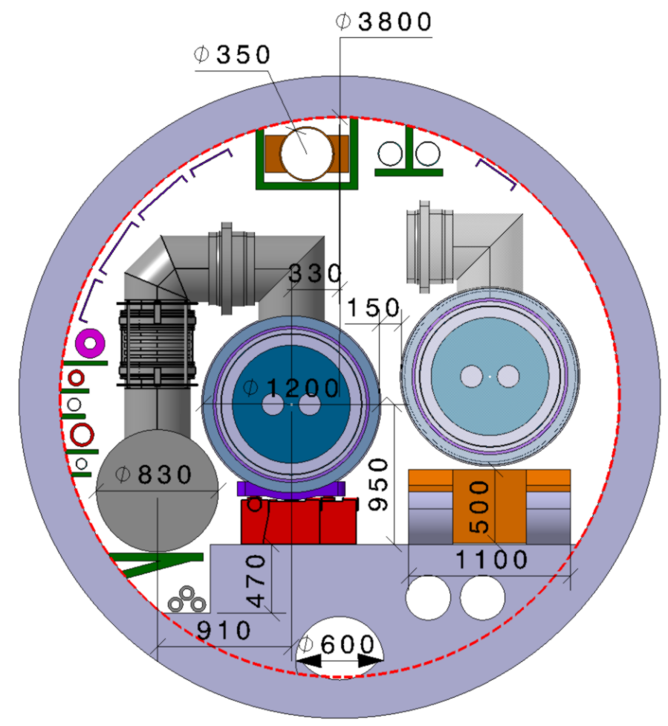
HE-LHC integration aspects
  Working hypothesis for HE LHC design:
  No major CE modifications on tunnel and caverns
  Similar geometry and layout as LHC machine & experiments
  Maximum magnet cryostat diameter ~1200 mm
  Maximum QRL diameter ~830 mm
  LHC tunnel diameter 3.8 m
Integration strategy:
Development of optimized 16 T magnet, compatible with both HE LHC and FCC-hh
New cryogenic layout to limit QRL dimension

Slide 4
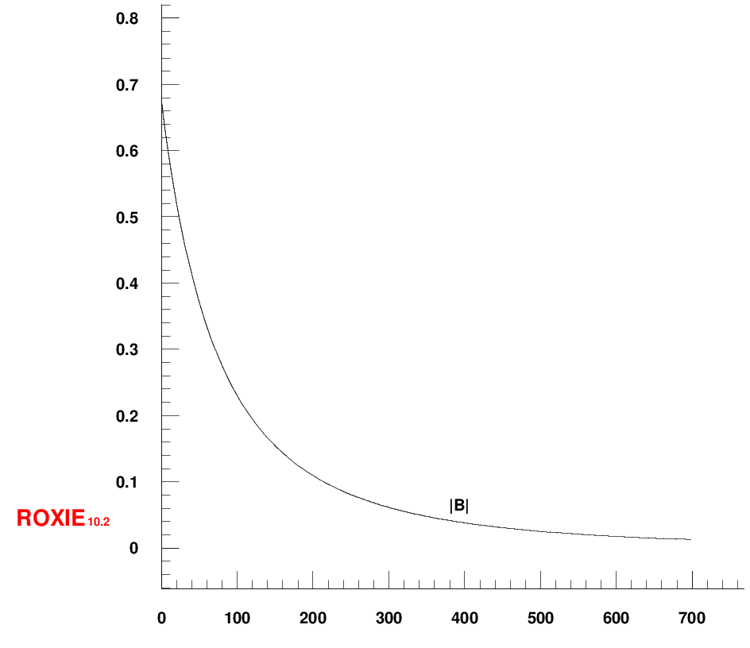
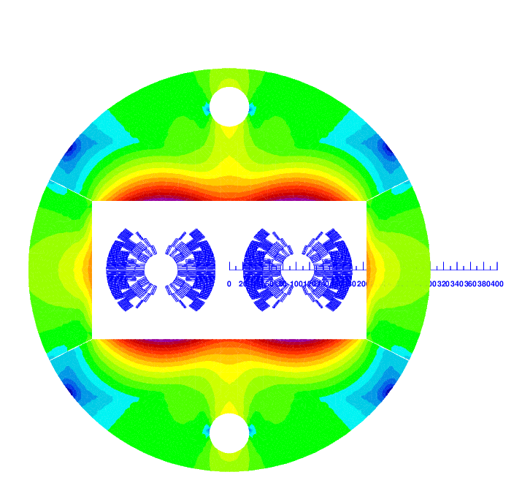
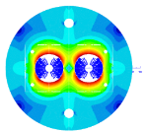
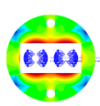
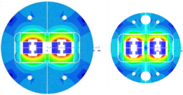
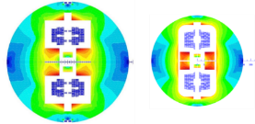
16 T dipole design evolution
  Coil optimization and margin 18 → 14%
  Inter-beam distance 250 → 204 mm
  Stray-field < 0.1 T at cryostat
Description | ID in mm | OD in mm
Iron yoke | - | 600
Aluminium shrinking cylinder | 600 | 740
Stainless steel He tight shell | 740 | 760
Al radiation shield | 934 | 940
Vacuum vessel (magnetic steel) | 1120 | 1220
Fringe field – x axis [T]
800 mm 600 mm
cold mass 40t
total mass 62t
Cosine-theta (baseline)
0 700 mm
Field [T]
Block-type coils
0.06 T at cryostat edge 600 mm radius
Common-coils
2015 2017
mm distance from yoke

Slide 5
FCC-hh design – evolution since Berlin
L* 40 m
Experimental insertion adaption
Overall lenght 1.400 m
Optimisation work on betatron and momentum collimation systems
Optimisation of extraction/dump line design
Vertical extraction
Combination of injection with low luminosity experiments

Slide 6
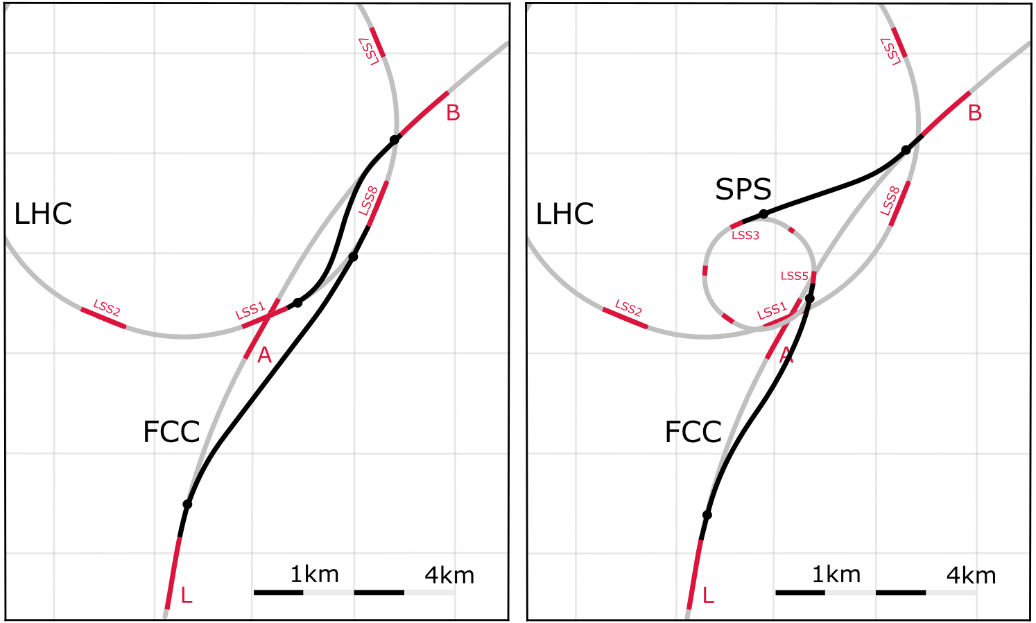
FCC-hh injector options and transfer lines
Baseline:
LHC @ 3.3 TeV
Alternative:
scSPS @ 1.3 TeV
Current baseline:
Injection energy 3.3 TeV LHC
→ Field-swing FCC-hh like LHC
Alternative options:
Injection from SPS_{upgrade} around 1.3 TeV
SPS_{upgrade} could be based on fast-cycling SC magnets, 6-7T, ~ 1T/s ramp, cf. SIS 300 design
SPS_{upgrade} would also be an ideal injector for HE LHC (as alternative to the 450 GeV SPS)
Total of O(5.5 km) superconducting bends in transferlines from LHC, at 7.2 T
O(6.5 km) normal-conducting bends from SPS, at 1.8 T

Slide 7
FCC-hh beam power handling: collision debris
500kW debris per experiment (HL-LHC x 42)
For 30 ab-1 | max. dose | Comment
radiation in triplet | 70 (40) MGy | today’s limit 30 Mgy (for rotated crossing)
heat load In triplet | 4.5 mW | expected limit (with safety margin) 5 mW
radiation in dipole | 90 MGy unshielded | today’s limit 30 MGy; better protection possible
triplets protected by 35 mm inner lining (tungsten shielding)

Slide 8
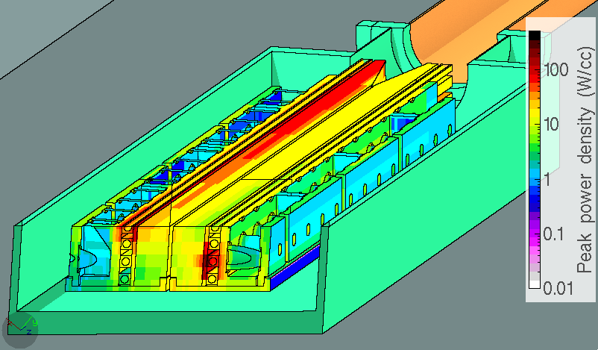
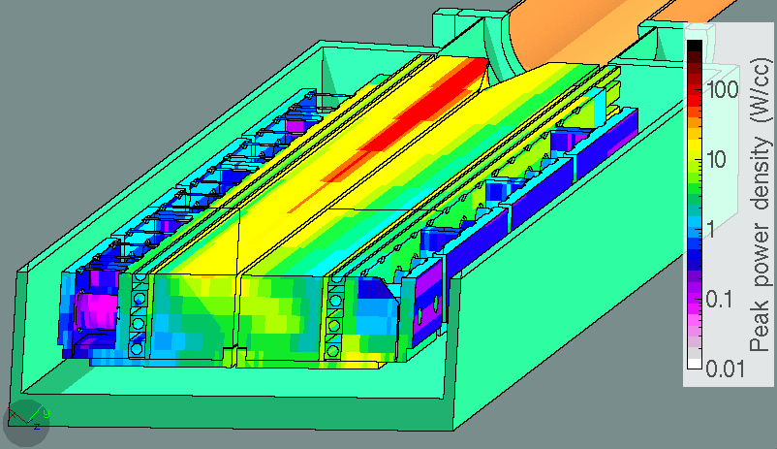
Beam handling: robust low-loss collimation
Complete designs of collimation insertions, main issue: sustain beam lifetime of 12 mins (12 MW loss)
1 MW
50 kW/m
FLUKA simulations highlighted four critical points
1st Secondary Collimator
Old design
<5 kW
max power density
800 Wcm⁻³
total power
225 kW
260 kW
225 kW
New design
Primary Collimators
Active length halved
Max. power reduced from 260 kW to 80 kW
50 to 100 kW considered OK
max power density
115 Wcm⁻³
total power
92 kW
Arc protection Protection design offers sufficient margin

Slide 9
Worldwide FCC Nb₃Sn program
5400 mm²
3150 mm²
Main development goal is wire performance increase:
J_{c} (16T, 4.2K) > 1500 A/mm² →50% increase wrt HL-LHC wire
Reduction of coil & magnet cross-section
~1.7 times less SC
~10% margin
HL-LHC
~10% margin
FCC ultimate
After only one year development, prototype Nb₃Sn wires from several new industrial FCC partners already achieve HL-LHC performance
Conductor activities for FCC started in 2017:
Bochvar Institute (production at TVEL), Russia
KEK (Jastec and Furukawa), Japan
KAT, Korea
Columbus, Italy
University of Geneva, Switzerland
Technical University of Vienna, Austria
SPIN, Italy
University of Freiberg, Germany
  In addition, agreements under preparation:
  Bruker, Germany
  Luvata Pori, Finland
Notes:
New slide from Davide.
Showing that conductor development is launched at international level, Russia, Japan, (Korea and Europe in preparation)
Underline importance of that development as main cost driver for the hadron collider machine.

Slide 10

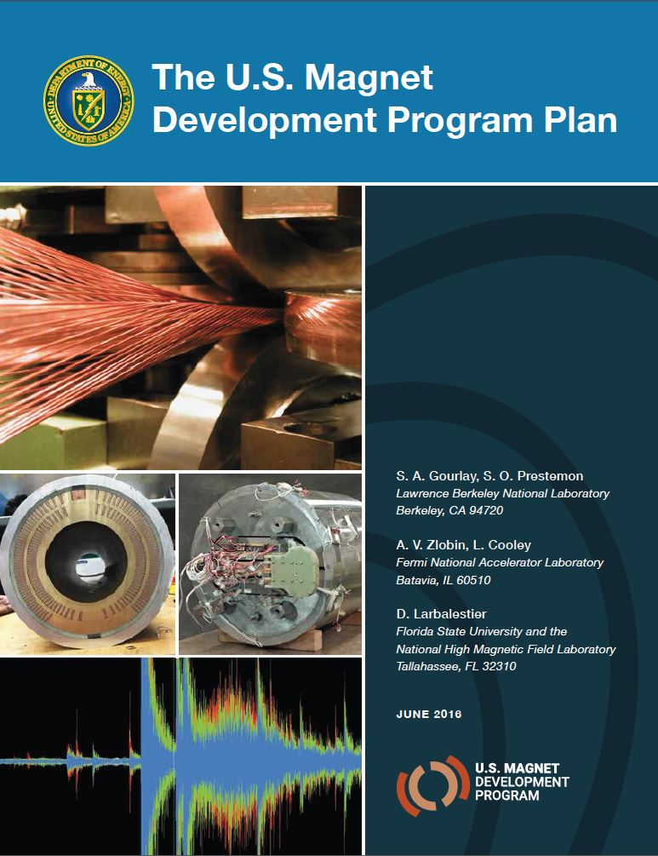
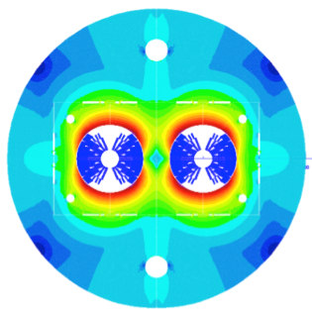
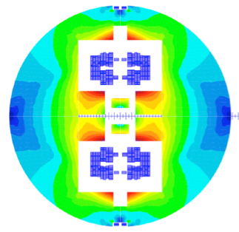

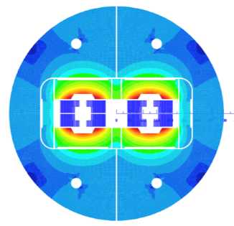
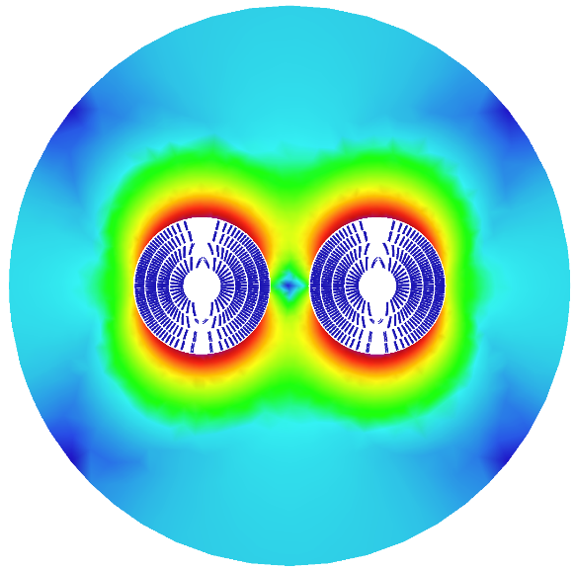
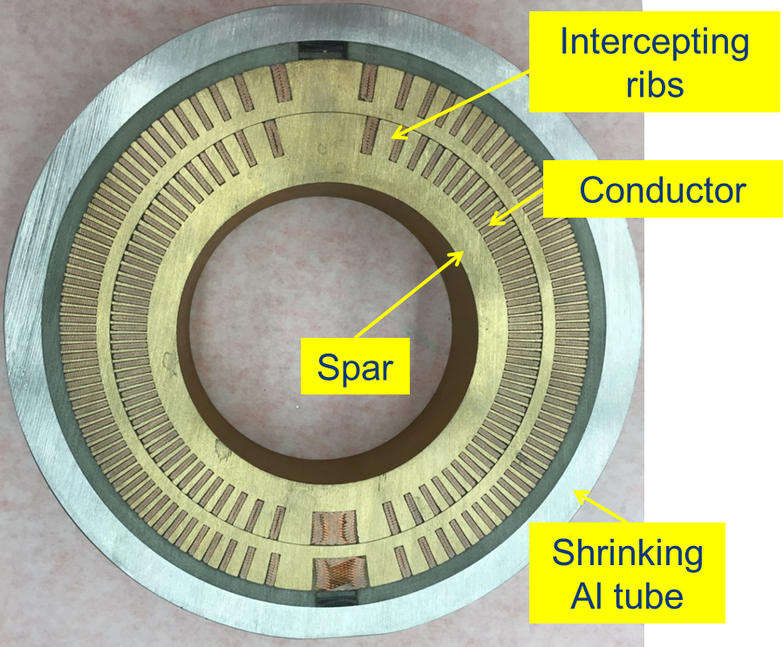
16 T dipole design activities and options
H2020
Swiss contribution
Cos-theta
Common coils
Canted
Cos-theta
Blocks
INFN
CIEMAT
LBNL
CEA
PSI
FNAL
Short model magnets (1.5 m lengths) will be built from 2018 – 2022
Russian 16 T magnet program launched by BINP recently.

Slide 11

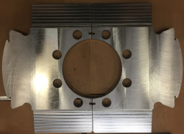
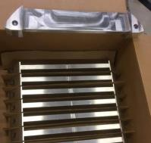
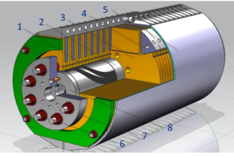
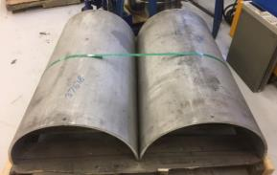
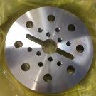
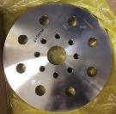
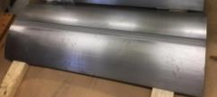
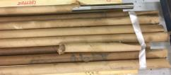
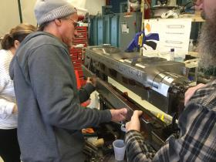
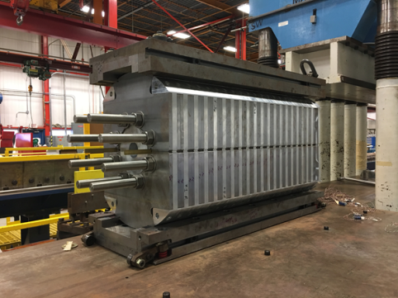
15 T dipole demonstrator (US-MDP)
Iron Laminations
AL I-Clamps
StSt Skin
End Plates
Fillers
Axial Rods
All coil parts, structural components and tooling are available at FNAL
Coil fabrication and the work with mechanical structure are in progress
First magnet test in September 2018

Slide 12
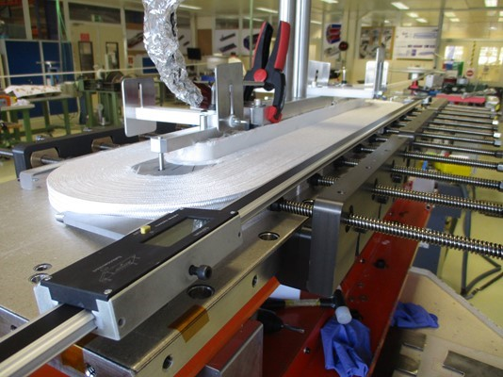
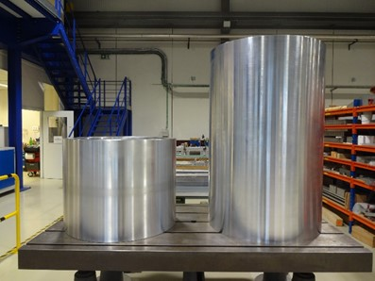
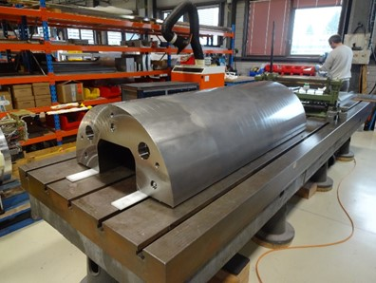
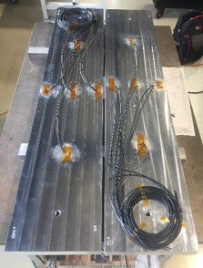
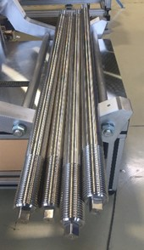
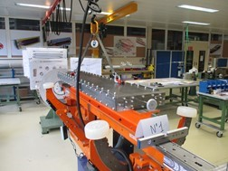
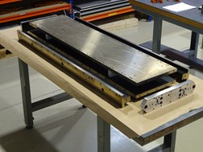
16 T ERMC construction at CERN
Aluminum shell
Coil fabrication
  Winding of the first coil has been completed
  Preparation for reaction on-going
  All tooling for coil production ready
Magnet yoke
First ERMC coil winding
Magnet assembly
  components and tooling ready
  Dummy assembly to characterize the structure behavior on-going.
Coil Reaction Tool
Coil Impregnation Tool
Dummy coils
Axial rods

Slide 13
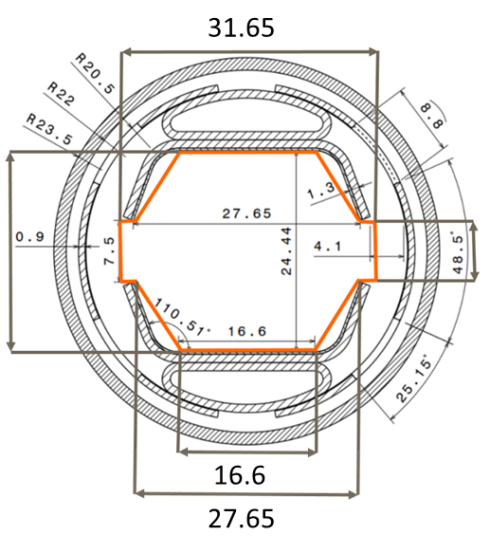
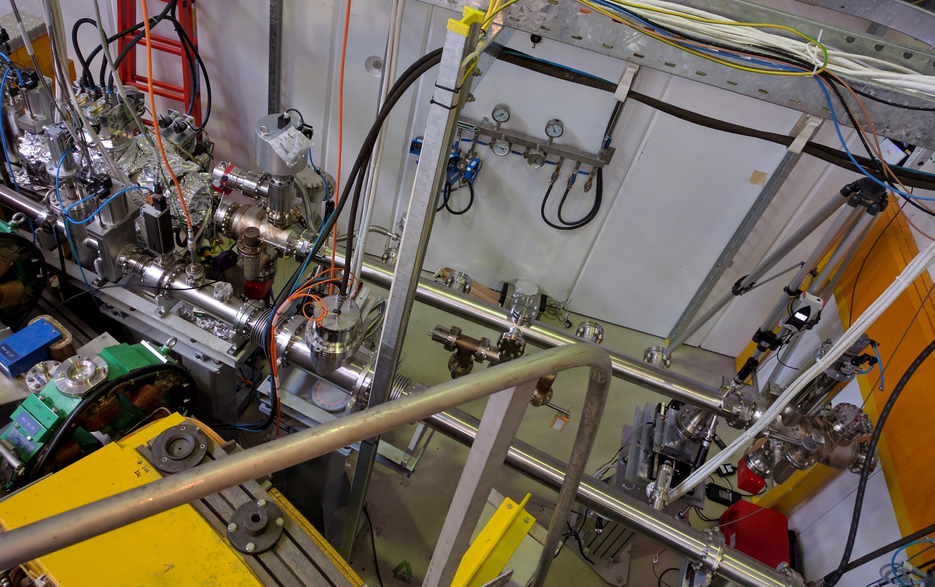
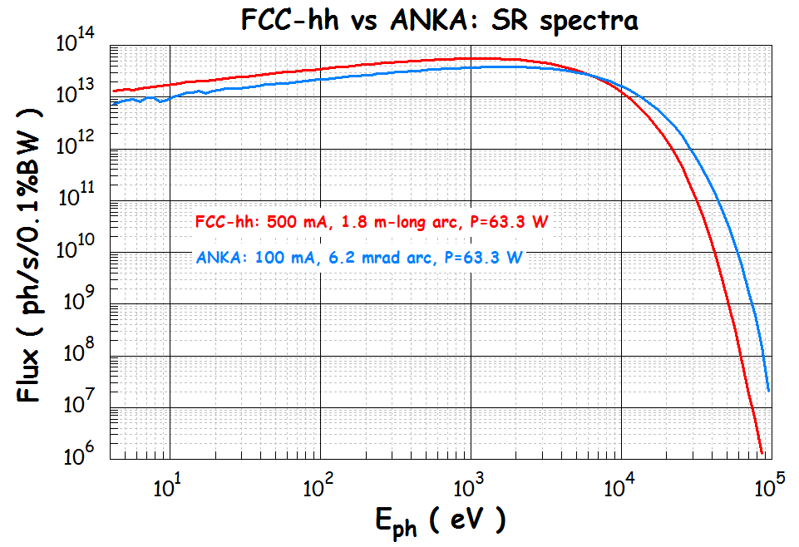
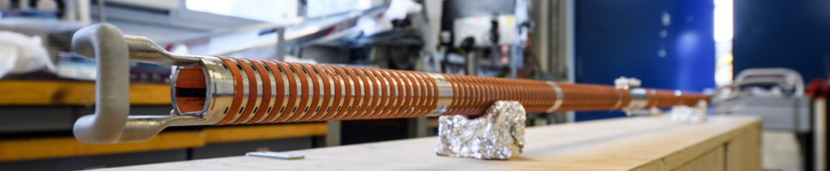
FCC-hh cryogenic beam vacuum system
synchrotron radiation (~ 30 W/m/beam (@16 T field) (cf. LHC <0.2W/m) ~ 5 MW total load in arcs
absorption of synchrotron radiation at higher temperature (> 1.8 K) for cryogenic efficiency
FCC-hh beam-screen test set-up at ANKA/Germany:
beam tests since June 2017, with 3 prototypes
X-ray fan
ANKA e⁻ photon spectrum
= FCC –hh spectrum
2.5 GeV ANKA/KIT storage ring

Slide 14
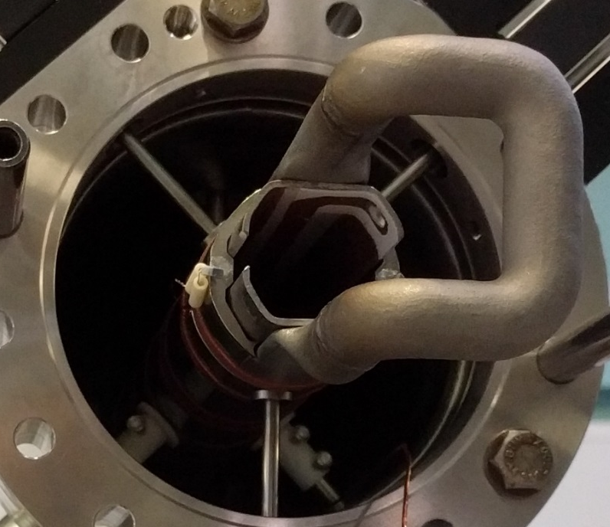
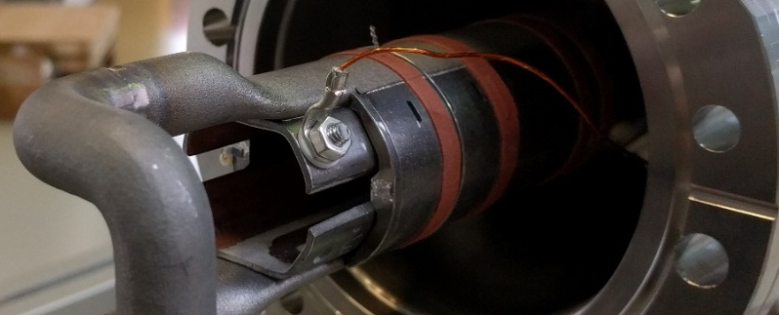
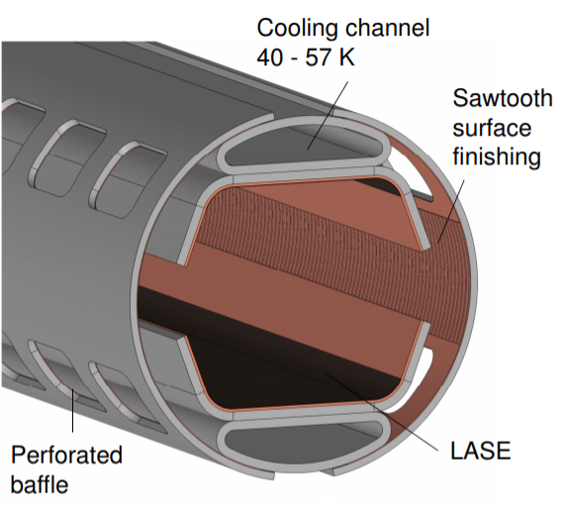
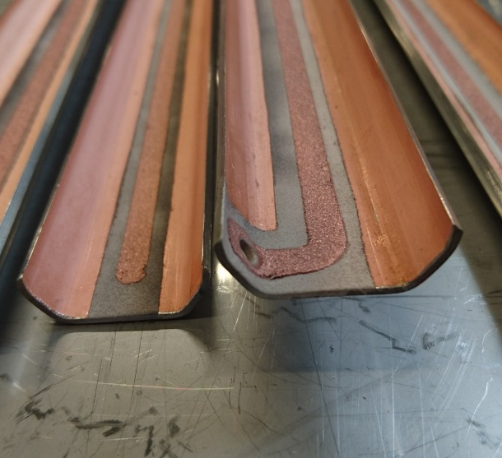
FCC-hh: beam screen evolution & tests
Optimised BS design in view of:
Mass production
Impedance optimization
e- cloud mitigation
latest version to be tested summer ‘18
Cold Sprayed Isolated Electrode
(e-cloud mitigation option)
Measurements at KARA/KIT (pressure evolution) confirm MC vacuum simulations
Confident to use simulations for all vacuum design
Design optimisation:
Ribs removed; Optimization of thickness of copper and steel
Connection absorber/cooling tube, and welding positions

Slide 15
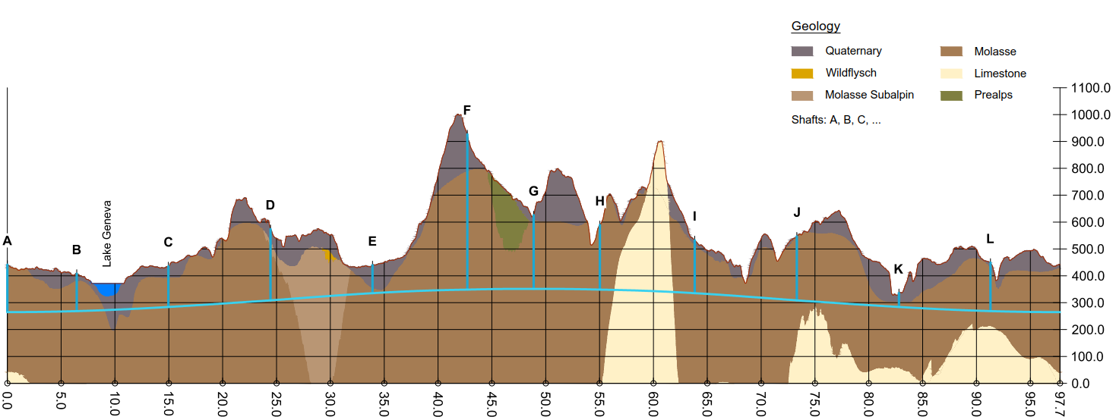
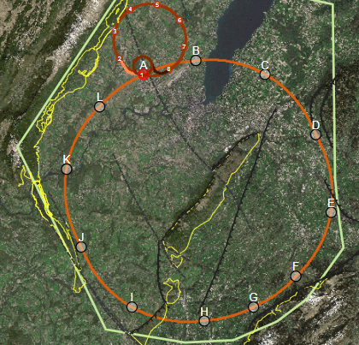
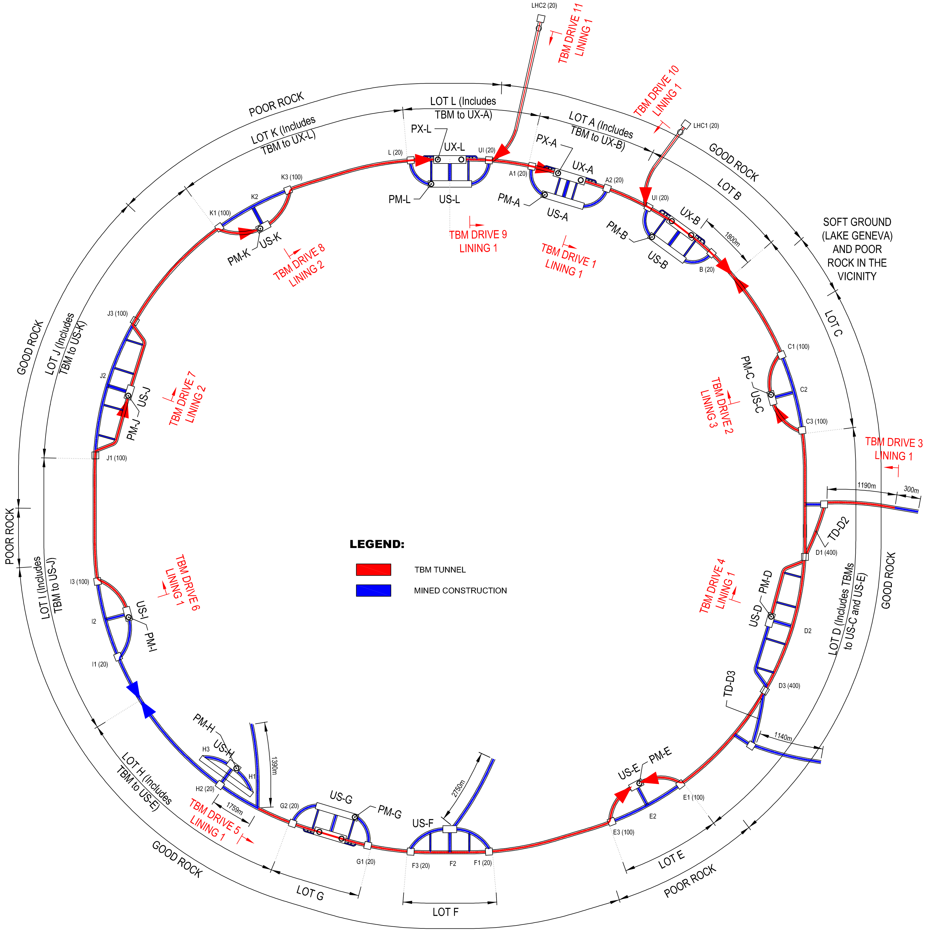
FCC implementation - footprint baseline
Present baseline position was established considering:
lowest risk for construction
fastest and cheapest construction
feasible positions for large span caverns (most challenging structures)
next step: review of surface site locations and machine layout

Slide 16
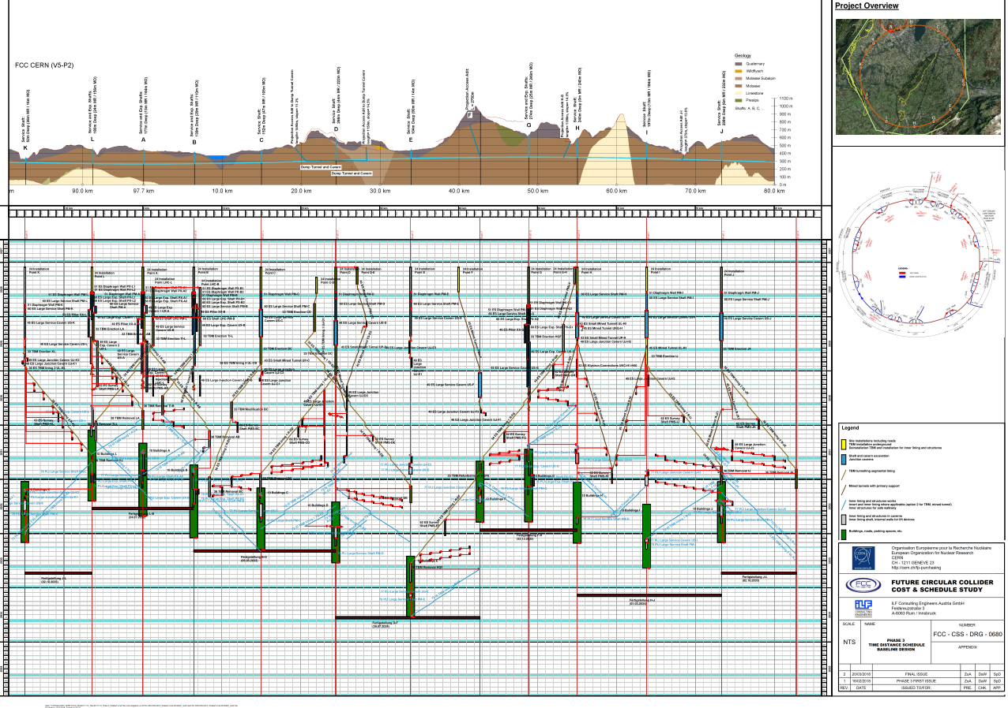
CE schedule studies
4.5yrs
6.5yrs
Total construction duration 7 years
First sectors ready after 4.5 years

Slide 17
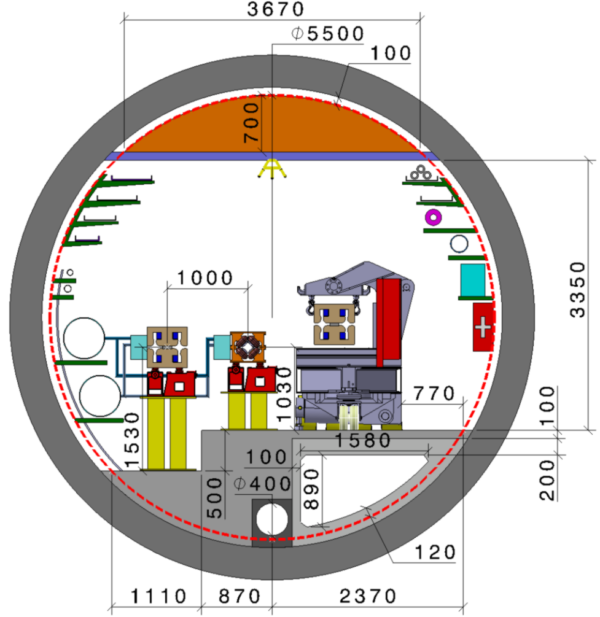
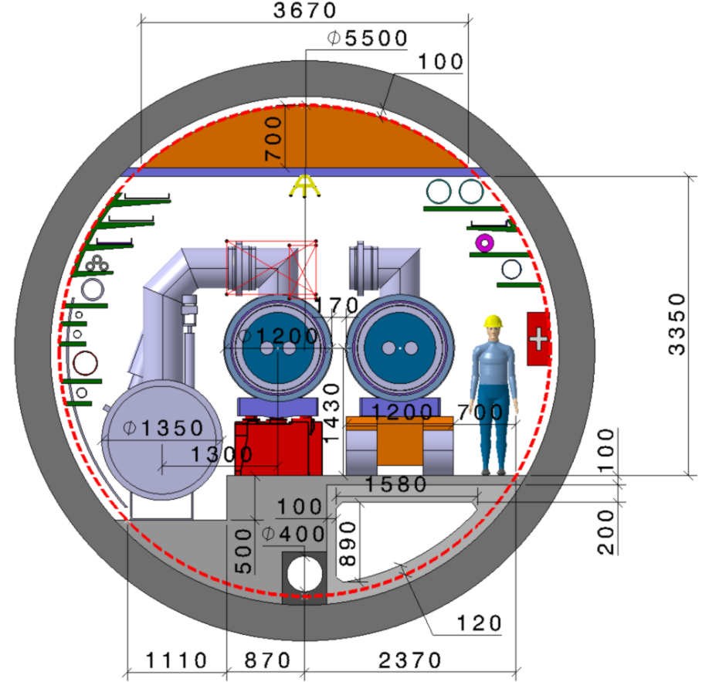
FCC – tunnel integration in arcs
  FCC-ee FCC-hh
  5.5 m inner diameter

Slide 18
Technical Schedule for each of the 3 options
20
22
24
26
28
30
32
34
36
38
40
42
Technical Design Phase
Strategy Update 2026 – assumed project decision
Dipole short models
Dipole long models
16 T magnets
SC Magnets
16 T dipole indust. prototypes
16 T dipoles preseries
16 T series production
Civil Engineering FCC-hh ring
FCC-hh
FCC-hh
CE TL to LHC
LHC Modification
Installation + test FCC-hh
CE FCC-ee ring + injector
FCC-ee
FCC-ee
Injector
Installation + test FCC-ee
LHC Removal
HE-LHC
HE-LHC
schedule constrained by 16 T magnets & CE
→ earliest possible beam operation dates
FCC-ee: 2039
FCC-hh: 2043
HE-LHC: 2040 (with HL-LHC stop LS5 / 2034)
Installation HE-LHC

Slide 19
Further Planning – CDR Production
CDR Concise summary volumes 1 (PH), 2 (hh), 4 (ee), 6 (HE):
  Completion of design work, coherent and consistent contents for concise volumes by end June 2018.
  Overall final editing July – August 2018
  Proof reading and approval September – October
  “Print-ready” versions by November 2018
CDR long technical volumes 3, 5, 7:
  Collection of input (from status June 2018) during July – October 2018.
  Overall volume editing November 2018 – January 2019
  Proof reading and approval February – March 2019
Cost study based on CDR status (June 2018), other documents for ESU, June - November 2018

Slide 20

Global FCC Collaboration
124
Institutes
30
Companies
32
Countries
EC
H2020

Slide 21

EASITrain Marie Curie Training Network
European Advanced Superconductivity Innovation and Training Network
Started 1 October 2017, by now 14 of 15 Early Stage Researchers hired & active.
SC wires at low temperatures for magnets (Nb₃Sn, MgB₂, HTS)
Superconducting thin films for RF and beam screen (Nb₃Sn, Tl)
Electrohydraulic forming for RF structures
Turbocompressor for Nelium refrigeration
Magnet cooling architectures
Horizon 2020 program
Funding for 15 Early Stage Researchers over 3 years & training
13 Beneficiaries
I-CUBE
12 Partners

Slide 22
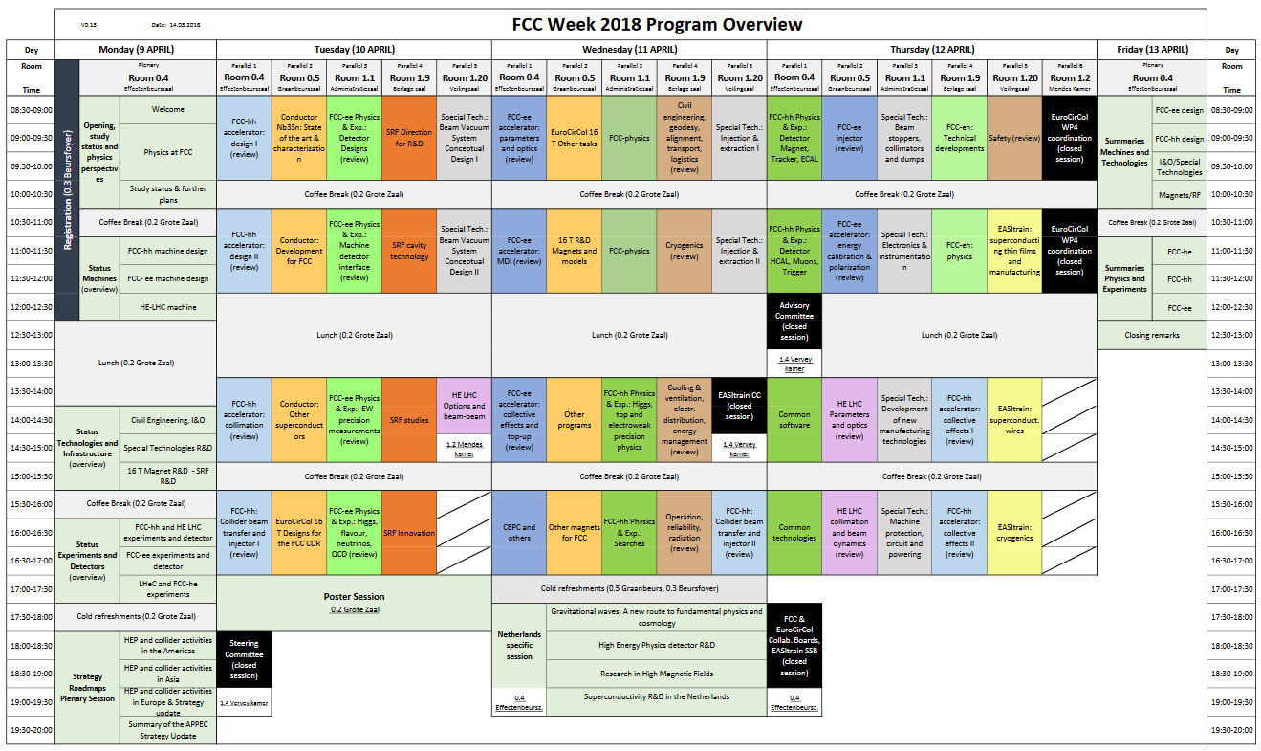
FCC week 2018 – Amsterdam
475 participants
285 presentations and 80 posters

Slide 23
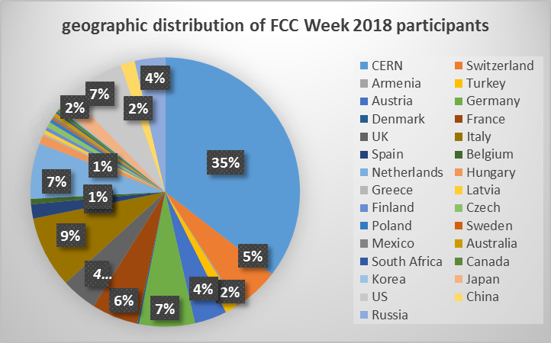

Slide 24
EuroCirCol update
Mid-term review:
The mid-term review of the project took place during the third FCC week in Berlin in May 2017. The reviewer was Oliver Kester from TRIUMF.
No strict recommendations has been made by the reviewer, who assessed that the project is very well on track.
WP3 management change:
WP leader Andre SERYI (JAI) has left the project (and JAI to join JLAB) and is replaced by the WP deputy R. Tomas (CERN).
All milestones and deliverables were submitted in time
2nd Periodic Report will be submitted this week (December 2016 – May 2018)

Slide 25
Next meetings
EuroCirCol autumn meeting:
Autumn meeting (2 days)
17-18 October 2018 at Karlsruhe Institute of Technology (Germany)
FCC ‘CDR’ presentation event:
29 January 2019, Paris (France)
FCC week 2019:
FCC Week, combined with Final EuroCirCol Study Meeting
24-28 June 2019, Brussels (Belgium)

Slide 26
Conclusions
Good advancement of the FCC/EuroCirCol studies in all areas
Worldwide R&D programme in place, on Nb₃Sn superconductor, high-field magnets, and on highly-efficient SC RF
Good progress on all key technologies
International FCC collaboration growing steadily
Focus now on the CDRs, as input for European Strategy Update

