Slide 1
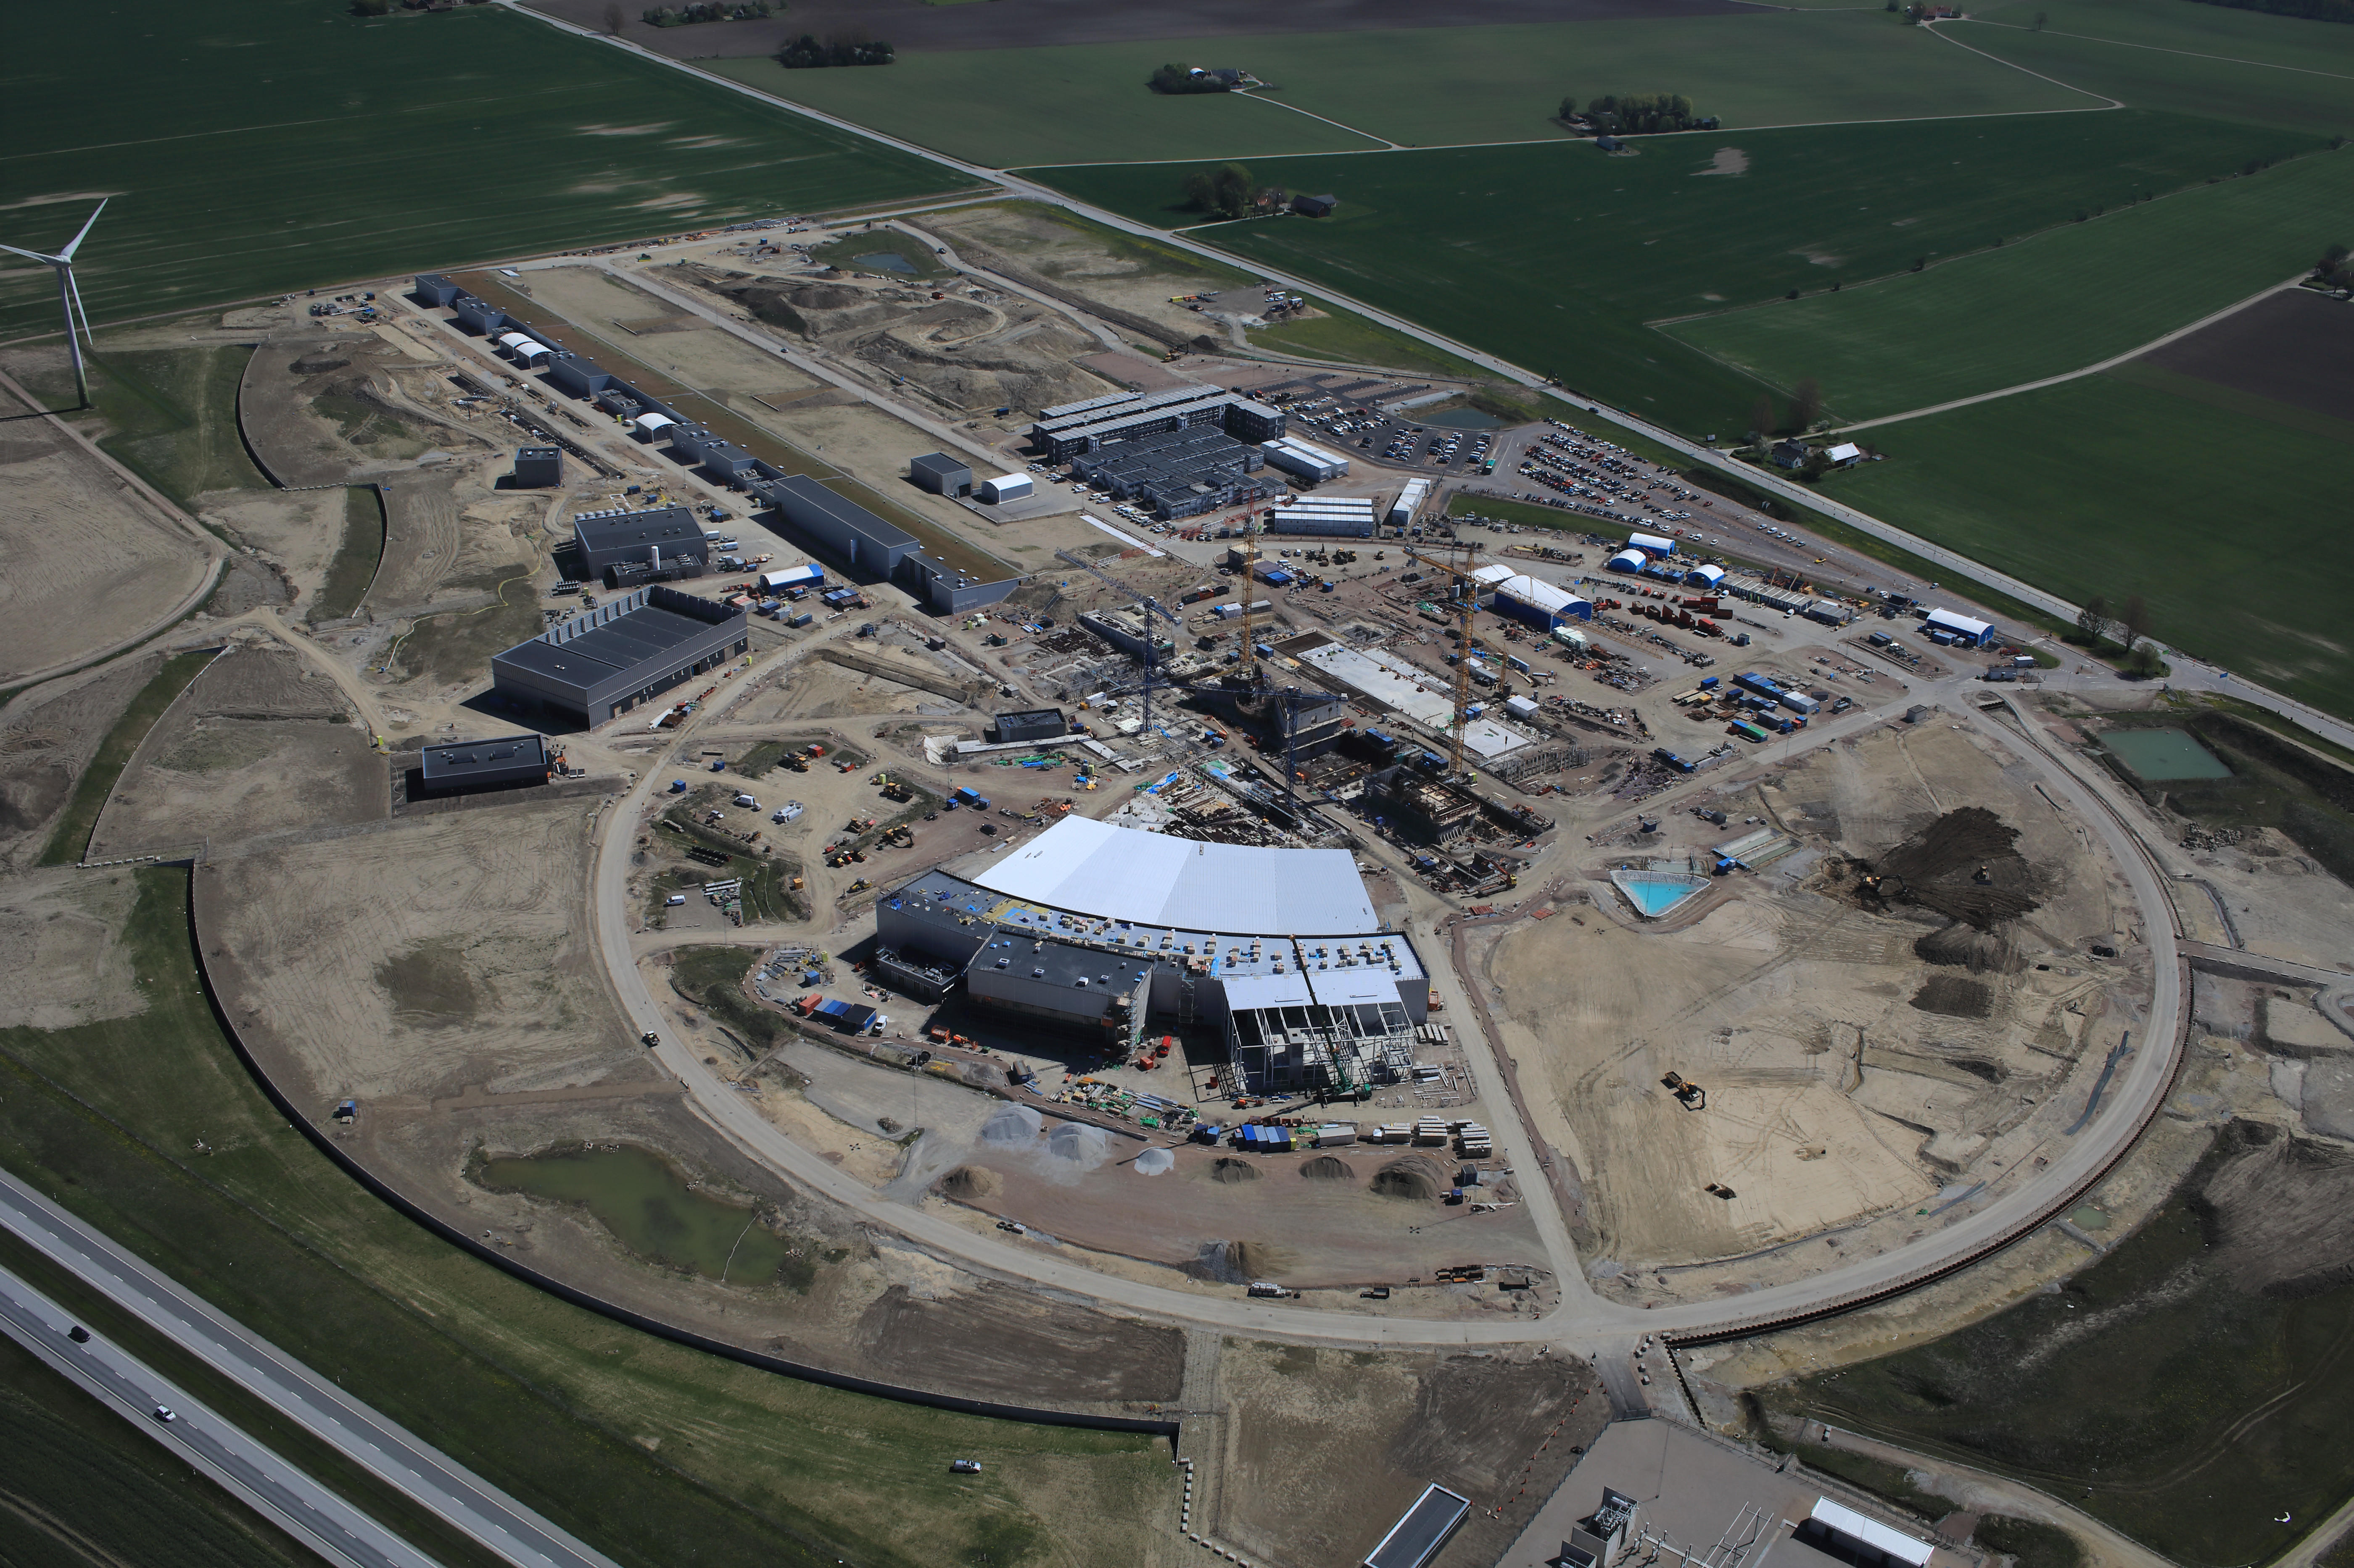


How BrightnESS Helped Deliver the European Spallation Source
John Womersley, Director General
Brussels, 22 June 2018
BrightnESS is funded by the European Union Framework Programme for Research and Innovation Horizon 2020, under grant agreement 676548

Slide 2
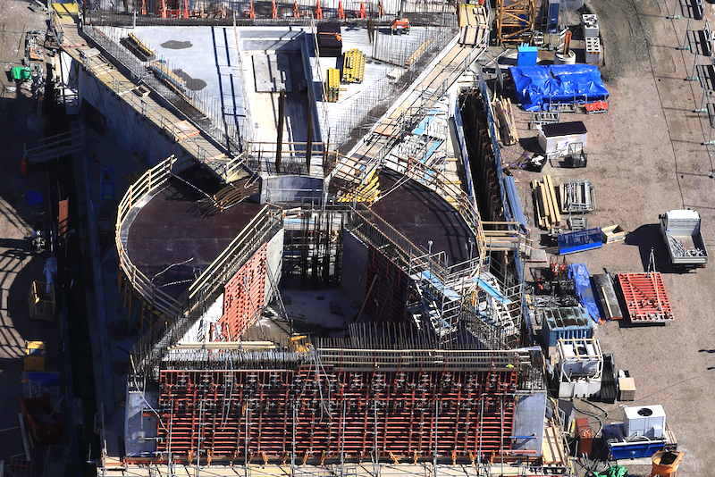
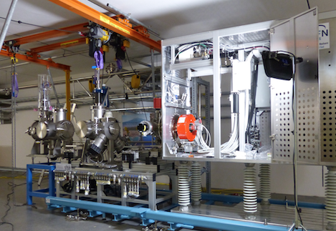
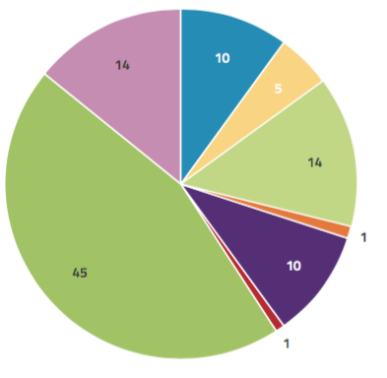
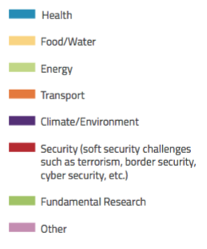
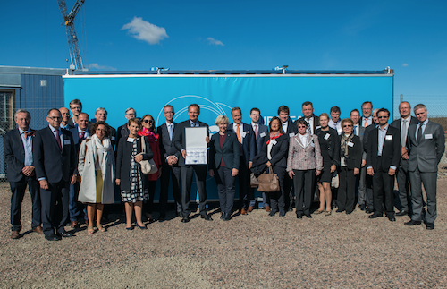
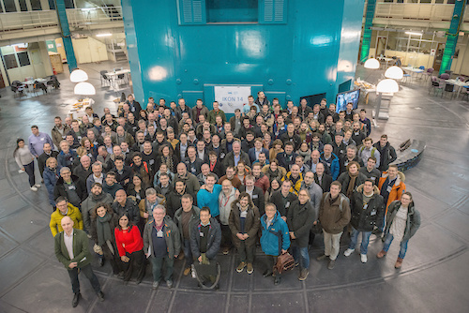
The Importance of Research Infrastructures
RIs are used to address grand societal challenges and develop new solutions
State-of-the-art RIs are complex and need to be built through international collaboration
Building RIs through IKC from international partners brings both benefits and challenges
BrightnESS survey: Horizon2020 topics and challenges expressed as % of research at neutron sources in Europe
When science moves forward, it is often due to breakthrough improvements in the tools available for scientific experiments
Unique capabilities of ESS will both greatly exceed and complement those of today's leading neutron sources
ESS is one of the biggest research infrastructure projects being built in Europe today

Slide 3
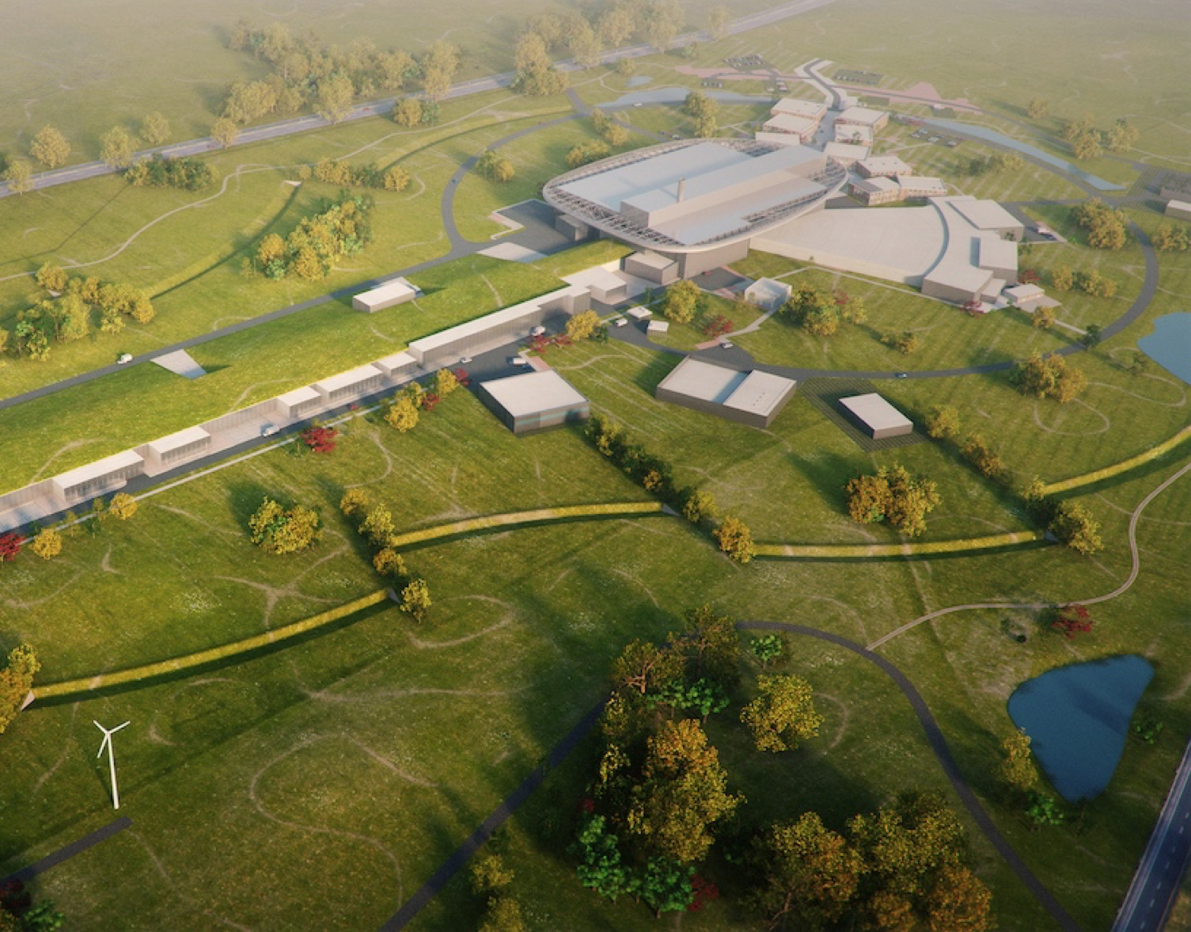
2025
ESS Construction Phase Complete
2014
Construction Starts on Green Field Site
2023
ESS Starts
User Program
2009
Decision to Site ESS in Lund
2019
Start of Initial Operations Phase
2012
ESS Design Update Phase Complete
2003
European Design of ESS Completed
BrightnESS is funded by the European Union Framework Programme for Research and Innovation Horizon 2020, under grant agreement 676548

Slide 4
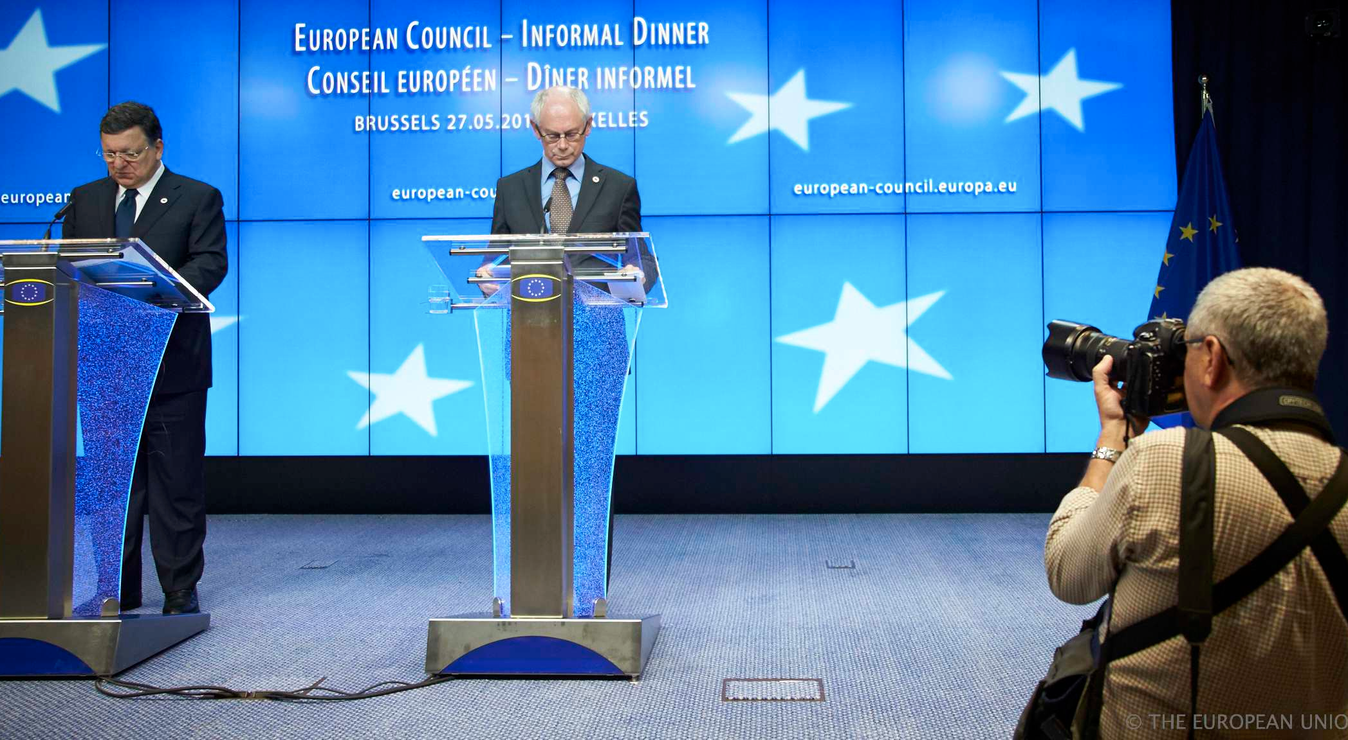
Approach to INFRADEV-3 call
ESS selected as one of three prioritised research infrastructure projects in Europe.
“The Council adopted conclusions in support of the implementation of the roadmap for the European Strategy Forum on Research Infrastructures (ESFRI) … ESFRI has identified three projects that are strategically relevant for Europe and are ready for development:
the European Plate Observing System (EPOS), the European Life-Science Infrastructure for Biological Information (ELIXIR), and the European Spallation Source.”
- Competitiveness Council, 27.05.2014
BrightnESS is funded by the European Union Framework Programme for Research and Innovation Horizon 2020, under grant agreement 676548

Slide 5
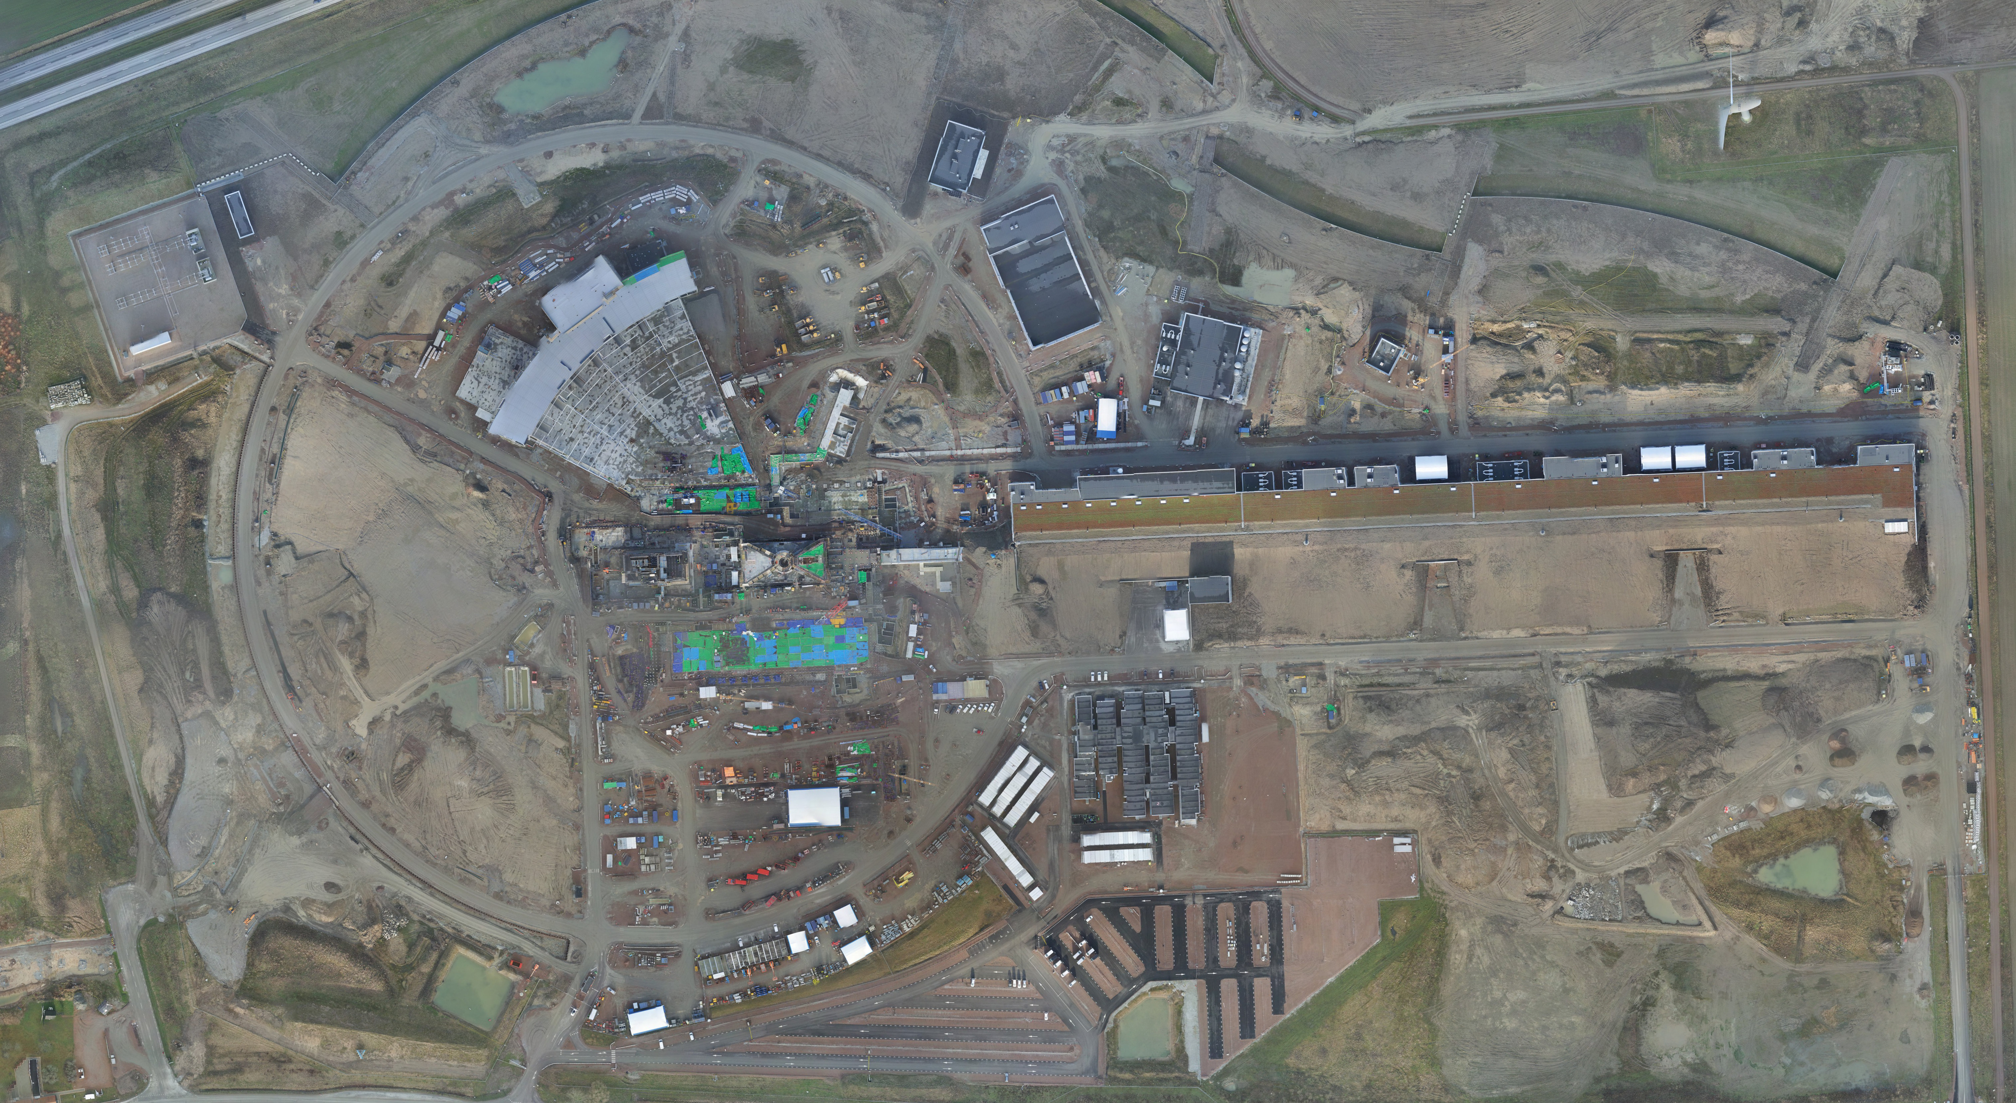
BrightnESS is funded by the European Union Framework Programme for Research and Innovation Horizon 2020, under grant agreement 676548

Slide 6
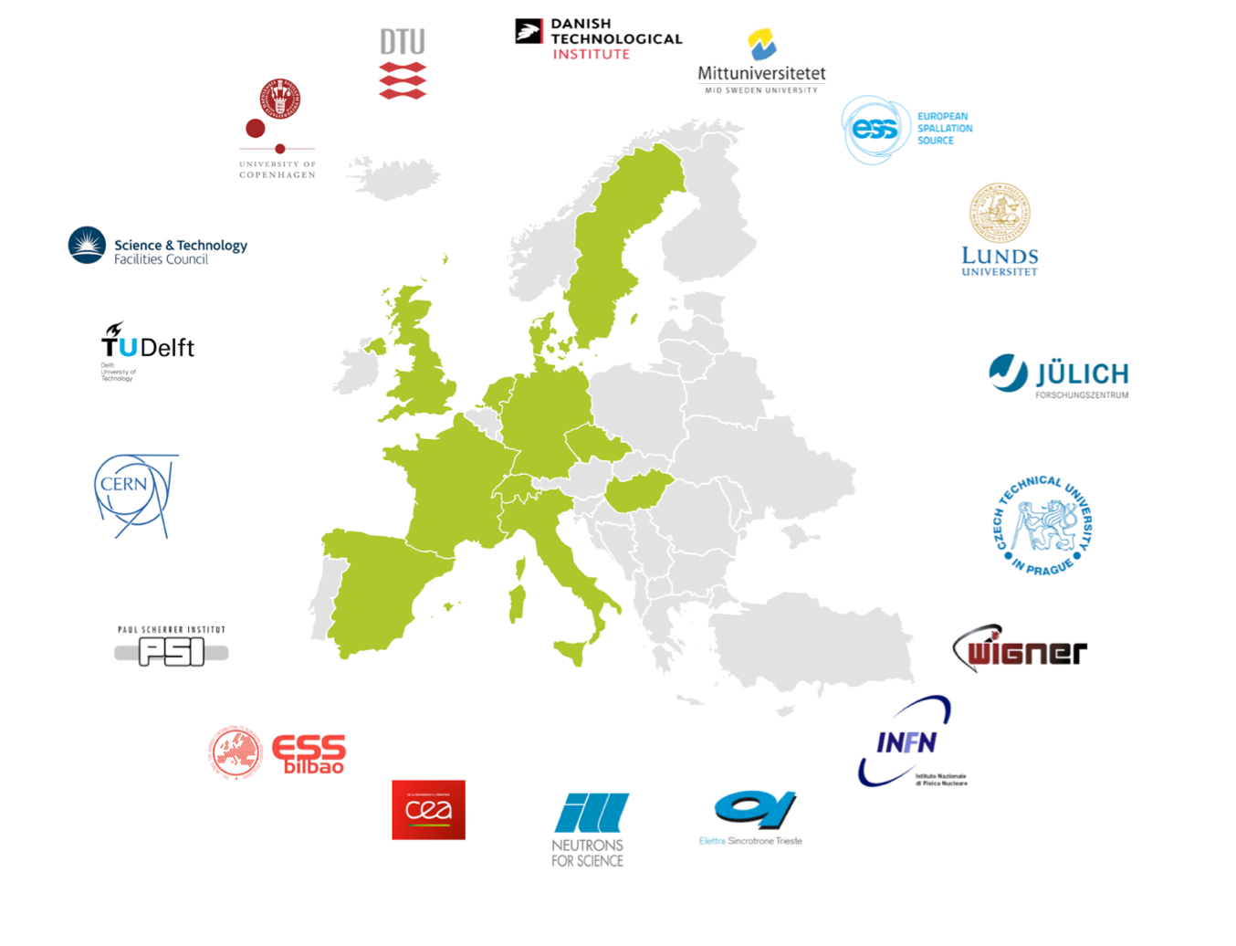

Consortium: 18 partners,
11 countries
Duration: 36 months
(Sep 2015 – Aug 2018)
Budget: €19.9M

Slide 7





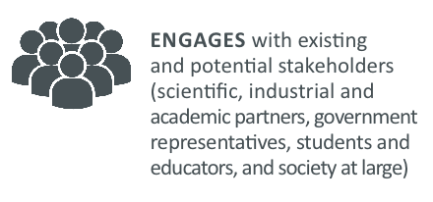
BrightnESS in Short
BrightnESS
WP 1:
Project Management
WP 2:
Strengthening In-Kind Contribution and Coordination
WP 3:
Organisational Innovation
WP 6: Collaboration, Communication and Dissemination
WP 4: Innovation of Key Neutronic Technologies: Detectors and Moderators
WP 5:
Real-Time Management of ESS Data

Slide 8
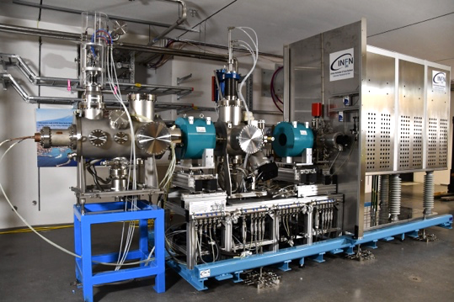
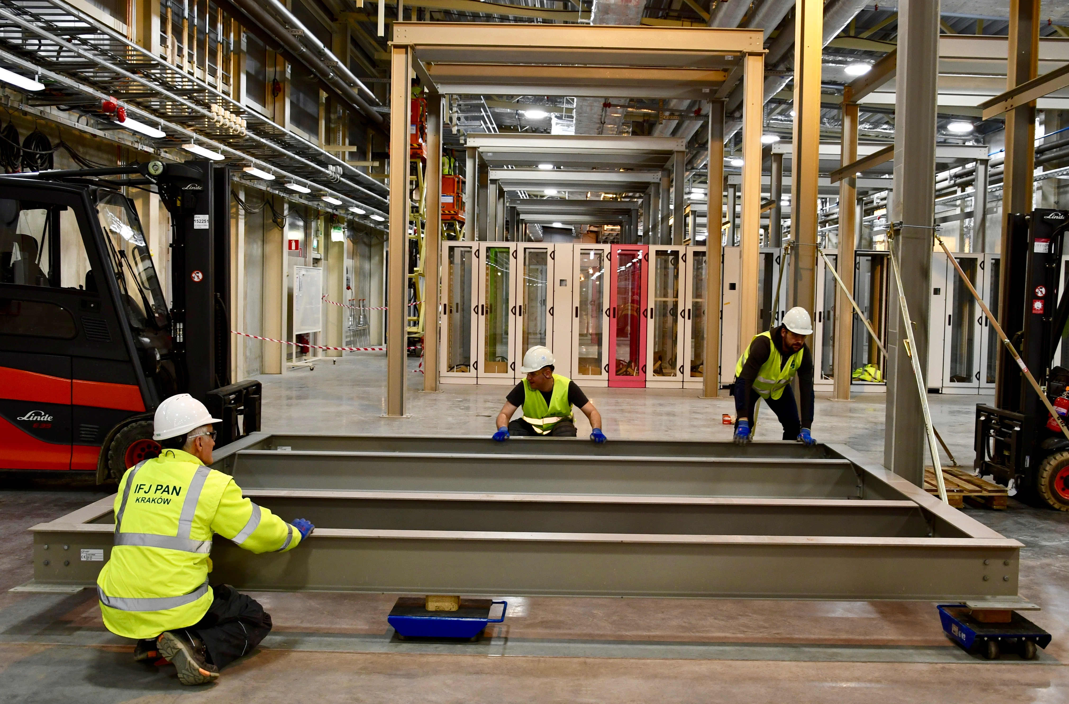
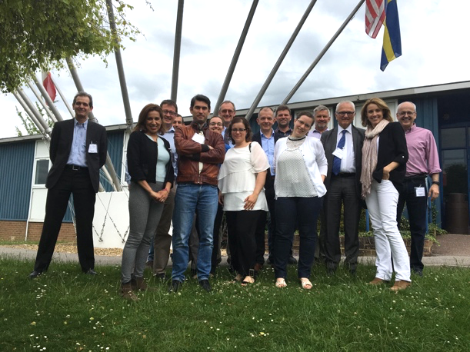
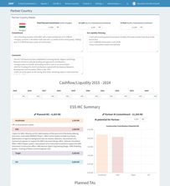
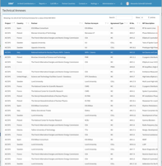



Strengthening In-Kind Contribution and Coordination
Securing In-Kind Contracts through Field Coordinators
IKC Best Practice Exchange
Best Practice Workshops to share knowledge and recommendations on engineering, testing, component assembly and installation etc.
188 IKC contracts with 40+ institutes
Total value: 550MEUR
(333 MEUR signed)
Field Coordinators track activities and highlight risks
Strong networks IKC partners
Ion Source, IKC by INFN, Italy
IKC Information System (XRM+)
XRM+ is the IKC data management system
Fundamental tool for IKC accounting, reporting, documentation and contacts
Wave Guide Support Structure from STFC, UK and Installations by IFJ PAN, Poland
BrightnESS WP2 IKC Field Coordinators
4 349 587€
Notes:
XRM+ has become the central nervous system for managing In-Kind, handling over 230 contracts, with 40+ institutes around Europe.
Tailor made to fit our needs, with bespoke reporting, managing call-offs, country sheets, Council and IKRC documentation and contacts
Fundamental tool for In-Kind accounting
Great productive relationship with Elettra, delivering a truly impressive software package
An informal forum for all levels of In-Kind discussions with the majority of partners and countries represented.
Wide range of experiences and knowledge aiding constructive communication
Reducing In-Kind and hence ESS risk by sharing information and collecting feedback

Slide 9
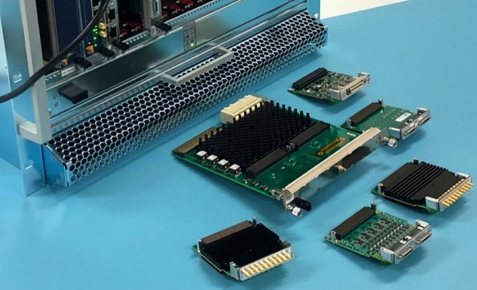
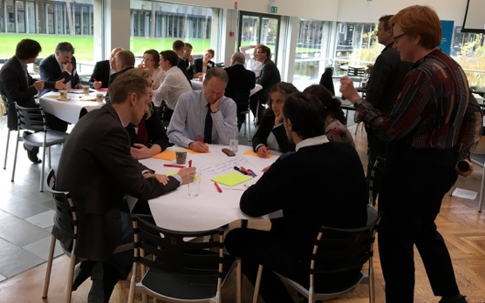
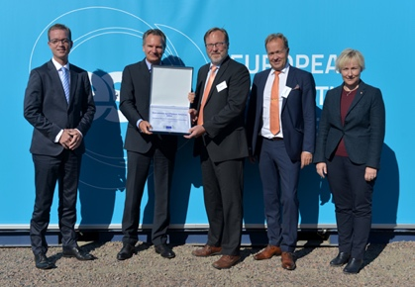


Organisational Innovation
Completion of ERIC Implementation
Capacity Building in Technology Transfer
Identified pertaining challenges and solutions in the areas of: Procurement, VAT & Accounting in In-Kind, and International Staffing
Role model for the other ERICs
Set up a Technology Transfer Office
Knowledge transfer and establishing an innovation framework
Components and Crate for ESS MTCA.4 solution (PPI Case)
Capacity Building of Public Procurement of Innovation
Capacity for early engagement with industry through PCP & PPI
Promoting the development of new standards by industry
Innovation workshop during Tech Transfer meeting at DTU
ERIC Plate Ceremony
1 298 780€

Slide 10
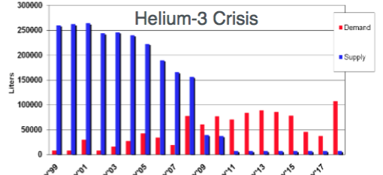
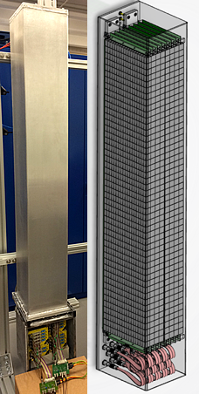
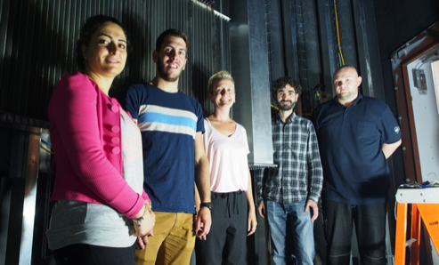
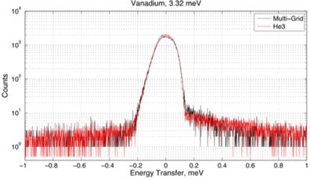
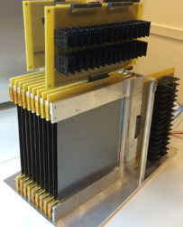
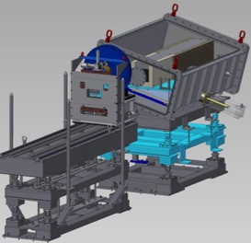








Innovation of Key Neutronic Technologies:
Detectors and Moderators
Deployment and Realisation of Technologies for ESS
Elimination of most technical risk from detectors and moderators
By enhancing moderator and detector capability, maximise early science impact of ESS
Impact on 9 current and future ESS Instruments
Ensuring development sequence for niche technologies to implemented as cutting edge instrumentation
Innovation of Key Neutronic Technologies
Going beyond the state-of-the-art in neutronic technologies
Technological evolution of neutron detectors to competitively replace 3He-based detectors (in terms of resolution, intensity and size/cost)
Prototype the implementation of a new design concept for cold neutron moderators
Multi-Grid Design and results
Multi-Blade Design
ESS moderator Test Beamline layout
6 041 050€
Notes:
Check budget

Slide 11
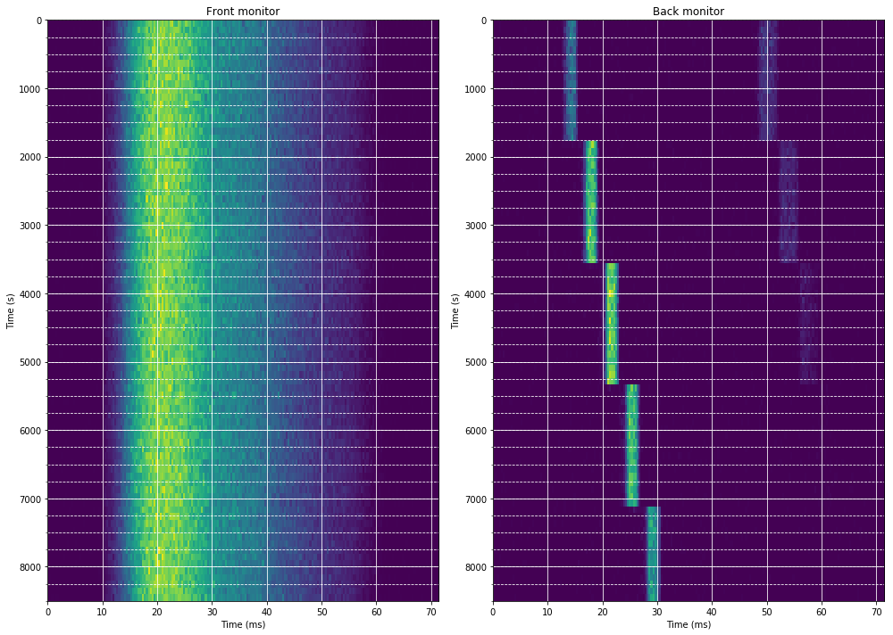
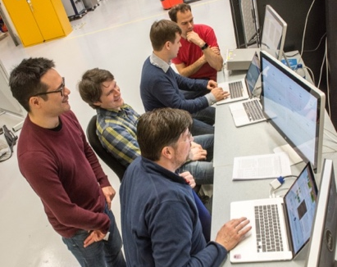
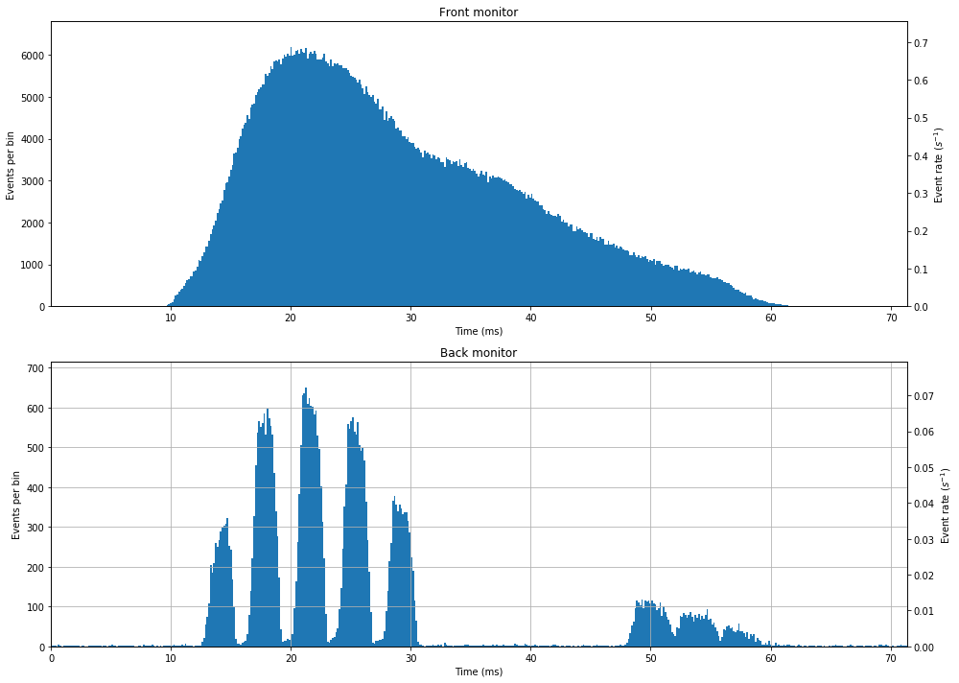
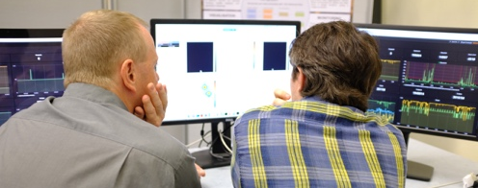
Real Time Management of ESS Data
Innovative Software Infrastructure
Integration & Verification
Creating innovative software infrastructure to make the experimental data available as a live stream to which data reduction, and analysis, software can subscribe to process and visualize the data
Risk mitigation through early integration and verification of the feasibility.
Coordination with European neutron facilities.
Jointly developed neutron data acquisition platform with partners (PSI, ISIS): more developers to maintain the software stack long term, into operations and beyond
DMSC Staff
DMSC Staff
Results of chopper tests at HZG
2 792 437€

Slide 12
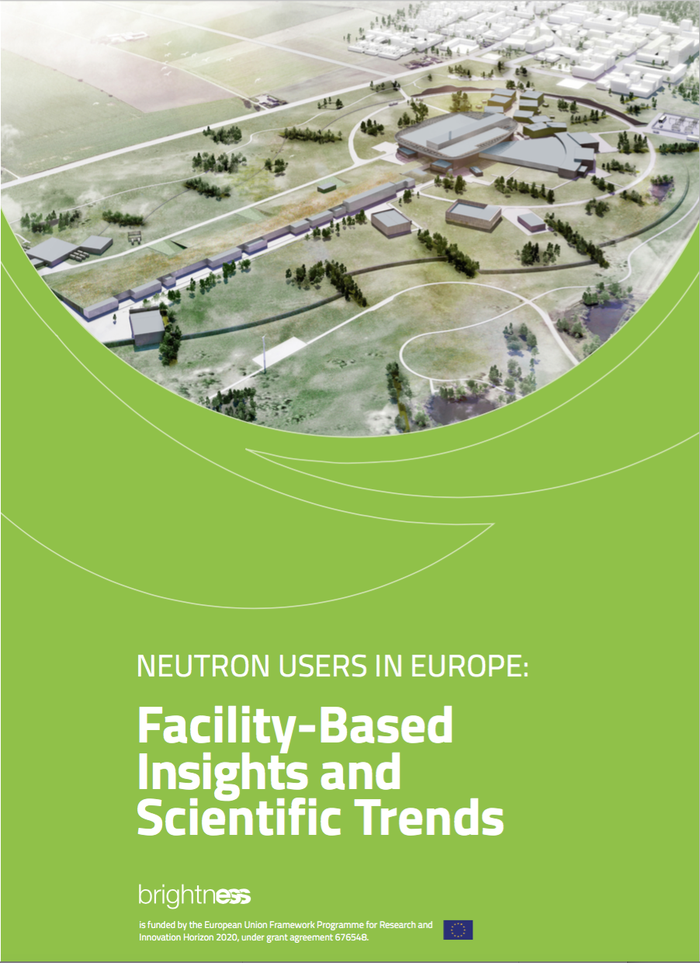
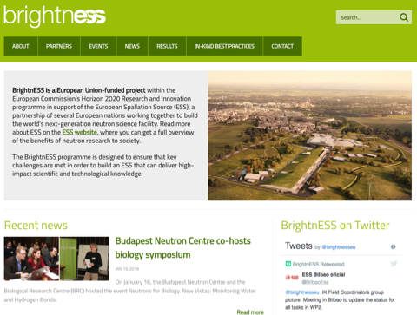
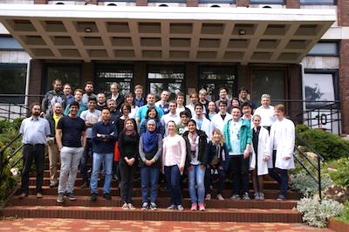

Collaboration, Communication & Dissemination
Collaboration and Outreach
Communication & Dissemination
Target group analyses of future academic and industrial users
Awareness raising across Europe
Training of future users by supporting organisation of neutrons schools
Hosting of 16,570 visitors at ESS
Organisation and support of industry events
Dissemination of project results such as detector publications etc.
Content creation for ESS + partners website and Twitter through @brightnESSeu
Cross-promotion of other EU projects such as SINE2020, NNSP, BalticTram, RACIRI etc.
Europe: Science fields expressed as percentage of experiments
Enlargement of Membership
UK joins as Founding Member,
June 2016
Spain joins as Founding Member, April 2018
Establishing links on a global level/GSO Case Study
BrightnESS website
Central European Training School on Neutron Techniques (CETS) at BNC, Hungary
12
12
2 929 231€

Slide 13
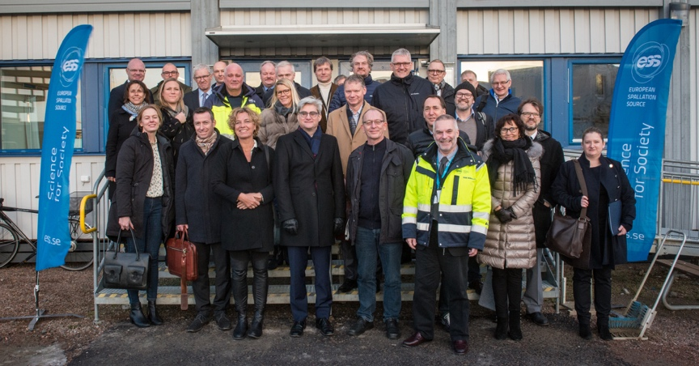
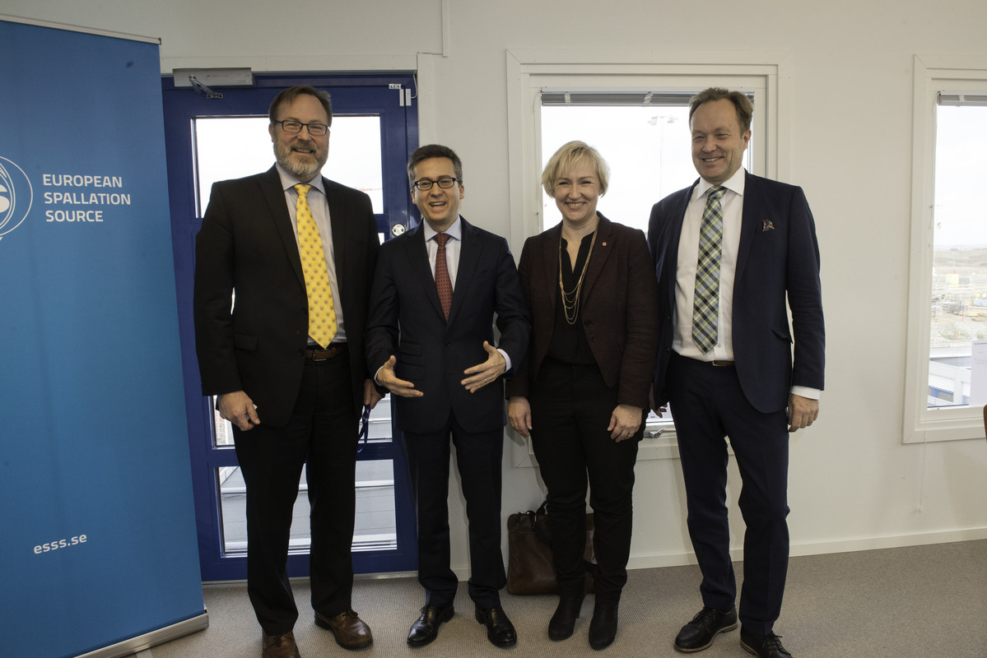
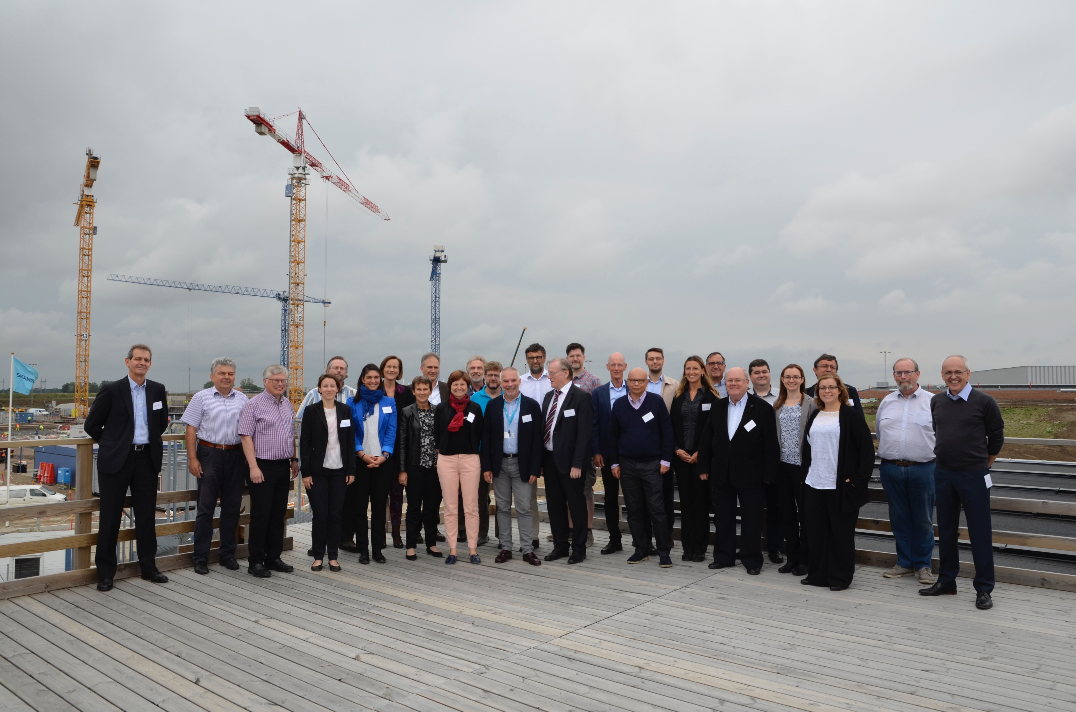
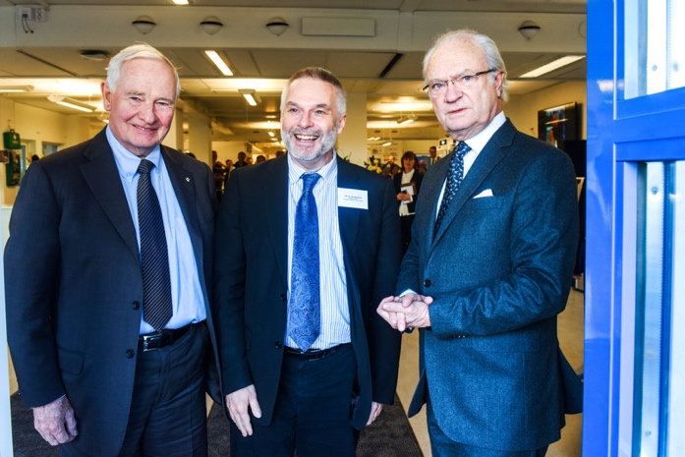
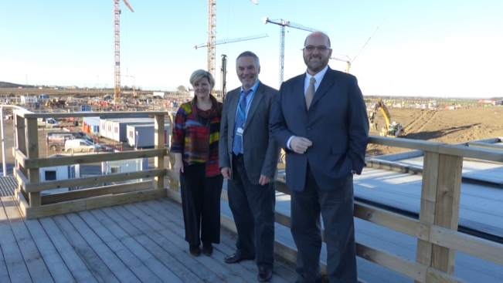
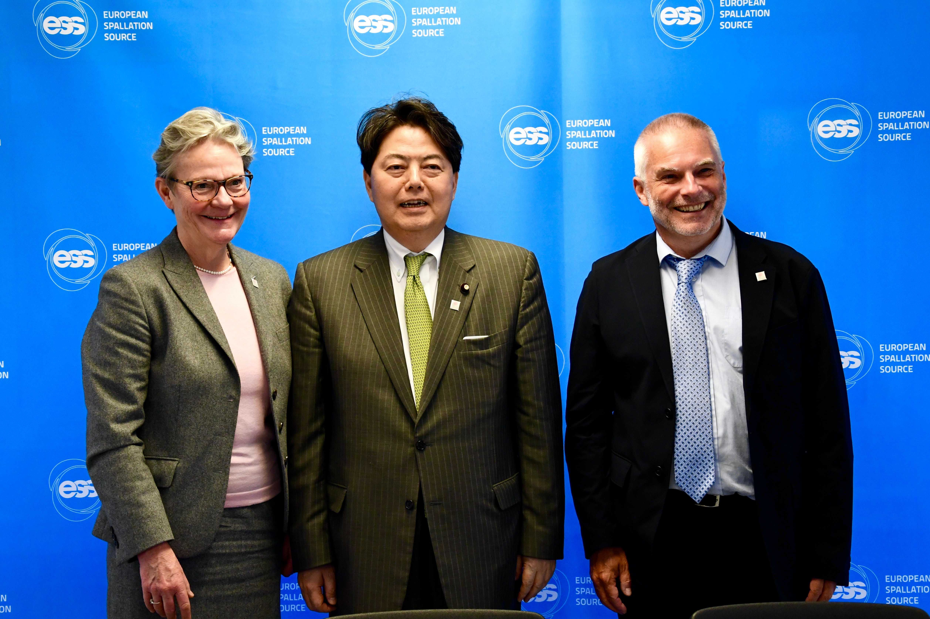
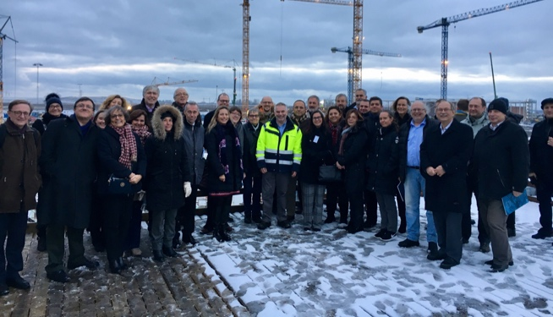
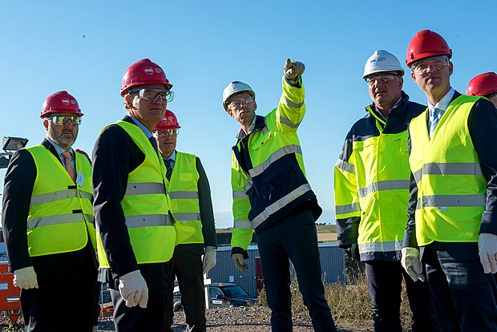
Visits to ESS - Highlights (Sep 2015 – May 2018)
16,570
Visitors
1,659
Groups
Notes:
Top left: Commissioner Moedas and SE Minister for Higher Education and Research Hellmark Knutsson
Top middle: DK Minister of Science, Technology, Information and Higher Education Søren Pind and DK Parliamentarians
Top right: BrightnESS MidTerm Review
Middle left: Canadian Ambassador Heather Grant
Middle middle: King Carl XVI Gustaf of Sweden and the Governor General of Canada, David Johnston
Bottom left: ESFRI Committee
Bottom middle: EC Director-General for Research and Innovation, Robert-Jan Smits
Bottom right: Japanese Minister of Education, Culture, Sports, Science and Technology Yoshimasa Hayashi and Swedish State Secretary Röding

Slide 14
From Risk Mitigation to Long-Term Sustainability
BrightnESS
Shaping the European Neutron Strategy
Up to 550 MEUR in IKC contracted or pending
Alternative detector technology in place
Moderator concept tested
Innovative software infrastructure
Innovative Framework established
New Members Policy in Place
Future users from academia and industry analysed
Evolving the
IKC Model
Ensuring long-term sustainability of neutron scattering in Europe
Boosting Innovation
Reinforcing ESS as
Global RI
Delivering
Socio-Economic Impact

Slide 15



Thanks to the support of the European Commission, the BrightnESS Project
FACILITATED
transition of ESS from its initial phase to ERIC
SUPPORTED
development, testing and optimization of state-of-the-art technology in neutron detectors
DEVELOPED
real-time management of data taken on ESS instruments
IKC management process
ENGAGED
existing and potential stakeholders
FOSTERED collaborative spirit through active knowledge-sharing
STRENGTHENED
https://brightness.esss.se/
@brightnESSeu

Slide 16
Panel 1:
The European Neutron Landscape
Panel 2:
Technical Innovation
Panel 3:
IKC and the ERIC Framework
KEYNOTE
Caterina Petrillo
John Womersley
Jean-David Malo
Caterina Petrillo
Christiane Alba-Simionesco
Helmut Schober
Andreas Wischnewski
Richard Hall-Wilton
Tobias Richter
Andreas Schreyer
Tom Griffin
Karl Zeitelhack
Giovanna Davatz
Richard Hall-Wilton
Tobias Richter
Allen Weeks
Lars Börjesson
Jean-David Malo
Paolo Centore
László Rosta
Petr Lukáš
Allen Weeks
MODERATOR
PANELLISTS

