Slide 1
Using Mantid to process single crystal data
Vickie E Lynch lynchve@ornl.gov
IKON15/DMSC for SX Diffraction September 12, 2018

Slide 2
Outline
Algorithms available in Mantid to process single crystal data
Reduction scripts and GUI
Normalization and visualization
3D profile fitting for peak integration
Reduction of modulated structures

Slide 3
Algorithms available in Mantid to process single crystal data

Slide 4
Loading and Converting Data
LoadEventNexus loads event data
ConvertToMD converts events to Q space.

Slide 5
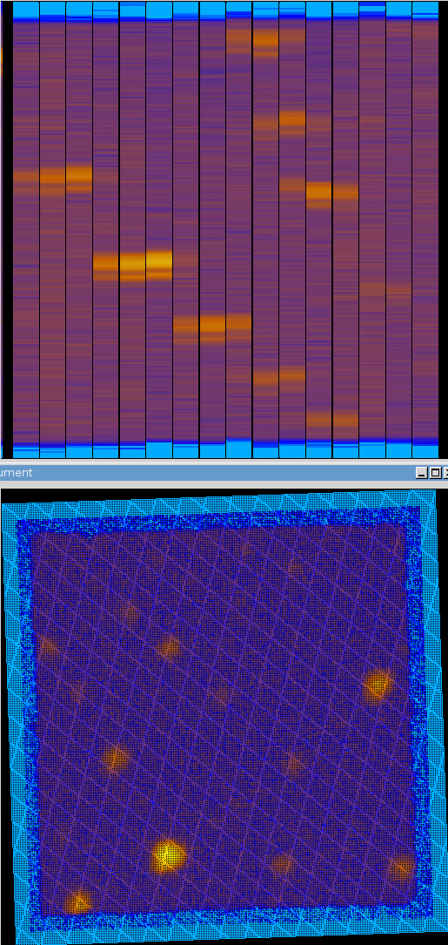
Geometry
Algorithms work for both rectangular detectors and tubes
Column=Tube; Row=Pixel
Peak centers can be between tubes
Use tube-gap parameter
Resizing pixels does not work for tubes (needed for calibration)

Slide 6
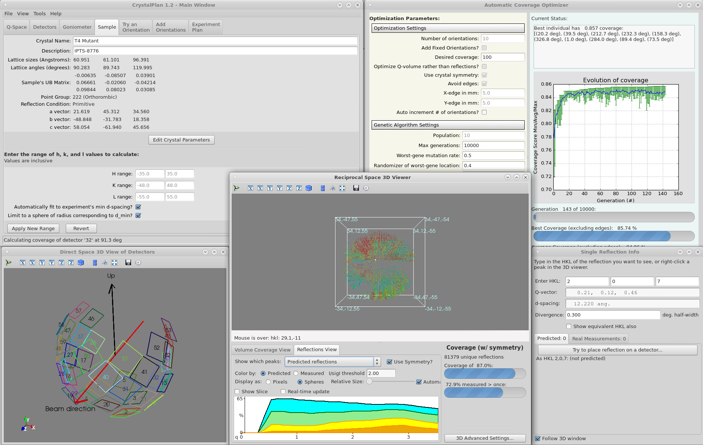
Experiment Planning & Mantid
CrystalPlan optimizes goniometer angles to maximize beam time usage.
Future version will use Mantid Instrument Definition, Goniometers, PredictPeaks and PointGroups.

Slide 7
Calibrating Detectors
SCDCalibratePanels
This algorithm calibrates Rectangular Detectors or tubes
The initial path, panel centers and orientations are adjusted so the error in Q positions from the theoretical Q positions is minimized.
Given a set of peaks indexed by h,k,l we modify the instrument parameters and then find Q in the sample frame that minimizes the following:
Output saved as DetCal file and loaded with LoadIsawDetCal

Slide 8
Single Crystal Peaks
FindPeaksMD
Sorts all the boxes in the workspace by decreasing order of signal density (total weighted event sum divided by box volume).
The centroid of the strongest boxes are considered peaks.
PredictPeaks
Using a known crystal lattice and UB matrix, predict where single crystal peaks should be found in detector/TOF space
Improving performance would help transition to experiment planning with Mantid

Slide 9
Finding UB matrices
FindUBUsingFFT
Best algorithm for finding UB for Niggli cell
FindUBUsingMinMaxD
FindUBUsingLatticeParameters
FindUBUsingIndexedPeaks
OptimizeLatticeForCellType
CalculateUMatrix
Calculates U matrix from indexed peaks and lattice parameters

Slide 10
Unit Cell Symmetry
ShowPossibleCells, SelectCellOfType, SelectCellWithForm
“Lattice Symmetry and Identification – The Fundamental Role of Reduced Cells in Materials Characterization”, Alan D. Mighell, Vol. 106, Number 6, Nov-Dec 2001, Journal of Research of the National Institute of Standards and Technology.
Transformation matrix from Niggli to Conventional Cell
PointGroup and SpaceGroup
http://docs.mantidproject.org/nightly/concepts/PointAndSpaceGroups.html?highlight=pointgroup
Factories exposed to python
Written by Michael Wedel

Slide 11
Indexing Peaks
IndexPeaks
Index the peaks using the UB from the sample.

Slide 12
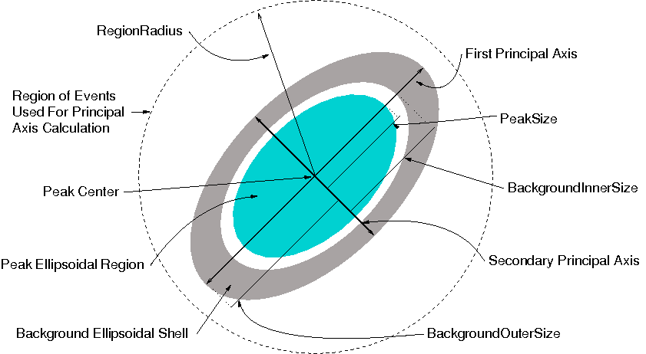
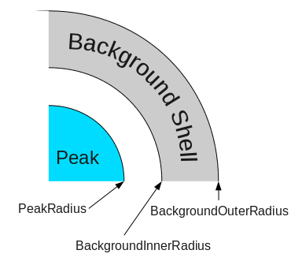
Integrating Peaks in Reciprocal Space
Mantid ellipsoidal integration
Mantid spherical integration
Mantid cylindrical integration 1D profile fit, convolution of Gaussian and exponential

Slide 13
Comparing Integration Algorithms
Schultz, A. J., et al. (2014). "Integration of neutron time-of-flight single-crystal Bragg peaks in reciprocal space." Journal of Applied Crystallography 47(3): 915-921 compared Mantid integration algorithms.
All the Q space integration methods were significantly better than detector-space method.
IntegrateEllipsoids is preferred for TOPAZ data
For weak peaks and high background, fitted profile best with convolution of Gaussian with an exponential.

Slide 14
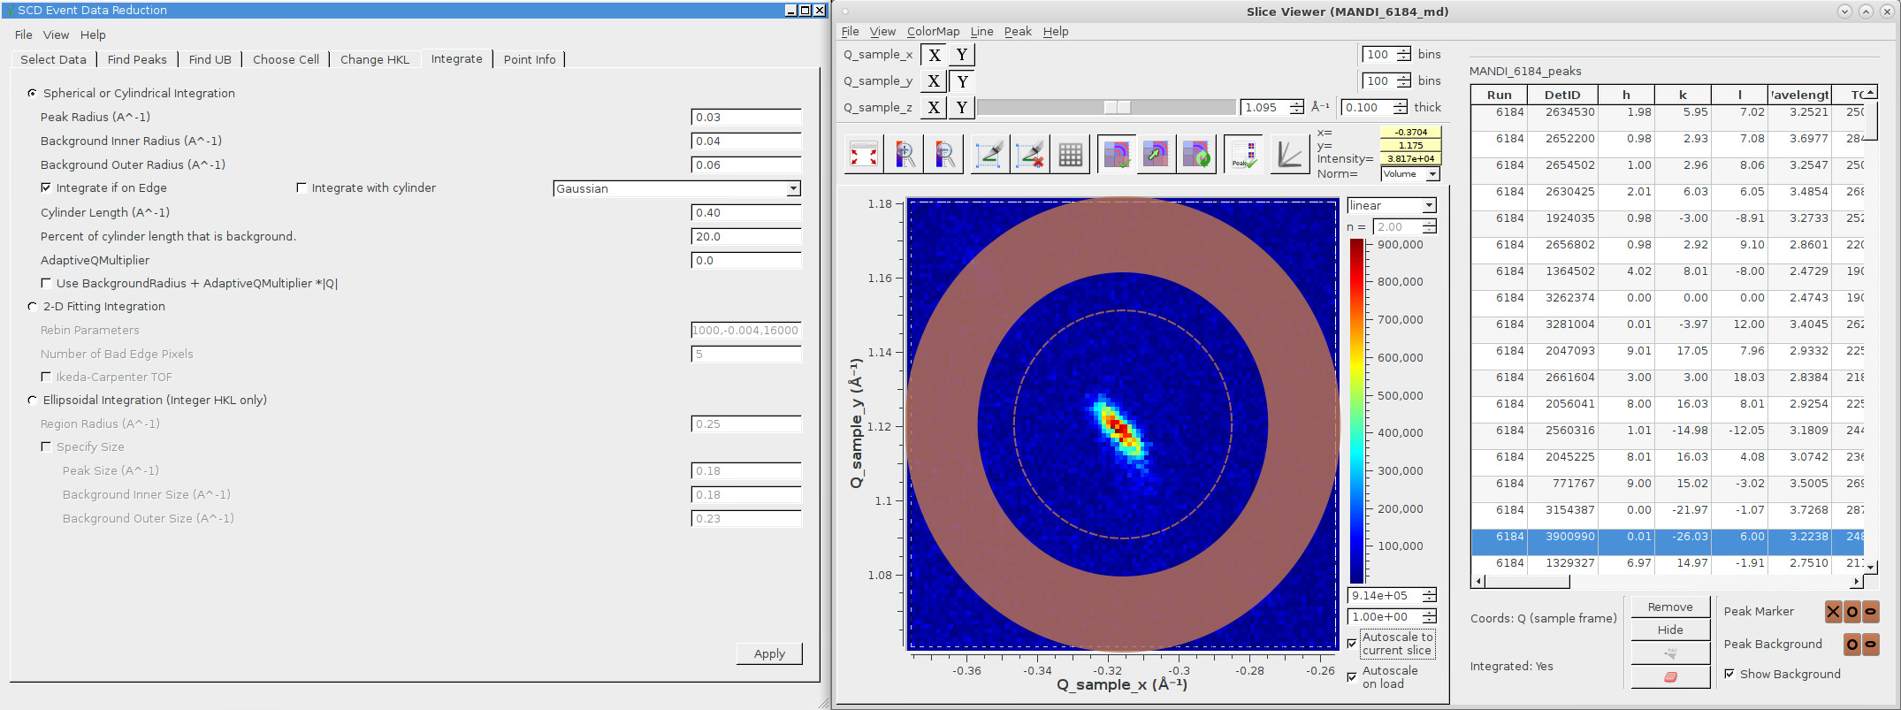
Viewing Peaks with SliceViewer
Checking peak integration volume

Slide 15
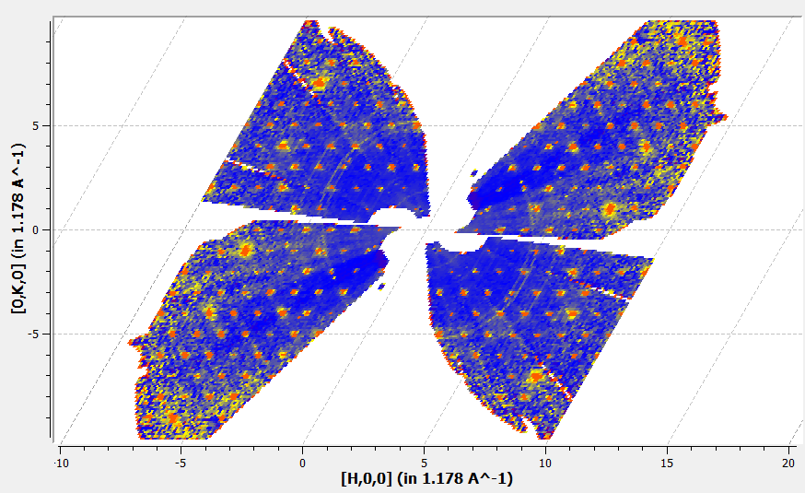
Options for SliceViewer
Mantid has Crystallographic Convention option in Preferences
SliceViewer
Non-orthogonal axes

Slide 16
Corrections
SetSampleMaterial (bound hydrogen vs free hydrogen)
Sets the absorption correction coefficients
SetDetScale
Sets detector bank scales
AnvredCorrection ${{sin⁡(θ)}^{2}}/{(λ^{4}∗trans}$)
Lorentz correction and/or absorption correction (sphere)
ConvertToMD ${{ sin⁡(θ)}^{2}}/{λ^{4}}$
Lorentz correction
SaveHKL ${{c_{det}∗sin⁡(θ)}^{2} ∗{{10}^{6}/c}_{mon}∗sp_{ratio}}/{{(λ}^{4}∗spec∗trans}$)

Slide 17
Post-Reduction Algorithms
StatisticsOfPeaksWorkspace
Similar output to xprep
No. of Unique Reflections, Resolution range, Multiplicity, Mean, ((I)/sd(I)), Rmerge, Rpim, Data Completeness
SaveLauenorm
Provide input files for the program LAUENORM which is used to perform a wavelength normalization for Laue data using symmetry equivalent reflections measured at different wavelengths.
SaveNexus, SaveIsawPeaks, SaveIsawUB, SaveHKL
Output formats for single crystal peaks

Slide 18
Reduction scripts and GUI

Slide 19
SCD Event Data Reduction Interface
Interface for basic data reduction steps for one crystal orientation in a time-of-flight single crystal neutron diffraction experiment.
loading data, converting to reciprocal space
finding peaks
finding a UB matrix
choosing a conventional cell
peak integration

Slide 20
Parallel Python Reduction
After using the SCD reduction interface for one or two runs from a sequence of runs at different crystal orientations, there should be enough information to set up a configuration file.
See mantid/scripts/SCD_Reduction
A parallel reduction script can be run to produce a combined file of integrated intensities from all the runs.
Orientations are run at the same time in parallel so wallclock time is reduced.

Slide 21
Timings of Parallel Reduction
Time for reducing one run (OpenMP):
real 3m20.522s Wallclock Time
user 3m2.982s CPU TIme
sys 10m39.613s Malloc+I/O
Speedup 4.14
Time for reducing 9 runs (OpenMP and threads):
real 4m46.675s
user 27m11.130s
sys 31m25.036s
Speedup 12.34

Slide 22
GUI for Single Crystal Reduction Enables Autoreduction
New GUI for TOPAZ Reduction working
All of the corrections are applied without running additional scripts
A previous configuration file can be input for initial values
The resulting configuration file is copied and used to automatically reduce all future data for that experiment
Tabs from reduction GUI

Slide 23
Normalization and Visualization
Andrei Savici, Steven Hahn, Tara Michels-Clark, Christina Hoffmann, Xiaoping Wang, Ross Whitfield, Vickie Lynch

Slide 24
Normalizing Data
MDNormSCD
Input the flux and solid angle calculated from vanadium and MDEventWorkspace calculated from sample.
Large memory required.
Run MDNormSCD for each sample.
Sum the OutputWorkspaces and OutputNormalizationWorkspaces from MDNormSCD separately and then divide the two sums.
Intensity will not be increased in overlap regions using this method.
Reference: Michels-Clark, T. M., et al. (2016). "Expanding Lorentz and spectrum corrections to large volumes of reciprocal space for single-crystal time-of-flight neutron diffraction." J Appl Crystallogr 49(Pt 2): 497-506.

Slide 25
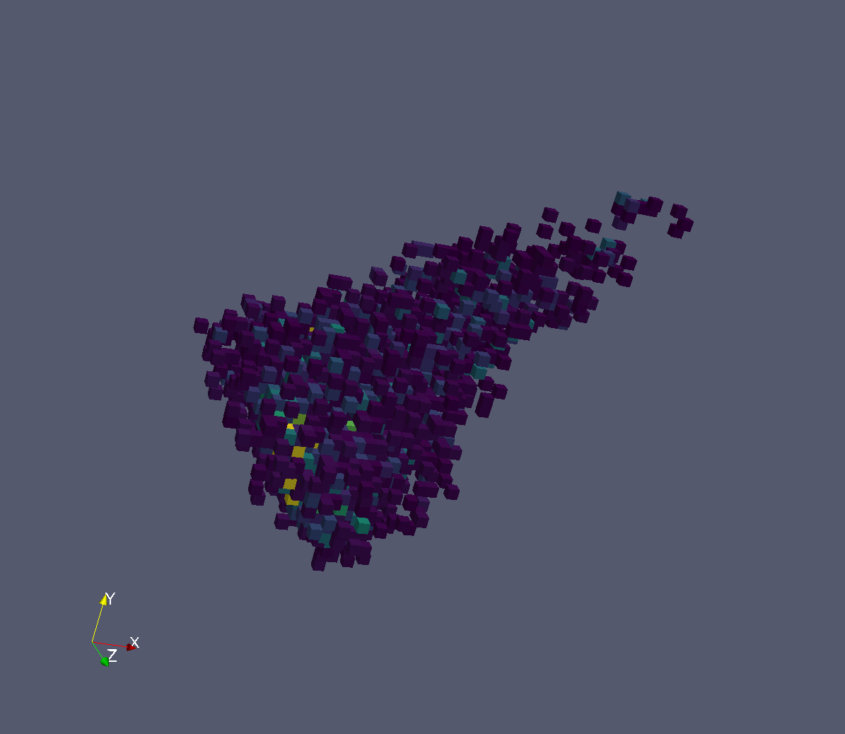
Integrating MD Histograms
IntegratePeaksMDHKL
The units of the workspace must be HKL.
The main usage will be for data normalized by MDNormSCD.
A 3D box is created for each peak and the background and peak data are separated.
The intensity and sigma of the intensity is found by summing.

Slide 26
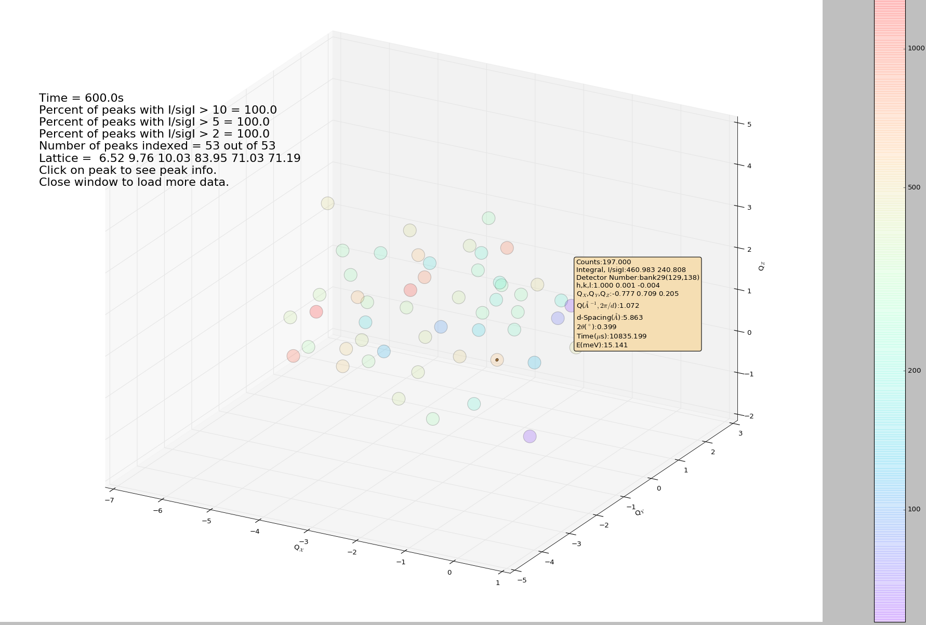
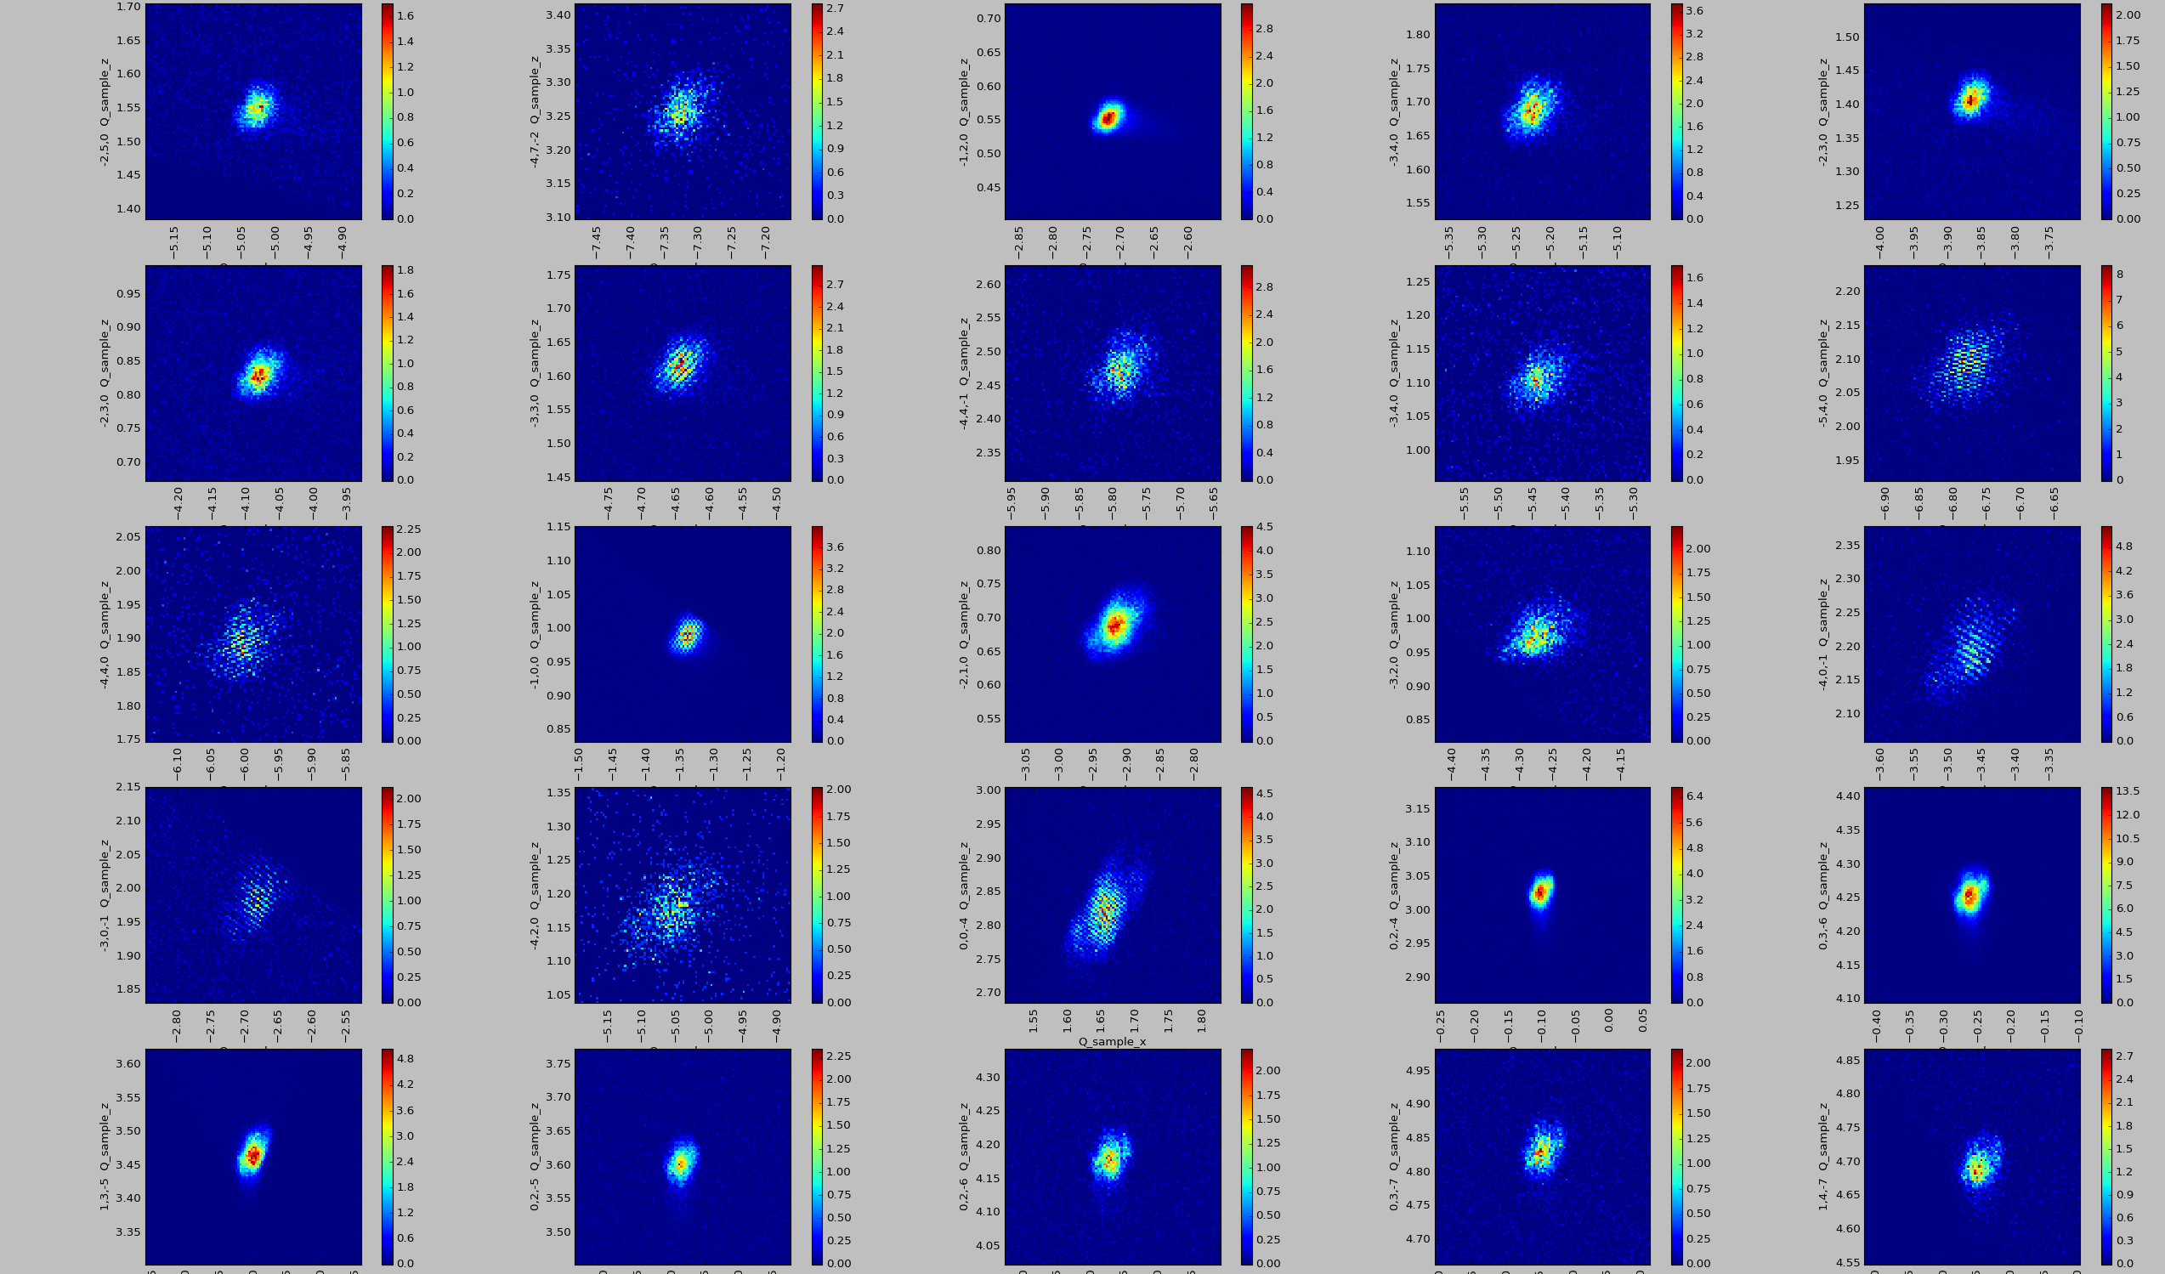
Live Data Viewer
Mantid + Matplotlib/Plotly
Interactive alignment of peaks
Picker gives information about peaks

Slide 27
Vates Splatter Plot
Useful for viewing peaks
Uses ParaView

Slide 28
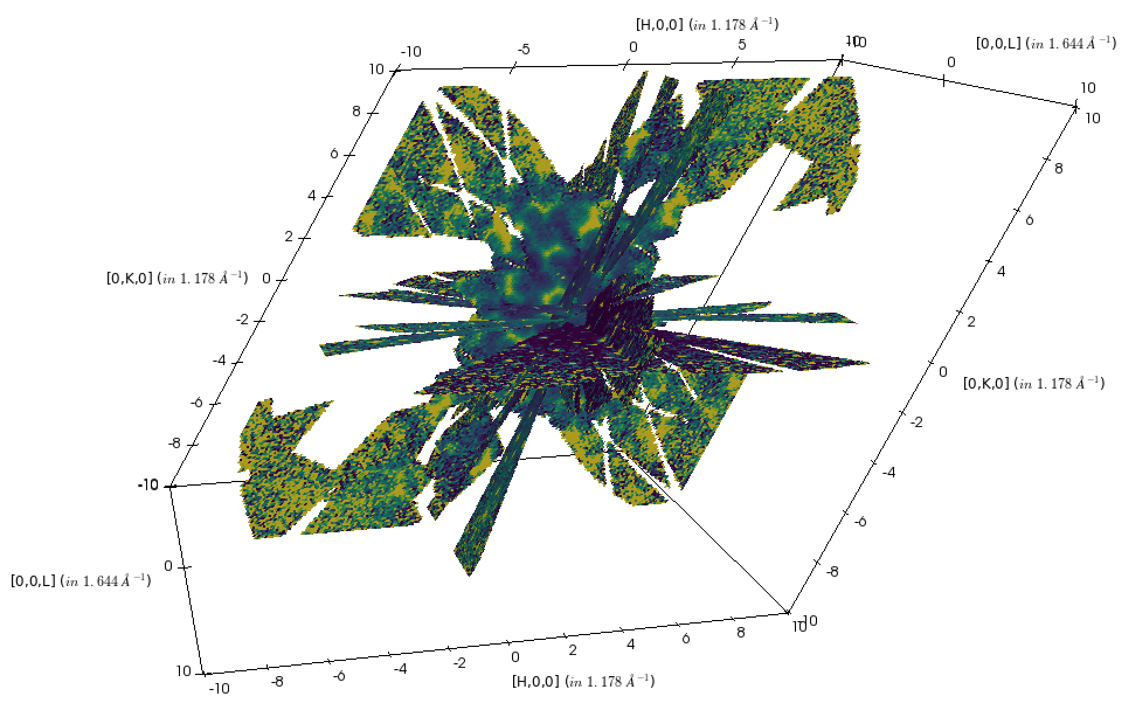
Vates Simple Interface
Useful for viewing diffuse scattering.
Requires much memory.

Slide 29
Vates Visualization Capabilities

Slide 30
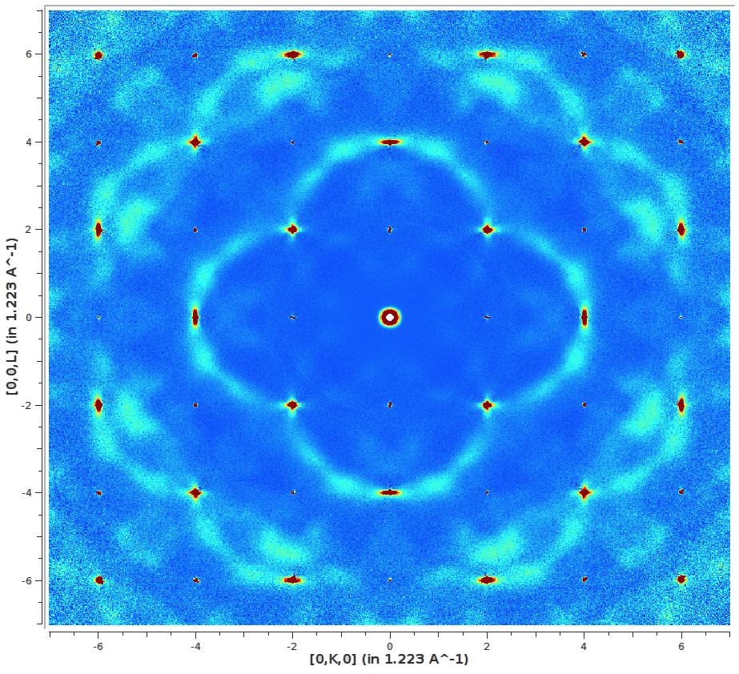
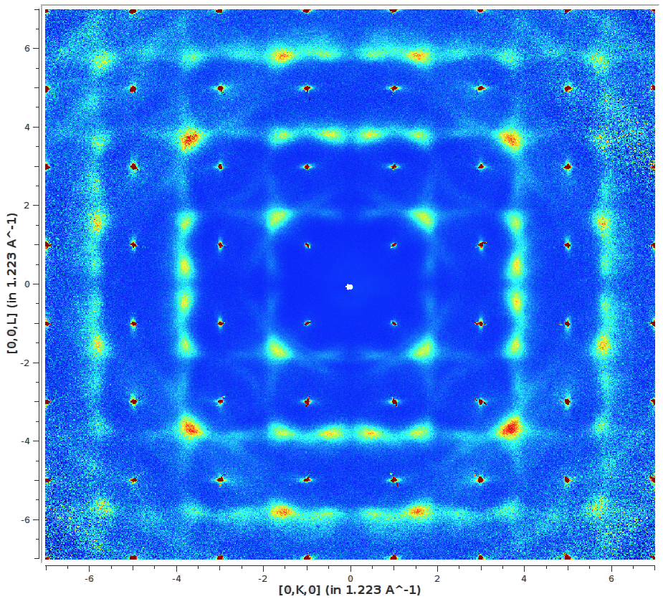
Diffuse Scattering
Single crystal 3D volume diffuse scattering data reduction has become routine on both CORELLI and TOPAZ
The use of crystal symmetry operations has been developed which improves the statistics of data collected
A 3D-delta PDF reduction method has been developed in Mantid and demonstrated on CORELLI and TOPAZ diffuse scattering
Symmetrized diffuse scattering from ZrO₂
Left - HK0 Right - HK1

Slide 31
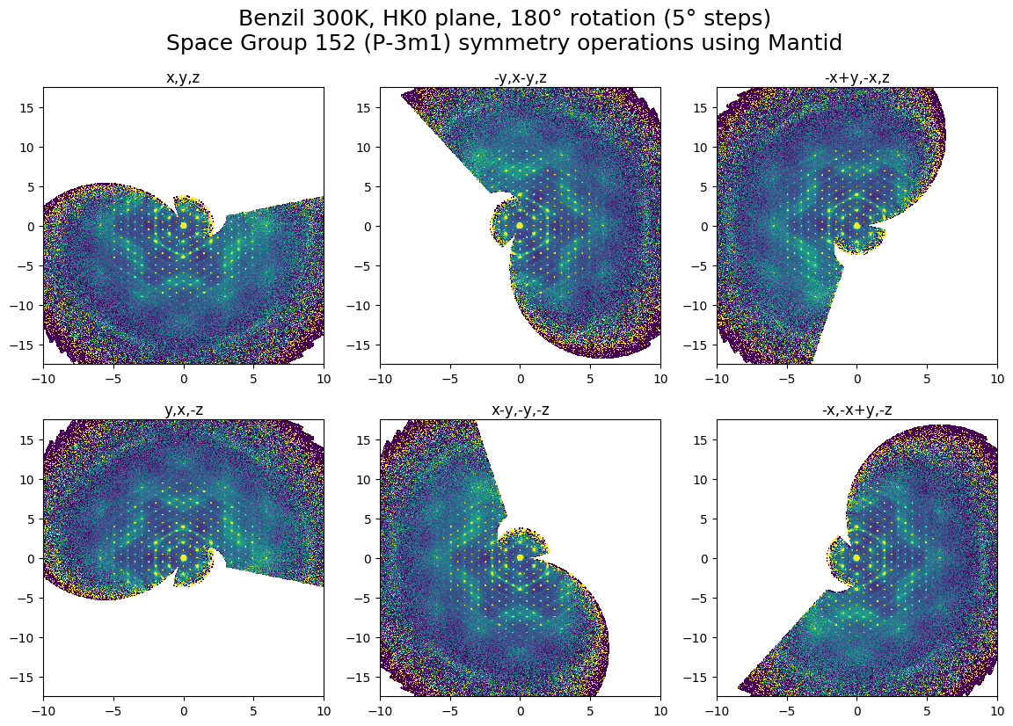
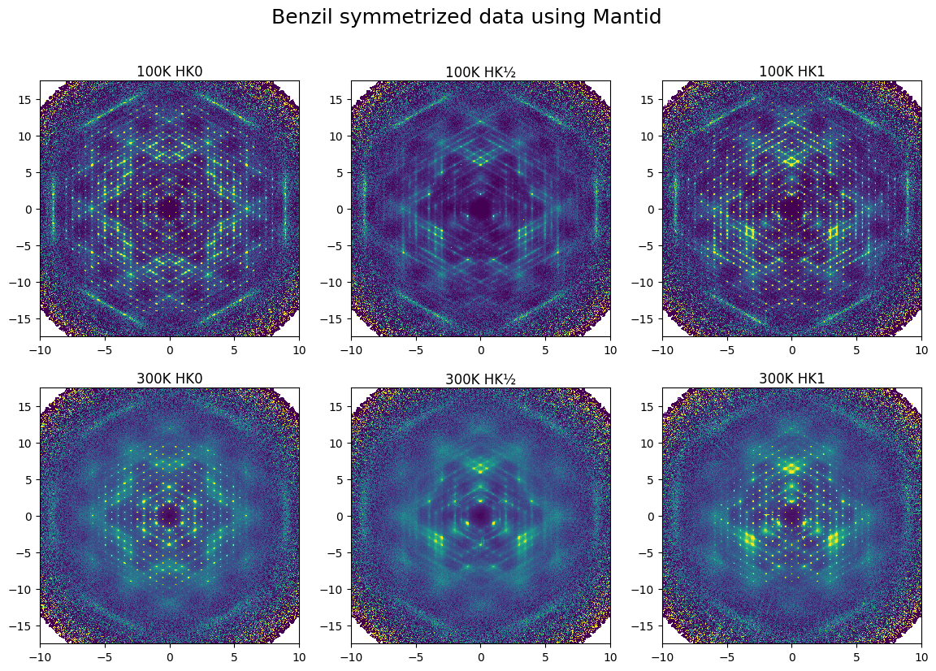
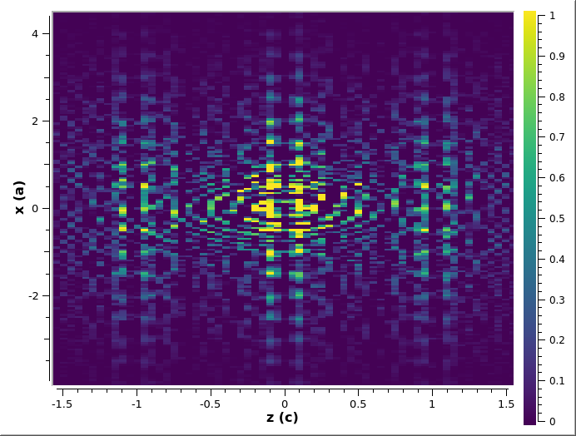
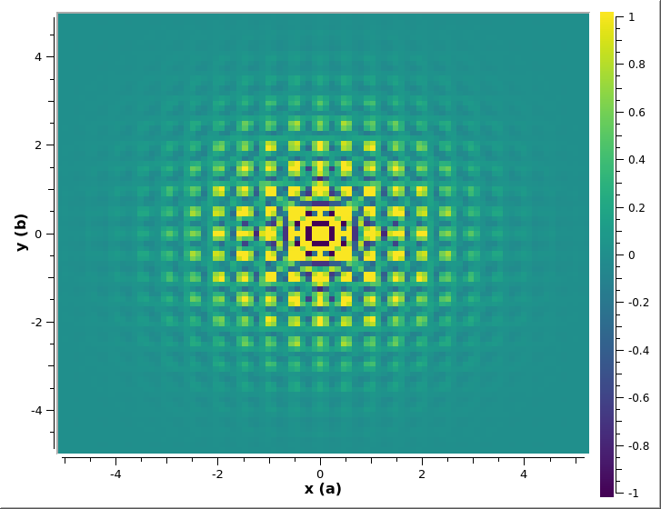
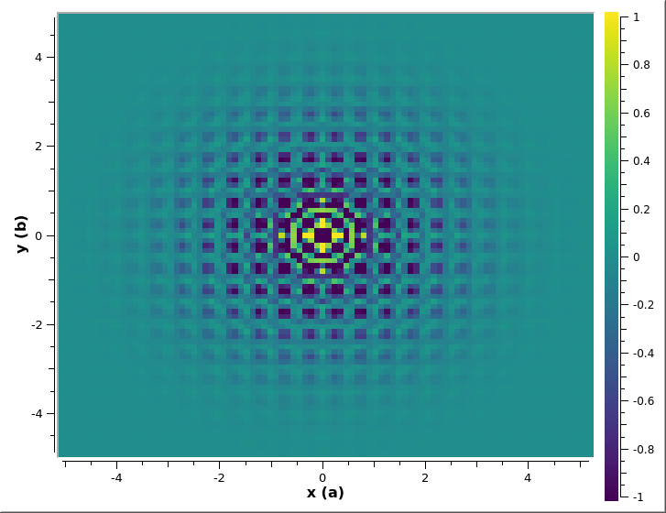
Diffuse Scattering
3D-deltaPDF
Benzil 300K, y=0.5
DTO 680mk H=1.2 z=0
DTO 680mk H=1.2 z=0.25

Slide 32
3D Profile Fitting for Peak Integration
Brendan Sullivan, Rick Archibald, Leighton Coates, Xiaoping Wang, Franz Gallmeier, Jack Carpenter, Vickie Lynch, Paul Langan
Samples: Patricia Langan (ORNL), Holger Dobbek and Martin Bommer (Humboldt-Universitat zu Berlin), Robert McFeeters (University of Alabama, Huntsville), Martin Egli and Joel Harp (Vanderbilt University)
Data from the MaNDi and TOPAZ beamlines at the Spallation Neutron Source – Oak Ridge National Laboratory
Funding: NIH R01-GM071939

Slide 33
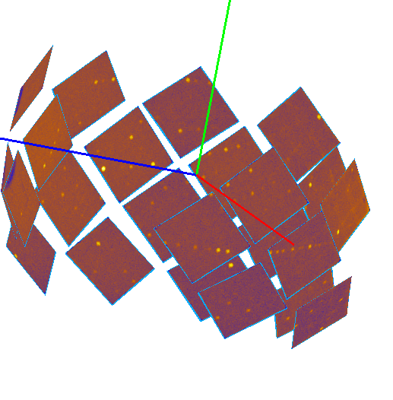
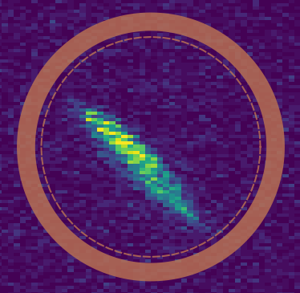
Currently use peak-minus-background integration
Bragg peaks are complex 3D intensity profiles which can be integrated in detector space or reciprocal space
Detector space run into overlap
Reciprocal space separates peaks
$I=ΣN_{Inside}−γΣN_{outside}$

Slide 34
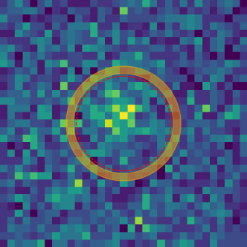
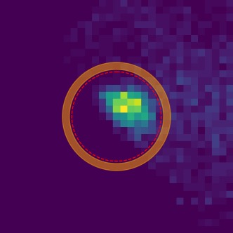
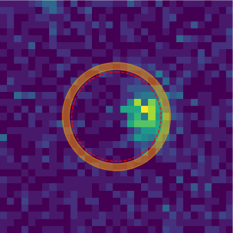
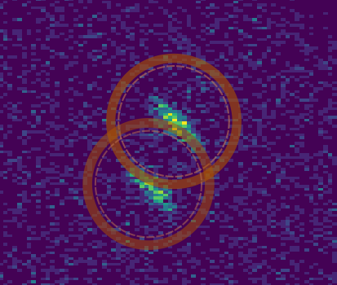
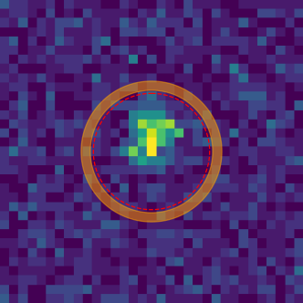
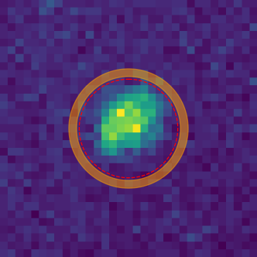
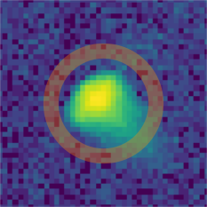
Shortcomings of peak-minus-background approaches
Weak Peaks
Inaccurate Peak
Adjacent and
Profile fitting overcomes all of these issues!
Overlapping Peaks
Detector Edges
Prediction
Integrate the tail
Varying Peak Sizes

Slide 35
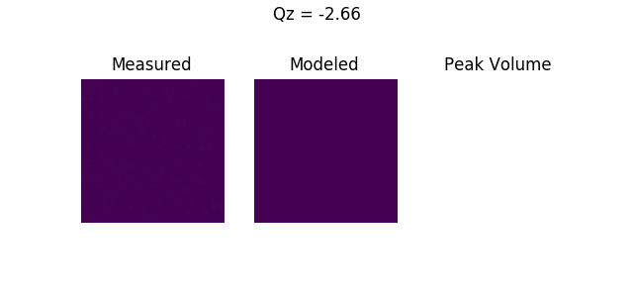
Details of peak integration
Goal of integration is to get I, σ(I) for each peak – need to define an integration volume
Here: N / N_{max} > 0.05
Tunable parameter
Integrate peak:
Variance:
$$I=ΣN_{model}$$
$$σ^{2}\left(I\right)=ΣN_{obs}+ΣN_{bg}+\frac{ΣN_{obs}{\left(N_{obs}−N_{model}\right)}^{2}}{ΣN_{obs}}$$
Poission Statistics
Fit Variance

Slide 36
Profile fitting recovers intensities at detector edges
 | Profile Fitting | Spherical
Percent of Total Reflections | 20.1% (21.4%) | 25.4% (25.6%)
No. Unique Reflections | 14,928 (1,090) | 19,823 (759)
Multiplicity | 1.60 (1.38) | 2.02 (1.69)
R_{pim} | 15.3% (20.6%) | 22.8% (27.6%)
CC_{1/2} | 0.907 (0.432) | 0.834 (0.082)
Look at peaks 15 detector pixels or fewer from the edge
Affects ~20% of peaks!
By forcing nearest neighbor profile we improve merging statistics
Detector Edges

Slide 37
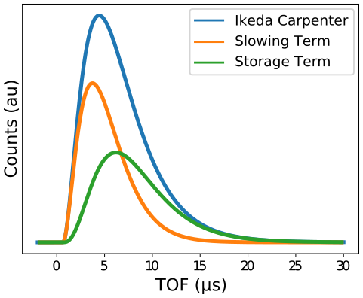
Moderator emission and the Ikeda-Carpenter function
1985 – Ikeda Carpenter function describes moderator emission
SNS moderators have been modeled using MCSTAS
We get fitting parameters from these
High TOF tail gives rise to tail in reciprocal space
For peak fitting – convolve with tophat function and Gaussian function
$$TOF \sim \frac{L sin⁡(θ)}{|\vec{q}|}$$

Slide 38
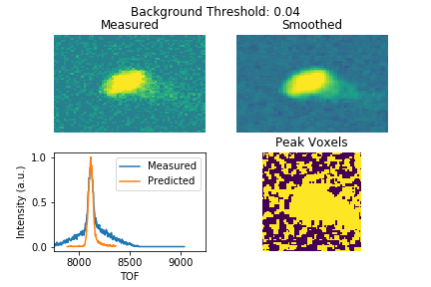
Background from expected profile fit
Each voxel in intensity profile has a TOF associated with it
TOF profile is just a histogram of events
Can determine which voxels are peak vs. background by least squares fitting with expected profile

Slide 39
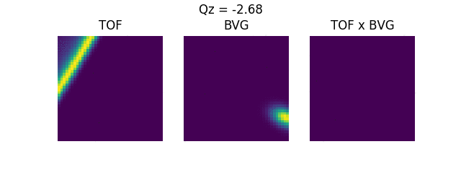
Angular coordinates from bivariate normal distribution
TOF
$$q_{x},q_{y}{,q}_{z} →q_{r},q_{θ},q_{φ}^{az}$$
In spherical coordinates, remaining two components are along scattering direction and around beam direction
Peaks in this direction are well-described by a bivariate Gaussian
Take these parameters and multiply by IC parameters to get 3D profile
Could do as full 3D fit, but (2+1)D fit computationally simpler and gives same answer
$$q_{φ}^{az}$$
$$q_{θ}$$

Slide 40
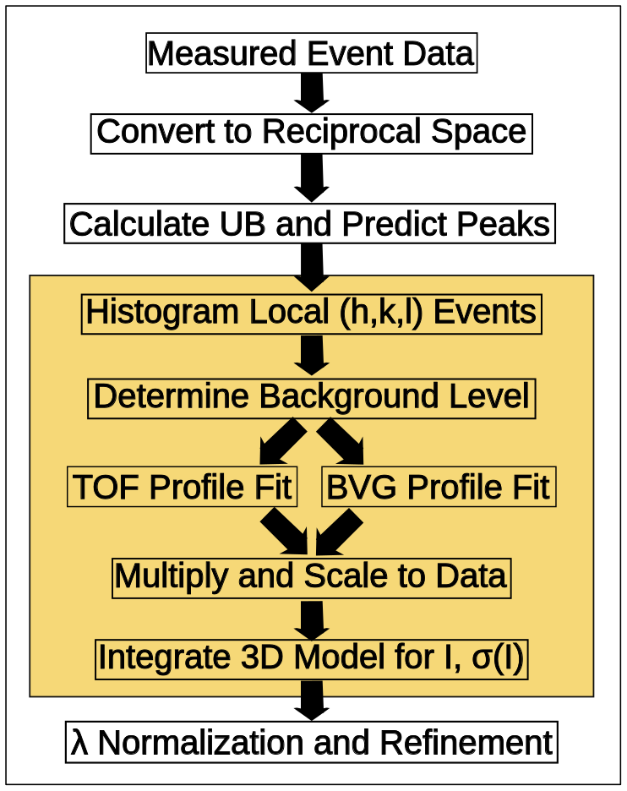
Angular coordinates from bivariate normal distribution
TOF
$$q_{x},q_{y}{,q}_{z} →q_{r},q_{θ},q_{φ}^{az}$$
In spherical coordinates, remaining two components are along scattering direction and around beam direction
Peaks in this direction are well-described by a bivariate Gaussian
Take these parameters and multiply by IC parameters to get 3D profile
Could do as full 3D fit, but (2+1)D fit computationally simpler and gives same answer
$$q_{φ}^{az}$$
$$q_{θ}$$

Slide 41
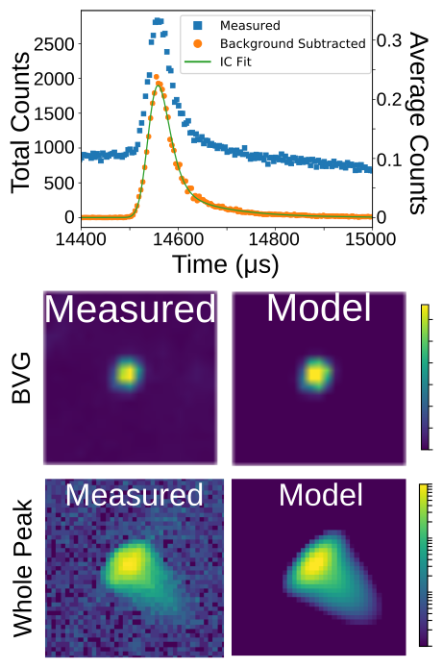
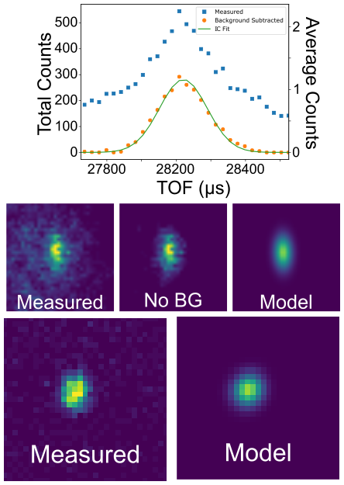
Works well strong peaks not near detector edges
Strong Peak from TOPAZ
Strong Peak from MaNDi

Slide 42
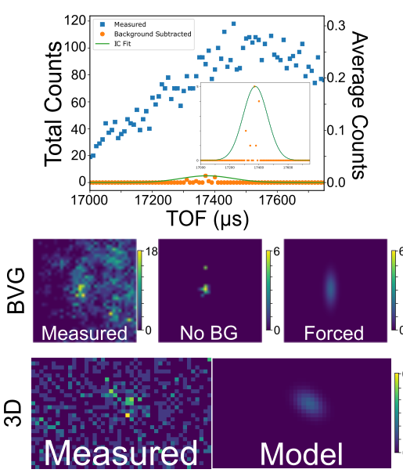
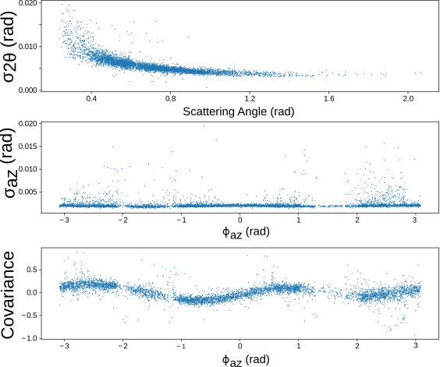
Weak peaks use profile of neighboring strong peak
Peak shape parameters vary slowly as you
go around detector sphere
So we can take the profile of the nearest
strong neighbor

Slide 43
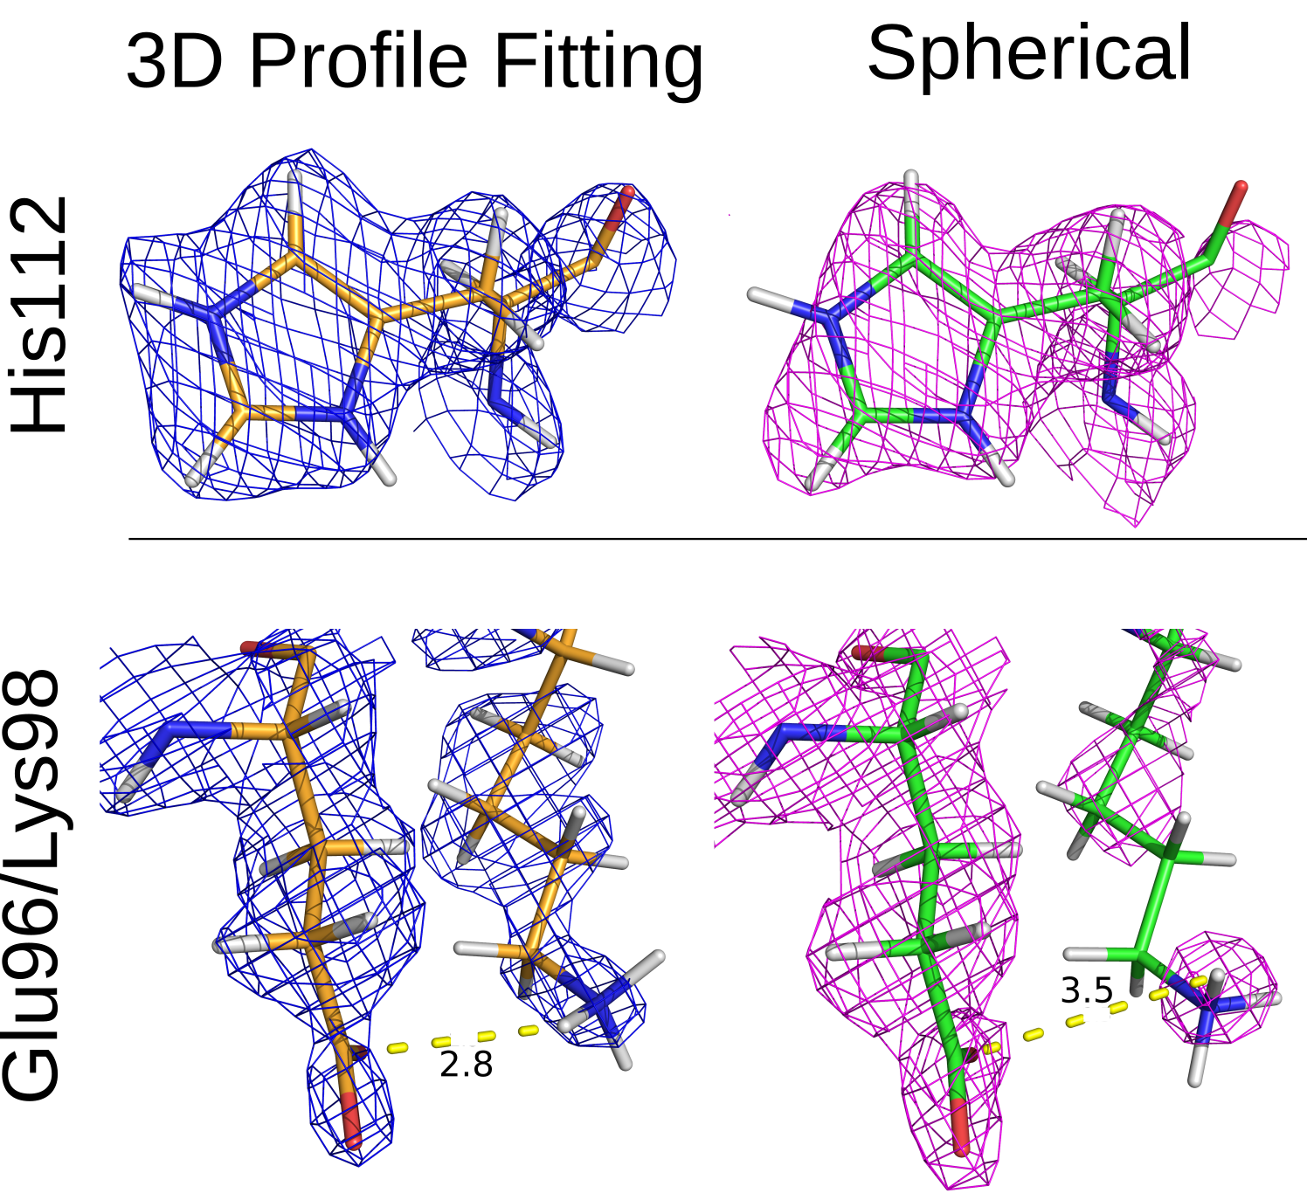
Case study: Perdeuterated β-lactamase mutant
β-lactamases are a class of enzymes involved in antibiotic resistance
Diffracts excellently – great case for testing profile fitting
CC_{1/2} < 0.3:
Profile fitting: < 1.9 Å
Spherical: 2.2 Å
~0.3 Å increase
Unit Cell Parameters | a = b = 73.7 Å, c = 99.8 Å
 | α = β = 90◦, γ = 120◦
Space Group | P3₂21
Number of Orientations | 11
 | 3D Profile | Spherical
Resolution Range (Å) | 14.77 - 1.89 (1.96 - 1.89) | 14.77 – 1.89 (1.96 – 1.89)
No. Unique Reflections | 24,386 (2,144) | 24,918 (2,195)
Multiplicity | 4.86 (3.19) | 6.32 (4.57)
Mean I/σ(I) | 8.5 (2.7) | 7.4 (3.8)
Completeness | 96.6% (86.7%) | 96.7% (93.2%)
R_{pim} | 8.7% (16.1%) | 9.7% (14.1%)
CC_{1/2} | 0.958 (0.398) | 0.935 (0.076)
R_{work} | 0.219 | 0.181
R_{free} | 0.258 | 0.272
Keep I/σ(I) > 1
R_{work}, R_{free} from refinement on initial model
Sample: Patricia Langan - ORNL

Slide 44
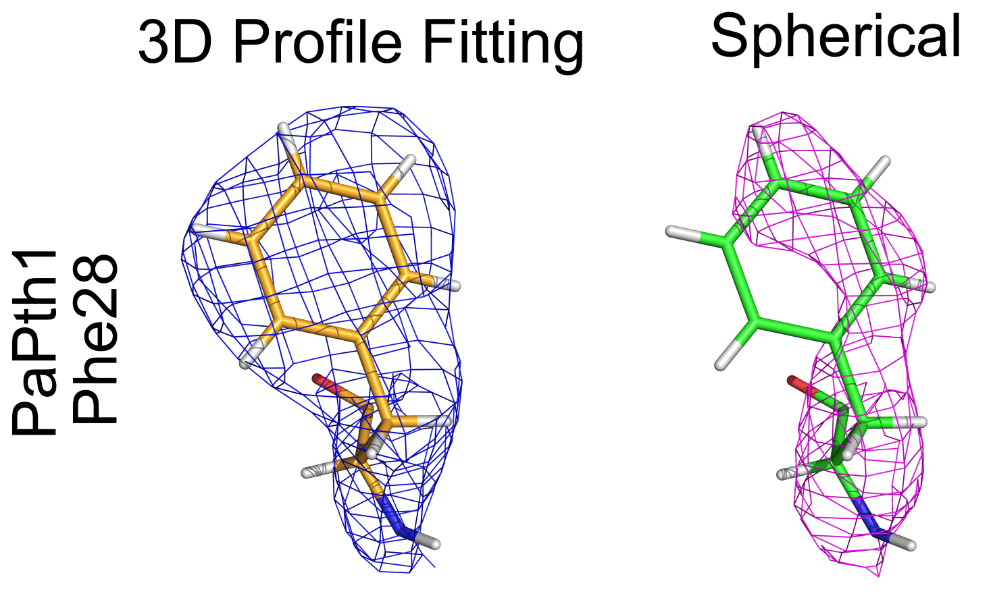
Case Study: Perdeuterated PaPth1
Unit Cell Parameters | a = b = 64.93 Å, c = 156.52 Å
 | α = β = 90◦, γ = 120◦
Space Group | P6₁22
Number of Orientations | 6
 | 3D Profile | Spherical
No. Unique Reflections | 5,186 (493) | 4,598 (436)
Resolution Range (Å) | 12.92-2.60 (2.69-2.60) | 12.92-2.60 (2.69-2.60)
Multiplicity | 2.8 (2.3) | 2.5 (2.1)
Mean I/σ(I) | 6.5 (2.7) | 4.0 (2.4)
Completeness | 79.2% (78.6%) | 70.2% (69.5%)
R_{pim} | 10.9% (19.4%) | 16.3% (35.8%)
CC_{1/2} | 0.920 (0.350) | 0.858 (0.039)
R_{work} | 0.272 | 0.323
R_{free} | 0.350 | 0.382
Peptidyl-tRNA hydrolase 1 (PaPth1) catalyzes cleavage of peptidyl tRNA to free peptide and tRNA
Important for bacteria to stay alive
Early dataset for MaNDi, initially pushed to ~2.8 Å.
CC_{1/2} < 0.3:
Profile fitting: < 2.6 Å
Spherical: ~2.9 Å
~0.3 Å increase
Sample: Robert McFeeters - University of Alabama Huntsville
Initial refinement on preliminary model

Slide 45
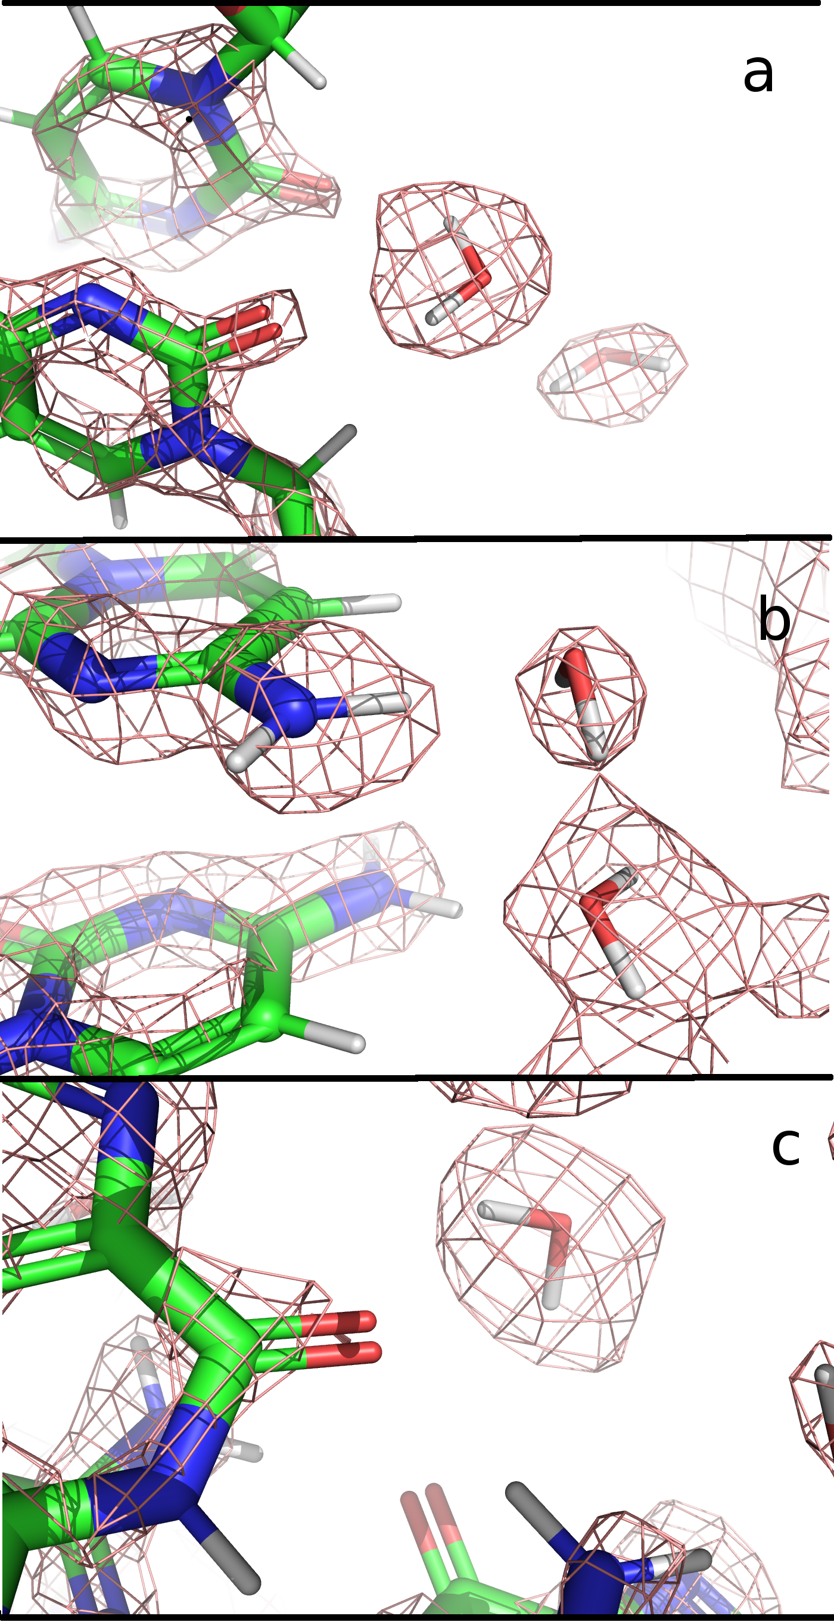
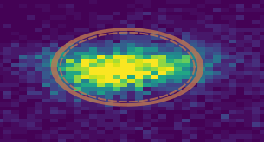
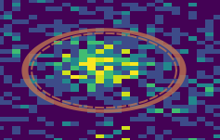
Case study: H-D Exchanged Z-DNA
Left handed Z-DNA crystals diffract to 1 Å show X-rays with regular hydration pattern outside helix
Still blind to visualizing H
RT Z-DNA with neutrons found 44 water molecules (~50%) at 1.8 Å resolution but could not water molecule determine orientation
Data collected in 48h from 0.25mm³ crystal
Spherical Integration: 1 water molecule
Profile fitting: 30 water molecules with tentative orientation
2mFo-Fc at 1.5 rmsd
Very different
peak sizes
Sample: Martin Egli and Joel Harp, Vanderbilt University

Slide 46
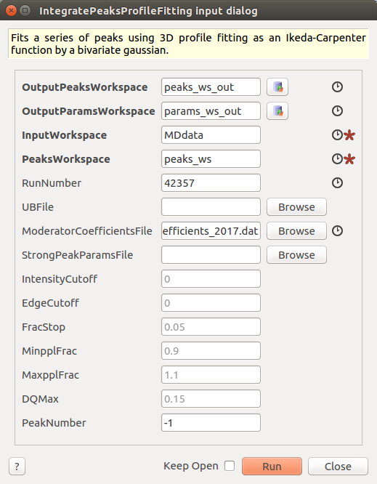
3D profile fitting is an algorithm in Mantid
Implemented profile fitting algorithm in Mantid Nightly as IntegratePeaksProfileFitting
Has companion Jupyter notebook for visualizing peak fits
Will be able to replace other integration algorithms in standard data SCD reduction workflows
Could be useful for re-analyzing old data

Slide 47
Python script for TOPAZ
Load(Filename='/SNS/TOPAZ/IPTS-9918/0/15647/NeXus/TOPAZ_15647_event.nxs', OutputWorkspace='TOPAZ_15647_event', FilterByTofMin=500, FilterByTofMax=16666, LoadMonitors=True)
FilterBadPulses(InputWorkspace='TOPAZ_15647_event', OutputWorkspace='TOPAZ_15647_event', LowerCutoff=25)
LoadIsawDetCal(InputWorkspace='TOPAZ_15647_event', Filename='/SNS/TOPAZ/shared/PeakIntegration/calibration/TOPAZ_2016A.DetCal')
ConvertToMD(InputWorkspace='TOPAZ_15647_event', QDimensions='Q3D', dEAnalysisMode='Elastic', Q3DFrames='Q_lab', LorentzCorrection=True, OutputWorkspace='TOPAZ_15647_md', MinValues='-25,-25,-25', MaxValues='25,25,25', SplitInto='2', SplitThreshold=100, MaxRecursionDepth=14)
LoadIsawUB(InputWorkspace='TOPAZ_15647_md', Filename='/SNS/TOPAZ/shared/PeakIntegration/DataSet/Si2mm_2016A_15647_15669/15647_Niggli.mat')
LoadIsawPeaks(Filename='/SNS/TOPAZ/shared/PeakIntegration/DataSet/Si2mm_2016A_15647_15669/15647_Niggli.integrate', OutputWorkspace='TOPAZ_15647_peaks')
LoadIsawUB(InputWorkspace='TOPAZ_15647_peaks', Filename='/SNS/TOPAZ/shared/PeakIntegration/DataSet/Si2mm_2016A_15647_15669/15647_Niggli.mat')
LoadIsawUB(InputWorkspace='TOPAZ_15647_md', Filename='/SNS/TOPAZ/shared/PeakIntegration/DataSet/Si2mm_2016A_15647_15669/15647_Niggli.mat')
PredictPeaks(InputWorkspace='TOPAZ_15647_peaks', WavelengthMin=1, WavelengthMax=2, MinDSpacing=0.5, OutputWorkspace='TOPAZ_15647_peaks', EdgePixels=20)
SetInstrumentParameter(Workspace='TOPAZ_15647_peaks', ParameterName='peakMaskSize', ParameterType='Number', Value='6')
runNumber = int(mtd['TOPAZ_15647_peaks'].getPeak(0).getRunNumber())
IntegratePeaksProfileFitting(OutputPeaksWorkspace='peaks_ws_out', OutputParamsWorkspace='params_out',
InputWorkspace='TOPAZ_15647_md', PeaksWorkspace='TOPAZ_15647_peaks', RunNumber=runNumber,
UBFile='/SNS/TOPAZ/shared/PeakIntegration/DataSet/Si2mm_2016A_15647_15669/15647_Niggli.mat',
ModeratorCoefficientsFile='/SNS/TOPAZ/shared/ProfileFitting/franz_coefficients_2010.dat',
StrongPeakParamsFile='/SNS/users/vel/Dropbox (ORNL)/analysis/strongPeakParams_topaz_silicon.pkl')

Slide 48
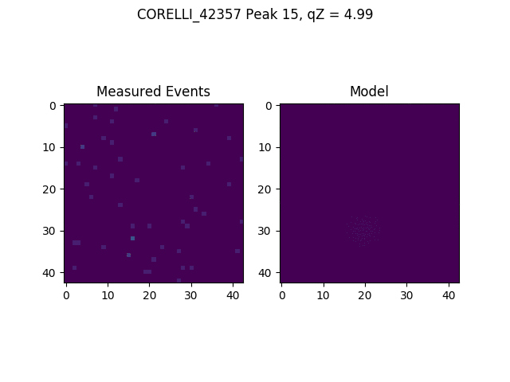
Profile fitting can recover intensities in ³He detectors
Different detector system: ³He tubes
There is a gap between each tube, set of tubes, and each bank
Profile fitting can recover the intensities in these gaps

Slide 49
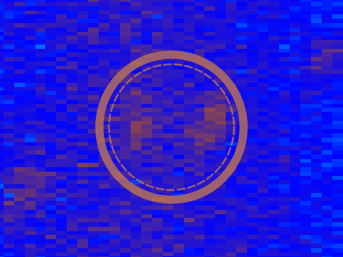
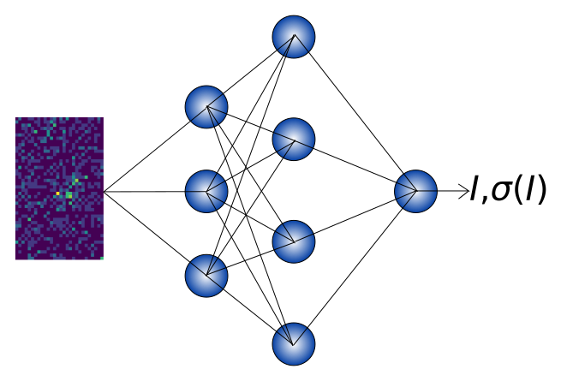
Planned for profile fitting
Fit crystal and instrument
parameters
Overlapping Peaks
Image segmentation
through machine learning

Slide 50
Modulated Structures
Shiyun Liu, Xiaoping Wang, Vickie Lynch
Samples: Shiyun Liu, A. Banerjee, X.P. Wang, C.M. Hoffmann, M. Lumsden, B.C. Sales, K.J. Woo, B.C. Chakoumakos
Data from the TOPAZ beamlines at the Spallation Neutron Source – Oak Ridge National Laboratory
Funding: GO student

Slide 51
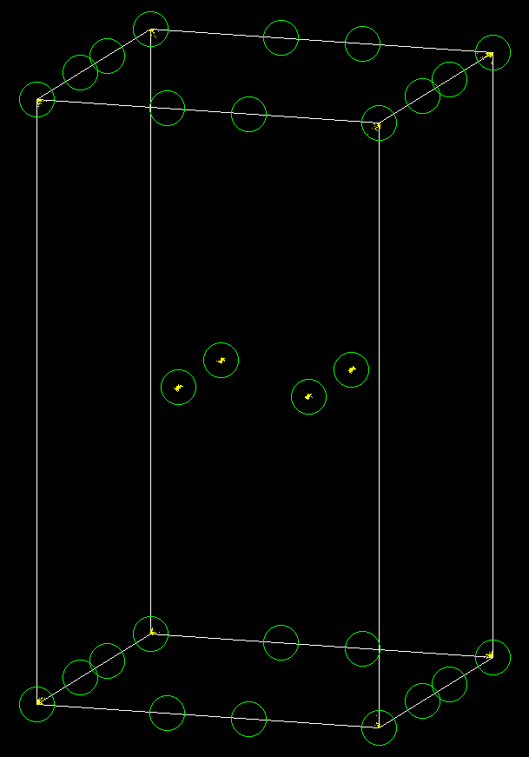
Modulated Structure Example
No cross-terms of satellite observed
1d modulated Cmm2 with twinning
hk0
q₂
q₁+q₂
hk0.5
q₁

Slide 52
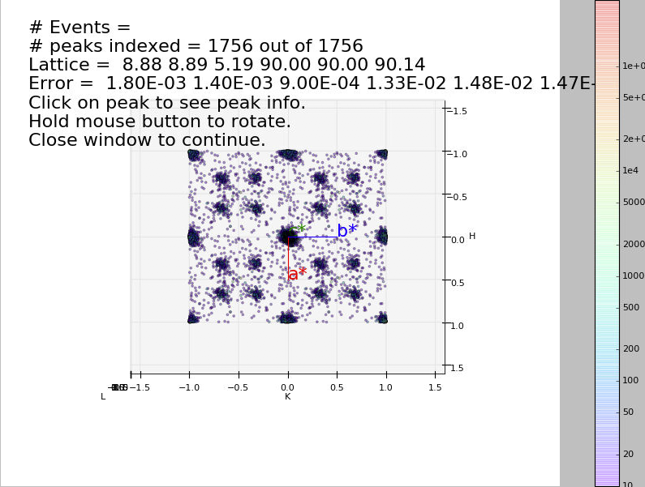
Finding Modulation Vectors
Visual aid for identifying the satellite peaks
Finds clusters of peaks by binning the number of peaks in the collapsed HKL space into specified sized boxes
The resulting clusters of peaks are modulation vectors

Slide 53
Modifications to Mantid
ModUB is added to the OrientedLattice class
Members ModHKL and errorModHKL are added to UnitCell class
$$ModUB=\left(\begin{matrix}{MV}_{11} & {MV}_{12} & {MV}_{13} \\ {MV}_{21} & {MV}_{22} & {MV}_{23} \\ {MV}_{31} & {MV}_{32} & {MV}_{33}\end{matrix}\right)$$
$$Modulation Vector i=\left(\begin{matrix}{MV}_{1i} \\ {MV}_{2i} \\ {MV}_{3i}\end{matrix}\right)$$
$$ModHKL=\left(\begin{matrix}{dh}_{1} & {dh}_{2} & {dh}_{3} \\ {dk}_{1} & {dk}_{2} & {dk}_{3} \\ {dl}_{1} & {dl}_{2} & {dl}_{3}\end{matrix}\right)$$
$$errorModHKL=\left(\begin{matrix}err{dh}_{1} & err{dh}_{2} & err{dh}_{3} \\ err{dk}_{1} & err{dk}_{2} & err{dk}_{3} \\ err{dl}_{1} & err{dl}_{2} & err{dl}_{3}\end{matrix}\right)$$
$$\left(\begin{matrix}x_{i} \\ y_{i} \\ z_{i}\end{matrix}\right)=\left(\begin{matrix}UB & ModUB\end{matrix}\right)×\left(\begin{matrix}\begin{matrix}h_{i} \\ k_{i} \\ l_{i}\end{matrix} \\ \begin{matrix}m_{i} \\ n_{i} \\ p_{i}\end{matrix}\end{matrix}\right)$$

Slide 54
Modifications to Mantid cont.
(${dh}_{i}$, ${dk}_{i}$, ${dl}_{i}$) is the modulation vector i (i=1,2,3) in HKL space. And the relation between ModUB and ModHKL is:
New functions setModUB is added to OrientedLattice class, and setModHKL, getModHKL, setModerr1, setModerr2, setModerr3, setModVec1, setModVec2, setModVec3, getModerr(i), getModVec(i), getdh(i), getdherr(i), getdk(i), getdkerr(i), getdl(i), getdlerr(i) are added to UnitCell class. Value for ModHKL in UnitCell is set when the function setModUB is used in OrientedLattice.
$$ModUB=UB×ModHKL$$

Slide 55
Modifications to Mantid cont.
IndexPeaks will now index both main reflections and satellites
Will index up with up to 3 modulation vectors
Uses maximum order of satellites to index
Uses Boolean for whether to include satellites of crossed terms
Use smaller tolerance than usual for main reflections with satellites
FindUBUsingIndexedPeaks uses the indexed peaks to calculate the UB and ModUB
FindUBUsingIndexedPeaksWithSatellites uses the indexed peaks from to calculate the UB and ModUB and has addition input for the modulation vectors

Slide 56
Modifications to Mantid cont.
With dh,dk,dl as input for PredictSatellitePeaks, all the satellite peaks that hits the detector within the wavelength range are predicted
LoadIsawUB and SaveIsawUB now input/output three more columns if there is a modulation vector
h k l m n p
IntegrateEllipoidsWithSatellites integrated both main and satellite peaks
$$\left(\begin{matrix}x_{i} \\ y_{i} \\ z_{i}\end{matrix}\right)=UB×\left( \begin{matrix}h_{i}+dh \\ k_{i}+dk \\ l_{i}+dl\end{matrix}\right)$$

Slide 57
FindUBUsingIndexedPeaks with Satellites
FindUBUsingIndexedPeaks-[Notice] FindUBUsingIndexedPeaks started FindUBUsingIndexedPeaks-[Notice] Number of Indexed Peaks in Run 24281 is 1753 FindUBUsingIndexedPeaks-[Notice] Lattice Parameters: 7.592302 7.628449 7.096641 106.925624 100.586711 115.107697 332.912929 FindUBUsingIndexedPeaks-[Notice] Parameter Errors : 0.000584 0.000658 0.001245 0.010293 0.010415 0.007113 0.086289 FindUBUsingIndexedPeaks-[Notice] New UB will index 853 main Peaks with tolerance 0.12 and 902 Satellite Peaks with tolerance 0.1 ,out of 2157 Peaks FindUBUsingIndexedPeaks-[Notice] Lattice Parameters: 7.592302 7.628449 7.096641 106.925624 100.586711 115.107697 332.912929 FindUBUsingIndexedPeaks-[Notice] Parameter Errors : 0.000584 0.000658 0.001245 0.010293 0.010415 0.007113 0.086289 FindUBUsingIndexedPeaks-[Notice] Modulation Dimension is: 1 FindUBUsingIndexedPeaks-[Notice] Modulation Vector 1: [-0.490880,-0.442061,0.384217] FindUBUsingIndexedPeaks-[Notice] Modulation Vector 1 error: [0.006756,0.007009,0.008165] FindUBUsingIndexedPeaks-[Notice] FindUBUsingIndexedPeaks successful, Duration 0.01 seconds

Slide 58
IndexPeaks with Satellites
IndexPeaks-[Notice] IndexPeaks started IndexPeaks-[Notice] Maximum Order: 2 IndexPeaks-[Notice] ALL Runs: indexed 1765 Peaks out of 2157 with tolerance of 0.12 IndexPeaks-[Notice] Out of 1765 Indexed Peaks 853 are Main Bragg Peaks, and 912 are satellite peaks IndexPeaks-[Notice] Average error in h,k,l for indexed peaks = 0.0149101 IndexPeaks-[Notice] Average error in h,k,l for indexed main peaks = 0.0145036 IndexPeaks-[Notice] Average error in h,k,l for indexed satellite peaks = 0.0152904 IndexPeaks-[Notice] Lattice Parameters: 7.592302 7.628449 7.096641 106.925624 100.586711 115.107697 332.912929 IndexPeaks-[Notice] Parameter Errors : 0.000584 0.000658 0.001245 0.010293 0.010415 0.007113 0.086289 IndexPeaks-[Notice] IndexPeaks successful, Duration 0.00 seconds

Slide 59
Conclusions
Mantid algorithms are reducing single-crystal data
TOPAZ is using autoreduction with reduction GUI for setup
Large memory is needed for normalization of orientations and visualization of data.
Visualization is very important for single crystal data.
3D Profile fitting for integration is available in Mantid
Reduction of data with modulated structures will soon be available in Mantid

