Slide 1
Introduction to Jana software
Václav Petříček and Michal Dušek
Institute of Physics
Academy of Sciences of the Czech Republic

Slide 2
General features
General crystallographic software for solution and refinement difficult crystal structures.
It can be applied to:
Regular including disordered structures
Structures affected by twinning
Modulated and composite structures
Magnetic structures
Charge density studies
ADP anharmonic refinements
As an input diffraction data we can use single crystal or powder data from:
Conventional X-ray diffractometers
Synchrotron sources
Neutron sources
Electron diffraction experiment - kinematical approach
Electron diffraction experiment - dynamical approach thanks to the connection with Dyngo developed by Lukáš Palatinus

Slide 3
General features
General crystallographic software for solution and refinement difficult crystal structures.
It can be applied to:
Regular including disordered structures
Structures affected by twinning
Modulated and composite structures
Magnetic structures – Margarida's lecture
Charge density studies
ADP anharmonic refinements
As an input diffraction data we can use single crystal or powder data from:
Conventional X-ray diffractometers
Synchrotron sources
Neutron sources
Electron diffraction experiment - kinematical approach
Electron diffraction experiment - dynamical approach thanks to the connection with Dyngo developed by Lukáš Palatinus

Slide 4
General features
For both twinned and modulated structures we shall try to answer following questions:
Can we recognize the problem from directly diffraction pattern?
How can we index diffraction spots and integrate them?
Laue symmetry?
Crystal structure symmetry?
Solution of the structure?
Refinement, presentation of results?

Slide 5
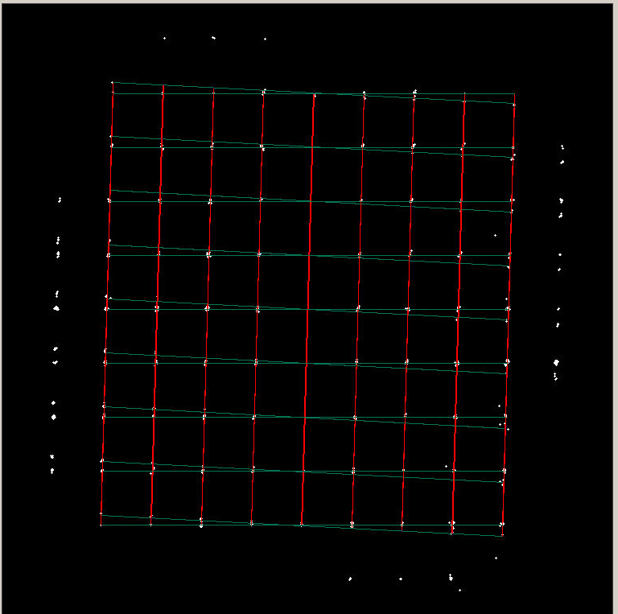
Twins

Slide 6
Twins
Relationship between independently diffraction domains is described by twinning matrix:
where are indices with respect to the n^{th} twin domain.

Slide 7
Twins
I – sygnonic or metric merohedry
The diffraction pattern does not indicate any problem !!! The twinning matrix can be derived from symmetry considerations and all elements of twining matrices are integers.

Slide 8
Twins-type I
Point group of the structure 4/m
Point group of the lattice 4/mmm

Slide 9
Twins-type I
Twinning by m_{x} - 50% of the second domain

Slide 10









Twins-type I
Sygnonic merohedry
Basic condition: The symmetry of the lattice is higher that the point (Laue) symmetry of the structure. But both symmetries belong to the same crystal system.
Example cubic system:
$$m\overline{3}m$$
$$\overline{1}$$
$$\overline{1}$$
$4$+$\overline{1}$
$$4$$
$$432$$
$$\overline{4}3m$$
$$23$$
$$m\overline{3}$$
The black arrows indicate those which can be returned back to $m\overline{3}m$ by adding of the inversion center.

Slide 11


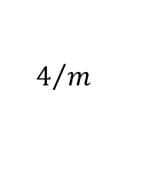


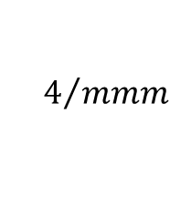







Twins-type I
Sygnonic merohedry
Example tetragonal case:
$$4/m$$
$$422$$
$$m_{x}$$
$$\overline{1}$$
$${\overline{1} +m}_{x}$$
$$\overline{1}$$
$$\overline{4}$$
$$4/{mmm}$$
$$\overline{4}m2$$
$${\overline{1} +m}_{x}$$
$$\overline{1}$$
$$4$$
$$4mm$$

Slide 12
Twins-type I
Metric merohedry
Basic condition: The symmetry of the lattice is higher that the point (Laue) symmetry of the structure. But both symmetries do not belong to the same crystal system.
Additional conditions: For full overlaps some geometrical conditions are to be fulfilled. For example: the monoclinic angle is, within accuracy of our experiment, equal 90°

Slide 13
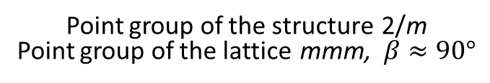
Twins-type I
Point group of the structure 2/m
Point group of the lattice mmm, $β≈90°$

Slide 14
Twins-type I
Twinning by m_{x} - 50% of the second domain

Slide 15
Twins-type I
Can we recognize the problem from directly diffraction pattern?
No, the diffraction pattern looks like for regular structure
How can we index diffraction spots and integrate them?
All diffraction spots can be indexed with three indices
Laue symmetry?
Crystal structure symmetry?
Solution of the structure?
Refinement, presentation of results?

Slide 16
Twins-type I
The twinning operations can be derived from the group – subgroup relationship:
the point group of the structure
the point group of the lattice

Slide 17
Twins-type I
The detected intensity is a sum of individual intensities from each domain. Without loosing generality we assume that . The coefficients are individual volume fractions normalized to one:

Slide 18

Twins-type I
$${\hat{S}}_{i}$$
Take any symmetry element from the point group H and calculate the structure factor for the symmetry related intensity:

Slide 19




Twins-type I
$${\hat{S}}_{i}$$
$${\hat{S}}_{i}$$
$${\hat{S}}_{i}$$
$${\hat{S}}_{i}$$
No interchanging of twin domains → this symmetry operation is present in the combined diffraction pattern

Slide 20




Twins-type I
$${\hat{S}}_{i}$$
$${\hat{S}}_{i}$$
$${\hat{S}}_{i}$$
$${\hat{S}}_{i}$$
Interchanging of twin domains → this symmetry operation is not present in the combined diffraction pattern

Slide 21
Twins-type I
Can we recognize the problem directly from diffraction pattern?
No, the diffraction pattern looks like for regular non-twinned structure
How can we index diffraction spots and integrate them?
All diffraction spots can be indexed with three indices
Laue symmetry?
Diffraction pattern do not need to show correct point group of the structure. It can be higher or lower than what we can see from the diffraction pattern.
Crystal structure symmetry?
Solution of the structure?
Refinement, presentation of results?

Slide 22
Twins-type I
Point group of the structure mmm – space group Pmma
Point group of the lattice 4/mmm, a ≈ b

Slide 23
Twins-type I
Twinning by four-fold axis
50% of the second domain

Slide 24
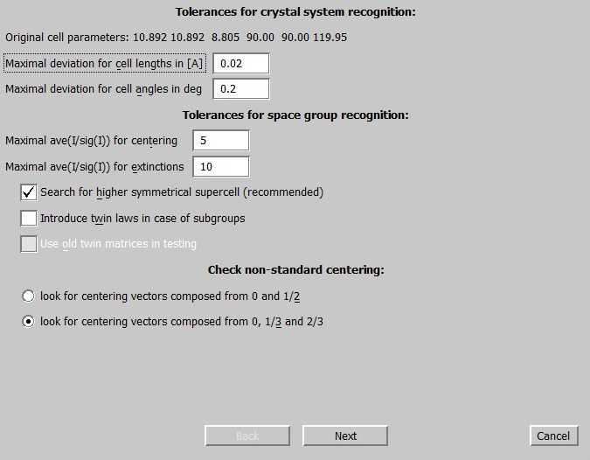
Twins-type I
Example: Lattice point group 6/mmm, structure point group ???
Regular test

Slide 25
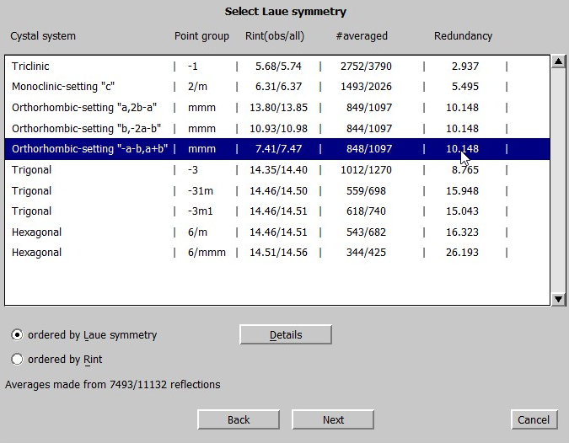
Twins-type I
Example: Lattice point group 6/mmm, structure point group ???
Regular test

Slide 26
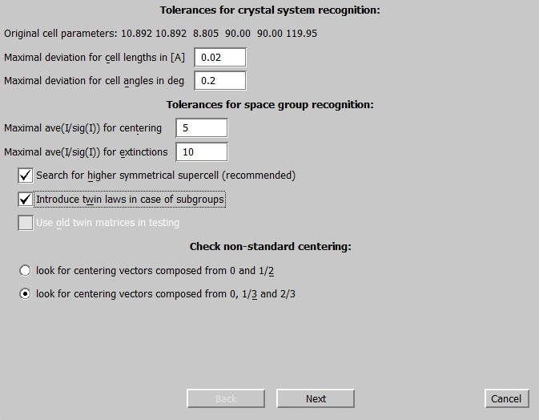
Twins-type I
Example: Lattice point group 6/mmm, structure point group ???
Test taking into account twin laws for subgroups

Slide 27

Twins-type I
Example: Lattice point group 6/mmm, structure point group ???
Test taking into account twin laws for subgroups

Slide 28
Twins-type I
Can we recognize the problem directly from diffraction pattern?
No, the diffraction pattern looks like for regular non-twinned structure
How can we index diffraction spots and integrate them?
All diffraction spots can be indexed three indices
Laue symmetry?
Diffraction pattern do not need to show correct point symmetry of the crystal. It can be higher or lower than what we can see from the diffraction pattern.
Crystal structure symmetry?
The systematic extinctions can be fully or partly hidden. A special testing procedure is needed.
Solution of the structure?
Difficult to solve the structure. Fortunately very often the structure has some relationship to higher symmetry of the lattice.
Refinement, presentation of results?
Volume fractions are needed as new parameters in the refinement.

Slide 29
Twins
II – reticular merohedry
The diffraction pattern usually (but not always) indicates fully separated and fully overlapped reflections. The twinning matrix can be calculated from orientation matrices of two domains:
All elements of the twinning matrix are rational numbers.

Slide 30
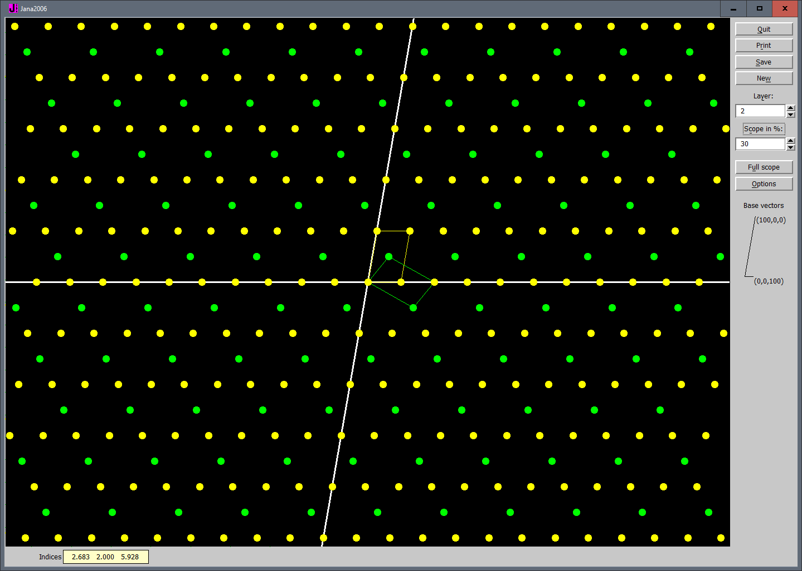
Twins-type II
Diffraction pattern indicates some problems. Some reflections are systematically absent but not as a result of crystal symmetry but due to combining of two or more domains:

Slide 31
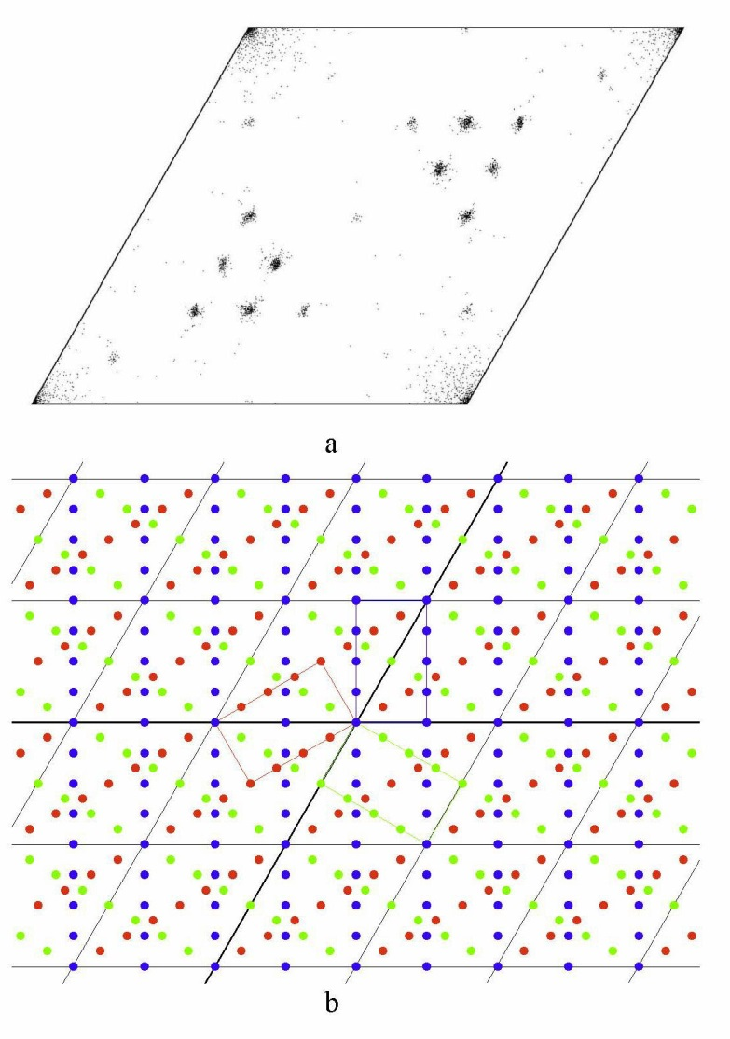
Twins-type II
Diffraction pattern indicates some problems. Some reflections are systematically absent but not as a result of crystal symmetry but due to overlaps of two or more domains:

Slide 32
Twins-type II
Diffraction pattern indicates some problems. Some reflections are systematically absent but not as a result of crystal symmetry but due to overlaps of two or more domains:

Slide 33
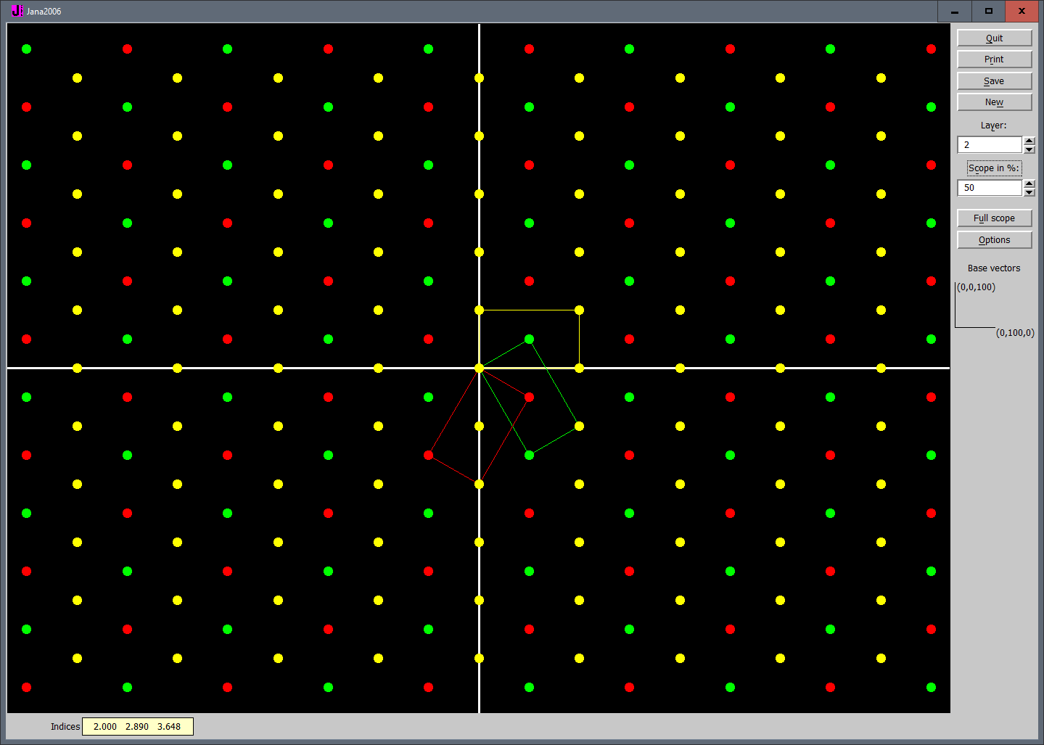
Twins-type II
However, in some cases the overlaps can generate a diffraction pattern which fakes real translation symmetry and no extra extinctions are detected:

Slide 34

Twins-type II
However, in some cases the overlaps can generate a diffraction pattern which fakes real translation symmetry:

Slide 35
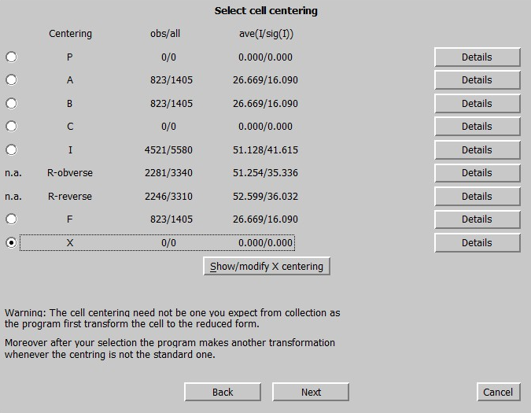
Twins-type II
However, in some cases the overlaps can generate a diffraction pattern which fakes real translation symmetry:

Slide 36
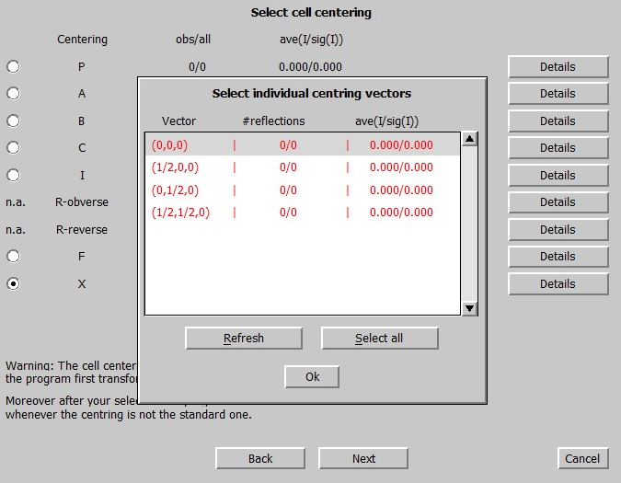
Twins-type II
However, in some cases the overlaps can generate a diffraction pattern which fakes real translation symmetry:

Slide 37
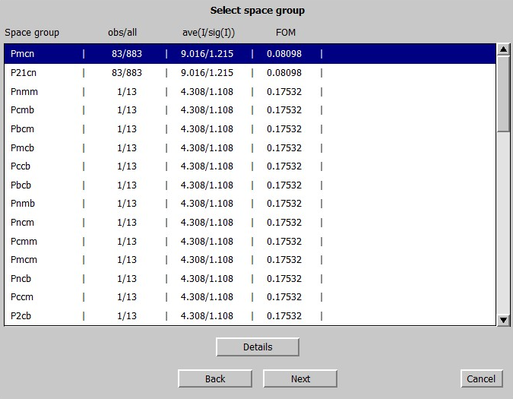
Twins-type II
However, in some cases the overlaps can generate a diffraction pattern which fakes real translation symmetry:

Slide 38
Twins-type II
Can we recognize the problem directly from diffraction pattern?
Yes, in most cases.
How can we index diffraction spots and integrate them?
All diffraction spots can be indexed three indices
Laue symmetry?
A special testing procedure needed.
Crystal structure symmetry?
A special testing procedure needed.
Solution of the structure?
Similar as for type I. Here better chance as we have some not-overlapping set of spots.
Refinement, presentation of results?
Similar as for type I.

Slide 39
Twins
III reticular pseudomerohedry
Random overlaps – some spots are so close that it is difficult to decide if they are integrated separately or not. The twinning matrix can be calculated from orientation matrices of two domains:
All elements of the twinning matrix are general numbers.

Slide 40
Twins-type III
Main problem how to separate partly overlapped reflections. Tis can be made only during the integration of data from frames – hklf5 format.

Slide 41
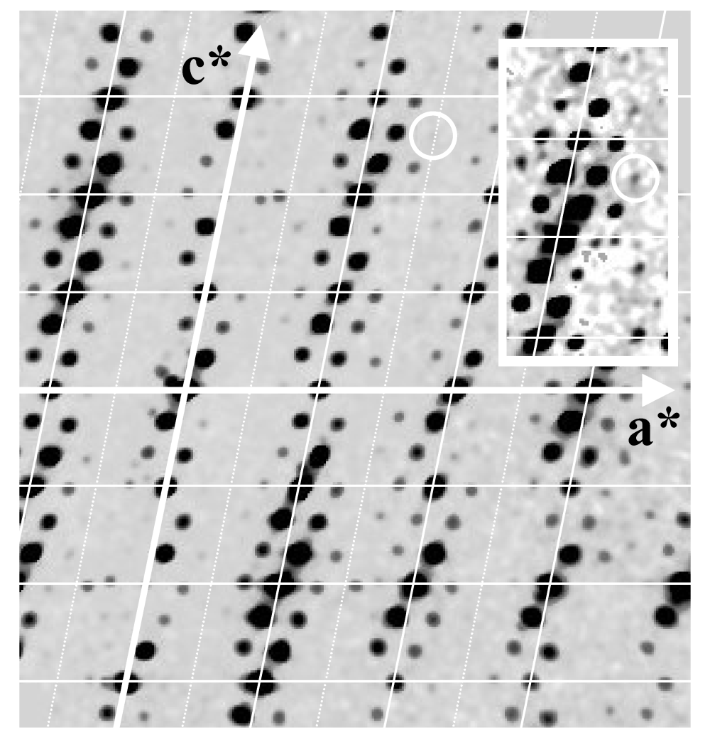
Modulated structures
Diffraction pattern
Example – Na₂CO₃

Slide 42
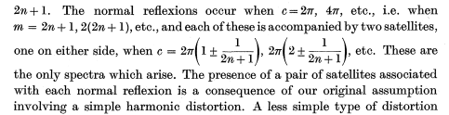
Modulated structures
Additional diffraction spots:
Modulated structures:
“Gittergeister” U.Dehlinger, Z. Kristallogr. (1927) 65 615–31.
“Satellites” G.D.Preston Proc. R. Soc. (1938) 167 526–38.
M. Korekawa (1967) Theorie der Satellitereflexe Habilitationschrift (München, Germany: Ludwigs-Maximilians-University).
Korekawa & Jagodzinski (1967), Schweitz.Miner.Petrogr.Mitt., 47, 269-278.
The theory of satellite reflections due to various types of modulation waves.
Composite crystals:
S. van Smallen, (1991), Phys. Rew. B, 43, 11330-11341.
E. Makovicky & B.G.Hide, (1992), Material Science Forum, 100&101, 1-100.

Slide 43
Modulated structures
Diffraction pattern ← Fourier transform → Charge (nuclear) density
3d lattice translation symmetry in
3 dimensional space
translation symmetry in
(3+d) dimensional space
⇒ Description in 3+d dimensional superspace
additional satellite spots

Slide 44
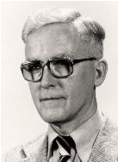

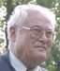
Modulated structures
Superspace theory
Peter M. de Wolff
Ted Janssen
Aloysio Janner
Aminoff prize in 1998
Ewald prize in 2014

Slide 45
Modulated structures
R₃

Slide 46
Modulated structures
Diffraction pattern ← Fourier transform → Charge (nuclear) density
Artificial description in (3+d)
Projection from (3+1)d superspace 3d section through
into 3d space (3+1)d superspace
↓ ↓
Diffraction pattern Real 3d Modulated structure

Slide 47
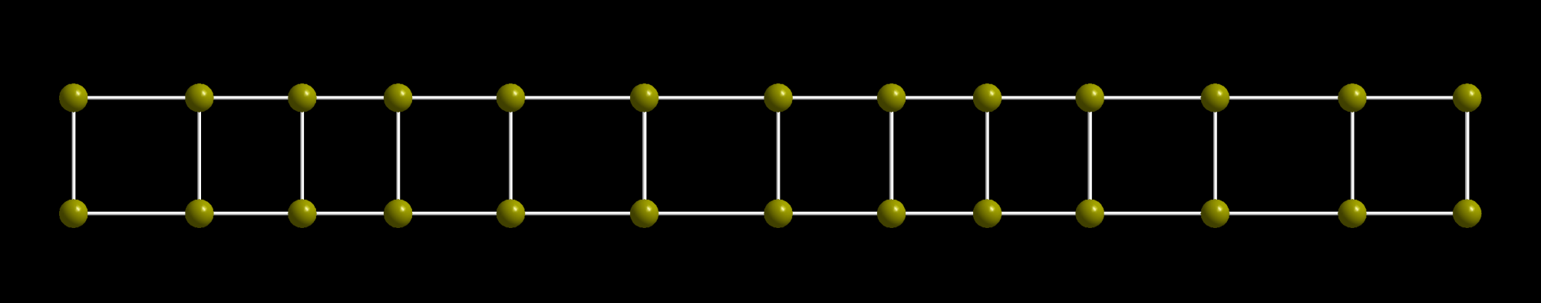
Modulated structures
Positional modulation
Modulation vector :
Modulation wave :

Slide 48
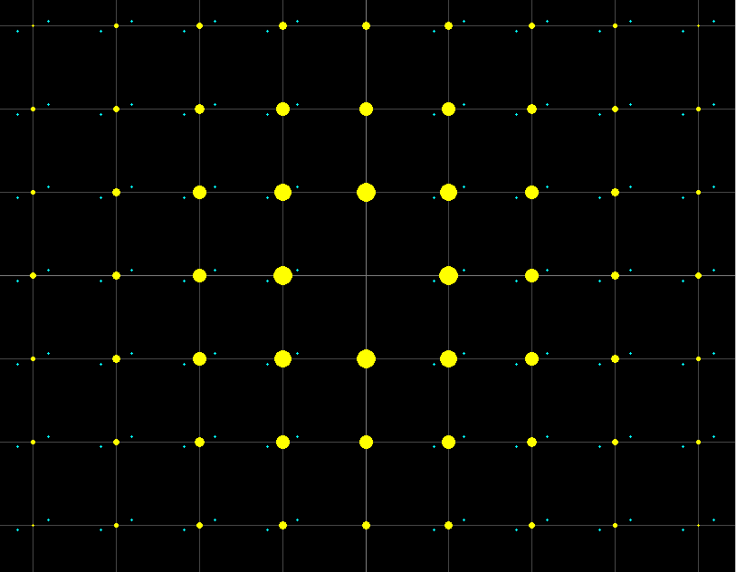
Modulated structures
Positional modulation – small amplitude

Slide 49
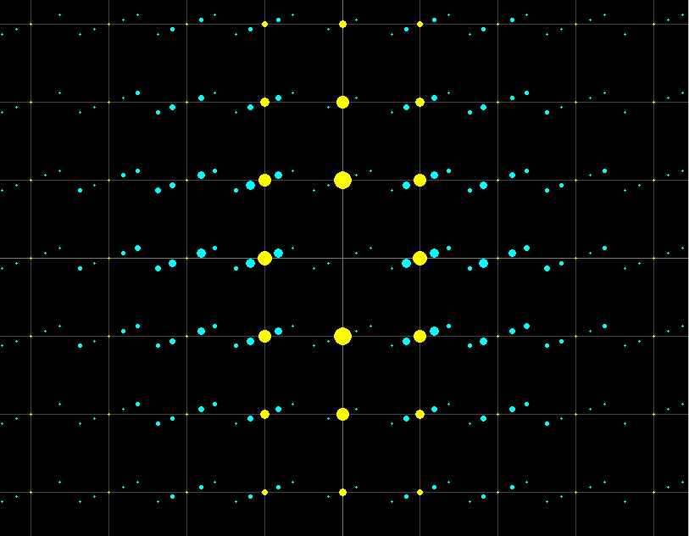
Modulated structures
Positional modulation – large amplitude

Slide 50
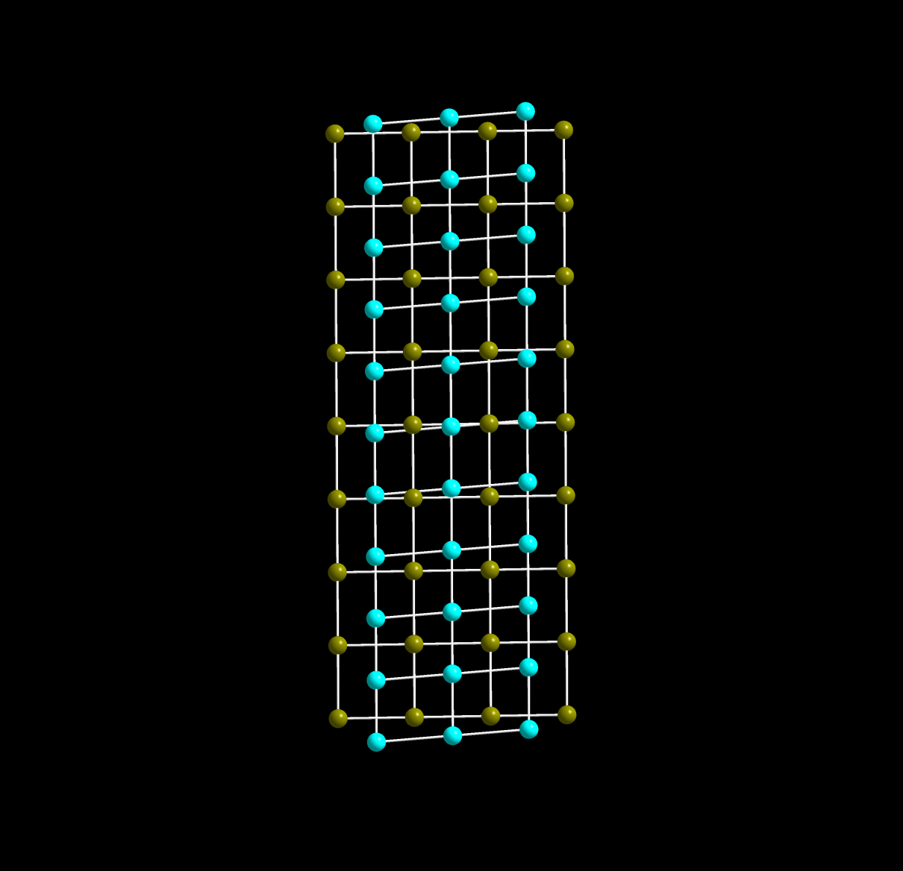
Modulated structures
Composite structure – no mutual modulation

Slide 51
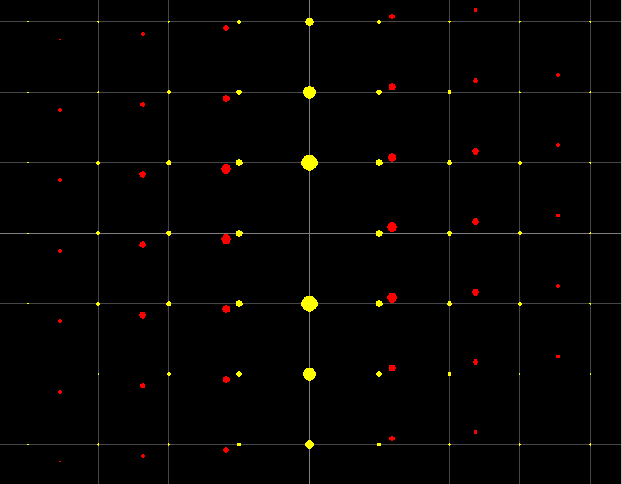
Modulated structures
Composite structure – no mutual modulation

Slide 52
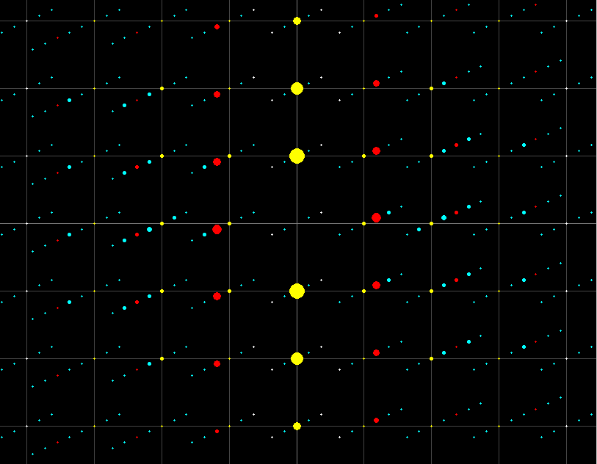
Modulated structures
Composite structure – strong mutual modulation

Slide 53
Modulated structures
Can we recognize the problem directly from diffraction pattern?
With area detectors we can directly detect modulations in the crystal.
How can we index diffraction spots and integrate them?
All diffraction spots can be indexed and integrated with (3+d) indices
Laue symmetry?
Crystal structure symmetry?
Solution of the structure?
Refinement, presentation of results?

Slide 54
Modulated structures
↓ ↓ ↓
basic property unitary operator matrix representation
Trivial symmetry operator - translation symmetry :
Generally these conditions are also used for space group in (3+d) dimensional space.
But the de Wolff construction leads to a specific simplification. The superspace groups are in fact 3+d reducible subgroups of more general (3+d) dimensional space groups

Slide 55
Modulated structures
Superspace symmetry operation:
(3x3) external, (dx3) mixed and (dxd) internal blocks of the rotational part of the superspace symmetry operation
3x1 external and (dx1) internal block of the translation part of the superspace symmetry operation
Application of superspace operation to a point x:
external and internal coordinates
In the (3+1) dimensional superspace we have 4 components

Slide 56
Modulated structures
Superspace symmetry operation:
From the basic symmetry as determined from main reflections
Internal space cannot be mixed up with external one
Form the metric properties (unitary conditions) →
The only new independent information are modulation vector(s) and intrinsic part of the 4th component of the translation vector. This component, analogically to 3d symmetry, affects systematic extinctions of reflections (here satellites). It expressed how the modulation wave is shifted the internal space.
The modulation vector can be split into two parts rational and irrational.
The rational part is made of zeros and specific fractions 1/2 , 1/3 fixed by symmetry.
→ complete separation of the external and internal case

Slide 57
Modulated structures
Superspace group symbols
For (3+1) dimensional superspace groups
Originally proposed by P.M.de Wolff, T. Janssen and A. Janner, Acta Cryst. (1981). A37, 625-636
Later modified and included into International Tables for Crystallography, volume C.
For (3+1), (3+2) and (3+3) dimensional space groups
H.T. Stokes, B. Campbell and S. van Smaalen, Acta Cryst. A47, 45-55.
Examples:

Slide 58
Modulated structures
Can we recognize the problem directly from diffraction pattern?
With area detectors we can directly detect modulations in the crystal.
How can we index diffraction spots and integrate them?
All diffraction spots can be indexed and integrated with (3+d) indices
Laue symmetry?
Diffraction pattern follows Laue symmetry not only form main diffraction spots but also for satellites
Crystal structure symmetry?
Superspace groups – extinction conditions affects also satellites
Solution of the structure?
Refinement, presentation of results?

Slide 59
Modulated structures
Charge flipping method
A new technique applicable to regular and modulated structures,
For regular structures:
G. Oszlányi and A. Süto, (2004). Acta Cryst. A60, 134.
For modulated structures:
L. Palatinus (2004). Acta Cryst. A60, 604.
L. Palatinus and G.Chapuis, (2007). J. Appl. Cryst. 40, 786.
It represents a small revolution in the structure analysis of modulated crystals. It is applicable even for strongly modulated crystals having discontinuously modulated occupancies or positions.

Slide 60
Modulated structures
Can we recognize the problem directly from diffraction pattern?
With area detectors we can directly detect modulations in the crystal.
How can we index diffraction spots and integrate them?
All diffraction spots can be indexed and integrated with (3+d) indices
Laue symmetry?
Diffraction pattern follows Laue symmetry not only form main diffraction spots but also for satellites
Crystal structure symmetry?
Superspace groups – extinction conditions affects also satellites
Solution of the structure?
Superflip
Refinement, presentation of results?

Slide 61
Modulated structures
Structure factor formula:
Generally any structural parameter, i.e. site occupancy, position, ADP parameters, can be modulated. An actual value p can be described by a modulation function having periodicity 1:
Fourier expansion:
The structure factor is to be integrated over the interval $\left(0,1\right)$.
Analytical method: occupancy – simple formula
position – Bessel functions
ADP (harmonic) – modified Bessel functions
Combination of modulations: Convolution of previous functions
Numerical integration

Slide 62
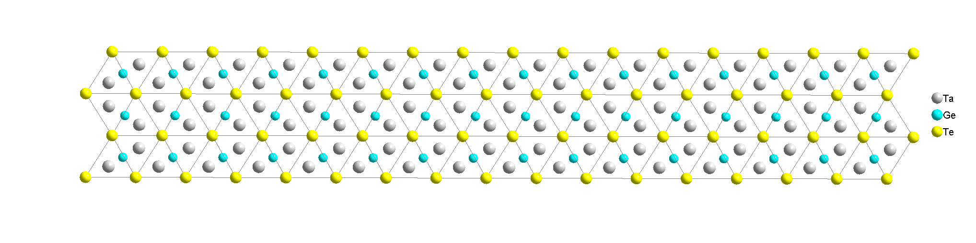
Modulated structures
The modulation curves and corresponding density maps play a crucial role during the solution and refinement process. But a fine presentation should be made in the 3d real space. Several cells and more different sections are to be presented to see various configurations in the modulated crystal:
The same example as for the crenel function - TaGe_{0.354}Te – F. Boucher, M.Evain & V. Petříček, (1996). Acta Cryst., B52, 100:
Average structure

Slide 63
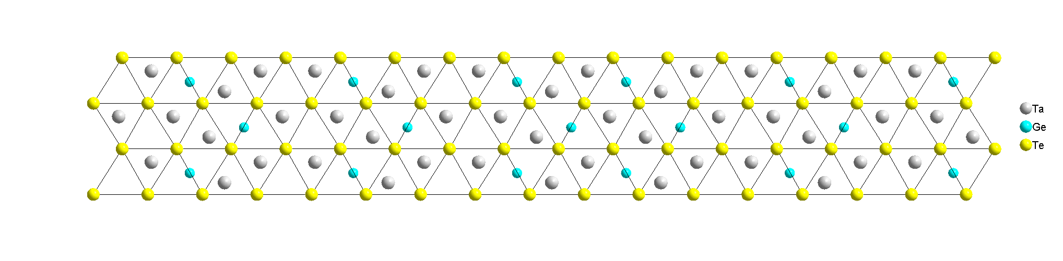
Modulated structures
The modulation curves and corresponding density maps play a crucial role during the solution and refinement process. But a fine presentation should be made in the 3d real space. Several cells and more different sections are to be presented to see various configurations in the modulated crystal:
The same example as for the crenel function - TaGe_{0.354}Te – F. Boucher, M.Evain & V. Petříček, (1996). Acta Cryst., B52, 100:
Only occupational modulation

Slide 64
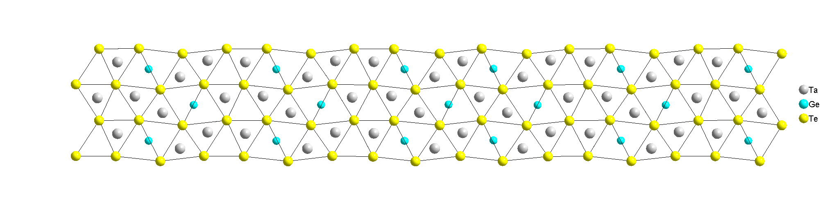
Modulated structures
The modulation curves and corresponding density maps play a crucial role during the solution and refinement process. But a fine presentation should be made in the 3d real space. Several cells and more different sections are to be presented to see various configurations in the modulated crystal:
The same example as for the crenel function - TaGe_{0.354}Te – F. Boucher, M.Evain & V. Petříček, (1996). Acta Cryst., B52, 100:
Final result

Slide 65
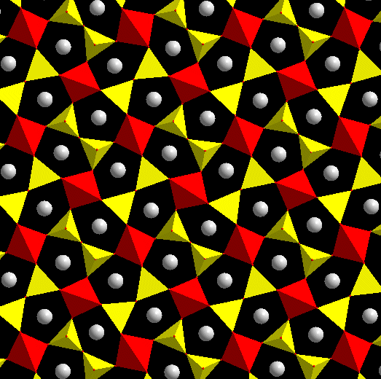
Modulated structures
Animation by graphic program

Slide 66
Modulated structures
Can we recognize the problem directly from diffraction pattern?
With area detectors we can directly detect modulations in the crystal.
How can we index diffraction spots and integrate them?
All diffraction spots can be indexed and integrated with (3+d) indices
Laue symmetry?
Diffraction pattern follows Laue symmetry not only form main diffraction spots but also for satellites
Crystal structure symmetry?
Superspace groups – extinction conditions affects also satellites
Solution of the structure?
Superflip
Refinement, presentation of results?
For calculation of structure factors - integration over t. Presentation in a large supercell or by animation

Slide 67
Anharmonic ADP
ADP tensors of the second order (harmonic ADP, “temperature parameters”) need not fully describe distribution of atoms in the crystal. Then the Gram-Charlie expansion can be used:
contravariant components of symmetric tensor of order 3,4,5,6

Slide 68
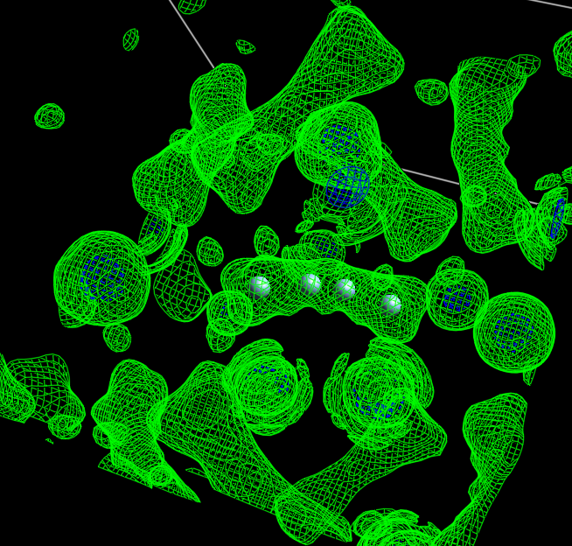
Anharmonic ADP
Ionic conductor Ag₈TiSe₆ – argyrodite
E.Gaudin, V.Petříček, F.Boucher, F.Taulelle & M.Evain, ActaCryst (2000), B56, 972-979.
Jana calculates j.p.d.f. maps and then calls 3d visualization program.

Slide 69
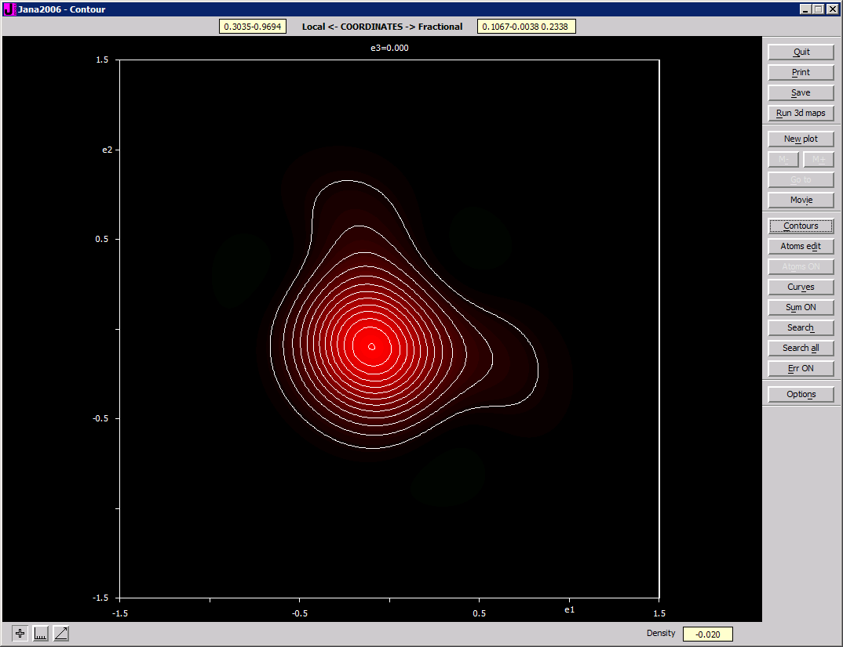
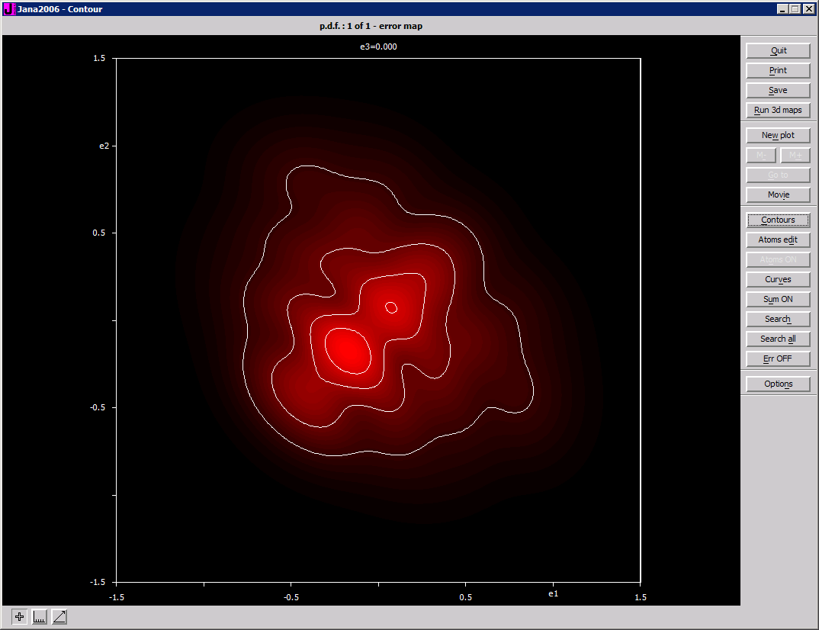
Anharmonic ADP
Except of p.d.f. and j.p.d.f. map Jana can calculate also so called error map showing “map uncertainty” as follows from covariation matrix from the refinement. For this a Monte-Carlo technique according to Kuhs, W.F. (1992). Acta Cryst. A48, 80-98 is implemented:

Slide 70
Anharmonic ADP
[1,1,0] section through j.p.d.f. Potential curve
Chance to localize possible positions of atoms after LT phase transition

Slide 71
Thank you for your attention

