Slide 1
FullProf & Esmeralda
Céline Durniak
on behalf of Juan Rodriguez Carvajal
Single crystal diffraction workshop
IKON15
12 September 2018

Slide 2
FullProf Suite

Slide 3
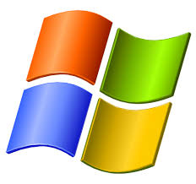
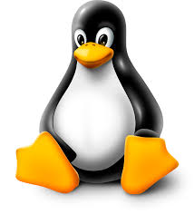
FullProf Suite – Description of project
project started in 1990s
code in Fortran, GUI using Winteracter (commercial)
not open source
supported operating systems
(2 versions)
set of crystallographic programs, based on Crystallographic Fortran Modules Library (CrysFML)¹
programs can be run in stand alone form or from a GUI
¹: http://forge.epn-campus.eu/projects/crysfml

Slide 4
FullProf Suite - Functionalities
mainly developed for Rietveld analysis of powder diffraction data for
X-ray
constant or variable step in scattering angle 2𝜃
neutrons
constant wavelength, TOF, nuclear and magnetic scattering, polarised neutrons
all options existing for powders exist also for single crystals.
for single crystal only
refinement of domain (twins) populations
secondary extinction parameters.
combined refinement of powder and single crystal data coming from different kinds of experiment on the same material.

Slide 5
FullProf Suite - GUI
Programs / Tools
CIFs_to_PCR mCIF_to_PCR
Mol_to_PCR CrysCalc
EdPCR
BasIreps
graphical editor for input PCR files for FullProf
calculating basis functions of irreducible representations of space groups
CheckGroup
DataRed
FullProf
Programs for crystallographic calculations
unique set of independent reflections (twinning, incommensurate magnetic structures)
crystal and magnetic structure refinement, multiple patterns, simulated annealing

Slide 6
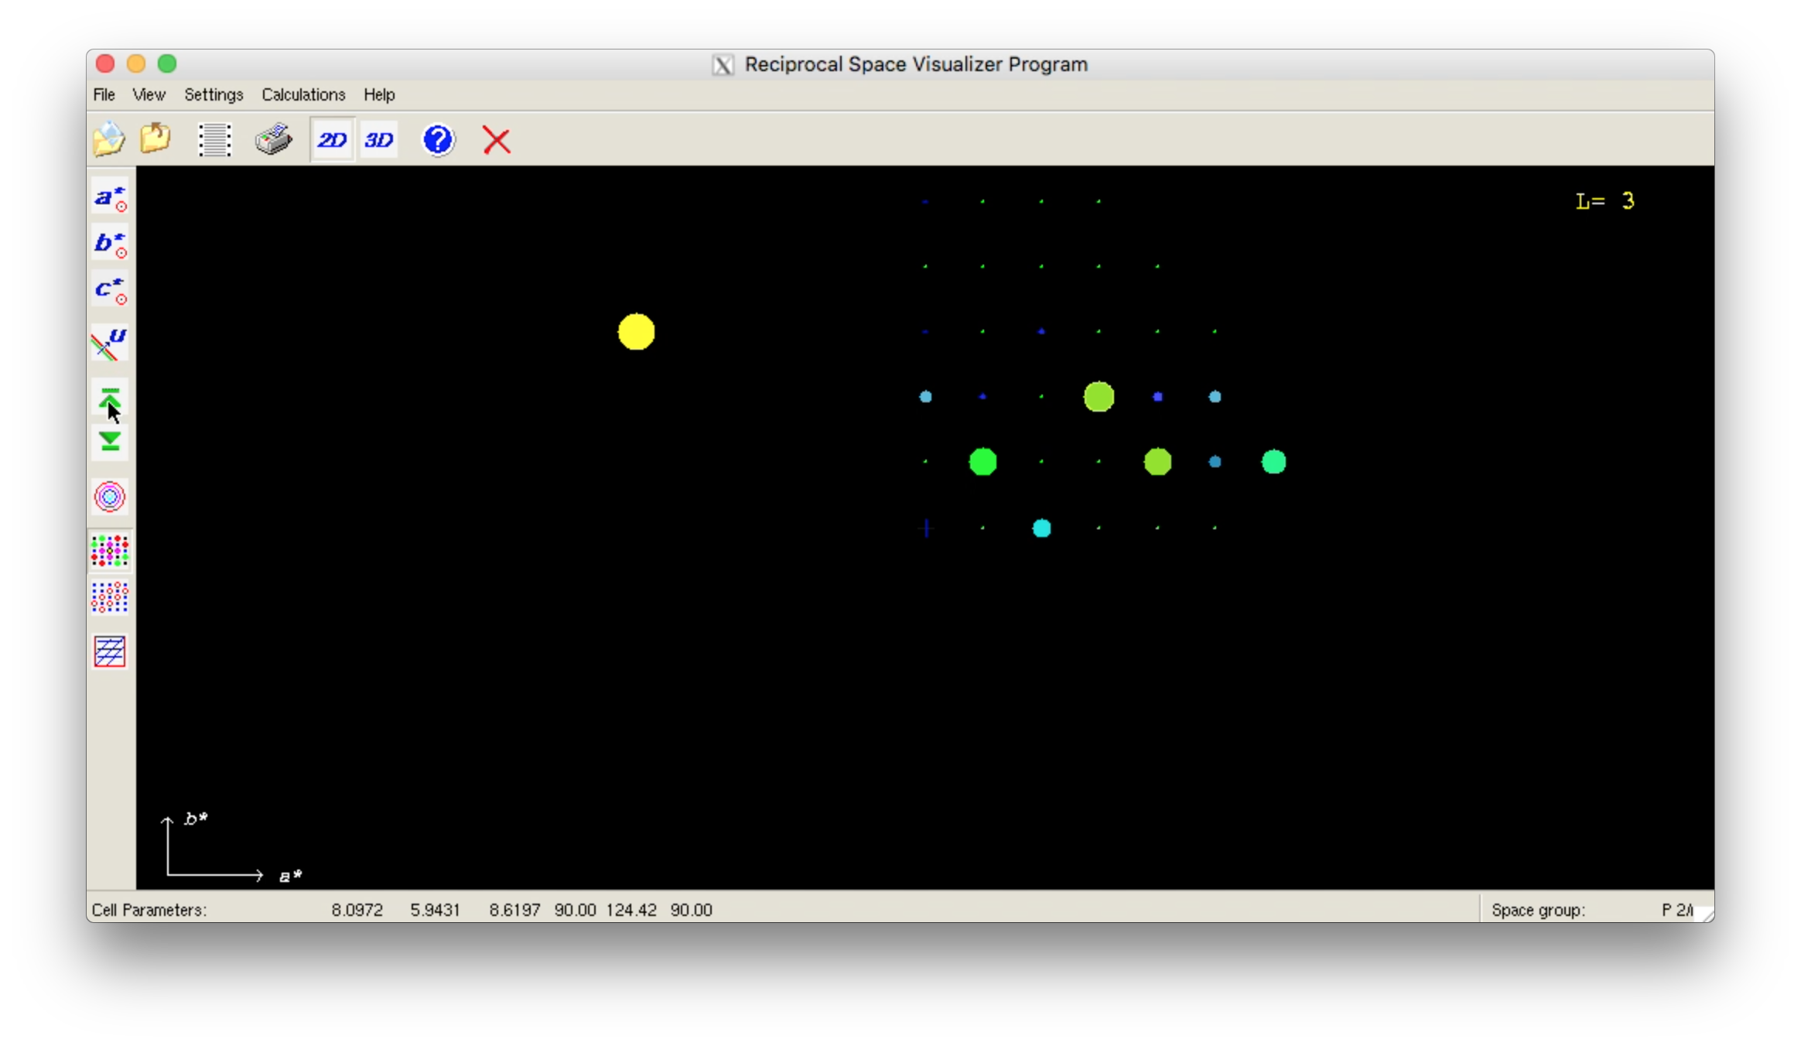
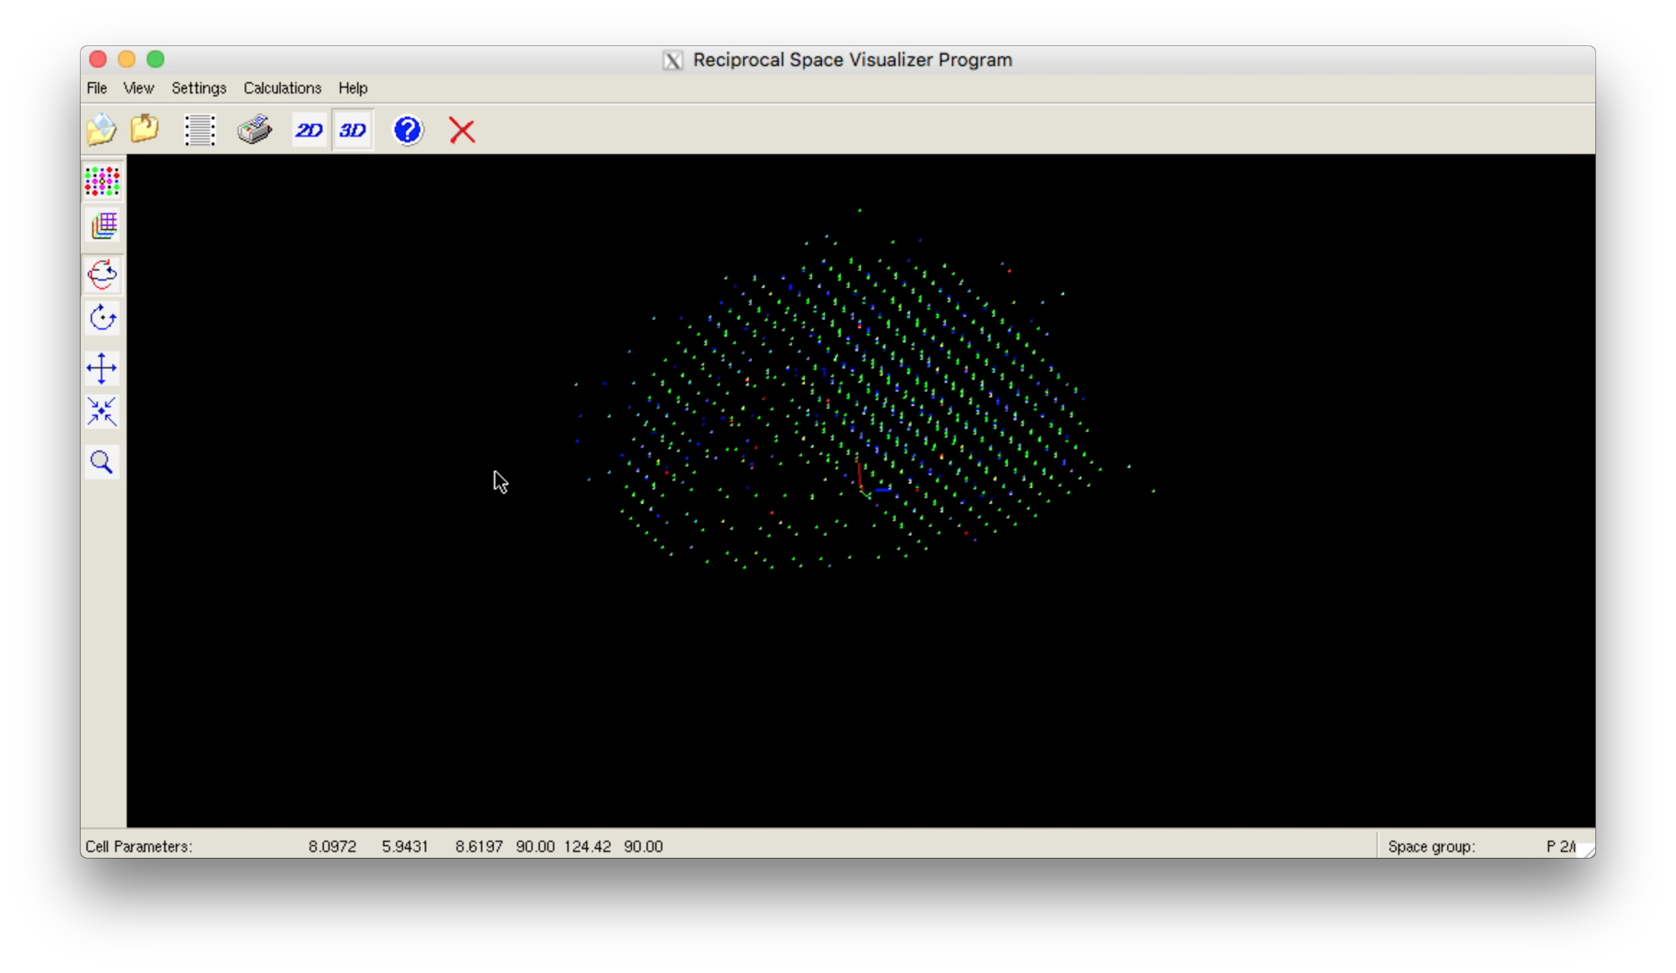
Example – Naphthalene (D9 @ ILL)
CFL file
Reciprocal Space Visualizer
Measured region of reciprocal space

Slide 7
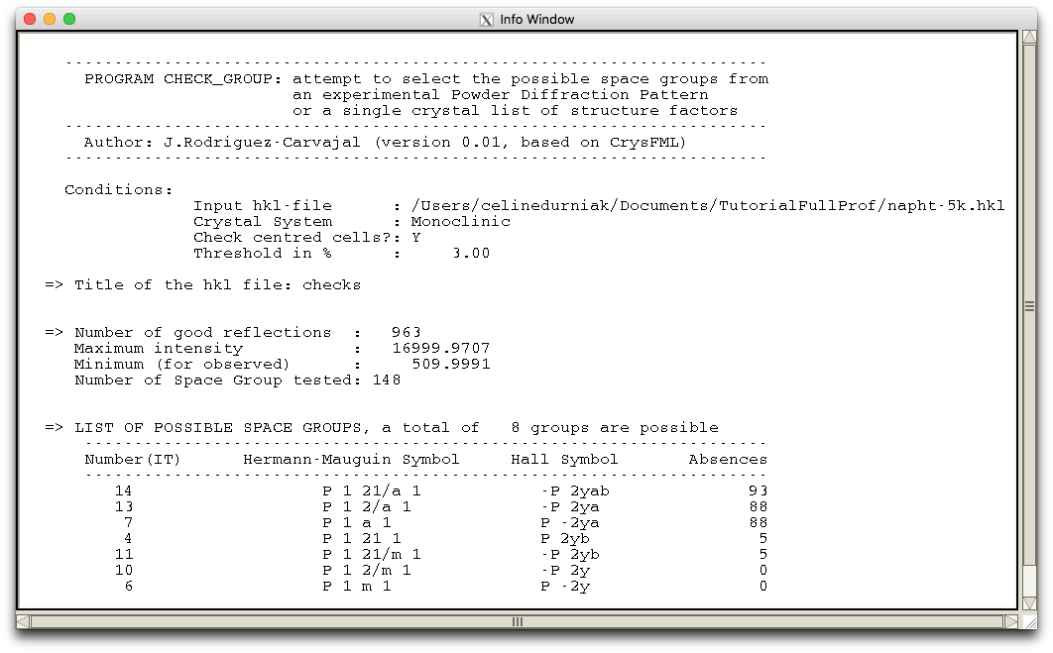
Example – Naphthalene (D9 @ ILL)
CFL file
HKL file
Reciprocal Space Visualizer
CheckGroup
Measured region of reciprocal space
List of possible space groups
7

Slide 8
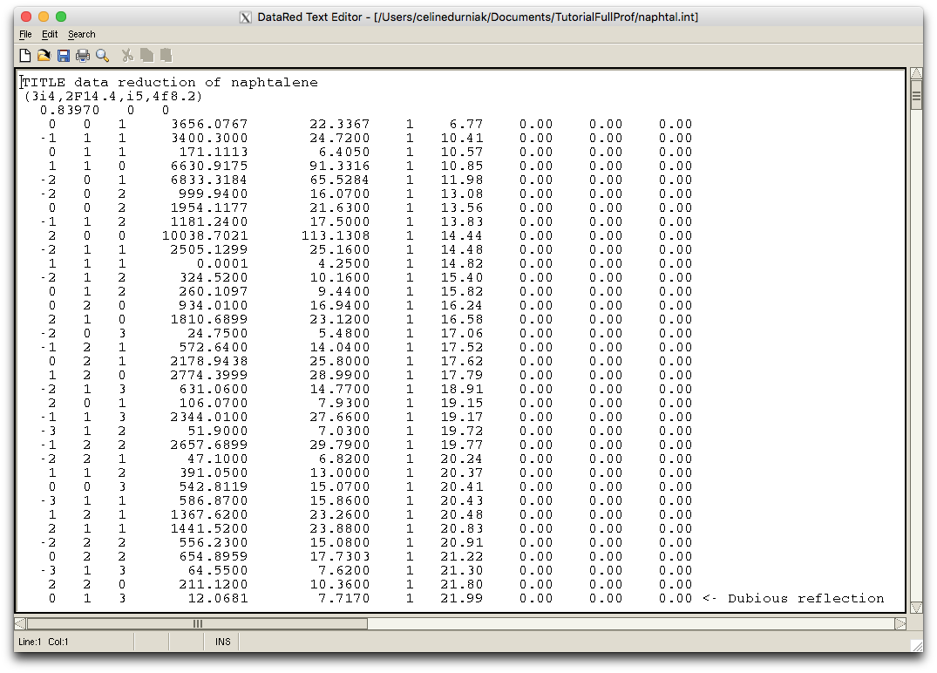
Example – Naphthalene (D9 @ ILL)
CFL file
HKL file
HKL file
Reciprocal Space Visualizer
CheckGroup
DataRed
Average of equivalent reflections
Measured region of reciprocal space
List of possible space groups
8

Slide 9
Example – Naphthalene (D9 @ ILL)
Mol_tpcr
CFL file
HKL file
HKL file
Pcr file
Reciprocal Space Visualizer
CheckGroup
DataRed
FullProf
Average of equivalent reflections
Measured region of reciprocal space
List of possible space groups
Intensity file
9

Slide 10
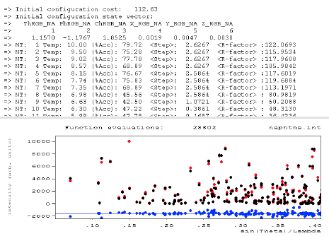
Example – Naphthalene (D9 @ ILL)
Mol_tpcr
FullProf Studio
CFL file
HKL file
HKL file
Pcr file
Display of structure
Reciprocal Space Visualizer
CheckGroup
DataRed
FullProf
Average of equivalent reflections
Display of diffraction pattern
Measured region of reciprocal space
List of possible space groups
Intensity file
10

Slide 11
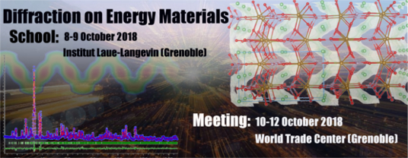
FullProf Suite – Future plans & events
For both single crystals and powders
merge molecular fragments from different structures
generate automatic or manual z-matrices using a GUI
settings of automatic planar restraints, combination or rigid-bodies with restraints...
Direct treatment of raw Laue integrated intensity data, without passing by the normalization step (extraction of wavelength-independent structure factors)
a better control of the refinement of incident spectrum and extinction effects

Slide 12
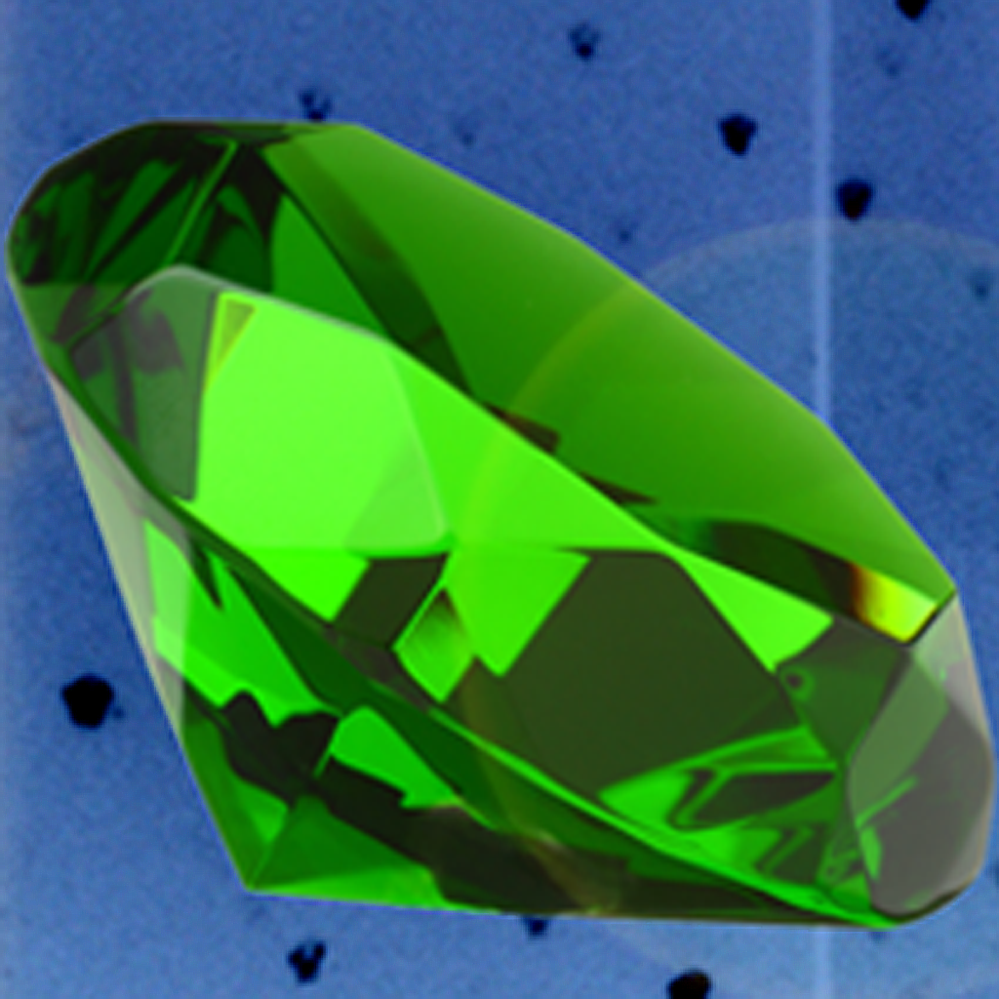
The Esmeralda Laue Suite

Slide 13
Laue Diffraction with neutrons - Technique
Generally used in single crystal spallation sources diffractometers with the advantage of separating exact overlaps thanks to TOF analysis
In reactor sources overlap cannot be avoided but concerns ≤ 20% of reflections
Continuous flux ➜ high efficiency in data collection with cheap detectors
Advantages
very small crystals can be analysed
fast survey of the reciprocal space as a function of T, field, etc
Drawbacks
complexity of data treatment ➜ not as precise as monochromatic refinements
difficulties to model all physical effects affecting integrated intensities

Slide 14
Laue neutron diffraction Data treatment using Esmeralda
project started in 2010
written in Fortran, Winteracter for GUI (commercial)
authors
Juan Rodriguez-Carvajal (ILL)
Luis Fuentes-Montero (Diamond facility UK)
Petr Cermak (MLZ Germany, now in Prague)
repository
https://forge.epn-campus.eu/projects/esmeralda
supported operating systems

Slide 15
The Esmeralda Laue Suite - Structure of project
developed from CrysFML + several calculation modules specialized for Laue technique
Modularity: calculation modules separated from GUI modules
main GUI program (Esmeralda) can run other standalone console programs (more adapted to treat large amount of data)
Script files for running these programs (Cyclops2Cyl Laue_Orient, Ref_UB_Laue, Laue_kSearch, Laue_Integration, Normalize_Laue …) can be generated automatically from the GUI

Slide 16
The Esmeralda Laue Suite – Data treatment workflow
Objectives
list of integrated intensities of well identified Bragg spots collected in series of images differing by the spindle angle associated with the rotation of the crystal
Data treatment
Manipulation of experimental images (geometric transformations)
Laue simulator
Calculation of integrated + profile intensities
Indexing and refinement of the orientation matrix
Integration of Laue Spots
Choice between 2 methods: 2D-Lehmann-Larsen and profile integration
Normalization of Laue intensities
Extraction of wavelength independent structure factors

Slide 17
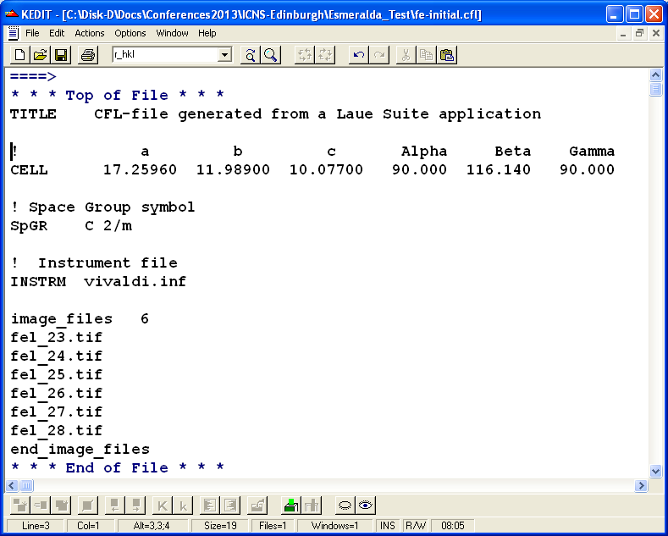
The Esmeralda Laue Suite – Input
CFL file
(cell parameters, space group, name of the instrument file)
Esmeralda

Slide 18
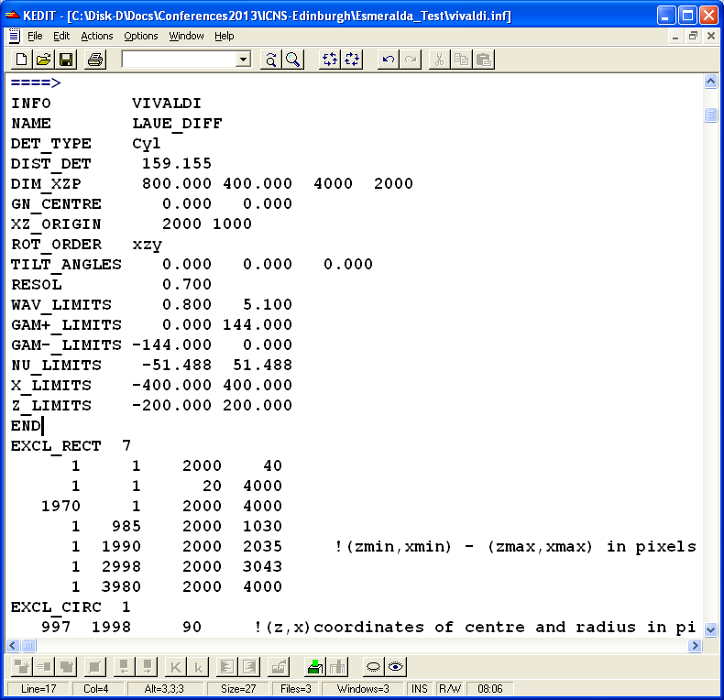
The Esmeralda Laue Suite – Input
CFL file
(cell parameters, space group, name of the instrument file)
Instrument file
geometrical characteristics of the instrument and detector system (flat or cylindrical)
Esmeralda
18

Slide 19
The Esmeralda Laue Suite – Input
CFL file
(cell parameters, space group, name of the instrument file)
Instrument file
geometrical characteristics of the instrument and detector system (flat or cylindrical)
Esmeralda
Laue images files (tif, bmp, hbin, bin, img, raw, reo)
19

Slide 20
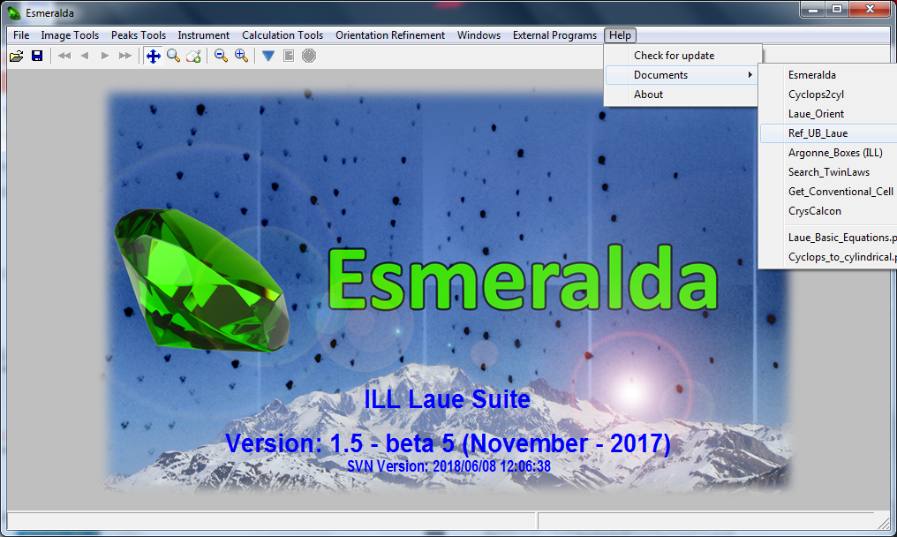
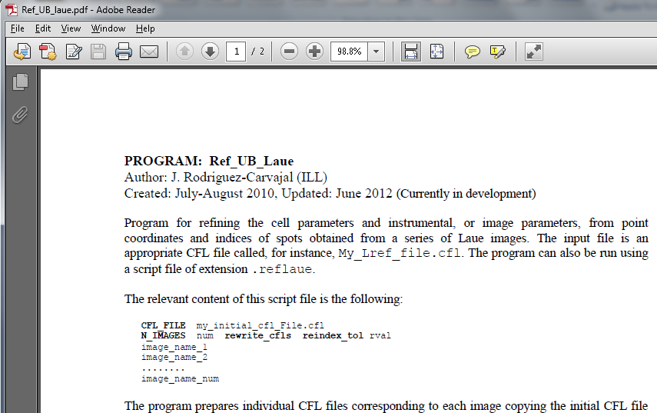
The Esmeralda Laue Suite - Documentation
20/31

Slide 21
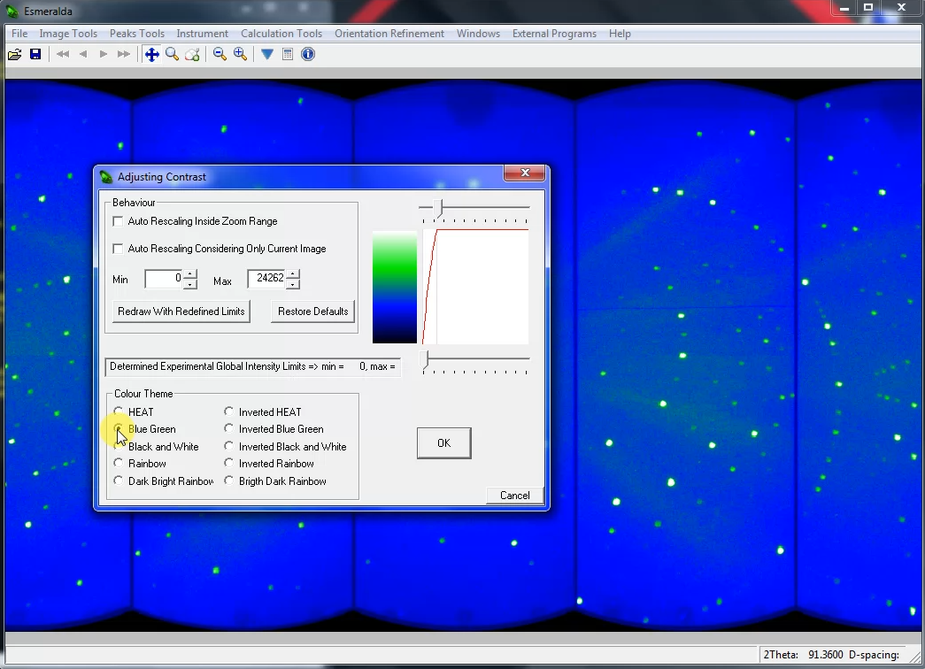
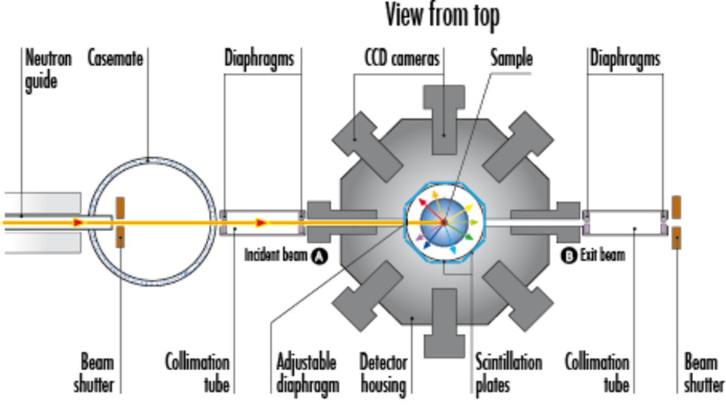
The Esmeralda Laue Suite - Functionalities
Customisation of plots
3D surface visualisation of the Laue diffraction patterns
CYCLOPS @ ILL

Slide 22
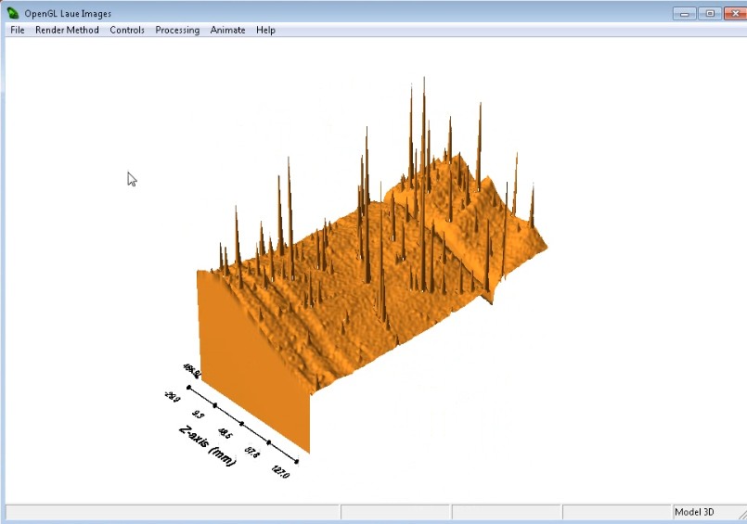
The Esmeralda Laue Suite - Functionalities
Customisation of plots
3D surface visualisation of the Laue diffraction patterns

Slide 23
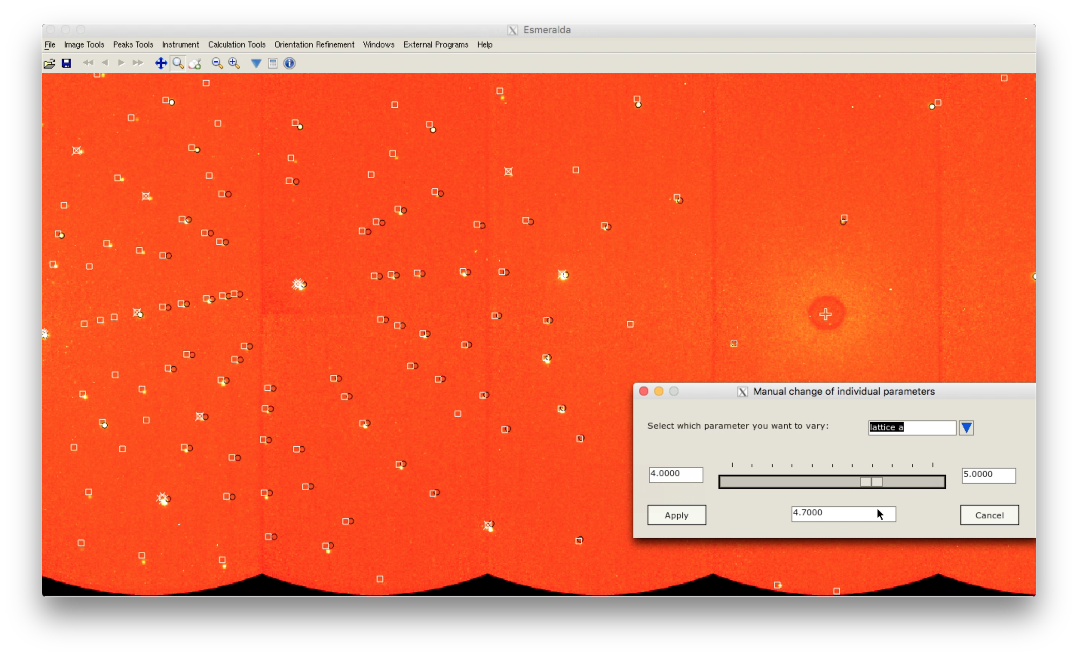
The Esmeralda Laue Suite - Functionalities
Customisation of plots
3D surface visualisation of the Laue diffraction patterns
Automatic peak search and crystal orientation
Manual control of specific parameters e.g. cell parameters, propagation vectors…
Modification of calculated pattern

Slide 24
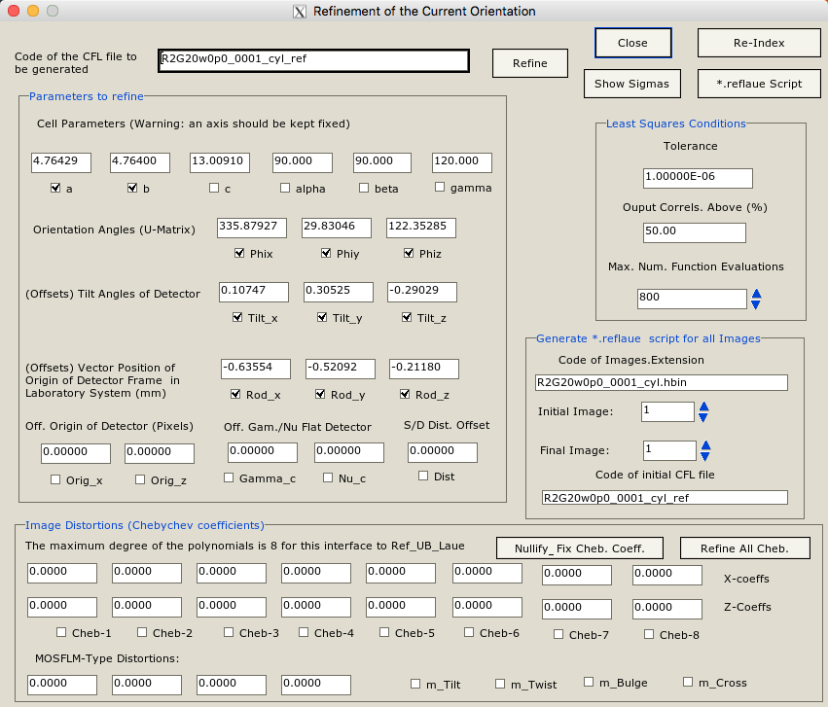
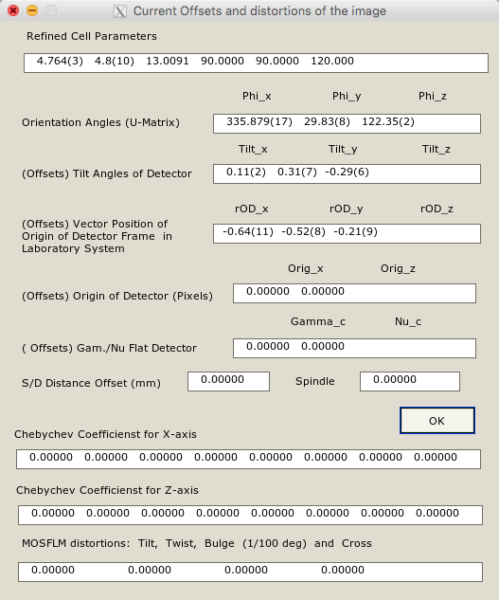
The Esmeralda Laue Suite - Functionalities
Customisation of plots
3D surface visualisation of the Laue diffraction patterns
Automatic peak search and crystal orientation
Manual control of specific parameters e.g. cell parameters, propagation vectors…
Least squares refinement of the orientation matrix, instrument offsets, crystal positioning, image distortions…

Slide 25
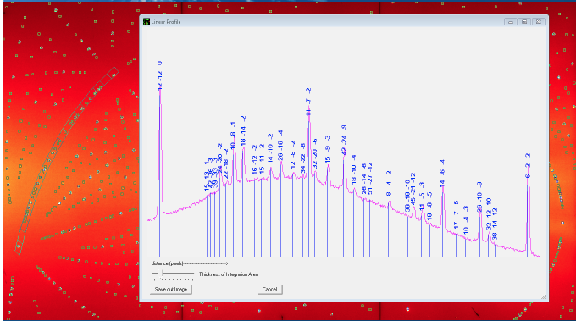
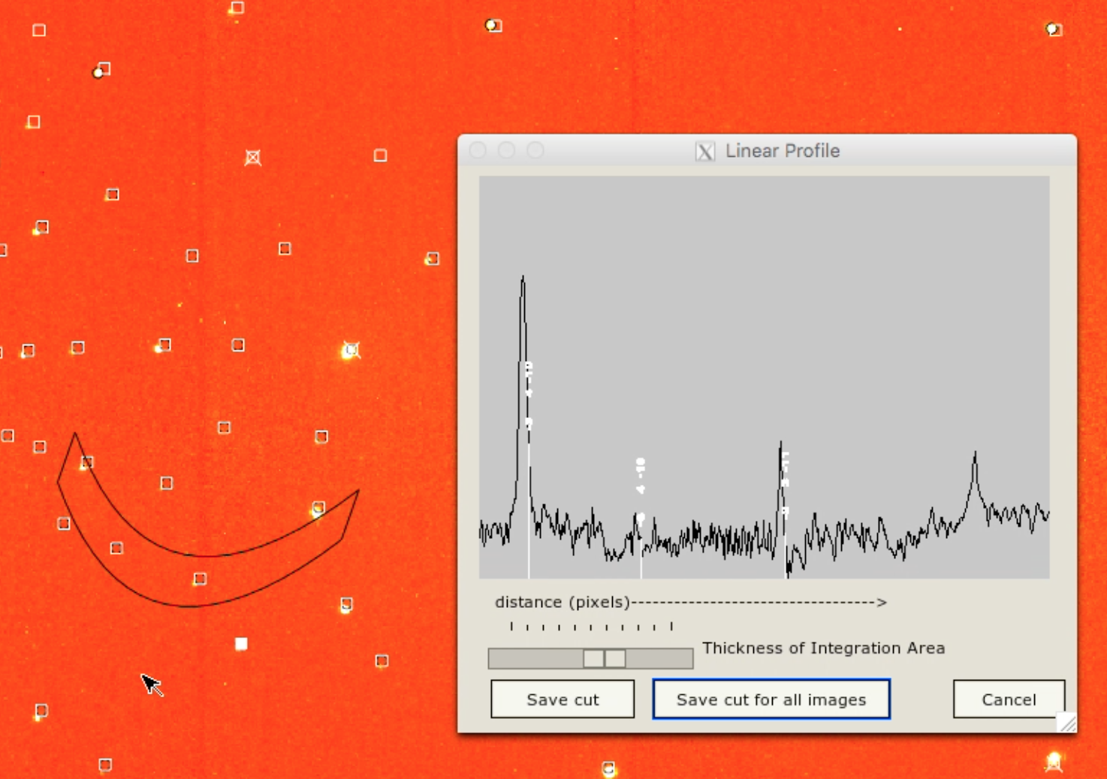
The Esmeralda Laue Suite - Functionalities
Customisation of plots
3D surface visualisation of the Laue diffraction patterns
Automatic peak search and crystal orientation
Manual control of specific parameters e.g. cell parameters, propagation vectors…
Least squares refinement of the orientation matrix, instrument offsets, crystal positioning, image distortions…
Profile visualisation along a curve

Slide 26
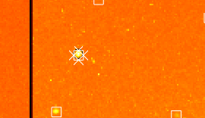
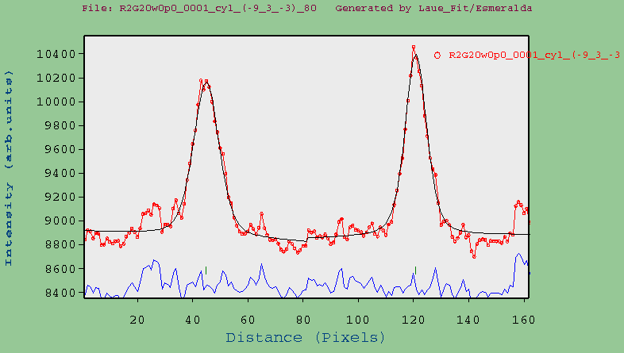
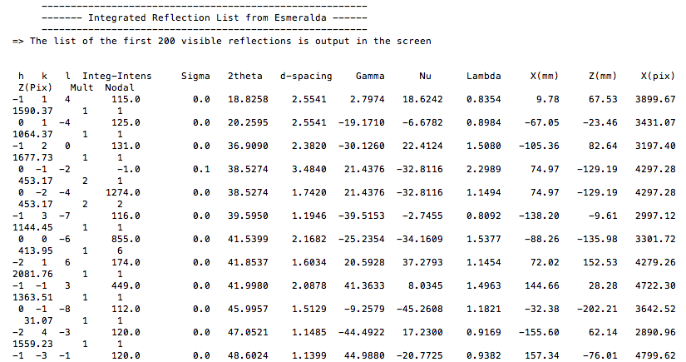
The Esmeralda Laue Suite - Functionalities
Customisation of plots
3D surface visualisation of the Laue diffraction patterns
Automatic peak search and crystal orientation
Manual control of specific parameters e.g. cell parameters, propagation vectors…
Least squares refinement of the orientation matrix, instrument offsets, crystal positioning, image distortions…
Profile visualisation along a curve
Determination of modulation / propagation vectors using Laue_kSearch
Peak integration
Vertical & horizontal profiles integration
Vertical
Horizontal
Integration – Calculated positions

Slide 27
The Esmeralda Laue Suite - Functionalities
Customisation of plots
3D surface visualisation of the Laue diffraction patterns
Automatic peak search and crystal orientation
Manual control of specific parameters e.g. cell
parameters, propagation vectors…
Least squares refinement of the orientation matrix, instrument offsets, crystal positioning, image
distortions…
Profile visualisation along a curve
Determination of modulation / propagation vectors
using Laue_kSearch
Peak integration
Normalization of integrated intensities using Normalize_Laue ➜ wavelength-free squared structure factors

Slide 28
Future developments for Esmeralda Laue Suite
Extension for superspace formalism
Update Laue Simulator. Strategy of data collection
Profile refinement in 2D
Implement Eulerian and Kappa cradles as orienting device
Calculation of approximate shape parameters of spots as a function of mosaicity, divergence and shape of the crystal before the integration process
Treatment of total integrated intensities within FullProf

