Slide 1
Single Crystal Neutron Diffraction and Event Mode
Christina Hoffmann
Diffraction Group
Neutron Scattering Division
Neutron Sciences Directorate
Oak Ridge National Laboratory
This research is supported by UT Battelle, LLC under Contract DE-AC05-00OR22725 for the U.S. Dept. Energy, Office of Science.

Slide 2
Experiment Flow
Sample choice & mount
Sample quality
Scattering quality
Single domain / multiples
Symmetry
Sample alignment
Centering, direction, UB-matrix
Experiment goal
Type of study: temperature, steady state or cycling
Experiment plan
Sample environment changes
Symmetry related orientations
Phase change tracking
Experiment check
Real data & simulated data
Visualization
Meaningful
Real time
Interactive
Processing
Automated
Real time
Universal
Analysis
Streamlined
Real time
Universal
Planning
Automated
Real time
Customized
Software
ISAW
CrystalPlan
Mantid
Paraview
Data processing
Automated corrections & reduction
Structure Factor (Bragg, Volumetric)
Analysis software formats
Data analysis
Data analysis flow (Refinement, Simulation)
Visualization
Statistical analysis
Data setup
Setup collection strategy
Data collection
Automated data collection with SEnv integration
Notes:
SCD is complicated: multiple orientations, multiple experiment goals
Meaningful visualization: Q-space, specific directions or planes or volumes
With corrections

Slide 3
Experiment Flow
Sample choice & mount
Sample quality
Scattering quality
Single domain / multiples
Symmetry
Sample alignment
Centering, direction, UB-matrix
Experiment goal
Type of study: temperature, steady state or cycling
Experiment plan
Sample environment changes
Symmetry related orientations
Phase change tracking
Experiment check
Real data & simulated data
Bottle neck:
Instrument Scientists
Visualization
Meaningful
Real time
Interactive
Processing
Automated
Real time
Universal
Analysis
Streamlined
Real time
Universal
Planning
Automated
Real time
Customized
Software
ISAW
CrystalPlan
Mantid
Paraview
Data processing
Automated corrections & reduction
Structure Factor (Bragg, Volumetric)
Analysis software formats
Data analysis
Data analysis flow (Refinement, Simulation)
Visualization
Statistical analysis
Data setup
Setup collection strategy
Data collection
Automated data collection with SEnv integration
Notes:
SCD is complicated: multiple orientations, multiple experiment goals
Meaningful visualization: Q-space, specific directions or planes or volumes
With corrections

Slide 4
Neutron event mode
Event mode at HFIR/SNS
Events and associated metadata
Metadata tracking and use
Possibilities
Full spectrum diffraction – time-of-flight Laue SCD neutron diffraction for total scattering due to time-space coverage
Event filtering according to selected associated metadata log values
Temperature, field (E, H), …
Stroboscopic data (pulsed magnet)
Cycling (high voltage, batteries)
Bad event tracking (moderator inconsistencies, sample environment, sample fatigue)
Background treatment and filtering
Elastic & inelastic data
Inelastic discrimination with correlation/statistical chopper (CORRELLI)
Notes:
Adjust heating and cooling rates to neutron flux measurement to

Slide 5
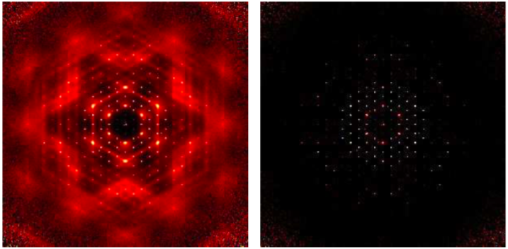
Inelastic Discrimination
Event mode at HFIR/SNS
Events and associated metadata
Direct metadata tracking and use
T.R. Welberry and R. Whitfield, Quantum Beam Sci. 2018, 2, 2; doi:10.3390/qubs2010002
Notes:
Adjust heating and cooling rates to neutron flux measurement to

Slide 6
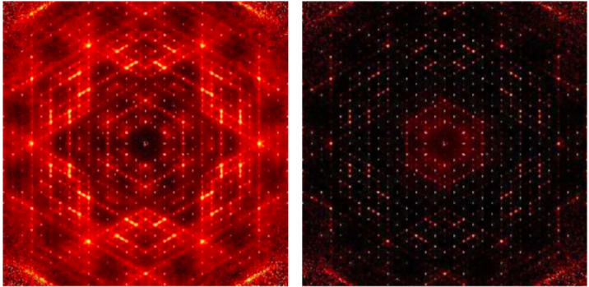
Inelastic Discrimination
Event mode at HFIR/SNS
Events and associated metadata
Direct metadata tracking and use
Notes:
Adjust heating and cooling rates to neutron flux measurement to

Slide 7
Q-space Use
Opportunities:
Sample specific data visualization
Efficient experiment planning
Streamlining of data processing and corrections: instrument specific, sample dependent, incident beam dependent, scaling and normalization
Notes:
Adjust heating and cooling rates to neutron flux measurement to

Slide 8
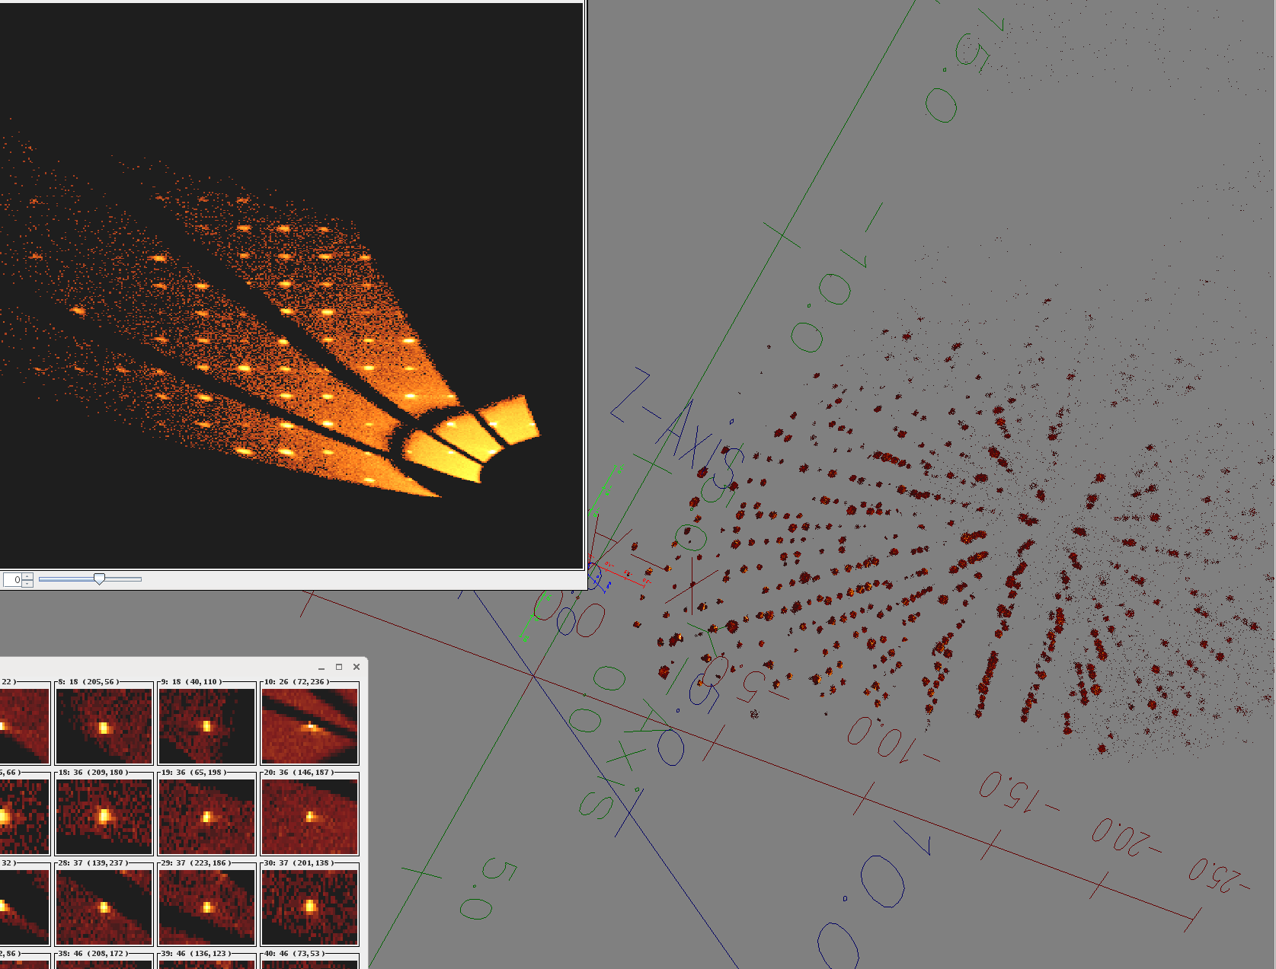
Q-space Use
Opportunities:
Sample specific data visualization
Efficient experiment planning
Streamlining of data processing and corrections: instrument specific, sample dependent, incident beam dependent, scaling and normalization
Notes:
Adjust heating and cooling rates to neutron flux measurement to

Slide 9
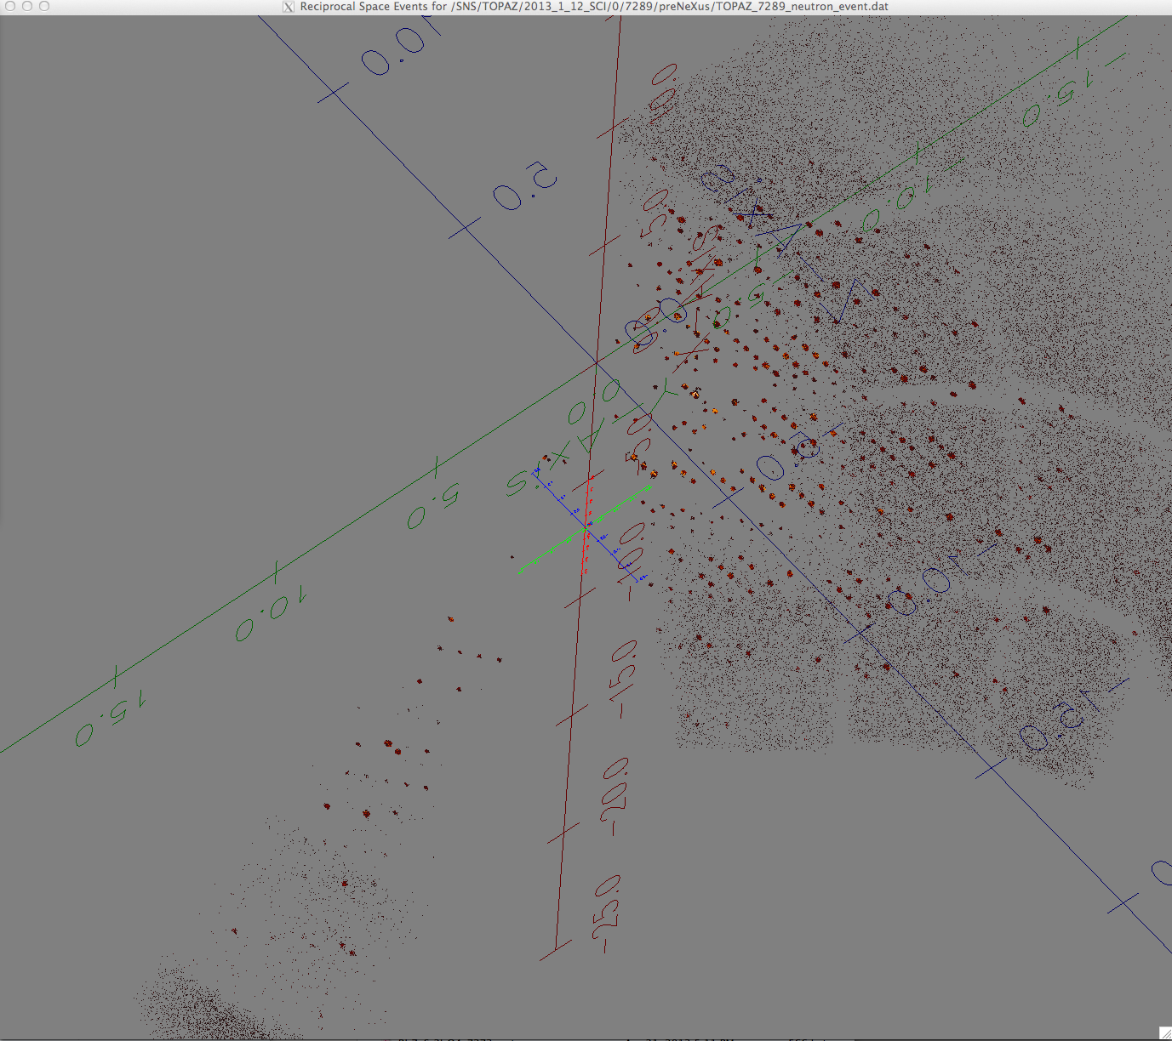
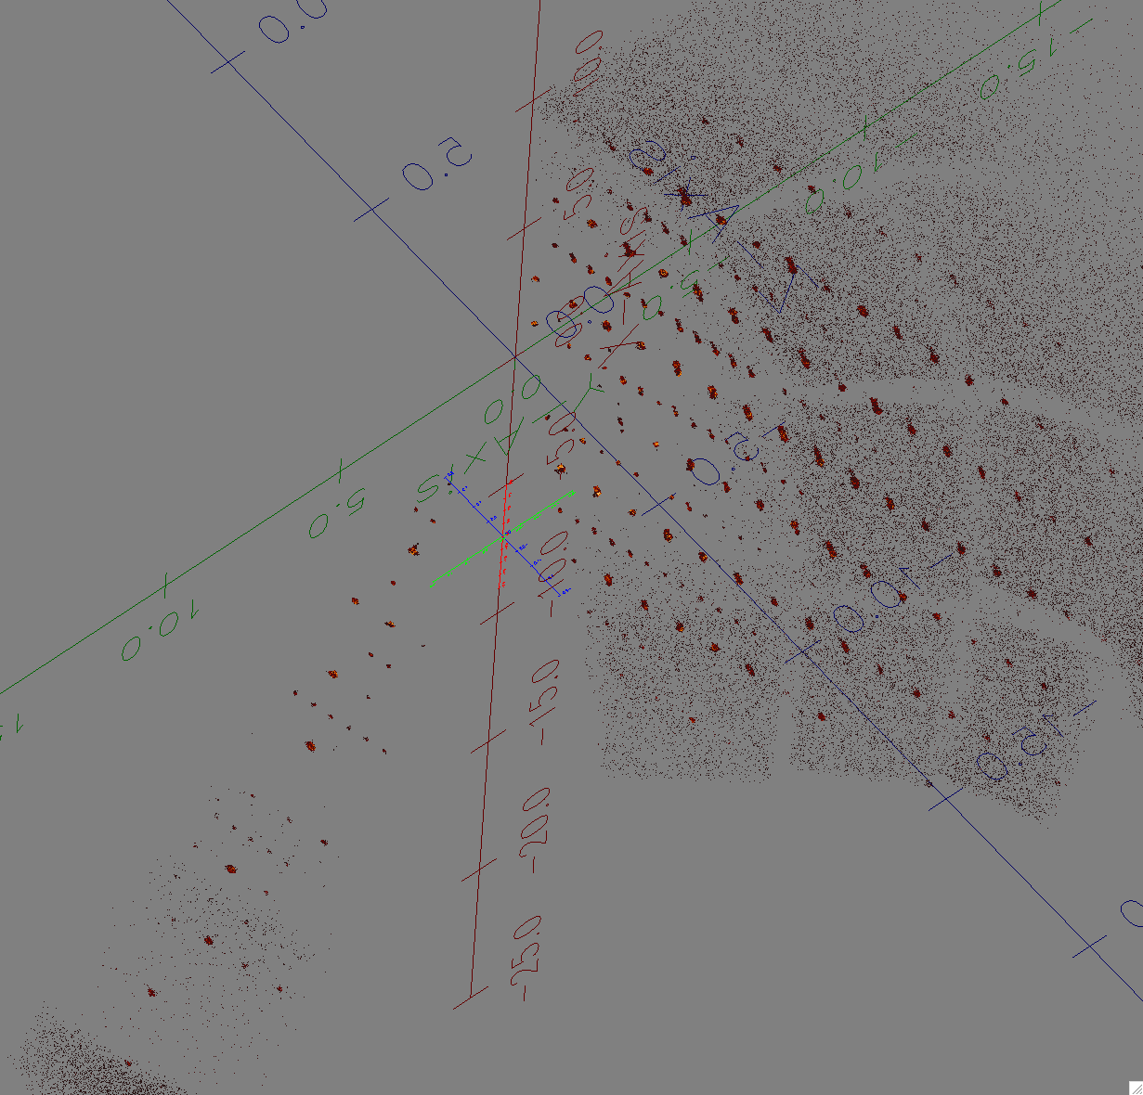
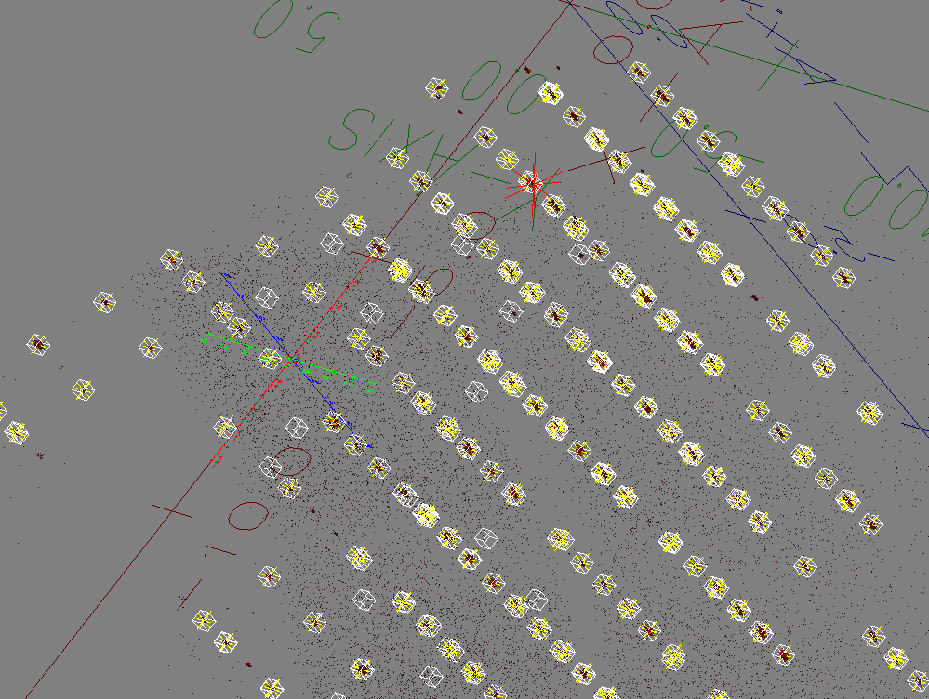
Q-Space View & Orientation
&Indexing
[k]
[h]

Slide 10
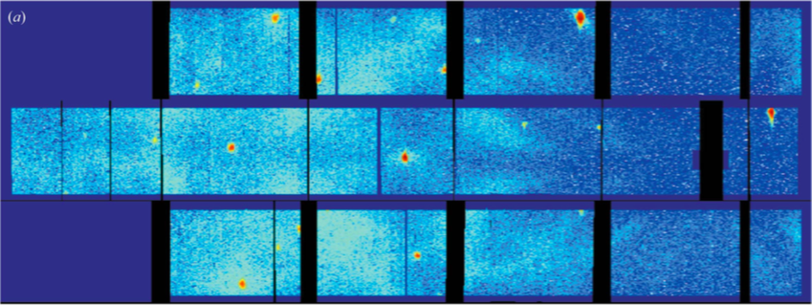
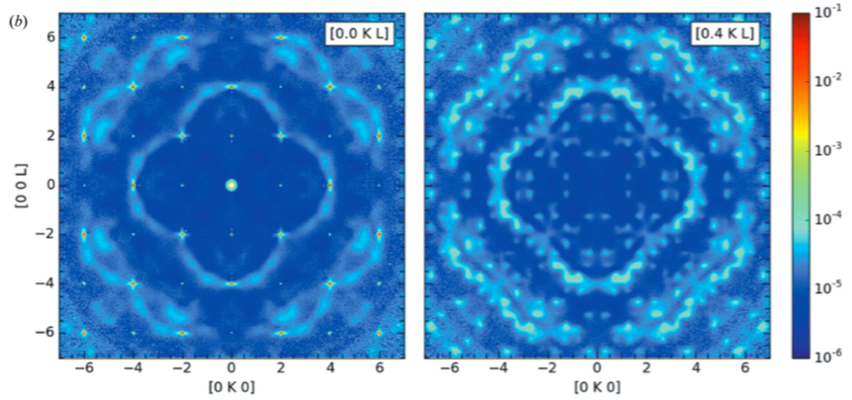
Q-space Use
Elastic diffuse from Zr0.85Ca0.15O1.85 (CORELLI @ RT).
(a) Instrument view for one crystal orientation.
(b) Slices of reciprocal lattice planes (0, K, L) and (0.4, K, L)
Data were collected at multiple angles, then merged after cross correlation and symmetrization
F. Ye et al., J. Appl. Cryst. (2018). 51, 315–322
https://doi.org/10.1107/S160057671800403X
Notes:
Elastic diffuse neutron scattering data collected from a Zr0.85Ca0.15O1.85 single crystal on CORELLI at room temperature.
(a) Instrument view for one crystal orientation.
(b) Slices of the reciprocal-lattice planes (0, K, L) and (0.4, K, L) with the data integrated in the normal direction over a range of 0.1 r.l.u.
The data were collected at 91 angles with a step size of 2 and then merged after cross correlation and symmetrization using the mmm Laue point group.

Slide 11
Q-space Use
Opportunities:
Sample specific data visualization
Efficient experiment planning
Streamlining of data processing and corrections: instrument specific, sample dependent, incident beam dependent, scaling and normalization
Notes:
Adjust heating and cooling rates to neutron flux measurement to

Slide 12
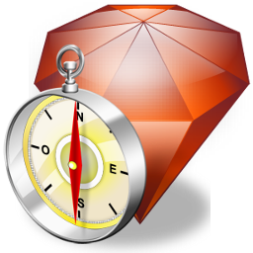
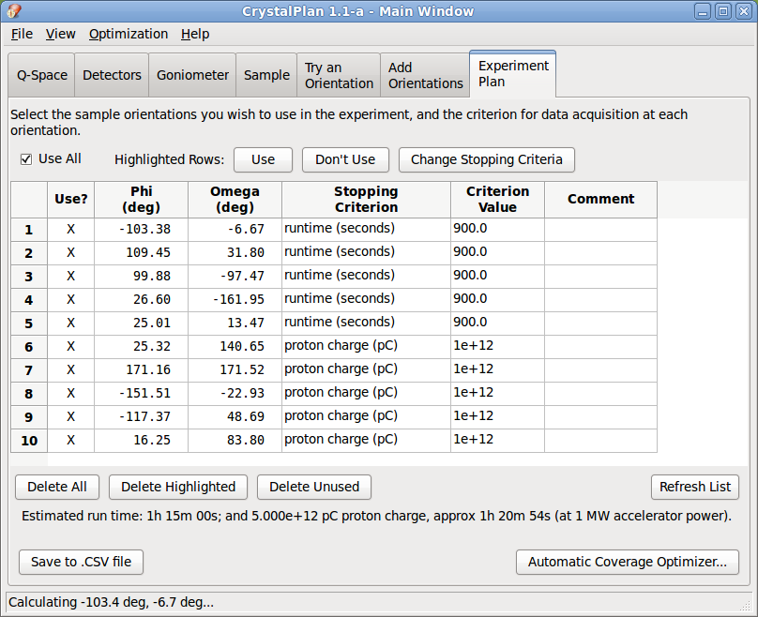
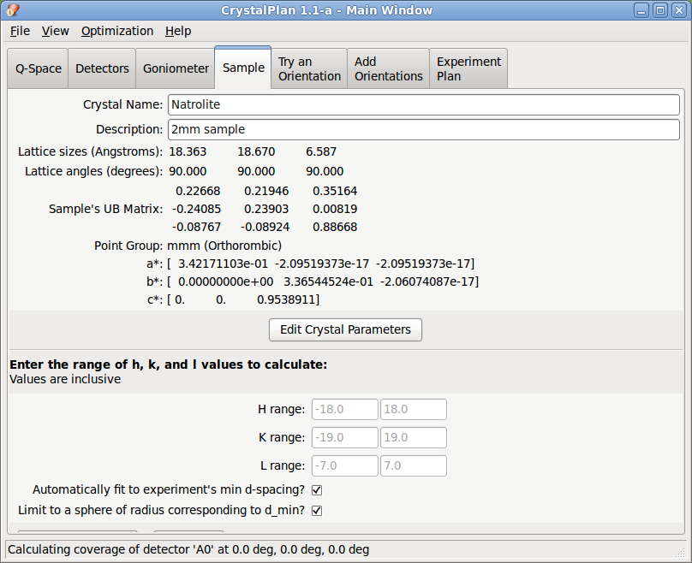
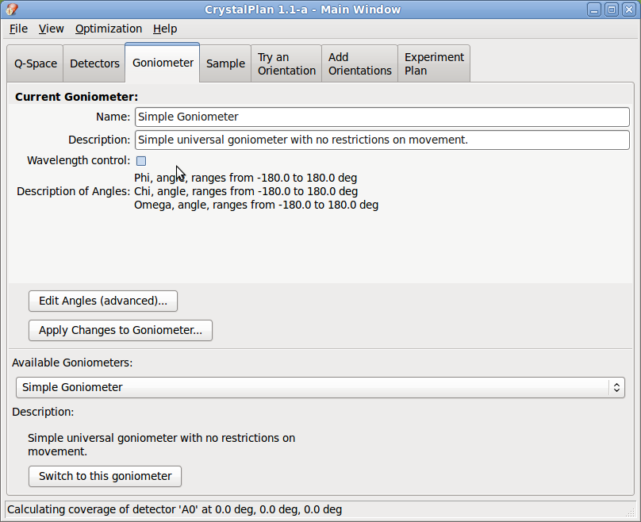
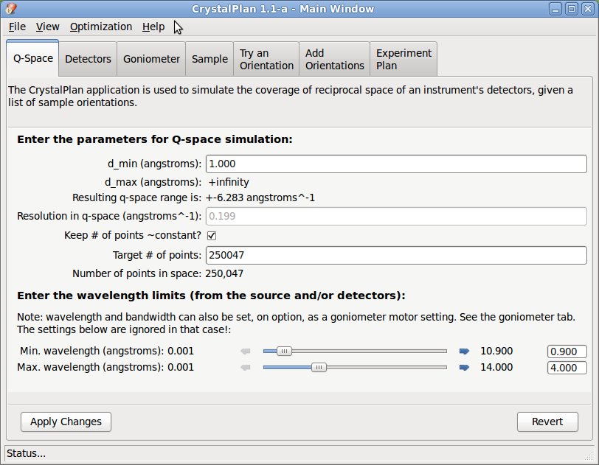
Experiment planning setup: Crystal Plan
Zikovsky J., et al., J. Appl. Cryst. (2011), 44, 418-423.

Slide 13
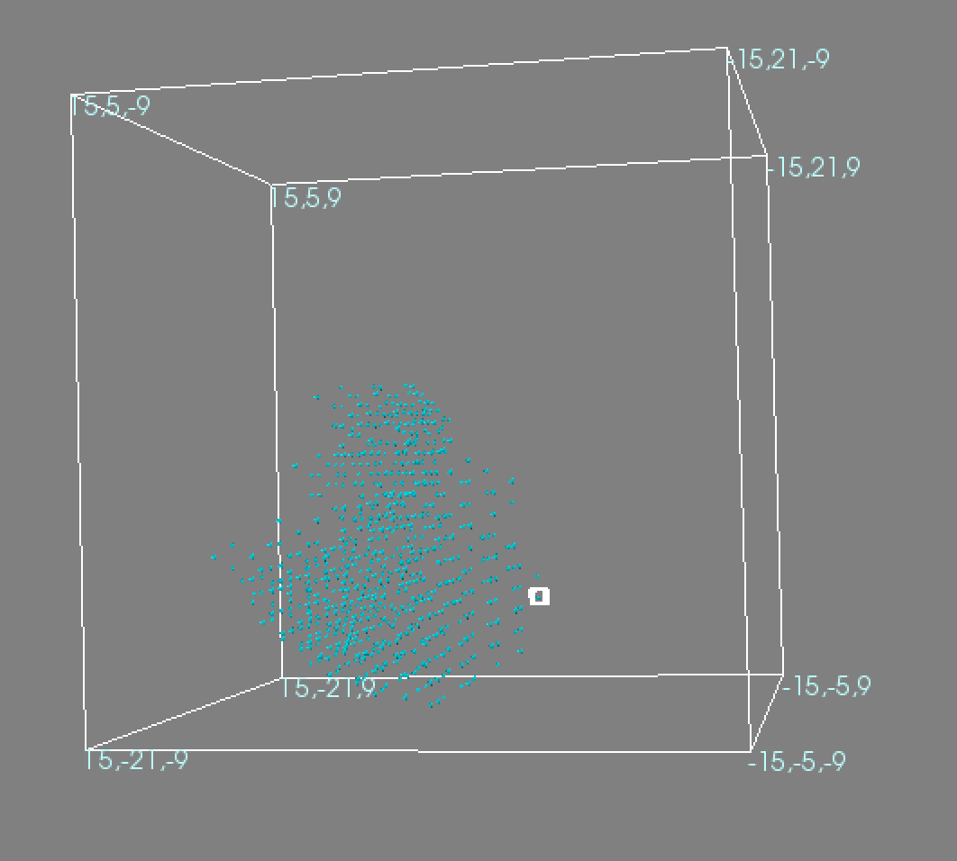
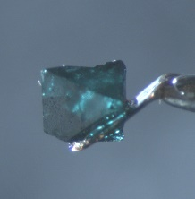
Collecting Volumes of Diffraction Space

Slide 14
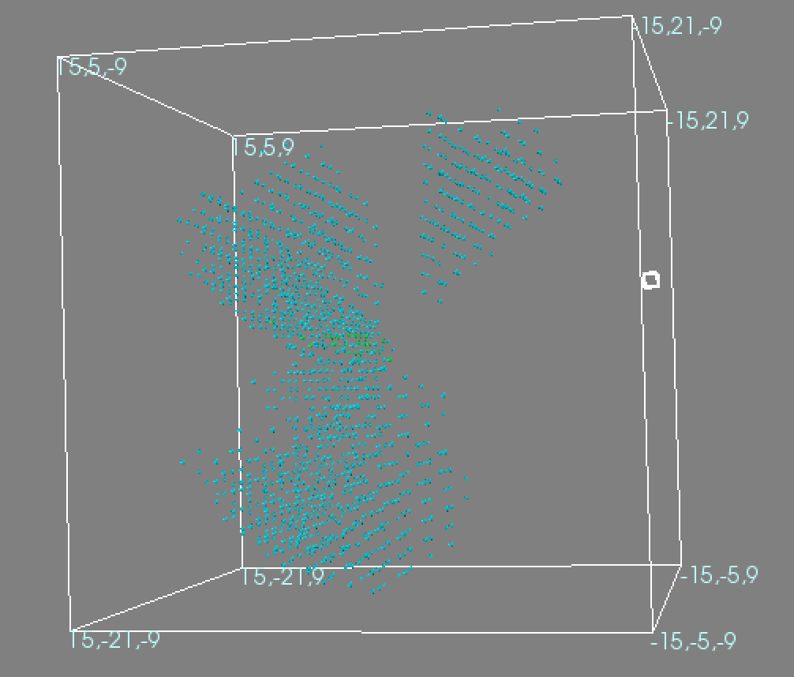
Collecting Volumes of Diffraction Space

Slide 15
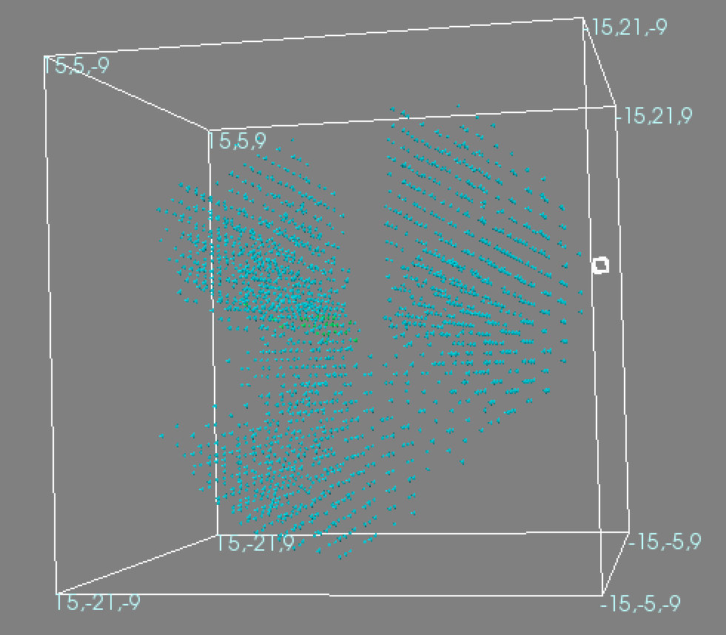
Collecting Volumes of Diffraction Space

Slide 16
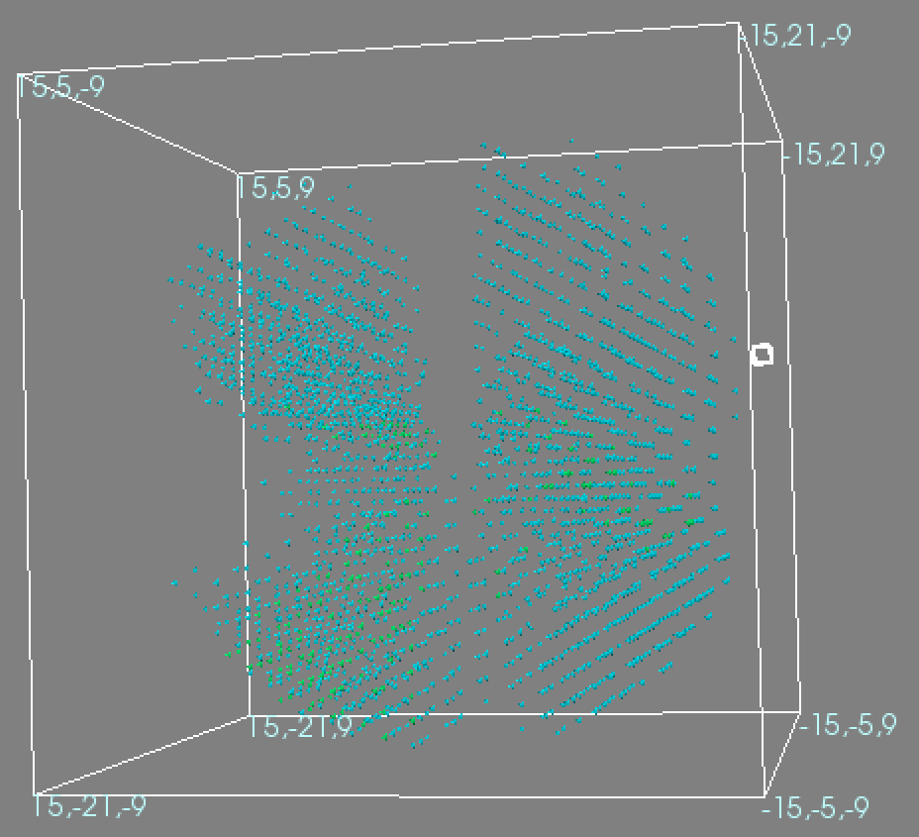
Collecting Volumes of Diffraction Space

Slide 17
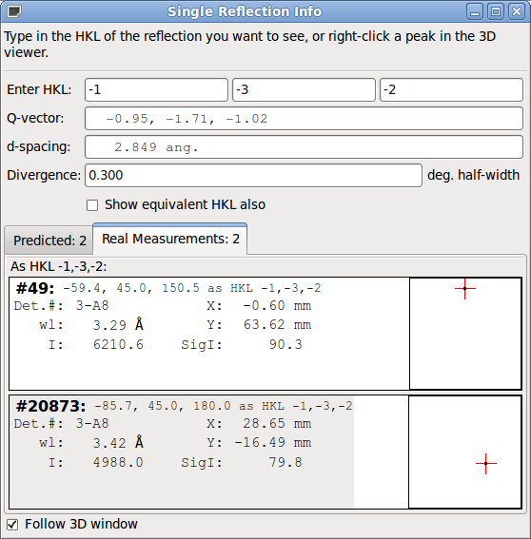
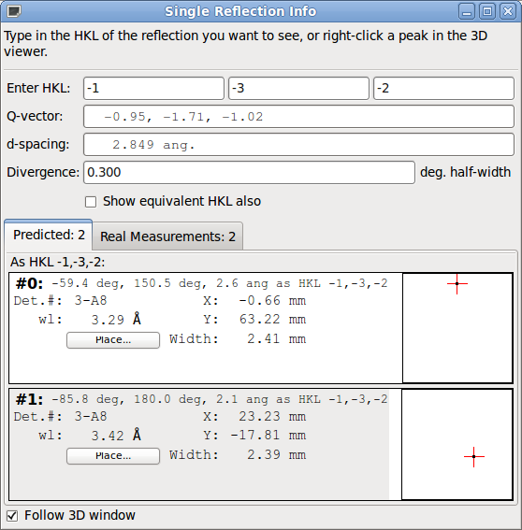
Collecting Volumes of Diffraction Space

Slide 18
Q-space Use
Advantages:
Equally applicable to elastic and inelastic scattering ➔ instrument independent (comparison, analysis)
Undistorted view (quality, consistency)
Direct visualization of symmetry and sample/structure relevant information
Multi dimensional spaces
Disadvantages:
A geometric transformation
Requires good centering and instrument calibration
Notes:
Adjust heating and cooling rates to neutron flux measurement to

Slide 19
Q-space Use
Real time visualization:
Q-space view shows the sample response
Undistorted view
Real time processing
Processing and Analysis:
Homogeneous space treatment
Streamlining of algorithms across instruments (TOPAZ, ARCS, SEQUOIA, CORELLI,..)
For the user:
Minimize instrument specific knowledge for experiment planning
Quick learning and understanding of experiment to minimize mistakes and maximize experiment success
Pre-experiment planning/simulation applications (on the web)
Streamlined and remote user operation
Notes:
Adjust heating and cooling rates to neutron flux measurement to

Slide 20
Thank You!
Xiaoping Wang
Vickie Lynch
Pete Petersen
Andrey Savici
Michael Reuter
Junhong He
Matt Frost
Mads Jørgensen
Dennis Mikkelson
Ruth Mikkelson
Arthur Schultz
Tara Michels-Clark
Hans-Beat Bürgi
Michal Chodkiewicz
…
Oak Ridge National Laboratory
– ” –
– ” –
– ” –
– ” –
– ” –
– ” –
Center for Materials Crystallography, iNano & Department of Chemistry, Aarhus University
University of Wisconsin Stout
– ” –
TechX, Argonne & Oak Ridge National Laboratory
Lawrence Berkeley National Laboratory & University of Tennessee
University of Zürich & University of Berne
University of Warsaw & University of Zürich
University of Tennessee Department of Chemistry
Joint Institute of Computational Sciences
Office of Basic Energy Sciences, US Department of Energy with UT Battelle, LLC.
National Science Foundation
Computing time from NERSC (National Energy Research Scientific Computing)
Danish National Science Foundation
Sinergia grant from the Swiss National Science Foundation
This research is supported by UT Battelle, LLC under Contract DE-AC05-00OR22725 for the U.S. Department of Energy, Office of Science.

Slide 21
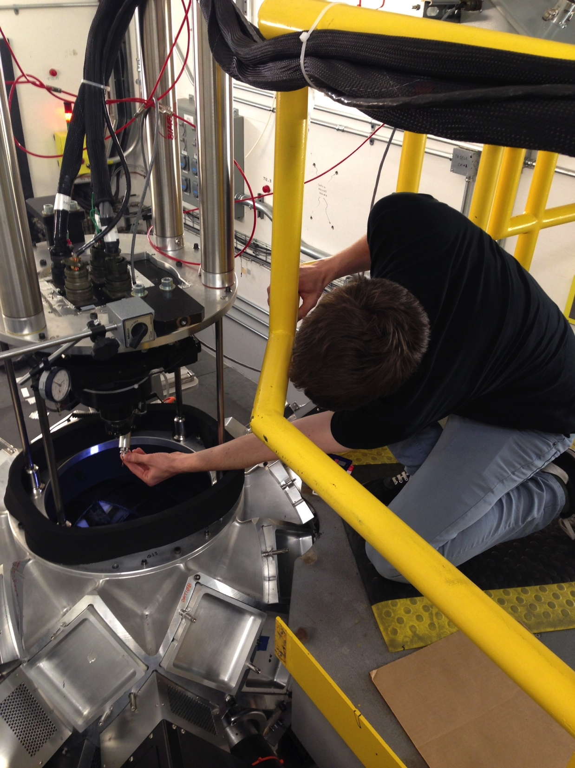
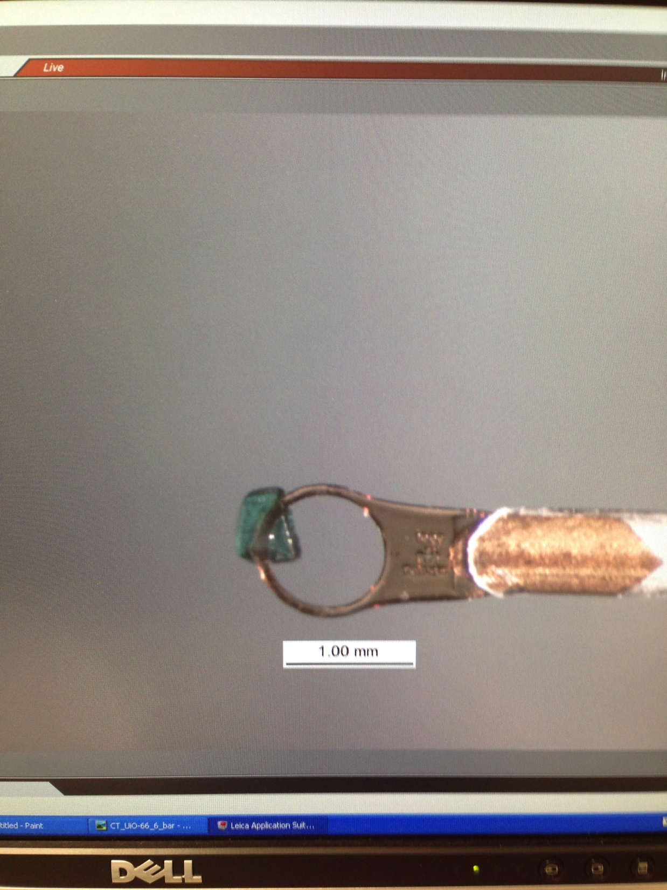
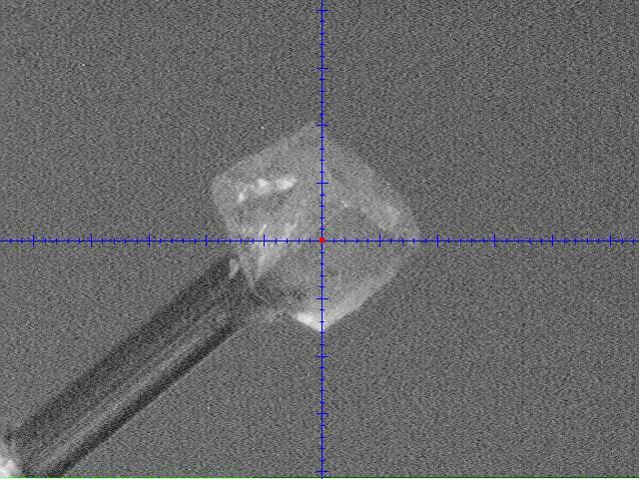
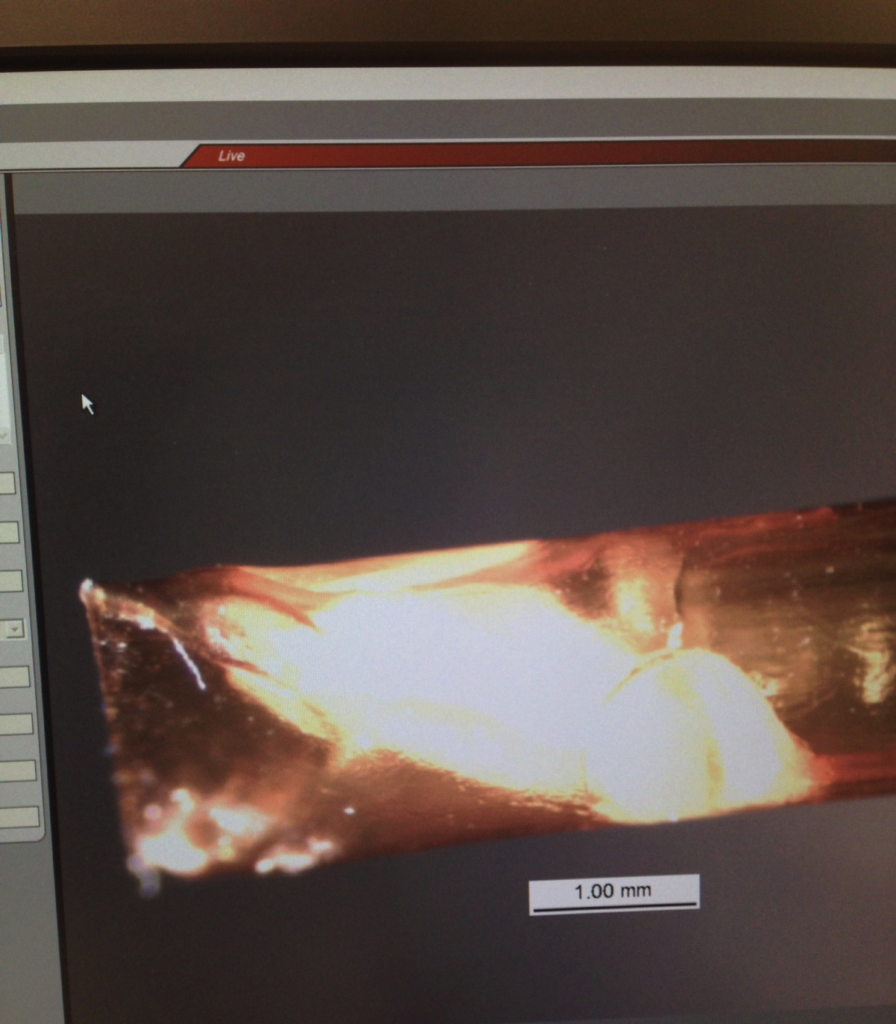
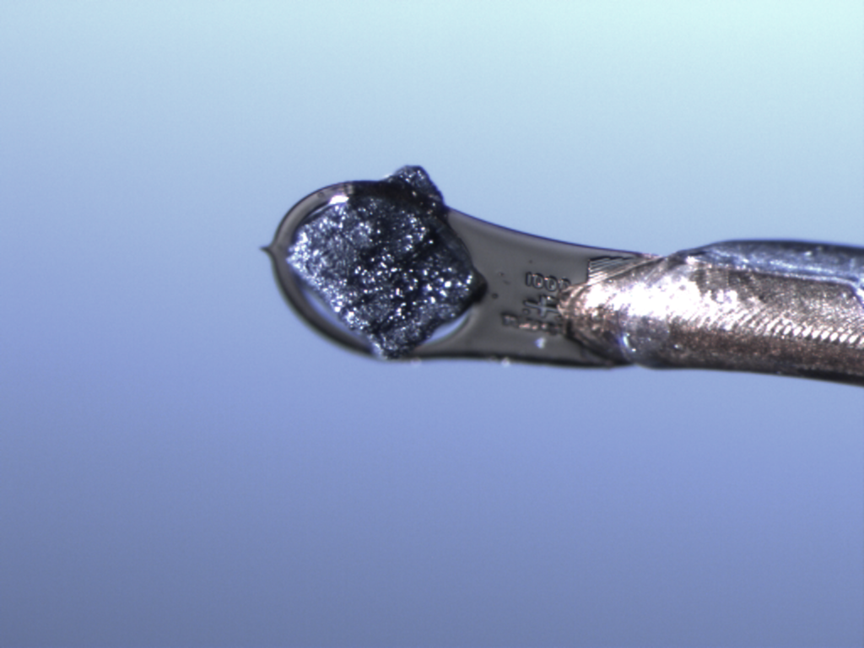
Thank you
IOC
This research is supported by UT Battelle, LLC under Contract DE-AC05-00OR22725 for the U.S. Dept. Energy, Office of Science.

