Slide 1
Experiences as a user of neutron diffraction

Slide 2
Molecular magnetism
$B=μ_{0}\left(H+M\right)$
$M=χH$
Direction of largest susceptibility → magnetic easy axis
M_{J} = J
M_{J} = -J

Slide 3
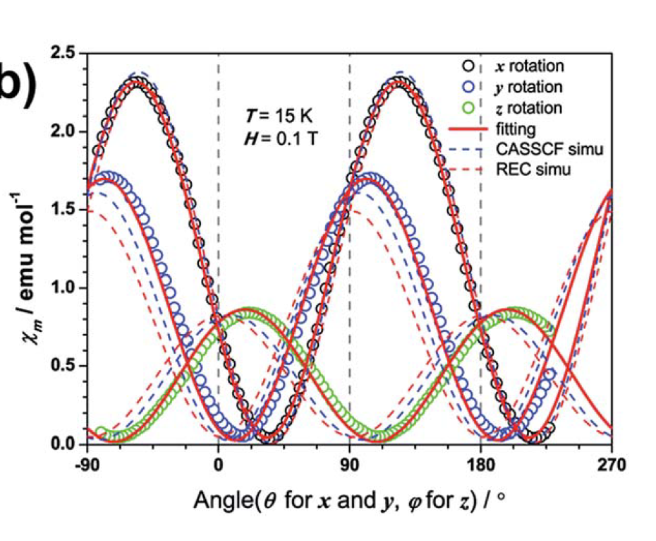
The use of neutrons in mm
Susceptibility $χ$
Problem: This only works for triclinic crystals!
H
Rotation angle $θ$
Qian et al. Chem. Sci. 2015, 6, 4587-4593

Slide 4
The use of neutrons in mm
$$χ_{site}=\left[\begin{matrix}χ_{1} & χ_{4} & χ_{5} \\ χ_{4} & χ_{2} & χ_{6} \\ χ_{5} & χ_{6} & χ_{3}\end{matrix}\right]$$
$$χ_{u.c.}=\sum_{i}{R_{i}}χ_{site}R_{i}^{−1}$$
$$P\overline{1}$$
$$P2_{1}/c$$
$$χ_{u.c.}=2\left[\begin{matrix}χ_{1} & χ_{4} & χ_{5} \\ χ_{4} & χ_{2} & χ_{6} \\ χ_{5} & χ_{6} & χ_{3}\end{matrix}\right]$$
$$χ_{u.c.}=4\left[\begin{matrix}χ_{1} & 0 & χ_{5} \\ 0 & χ_{2} & 0 \\ χ_{5} & 0 & χ_{3}\end{matrix}\right]$$

Slide 5
Modelling the diffraction
Magnetic structure factor
Site susceptibility
Resulting magnetic structure factor
$$F_{M}\left(k\right)=\sum_{j}{f_{j}\left(k\right)m_{j}}e^{ik⋅r_{j}}$$
$$χ_{molecule}=χ_{Dy}=\left[\begin{matrix}χ_{11} & χ_{12} & χ_{13} \\ χ_{12} & χ_{22} & χ_{23} \\ χ_{13} & χ_{23} & χ_{33}\end{matrix}\right]$$
$$m_{j}=χ_{j}H$$
$$F_{M}\left(k\right)=\sum_{j}{f_{j}\left(k\right)\frac{1}{N_{a}}\sum_{p}{R_{p}χ_{j}R_{p}^{−1}H}}e^{ik⋅(R_{p}r_{j}+t_{p})}$$
Gukasov, A. & Brown, P.J. J. Phys. Condens. Matter 2002, 14, 8831

Slide 6
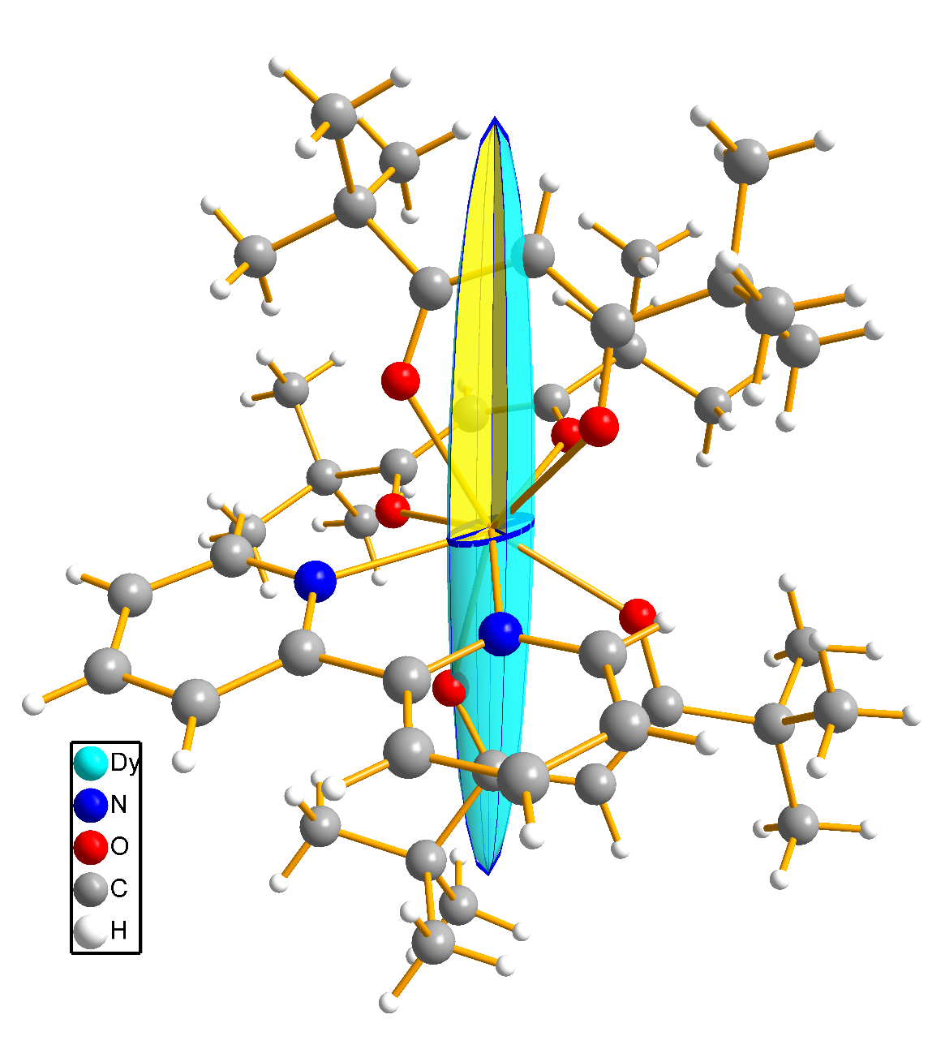
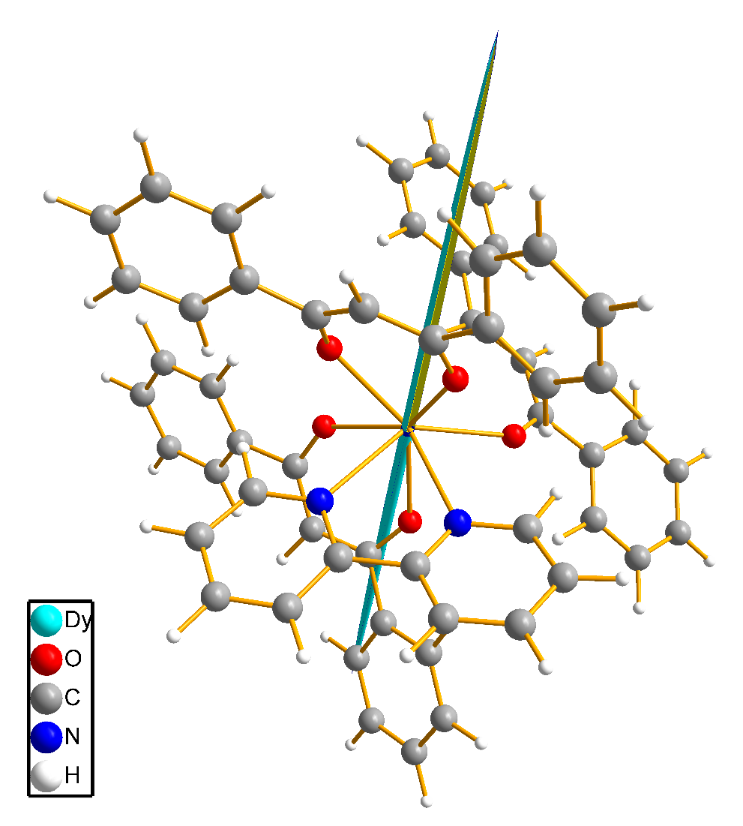
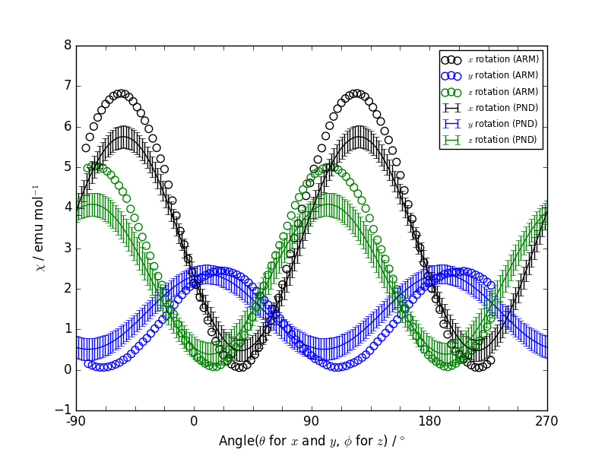
Results from pol neutron diff
1 $P2_{1}/c$
a | 13.2248(5)
b | 22.1323(6)
c | 16.0555(6)
α | 90▫
β | 109.646(8)
γ | 90▫
2 $P\overline{1}$
a | 11.0343(3)
b | 12.2286(3)
c | 17.5339(5)
α | 77.103(5)▫
β | 85.701(6)▫
γ | 69.694(5)▫
Klahnet al., Chem. Eur. J., 10.1002/chem.201803300 (accepted)

Slide 7
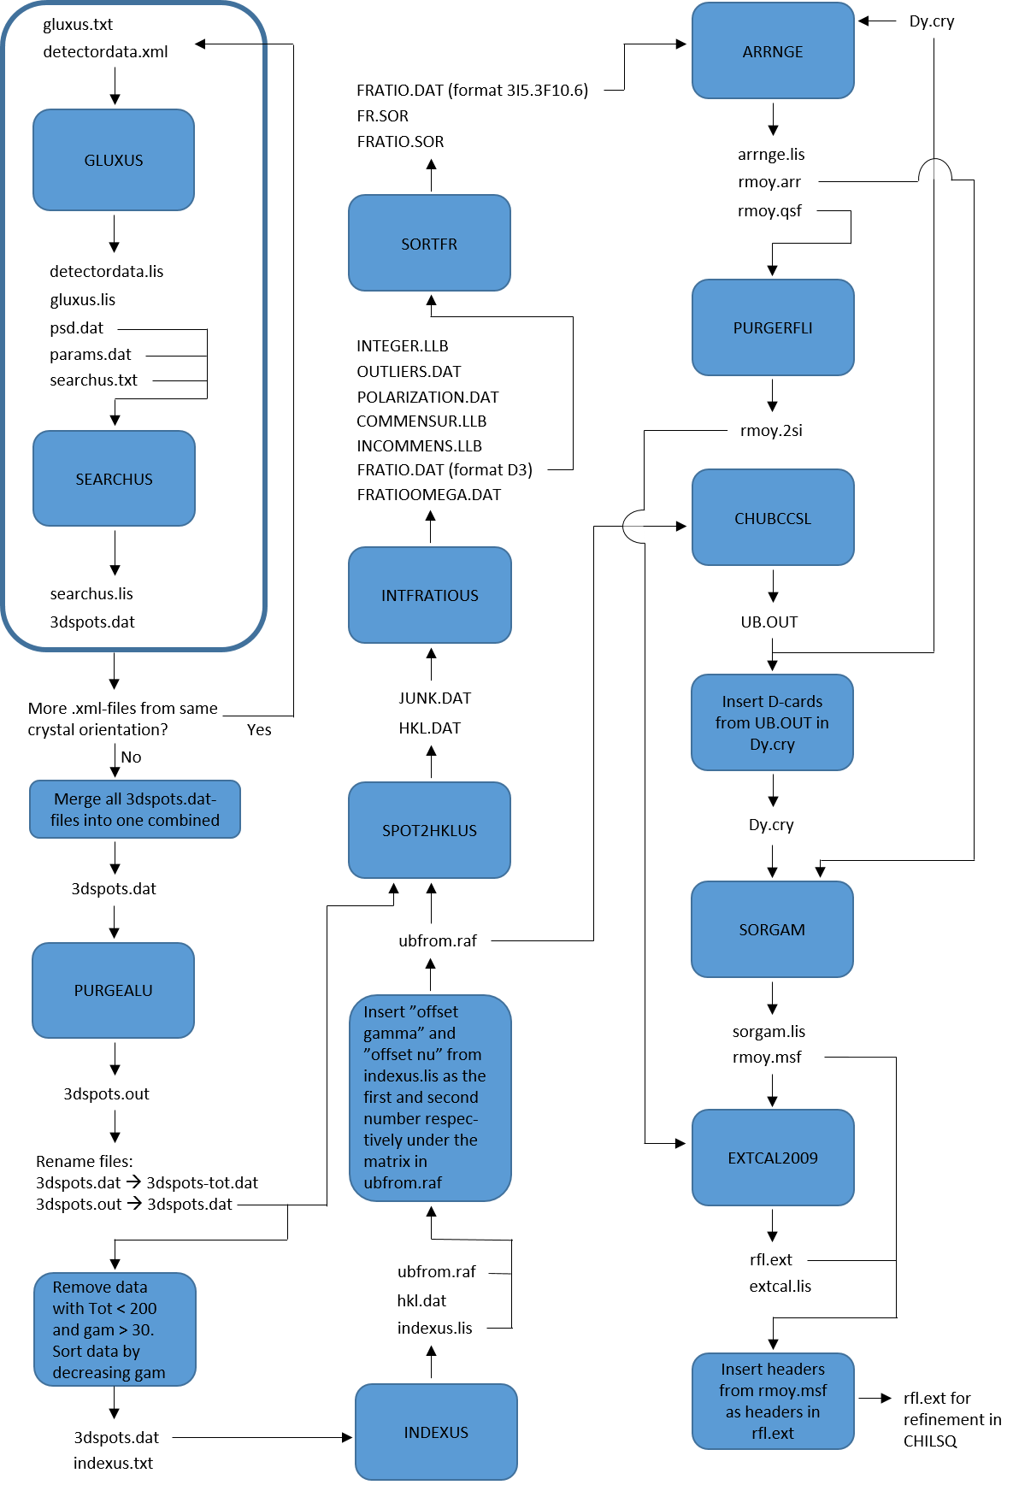
Workflow – susceptibility refinement
user actions
# of data points (filename) | O1
Searchus (3dspots-tot.dat) | 1828
Purgealu (3dspots.dat) | 643
Indexus (indexus.lis) | 130
Intfratious (fratio.dat) | 281
Arrnge (rmoy.qsf) | 167
Purgerfli (rmoy.2si) | 36
Extcal2009 (rfl.ext) | 36

Slide 8
Workflow – susceptibility refinement
Original information
Unedited files
Edited files
Two starting files containing information
cry-file (structural information and program instructions)
Raw detector data
Total # of files | 40
Files edited | 8
Other files | 30

Slide 9
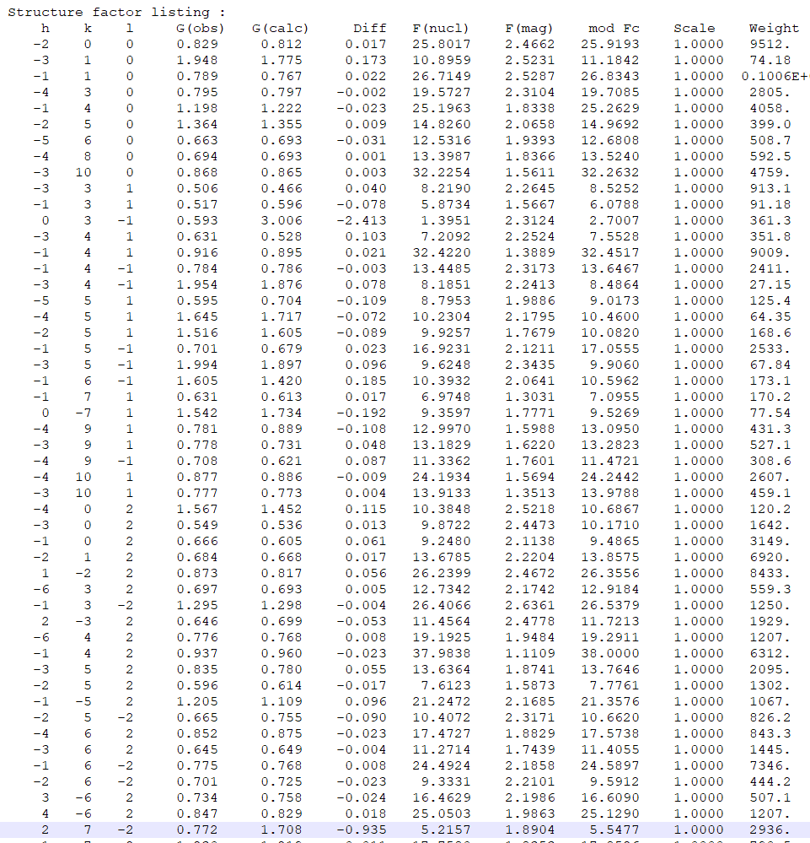
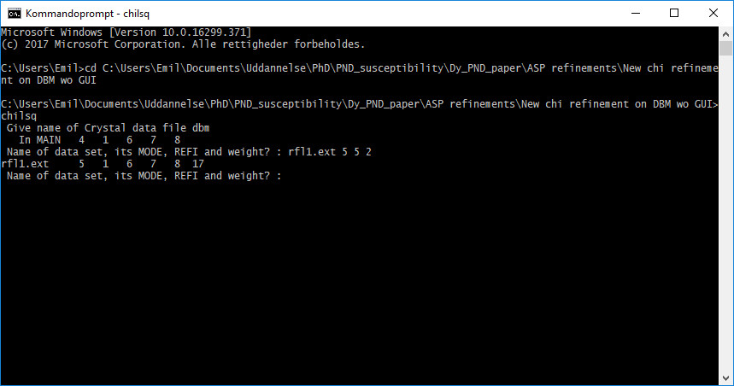
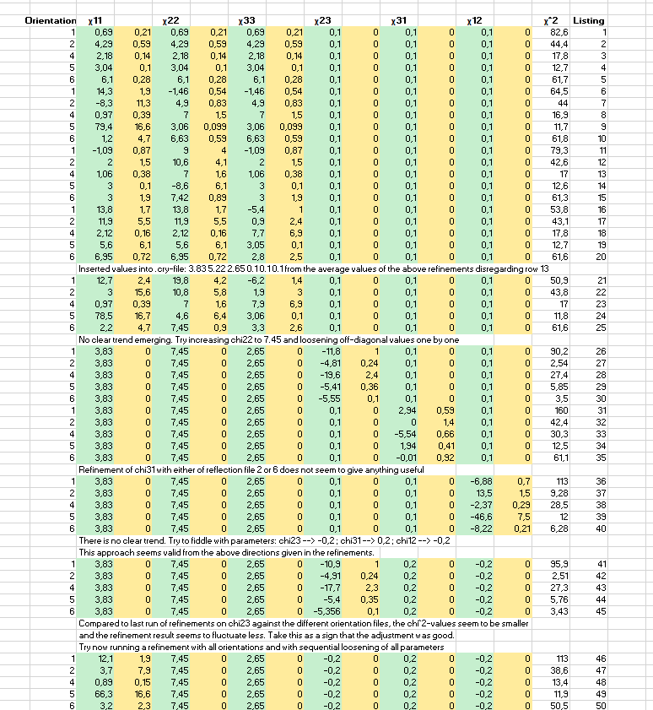
Workflow – susceptibility refinement
Notes:
It’s easy to get lost

Slide 10
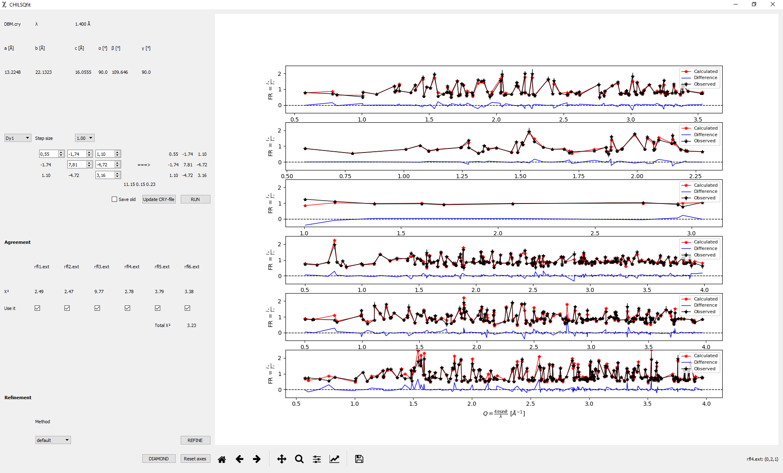
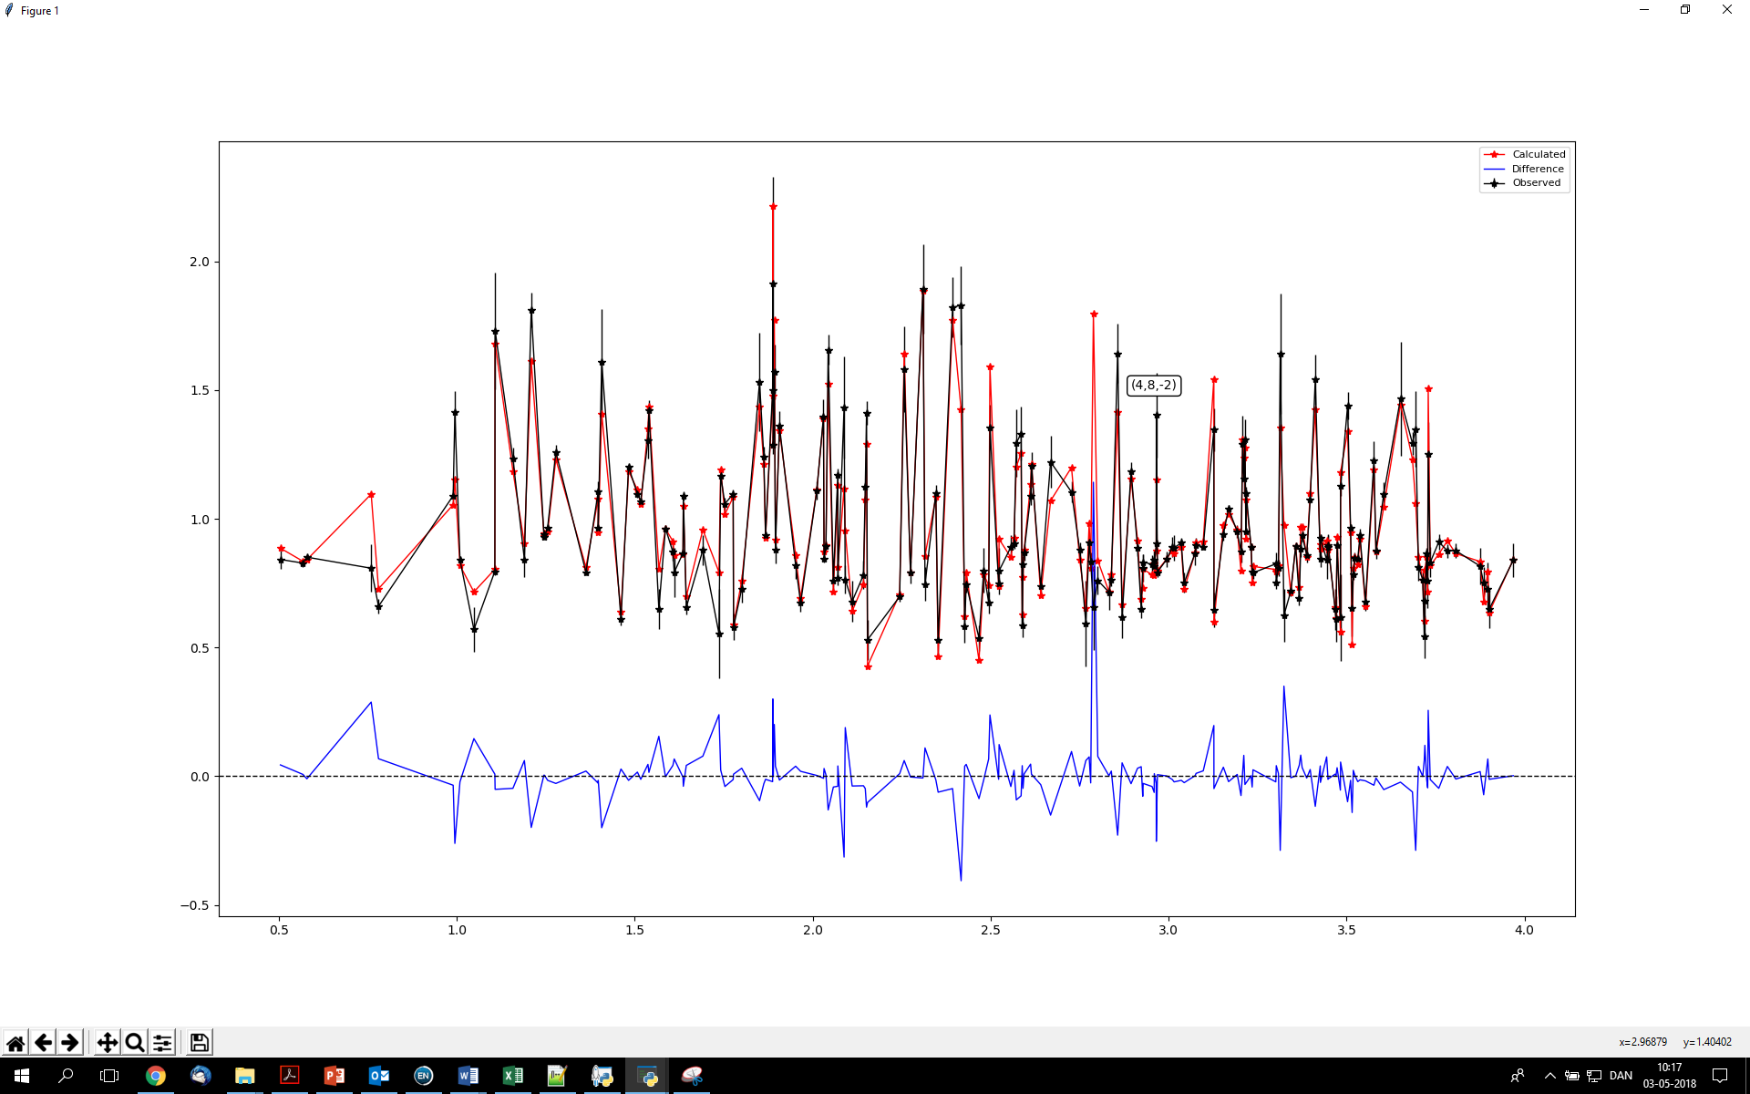
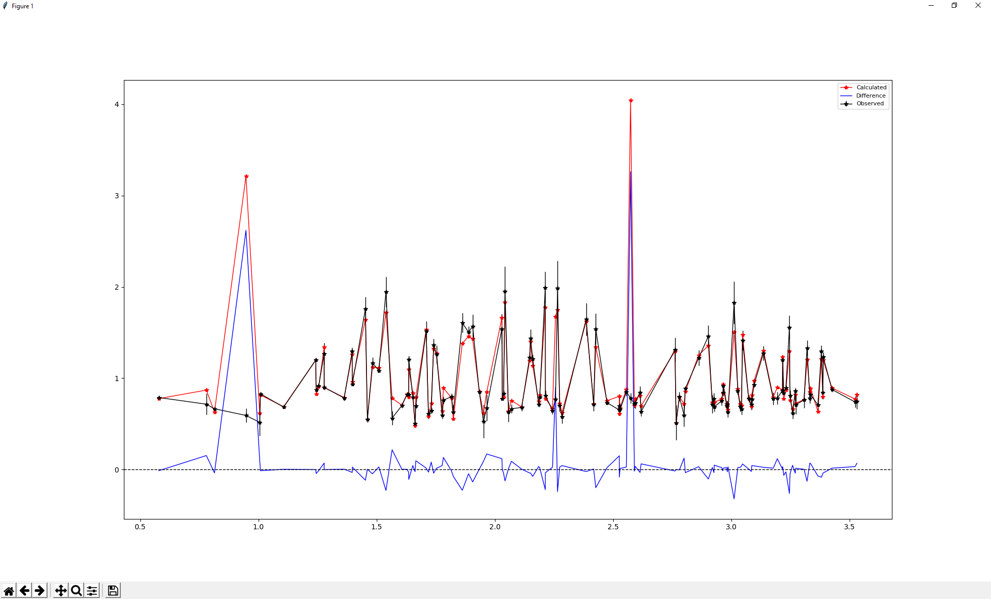
Workflow improvements

Slide 11
conclusions
Susceptibility refinements were largely able to be automated
Less need for manual steps leaves
more time for science
”If you do something more than 3 times,
write a function for it”

Slide 12
aknowledgements
Chen Gao (AU)
Jacob Overgaard (AU)
Shang-Da Jiang (PKU)
Beatrice Gillon (LLB)
Arsen Gukasov (LLB)
Xavier Fabreges (LLB)
Ross O. Piltz (ANSTO)

