Slide 1
Alignment, Scanning
Malcolm Guthrie
www.europeanspallationsource.se
13 September, 2018

Slide 2
Alignment needs
Traditional alignment of neutron samples done with a tape measure
Majority of ESS instruments consider using < 1mm samples
Need higher precision alignment approach.
Notes:
SAM = survey, alignment & metrology

Slide 3
synchrotrons
Luckily, problem solved in 1980’s
Scanning based approach.
Notes:
SAM = survey, alignment & metrology

Slide 4
Scanning methodology
Setup:
z-axis
Beam
Detector
x-axis
x
x
Notes:
SAM = survey, alignment & metrology

Slide 5
Requirements
Monitors
Active area larger than the beam
Uniform response across area
TOF capable
Motors
High speed: full scan in < 10s
2-axis
Complex scans (e.g. spirals)
Notes:
SAM = survey, alignment & metrology

Slide 6
Requirements
Software
Easy user interface
Relative vs absolute scan capability
ability to define scan parameters (start, stop, step size)
Interfaces
SAD
Detector group
ICS group
Motion control…
Notes:
SAM = survey, alignment & metrology

Slide 7
Current status
Prototype in Utgård, (using laser)
Diode based detector
Linear motor (driven by Beckhoff controller)
Next steps:
Scanning software (already exists in EPICS)
Neutron version (V20)
Notes:
SAM = survey, alignment & metrology

Slide 8
Beam characterisation
In addition to alignment, also reveals beam profile
TOF capability enables wavelength-dependent measurements
Scanning at different points along beam measures divergence + focal points
Notes:
SAM = survey, alignment & metrology

Slide 9
Alignment of equipment
neutron pinhole/cross-hair is also optically visible
Can align a camera system to same target, thus mapping optical camera to neutron beam
Notes:
SAM = survey, alignment & metrology

Slide 10
Metrology
Need high-precision metrology system to commission mounts.
SAM provides alignment services (laser-based)
Need local system for day-to-day commissioning
Devised “simple” 2-camera system:
z
z
Cam 2
y
x
Beam
O
Cam 1
Cam 1
Cam 2
after calibration: click gives x,y,z coords in USCS
Notes:
SAM = survey, alignment & metrology

Slide 11
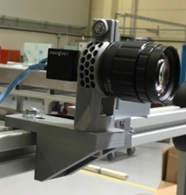
“Simple”
Devise optical spec for cameras (F.L., FOV, mag)
Devise interface spec for cameras (PoE)
Implement EPICS interface for cameras
Software to convert pixel coords to USCS coords.

Slide 12
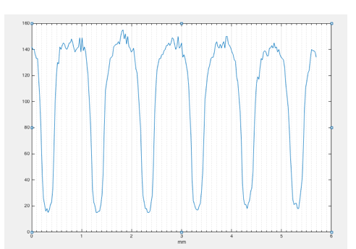
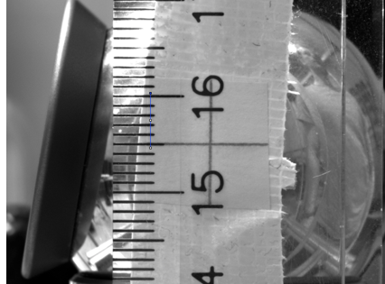
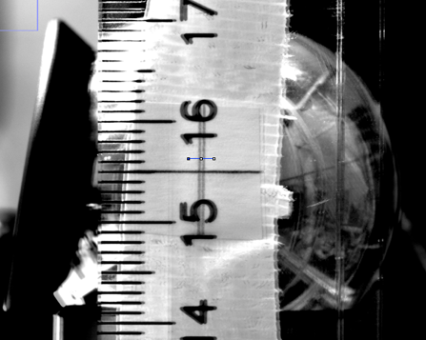
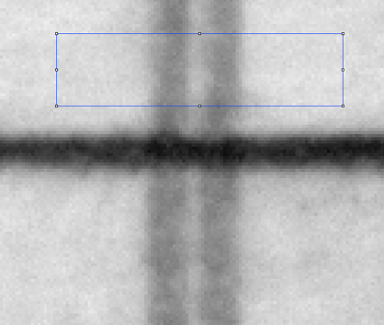
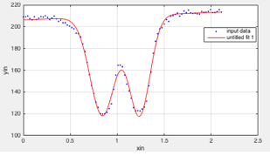
Camera test

Slide 13
Camera test
Coordinate | Original pos. (mm) | Shifted pos (mm) | δy laser(mm) | δy camera (mm)
X | 0.24 | 0.47 | + 0.23 | ?*
Y | -0.33 | 0.06 | - 0.39 | -0.390
z | -0.01 | 0.01 | -0.02 | -0.027
< 10μm precision on displacements

Slide 14
Universal Coordinates
Kinematic Positioning
Interface has two separable parts:
High positional repeatability when they are connected:
High Level Requirements:
Rapid installation, minimise online alignment
High positioning precision ~1mm sample sizes).
Flange and floor-mounted compatibility.
Minimise adapters by establishing standard interfaces
Equipment mount
Concepts:
Use kinematic positioning to ensure repeatability
Calibrate instrument part of mount to have identical spatial relation to the sample position on each instrument
Repeat process on multiple ”Levels” to cover wide range of equipment and tolerance requirements
Instrum. mount
Calibration process:
Take a unique calibration standard and interface it with each instrument
Translate/rotate instrument mount until standard is centred on sample position
Lock this position
Equipment mount
Instrum. mount

Slide 15
Alignment protocol* (*assumes known sample position “+”)
Before alignment:
Beam
Calib’Standard
Inst. 1
Inst. 2
Inst. “n”

Slide 16
Alignment protocol* (*assumes known sample position!)
Install standard
Beam
Calib’Standard
Inst. 1
Inst. 2
Inst. “n”

Slide 17
Alignment protocol* (*assumes known sample position!)
Install standard
Adjust mount to align
Beam
Calib’Standard
Inst. 1
Inst. 2
Inst. “n”

Slide 18
Alignment protocol* (*assumes known sample position!)
Install standard
Adjust mount to align
Repeat on Inst 2
Beam
Calib’Standard
Inst. 1
Inst. 2
Inst. “n”

Slide 19
Alignment protocol* (*assumes known sample position!)
Install standard
Adjust mount to align
Repeat on Inst 2
Beam
Calib’Standard
Inst. 1
Inst. 2
Inst. “n”

Slide 20
Alignment protocol* (*assumes known sample position!)
Install standard
Adjust mount to align
Repeat on Inst 2
Etc…
Beam
Calib’Standard
Inst. 1
Inst. 2
Inst. “n”

Slide 21
Alignment protocol* (*assumes known sample position!)
Install standard
Adjust mount to align
Repeat on Inst 2
Etc…
Beam
Calib’Standard
Inst. 1
Inst. 2
Inst. “n”

Slide 22
Alignment protocol* (*assumes known sample position!)
Install standard
Adjust mount to align
Repeat on Inst 2
Etc…
Beam
Calib’Standard
Inst. 1
Inst. 2
Inst. “n”
Expect periodic recalibration (beam drift, concrete subsidence etc.)
Note: Samples must be calibrated relative to “equipment” mount
This can be done offline by calibrating an “alignment station” in exactly the same way as the instruments

Slide 23
Hidden ROI
Define sample frame A^{s}
A Cartesian frame, defined by three basis vectors, fixed with respect to sample
A^{s} = [e₁,e₂,e₃]
Any point in the sample described by vector r, written in terms of A^{s} as
$\underline{r}=\left(e_{1}e_{2}e_{3}\right)\left(\begin{matrix}x \\ y \\ z\end{matrix}\right)=A^{s}$X
Where X = (x,y,z) is the coordinate matrix
Coordinates of ROI are known in A^{s}
Also coordinates of several “fiducial” points* are known

Slide 24
Hidden ROI
2. Equivalent instrument frame A^{I}
With coordinate matrices X’ = (x’,y’,z’)
3. Determine X’ for several (visible) reference points on object.
4. Obtain transformation between A^{S} and A^{I}
5. Obtain coordinates of ROI in instrument frame
A^{I}
Sample position (Origin of instrument frame)

