Slide 1
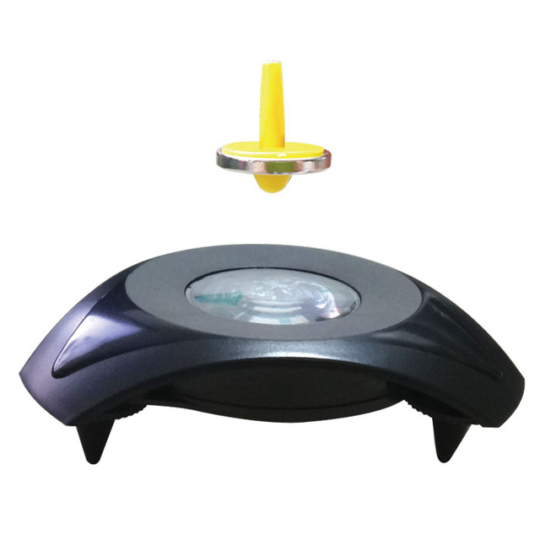
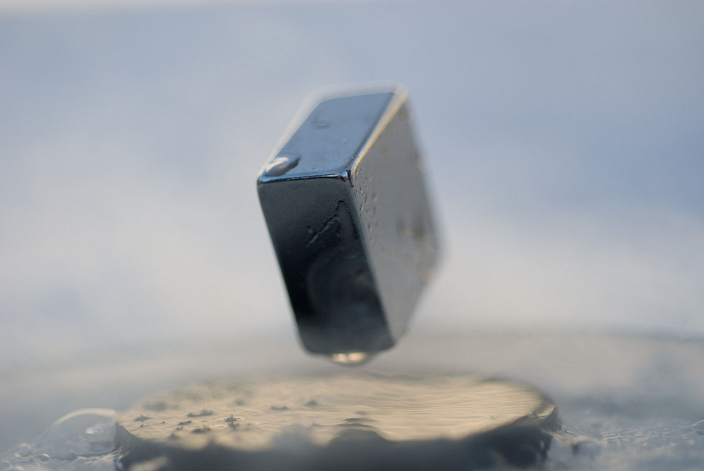
FLUCO FLUids incl. gases, vapors and COmplex fluids - H. Schneider -
Something about levitation
Levitation refers to raising an object against the force of gravity
in such a way that it remains suspended without any physical contact.
Electromagnetic levitation, DC/RF coils , induction furnace
Magnetic levitation
Air/gas levitation , air stream , air pads
Ultrasonic levitation , small samples , ultrasonic transducer
Others , magicians , flying carpets , …………….
Notes:
Disolve this slide or use as summary; link to SAC comments
Needs to specifc what it want from the pool and what they build for their instrument.
Instrumet team takes team during construction (and potentially in operation)

Slide 2
FLUCO FLUids incl. gases, vapors and COmplex fluids - H. Schneider -
Something about levitation
Levitation refers to raising an object against the force of gravity
in such a way that it remains suspended without any physical contact.
Electromagnetic levitation, DC/RF coils , induction furnace
Superconducting effects
Magnetic spinning top
Air/gas levitation , air stream , air pads
Ultrasonic levitation , small samples , ultrasonic transducer
Others , magicians , flying carpets , …………….
Notes:
Disolve this slide or use as summary; link to SAC comments
Needs to specifc what it want from the pool and what they build for their instrument.
Instrumet team takes team during construction (and potentially in operation)

Slide 3
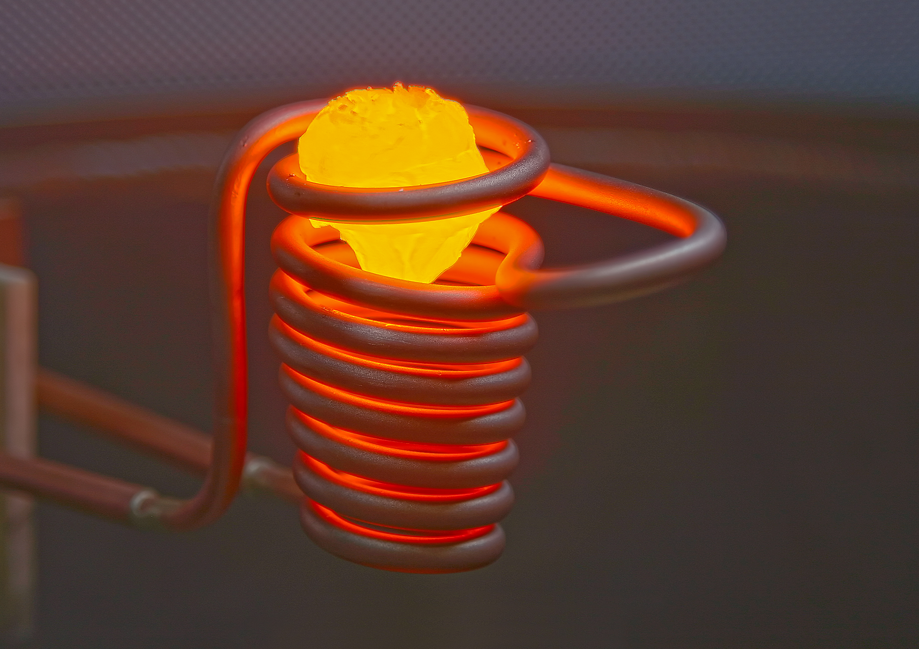
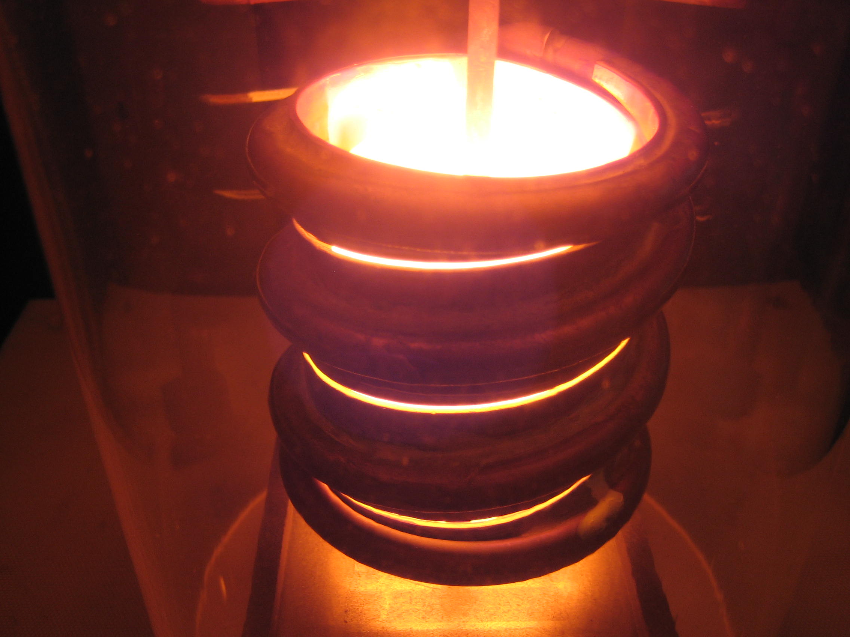
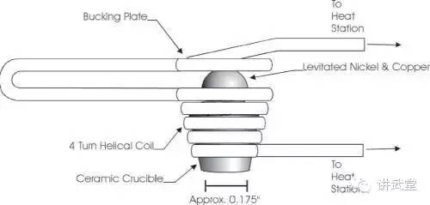
FLUCO FLUids incl. gases, vapors and COmplex fluids - H. Schneider -
Electromagnetic levitation
DC coil – high current
RF-induction coil, heating and levitation
Hight temp melting without melting pot, metal alloys
Pure high quality meltings/alloys
Also used for high temp. crystal groth
See TEFI – expertise
See PREMP , materialscience/ dilatation units
Notes:
Disolve this slide or use as summary; link to SAC comments
Needs to specifc what it want from the pool and what they build for their instrument.
Instrumet team takes team during construction (and potentially in operation)

Slide 4
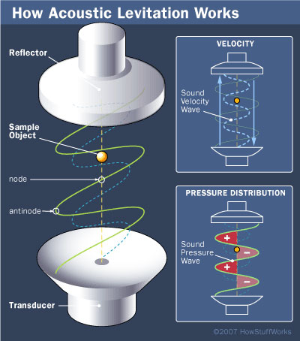
FLUCO FLUids incl. gases, vapors and COmplex fluids - H. Schneider -
Ultrasonic levitation
Smart device, carrying small sample without holder
No boundary surface effects with sample holder (liquids)
Enables free “flying droplets”
Also useful for small crystals and powder samples
Ambient temperature control by cell thermalizing
Modulation of transducer allows rotating of sample,
in multi transducer systems
Notes:
Disolve this slide or use as summary; link to SAC comments
Needs to specifc what it want from the pool and what they build for their instrument.
Instrumet team takes team during construction (and potentially in operation)

Slide 5
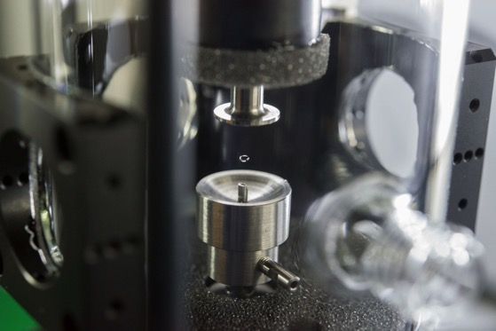
FLUCO FLUids incl. gases, vapors and COmplex fluids - H. Schneider -
Ultrasonic levitation
Example JCNS@MLZ
Commercial levitator
Droplet at KWS3 instrument
Only bulky sample in the beam
No boundary surface effects
-In the future plan of FLUCO-
Notes:
Disolve this slide or use as summary; link to SAC comments
Needs to specifc what it want from the pool and what they build for their instrument.
Instrumet team takes team during construction (and potentially in operation)

