Slide 1
Sample Environment for Mechanical Processing
Malcolm Guthrie
www.europeanspallationsource.se
10 September, 2018

Slide 2
Talk Overview
Introduction: what is Mechanical Processing (MP) sample environments
Input: BEER team, Robin Woracek, SEE STAP and “Neutron and Synchrotron Sample Environment” workshop”, Sønderberg, DK (2-3 May 2018)
Summary of currently planned MP equipment (construction)
instrument
specific pool
external.
Details on instrument specific BEER strain rig project as example

Slide 3
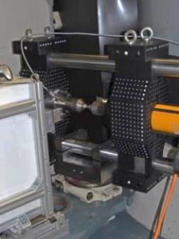
Mechanical Processing
PREMP is a platform within Science Support Systems (PREssure and Mechanical Processing)
Equipment for mechanically manipulating materials:
in situ, in operando processes
Stress-strain
Welding
…many others (often user supplied)
Complete suite of equipment includes:
SEE pool,
instrument-specific SEE,
External, User-contributed SEE
Primary stakeholders: Imaging and engineering class (BEER and ODIN) also SANS
NSS Construction budget supports first 8 instruments prioritising ”early science success”

Slide 4
Current Mechanical Processing suite
Suite = Pool + Instrument specific + User supplied
Equipment | Category | cost (k€) | Funded (k€) | Source
Stress-strain rig | Inst. specific - BEER | 300 | 300 | PREMP
Dilatometer | Inst. specific - BEER | 400 | 300 | PREMP
Stir welding | Inst. specific - BEER | 200 | 0 | (upgrade?)
Gleeble | Inst. specific - BEER | 1000 | 0 | (upgrade?)
Furnace for strain rig | Inst. specific – BEER | - | 840* | External (Chalmers)
Generic strain rig | Pool | 50 | 50 | PREMP
MP pool | ? | ? | 100 | PREMP
Unallocated €100k could either fund dilatometer or bolster pool
Additional need for diversity of strain rigs has been identified by SEE STAP
What is most beneficial for “early science success”
(*4 year project including labour over 4 years)

Slide 5
Example: BEER deformation rig
Deformation rig key component of engineering diffractometers
Full scope BEER proposal listed multiple rigs:
middle size 100 kN rig
small size 15 kN rig
50kN rigs for long-term testing
Wide variety of simultaneous parameters: heating, cooling, special atmosphere, electric and magnetic fields…
Within PREMP budget, €300k allocated for a single rig.
primarily optimized for BEER with possible occasional use on other instruments

Slide 6
Example: BEER deformation rig
Scope | Strain rig to support engineering science. Primarily on BEER, occasionally on other. Interface with external furnace project (M. Colliander Chalmers)
Budget | €300k PREMP (excl “interal” labour, but inc. “external” labour)
Roles & responsibilities | SAD - manage budget, manage ESS interfaces (ICS integration, mechanical, safety/CE-marking) BEER – concept, detailed design, procurement OTHER INSTRUMENTS – contribute requirements (e.g. 360° access)
In Kind | Identify IK partner to build and commission rig
Schedule | BEER HC starts at BOT (Q3/22). kick-off = BOT- (project + float)

Slide 7
Provisional Stress Rig Project Schedule
 | 2019 |  |  |  | 2020
 | Q1 | Q2 | Q3 | Q4 | Q1 | Q2 | Q3 | Q4
BEER |  |  |  | Installation and integration
SEE | Prelim. des. | Detailed design |  |  |  | Procurement
 |  | 2021 |  |  |  | 2022
 |  | Q1 | Q2 | Q3 | Q4 | Q1 | Q2 | Q3 | Q4
 | BEER | Installation and integration |  |  |  |  |  | comm./early sci
 | SEE | Installation and integration |  |  |  | float
 |  |  | 2023
 |  |  | Q1 | Q2 | Q3 | Q4
 |  | BEER | commissioning/early sci |  |  | User prog?
finalise spec
freeze design
Final delivery

Slide 8
External projects: VR funded furnace for stress rig

Slide 9
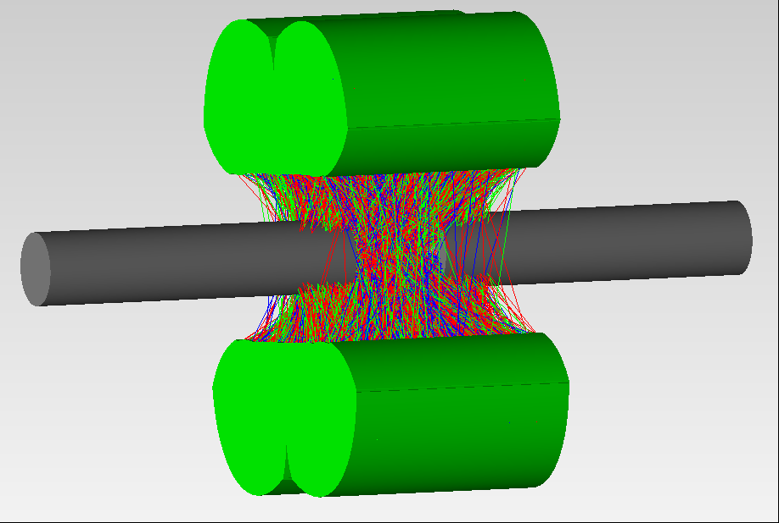
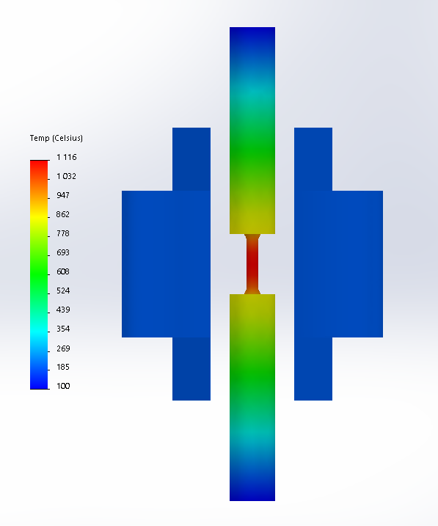
UHT@BEER
Ultra-high temperature mechanical testing at BEER
Joint project with three Swedish universities (Chalmers, Linköping and KTH) and representatives from BEER (NPI), funded by Swedish Research Council. Collaboration with ENGIN-X at ISIS.
Aimed at developing a furnace for in-situ mechanical testing at temperatures up to 1600 °C, available from day one from the SE pool.
Radiative heating to allow testing of e.g. CMCs. Currently in conceptual design phase where raytracing and thermal FE simulations are used to develop lamp based concept with optimized reflector design. Current results indicate that target temperatures should be readily reached.
Designed to allow access to ±90° diffraction detectors and future SANS detector in transmission, but depending on the need for secondary reflectors other detector banks (in the scattering plane) should be accessible.
Prototype reflectors will be built by ENGIN-X during fall to evaluate performance. Final design will also consider contactless extensometers and controlled environments (vacuum and/or gas).
Contact: Magnus Colliander (magnus.colliander@chalmers.se)

Slide 10
Integrating external SEE
SAD can play an important role in integrating “user provided” equipment
Multiple interfaces must be managed:
ICS/EPICS integration
Safety/Quality
Mechanical standards
Project plans should included adequate time
“SEE developers” should identify point-of-contact within SAD

Slide 11
Summary
Sample environment system Suite
Currently heavily instrument specific (BEER)
Single external (“user”) project…but expect many more (and diverse)
Pool very limited, perceive need to expand.
Each System is a miniature Project
Has its own budget, scope, schedule, milestones etc.
loosely coupled to instrument schedule (i.e. del. date defined by inst milestones)
To manage interfaces, highly recommended to involve SAD (even for user developed equipment)

