Slide 1
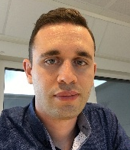
Instrument labs, ventilation and sample handling
Monika Hartl
Melissa Sharp, Katrin Michel, Athanasios Stathis
Scientific Activities Division
www.europeanspallationsource.se
18-09-25

Slide 2
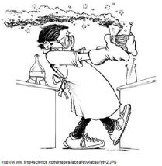
WHAT do we (SULF) do for the instruments? WHO to ask?
+ rules/regulations/training
+ provide user labs
+ user support
Katrin, Melissa,
Monika
ESS chem. labs
Instr. spec. labs
Contain-ment / conven-tional exhaust
Sample Handling
-no support/responsibility
for operations
+ support with safety
req./paperwork
…and tollgates
Monika, Melissa
Katrin, Melissa,
Monika
+ user support in labs
+ rules/regulations/training
Monika, Athanasios
+ support with safety
+ info what is supplied
-no support/responsibility
for operations

Slide 3
WHAT do we (SULF) do? WHO to ask?
+ rules/regulations/training
+ provide user labs
+ user support
KM,MS,MH,AS
ESS chem. labs
Instr. spec. labs
Contain-ment / conven-tional exhaust
Sample Handling
-no support/responsibility
for operations
+ support with safety
req./paperwork
…and tollgates
MH/MS
MS,MH
+ user support in labs
+ rules/regulations/training
AS/MH
+ support with safety
+ info what is supplied
-no support/responsibility
for operations

Slide 4
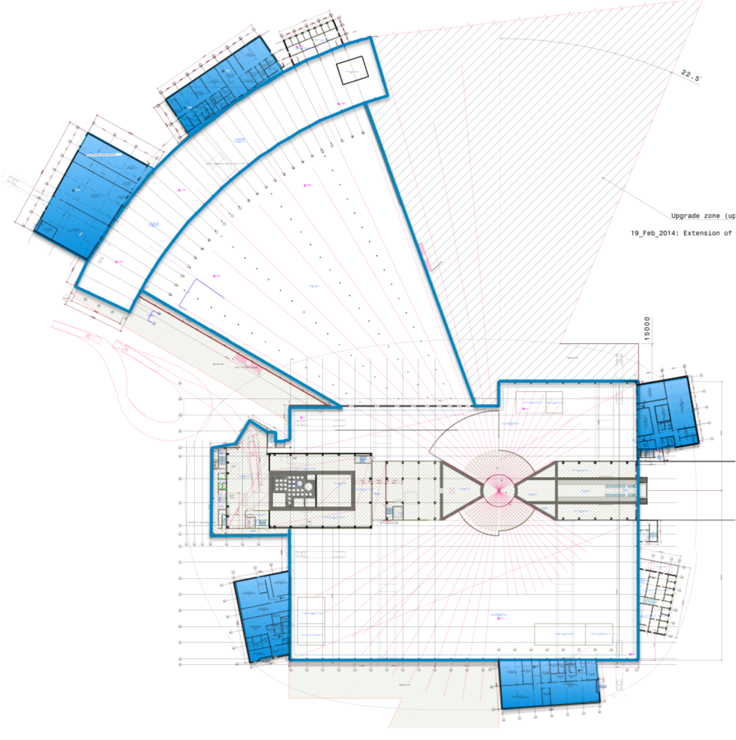
ESS – Chemistry Laboratories: Experimental Hall and Laboratories
Experimental halls:
instruments
small work areas
workshops
Further details: please talk to us
during the IKON.
Laboratory space
Chem/bio labs
Rad mat. Lab
X-ray lab
Engineering lab
…..

Slide 5
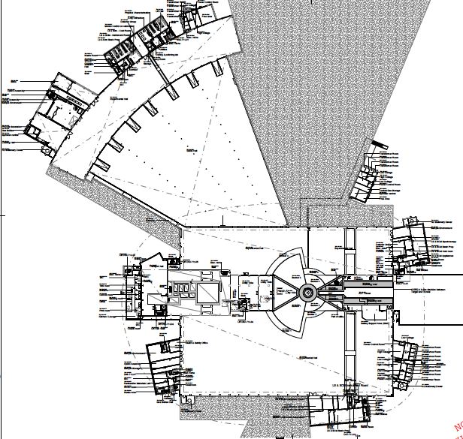
Overview of sample labs level 100
E04 (ready Q1 2020):
LS&SCM basic prep: 94 m²
Instr. room: 18 m²
Cold room: 12 m²
X-ray diff: 50 m²
Phys. char.: 99 m²
Cutting & polishing: 31 m²
Storage: 11 m²
Hall 3
D04 (ready Q3 2020):
LS&SCM basic prep.: 150 m²
LS&SCM Spec.: 27 m²
LS&SCM Appl.: 19 m² LS&SCM cold room: 16 m²
E03 (ready Q1 2020):
SLIME (eng. lab): 212 m²
Hall 2
D07 (2023):
LS&SCM basic prep: 154 m²
LS&SCM cold room: 24 m²
LS&SCM instr. room: 46 m²
SAXS: 25 m²
Hall 1
D08 (RML ready Q3 2020):
Radioactive materials lab (RML): 51 m² Storage: 50 m²

Slide 6
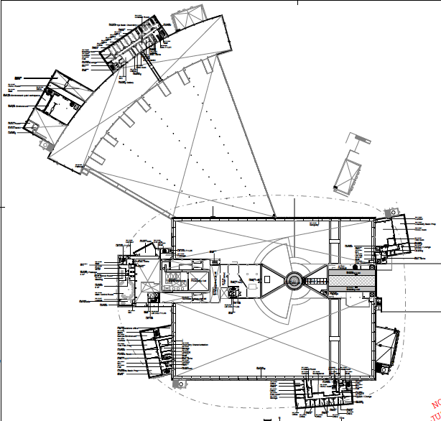
Overview of sample labs
Level 110
Hall 3
E04:
Chem. basic prep: 105 m²
Storage: 12 m²
D04:
Chem. basic prep: 151 m²
Hall 2
D08 (ready Q3 2022):
Furnace room: 49 m²
Thin film prep: 49 m²
Chem. basic prep: 99 m²
Chem. char.: 21 m²
Storage: 24 m²
Hall 1

Slide 7
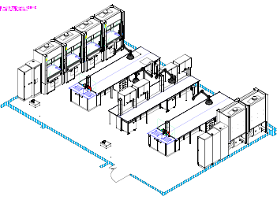
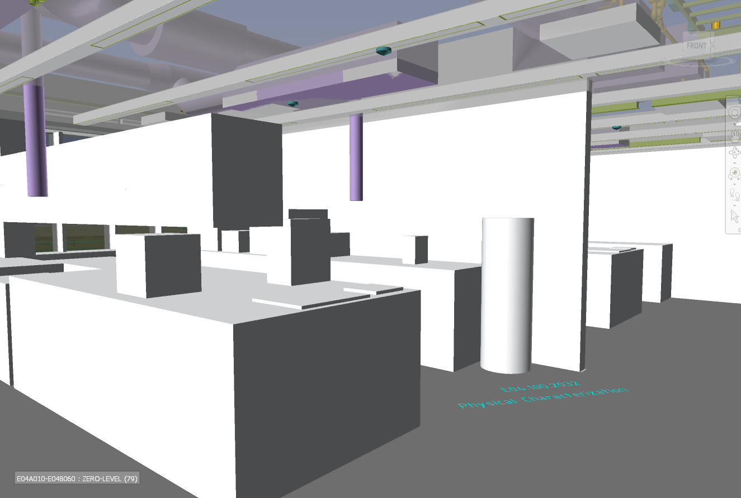
ESS – Chemistry Laboratories:
What we provide
8 large general user preparation labs covering chemistry, soft matter and life science situated in D04, D07, D08, E03, E04 support buildings
15 specialized labs for sample characterization, furnace room, thin film, X-rays, cold rooms, etc.
E-labs to commence furnishing in early 2020, on schedule, RML still on track for BOT
General user labs on schedule to be completed in time for nearby instruments starting hot commissioning
earliest labs ready for use in mid- 2020 (E04)

Slide 8
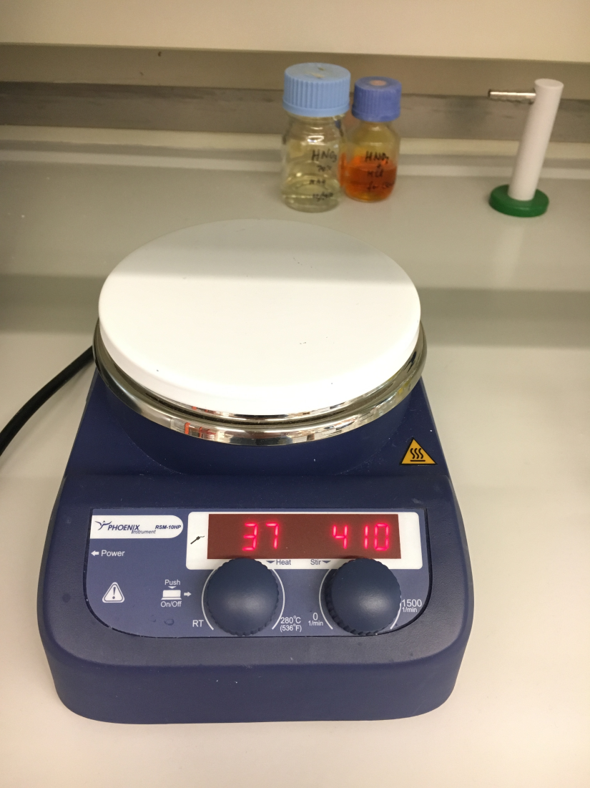
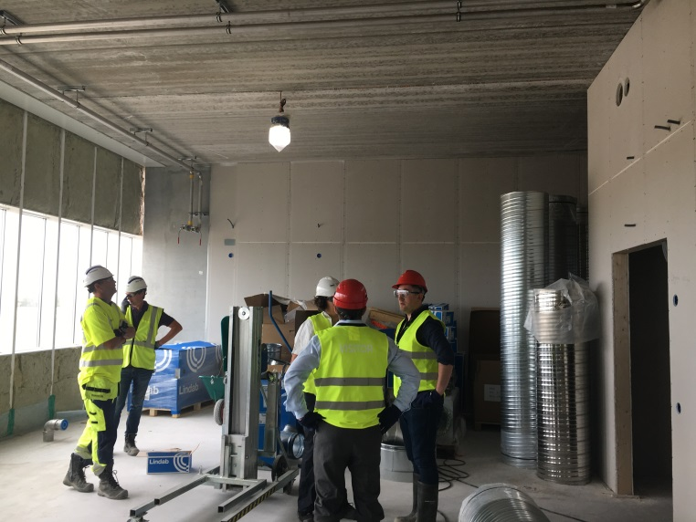
ESS – Chemistry Laboratories:
We are starting to get ready…
Procurement of equipment/chemicals
Preparing equipment, manuals and safety paperwork to be ready when we move in in mid-2020 (E04)
Start participating in grants connected to labs and neutron scattering to obtain equipment useful for the user laboratories and to start building user community for ESS
However – focus is on construction and setup of labs

Slide 9
WHAT do we (SULF) do? WHO to ask?
+ rules/regulations/training
+ provide user labs
+ user support
KM,MS,MH,AS
ESS chem. labs
Instr. spec. labs
Contain-ment / conven-tional exhaust
Sample Handling
-no support/responsibility
for operations
+ support with safety
req./paperwork
…and tollgates
MH/MS
MS,MH
+ user support in labs
+ rules/regulations/training
AS/MH
+ support with safety
+ info what is supplied
-no support/responsibility
for operations

Slide 10
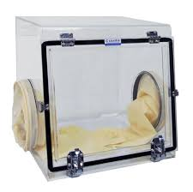
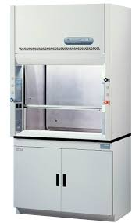
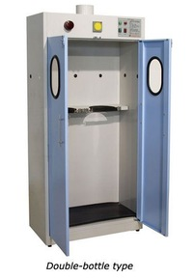
Instrument Specific Laboratories (IS labs): What is it?
= Area on each instrument used for handling samples
Design of area is responsibility of instrument team
rules/regulations are responsibility of ESS
Operation of IS labs is responsibility of instr. team (staffing/equipment/enforcement of safety)
SULF will assist in assuring the design/proposed work aligns with the safety requirements (TOLLGATE documents…).
Potential restrictions for IS labs:
Fire load (flammable solvents & gases)
Health hazards (toxicity, nanoparticles, …)
Radioactivity (maximum inventory/ shielded cabinets/…)

Slide 11
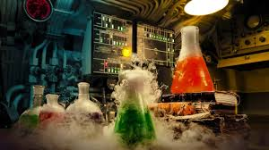
Instrument Specific Laboratories (IS labs): sample handling
Whether or not sample can be handled on the instrument will depend on experiment safety review AND provision on instrument (Sample management procedures: ESS-0024107, ESS-0024109, ESS-0024112)
REMEMBER: the nearest user lab is not far from you and there we take the responsibility and make provisions for hazardous samples and user support!

Slide 12
WHAT do we (SULF) do? WHO to ask?
+ rules/regulations/training
+ provide user labs
+ user support
KM/MH/MS/AS
ESS chem. labs
Instr. spec. labs
Contain-ment / conven-tional exhaust
Sample Handling
-no support/responsibility
for operations
+ support with safety
req./paperwork
…and tollgates
MH/MS
MS,MH
+ user support in labs
+ rules/regulations/training
AS/MH
+ support with safety
+ info what is supplied
-no support/responsibility
for operations

Slide 13
Containment vs conventional exhaust
Containment exhaust: goes to the main stack of ESS, can be used on sample area even if materials are radioactive
typical use: pump exhaust in experimental cave to provide containment for radioactive material or for gas flow experiments
Conventional ventilation: goes to a regular exhaust (NO radioactive fumes are allowed!)
typical use: fume hood in instrument area for preparing samples or exhaust for flammable solvent/gas cylinder cabinet

Slide 14
Containment exhaust
Containment exhaust => inner diameter 250 mm
usable for:
vacuum pump exhaust from sample area
slow gas flow over sample
Needed from the instrument teams:
run pipe to the experimental cave area of instrument,
install HEPA filter to catch particles,
Keep line closed when not in use
Provided by ESS: ESS-0040840 (will be updated)
Specifications for HEPA filters
Specify restrictions for use (e.g. no large amount of undiluted corrosives….)

Slide 15
Conventional exhaust
Conventional exhaust => inner diameter 315 mm
usable for:
Fume hoods/overhead extraction for IS labs
Cabinets with flammable/toxic liquids/gases
Sample storage cabinets
Needed from the instrument teams:
run pipe to the IS lab area
add damper/filter for fume hoods/overhead extraction
Cover end flange if not in use
Provided by ESS: ESS-0040840 (needs update)
Specification for damper/filter to the extent of our knowledge:
(= we can specify one model and facilitate contact to builder to see if other models might work)

Slide 16
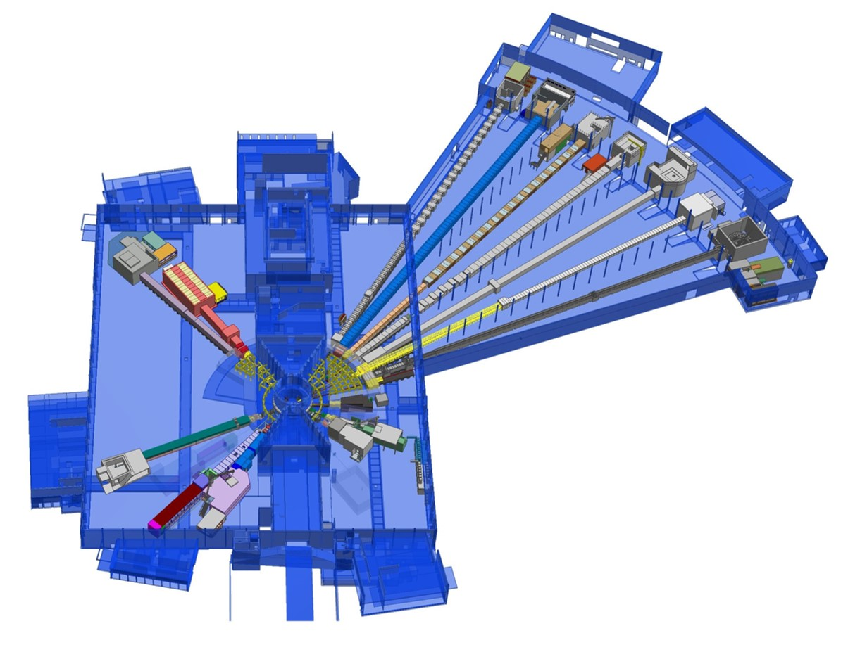
Instrument Overview – S/E/N/W halls
D08: RML Q3,2020
Rest: 2021
E03/E04: Dec 2019
NMX
BEER
C-SPEC
BIFROST
MIRACLES
MAGIC
T-REX
ODIN
HEIMDAL
DREAM
D07:
During pre-ops
LoKI
VESPA
FREIA
SKADI
ESTIA
D04:

Slide 17
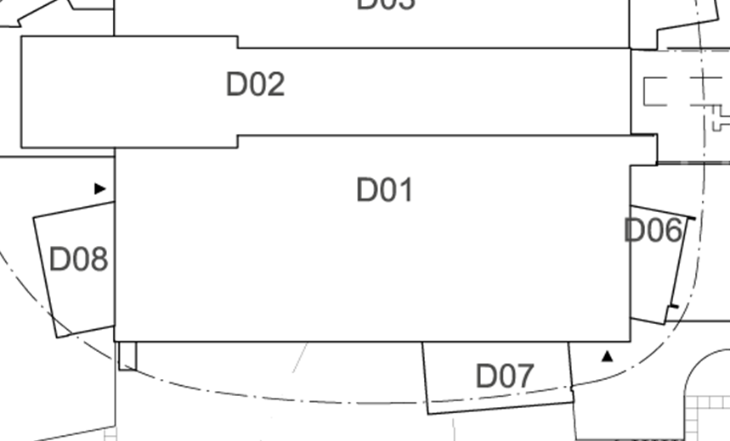
D01 Building - Chemical & Containment Ventilation
Level 090 – galleries:
9 fume hood connections
D = 315 mm, t = 0.55mm
Level 100 – exp. hall:
9 containment connections
D = 250 mm, t = 0.5mm
t, Thickness (mm)
D, Inner Diameter (mm)
Material: Galvanized Sheet Steel Metal

Slide 18
D03 Building - Chemical & Containment Ventilation
Level 090 – galleries:
4 fume hood connections
D = 315 mm, t = 0.55mm
Level 110 – exp. hall:
containment pipe on wall (connections ??)
D = 250 mm, t = 0.5mm
Material: Galvanized Sheet Steel Metal
t, Thickness (mm)
D, Inner Diameter (mm)

Slide 19
E01 Building - Chemical & Containment Ventilation
Level 105 – wall:
8 fume hood connections
D = 315 mm, t = 0.55mm
Level 105 – wall:
8 containment connections
D = 250 mm, t = 0.5mm
Material: Galvanized Sheet Steel Metal
t, Thickness (mm)
D, Inner Diameter (mm)

Slide 20
Utilities – D01 Building
Level 090 – galleries 16 Connections
De-Ionized Water
Instrument Air
Nitrogen
Material: Stainless Steel
Steel Name: X2 CrNiMo17-13-3
Steel Nr: 1.4432
2.0 (mm), Thickness
33.7 (mm), Outer Diameter

Slide 21
Utilities – D03 Building
Level 090 – galleries:
9 Connections
De-Ionized Water
Instrument Air
Nitrogen
Material: Stainless Steel
Steel Name: X2 CrNiMo17-13-3
Steel Nr: 1.4432
2.0 (mm), Thickness
33.7 (mm), Outer Diameter

Slide 22
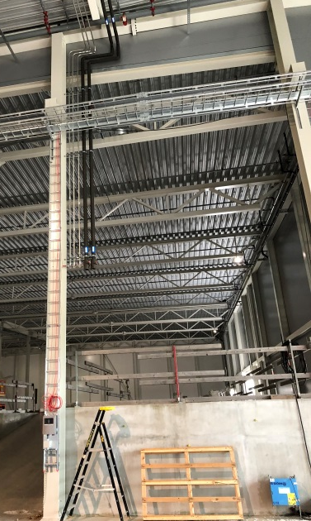
Utilities – E01 Building
Level 110 – hanging:
10 Connections
Cooling Water
De-Ionized Water
Instrument Air Nitrogen
Material: Stainless Steel
Steel Name: X2 CrNiMo17-13-3
Steel Nr: 1.4432
2.0 (mm), Thickness
33.7 (mm), Outer Diameter

Slide 23
WHAT do we (SULF) do? WHO to ask?
+ rules/regulations/training
+ provide user labs
+ user support
KM/MH/MS/AS
ESS chem. labs
Instr. spec. labs
Contain-ment / conven-tional exhaust
Sample Handling
-no support/responsibility
for operations
+ support with safety
req./paperwork
…and tollgates
MH/MS
MH/MS
+ user support in labs
+ rules/regulations/training
AS/MH
+ support with safety
+ info what is supplied
-no support/responsibility
for operations

Slide 24
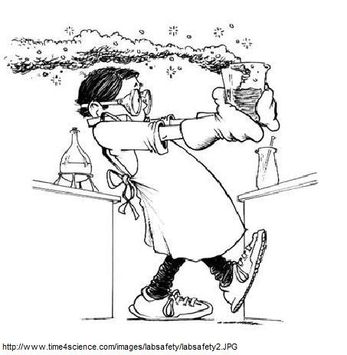
Sample Handling at ESS
Stay Safe
Develop rules, determine controls
Do Science
Science Support
Systems
Lab Safety
Experimental
Safety
Review
ES&H / Systems Engineering
Instrument
Safety
Experiment
Experiment Proposal
Sample “Retirement”

Slide 25
Sample Management Process
Users submit scientific proposals incl. Experimental Safety Form (ESF)
Once the scientific proposal has been accepted, the sample management process begins:
After the experiment is finished and the samples have been retired, the Experimental Safety Report (ESR) will be the output that will be archived at ESS
Exp. Safety Docu: ESD
Scientific acceptance of user proposal ESF
1. Safety Review Procedure
2. Sample Handling Procedure
Experiment is finished
ESR

Slide 26
1. Safety Review Procedure
Responsible: ES&H
The ESF submitted by user is pre-screened by the Safety Review Committee (SRC) members
Experiments considered medium or high hazard will be discussed in the SRC meeting.
Hazards and controls will be listed in the Experimental Safety Document (ESD) that will be signed by the SRC members.
SRC: ES&H + subject matter experts (IH and scientists)
ESF by user
Pre-Screening by SRC members
SRC meeting to discuss hazards and controls
ESD by SRC

Slide 27
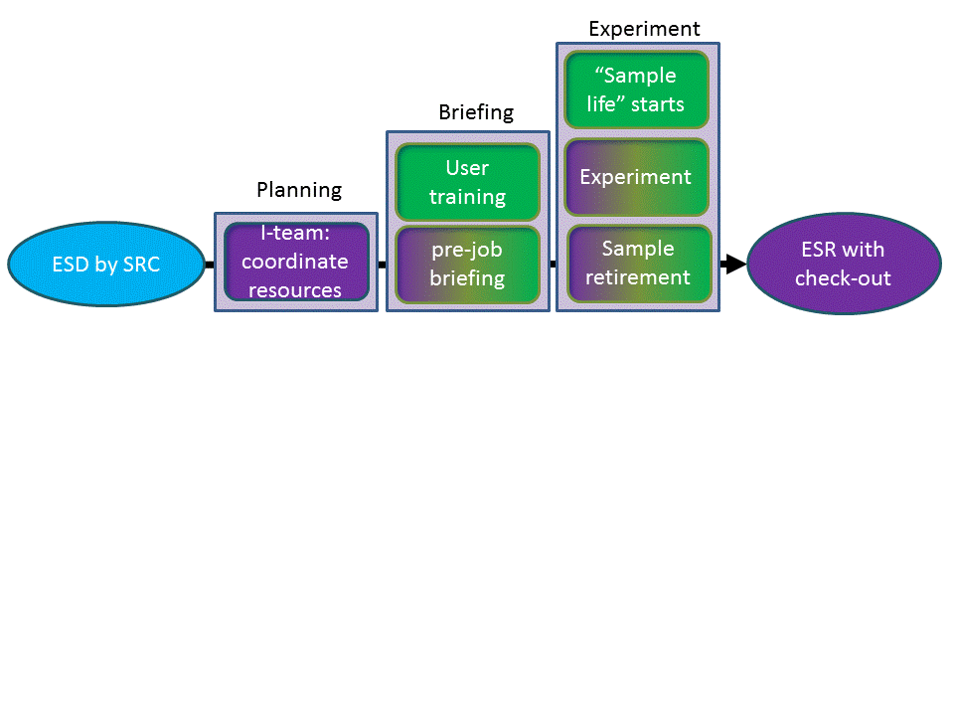
2. Sample Handling Procedure
ESD
Planning
Experiment
ESR
Briefing

Slide 28
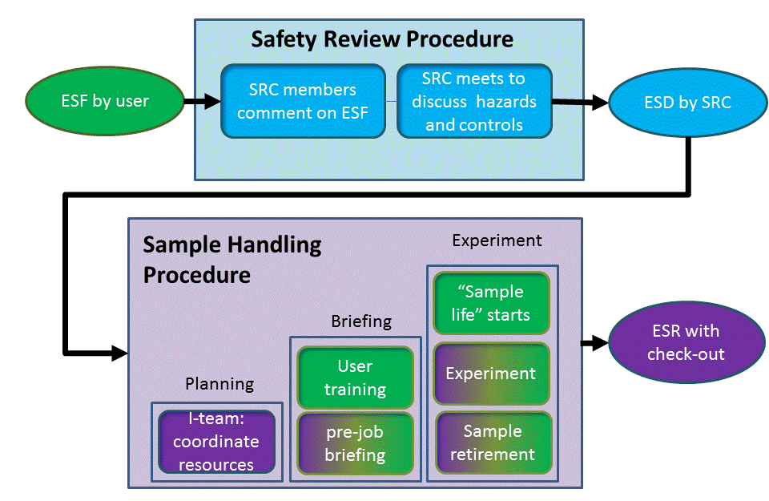
Sample Management Process
Experiment Safety
Form
Experiment Safety
Document
Experiment Safety
Report contains ESF, ESD,
Sample survey and disposal

Slide 29
WHAT do we (SULF) do?
-no support or responsibility
for operations
- no maintenance support if not agreed otherwise
+ support with safety
req./paperwork
+ rules/regulations (training)
+ provide user labs
+ user support in labs
ESS chem. labs
Instr. spec. labs
Contain-ment / conven-tional exhaust
Sample Handling
+ support with safety
+ info what is supplied
-no support/responsibility
for operations
+ user/instrument team support in labs
+ rules/regulations
+ support for experiments if high hazard

Slide 30
Conclusions:
Sample Handling at ESS including safety
Sample management procedure (this should be referenced during your TGs) – no need to do a hazard analysis on sample handling
Instrument Laboratories
-available: chemical ventilation, containment ventilation
-not available: sinks and drains -> need to use closed-cycle cooling and collect liquids
-if you have special needs, we will support you, e.g. either in the lab or in developing an IS (e.g. nanopowder box for diffractometer, sample loading station for SANS/reflectometry)
Generic instrument hazard analysis: sample environment and samples not part of generic instrument hazard analysis EXCEPT if constantly on instrument (e.g. robot arms NMX, CCR for VESPA)- see https://confluence.esss.lu.se/display/SD/Instrument+Hazard+Analysis
Documentation – chem vent/containment vent: ESS-0040840

Slide 31
Lab support
We realize instrument specific labs can be very useful and will support you in providing them !
We are also convinced that more hazardous handling of chemicals can be much better done in the fully equipped user laboratories.
Questions to:
Monika.Hartl@esss.se & Melissa.Sharp@esss.se

