Slide 1

FLUCO
Sample changer
- H. Schneider -
Possible principles of “non human driven” sample changer
1.) SANS – changer , also possible for Reflectometer
Thermalized magazine for SANS e.g. 50 pos. at the same Temperature.
  Driven by open water bath circulator , appr. 10˚C – 80˚C.
  Individual positions can have up 5 % error.
  Useful for “rough” thermalization
  All samples at the same Temperature
Magazine with individual T.-control , e.g. RUC/ESS project
  Driven by Peltier element on each position, open water bath circulator rough base temp.
  Each position is independent ,from 5 ˚C to 120˚C (with dry gas atmosphere down to -20˚C)
  More work needed for mechanical upgrade and electronics
Also tumbler magazines , with or without temperature control
Notes:
Disolve this slide or use as summary; link to SAC comments
Needs to specifc what it want from the pool and what they build for their instrument.
Instrumet team takes team during construction (and potentially in operation)

Slide 2
FLUCO
Sample changer
- H. Schneider -
Possible principles of “non human driven” sample changer
For diffractometer and spectrometer
2.) Sample changers / Sample environment system changers.
  e.g. Cells/sample sticks/cuvettes/troughs,…
  Robotics / translation- / rotational stage , and/or chain transport
  Examples : Changer at POWGEN / VISION / TOSCA
  Before starting two requirements have to be defined.
    Sample area of instruments has to be fixed/defined.
    Devices (SES) have to be defined in
      Shape
      Weight
      Connected pipes/cables
      Risc assessment
Sample environment itself will be changed, ambient temperatures, He flow cryostat
Most changer systems will be related to one instrument
Notes:
Disolve this slide or use as summary; link to SAC comments
Needs to specifc what it want from the pool and what they build for their instrument.
Instrumet team takes team during construction (and potentially in operation)

Slide 3
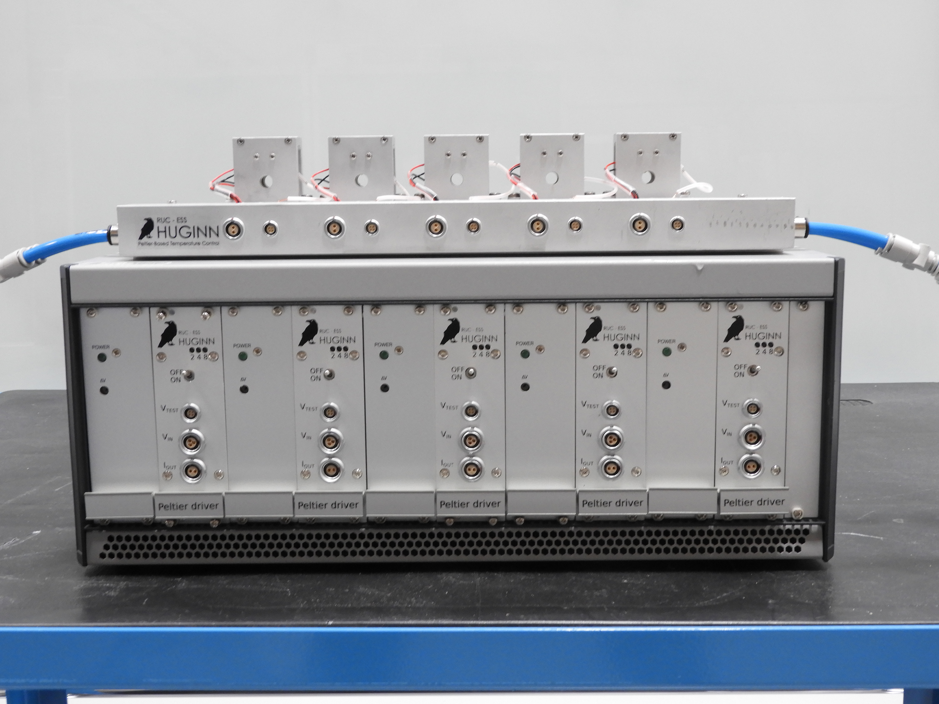
FLUCO
Sample changer
- H. Schneider -
Principle sketch of the device
Magazine 5 positions, up to 10 pos. possible
Different sizes of quartz /sapphire cuvettes
Stackable to 4 (5) x 10 Positions
Dedicated for SANS applications
Each position with individual controlled T performed by Peltier elements
Temperature range 5˚C – 120˚C Base plate thermalized by circulator
In “dry” atmosphere: temperatures down to – 20˚C
Cuvette holder w. Peltier elements
Thermalised base plate
SANS-Peltier-changer
Channel - 1
Channel - 2
Channel - 3
Channel - 4
Channel - 5
Cuvette holder
BOOSTER
IK Partner: B Jakobson, C Niss, RUC
Notes:
Disolve this slide or use as summary; link to SAC comments
Needs to specifc what it want from the pool and what they build for their instrument.
Instrumet team takes team during construction (and potentially in operation)

Slide 4
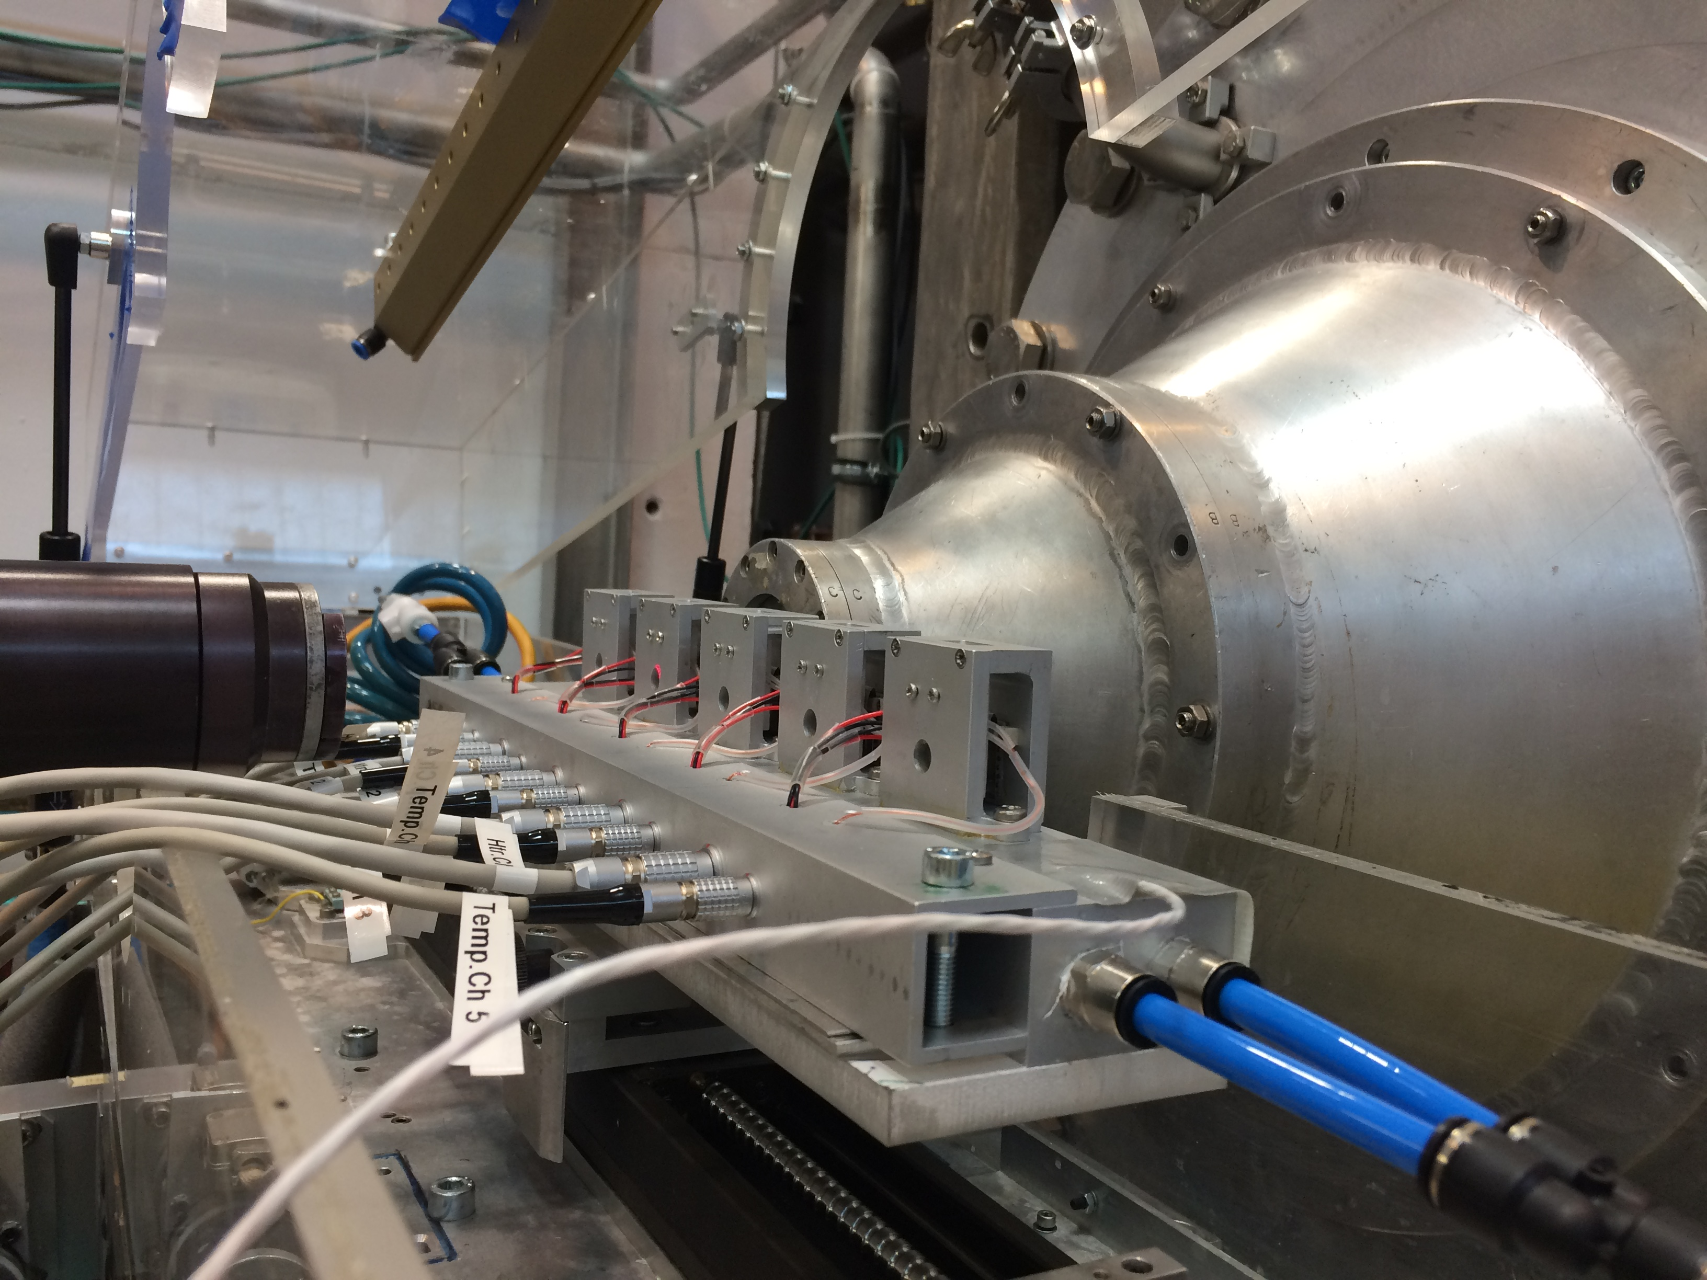
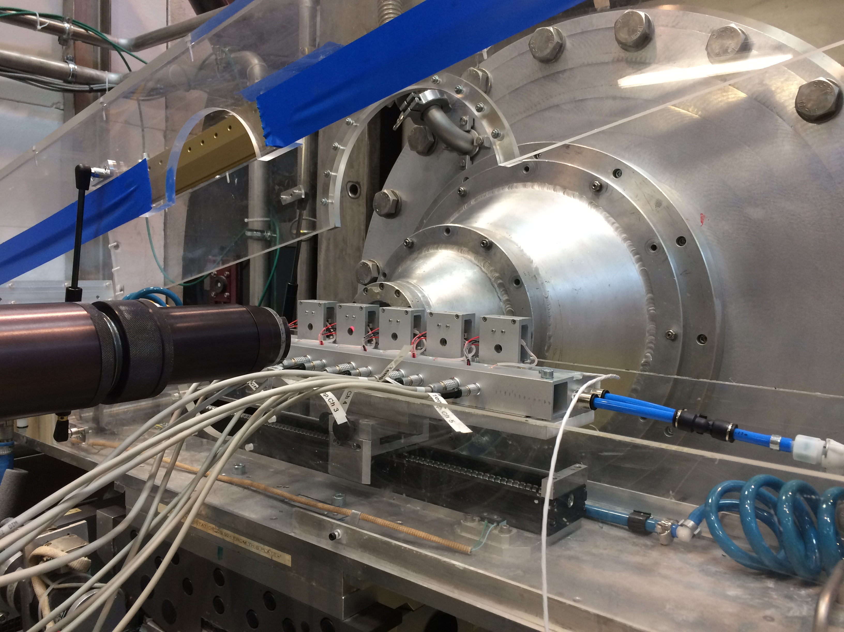
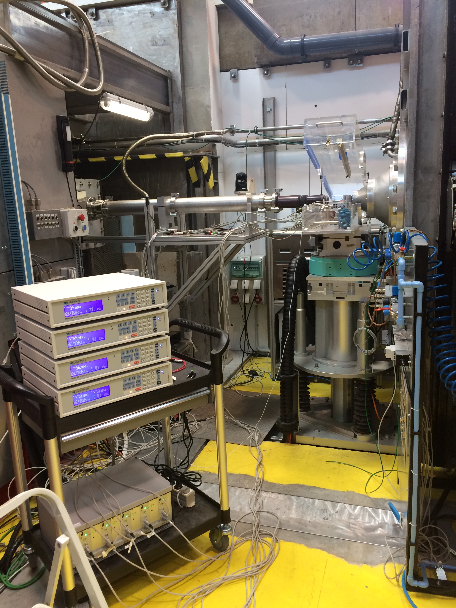
FLUCO
Sample changer
- H. Schneider -
First successful test , a.k.a. ”hot commissioning” with neutrons at D22 / ILL, 4th July 2018
Beam size of 5mm dia. , temperatures from 10˚C to 90˚C , were used for a biological sample
Result
  Although the multi channel temperature control was done by a stack of LS336
  controller , the instrument control was able to run the device in remote mode
  The success is established by the D22 team, when they “occupied’ the device
  for some more measurements in September 2018.
SANS sample changer at the sample position of D22
In plan and possible developments
- In collaboration with partners ILL, RUC -
Temperature control unit for as many channels as needed
Usage of commercial “smart” PLC units & PID units & booster is envisaged
-> Reducing costs , man power , installation and maintenance effort
Upgrading magazine to 10 positions
Stacking magazins to 4 (5) rows
Temporary temp. control
using a stack of LakeShore
LS336 controller for hot
commissioning at D22/ILL
IK Partner: B Jakobson, C Niss, RUC
Notes:
Disolve this slide or use as summary; link to SAC comments
Needs to specifc what it want from the pool and what they build for their instrument.
Instrumet team takes team during construction (and potentially in operation)

Slide 5
FLUCO
Sample changer
- H. Schneider -
Planned suite of sample environment equipment, started
Provided as internal R&D , FLUCO & Basque intern Sonia G. Scheifler
7 position rotating sample holder magazine
Notes:
Disolve this slide or use as summary; link to SAC comments
Needs to specifc what it want from the pool and what they build for their instrument.
Instrumet team takes team during construction (and potentially in operation)

Slide 6
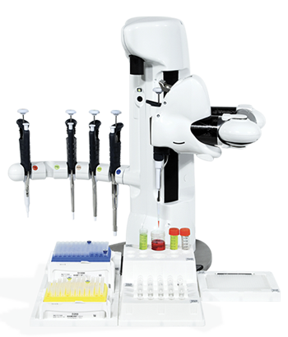
FLUCO
Sample changer
- H. Schneider -
Commercial sample changer / pipetting system
Fa Andrew Alliance , CH
Notes:
Disolve this slide or use as summary; link to SAC comments
Needs to specifc what it want from the pool and what they build for their instrument.
Instrumet team takes team during construction (and potentially in operation)

