Slide 1
Engineering Integration Utilities routing within the common shielding bunker
IKON 15
Talal Osman & Iain Sutton
www.europeanspallationsource.se
13 September, 2018

Slide 2
Presentation overview
Scope
Progress
Solutions
Guidelines
Summary
Next steps

Slide 3
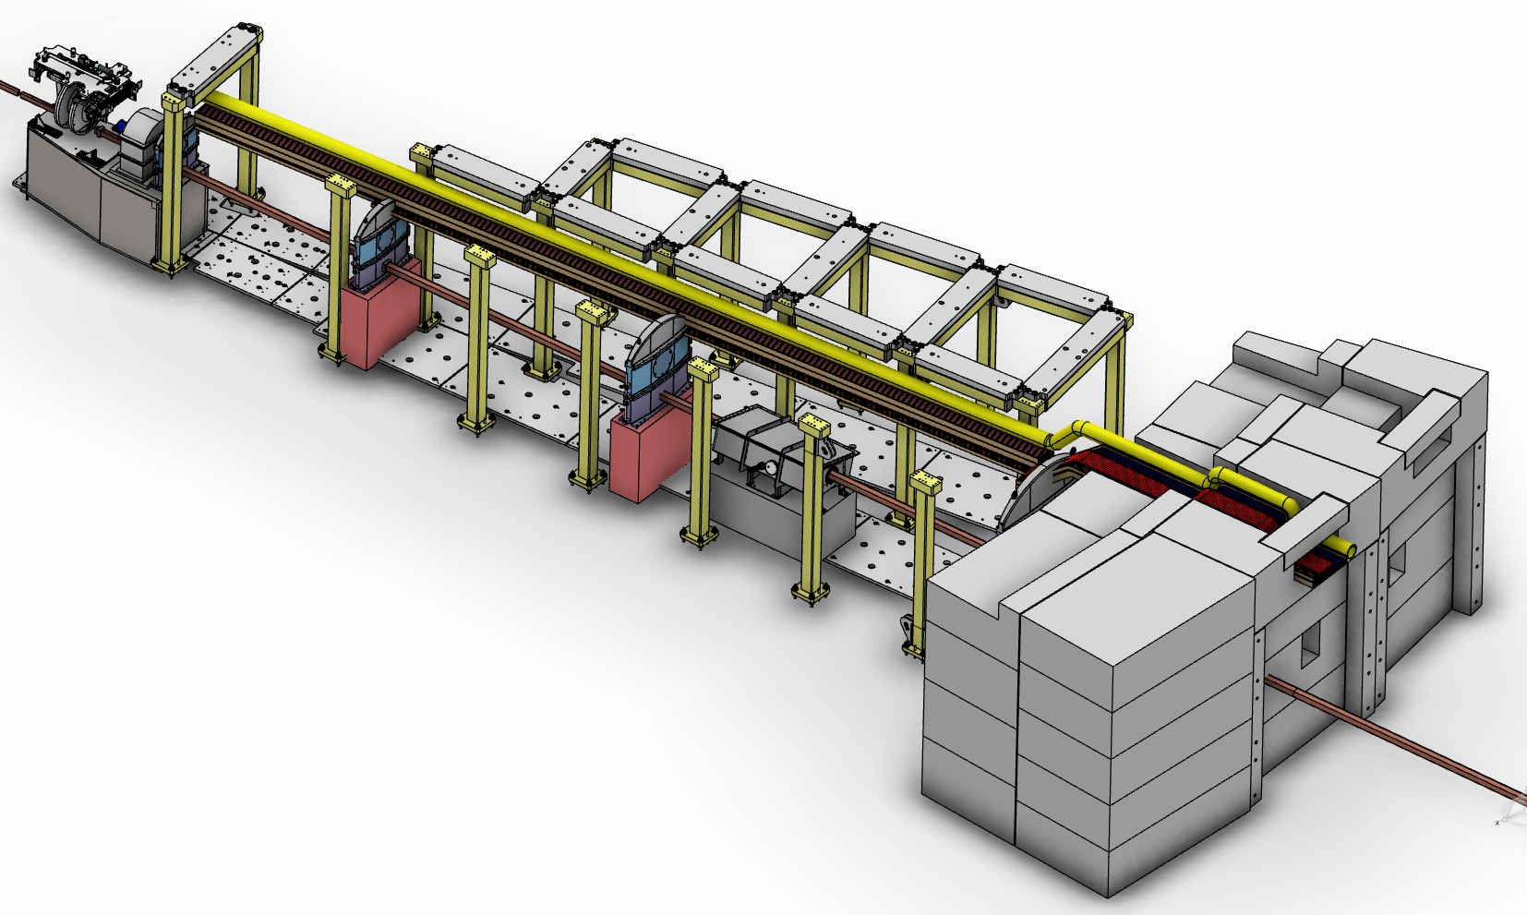
Scope
USE
4
Iain slide
USE
3
USE
2
ENTRY
1
Scope
Within shielding ‘bunker’ from Point of entry to Point of use
Bunker entry
Technical feed through
Run
Point of use connection

Slide 4
Objective
“Pave the way for the successful integration and installation of instrument systems into the bunker whilst ensuring personal safety and systems maintainability”
Deliverables
Routing strategy
Meeting the needs of instrument and facility
Approved material list
Fixtures & fittings
Engineering guidelines for implementation
Decisions
methods

Slide 5
Utilities routing Progress
IKON 14
IKON 15
Requirements
Concept
Solution development
Decision & Documentation
Needs
Electrical power
Signal
Vacuum
Cooling
PSS / MPS
Constrains
Access
Grounding
Fire
Radiation
An illustration to explore parameter space and for discussion with stakeholders
Exploring options Evaluating solutions
Meeting needs & constraints
Making decisions Defining solutions
Getting agreement

Slide 6
Solutions
Notes:
What could possibly go wrong ?

Slide 7
1 Bunker entry (BR)Exit strategy
?
Solution is Very situation specific
Long instruments
looks tractable
Short / Mid length
looks tricky
More work required !
Grounding solution implemented here

Slide 8
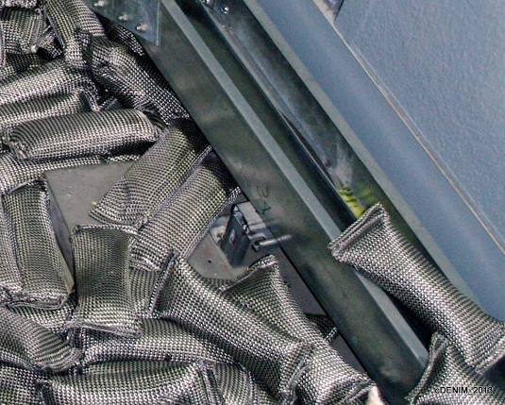
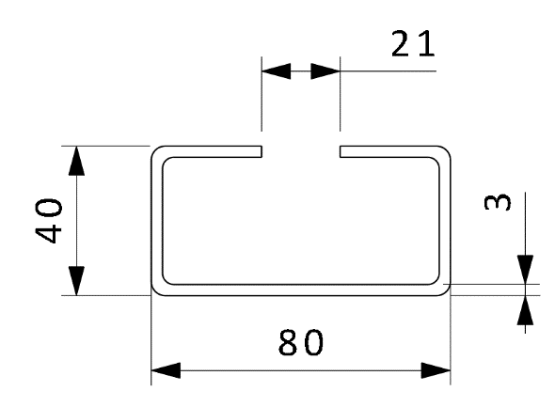
2 Feed through
Section is adequate for all instruments
Built in ‘halfen’ rails for attachment
Good access for installation
Vacant space to be filled with bagged shielding as required.
Steel shot
Borated poly
New neutronics underway but no significant changes expected

Slide 9
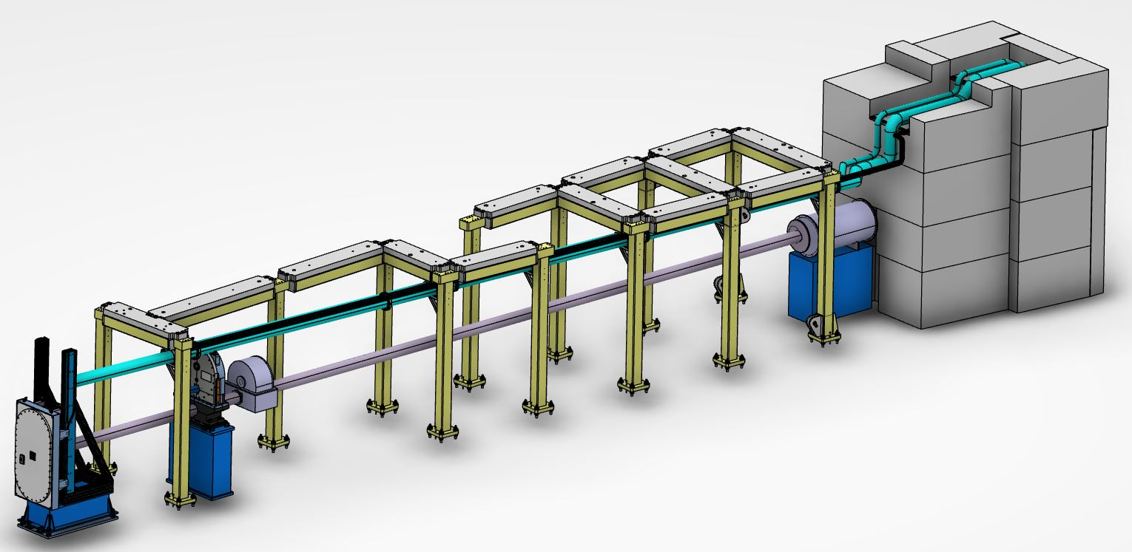
3 Run
Standard feed through
Custom connection
Standard section (4/2/1)
Custom feeder
Vertical
Cable
Chain Coupling
From feed through to POU it’s a Fixed installation
Route around access requirements
Exception for vacuum pipes (removable sections)
Compact
Support
Rail

Slide 10
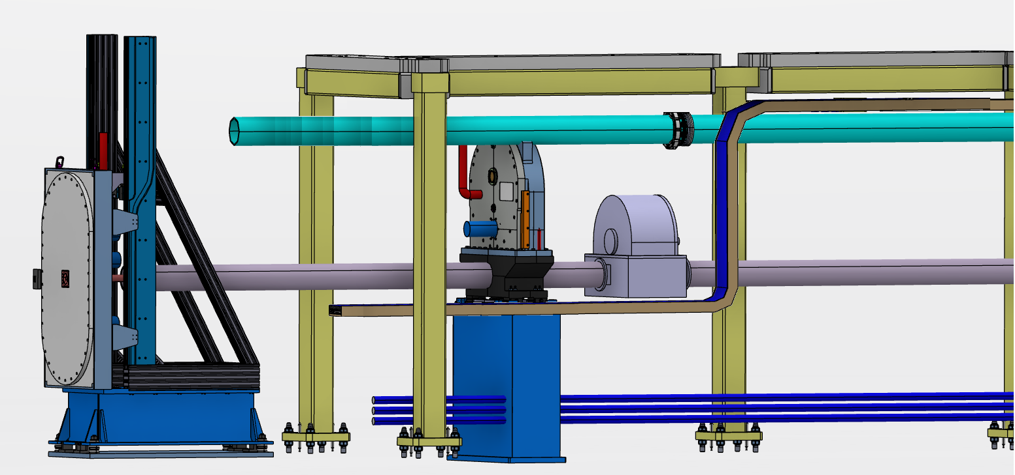
4 Point of Use going the last mile
R7 > Chopper
Flexible / Snorkel
R12-R7 Feeder
Removable
Accessable
Q. Couplings
R12 Quick Coupling
R12 > Rigid

Slide 11
Engineering rules
All unities shall be exclusively supported by vertical support pillars or walls.
No floor supports
All utilities shall enter the bunker through the roof level feed through.
Except cooling services in the long sector shall enter at floor level through corner blocks
All utilities shall use the feed through located above their respective beam port.
All exceptions must be formally approved by NSS management
Utilities shall follow the shortest route from point of entry to point of use
Roof level routes shall be directly adjacent to vertical support pillars.
Floor level routes shall run adjacent to walls …. then along the line of vertical support pillars
Utilities shall be routed to permit the removal of ‘Service components or RH components’ without their removal or displacement.
Cable trays shall be routed around the extraction volume avoiding removal
Fluids shall be routed around the extraction envelope, or if this results in unacceptable performance, removable sections shall be routed across the volume with the approval of RH.
All routing shall be positioned as far away from the neutron beam as practical.
Roof level routes shall be positioned 25mm below the level of horizontal crossbeams.
Floor level routes shall be positioned 50mm above floor plates
Utilities shall be packaged to minimizing their horizontal foot print
Cable trays shall be orientated vertically and located directly adjacent to supports pillars
Fluids shall be stacked vertically and positioned below cable trays

Slide 12
Approved equipment list
Cable trays / supports
Wibe (schneider-electric)
Vacuum
See vac group presentation
Cooling
Pipe materials
Choppers
Requirement Specs ESS-0059912
n
MORE INFORMATION IN RH
DOCUMENT ESS-0042943

Slide 13
Take away
Notes:
What could possibly go wrong ?

Slide 14
This mornings Take away
We believe we now have a workable strategy !
> Workable routing for all instrument (we hope)
We have approved component suppliers
Implementation Guidelines
For Own design or ESS design
Draft documents shortly on Confluence
https://confluence.esss.lu.se/x/wAs8Dw
Approved document will go on chess

Slide 15
Next step
Completion of draft guideline – review - approval
Working on pricing structure and cost sharing for installation work.
Possibility of organizing activities together
Same contactor
Lower costs
Simplified planning
Who interested ?

Slide 16
Thank you for your attention !
NSS Projects Division
Instrument teams

Slide 17
Extras

Slide 18
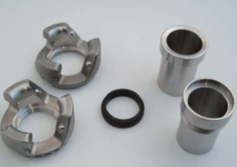
Deployment a graded approach
0m
6.05m
7m
8m
10m
12m
Standard EPDM O-ring (max. 250kGy)
kGy
100
86
71
44
10
60cm
Rad Hard EPDM O-ring (max. 20MGy)
MGy
10
8.6
7.1
4
1
4cm
Aluminum Gasket (> 20MGy)
MGy
200
170
140
81
20
2.8cm
Neutron beam size 6x6cm
n
Moderator
Requirement Specs ESS-0059912

Slide 19
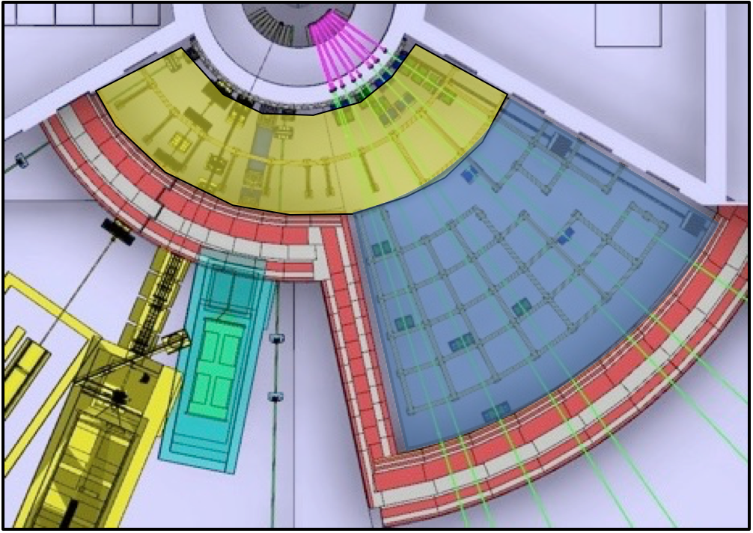
Implementation
Separation
After 48-72hrs
Front access
RH only
Rear access
Hands on (hotspot removed)
After 10-15days
Front access
RH only
or Hands (hotspot removed)
Rear access
Hands on
Restricted activities
‘Front’
Full-RH or Limited-RH
‘Back’
Full-RH or No-RH
Installation is not considered a RH-activity.
Notes:
No in-situ RH maintenance is foreseen.
Installation is not considered a RH-activity.

Slide 20
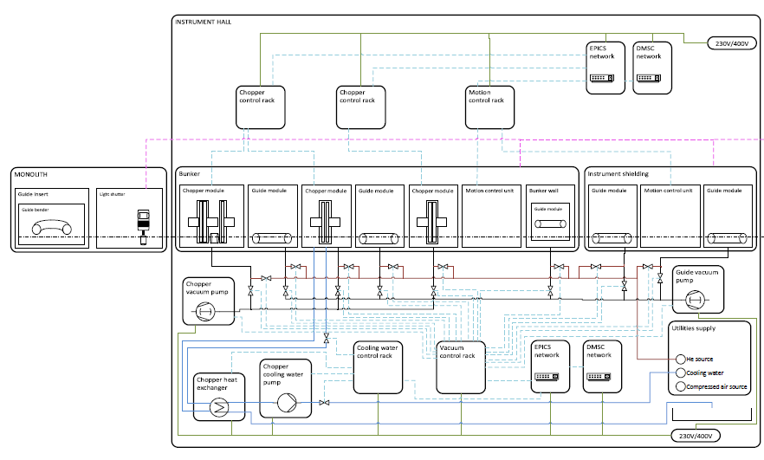
Scope
Instrument
power & control
Cooling
Vacuum
PSS / MPS
Bunker systems
Power
Lighting
PSS
Fluids

