Slide 1
Welcome
IKON15 meeting on
Software for Single Crystal Diffraction
Thomas Holm Rod, Group Leader DRAM, ESS
(Sept 12, 2018)

Slide 2
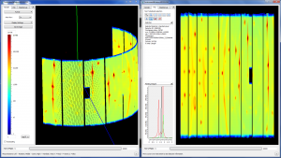
Scope of Data Management and Software Centre
?
Experiment control
Stream events & meta data
Data reduction & visualization
Data analysis
Data management
For each step provision sustainable software
Preferred languages / frameworks
Open source software
Quality assurance
Healthy user and developer community

Slide 3
What’s the best way forward for ESS?
Session 1 ESS instruments | 9:00 – 9:15 | Welcome | Thomas Holm Rod
 | 9:15 – 9:30 | ESS instruments / diffractometers | Werner Schweika
 | 9:30 – 9:50 | MAGIC | Xavier Fabrèges
 | 9:50 – 10:10 | DREAM | Florence Porcher
 | 10:10 – 10:30 | Discussions
Coffee break | 10:30- 11:00
Session 2 Instrument scientist and user perspective | 11:00 – 11:40 | Topaz | Christina Hoffmann Xiaoping Wang
 | 11:40 – 12:10 | Wish | Pascal Manuel Fabio Orlandi
 | 12:10 – 12:30 | User experience | Emil Andreasen Klahn
Lunch | 12:30 – 13:30
Session 3 Software perspective I | 13:30 – 14:10 | cctbx | Paul Adams
 | 14:10 – 14:50 | Reduction in Mantid | Vickie Lynch
 | 14:50 – 15:30 | Jana 2006 | Vaclav Petricek Margarida Henriques
Coffee break | 15:30 – 16:00
Session 4 Software perspective II | 16:00 – 16:20 | FullProf and Esmeralda | Céline Durniak
 | 16:20 – 16:40 | DaVinci | Andrew Sazonov
 | 16:40 – 17:30 | Discussions
Let’s have a workshop!
… and get advice
Organizers:
Céline Durniak
Danielle Adonis

Slide 4
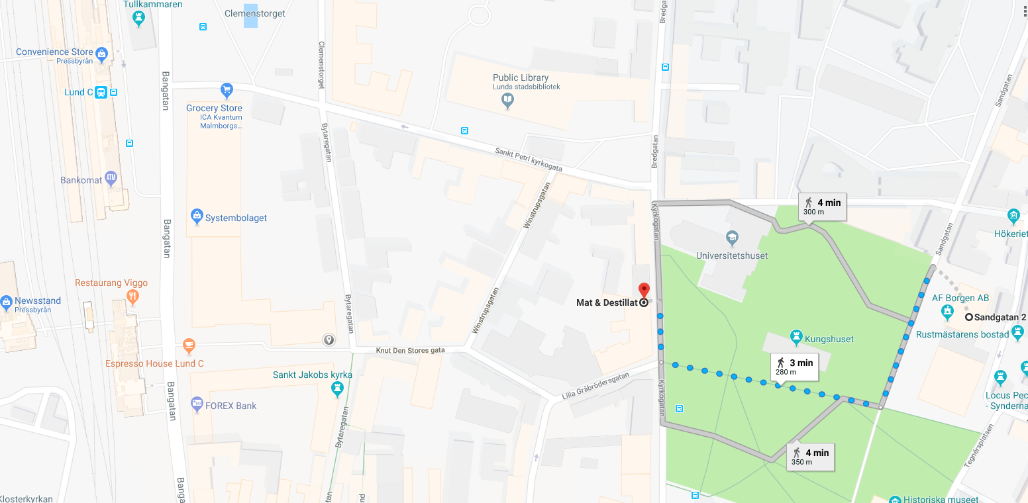
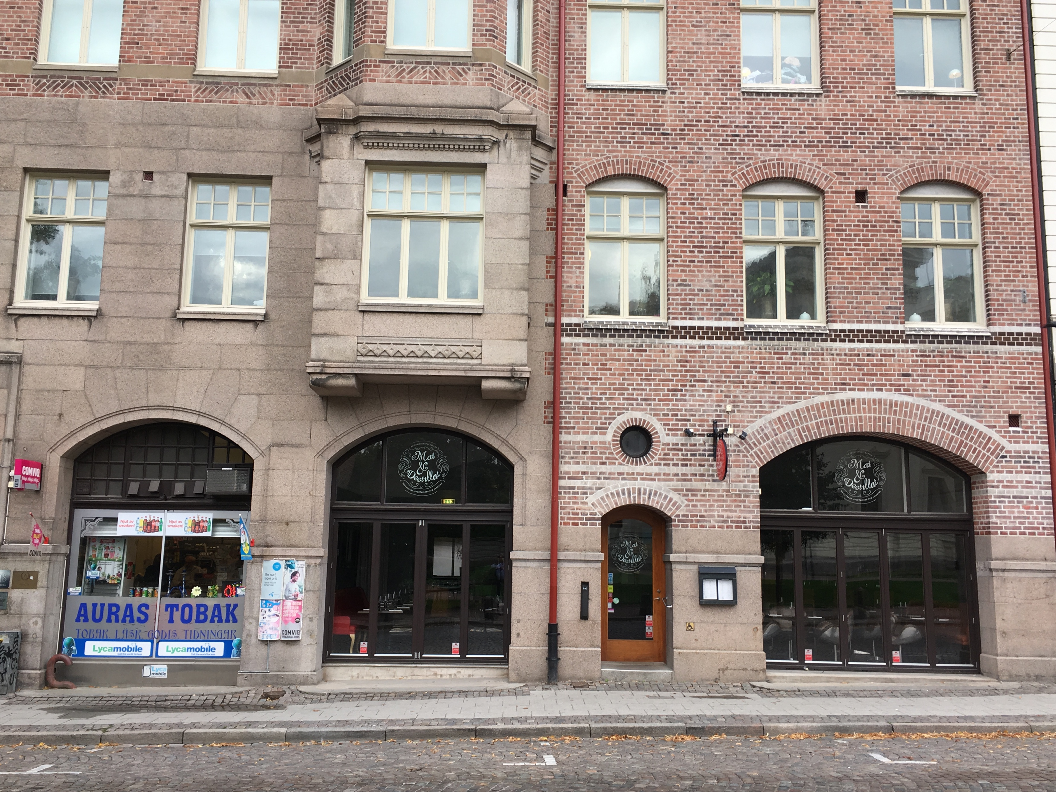
For those invited to dinner
Dinner at 18:00. Mat & Destillat: address: Kyrkogatan 17 - 22222 - Lund

Slide 5
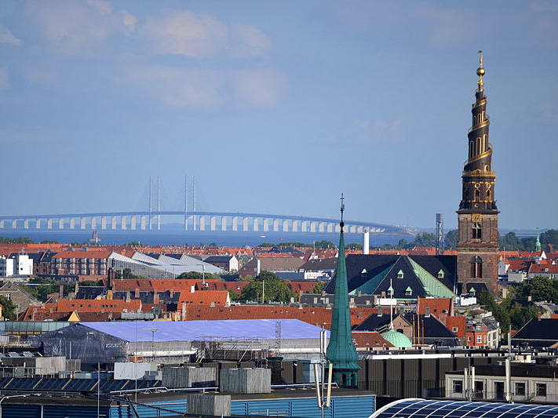
DMSC located in Copenhagen
Welcome

