Slide 1
Remote Handling An update
Erik Nilsson
Mechanical Engineer
ESS Chopper Group
www.europeanspallationsource.se
13 September, 2018

Slide 2
Overview
Workshop report
Technical updates and statuses
TG3 Information
Tooling introduction
ESS-0042943
ESS Requirements on neutron scattering instruments with respect to remote handling compatibility
Released
https://confluence.esss.lu.se/display/SD/NSS+Remote+handling+Homepage

Slide 3
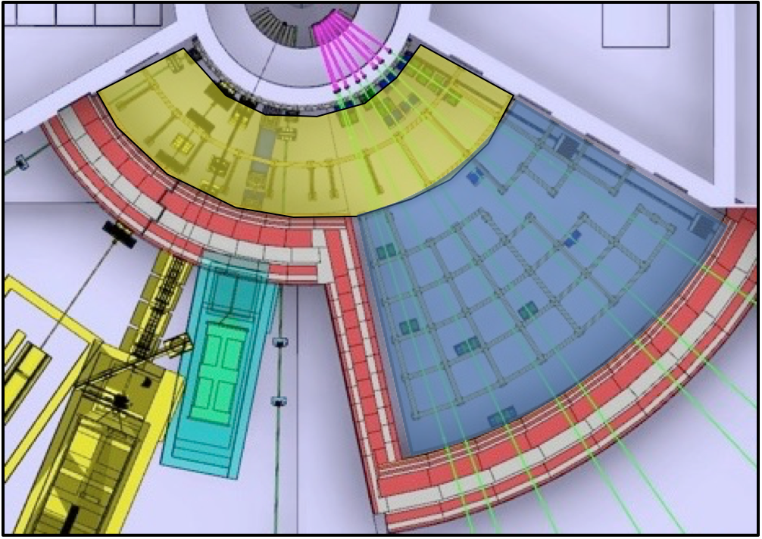
Quick reminder
Separation
After 48-72hrs
Front access
RH only
Rear access
Hands on (hotspot removed)
After 10-15days
Front access
RH only
or Hands (hotspot removed)
Rear access
Hands on
Restricted activities
‘Front’
Full-RH or Limited-RH
‘Back’
Full-RH or No-RH
Notes:
No in-situ RH maintenance is foreseen.
Installation is not considered a RH-activity.

Slide 4
Remote Handling Workshop 2 – May 2018
12/15 instruments present
ESS technical updates
Share, discuss and progress
Next workshop in ~November

Slide 5
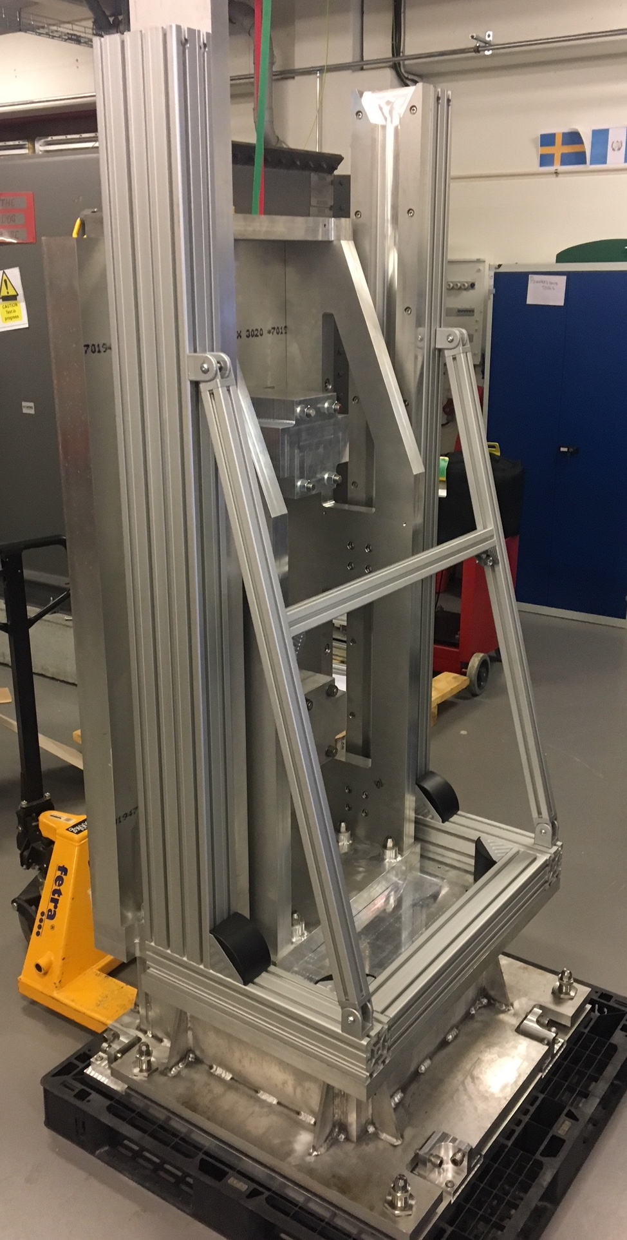
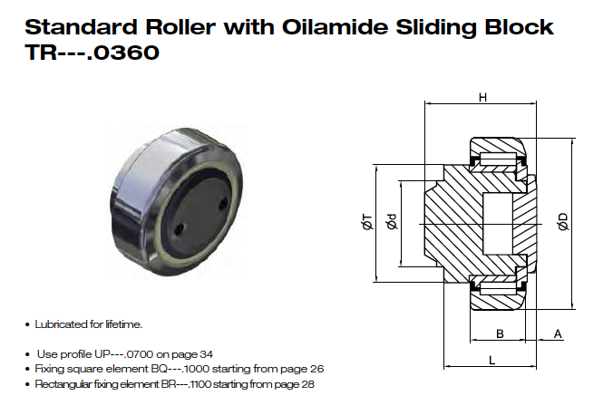
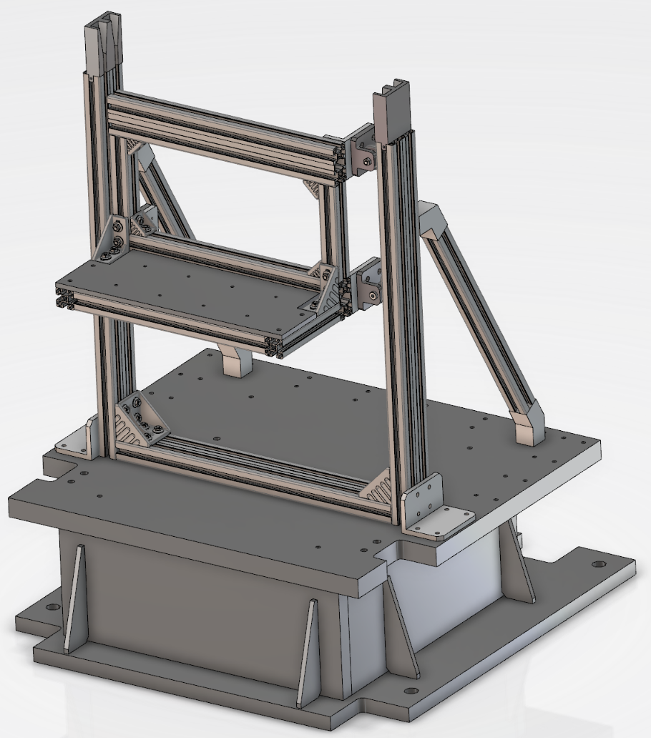
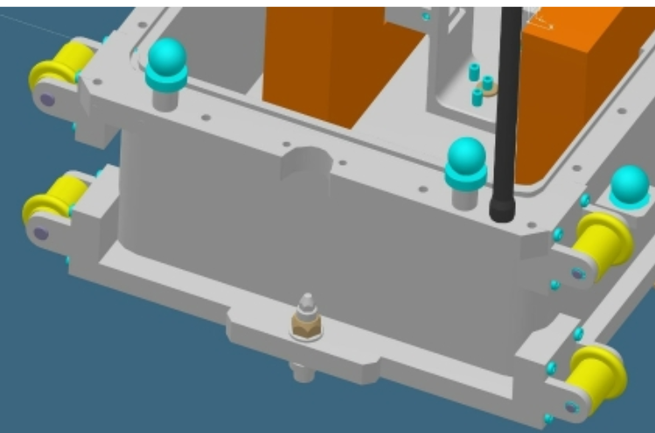
Technical developments Rollers and Guides
Solutions discussed during workshop
Current status
Rollers
Simplified rollers
Built and being tested

Slide 6
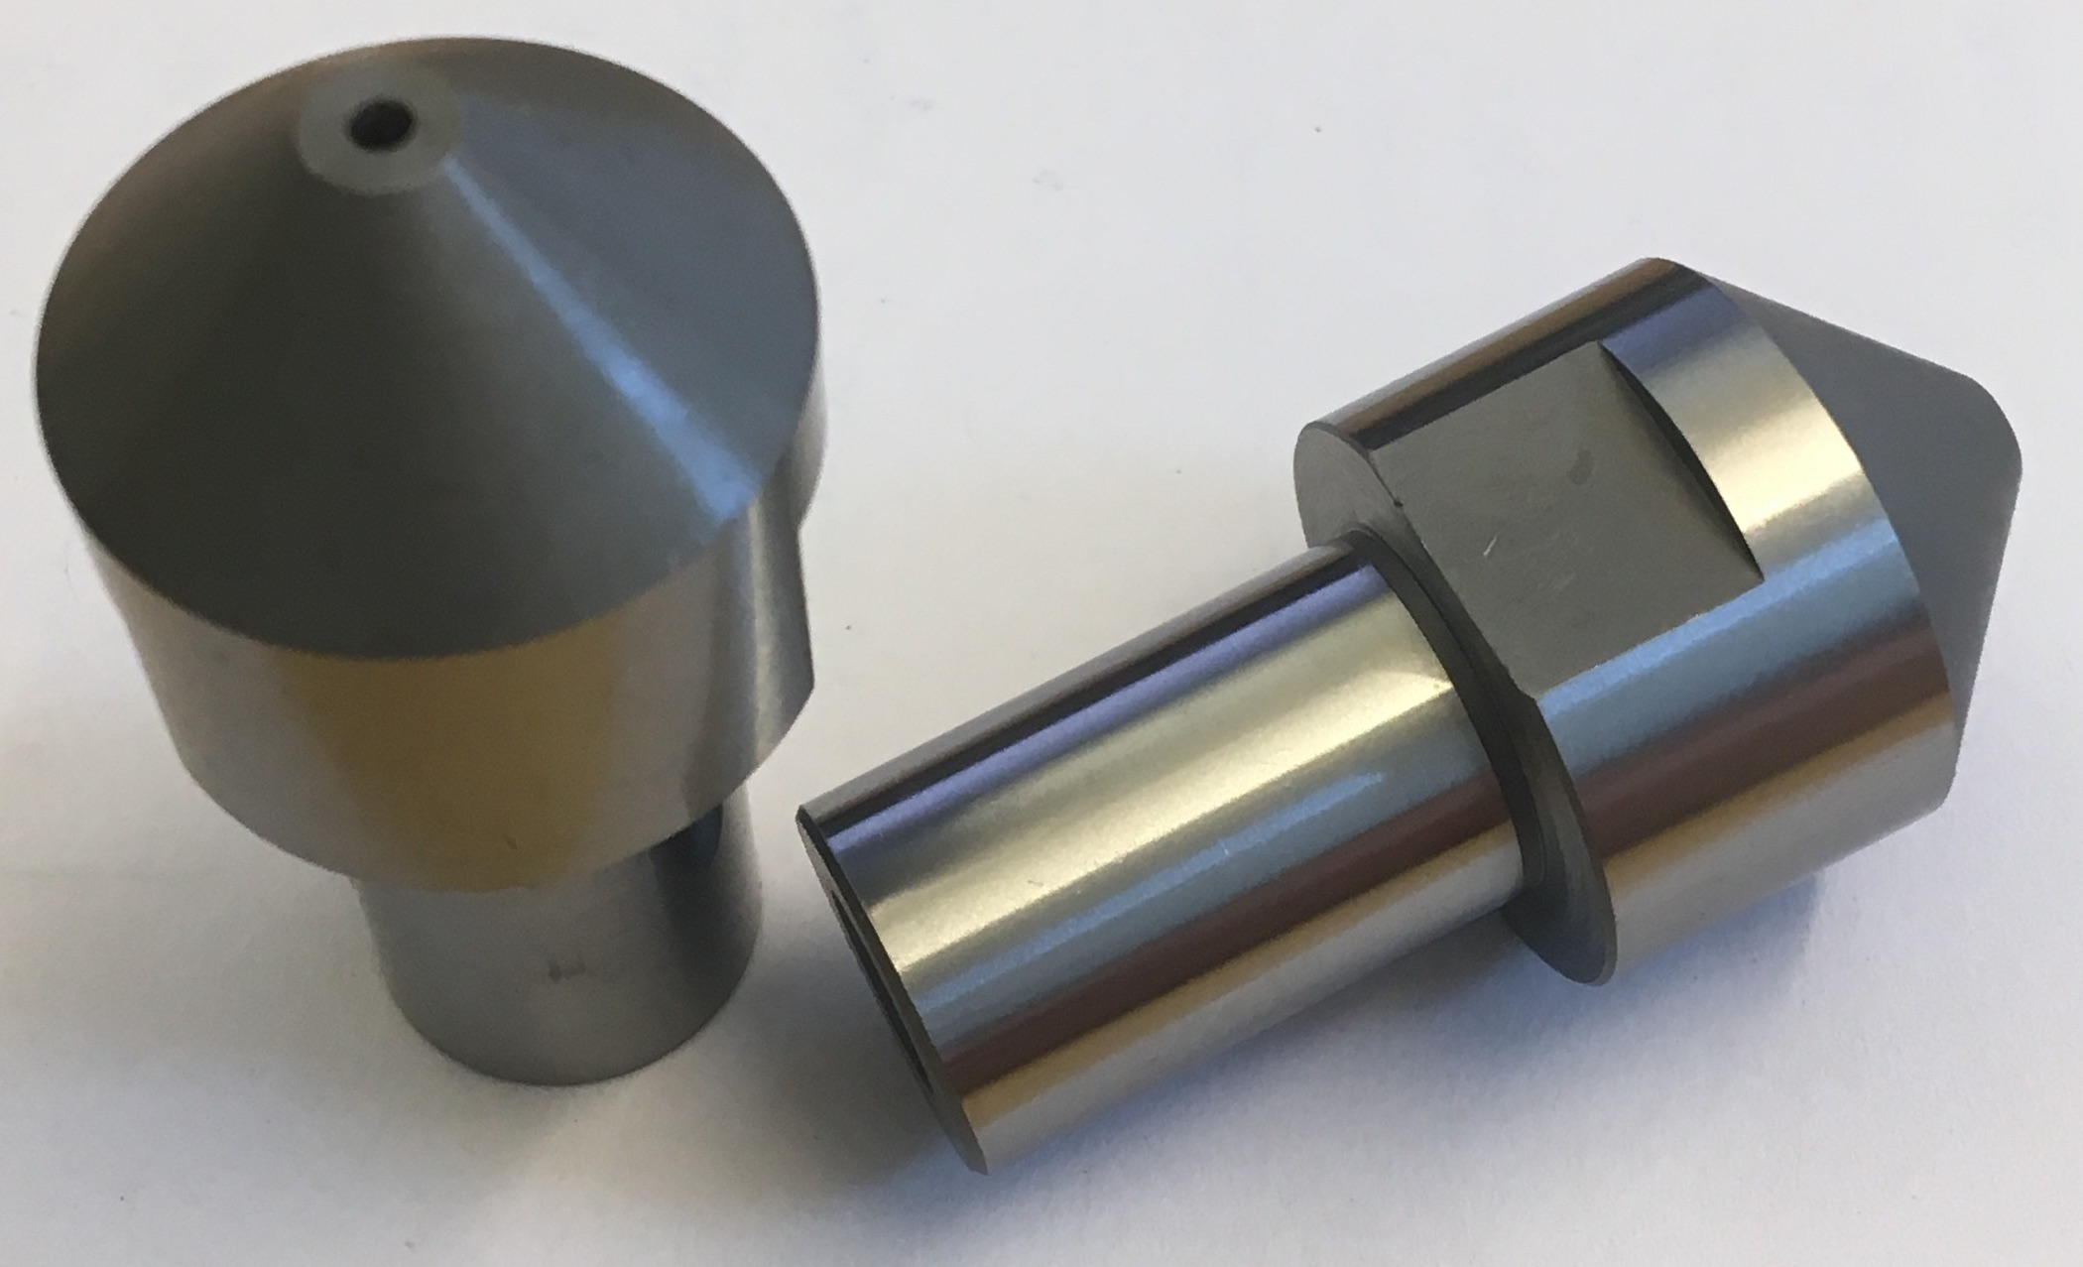
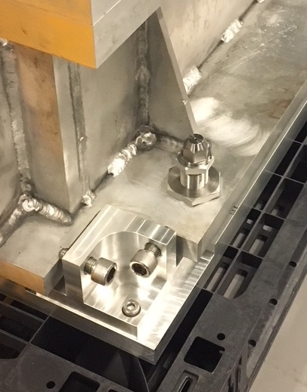
Technical developments Location and Alignment features
Solutions discussed during workshop
Current status
Misumi dowels
Built and being tested
RH-Z realignment
6

Slide 7
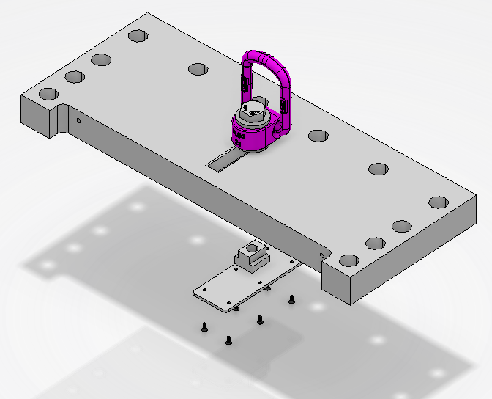
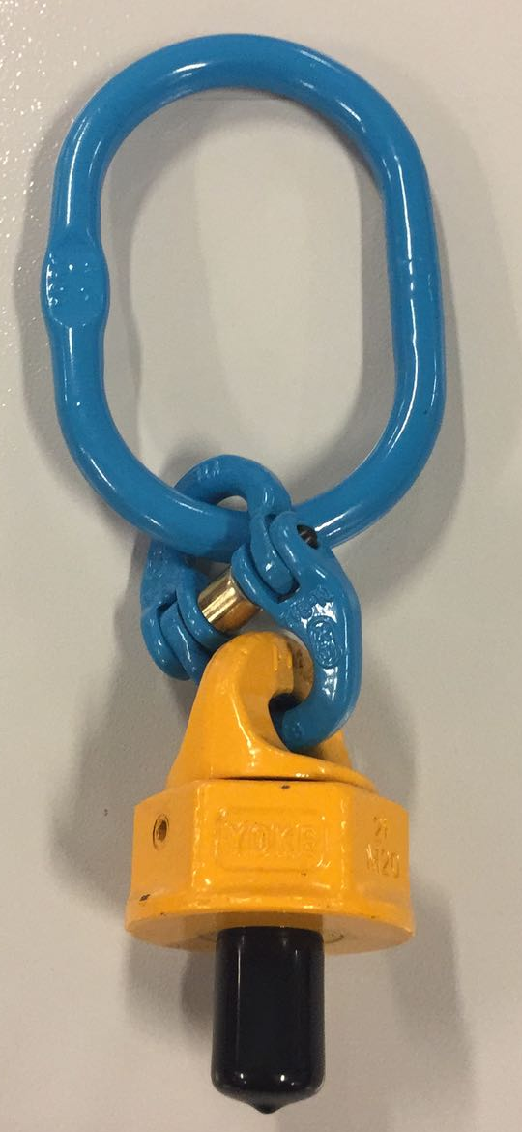
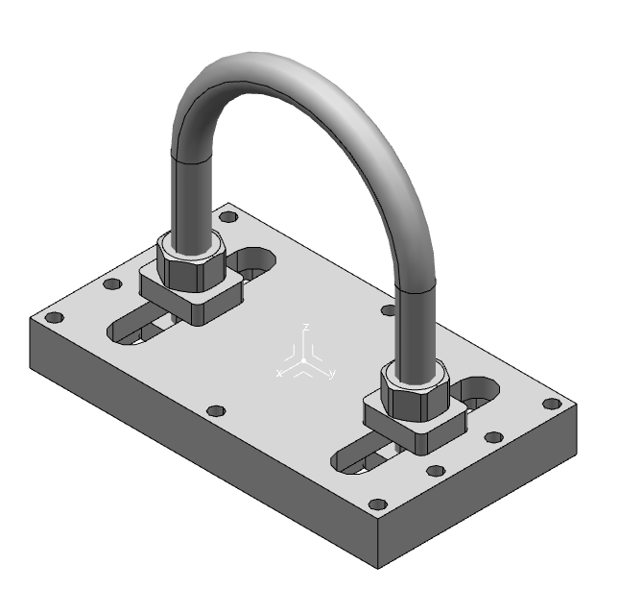
Technical developments Lifting
Solutions discussed during workshop
Current status
Industrial lifting eye
Lifting eye suitable for automatic hook
(Industrial supply)
In-house lifting system
7

Slide 8
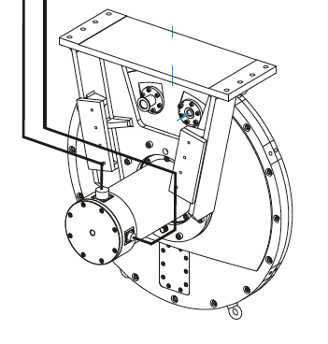
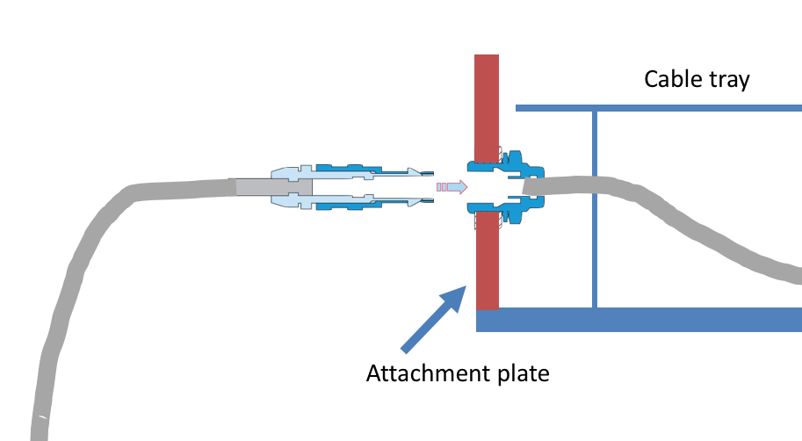
Technical developments Connectors (Chopper example)
Cables | Installation type | Special constraints | Approximate length
1 | Flexible | Radiation hardened or Replacement part | ~2m
2 | Fixed | Standard | 10-50m
B
2
Inside
shielding
Outside
shielding
1
Installed
Chopper
C
A
Supplier Controller
B
1
2
Connectors | Connector type | Attachment | Note
A | Supplier Standard | On Equipment
B | LEMO B/K FNG, S, EPDM, PEEK or equivalent | On plate* | https://confluence.esss.lu.se/display/SD/Electrical+and+fluid+interfaces
C | Supplier standard | On Equipment
Currently finalising choice
of fluid connectors
8

Slide 9
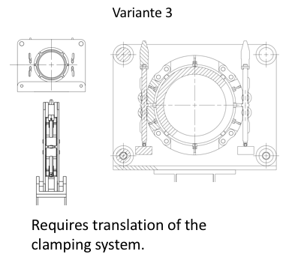
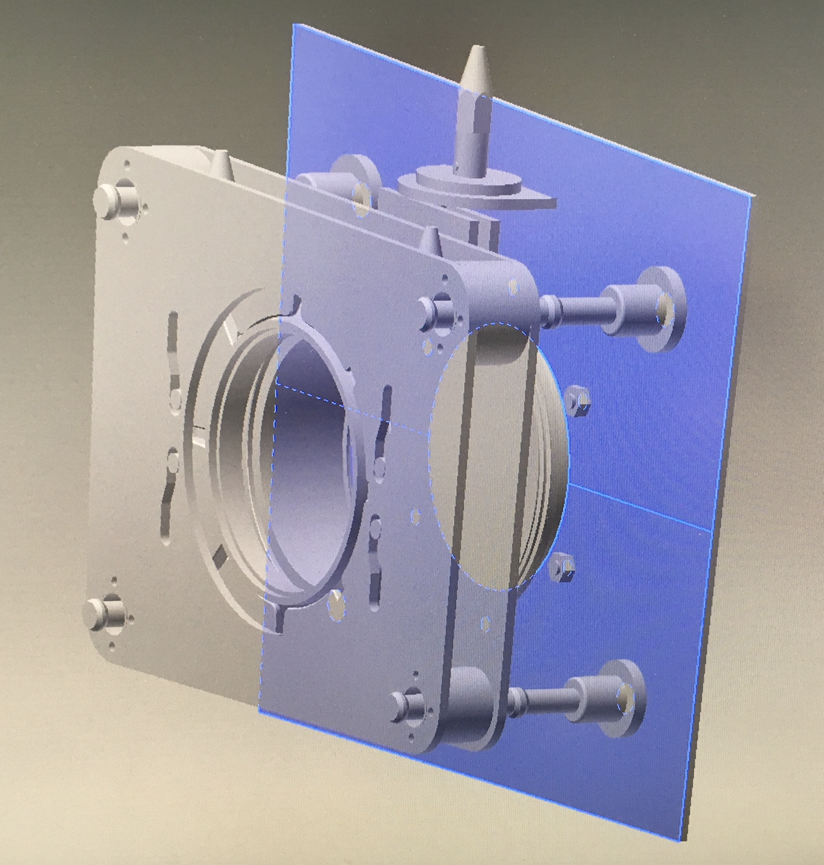
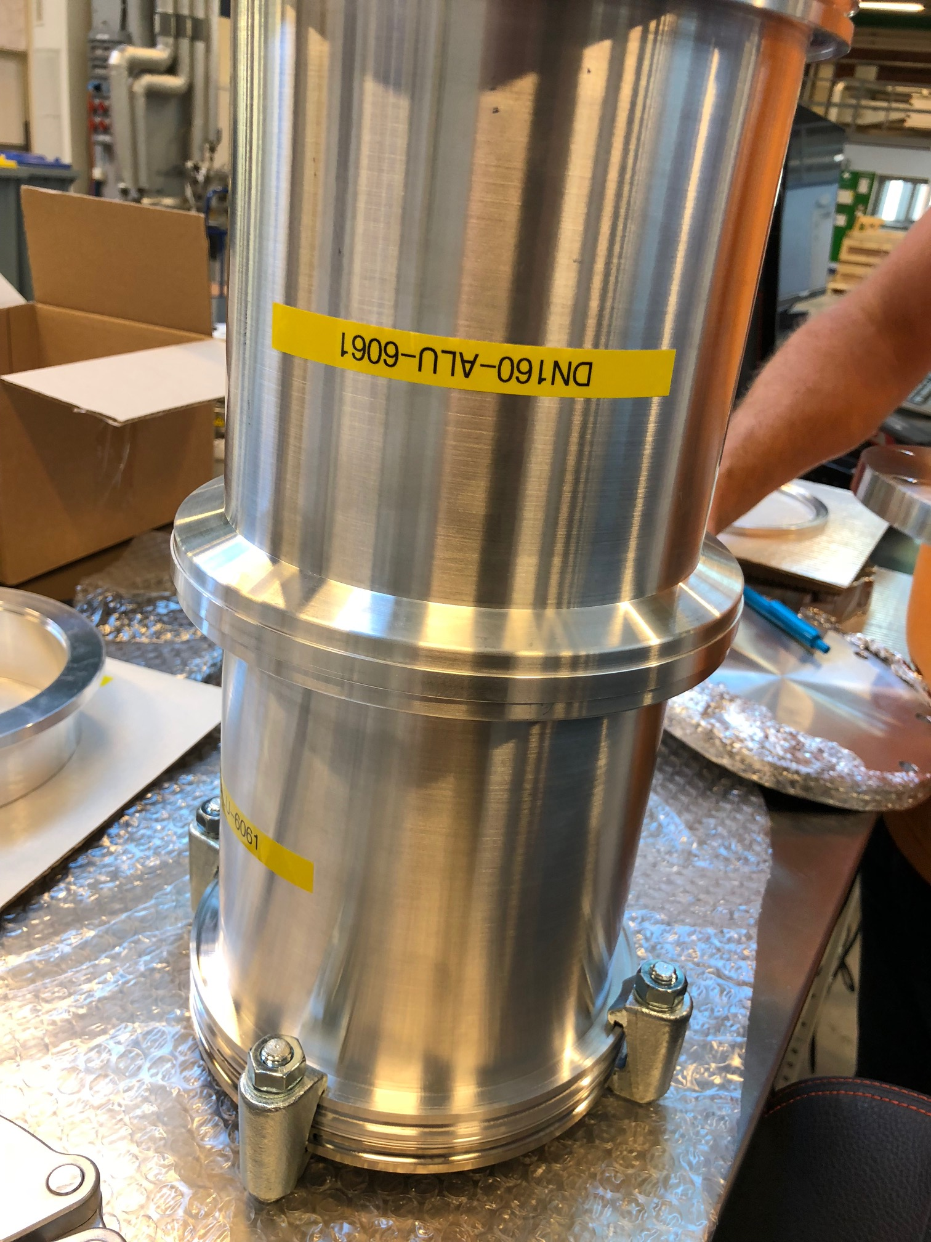
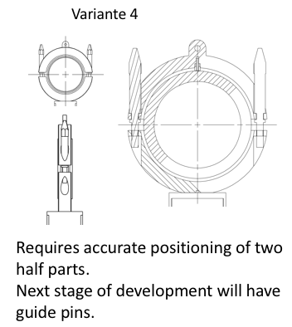
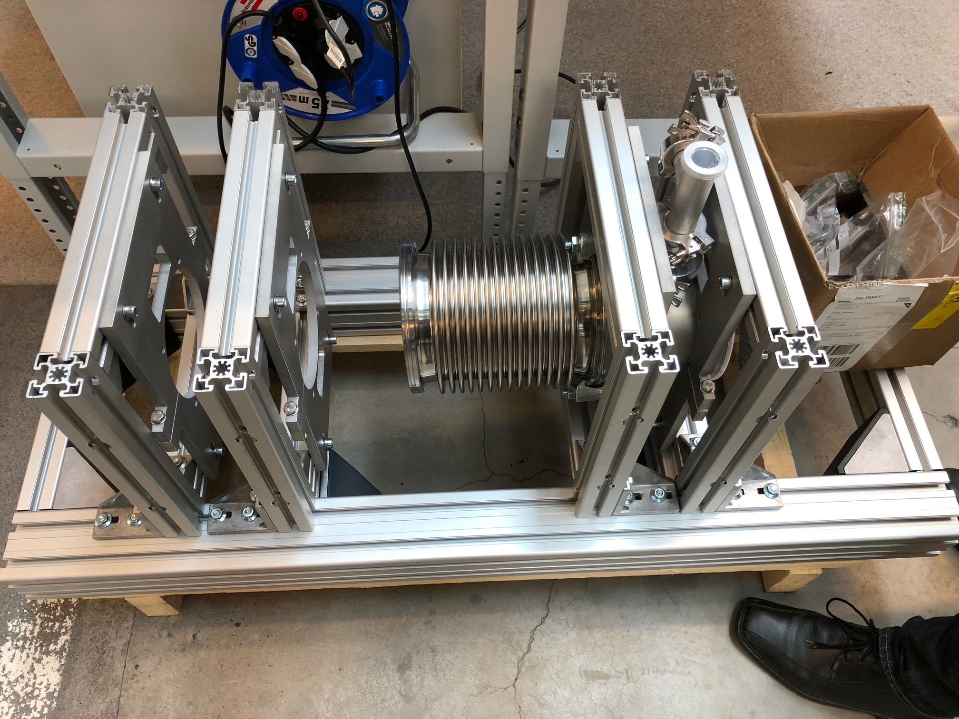
Technical developments RH Vacuum Flange
Solutions discussed during workshop
Current status
Multiple variants
Undergoing tests

Slide 10
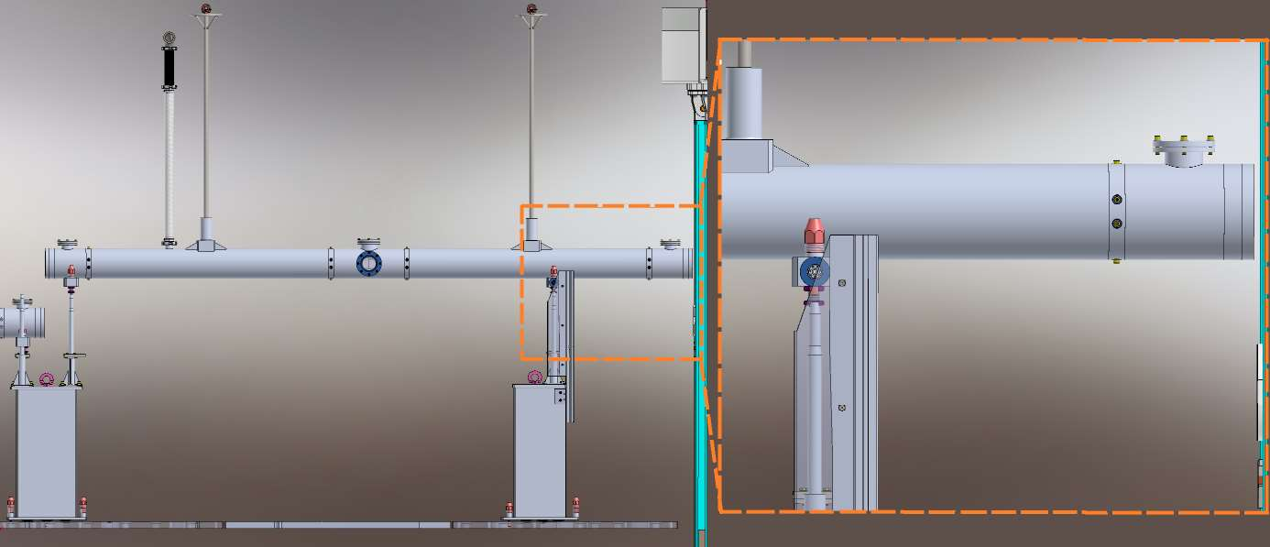
TG-3
Module definition and classification.
Shown considerations for handling, alignment and fastening.
Failure analysis of modules.
Case and reason when ESS best practices are not followed.
Case and reason when ESS standard RH equipment is not used.
ESTIA Module definition and classification
BIFROST Handling considerations
C-SPEC extraction simulation

Slide 11
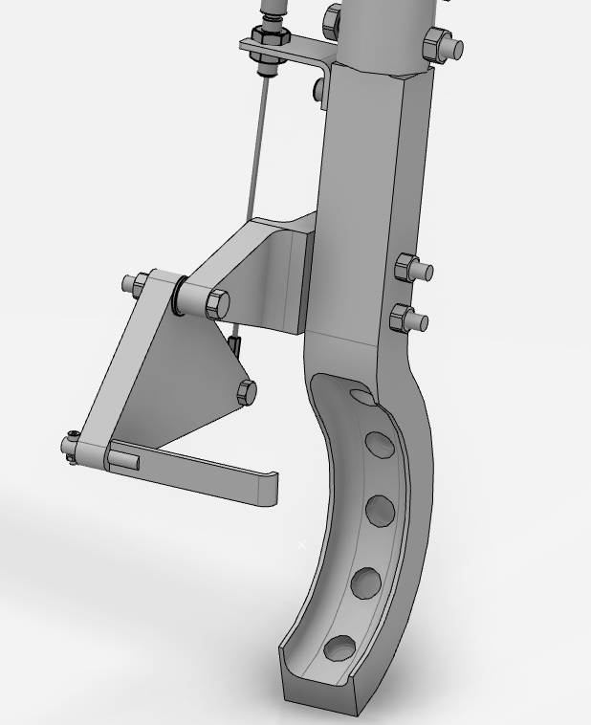
Tooling developments
Preliminary design during Autumn.
Definition of tool interfaces where applicable.
Head start with engagement tool and automated hook.
Engagement tool preliminary design

Slide 12
Tooling developments
CRANE MOVIE

Slide 13
Upcoming
Workshop 3 - November
Participation and feedback in Phase 2 / TG3 for all instruments.
Finalisation of Roller, alignment, positioning tests – September/Early October
Tools development start.

Slide 14
Thank you for your attention https://confluence.esss.lu.se/display/SD/NSS+Remote+handling+Homepage Questions?
Notes:
Add extra slides on what we are looking at.

