Slide 1









Science Support Systems at ESS
At IKON 15 - Sept 2018
Sample Environment, Laboratories,
Scientific Coordination & User Office
Arno Hiess
Scientific Activities Division
www.europeanspallationsource.se
Notes:
ADD AN OUTLINE REFERING TO SAC / STAP TOPICS.

Slide 2
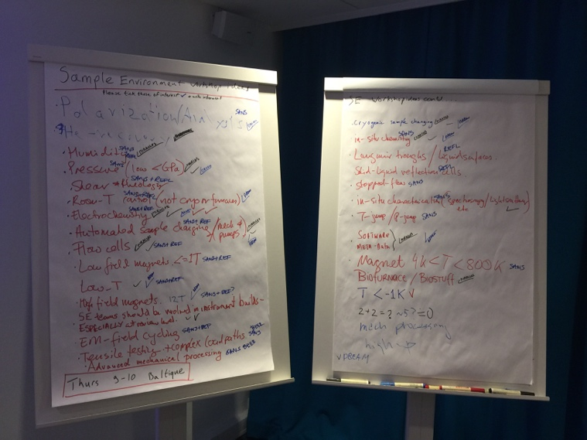
Meetings on
Sample Environment Systems (SES)
Common Topics of Interest collected during last IKON meeting
  Soft Matter Sample Environment
  Gases and Chemical Reactions
  Changers, Alignment, Scanning
  Magnets: Suite 2nd Iteration, High Field incl. Pulsed
  Low Temperature Systems
  Mechanical Processing
  High Pressure: 2nd Iteration
Meetings aimed to establish SES strategy and realising synergies
Format and agenda follows the successful magnet / high pressure meetings
Notes:
1 meetings on to establish SAD strategy and synergies for SES; similar format and agenda as for success magnet meeting

Slide 3
Meetings on
Sample Environment Systems (SES)
Meetings in 2018 providing update during IKON
  Mechanical Processing (M. Christensen, M. Guthrie)
  Gases and Chemical Reactions (M. Christensen, H. Schneider)
Mini Workshops during IKON
  Changers, Alignment, Scanning (Harald, Alex, Malcolm, Anders)
  Levitation and Furnaces (Harald, Alex)
Notes:
2 topics collected during last IKON :
(a) already performed incl feedback at IKON and
(b) mini workshops this afternoon

Slide 4
SAD Involvement during Instrument Detailed Design and (sub)TG3
TG3 checklist (ESS-0189147) up-to-date for each instrument
TG3 checklist is based on SAD reference documents
Agreed between instrument team and SAD contact at all (sub)TG3
SAD team relevant for specific topics only to check interfaces.
SAD to be invited to comment at the corresponding (Sub)TG3 :
  detector / vacuum tanks,
  sample table / stack,
  cave geometry / door.
This is reflected in Gabor’s / Judith’s planning.
Notes:
3 reminder on SAD involvement during instrument detailed design and (sub)TG3’s:
(s) SAD TG3 checklist (ESS-0189147) is up-to-date for each instrument and agreed between instrument team and SAD contact at all (sub)TG3.
(b) SAD team involved in specific topics and invited to comment at the corresponding (Sub)TG3 o check the SAD related interfaces from its reference documents: detector / vacuum tanks, sample table / stack, cave geometry / door. This is reflected in Gabor’s / Judith’s planning.

Slide 5
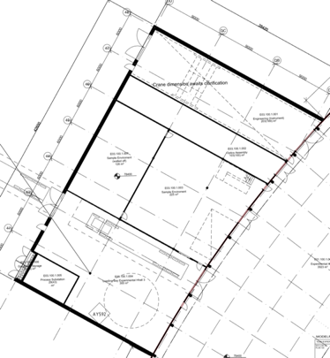
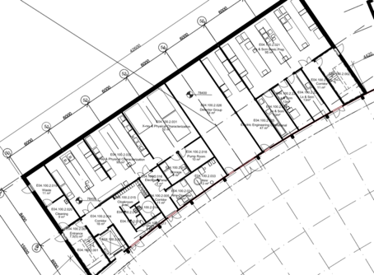
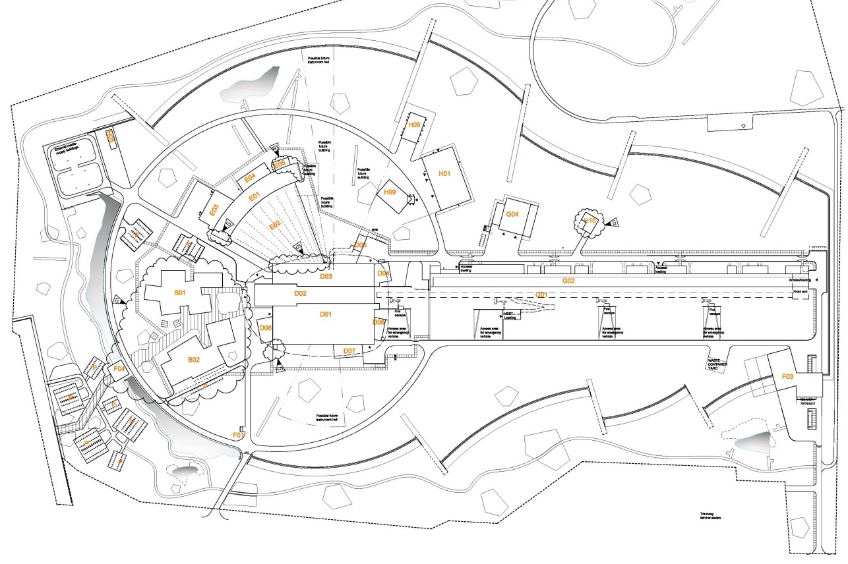
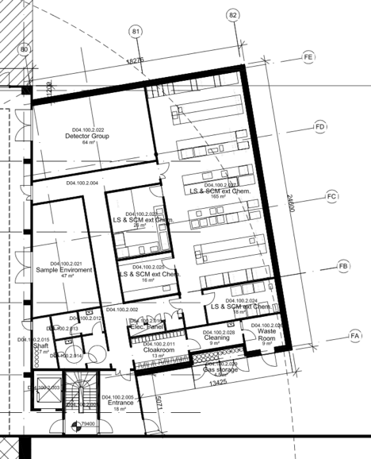
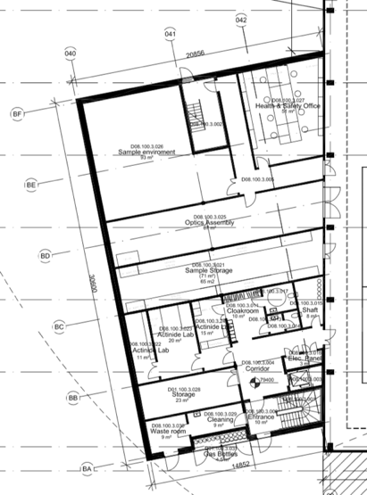
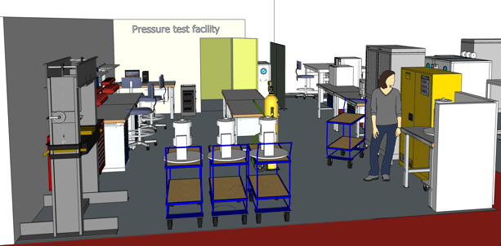
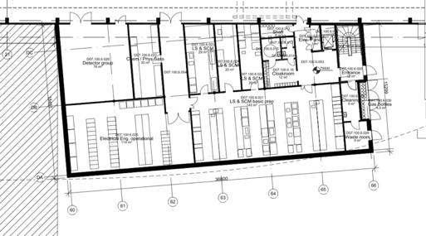
Workshops, Laboratories, Infrastructures at the instrument halls (M. Hartl)
E03
Sample Environment
Optics
E04
Chemistry labs
Detectors
Motion Control & Automation
D04
Detector
Sample Environment Life Science labs
D08
Radioactive Material (RML) lab
Sample Environment & Chemistry labs
Optics
D07
Detector
Motion Control & Automation
Life Science labs
Visit ESS
VR booth
Notes:
4 infrastructure available and required (! refer to Monika’s talk)

Slide 6
Delivering on the Sample Environment Reference Suite
https://1drv.ms/x/s!AuCQb_HPf3b9g8g2HHqvybpQKix-Lg
Sample Environment Reference Suite based on instrument needs. Timelines determined by instrument construction schedule and lead time.
NSS construction budget covers needs of first 8 instruments #1-#8. Additional budget provision for instruments #9-#15 in initial operation.
Cross-check regularly Sample Env. Reference Suite and Laboratory Requests; at least during each (sub-) TG3 jointly between SAD and instr. Team.
Each SES follows its own project plan incl. integration and safety assessment; e.g. SES are not part of the instrument TG3 process itself
Notes:
5 regular crosscheck the Sample Env. Suite and the laboratory requests at each sub-TG3 with the instrument teams again using checklist. To keep aligned with instrument construction, we will aim to adjust the project plans for each sample environment system. Each sample env equipment follows its own project plans incl. integration and safety assessment e.g. sample environment is NOT part of the instrument TG3 process itself.

Slide 7
Sample Environment Control Structure
SES integration ensures (potential) mobility between instruments & maintainability
SES require control hardware / PLC, algorithms / logic, sequences
Device Integration ongoing and ‘standards’ established to minimize duplication
EPICS (ICS): enginering UI, archiver, network boot, plug & play, network, timestamp
SECoP supported by SINE2020 grant provides cross-facility standard protocol
Exp. Control System (DMSC): NICOS integration, user interface, scripting, data coll.
Framework available for testing: Lab network, EPICS framework , ‘user PC’
SES
Sample Environ. System
EPICS
SECoP
ECS
Experiment Control System
Notes:
6: integration: To ensure (potential) mobility integration of each sample environment system is ‘stand-alone’ and linked to the instrument controls at DMSC (NICOS) level (show flow chart); system integration requires device integration and here ‘standards’ are established to minimise duplication and ensure maintainability.

Slide 8
Science Support 4 Instruments
(driven by 1st #1-8, #9-15 invited observers)
MESI is involved for all sample env. integration | LSS Estia, Loki Freia, Skadi | ENG Beer, Odin | DIF Dream, Magic Heimdal, NMX | SPEC CSPEC, Bifrost TREX, Vespa, Mir
FLUCO Harald | YES | MAYBE | YES | YES
TEFI Alex | YES | MAYBE | YES | YES
PREMP Malcolm | YES | YES | YES | YES
SULF Monika | YES | YES | YES | YES
DEMAX Zoë | YES | NO | NMX only | YES
SES 4 LSS
(autumn)
SES 4 ENG
FLUCO 4 DIF & SPEC
(w/o Bifrost, Magic, NMX)
TEFI & PREMP 4 DIF & SPEC
Labs 4 Instruments D Hall
Labs 4 Instruments E Hall
DEMAX 4 LSS, NMX, SPEC (w/o Bifrost)

