Slide 1
Common Controls and
Data Acquisition Infrastructure
Tobias Richter
Data Management Group – Experiment Control and Data Curation (ECDC)
IKON, Lund
September 2018

Slide 2

Instrument Readout Architecture
Instrument Hardware
DMSC Hardware
Detector Backend
Event Formation Unit
MRF
100 GB/s fibre
Detector Backend
Event Formation Unit
NeXus File Writing
Data Aggregation (Kafka)
Chopper
Live Feedback
EPICS
EPICS Bridge
MRF
Motion
BrightnESS is funded by the European Union’s Horizon 2020 research and innovation programme under grant agreement No. 676548

Slide 3
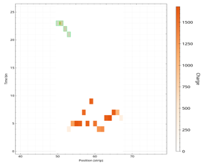
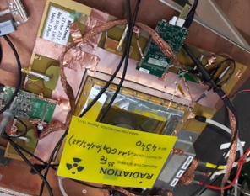


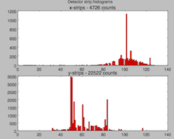
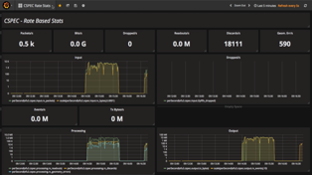
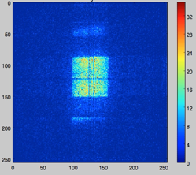
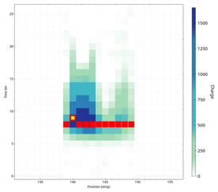
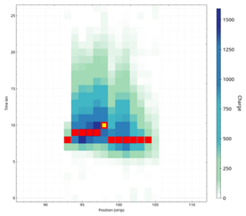
Detector Readout & Event Formation
Event formation
Detector and readout
Aggregation
Live View
Readout Master
Coincidence building and location refinement in software
Successfully demonstrated for a number of prototypes
More information on the hardware and timing in the next talks.
Gd-GEM
ICS / MRF Timing
Monitoring & Diagnostics

Slide 4


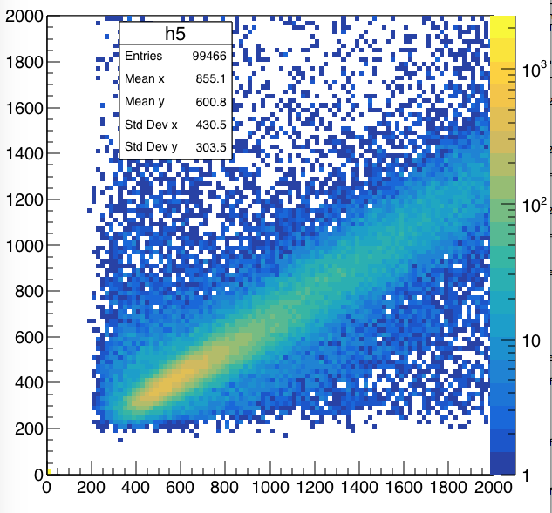
Detector Types Covered
Not all potential detectors for all ESS instruments are covered by existing event formation algorithms. The framework, however, will work for all of them and we have assembled the algorithm toolbox required.
Gd-GEM
Multi-Grid
Multi-Blade
SoNDe
processing complexity
most
other
future
ESS
detectors
Draft
Engagement with instrument teams:
We’re ready when you are ready – priorities are based on instrument schedule.

Slide 5
Latest Results
Latest data from SNS (SEQ) August 2018
Detector Hardware
Processing of SONDE, Multi-Grid, GEM
Live data visualisation of raw and processed detector data

Slide 6
Performance and Scalability
Current event formation algorithms are not heavily optimized.
Processing speeds are still acceptable and scale up easily on a single machine (by using all cores).
Scaling behavior of the Kafka cluster has been investigated and all behaves in line with expectations.
Confidence in our centralized infrastructure appears to be justified.
Event formation throughput on 1 or 2 cores
Streaming throughput
scales with number of
Machines in Kafka cluster

Slide 7


Past and Upcoming Integration Tests
@ HZB V20
ICS Chopper Group
MCA SAD
Detector Group DMSC
DETECTOR GROUP CONTROL & TIMING DEMONSTRATOR
First Session – November 2017:
Demonstration of Timing
Chopper low level control and operations
Readout of TDC values and beamline metadata
Second Session – January 2018:
EPICS and NICOS control of ESS chopper and beamline
Readout of monitors through DG system
Processing and storing of event data
Next Session – December 2018:
Recording of full static and dynamic beamline state in NeXus, like at the future ESS
Timestamped detector counts and chopper TDC signals to develop and demonstrate full data reduction capabilities with Wavelength Frame Multiplication
Collaboration with ICS and all NSS technology groups.
ADC
TEST
STATUS
DATA
TIMING
CONTROL
JTAG
POWER

Slide 8
Beamline Controls Group
ESS controls infrastructure is delivered by ICS
(Machine Directorate)
Scope for instrument controls is shared between ICS, NSS technology groups (MCA, Chopper, DG), SAD and DMSC
NSS have gathered the controls resources to form a
Beamline Controls Group with the aim to have:
  Better lines of communication
  Common prioritisation and single interface to ICS
  Single interface to instrument teams (TG3)
  More standardised implementation
Note: This has started over summer and is still ramping up.

Slide 9
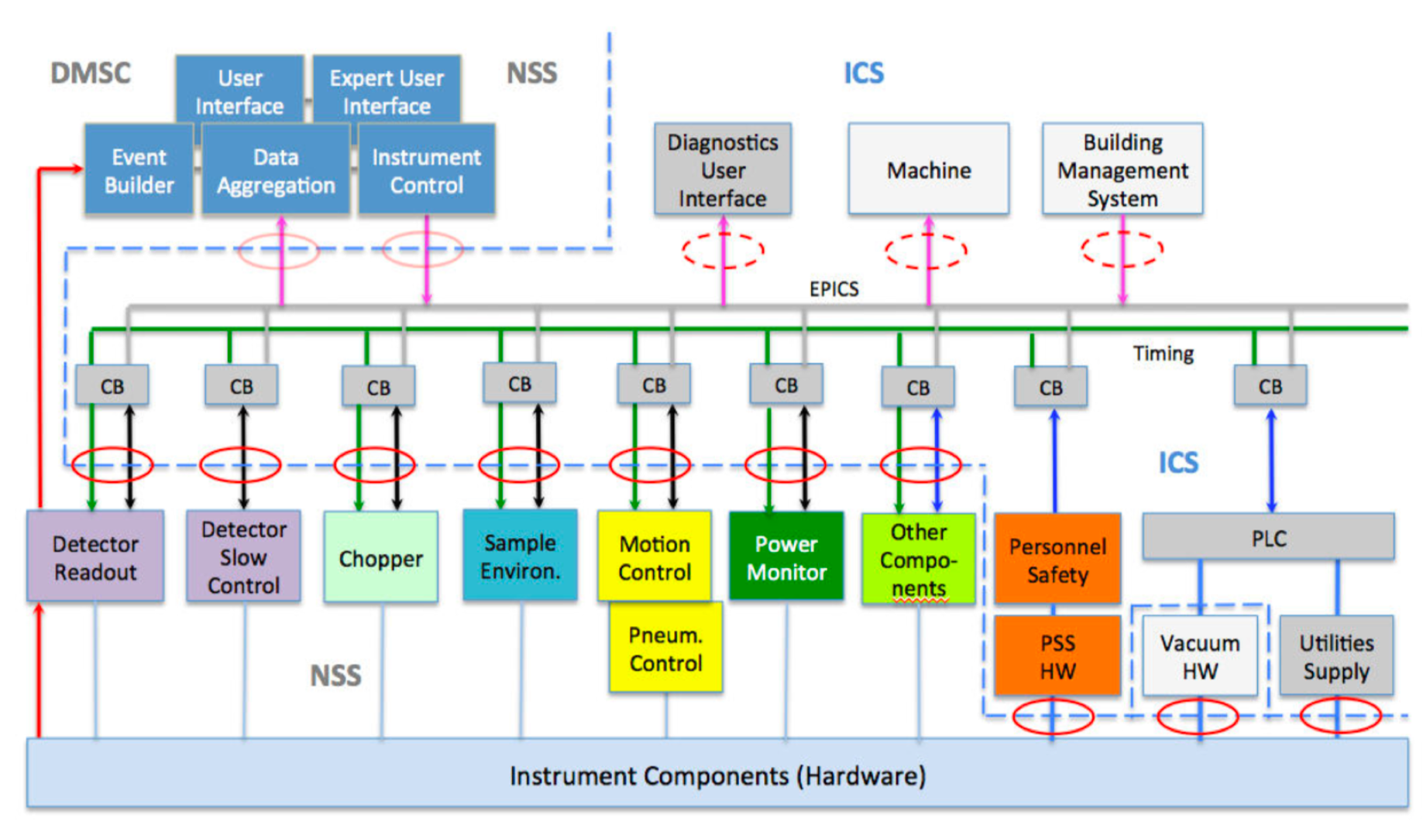
ESS Controls and Readout Architecture

Slide 10
Beamline Controls Group
Scope
NICOS (Scientific User Interface)
Expert Interfaces
Timing system
IOCs for NSS devices
  detector slow control
  area detector interfaces
  choppers
  sample environment
  motion control
EPICS Infrastructure
  PVaccess
  IOC factory
  configuration control
  network infrastructure
  archiver integration
  alarms, logging
  deployment
Manages shared control scope and priorities across NSS

Slide 11

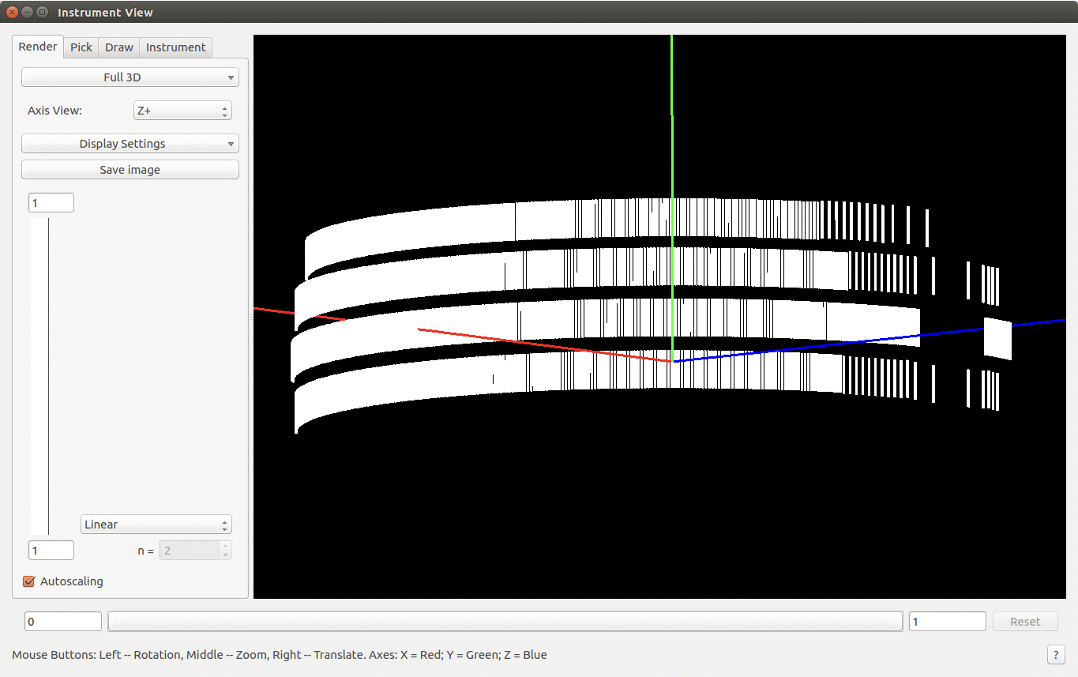
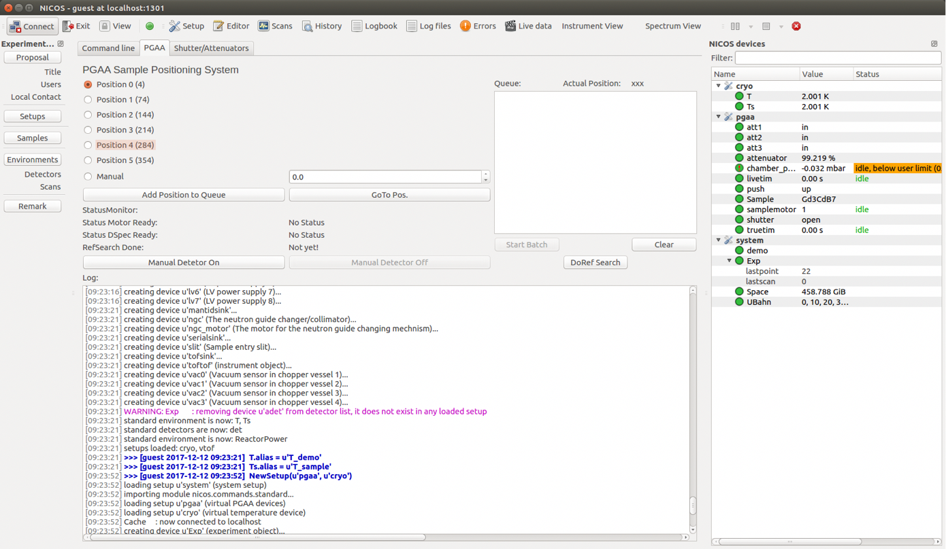
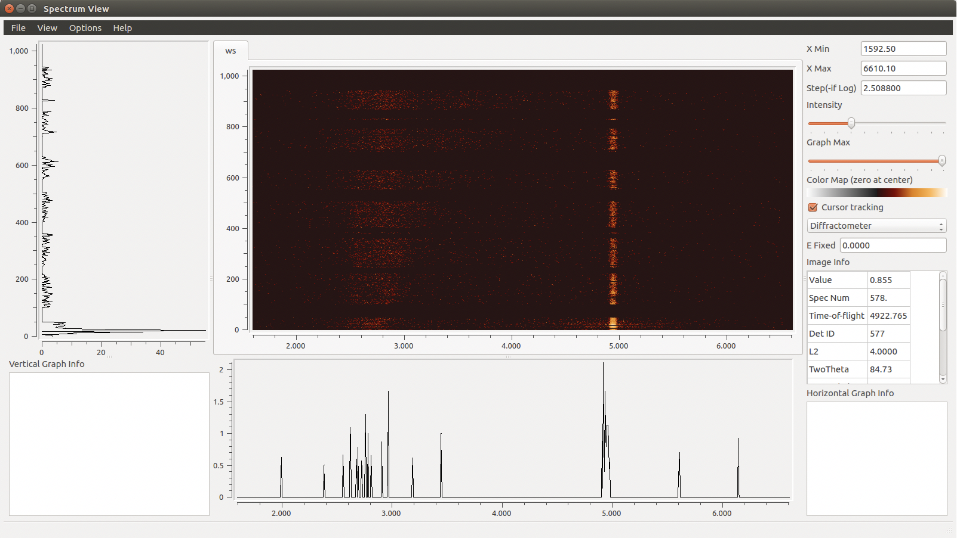
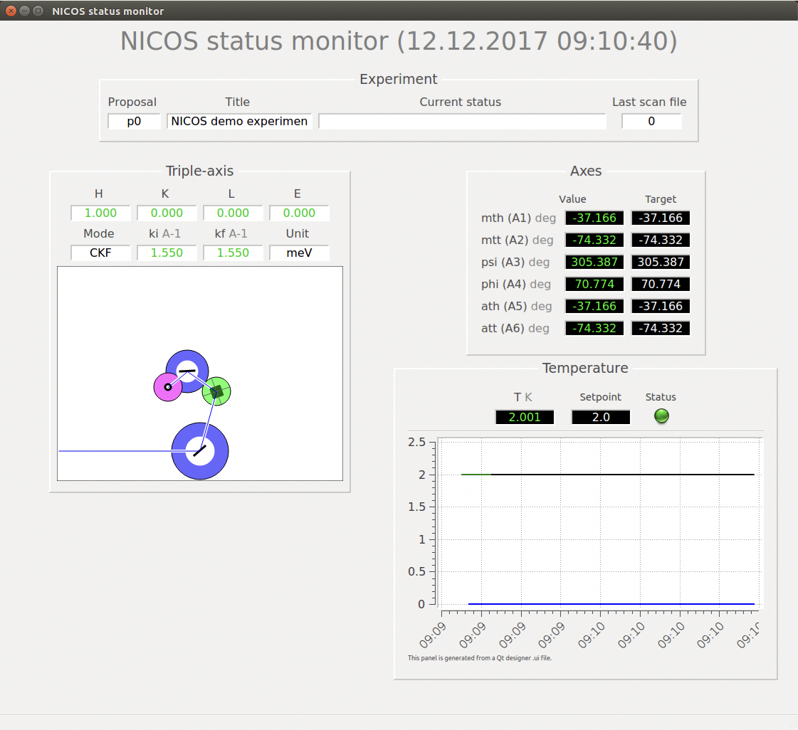

Experiment Control – NICOS
Feature complete and customizable
Acts as a high level interface to low level EPICS controls
Python CLI
Qt GUI

Slide 12
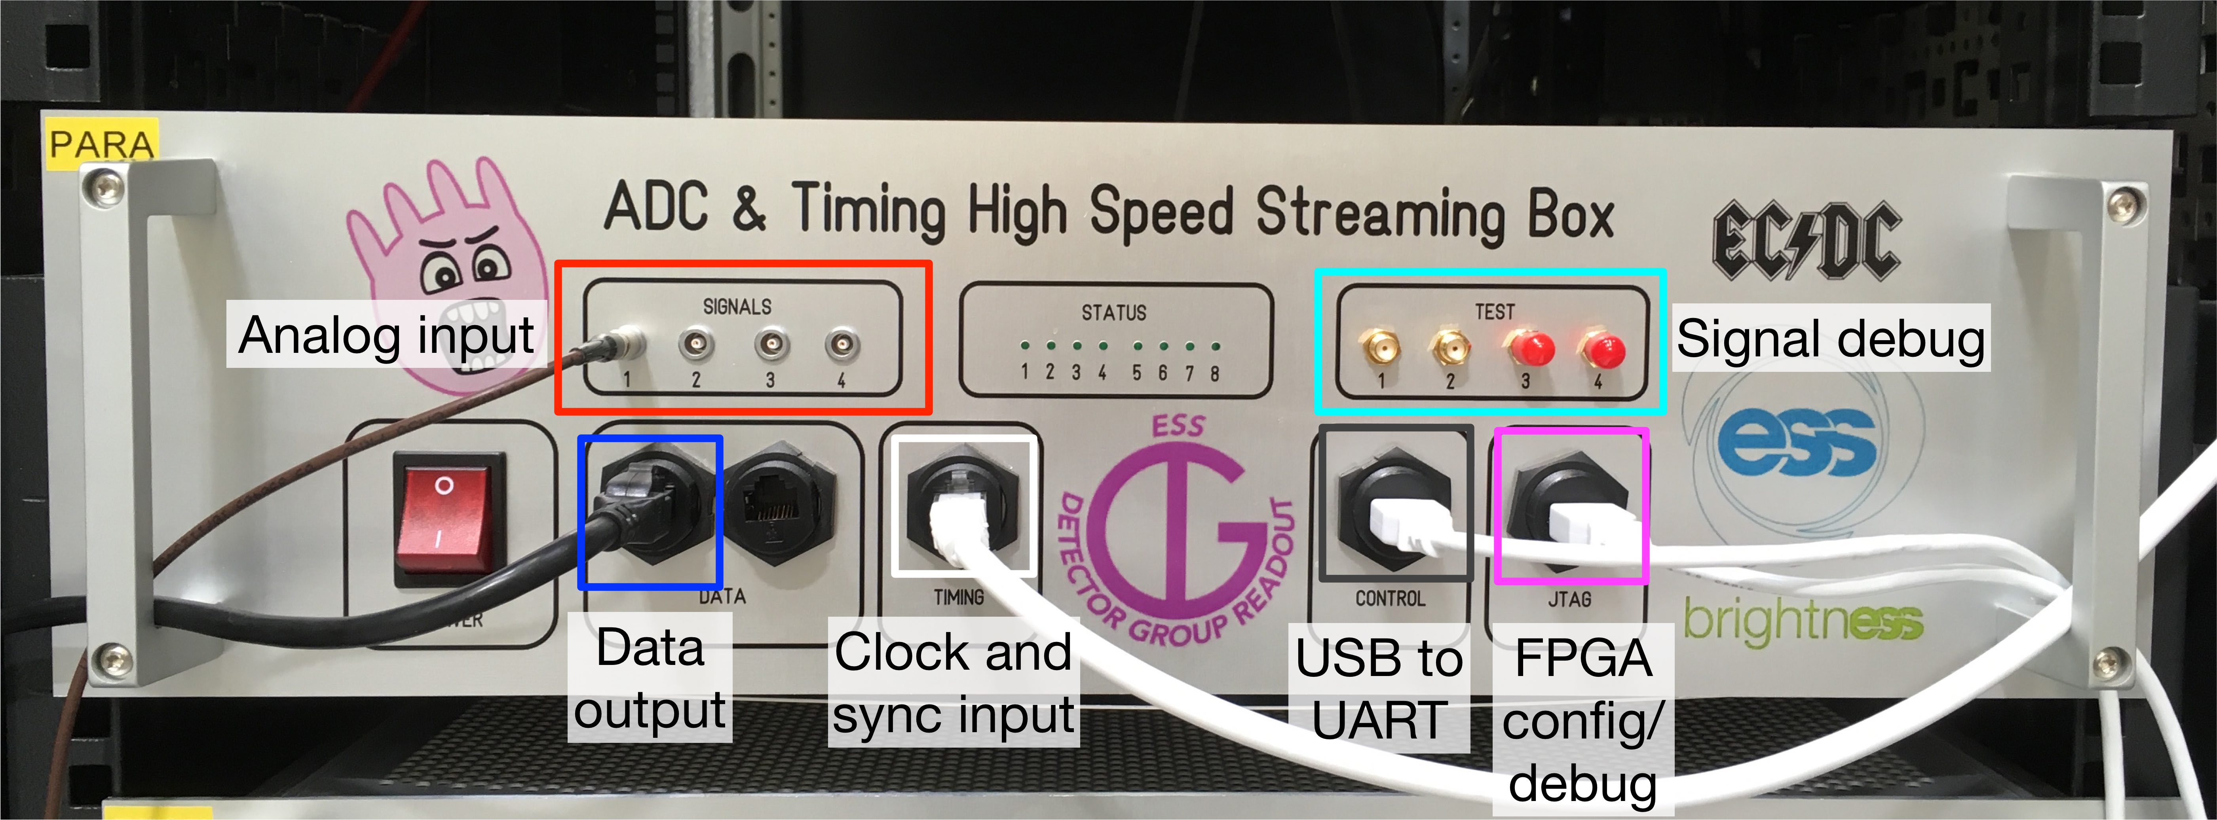
Fast Sample Environment
Combined hardware/software solution developed as part of BrightnESS
Based on detector group readout system.
Enables collecting “fast” sample environment data for example from stroboscopic experiments.
Solves:
  Absolute timestamping
  Continuous ADC operation at high rate
Verified in tests with beam monitors, serves as default timing test platform.
If you have a use case, get in touch.
Max sample rate | 1 M/s
Timing accuracy | 20 ns
ADC resolution | 12 bit
BrightnESS is funded by the European Union’s Horizon 2020 research and innovation programme under grant agreement No. 676548

Slide 13


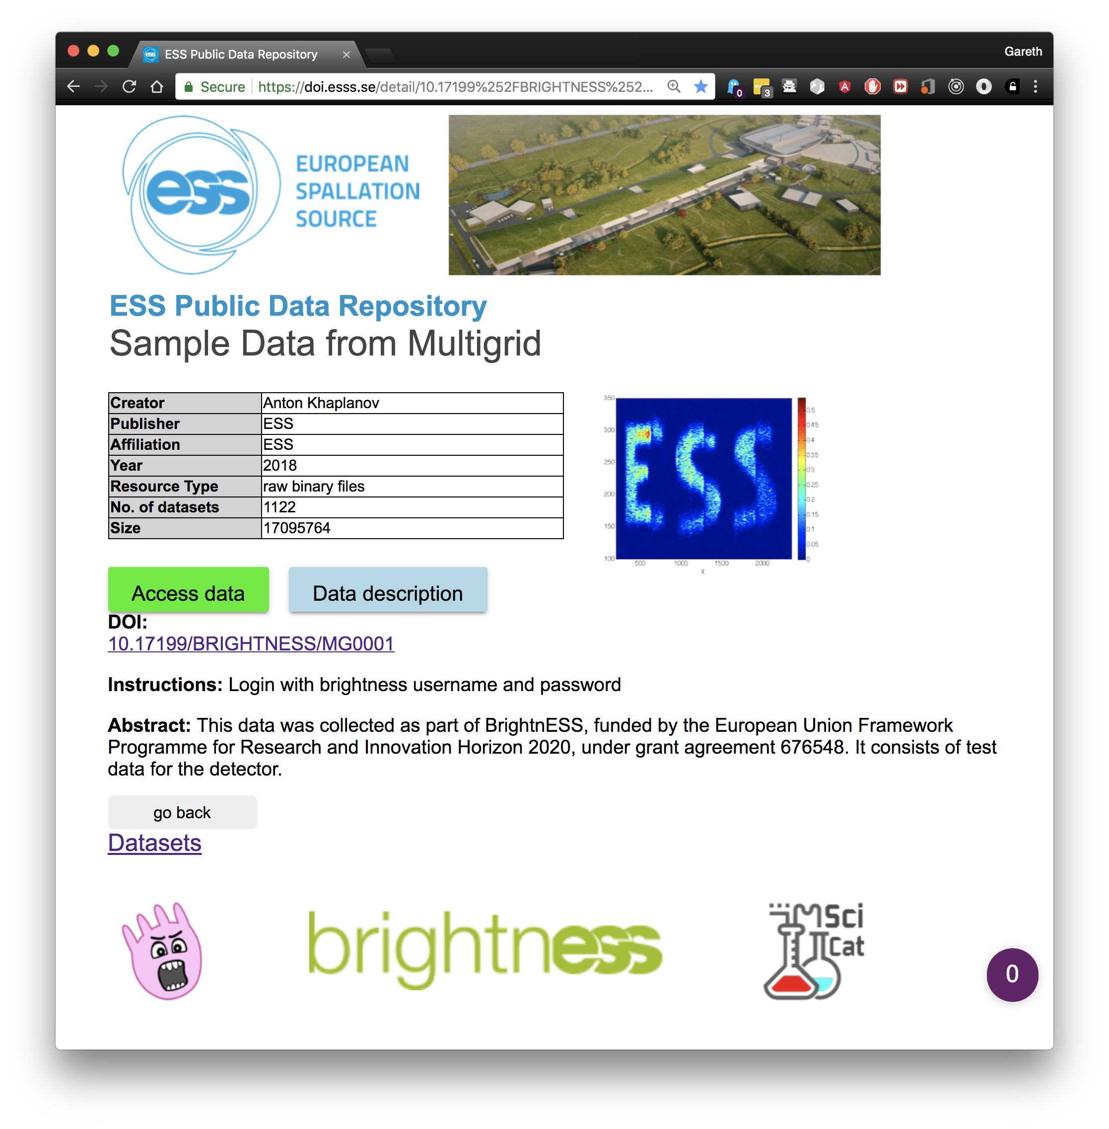




Data Curation
Data Catalogue with automatic metadata capture
BrightnESS published 250,000+ files in the
ESS data catalogue (https://scicat.esss.se)
  Collaboration with MAX IV and In-kind from PSI
Each dataset linked to publicly accessible DOI and
researcher ORCID (Findable).
Data can be downloaded (Accessible)
Catalogue is searchable and links to data use instructions (Interoperable, Reusable)
Data Curation Workshop – 6th November @ DMSC
https://indico.esss.lu.se/event/1056/
IN OPERATION

Slide 14
Conclusion
Standardisation helps everyone to build a working and maintainable instrument.
We (DMSC / BCG) have resources to engage with instrument teams.
Should they be limited, priority will be given based on rollout schedule.

Slide 15
Questions?

