Slide 1

Readout Systems Update
IKON15
11th September 2018
Steven Alcock (DG)

Slide 2
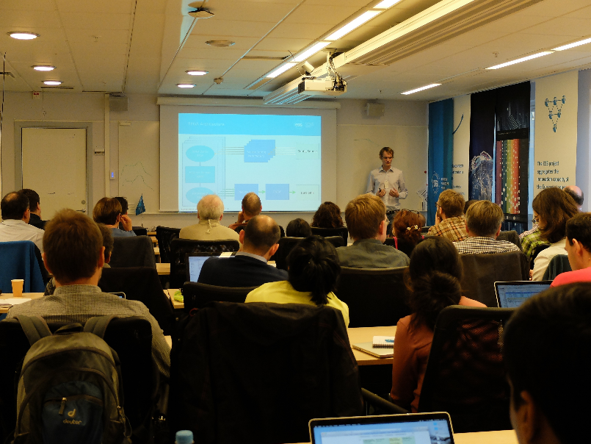
Rewind: IKON13
Two presentations on FPGA development for Detector Group Readout:
  ICS Timing/Control Demonstrator (Beam Monitor Session)
  (https://indico.esss.lu.se/event/858/contributions/6716/attachments/6515/9376/2_adc_demonstrator.pdf)
  High Rate Packet Generator (Detector and Event Formation Session)
  https://indico.esss.lu.se/event/858/contributions/6677/attachments/6555/9428/100g_demonstrator.pptx
Steven Alcock, Detector Group, 11th September 2018

Slide 3
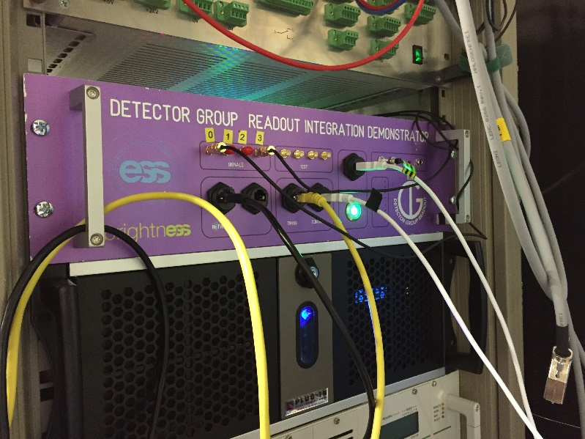
ICS Timing/Control Demonstrator ->
Beam Monitor Readout
Low channel-count readout solution, fully integrated and tested with the ICS and DMSC.
Successful commissioning at HZB for Vertical Integration Tests.
Currently the default beam monitor readout solution (subject to future developments).
Steven Alcock, Detector Group, 11th September 2018

Slide 4
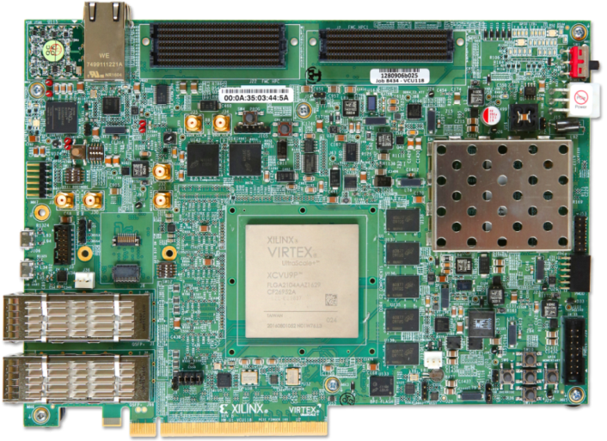
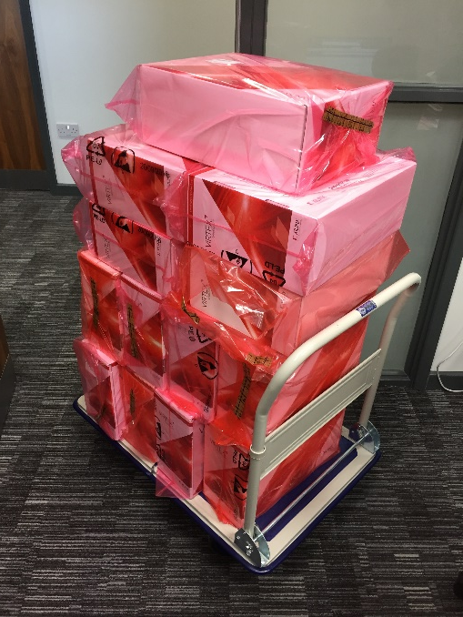
Packet Generator ->
Backend Master
VCU118 development boards chosen as target hardware for backend master.
Conducted hardware tests on device fabric and peripherals.
Developed data multiplexer and packet processing architecture.
Developing data test systems that are fully representative of the final architecture.
Steven Alcock, Detector Group, 11th September 2018

Slide 5
Questions?

Slide 6
Backup Slides

Slide 7
ESSIIP ADC Readout Demonstrator Architecture
Detector Group
ICS
Timestamp Generation
KU040 FPGA
MRF Timing System
EPICS Control
Control Registers
USB-UART
Analogue Electronics
OHWR ADC
ADC Deserialiser
Pulse Processing
Packet Generation
1 GbE NIC
Acquisition Software
DMSC
Detector
Steven Alcock, Detector Group, 11th June 2018

Slide 8
Key Features
ADC
  Open Hardware (CERN) design
  Four channels, 30 MHz analog bandwidth
  14-bit resolution
  105 MHz sample rate – we use 44 MHz from ICS timing system
  Programmable gain and offset
FPGA
  Avnet KU040 development board
  Configurable pulse detection/zero suppression to reduce data rate
  Maximum pulse length of about 4500 samples (100 us)
  Synchronous clocking and timestamping from ICS reference signals
  Custom readout protocol sent via standard Ethernet/IP/UDP.
Steven Alcock, Detector Group, 11th June 2018

Slide 9
V20 Tests
Acquisition Electronics
Processing/Storage/Visualisation
Preamp/
Shaper
Preamp/
Shaper
HZB Neutrons
Monitor
Chopper
Monitor
Beam Stop
EPICS Control and Timing
DMSC
Detector Group Readout
Detector Group Monitors
Chopper Group
ICS
Steven Alcock, Detector Group, 11th June 2018

Slide 10

Successes
Everything worked (most of the time) – data showed mini-chopper worked as expected.
Collaborative and cooperative working.
Seemingly excellent signal quality from monitors.
Pain-free integration with DMSC software, thanks to early engagement and testing.
Remote programming, configuration and diagnostics via ICS VPN tunnel.
Steven Alcock, Detector Group, 11th June 2018

Slide 11
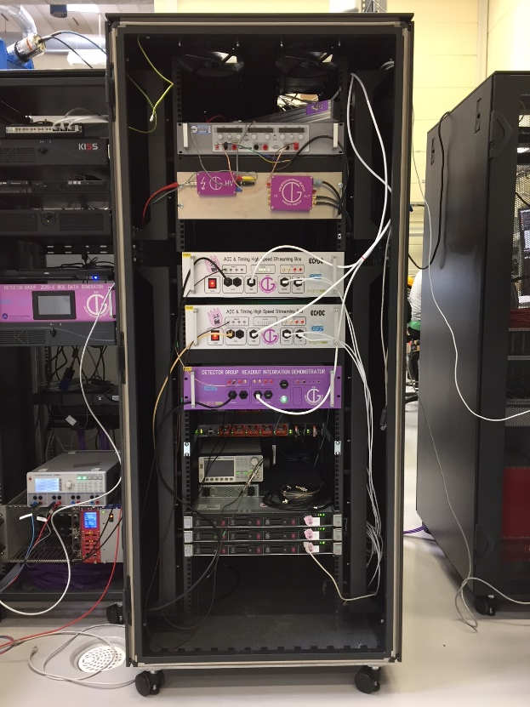
DMSC Fast Environment Sampling
BrightnESS deliverable for DMSC.
Built and commissioned two additional boxes that continuously stream data from all four channels.
Steven Alcock, Detector Group, 11th June 2018

Slide 12
Simplified Readout Electronics Architecture
Front Ends
Front Ends
Front Ends
Front Ends
Front Ends
Front Ends
FPGA Master
Switch
Diagnostic Server
DMSC
NICs
ICS
DMSC
NIC
DMSC
NIC
DMSC
NIC
DMSC
NIC
DMSC
NIC
Steven Alcock, Detector Group, 11th June 2018

Slide 13
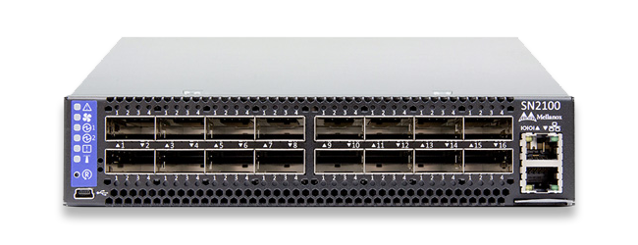
Key Features
Virtex Ultrascale+ (XCVU9) FPGA development board.
Demonstrator reads up to 24 data files stored on local memory, packetises the data, aggregates the data, and outputs 2x 100 Gb Ethernet streams.
Mellanox Switch can output data as 10/25/40/56/100 G. This means, for example, a 100 G stream could be split across 10 x 10 G outputs.
Steven Alcock, Detector Group, 11th June 2018

Slide 14
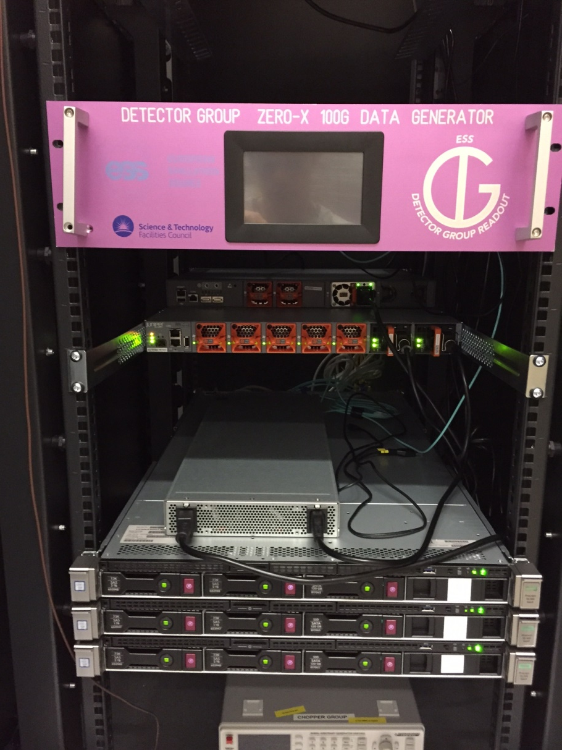
100 G Detector Readout Demonstrator
Provides the DMSC with high-rate packets
in a format representative of the final system.
Allows data packing format to be agreed.
Proves key interfaces.
Steven Alcock, Detector Group, 11th June 2018

Slide 15
Proposed Architecture
Front End Interfaces
Packet Engines
Large Mux
100 G CMAC
Steven Alcock, Detector Group, 11th June 2018

Slide 16
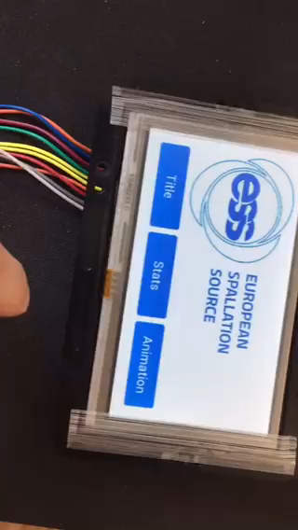
Touch Screen Display
Flexible tool for quick diagnostics.
FTDI FT800 display with SPI interface to FPGA running bare-metal Microblaze.
Steven Alcock, Detector Group, 11th June 2018

