Slide 1
Shielding guides out LOS. Gamma shielding.
Rodion Kolevatov
IKON15, 12/09/2018

Slide 2
Outline
Prompt gamma shielding
Capture in multilayer coatings
Capture related to low angle reflectivity loss
Shielding_logger, Shielding_calculator and Dose_calculator for McStas
Examples

Slide 3
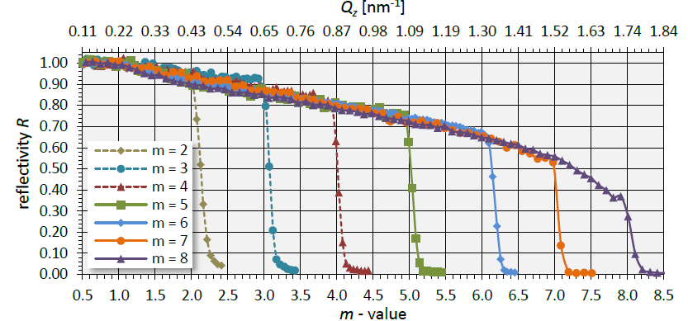
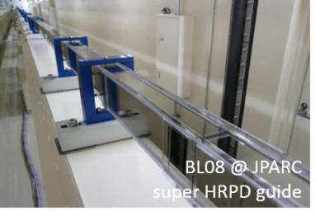
Gamma radiation around neutron guides
Potential prompt gamma sources:
Coating
Ni(Ni+Mo)/Ti multilayer
Up to few mkm thick
Substrate
Borosilicate glass,
Possibility for Cu/Al
Up to few cm thick
Neutron absorbing layer (optional)
Coating features:
>99.5% reflectivity at low angle ($θ_{c}=0.099 λ$)
Reflectivity reduces at higher glancing angles
Substantial fraction of not reflected neutrons absorbed in the coating, up to 20% at high m*⁾
Ni+Ti: ~0.9 photons/capture with $Eγ>5$MeV
Capture in borosilicate glass: mostly 477keV photons, easy to shield.
www.swissneutronics.ch
*⁾ C.Schanzer, M. Schneider, P.Böni, ECNS2015

Slide 4
Reflection from the supermirror
3
4
2
1
Capture (1/v law: $σ_{a}∼\frac{1}{v}∼λ$)
Diffuse scattering in the layer bulk (isotropic, $σ_{d}=σ_{i}+α\left(λ\right)σ_{c}$)
Penetrates substrate at large angle, negligible capture in metal substrates
Transmission
Penetrates substrate at low angle, hence high probability of capture in the substrates, including metal or sodium float.
Diffuse scattering on the interface roughness
Waviness $⇒$increase of the beam divergence $⇒$reflectivity loss below $θ_{c}$

Slide 5
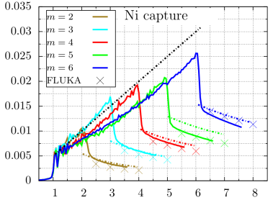
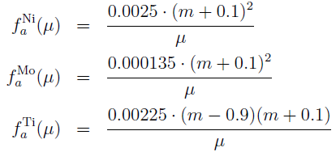
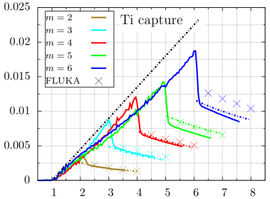
Multilayer coatings, parameterization for q>q_{c}^{Ni}
Capture probability per incident neutron is wavelength independent function of momentum transfer at reflection q only (convenient variable: ${μ≡q/q}_{c}$)
$1<μ<m$:
$μ>m$:
${μ≡q/q}_{c}; q_{c}=0.022 Å^{−1}$
$m$ – supermirror coating cutoff.
Interpretation: scales as path in the coating
R Kolevatov, C Schanzer, P Boeni – submitted to NIM A –
arXiv preprint arXiv:1708.04486, 2017

Slide 6
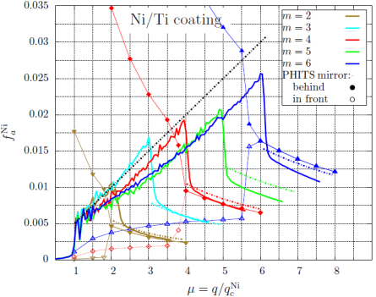
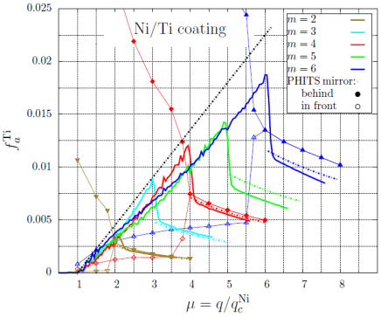
PHITS/MCNPX supermirror: be careful!
Ni capture
Ti capture
SM in front
SM behind
Plotted: capture probability per incident neutron vs momentum transfer
PHITS fails completely for momentum transfer q between q_{c} and coating cutoff, no matter where the reflecting surface is set.

Slide 7
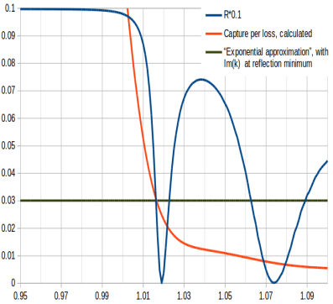
q<q_{c}^{Ni}: absorption per non-reflected
Idea by Marton Marko:
Waviness increases beam divergence, higher glancing angle on the average
A fraction of neutrons hits coating above the cutoff, is not transported further
0.5÷1% loss/incident is compatible with waviness reported by manufacturers.
Weight of neutrons with q<q_{c} tagged as “non reflected” by McStas is physically transmitted through the coating with q above coating cutoff.
IMPLEMENTATION:
Attribute losses to first reflection minimum
Approximate capture per non-reflected
$K_{min}^{Ni}$- momentum of a neutron (┴ component) hitting coating at reflection minimum while in the Ni layer.
Typical m=1 coating: $≤$1500Å Ni above thin Ti layer
~3% of non-reflected neutrons captured by Ni
$$P_{a}=\frac{σ_{a}(λ)}{σ_{a}\left(λ\right)+σ_{d}\left(λ\right)}(1−e^{−6 Im\left(K_{ min}^{Ni}\right)d})$$
Probability
m=q/q_{c}

Slide 8
Neutron capture and dose rates from McStas
Customize McStas components to set variable for m-value at reflection point:
Guide_custom, Guide_curved_custom (to replace Bender in shielding calculations, has same syntax), Elliptic_guide_gravity_custom, Guide_chanelled_custom
Make McStas Scatter Logger by E. Knudsen et al record m-value at reflection → Shielding_logger component
Implement coating capture probability in Scatter Log Iterator:
Shielding_log_iteratorNi, Shielding_log_iteratorTi, Shielding_log_iterator_total iterate though the unreflected states returning corresponding weights for capture
Processing neutrons entering iterators allows a straightforward construction of source terms for Monte-Carlo transport codes.
Table values for the capture γ spectra in Ni, Ti and borosilicate, attenuation and buildup factors of typical shielding materials are implemented in Shielding_calculator component (calculates shielding thickness for given dose outside) and Dose_calculator (dose rate outside shielding of fixed thickness)

Slide 9
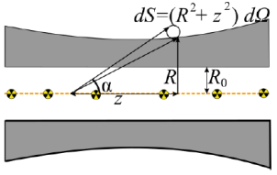
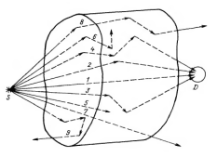
Dose rate from gamma
Neutrons captured in the guide walls give extended source of radiation: $I\left(E,z\right)$ (McStas)
Photon spectrum: 19 groups from IAEA data
Contribution of direct photons decreases exponentially with shielding thickness $e^{−μ(E)d(z)}$ (NIST data for μ)
Contribution of scattered photons and secondaries – “dose buildup” : $B_{dose}^{}\left(E, μd\right)$ (Mashkovich)
Biological effect varies with γ energy. Flux to dose rate conversion:$K(E)$ (ESS-19931)
$$\dot{H}(R,z)=\frac{1}{4 π} \int{dz dE K(E) I\left(E,z\right)B_{dose}^{}\left(E,μd\left(z\right)\right)\frac{1}{(R^{2}+z^{2})}e^{−μ(E)d(z)}}$$
$$d\left(z\right)= \frac{\left(R−R_{0}\right)\sqrt{R^{2}+z^{2}}}{R}$$

Slide 10
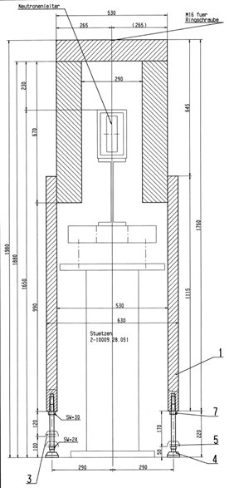
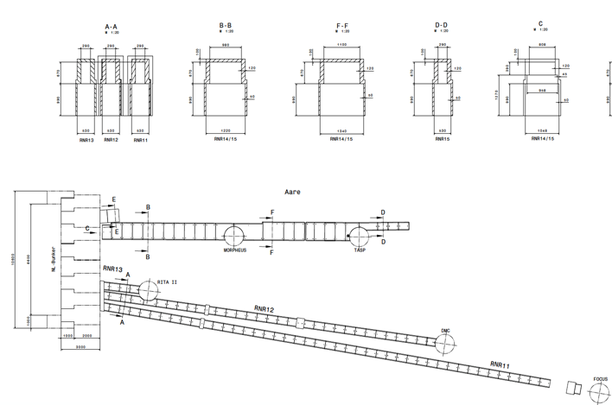
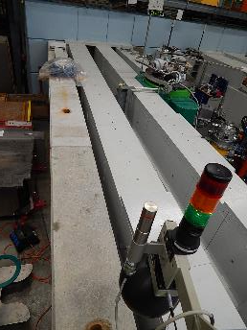
Benchmarking: Shielding at PSI
Communicated by Uwe Filges:
With 120 mm steel ~5 uSv/hr outside,
extra 50 cm concrete reduce to <1uSv/hr in the pathways.
Streaming of thermal neutron inside the steel shielding (results in capture with high-E photon emission)

Slide 11
Benchmarking: Shielding at PSI
Model calculation for FOCUS instrument (McStas only, no neutron streaming):

Slide 12
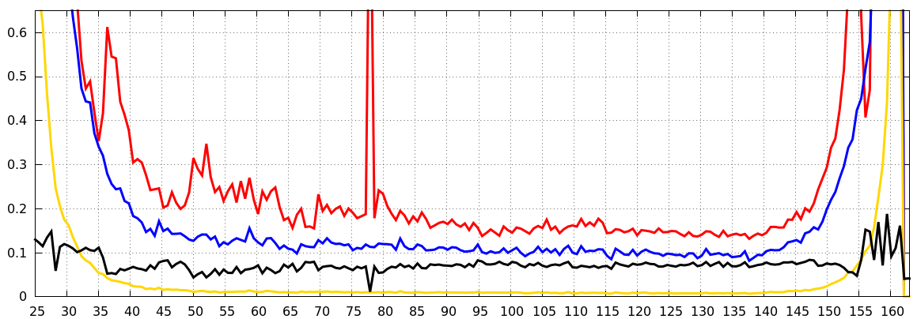
Example: BIFROST
Loss of high divergence
Chopper gap
Defocusing,
variable m
Straight, m=1.5 at 50-140 m from source
Focusing,
variable m

Slide 13
Example: BIFROST
Chopper position
5MW, R₀=0.99
Concrete shielding
Iron shielding
Current shielding layout of BIFROST (anticipated prior to common shielding project)
60 cm concrete up to ~130 m
120 cm concrete 130m—cave
Up to 20 cm extra steel in D03.

Slide 14
BEER and DREAM
BEER, concrete to reach 1uSv/hr outside
DREAM, concrete to reach 1uSv/hr outside
Factor 10 less total flux at guide exit than at BIFROST and lower divergence

Slide 15
BACKUP SLIDES

Slide 16
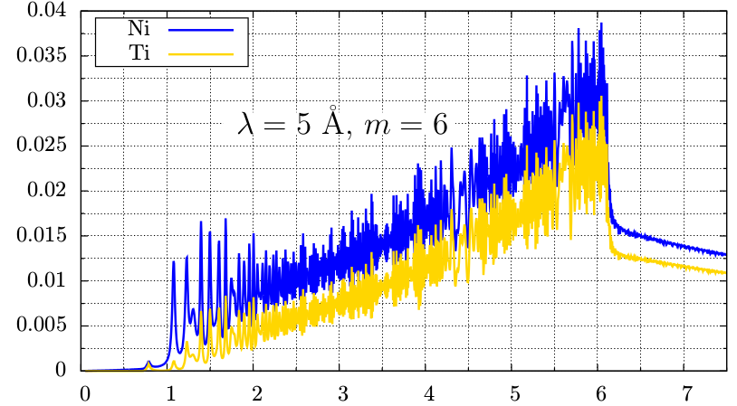
3 distinct regimes. Path length scaling
*⁾ Calculation performed for zero interfacial roughness
Capture probability per incident *
2
3
1
2.1
Momentum transfer at reflection in units of q_{c}^{Ni}
Little absorption per incident neutron for q<q_{c}^{Ni} .
Approximately linear growth for 1 < q < m q_{c}^{Ni}
Step in Ni absorption determined by a thickness of the outermost Ni layer
1/q scaling above the coating cutoff (transmission for q > m q_{c}^{Ni}, path length is inverse proportional to the glancing angle)

