Slide 1
TG3 process, practical implementation IKON 15
Gabor Laszlo
NSS Lead Instrument Engineer
www.europeanspallationsource.se

Slide 2
Delivery of documents
Intermediate Design Review (IDR)
E-mail, or
Confluence
Sub-TG3, TG3
CHESS
Why CHESS?
Because it is so good of SSM requirements.
Traceability/version control
Maintain a proper review process

Slide 3
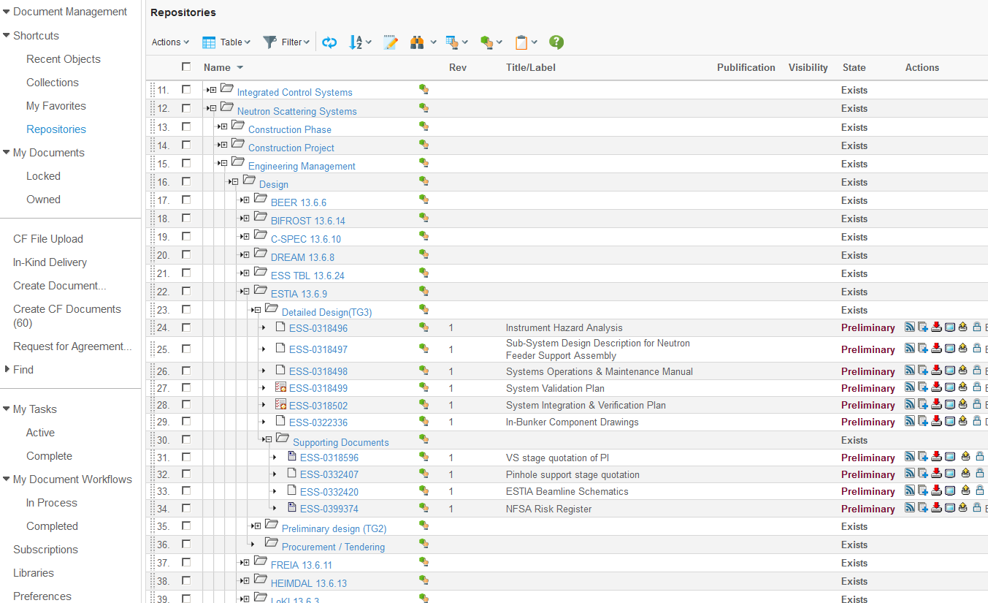
Delivery of documents/ CHESS repository
ESS will provide
The folder structure in CHESS.
Container and Template for the files, that contains the pre-defined review process of the document.

Slide 4
Delivery of documents/ CHESS repository
2
1
3
4
3: https://chess.esss.lu.se/enovia/link/21308.51166.30864.31162

Slide 5
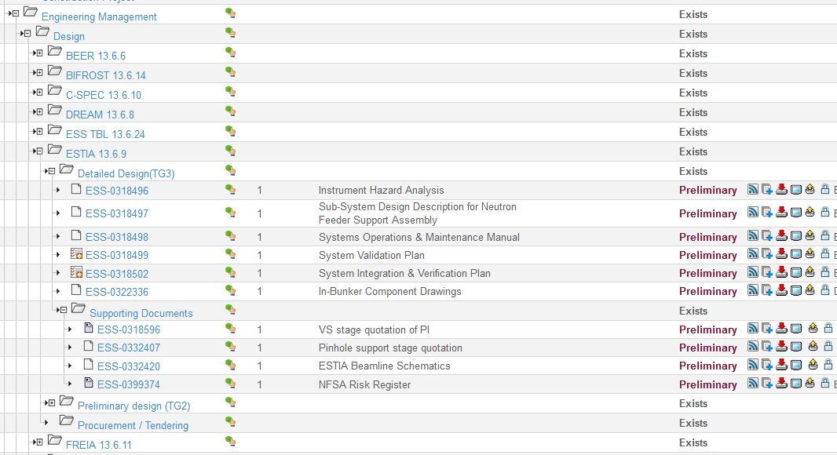
Delivery of documents CHESS upload and modification
Subcriptions (follow)
Check-in (Add)
Dowload
View
Check-out (locally saves and Opens the document to edit, with version control.)
Delete

Slide 6
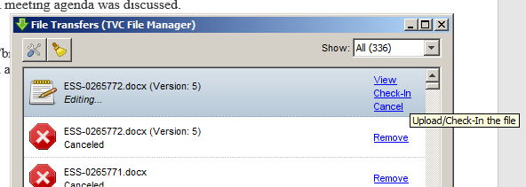
Delivery of documents CHESS upload and modification

Slide 7
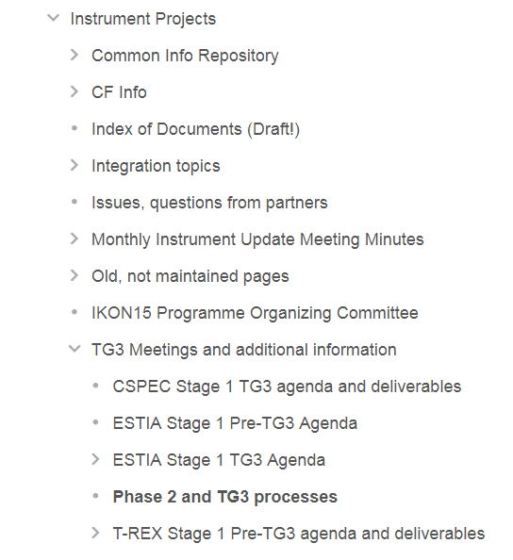
Delivery of documents CHESS upload and modification
Confluence
https://confluence.esss.lu.se/display/SPD/Phase+2+and+TG3+processes

Slide 8
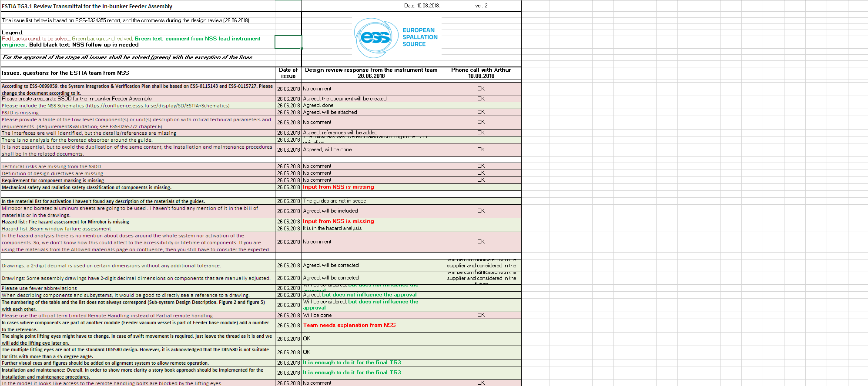
Result of the IDR: Review Transmittal

Slide 9
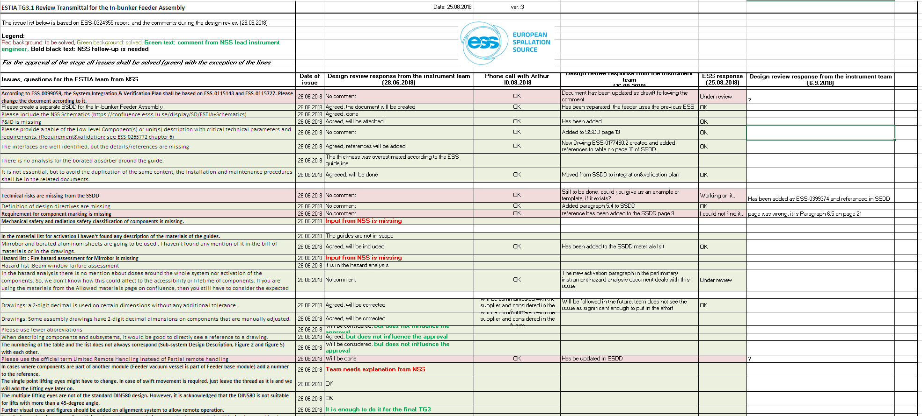
Result of the IDR: Review Transmittal

Slide 10
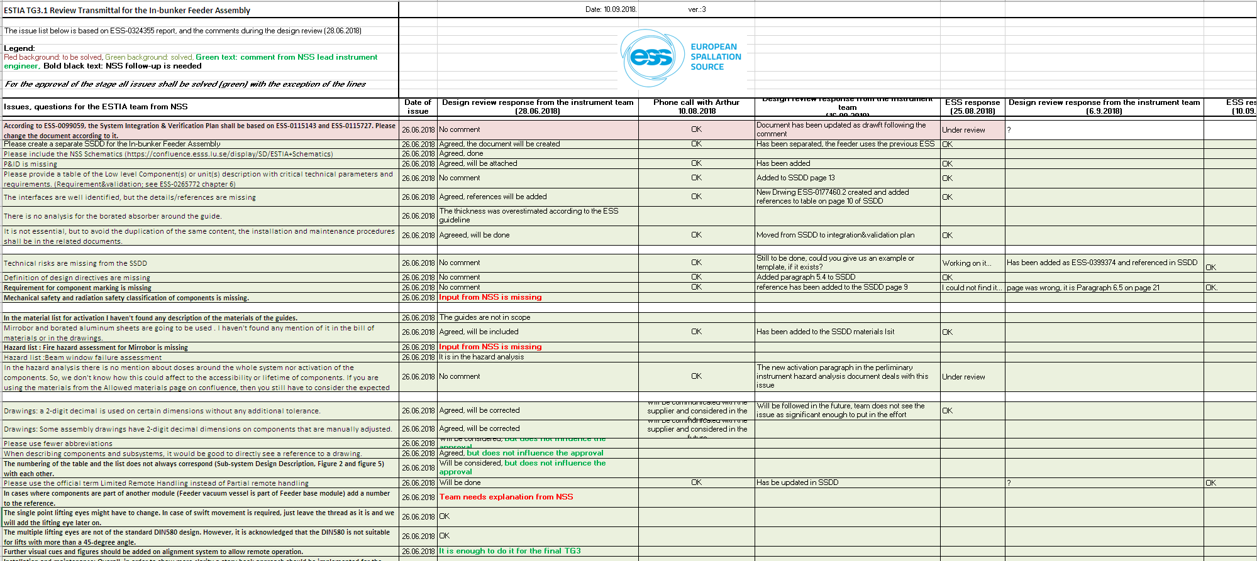
Result of the IDR: Review Transmittal

Slide 11
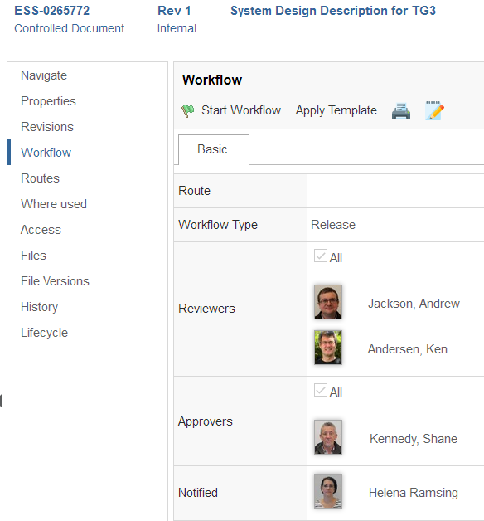
Delivery of documents
Start of the review process

Slide 12
Thank you!

