Slide 1

Phase 2 and TG3 processes
- for the Instrument Teams-
Judith Freita Ramos
NSS Instrument Project Tollgate Coordinator
www.europeanspallationsource.se
11 September 2018

Slide 2

DESIGN
Phase 2
REVIEW
TG3
Notes:
Tollgate 3 for Instrument Construction projects is the Engineering and Operation Review (also known as CDR)
The TG3 review process allows ESS Management to make the decision on approving the procurement and manufacturing of major instrument components with a properly defined and verified design and management plan.
The engineering and operation designs shall ensure that the instruments and their sub-systems meet the requirements defined by the ESS Technology Groups.
For that, the Inst. Teams are expected to approach the ESS Technology Teams and work closely from an early stage of the designs to ensure that understandings are aligned.

Slide 3
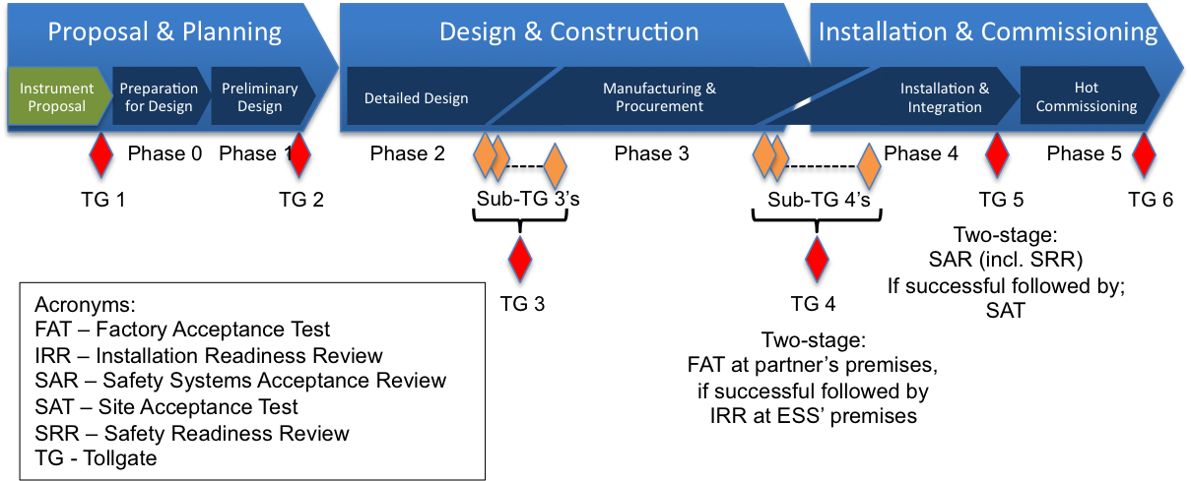
Notes:
Phase 2 starts with the end of the instrument TG2 and completes with the approval of its final TG3.
The TG3 demonstrates that the maturity of the design is appropriate to support proceeding with full-scale fabrication, assembly, integration, test, and future operation and decommissioning. The TG3 should also review initial planning for verification.
The Process for Neutron Instrument Design and Construction may require to introduce several sub-sets of TG3 during the design work in Phase 2, as some procurement and manufacturing has to be done to meet the instrument project schedule.
Installation & cold-Commissioning are also responsibility of each Inst. Team and the first will start before the TG3s complete, in some cases.
Antonio Bianchi will talk tomorrow about the Installation Resources during his presentation on installation.

Slide 4
Notes:
To help us to have a holistic view of the instrument, we came up with this breakdown of sub-systems on a hypothetical instrument. This is internal, not an official breakdown. This drawing helps us to ensure that you are submitting for review all sub-systems.
The TG3 process is well advanced for the Monolith components and it is being reviewed by Iain and Hansdieter.
Outside the bunker, it has timidly started already for a few sub-systems of a couple of instruments. From right after IKON 15, the process will fully start, and meetings and reviews will take place at a rate of about 4 per month (depending on which month)

Slide 5
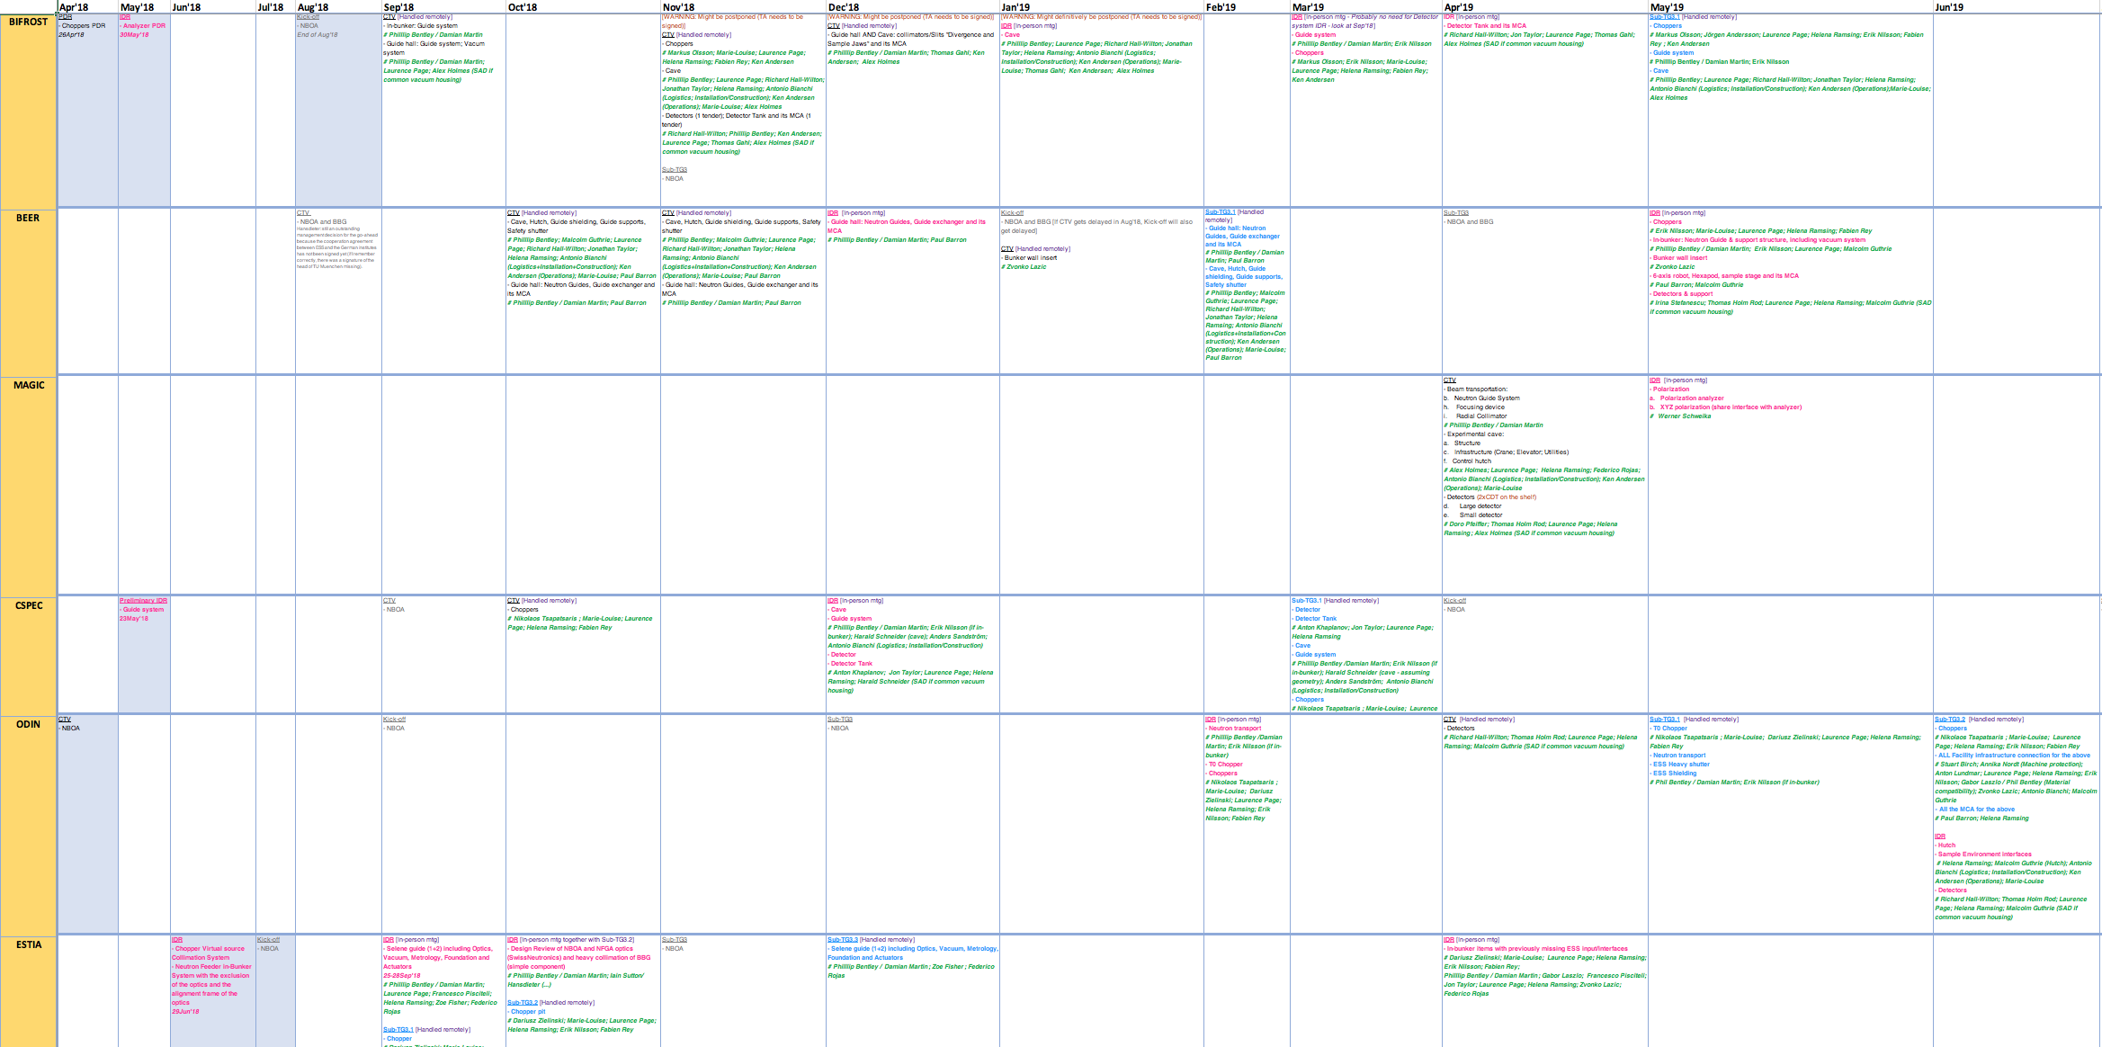
TG3 schedule (timeline 2018-2021)
Notes:
Together with the Inst. Teams, we have prepared a schedule for the whole process which, no doubt, will change. We will have the first Final TG3 in Sep19 (ODIN) and the last in Aug21 (FREIA).
Months like July will be, as much as possible, review-free, and no more than 4 events per month will take place.
This schedule will be reverted onto a Confluence calendar (well 1 calendar per instrument) after IKON 15.
Other than the date allocation of the different reviews, on the schedule you can find whether an in-person meeting will be required, and what teams and precise people are expected at each review.
One note is that, in some cases, the TG4 will start before TG3 completes.

Slide 6
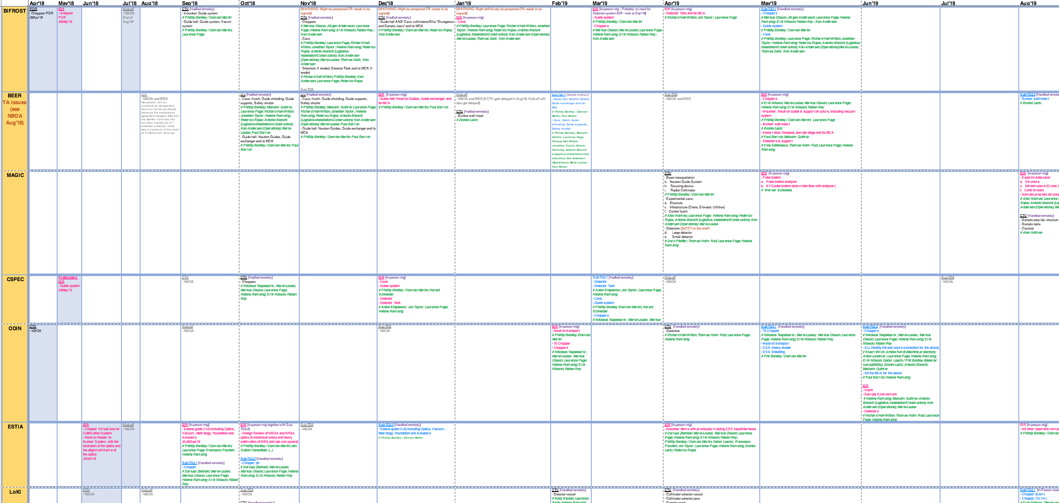
TG3 schedule (motivations)
Meet the requirements of the ESS project delivery schedule
(rebaseline schedule for Neutron Beam Instruments –V4.0 May 2018)
Motivations behind this schedule:
Schedule and preferred cluster of sub-systems by Inst. Teams
Building access and Installation timelines (Building accesses: E01 and E02.1 Sep’19; E02.2 May’21; Bunker Jul’21; D03 Jan’21; D01 Jun’21)
ESS reviewer resources
Short(-work) months
Prioritisation of instruments
Cluster of sub-systems and components that are related (interfacing)
Notes:
As ready as we are trying to be, TG3 will not be an easy process and we thank beforehand those instruments who will be dealing with their TGs first as we predict it will be a bit of a try-and-error to start with.

Slide 7
Flow diagram
For complex sub-systems
When outsourcing
To facilitate early procurement
Together with last Sub-TG3
Notes:
This flow diagram was jointly created with the input from some Inst. Teams and also ESS Technology Teams.
Most of you know it by now but for those who don’t, I will go quickly through the main stages.

Slide 8
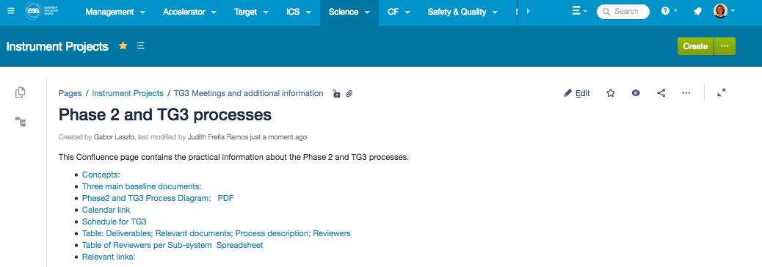
Confluence space
Notes:
Information about these processes can be found on Confluence. It can be found under: Instrument Projects → TG3 Meetings and additional information
* One can find there the 3 main documents for these Phase 2 and TG3 processes. Please, read them carefully, in particularly the first two documents on the list
* The Flow diagram. ;
* The calendars: on per instrument teams with the info from the schedule. They will get populated after IKON 15.
* The schedule itself
* A Table with the list of deliverables; Relevant documents; Specific description of each process; and the list of Reviewers for each deliverable.
* You can also find a table with the Reviewers per Sub-system
*This presentation will be linked to this Confluence space

Slide 9
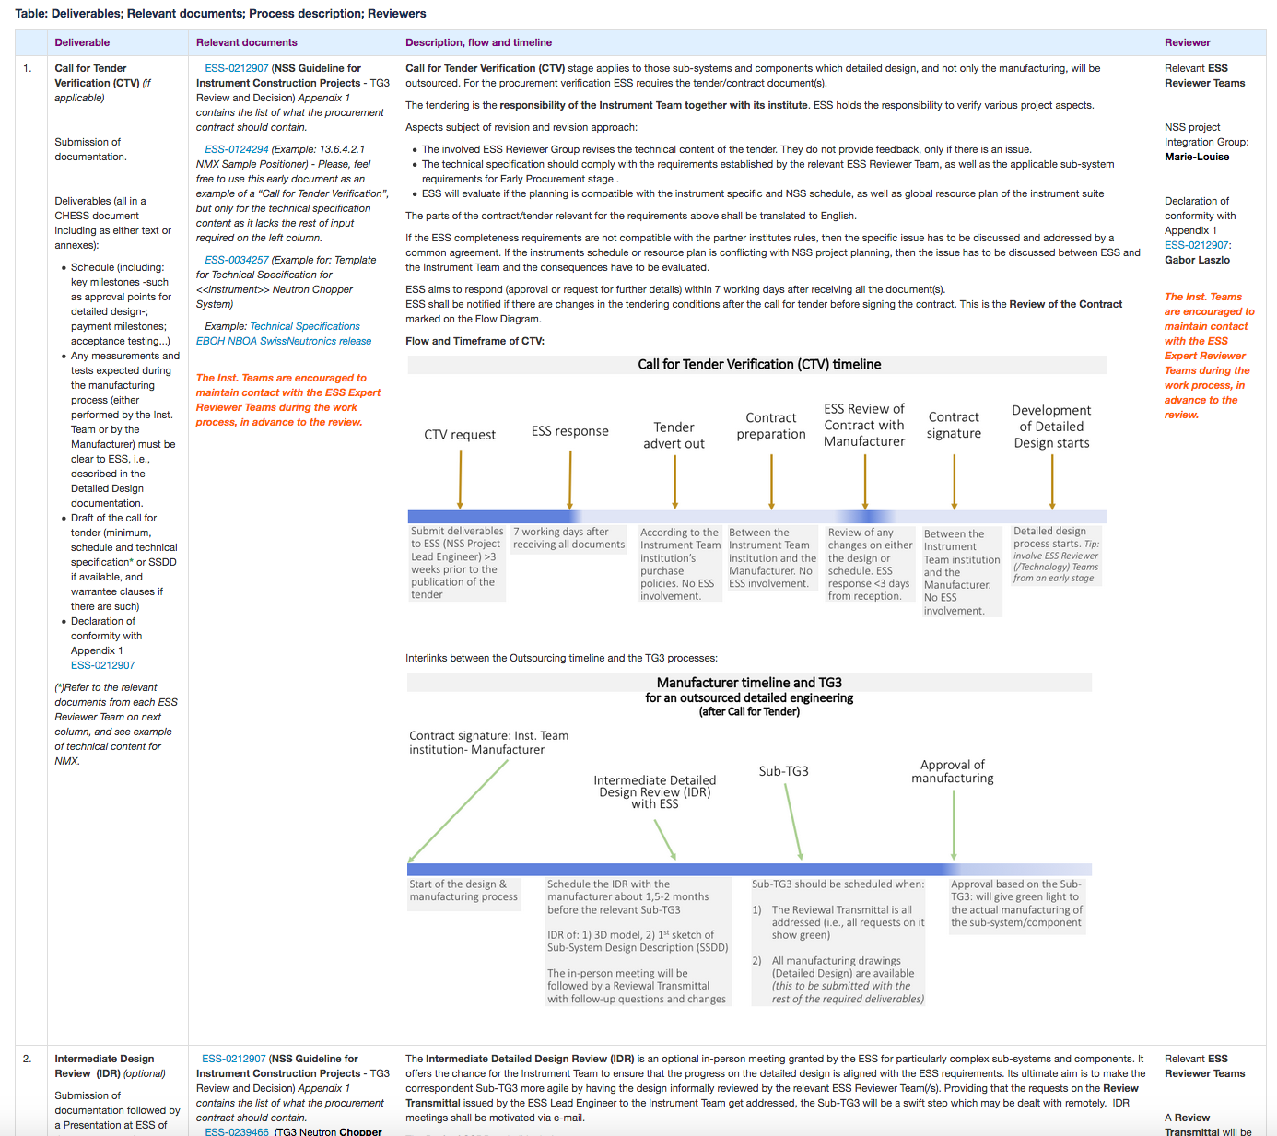
Confluence space:
Table of
- Deliverables
- Relevant documents
- Description, flow and timeline
- Reviewer
Notes:
This Confluence space was created to respond to the Inst. Teams’ request for having all the information gathered somewhere, altogether.
This Table might be particularly useful to get the perspective of the TG3 requirements, and finding practical information and resources. It contains:
- the list of deliverables, requested for each review stage;
- the relevant documents (or source documents), which include CHESS docs for these processes, as well as the requirements produced by the ESS Technology groups, and examples will be made available as the first Teams progress on their reviews;
- Specific description of each process;
- and the list of Reviewers for each deliverable.

Slide 10
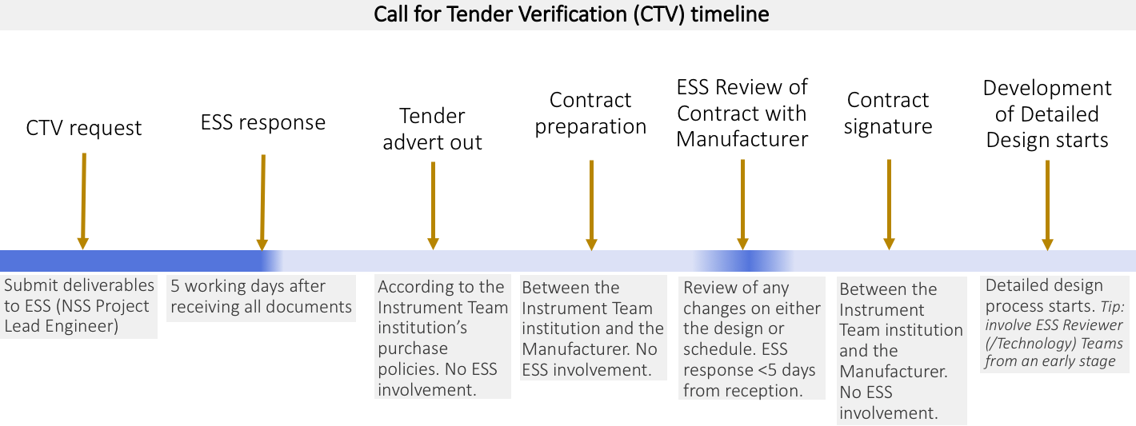
Input from Instrument Teams: CTV
Notes:
The first one is the Call for Tender Verification, which applies to those sub-systems and components which detailed design, and not only the manufacturing, will be outsourced.
The tendering is the responsibility of the Instrument Team together with its institute.
ESS holds the responsibility to verify various project aspects:
- Review that the technical content of the tender complies with the requirements established by ESS
- Review also of the planning, whether it is compatible with the instrument specific and NSS schedule, as well as global resource plan of the instrument suite.
The CTV’s will not require an in-person meeting, but emails instead with the NSS Lead Instrument Engineer and –where necessary- with the Technology Team.
On this slide you can find the timeline for this stage.

Slide 11
CTV: deliverables
Schedule (key milestones; payment milestones; acceptance testing...)
Measurements and tests expected during the manufacturing process
Draft of the call for tender (schedule and technical specification, and warranty clauses)
Declaration of conformity with Appendix 1 ESS-0212907
Notes:
The deliverables for a CTV shall be submitted when placing the CTV request.
- Schedule (including: key milestones -such as approval points for detailed design-; payment milestones; acceptance testing...)
- Any measurements and tests expected during the manufacturing process (either performed by the Inst. Team or by the Manufacturer) must be clear to ESS, i.e., described in the Detailed Design documentation.
- Draft of the call for tender (minimum: schedule and technical specification and warrantee clauses if there are such)
- Declaration of compliance with our requirements of the contract/tender (Appendix).

Slide 12
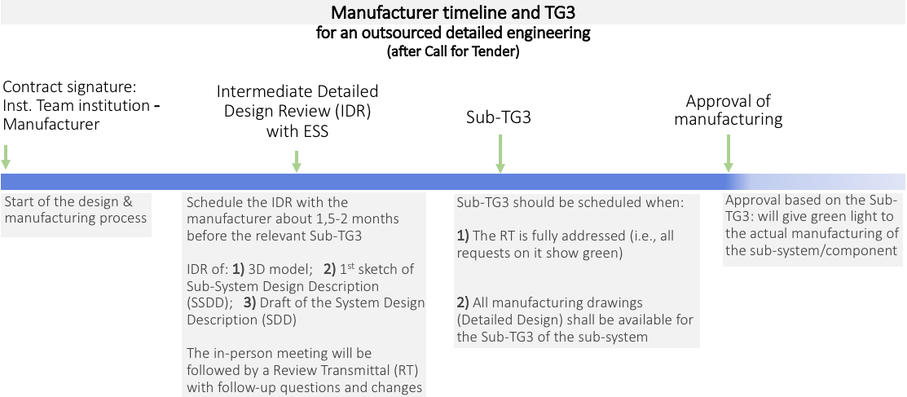
Manufacturer timeline and TG3
Notes:
We have heard the concern from some Inst. Teams of how to handle with the manufacturers several design outsourcings and their reviews.
We hope that the definition of the process detailed now helps the planning of the detail design for the various sub-systems. Our tips are:
- Plan timelines together with the manufacturer at the time of preparing the contract and T&C.
- Plan when the preliminary design shall be ready according to the IDR established on the schedule.
- Allow 1,5-2 months between the IDR and the relevant Sub-TG3
- Plan the timeline for the Sub-TG3 deliverables.
In summary, we recommend early planning and sticking to it as much as possible.

Slide 13
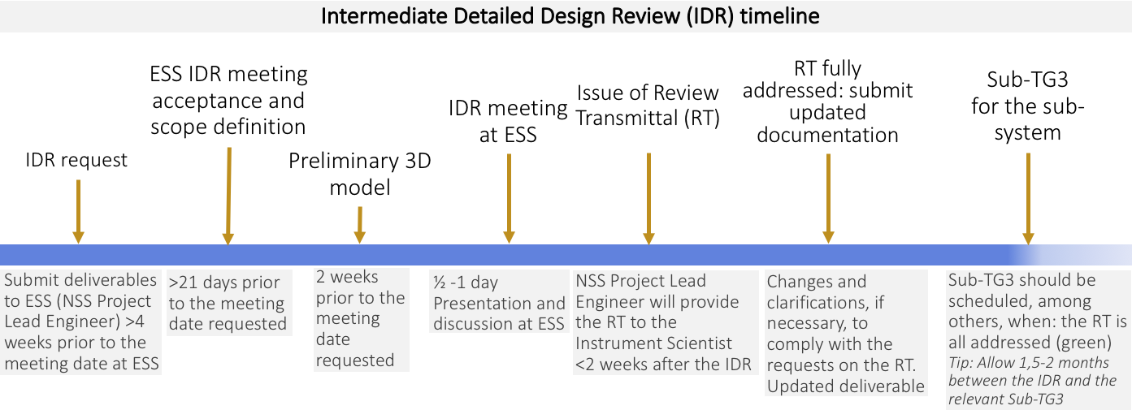
Input from Instrument Teams: IDR
Notes:
The IDR’s are Intermediate Detailed Design Reviews. They are offered to the Inst. Teams for complex sub-systems. This will give the chance to discuss the progress on the detailed design before it reaches its final shape.
The feedback will be offered to the Inst. Teams in a Review Transmittal, with requests for changes and clarifications. This will help to ensure that the detail design of that sub-system will be ready to be submitted for the Sub-TG3.
The IDR’s will require an in-person meeting where the Inst. Team will present the sub-system and a discussion will open.
It is very important to ensure that all relevant details are gathered on the document submitted by the Inst. Team since that is what will be finally approved by ESS.
The IDR mtgs will be open to Observers who must not participate otherwise during the session.

Slide 14
IDR: deliverables
Draft of SSDD
Intro: systematic relation of the sub-system to the whole-system from operational perspective
Prel. 3D model (2 weeks prior to the meeting)
Sub-system requirements
Updated documentation after RT completed
Updated Bill of Materials for Activation Inventory
Notes:
The deliverables for an IDR shall be submitted when placing the IDR request.
Draft of SSDD (sub-systemdesign description) Please, include here:
An introduction defining the relation of the sub-system to the whole-system from an operational perspective.
Sub-system requirements.
Updated Bill of Materials for the Activation Inventory.
Draft of SDD: but only the list of deliverables of the subsequent Sub-TG3.
3D model: should be submitted 2 weeks prior to the meeting.
Updated documentation after the issues on the RT are fully addressed.
For detailed on the deliverables for this phase, please, always refer to the TG3 Confluence page.

Slide 15
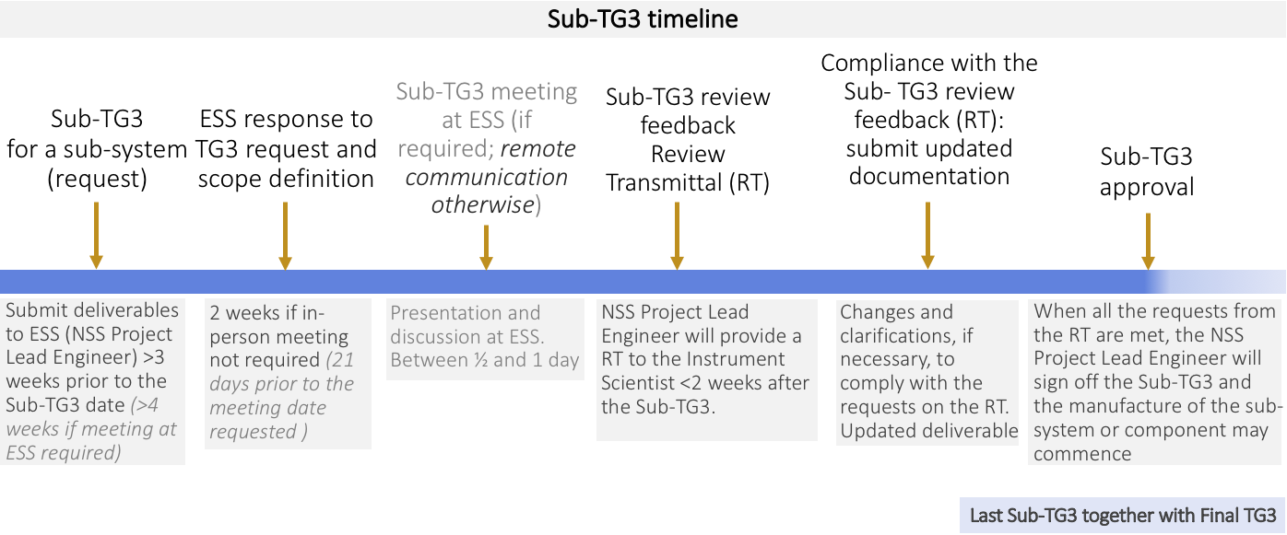
Input from Instrument Teams: Sub-TG3
Notes:
Sub-TG3’s are necessary for long lead time components/sub-systems where the manufacturing shall start before the final TG3.
It will be evaluated ad hoc whether a Sub-TG3 of a set of sub-systems require an in-person meeting or not. In principle, complex sub-systems have been carefully discussed during the IDR and amended with the Review Transmittal, and the other sub-systems might be straight forward enough to not need an in-person meeting.
In any case, ESS strongly suggests to the Instrument Teams to ensure a close contact with the Inst. Teams from an early stage during the development of their detail designs, ahead of the IDR and Sub-TG3 reviews.
The Sub-TG3 also use the RT tool, hence, the Reviewers will send their feedback to the NSS Lead Instrument Engineer who will include all requests for change and for clarification on a Review Transmittal. Gabor will follow up with the Inst. Team until the RT is fully addressed. Once the RT is fully addressed, and the Inst. Teams also complied with the rest of documentation required, Gabor will sign-off the Sub-TG3, meaning that the sub-system is endorsed for procurement/manufacturing.

Slide 16
Sub-TG3: deliverables
ESS-0099059
Updated project documents
SSDD Sub-System Design Description
Sub-system requirements
Actual Project Schedule
Draft of System Integration and Verification Plan
Draft of Project Quality Plan
Updated Bill of Materials for Activation Inventory
Draft of System Validation Plan
Draft of SDD with complete list of deliverables
Systems Operation and Maintenance Manual
Drawings/picts (in English)
Instrument Hazard Analysis
Process and Instrumentation diagrams
3D Model of the complete system
Hazard analysis
Notes:
The Sub-TG3 umbrella deliverable is the Sub-System Design Description; and the one for the Final TG3 is the System Design Description.
The SDD handles information with respect to external interfaces between the instrument and the environment.
The relevant SSDD describes the design solution to adhere to such an interface, and it is also the SSDD the one handling interfaces purely inside a sub-system.
The deliverables for a Sub-TG3 shall be submitted when placing the request.
The following are the content for the SSDD:***.
Please, always refer to CHESS doc ESS-0099059 and to the TG3 Confluence page.

Slide 17
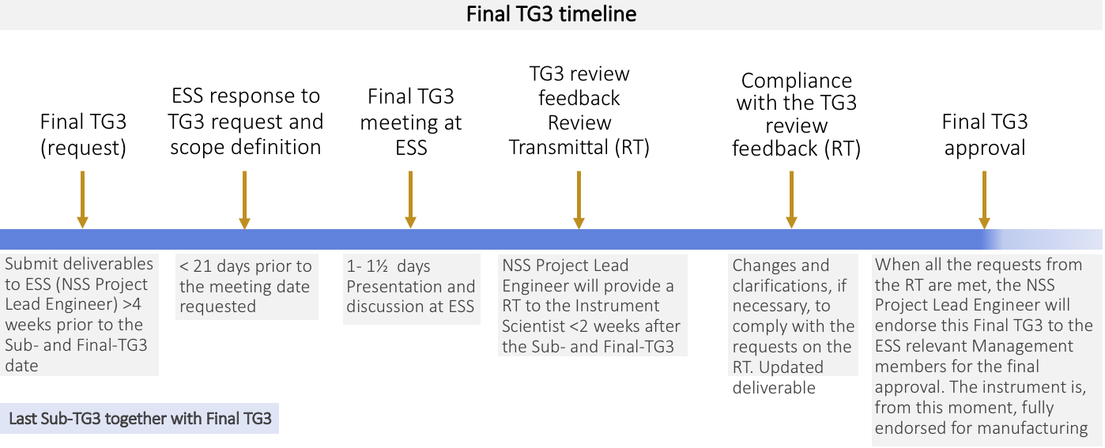
Input from Instrument Teams: Final TG3
Notes:
The Last Sub-TG3 takes place simultaneously to the Final TG3.
The timeline is very something in between an IDR and a Sub-TG3, as this slide shows.
Final TG3’s will be signed off by the relevant ESS Management members.

Slide 18
Final TG3: Deliverables
ESS-0099059
SDD System Design Description
Operational analysis of integration to Sample Environment Equipment and Lab Infrastructure & Logistics
References to the SSDD’s of the previous stages
Design of external infrastructural interfaces
Description of the external interfaces to the System
Certificate of Conformity for Hazardous Materials and Sustainability
System design for integration to Data acquisition and data analysis systems
Relevant sub-system requirements
Notes:
The Final-TG3 umbrella deliverable is the System Design Description.
The SDD handles information with respect to external interfaces between the instrument and the environment (i.e the ESS facility).
The deliverables for a Final-TG3 will be those for the last Sub-TG3 together with those for the Final-TG3 itself. The shall be submitted when placing the request.
The following are the content for the SDD:***.
Please, always refer to CHESS doc ESS-0099059 and to the TG3 Confluence page.

Slide 19
Making TG3 an agile process
DESIGN
IDR for complex sub-systems/components
Sub-TG3
Review Transmittal
NSS Lead Instrument Engineer: hub
Confluence page for Phase 2 and TG3
ESS Reviewer Teams available for the Inst. Teams along the development of their detail design
Phase 2
REVIEW
TG3
Notes:
Acknowledging that the TG3 is a complex process, we have tried to mitigate issues in terms of delays and work burden as much as possible. The measures that we are taking are:
Include IDRs for complex sub-systems and components to increase the efficiency of the design process.
Although when ESS resources are limited, we have tried to implement a few Sub-TG3s; more of them for the instruments which are prioritized.
The Review Transmittal will allow to have all requests for change and clarifications unified in only 1 doc.
We are using Gabor as the hub for feedback, which will hopefully make communication easier.
We have created a Confluence page for Phase 2 and TG3 processes gathering the most relevant information for the Inst. Teams.
We are ensuring to have our ESS Technology Teams available for the Inst. Teams and we hope they work alongside from a very early stage of the detail designs.
Not all might work, and we appreciate in advance the difficulties, in particular, for the Inst. Teams first dealing with these reviews. At this stage already, we want to apologize for the mutual learning process burdens and thank you beforehand for your patience.

Slide 20
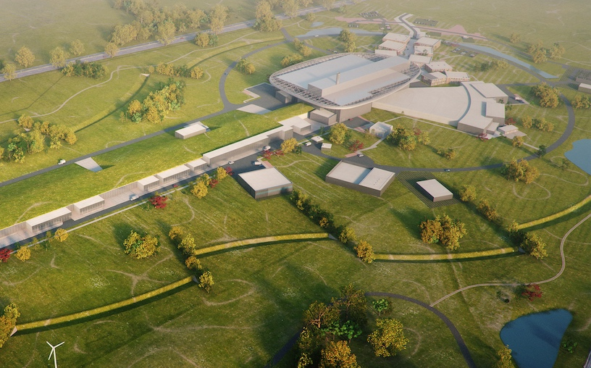
Journey to deliver the world’s leading facility for research using neutrons
Thank you
2025
ESS Construction Phase Complete
2014
Construction Starts on Green Field Site
2023
ESS Starts
User Program
2009
Decision to Site ESS in Lund
2019
Start of Initial Operations Phase
2012
ESS Design Update Phase Complete
2003
European Design of ESS Completed
Notes:
Thank you. And now Gabor will tell you:
How to create and upload the documents on CHESS
The evaluation process through the example of ESTIA.

