Slide 1
WP7 SINE2020 Review Meeting 22 - 23 Nov 2018 Prague, Czech Republic
Masaryk Dormitory Congress Centre, Prague, Czech Republic
https://www.masarykovakolej.cz/en/

Slide 2
Venue
https://www.masarykovakolej.cz/en
Meeting room, cattering
Hotel (in the immediate vicinity of the meeting place), 3 star
Restaurant (lunches)

Slide 3
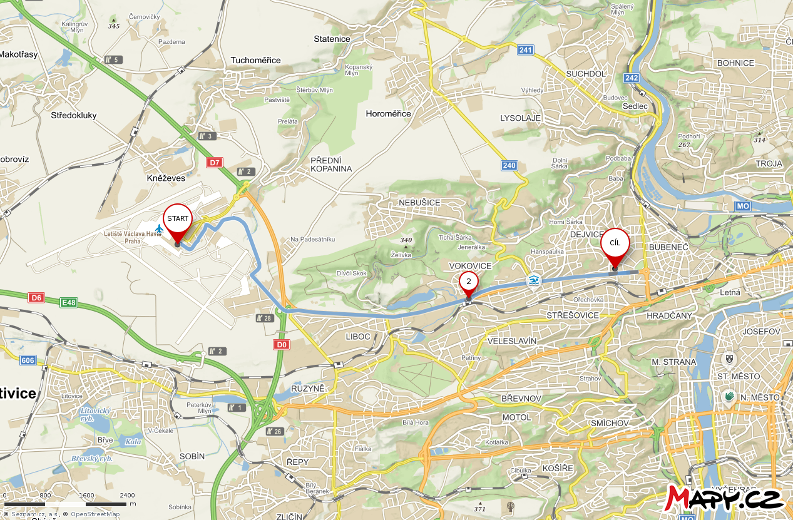
Travel
PRG, Prague Airport -> Masaryk Dormitory Congress Centre
To conference site public transport (about 30 min)
Taxi (about 20 min)

Slide 4
Schedule
Starts 22 Nov 2018 13:00
Ends 23 Nov 2018 13:30
Thursday-Friday, lunch-lunch meeting
A common dinner in town is planned on Thursday 22 November, 2018

Slide 5
Meeting web page
Webpage of the meeting
https://indico.esss.lu.se/e/WP7SINE2020PragueNovember
basic info
info on travel from the Prague airport to the conference site
schedule info
participants

Slide 6
Registration
Registration is now open at the webpage of the meeting
https://indico.esss.lu.se/e/WP7SINE2020PragueNovember
meeting announced rather sooner (to avoid troubles with accommodation)
limited number of rooms reserved until June 22, 2018, in Masaryk Dormitory Hotel (in the immediate vicinity of the meeting place)
Accommodation (prices per night, incl. VAT, breakfast, without recreation fee:
Single: 870,-CZK (around 35,-EUR)
Double: 1090,-CZK (around 44,-EUR)
Double for single use: 970,-CZK (around 39,-EUR)
It can be booked using the registration form at the meeting webpage
Registration for the meeting can be done also later (however, the accommodation in the Masaryk Dormitory Hotel cannot be then guaranteed)

