Slide 1
LO BOX and
LO/CLK DISTRIBUTION
Arash Kaftoosian
ESS Bilbao, May 2018

Slide 2
Outline
Divide-and-Mix LO Box
LO Distribution plan
New proposal: using 10 LO units instead of 9
LO/CLK Splitter Box Diagram
10-unit plan vs. 9-unit plan: Pros and Cons

Slide 3
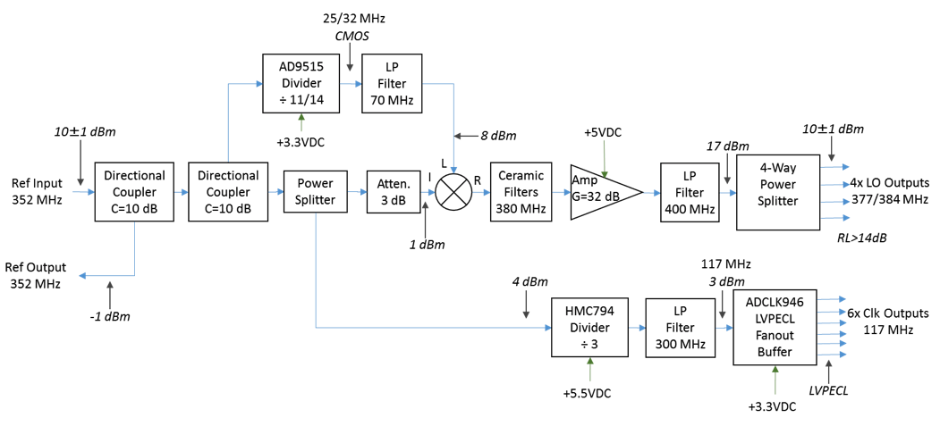
LO Box Block Diagram
Divide and Mix Topology

Slide 4
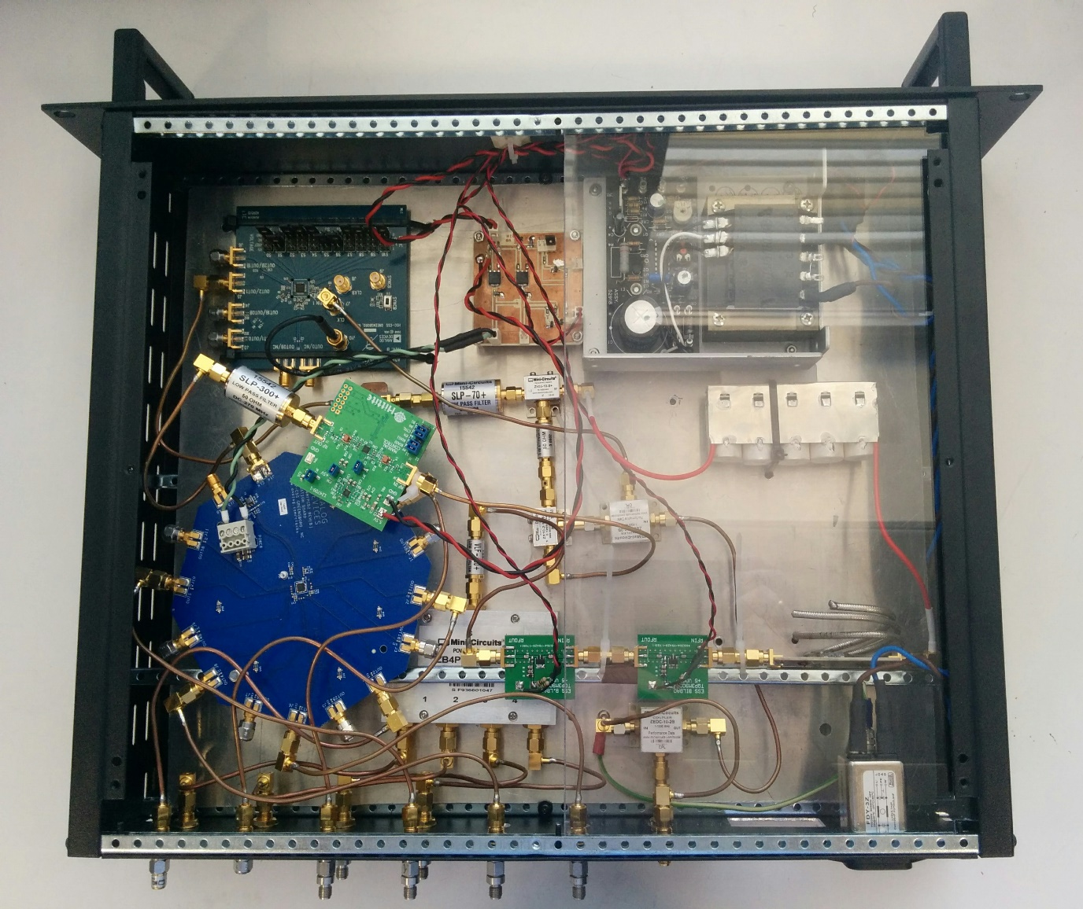
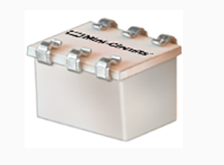
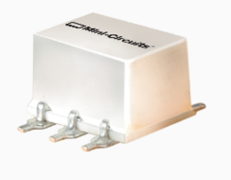
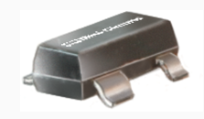
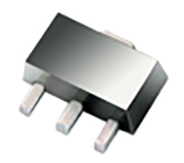
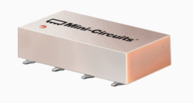
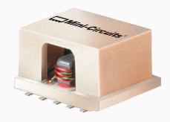
LO Box Prototype
Directional Coupler
Power Splitter
Attenuator
22dBm Amplifier
400MHz Low pass filter
1:4 Power Splitter

Slide 5
LO Box Fabrication
Number of LO boxes:
9 (or 10) for LLRFs of the 352MHz section
If ESS decides to employ this kind of LO system for the BPMs, the required number could be added to the same tender
It would be preferred to outsource the LO Box
SMD components will be used along with proper shielding/isolations to increase performance
Control/monitoring interfaces to be added to communicate to EPICS through Ethernet

Slide 6
LO BOX INTERFACES
RF Power Monitoring | Input (REF) Power | Ethernet
 | Output (CLK) Power | Ethernet
 | Output (LO) power | Ethernet
Power Supply Monitor | Voltage | Ethernet
 | Current | Ethernet
Temperature | Internal temperature Sensor | Ethernet
Interlock Signals | Fault (out) | Analog
 | Ready (out) | Analog
 | Reset (in) | Analog
 | Enable/Disable (in) | Analog

Slide 7
LO DISTRIBUTION
The current plan is to use 9 LO boxes for the 352MHz section of ESS linac:
1 for RFQ
1 for MEBT and DTL
7 for Spokes
In this configuration, each LO outputs for DTL should divide by 5 which has certain disadvantages:

Slide 8
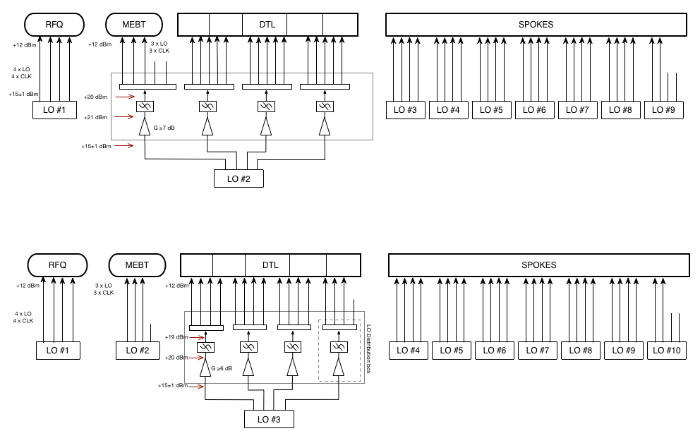
9-LO
10-LO

Slide 9
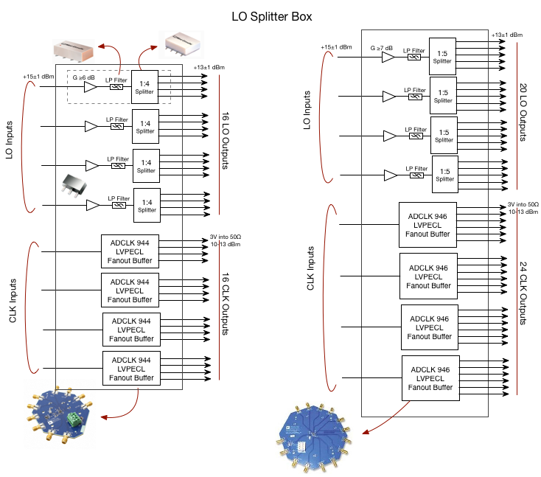
10-LO
9-LO

Slide 10
9-LO Topology vs. 10-LO: Pros and Cons
9 LO unit | 10 LO unit
1:5 splitters | 1:4 splitters
More expensive splitters with less performance and less options | Cheaper splitters with better performance and more options
Worse phase and amplitude balance | Better phase and amplitude balance
Different amplifier and splitter will be used | Same amplifier and splitter as in LO box
More cables with different length | Shorter cables and more symetric
Higher power amplifiers and thus more rated power filters and splitters | Lower power amplifiers and thus lower rated power filters and splitters
Higher power and gain thus less linearity and more harmonics level | Less power and gain thus better linearity and less harmonics
MEBT and DTL sharing the same LO box | Les cross dependency between MEBT and DTL low-level electronics

Slide 11
THANK YOU

