Slide 1
Short visitor safety induction
Michael Plagge OHS Engineer

Slide 2
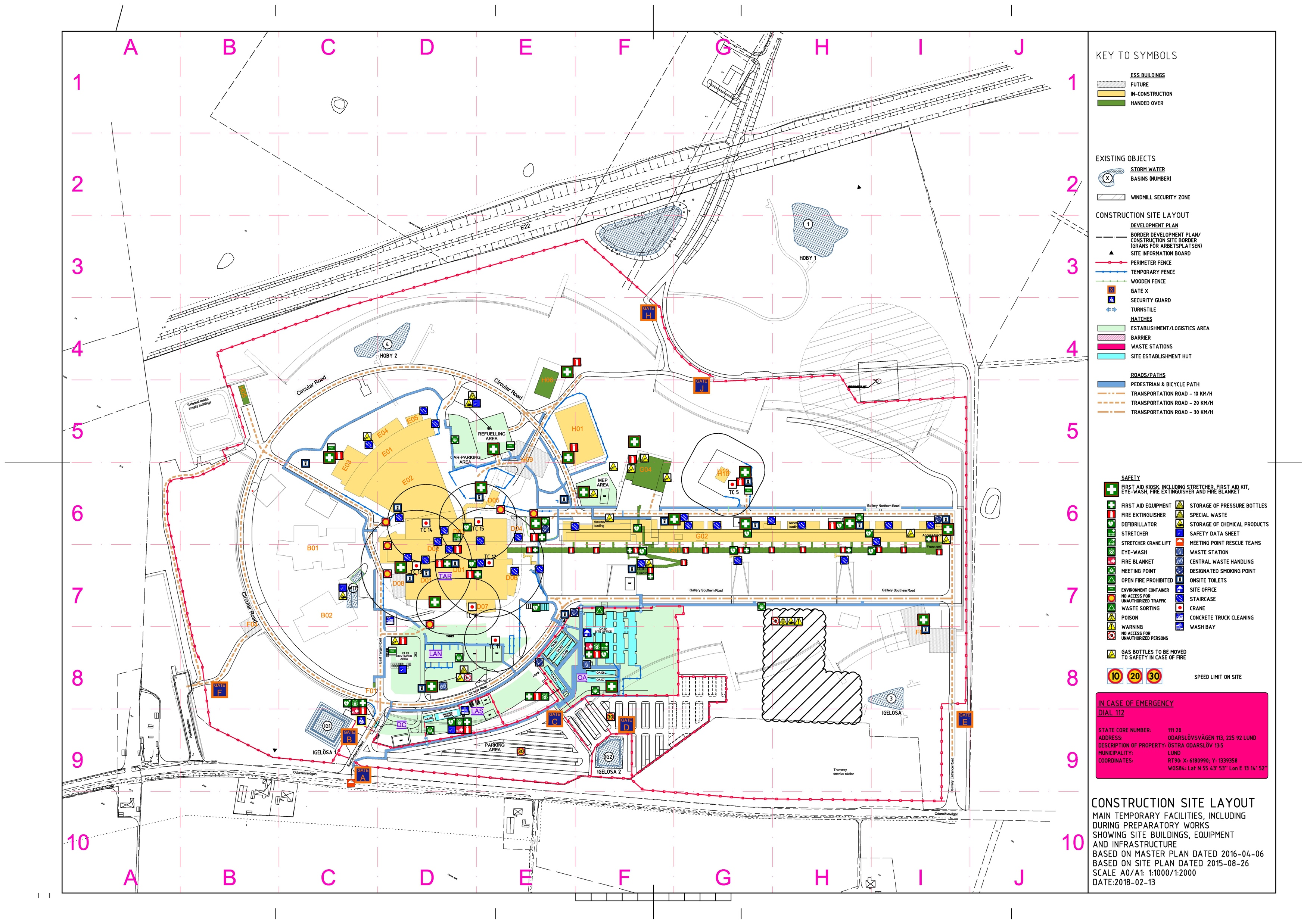
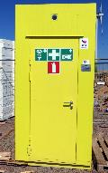
= Reassembly points in case of emergency
= Defibrillator
Accelerator buildings
Site Office

Slide 3
Shortlist
Only long trousers
Wear all prescribed personal protective equipment
Announce special needs (Medical etc.)
Stick to the guide
Use walkways and always check for traffic
Respect barriers
Do not walk and talk on the phone

Slide 4
Enjoy the tour
”We work Safely – or not at all!”
Skanska Sweden’s Health and Safety Policy
Notes:
Encourage safety dialogue before reporting.

