Slide 1
Overall description of the Ion Source & LEBT
Øystein Midttun
System Leader – Ion source and LEBT
SRR 1 – Ion Source & LEBT
2018-07-17--18

Slide 2
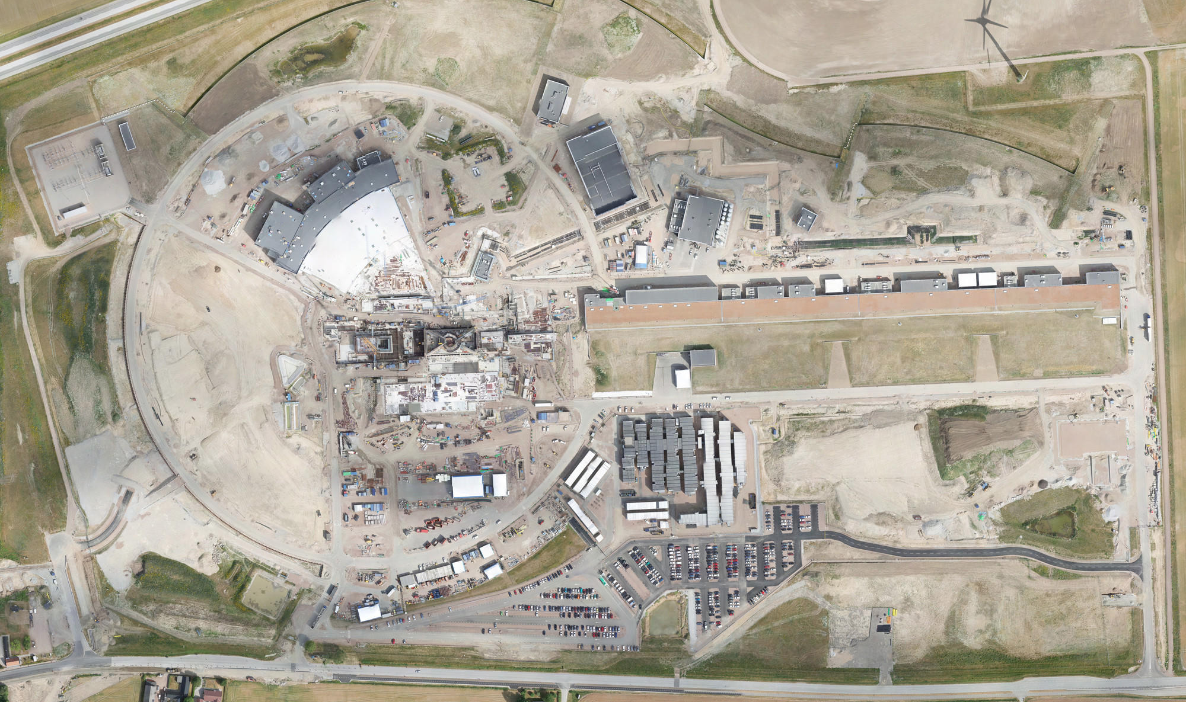
ESS layout (July 2018)
You are here
Ion source and LEBT
Target
Local control room

Slide 3
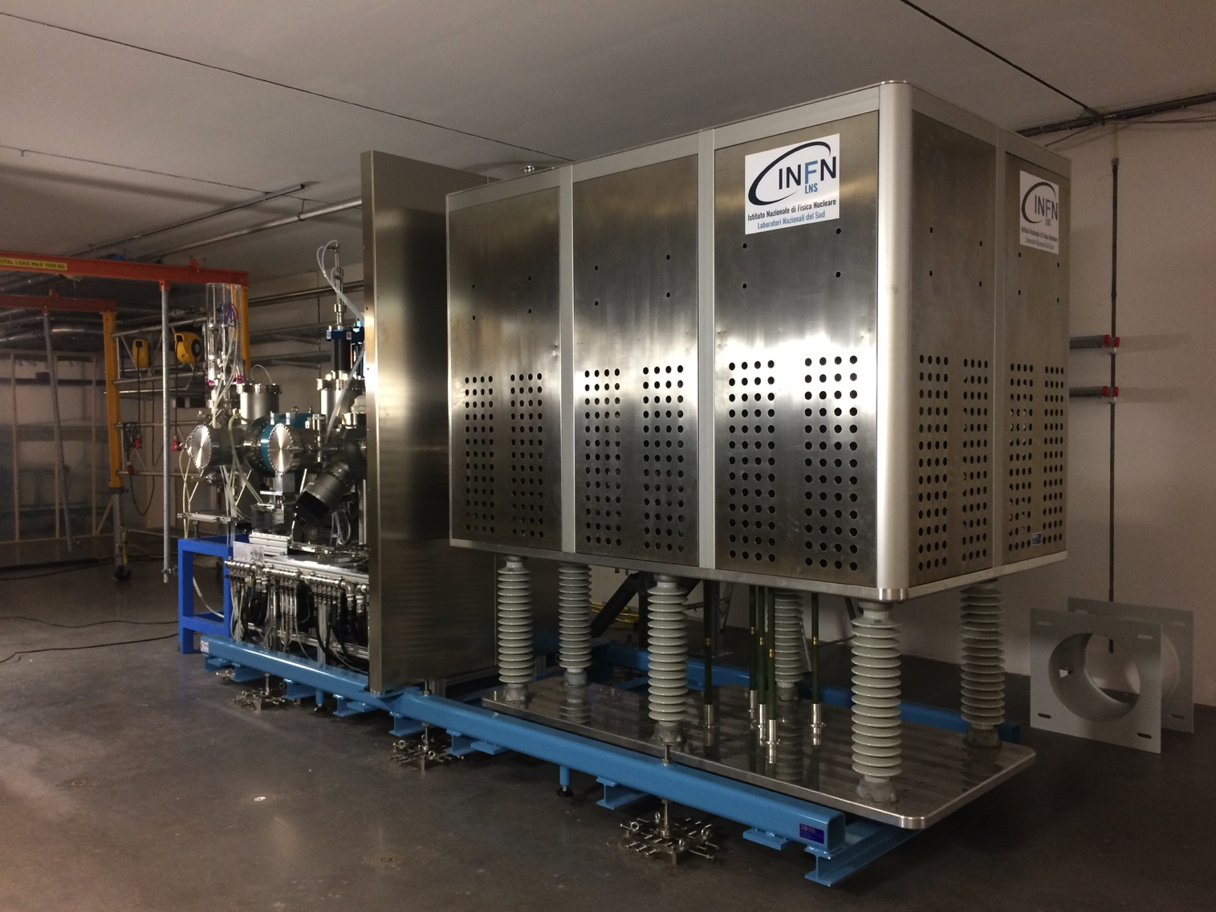
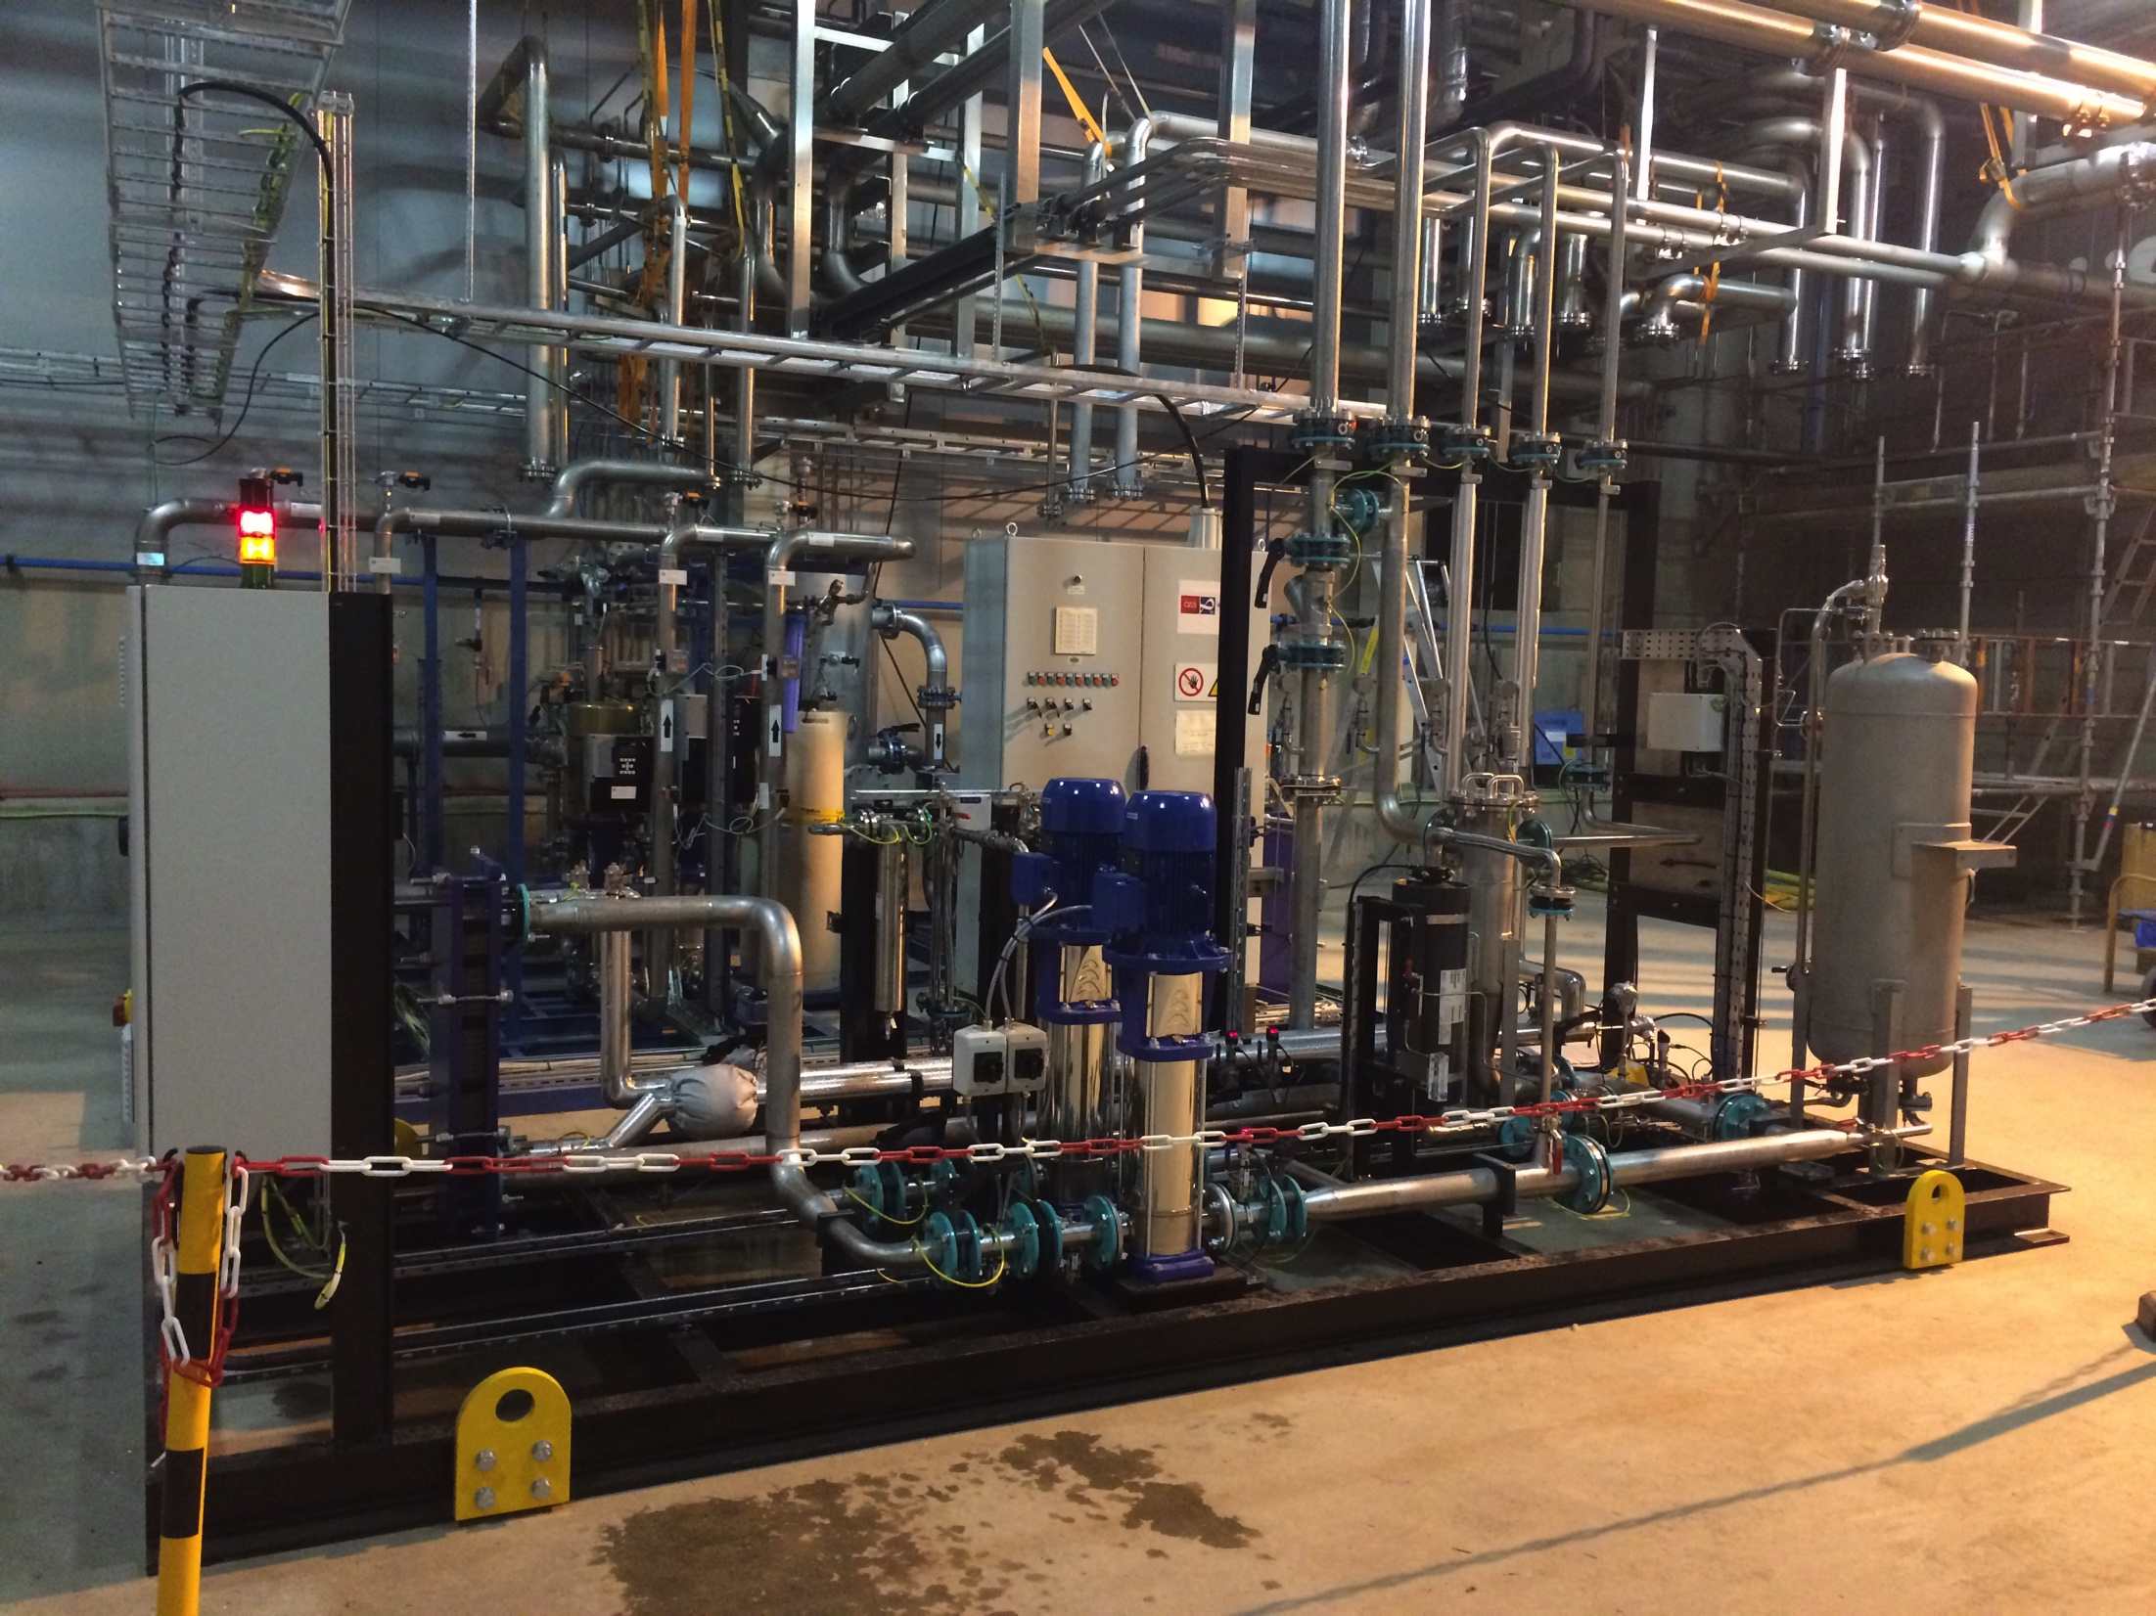
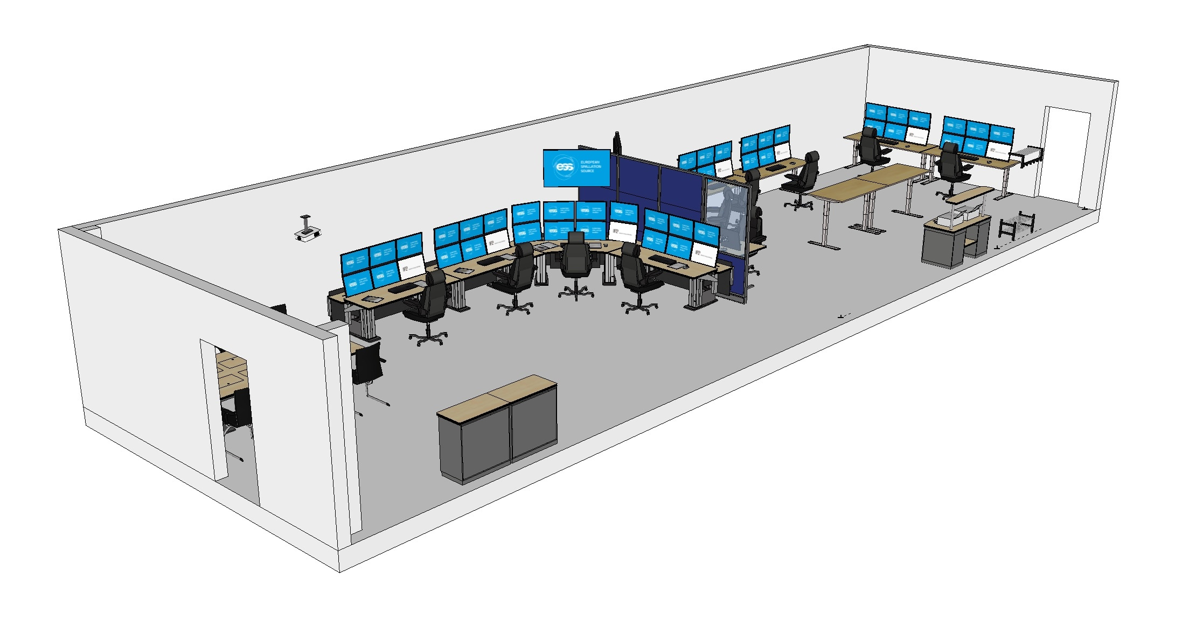
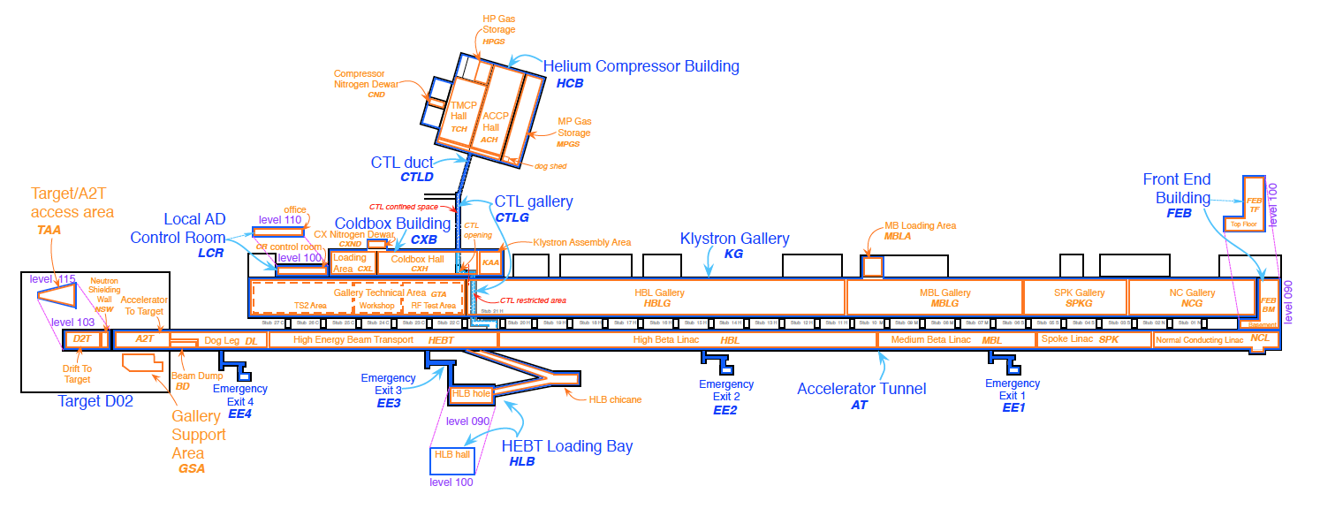
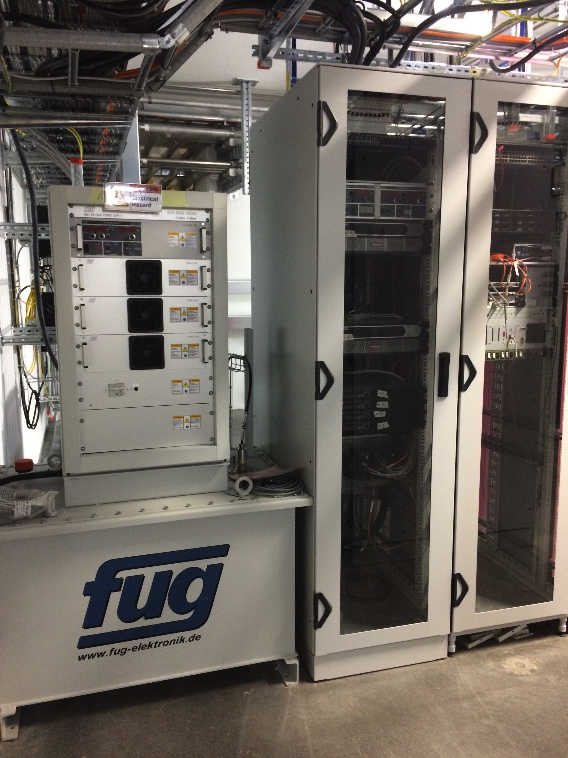
Overview of accelerator tunnel
Cooling water skid
Local control room
Electrical power (racks)
Ion source and LEBT

Slide 4
Table of content
System Requirements (high level)
Specific safety systems (engineered control)
Operating & safety procedures (administrative control)
Test & Verification
Allowed testing Envelope
Open issues
System Requirements
Specific safety systems
Operating & safety procedures (administrative control)
Test & Verification
Allowed testing Envelope
Open issues

Slide 5
System Requirements – Beam parameters at RFQ entrance
Particle Protons (H⁺)
Current 70 mA
Energy 75 kV
Pulse length 2.86 ms
Repetition rate 14 Hz
Duty cycle 4%
Emittance (99%) 2.25 mm mrad
Emittance (rms) 0.25 mm mrad
Stability
Flat top ±2%
Pulse to pulse ±3.5%

Slide 6
Sub-system overview
EMU 1
EMU 2
Faraday cup
Doppler shift
NPM 1
ACCT
NPM 2
Ion source
Solenoid 1
Iris
Chopper
Solenoid 2
Collimator
Electron
repeller
Electron
repeller
Gate valve
Gate valve
Pumping box
Permanent tank
Commissioning tank
ACCT: AC current transformer
EMU: Emittance measurement unit
NPM: Non-invasive profile monitor

Slide 7
Sub-systems – Ion source
Ion source
Plasma chamber
Extraction system
Pumping box
Magnetron
Waveguide
H₂ bottle
3 x solenoid
Repeller
High voltage (HV) platform
Voltage divider
Isolation transformer
HV power supply
Front End and Magnets

Slide 8
Sub-systems – LEBT
Ion source
Low energy beam transport (LEBT)
Plasma chamber
Extraction system
Pumping box
Solenoid
2 x steerer
Iris
Diagnostics tank
Solenoid
2 x steerer
Collimator
Commissioning tank (RFQ)
Magnetron
Waveguide
H₂ bottle
3 x solenoid
Repeller
Chopper
Repeller
Beam stop
N₂ bottle
High voltage (HV) platform
Voltage divider
Isolation transformer
HV power supply
Front End and Magnets

Slide 9
Sub-systems – Beam Diagnostics
Ion source
Low energy beam transport (LEBT)
Plasma chamber
Extraction system
Pumping box
Solenoid
2 x steerer
Iris
Diagnostics tank
Solenoid
2 x steerer
Collimator
Commissioning tank (RFQ)
Magnetron
Waveguide
H₂ bottle
3 x solenoid
Repeller
Chopper
Repeller
Beam stop
EMU H+V
ACCT
EMU H+V
N₂ bottle
Faraday cup
Faraday cup
High voltage (HV) platform
NPM H+V
NPM H+V
ACCT
Voltage divider
Doppler shift
Doppler shift
Isolation transformer
HV power supply
Front End and Magnets
ACCT: AC current transformer
EMU: Emittance measurement unit
NPM: Non-invasive profile monitor
TMP: Turbomolecular pump
Alternative location of beam instruments for commissioning
Beam Diagnostics

Slide 10
Sub-systems – Vacuum
Ion source
Low energy beam transport (LEBT)
Plasma chamber
Extraction system
Pumping box
Solenoid
2 x steerer
Gate valve
Iris
Diagnostics tank
Gate valve
Solenoid
2 x steerer
Collimator
Commissioning tank (RFQ)
Magnetron
Waveguide
H₂ bottle
3 x solenoid
Repeller
2 x TMP
Chopper
Repeller
Beam stop
EMU H+V
ACCT
EMU H+V
N₂ bottle
Faraday cup
Faraday cup
High voltage (HV) platform
NPM H+V
NPM H+V
ACCT
Voltage divider
Doppler shift
Doppler shift
2 x TMP
2 x TMP
Primary pump
Primary pump
Isolation transformer
HV power supply
Front End and Magnets
Vacuum
ACCT: AC current transformer
EMU: Emittance measurement unit
NPM: Non-invasive profile monitor
TMP: Turbomolecular pump
Alternative location of beam instruments for commissioning
Beam Diagnostics

Slide 11
Sub-systems – Cooling water
Ion source
Low energy beam transport (LEBT)
Ion source
LEBT 1
LEBT 2
Plasma chamber
Extraction system
Pumping box
Solenoid
2 x steerer
Gate valve
Iris
Diagnostics tank
Gate valve
Solenoid
2 x steerer
Collimator
Commissioning tank (RFQ)
Magnetron
Waveguide
H₂ bottle
3 x solenoid
Repeller
2 x TMP
Chopper
Repeller
Beam stop
EMU H+V
ACCT
EMU H+V
N₂ bottle
Faraday cup
Faraday cup
High voltage (HV) platform
NPM H+V
NPM H+V
ACCT
Voltage divider
Doppler shift
Doppler shift
2 x TMP
2 x TMP
Primary pump
Primary pump
Isolation transformer
HV power supply
Front End and Magnets
Vacuum
ACCT: AC current transformer
EMU: Emittance measurement unit
NPM: Non-invasive profile monitor
TMP: Turbomolecular pump
Alternative location of beam instruments for commissioning
Beam Diagnostics
Cooling water

Slide 12
Sub-systems – Safety
Ion source
Low energy beam transport (LEBT)
PSS0 controlled area
and radiation shielding
Ion source
LEBT 1
LEBT 2
Plasma chamber
Extraction system
Pumping box
Solenoid
2 x steerer
Gate valve
Iris
Diagnostics tank
Gate valve
Solenoid
2 x steerer
Collimator
Commissioning tank (RFQ)
Magnetron
Waveguide
H₂ bottle
3 x solenoid
Repeller
2 x TMP
Chopper
Repeller
Beam stop
EMU H+V
ACCT
EMU H+V
N₂ bottle
Faraday cup
Faraday cup
High voltage (HV) platform
NPM H+V
NPM H+V
ACCT
Voltage divider
Doppler shift
Doppler shift
2 x TMP
2 x TMP
Primary pump
Primary pump
Isolation transformer
HV power supply
Front End and Magnets
Vacuum
PSS
ACCT: AC current transformer
EMU: Emittance measurement unit
NPM: Non-invasive profile monitor
TMP: Turbomolecular pump
Alternative location of beam instruments for commissioning
Beam Diagnostics
Cooling water

Slide 13
Sub-systems – Control system
Ion source
Low energy beam transport (LEBT)
PSS0 controlled area
and radiation shielding
Ion source
LEBT 1
LEBT 2
Plasma chamber
Extraction system
Pumping box
Solenoid
2 x steerer
Gate valve
Iris
Diagnostics tank
Gate valve
Solenoid
2 x steerer
Collimator
Commissioning tank (RFQ)
Magnetron
Waveguide
H₂ bottle
HV controls
3 x solenoid
Repeller
2 x TMP
Chopper
Repeller
Beam stop
EMU H+V
ACCT
EMU H+V
N₂ bottle
Faraday cup
Faraday cup
High voltage (HV) platform
NPM H+V
NPM H+V
ACCT
Voltage divider
Doppler shift
Doppler shift
2 x TMP
2 x TMP
Primary pump
Primary pump
Isolation transformer
HV power supply
Ground potential controls
Front End and Magnets
Vacuum
PSS
ACCT: AC current transformer
EMU: Emittance measurement unit
NPM: Non-invasive profile monitor
TMP: Turbomolecular pump
Alternative location of beam instruments for commissioning
Beam Diagnostics
Cooling water
Control system

Slide 14
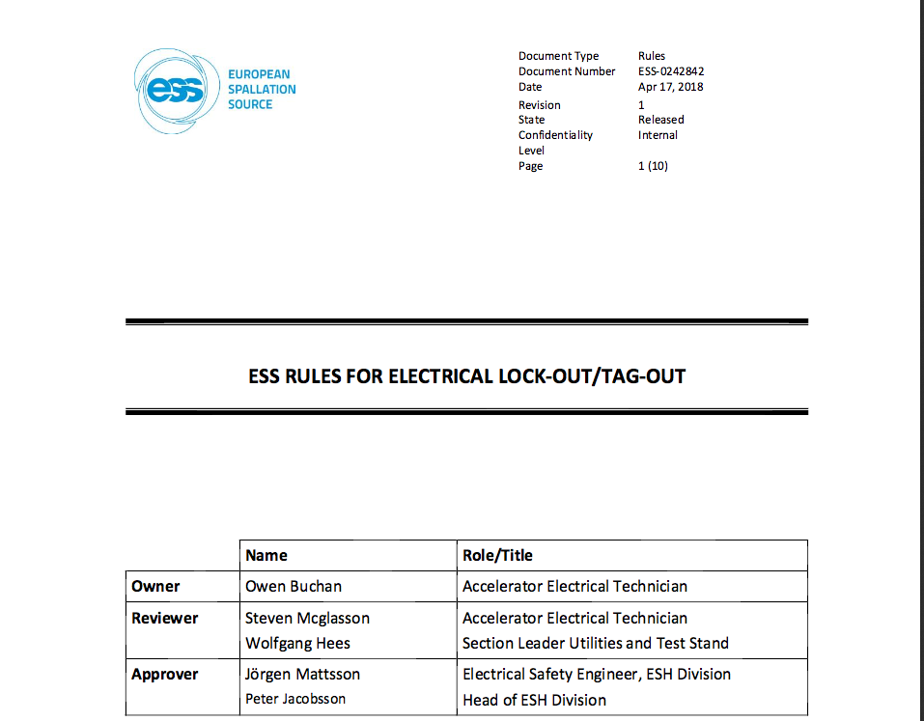
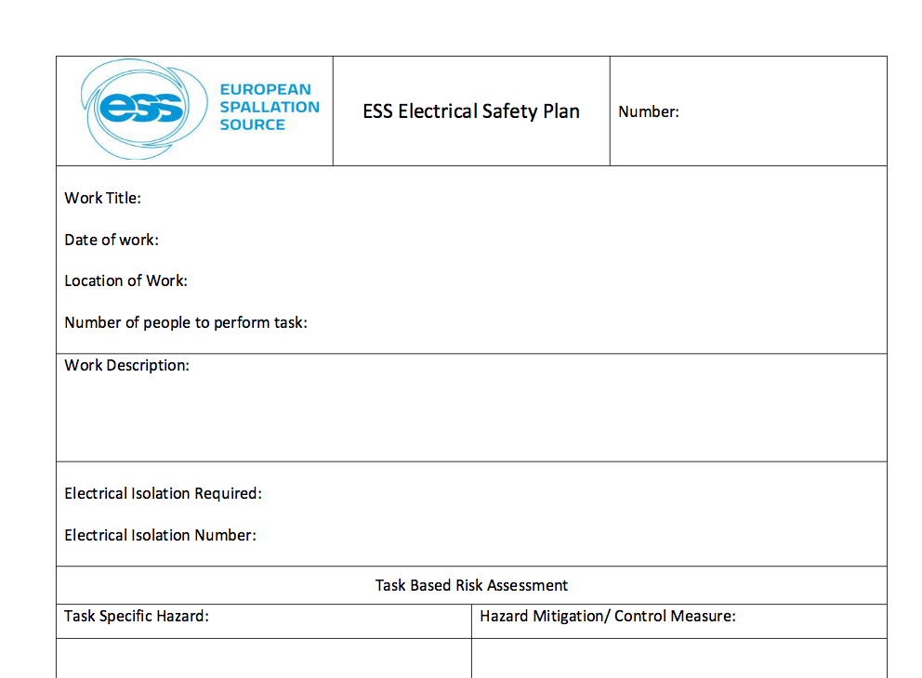
Specific safety systems – Electrical
– For energization of electrical equipment (e.g. racks, power supplies) we have the Electrical Safety Plan that needs to be presented to the Electrical Safety Leader
– Lock-out tag-out is performed by the Electrical Safety Leader
ESS-0242842 – ESS RULES FOR ELECTRICAL LOCK-OUT/TAG-OUT

Slide 15
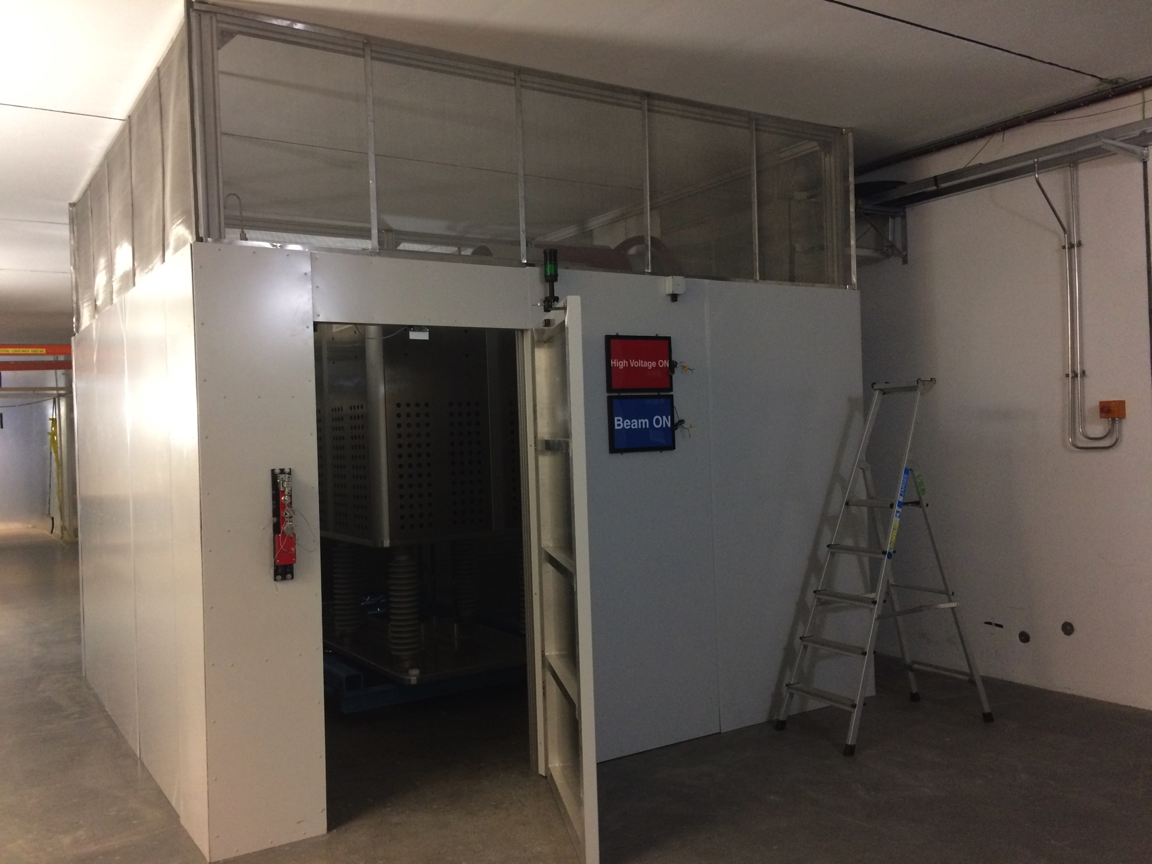
Specific safety systems – Personal safety
– Ion source safety fence with PSS access control mitigates the high voltage hazard

Slide 16
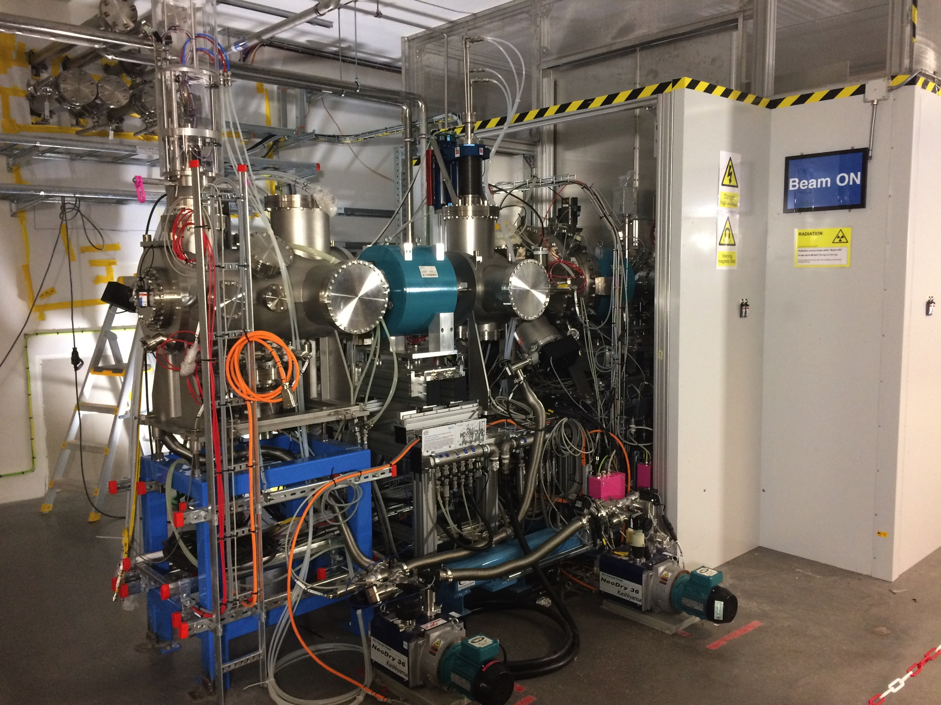
Specific safety systems – Radiation safety
– The ion source produces x-rays with energies up to 75 keV
– These x-ray originates from electrons that accelerated back to the plasma chamber
– The ion source safety fence includes 2 mm thick lead plates to reduce the radiation below natural background

Slide 17
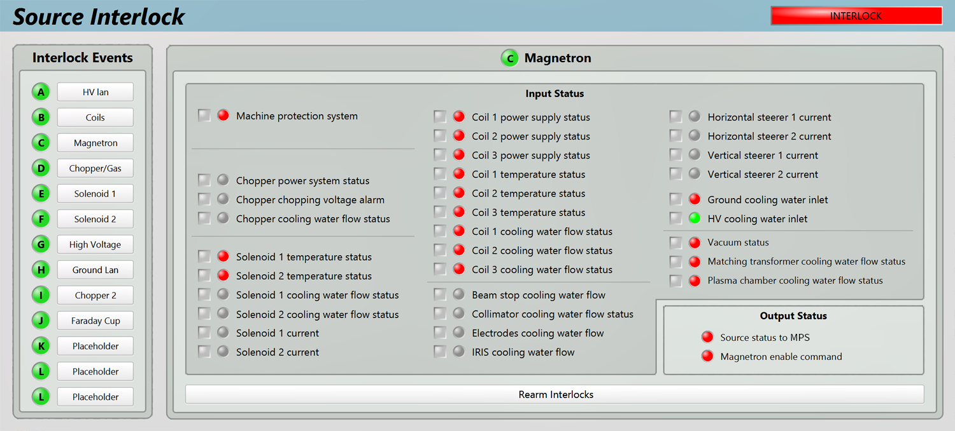
Specific safety systems – Machine protection
– For commissioning we have local protection (interlocks) for all devices

Slide 18
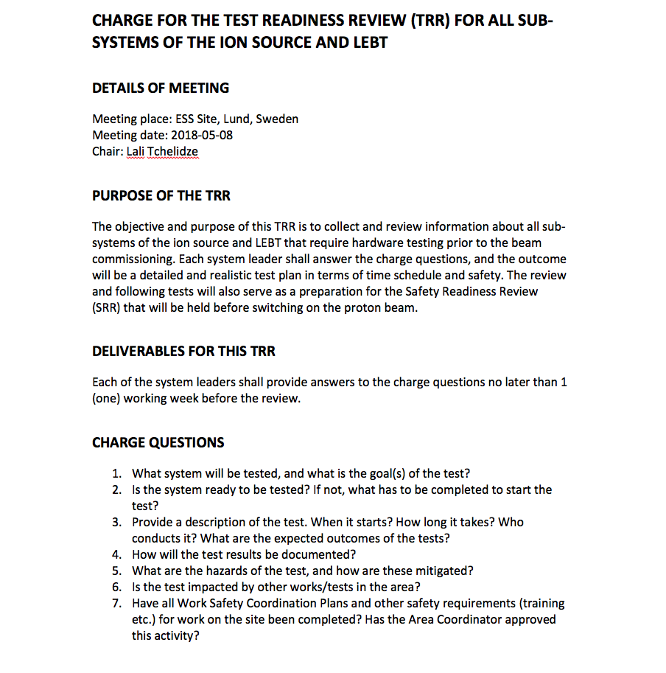
Test & Verification – TRR
From the test readiness review (TRR) we gathered the different stakeholder to define:
Which test to be done
The prerequisites for the tests
Coordination of the tests
Safety issues

Slide 19
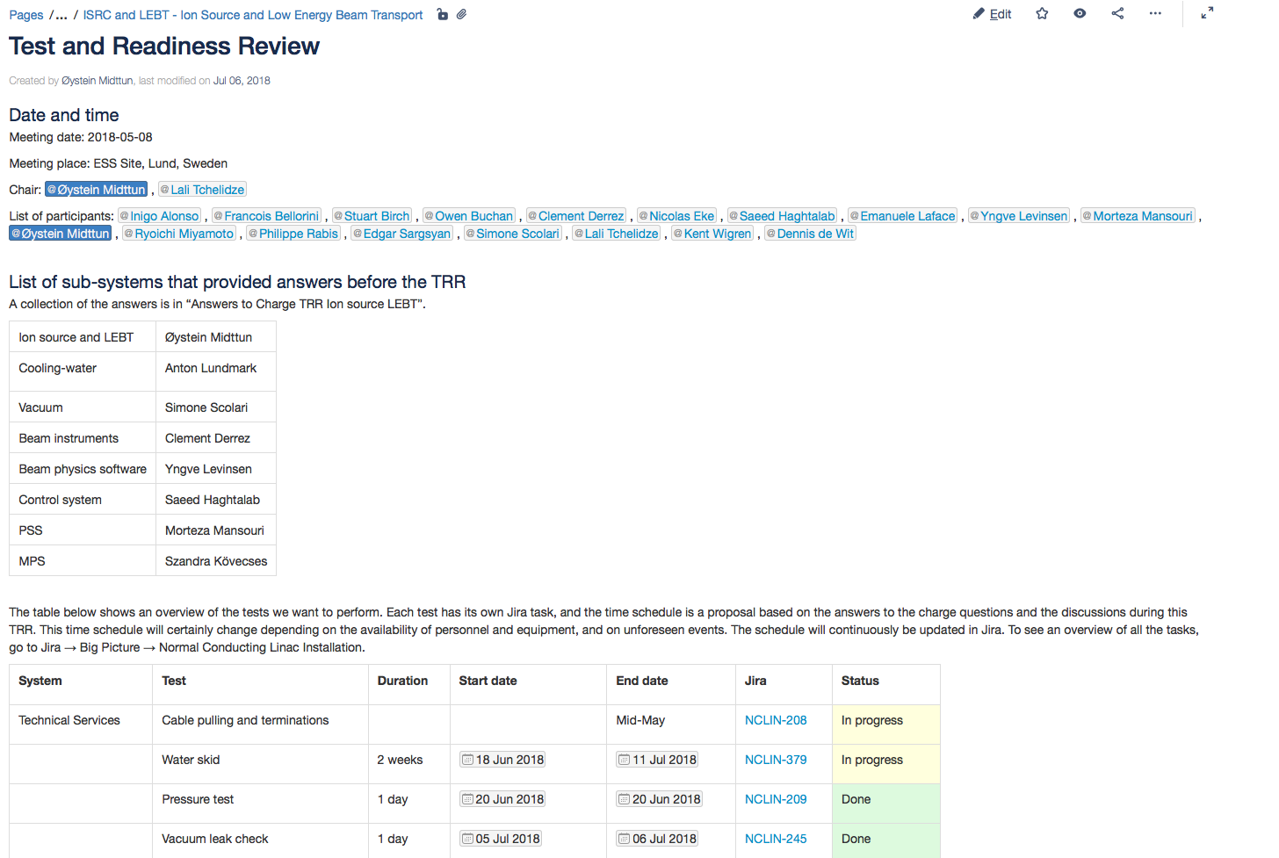
Test & Verification – TRR
TRR documentation
Meeting minutes in Confluence –https://confluence.esss.lu.se/display/LG/Test+and+Readiness+Review
Test and verification plan – ESS-0317305 - Ion source and LEBT verification plan
Test and verification report – collection of results from the test and verification plan

Slide 20
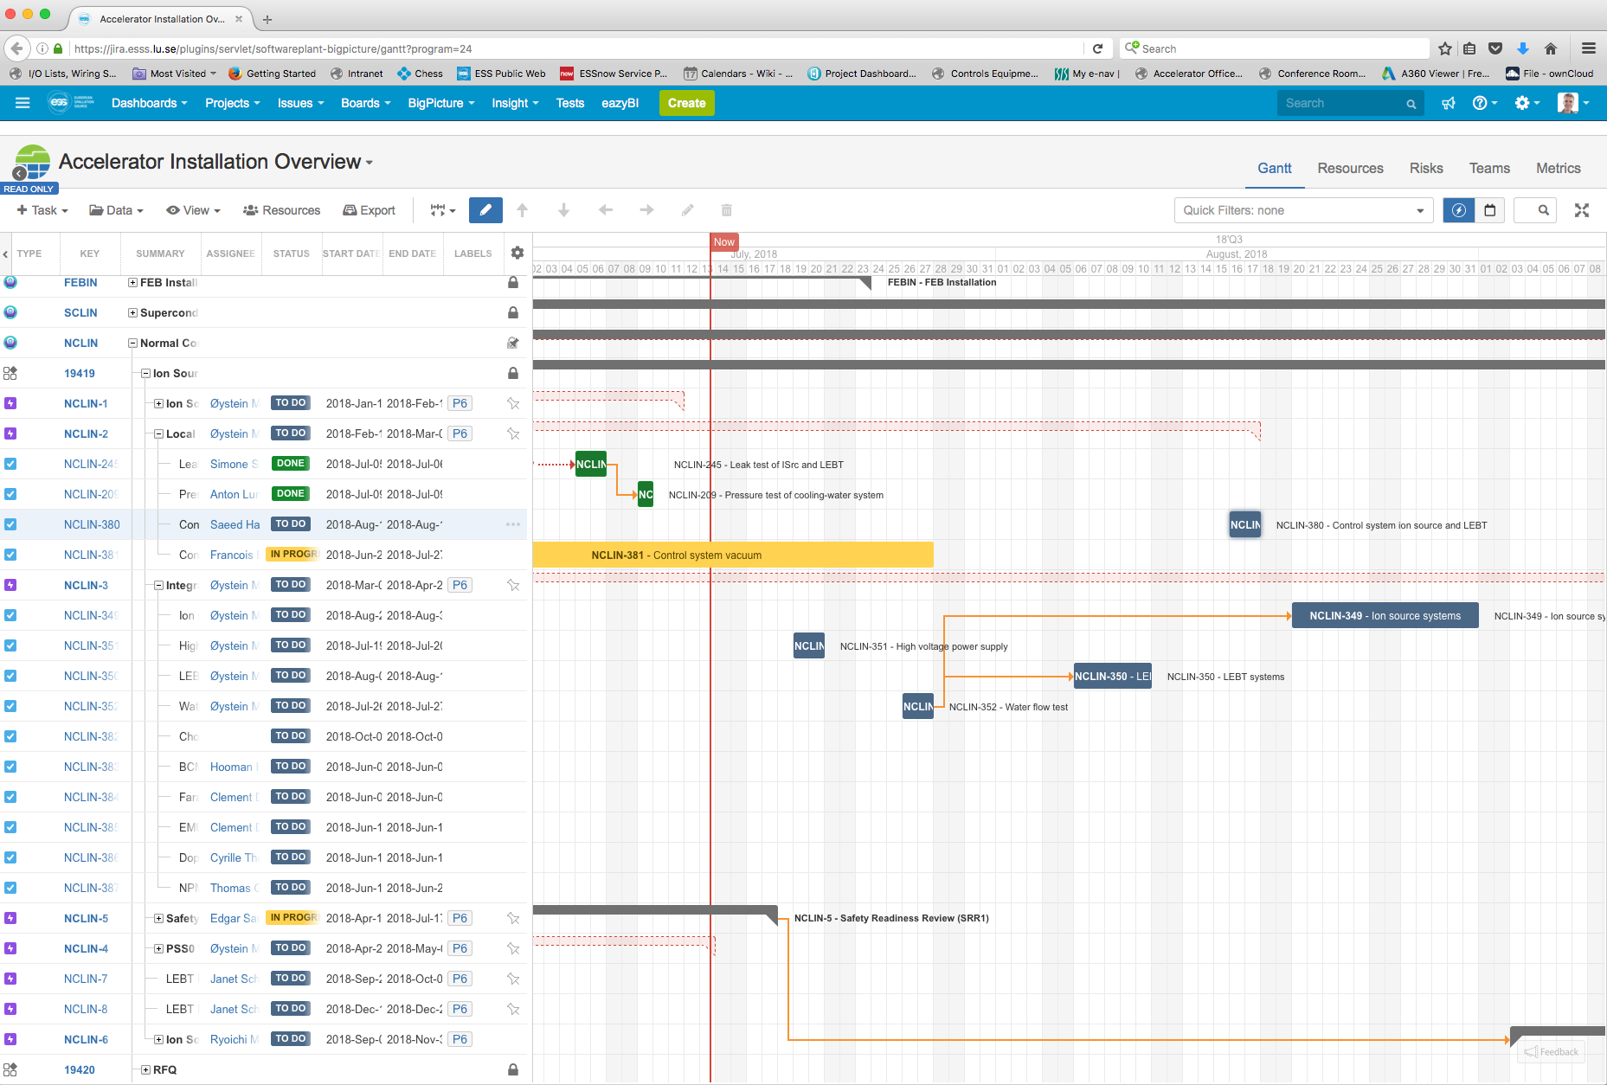
Test & Verification – TRR
– Tracking of progress in Jira
– Test are stored as Jira issues, where we can document progress and report

Slide 21
Test & Verification – allowed testing envelope
Any beam mode of the ESS accelerator is ok for the ion source and LEBT commissioning
To protect the machine, the following envelope must be respected (controlled by software)
High voltage 70-80 kV
Microwave power < 2 kW
Pulse length < 6 ms
Duty cycle < 8%
Pulse length for emittance measurement in the commissioning tank 200 µs (tbc by Beam Diagnostics)

Slide 22
Ion source and LEBT

