Slide 1
LEBT solenoids and correctors
Øystein Midttun
System Leader – Ion source and LEBT
SRR 1 – Ion Source & LEBT
2018-07-17--18

Slide 2
System – LEBT
Ion source
Low energy beam transport (LEBT)
PSS0 controlled area
and radiation shielding
Ion source
LEBT 1
LEBT 2
Plasma chamber
Extraction system
Pumping box
Solenoid
2 x steerer
Gate valve
Iris
Diagnostics tank
Gate valve
Solenoid
2 x steerer
Collimator
Commissioning tank (RFQ)
Magnetron
Waveguide
H₂ bottle
HV controls
3 x solenoid
Repeller
2 x TMP
Chopper
Repeller
Beam stop
EMU H+V
ACCT
EMU H+V
N₂ bottle
Faraday cup
Faraday cup
High voltage (HV) platform
NPM H+V
NPM H+V
ACCT
Voltage divider
Doppler shift
Doppler shift
2 x TMP
2 x TMP
Primary pump
Primary pump
Isolation transformer
HV power supply
Ground potential controls
Front End and Magnets
Vacuum
PSS
ACCT: AC current transformer
EMU: Emittance measurement unit
NPM: Non-invasive profile monitor
TMP: Turbomolecular pump
Alternative location of beam instruments for commissioning
Beam Diagnostics
Cooling water
Control system

Slide 3
Table of content
System Requirements
Protection systems
Test & Verification
Open issues

Slide 4
System Requirements
Particle Protons (H⁺)
Proton current 0-74 mA
Transmission > 95%
Energy 75 kV
Pulse length 2.86 ms
Repetition rate 14 Hz
Duty cycle 4%
Emittance (99%) 2.25 mm mrad
Emittance (rms) 0.25 mm mrad
Chopper efficiency 99%

Slide 5
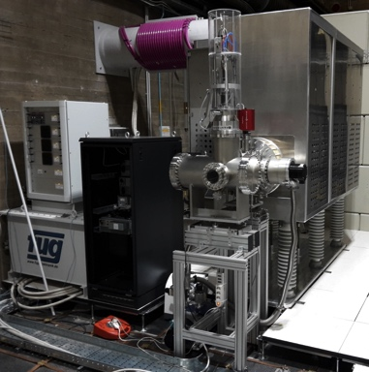
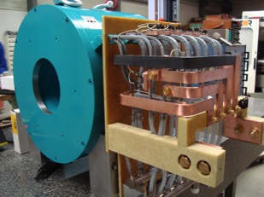
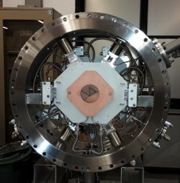
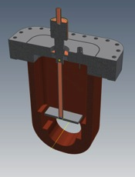
Two-solenoid LEBT
2.5 m
Proton source
– creates the beam
Solenoid
– focuses the beam
Iris
– controls the current
Chopper and collimator
– controls the pulse length

Slide 6
Two-solenoid LEBT
2.5 m
H₂⁺
H₃⁺
H⁺
6

Slide 7
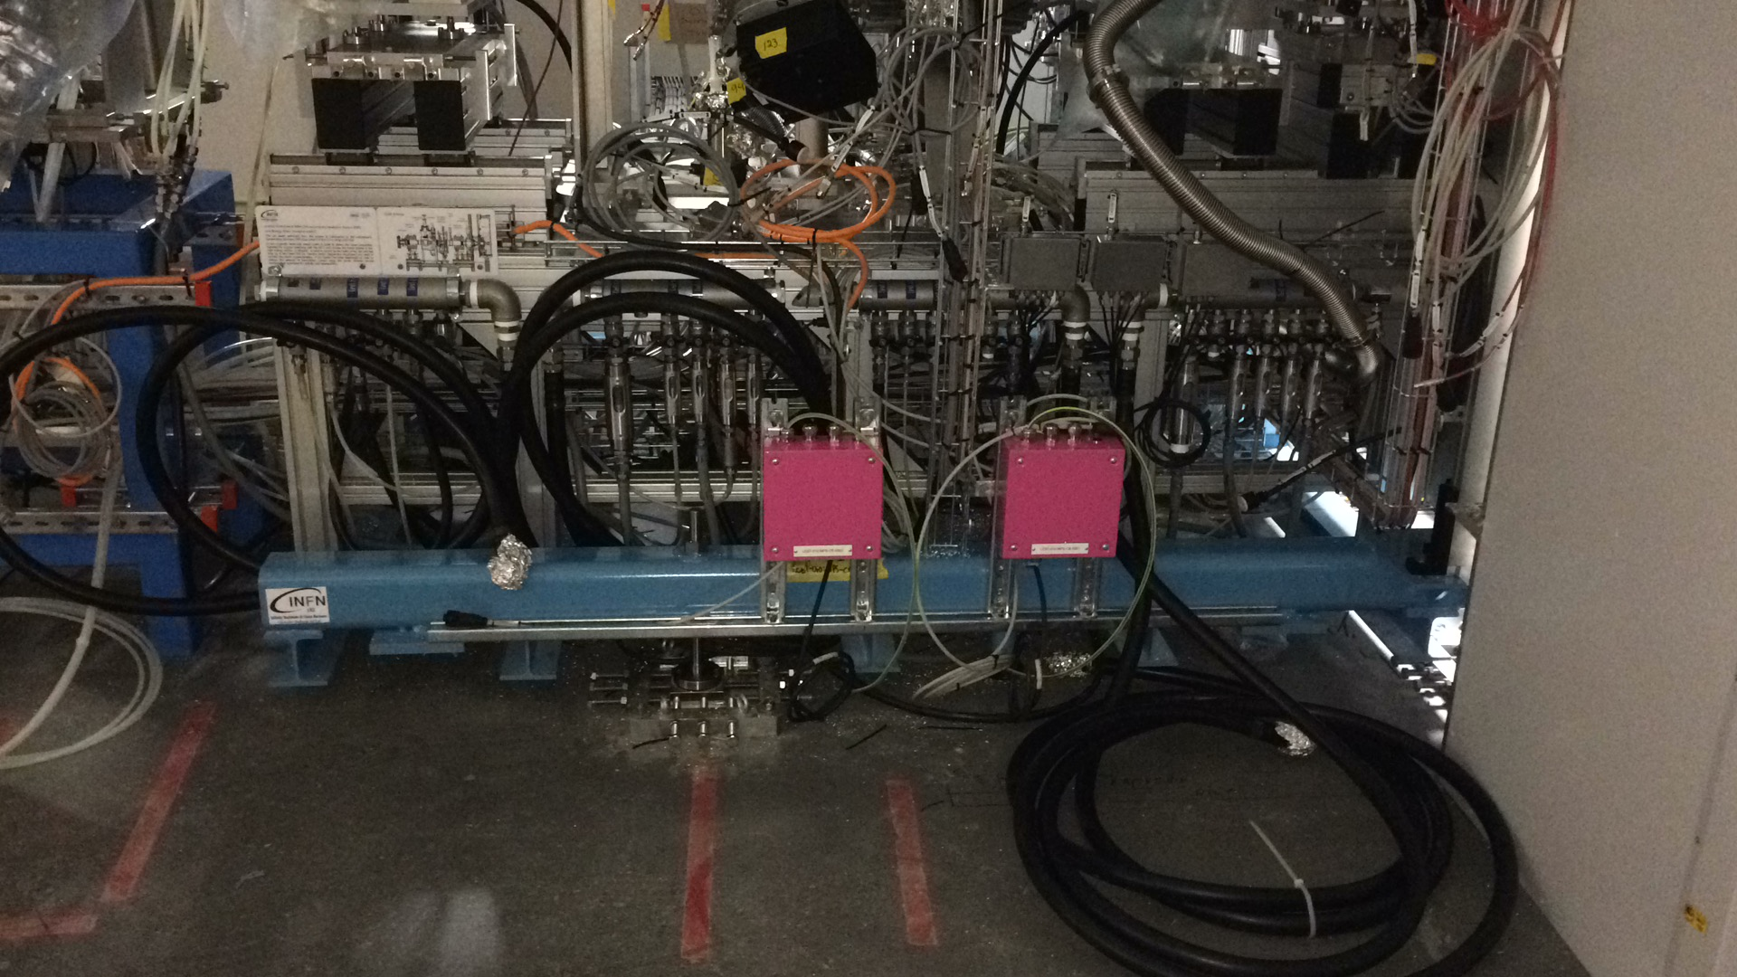
Protection systems – Temperature sensors and flow meters on cooling water manifold
– Temperature sensors on iris and collimator
– Temperature switches on solenoids
– Controlled by the interlock system

Slide 8
Test & Verification – ESS-0317305 - Ion source and LEBT verification plan
System testing
Solenoid x 2
Steerers x 2 (horizontal and vertical)
Repeller electrode
Iris
Protection systems testing
Manual testing of interlocks, i.e. flow meters, temperature and pressure sensors
Remaining installation
Chopper electronics
A team from INFN-LNS will come to ESS for installation and commissioning
This activity will be coordinated to be performed at the same time as the installation of the 2nd EMU head

Slide 9
Outstanding issues
# | System/Comp. | Status | Description | Due date | Remark
1 | LEBT test and verification | Not started | All tests in the verification plan | end-August | Procedure defined in ESS-0317305 - Ion source and LEBT verification plan
2 | Chopper electronics | Not installed | A team from INFN-LNS will come to ESS for installation and commissioning | October, tbc with in-kind partner | Missing the chopper is not critical for any beam line components
3 | Chopper hardware | Being designed | Chopper needs hardware change to improve the efficiency | December | Not critical for beam commissioning. Delivery by in-kind partner.

