Slide 1
Personnel Safety system 0 for the Ion Source and LEBT (PSS0)
Stuart Birch, Denis Paulic, Morteza Mansouri, Alberto Toral, Mattias Eriksson, Yong Kian Sin, Paulina Skog, Meike Ronn.
SRR 1 – Ion Source & LEBT
2018-07-17--18

Slide 2
Personnel Safety System 0 (PSS0)
Ion source
Low energy beam transport (LEBT)
PSS0 controlled area
and radiation shielding
Ion source
LEBT 1
LEBT 2
Plasma chamber
Extraction system
Pumping box
Solenoid
2 x steerer
Gate valve
Iris
Diagnostics tank
Gate valve
Solenoid
2 x steerer
Collimator
Commissioning tank (RFQ)
Magnetron
Waveguide
H₂ bottle
HV controls
3 x solenoid
Repeller
2 x TMP
Chopper
Repeller
Beam stop
EMU H+V
ACCT
EMU H+V
N₂ bottle
Faraday cup
Faraday cup
High voltage (HV) platform
NPM H+V
NPM H+V
ACCT
Voltage divider
Doppler shift
Doppler shift
2 x TMP
2 x TMP
Primary pump
Primary pump
Isolation transformer
HV power supply
Ground potential controls
Front End and Magnets
Vacuum
PSS
ACCT: AC current transformer
EMU: Emittance measurement unit
NPM: Non-invasive profile monitor
TMP: Turbomolecular pump
Alternative location of beam instruments for commissioning
Beam Diagnostics
Cooling water
Control system

Slide 3
Table of content
PSS0 High Level System Requirements
PSS0 hazard analysis
PSS0 Design
PSS0 Operation
PSS0 Verification and Validation
Outstanding Issues

Slide 4
PSS0 Documentation - Released
PSS0 Concept Document: ESS-0217911
PSS0 Scope Document: ESS-0237881
PSS0 hazard register: ESS-0229491
PSS0 Hazard and Risk Analysis Document: ESS-0229506
PSS0 Overall Safety Requirements and Their Allocation Document: ESS-0231390
PSS0 Safety Requirements Specification Document - ESS-0238059
PSS0/ISrc Interface Control Document: ESS-0237562
PSS0 Hardware Design Requirements Specifications Document: ESS-0237967
PSS0 Electrical Circuit Diagrams Document: ESS-0151602
PSS0 Concept of Operation Document: ESS-0134492
PSS0 Maintenance Manual: ESS-0290888
PSS0 Verification and Validation Document: ESS-0233615

Slide 5
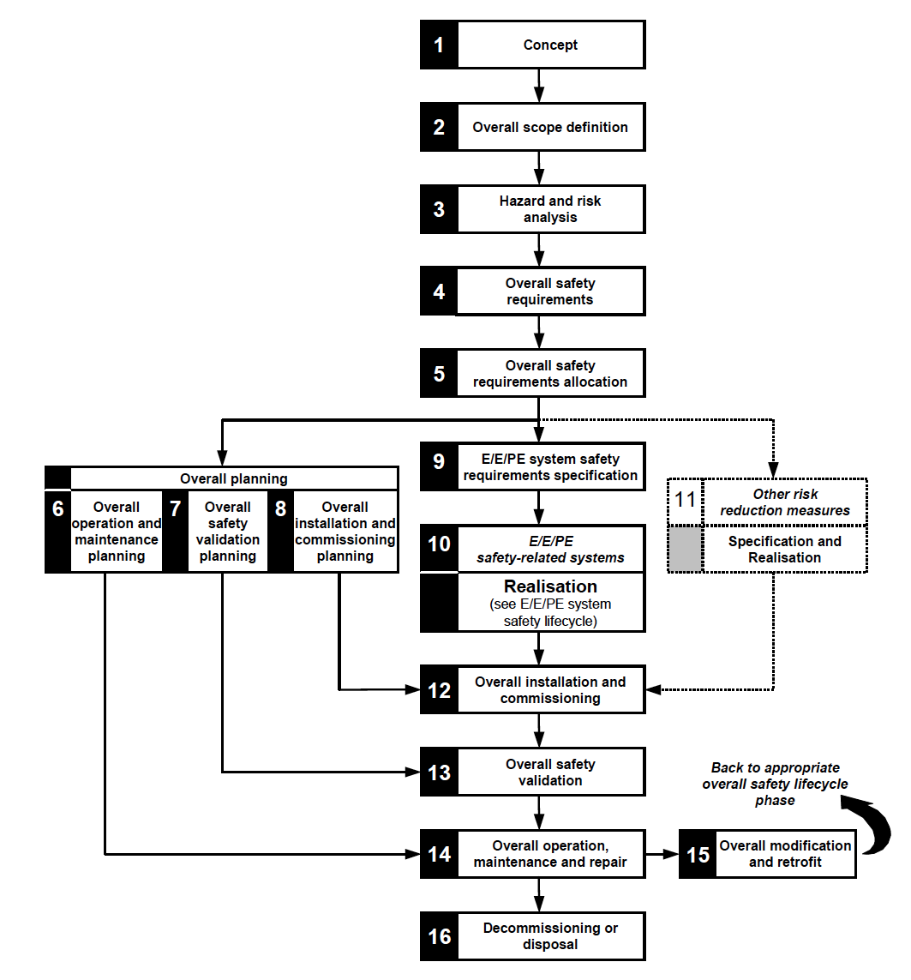
High level PSS0 system requirements - Functional safety standard
PSS0 is developed and complies with IEC-61508/IEC 61511:
Functional safety of electrical/electronic/programmable electronic
safety-related systems.
Designed, manufactured, commissioned and validated to IEC61508, using proven technology.
Designed as a two train system
Designed as fail safe system
Will include the following, in its design philosophy:
Single failure
Common Cause Failure
Redundancy
Diversity
Separation

Slide 6
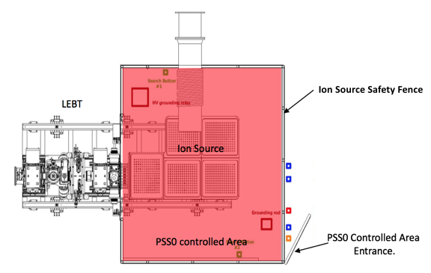
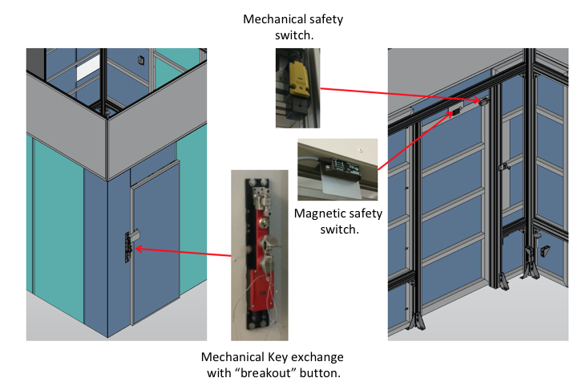
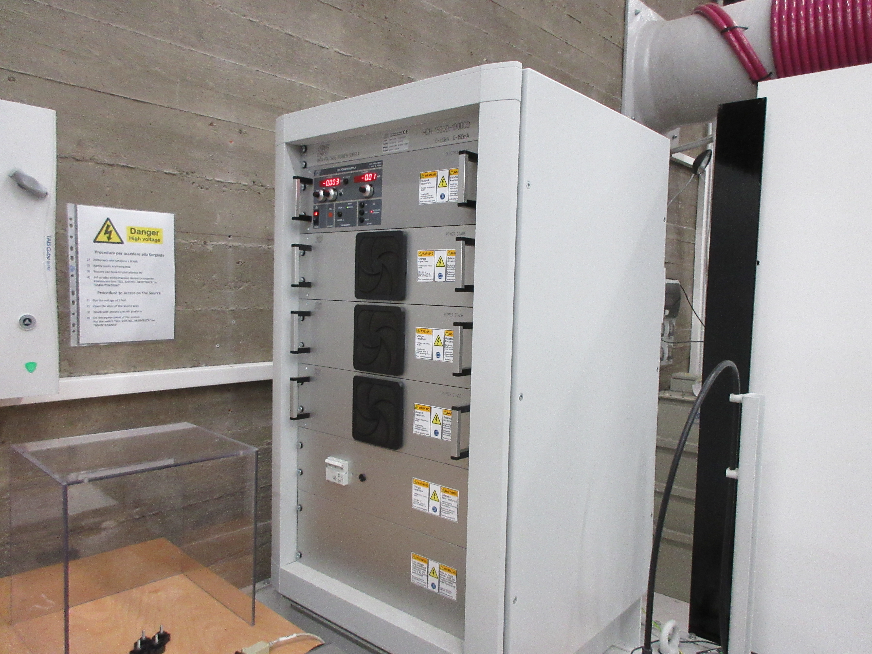
High level PSS0 system requirements
The primary role of the PSS0 is to protect workers from being harmed by exposure to high voltage (HV) arising from the ISrc and LEBT test stand operation.
This is achieved by preventing the access of workers to the PSS0 controlled area when a HV hazard is present and allowing safe access when the HV hazard is removed.
PSS0 Concept ESS-0217911
PSS0 Scope ESS-0237881
Equipment under control (EUC) | PSS0
ISrc HV power supply | X
ISrc Safety Fence door | X

Slide 7
PSS0 Hazard and Risk Analysis
ESS-0229506 Hazard and Risk Analysis
The main objective of this hazard and risk analysis report is to describe the hazard and risk analysis techniques used for PSS0, utilising mainly qualitative methods to identify the hazards and perform risk analysis.
To determine the hazards, hazardous events and hazardous situations relating to the Equipment Under Control (EUC) and the EUC control system (in all modes of operation), for all reasonably foreseeable circumstances, including fault conditions and reasonably foreseeable misuse;
To determine the event sequences leading to the hazardous events;
To determine the EUC risks associated with the hazardous events.
Hazard identification
Official HAZID meeting
Hazard Register
Risk Matrix
Accident Progression – Event Tree Analysis
Assumptions
Initiating Event Analysis
ESS-0229491 PSS0 Hazard Register

Slide 8
PSS0 Overall safety requirements and their allocation.
ESS-0231390 PSS0 Overall safety requirements and their Allocation
The main objective of this Overall safety requirements and their Allocation report is to document the Safety Integrity Level (SIL) assessment of the PSS0.
Determination of the potential frequency and consequence of agreed hazards
Determination of the risk reduction provided by other measures and the resulting risk gap, if any
Assignment of Safety Integrity Level (SIL) requirements for Safety instrumented Functions (SIF’s) to any resulting risk gaps in accordance with IEC 61508 and IEC 61511
Verification of SIF’s against SIL requirements in terms of random hardware reliability and minimum architecture

Slide 9
PSS0 Safety Requirements Specification
ESS-0238059 PSS0 Safety Requirements Specification
The scope of this study covers the SIFs identified by the PSS0 Hazard and Risk Analysis supported by the PSS0 Hazard Register, and the PSS0 Overall Safety Requirements and their Allocation produced by ESS PSS Team, which incorporates the Safety Integrity Level (SIL) Determination and Verification analysis.
Concept
Hazard and Risk Analysis
Hazard Register
Safety Requirements and their allocation
Safety Requirements Specification
Hardware and Software Design
Scope

Slide 10
PSS0 Design
ESS-0237967 PSS0 Hardware design document
This document provides an overall hardware design specification for the PSS0.
The objective is to describe the detailed requirement specifications for the PSS0 hardware.
Details the Electrical standards the we designed to
Details CE mark Certificates
Details the architecture and physical topology
Interfaces
Details of Components
Details of cable types and specification

Slide 11
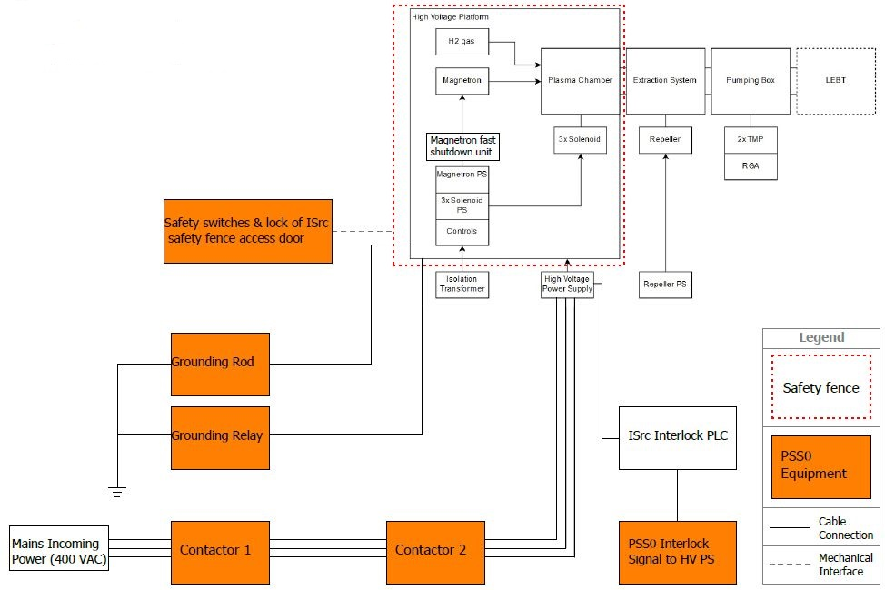
PSS0 Design interfaces

Slide 12
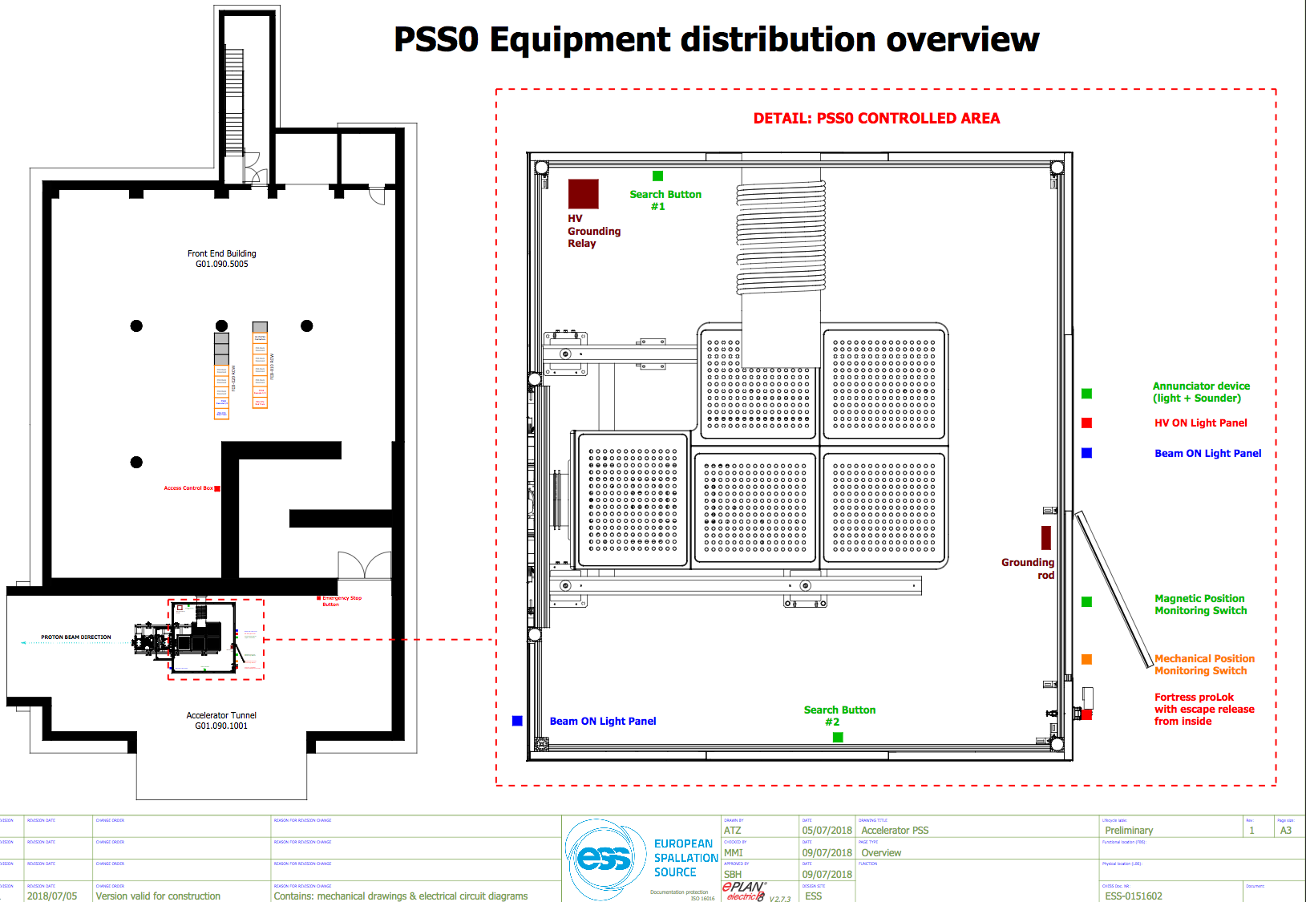
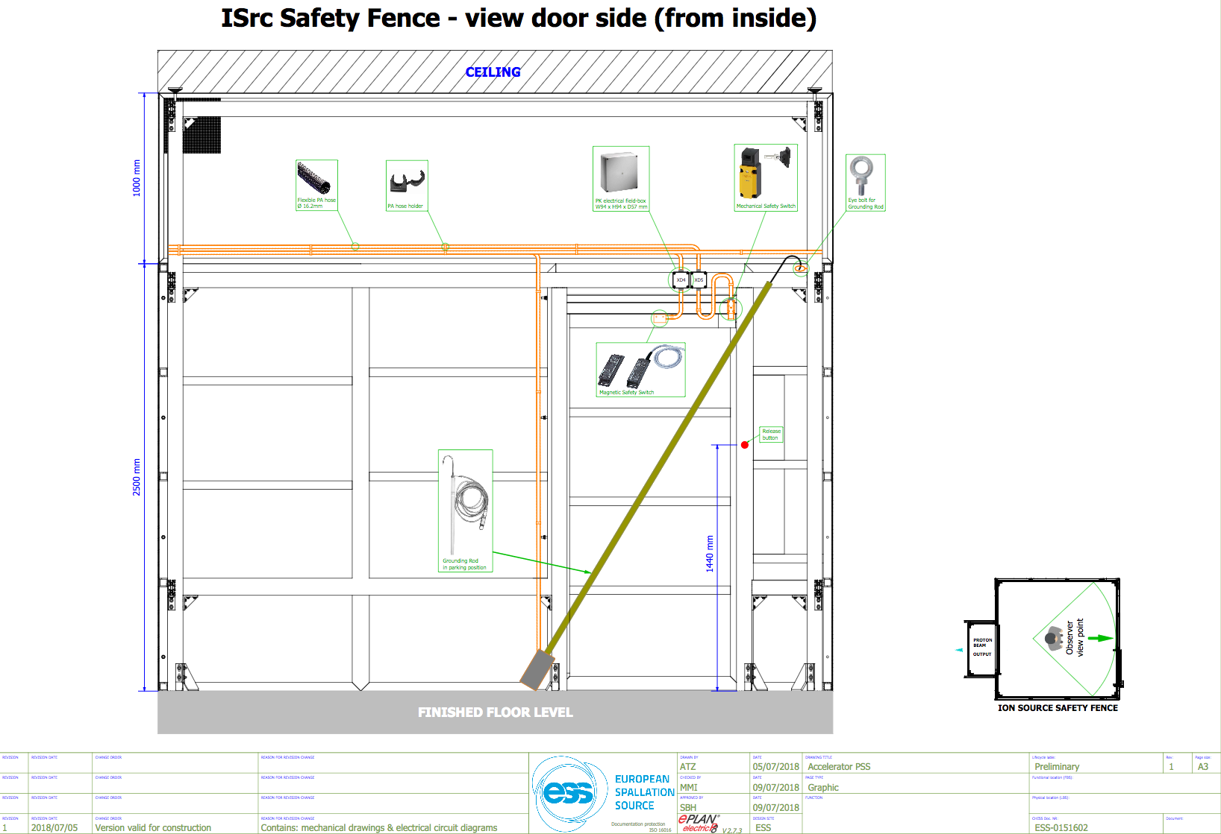
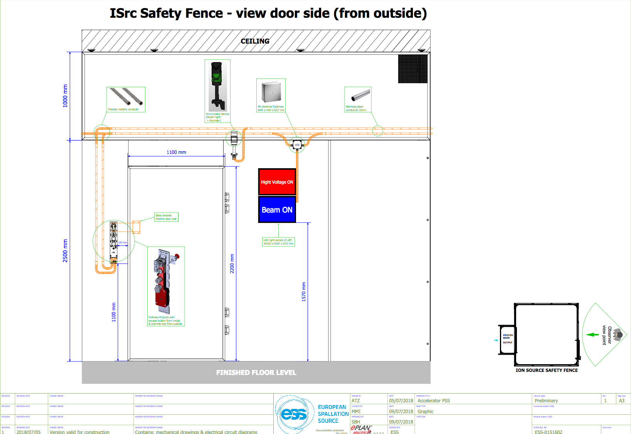
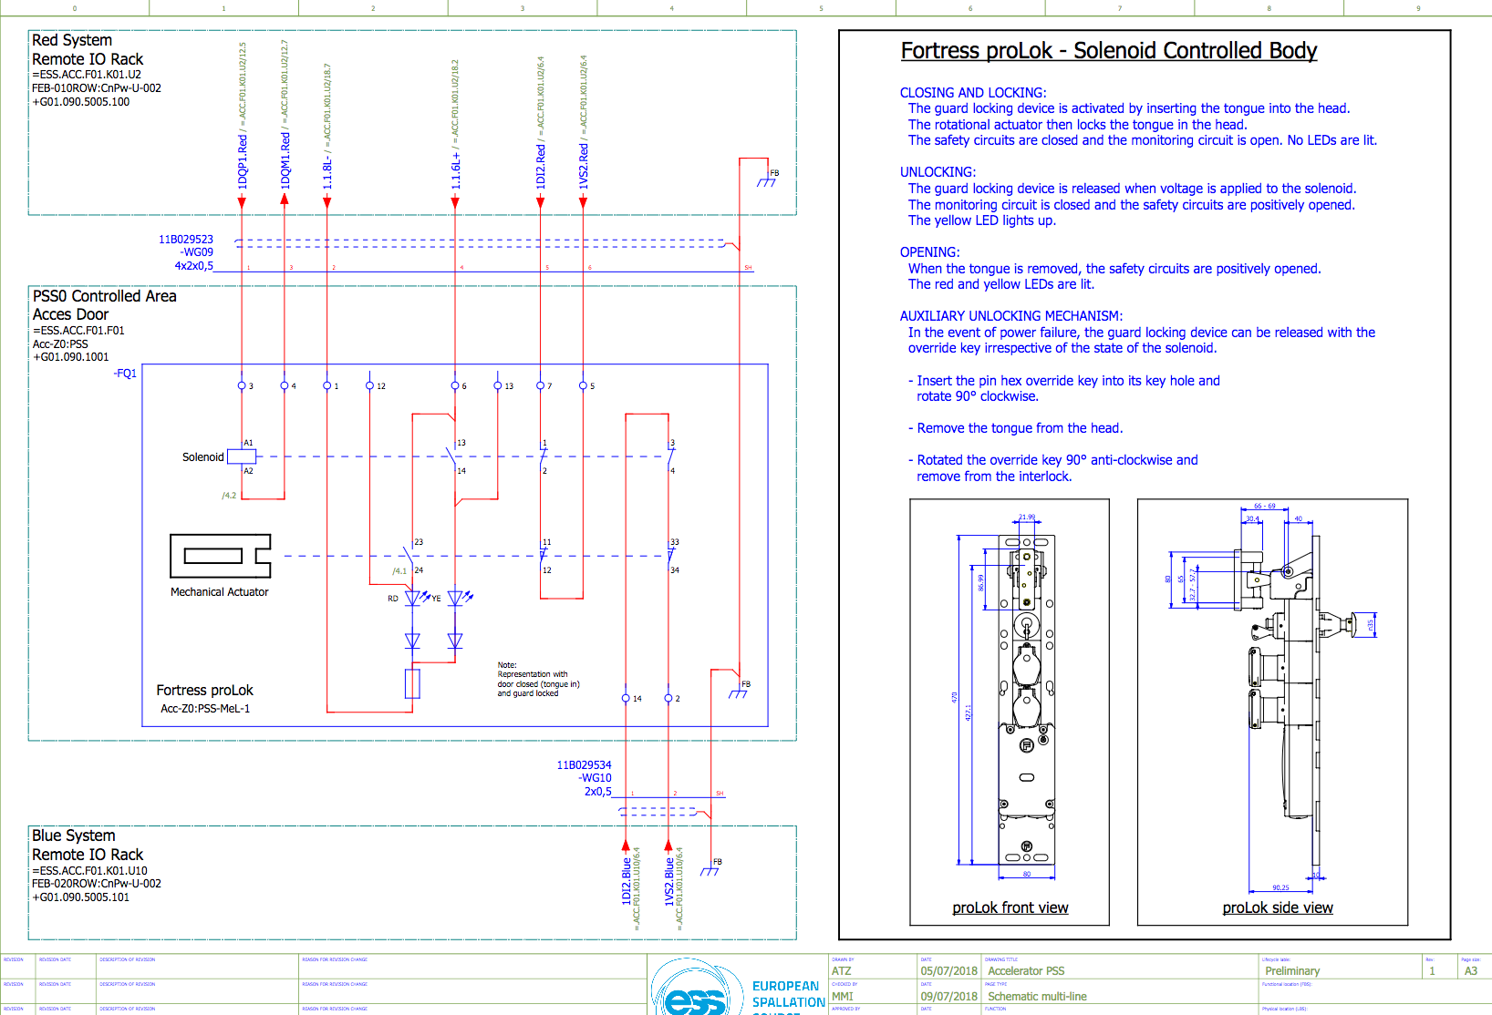
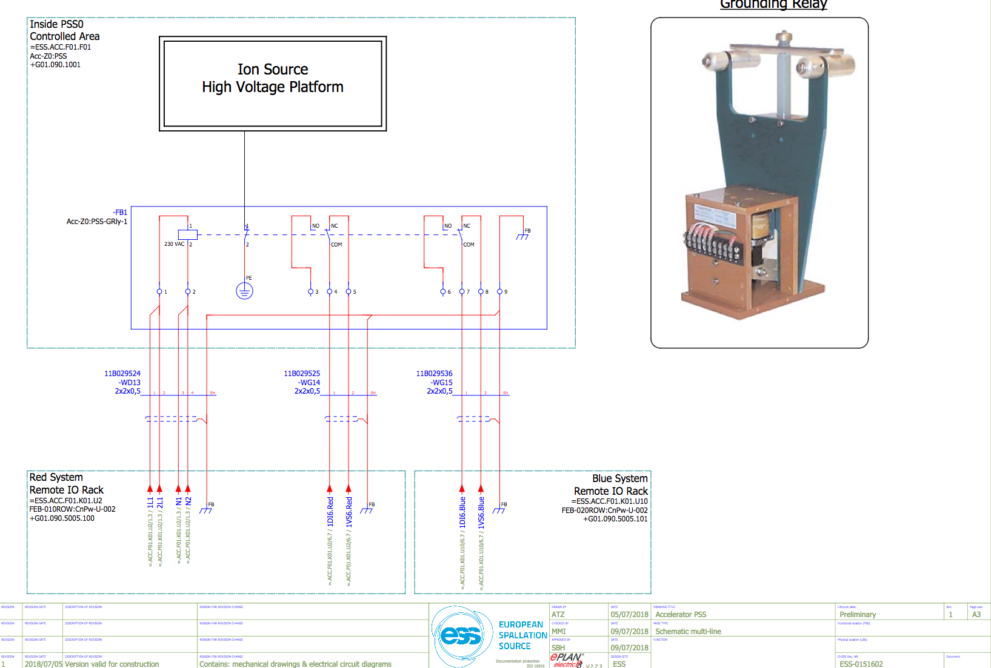
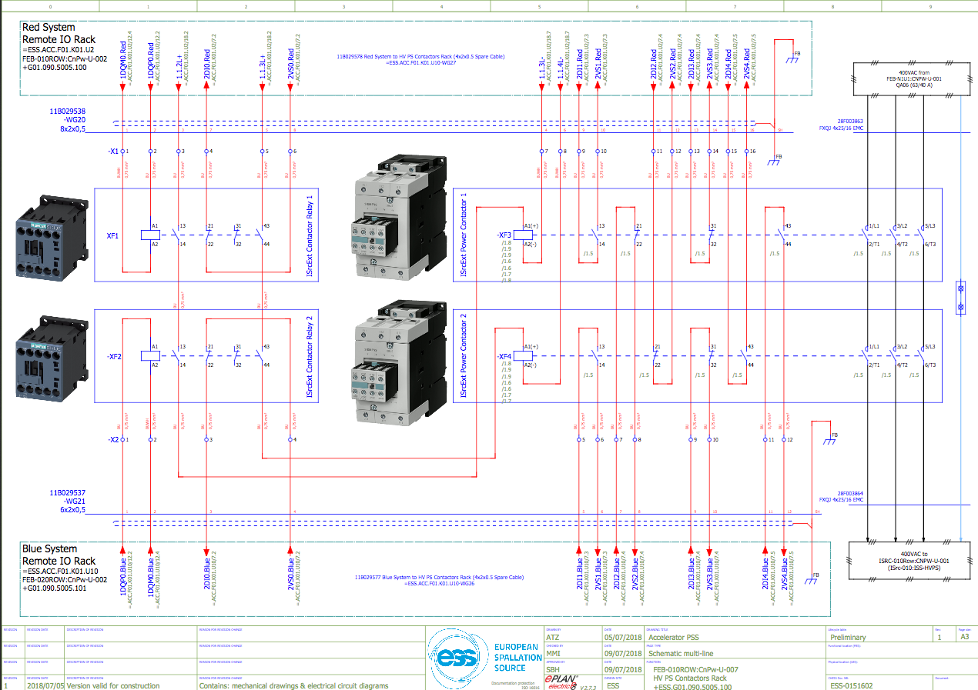
PSS0 Design
ESS-0151602 PSS0 Electrical circuit diagrams and hardware drawings
166 drawings detailing all circuit diagrams and mechanical installation

Slide 13
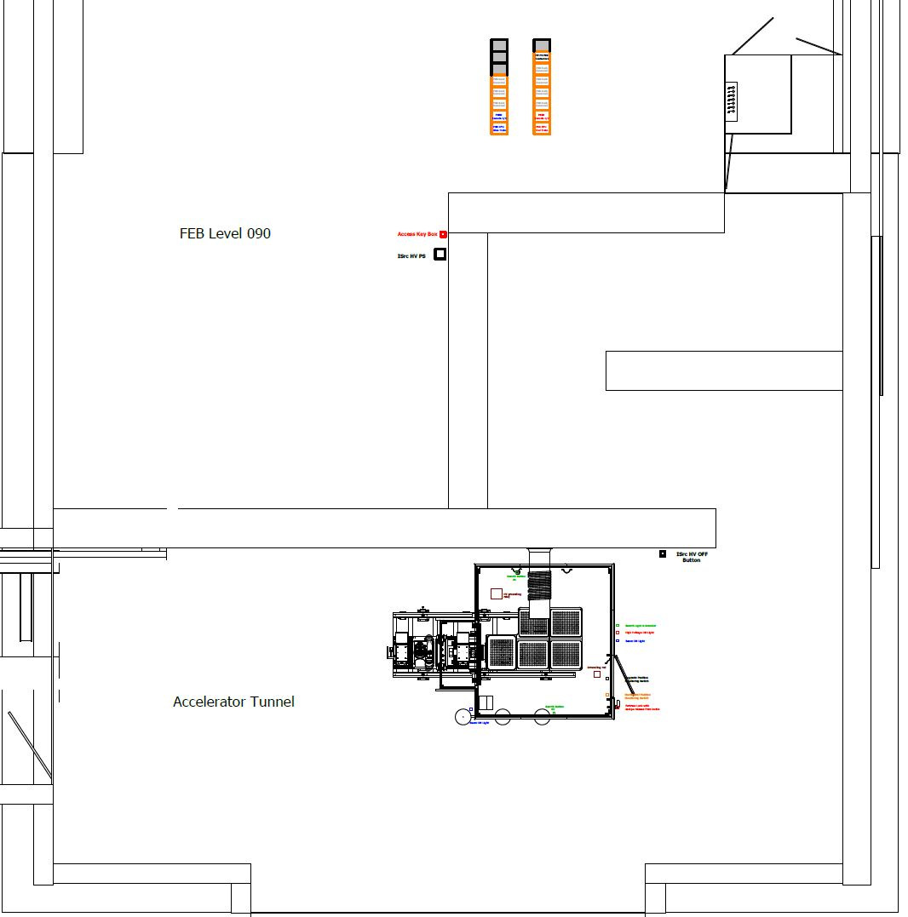
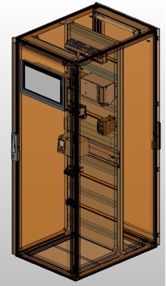
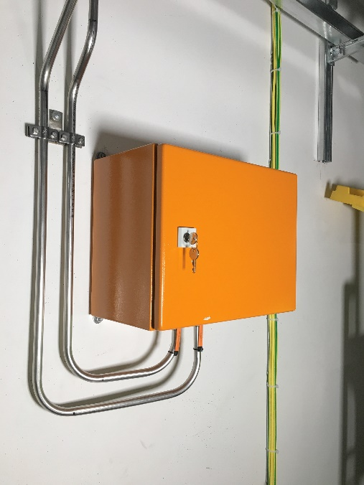
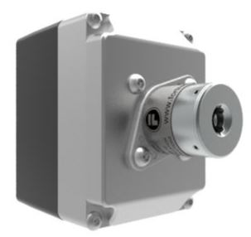
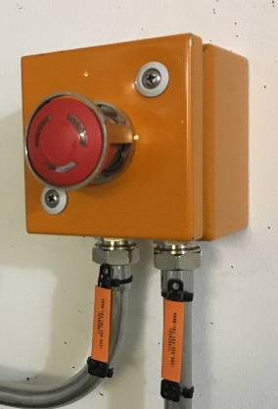
PSS0 Layout & Equipment
Key exchange box next to HV PS
PSS0 Controlled Area
PSS racks in FEB
ISrc HV OFF Button

Slide 14
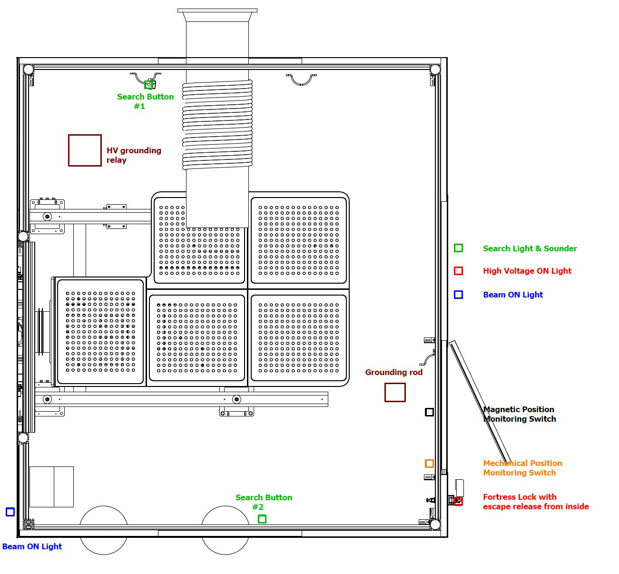
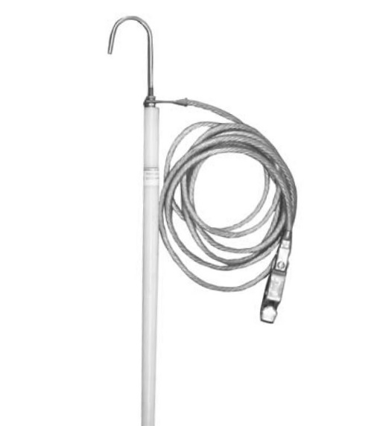
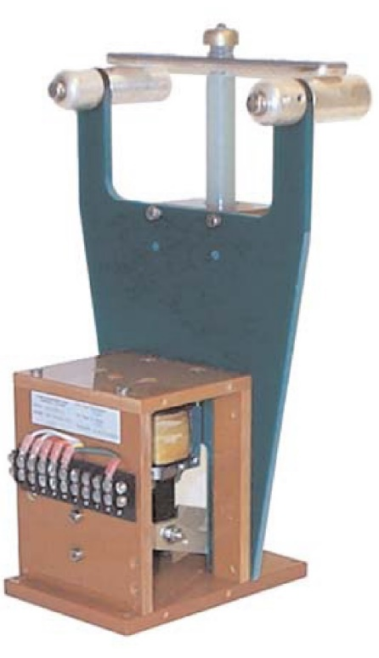
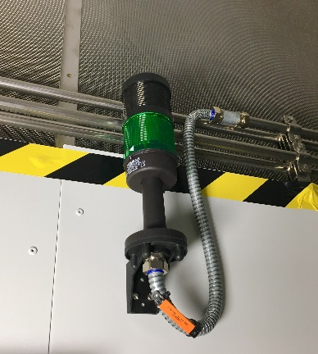
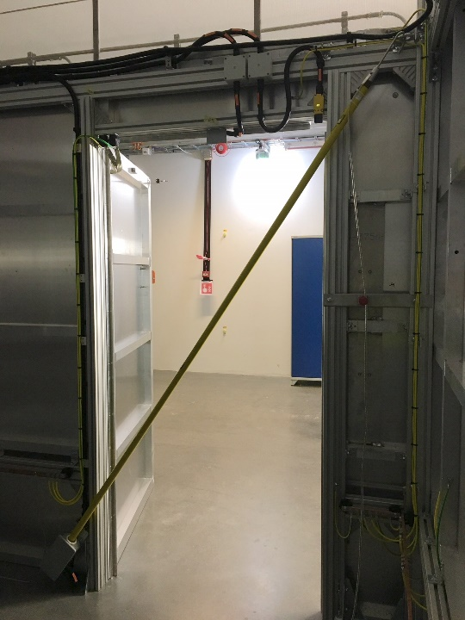
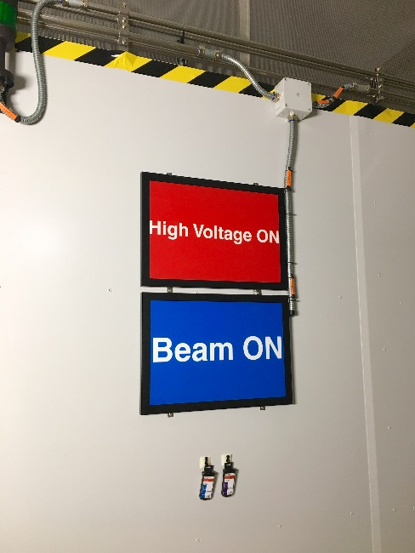
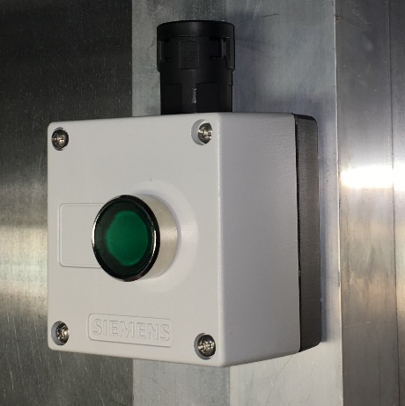
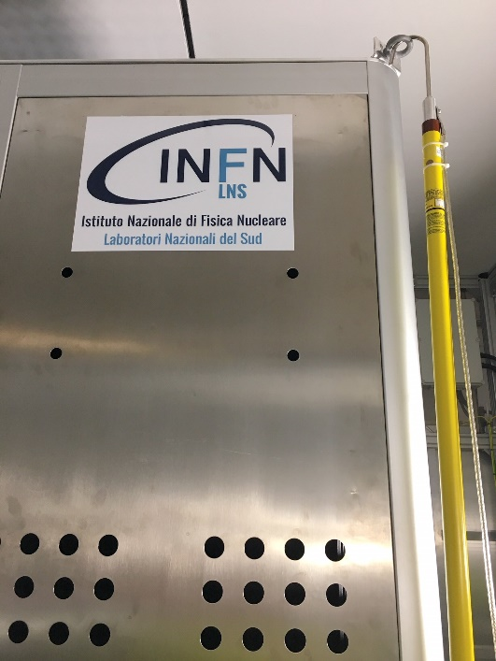
PSS0 Layout & Equipment
Position Monitoring Switches
Grounding rod
Grounding relay
Fortress Lock

Slide 15
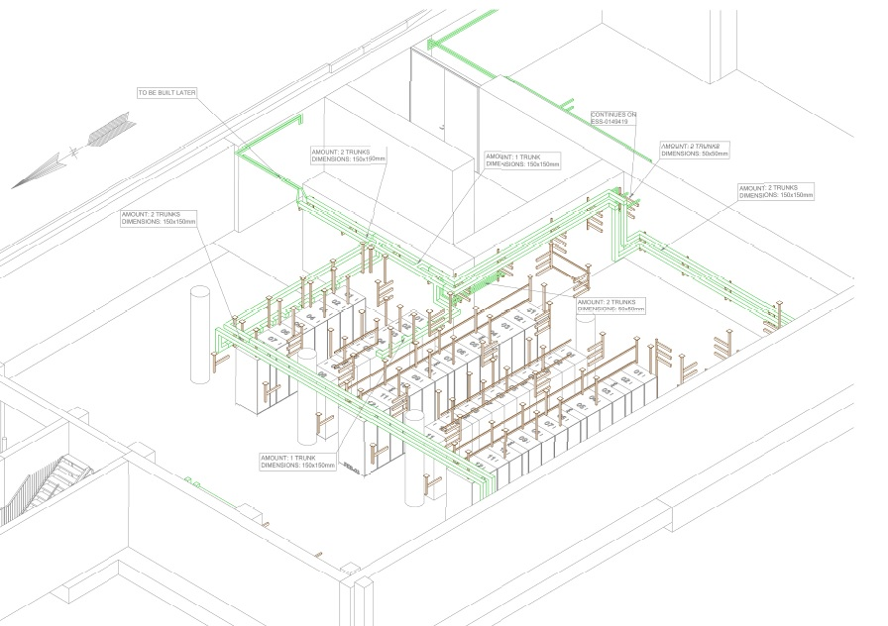
PSS0 Cable Routes & Cables
As part of safety requirements in accordance with IEC 61508:2010, the two independent PSS0 trains shoud be physically separated to reduce the possibility of the PSS0 being affected by the same external events.
Eddie Carse (ESS-0149416)

Slide 16
Operation procedures
ESS-0134492 Concept of operations
The purpose of this document is to describe the concept of operation for Accelerator
PSS0. This document defines a set of step-by-step instructions detailing operating procedures
of the PSS0 installed within the ESS ISrc and LEBT test stand.

Slide 17
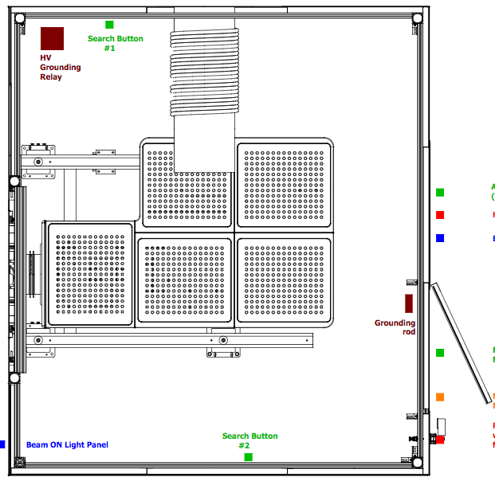
Operation procedures - PSS0 Basic Formalised Search
1
Start
‘Procedural’ check for personnel inside HV platform and that all HV platform doors are closed.
3
2
Press Search button 1. Search around HV grounding relay area and under HV platform. Search way around to the search button 2 area
3
2
4
Search around this area and again under the HV platform. Then press Search button 2
5
Remove grounding rod from the HV platform.
2
6
Place grounding rod in position across the door.
7
Close door place ‘Safety Key” into key exchange and remove ‘Access key’.
8
Finish. The formalised search is now complete.
5
1
Start
4
6
7
8
Finish

Slide 18
Operation procedures – Key exchange philosophy
G01-FEB
HV Power Supply
G01- accelerator tunnel
HV fenced area door
PSS contactors interfacing the mains incoming power of the HV PS open.
The grounding relay closes.
Solenoid ON
Door Open
Access Key: Ensures door cannot be opened without
this key. Access key is released by a separate unit in FEB.
Safety Key: Removed key ensures door cannot be locked
until operator returns from ISrc fenced area with the key.

Slide 19
Operation procedures – Maintenance manual
ESS-0290888 Maintenance Manual
This document provides a maintenance manual for the Accelerator Personnel Safety System 0 (PSS0). The objective is to describe how to preform maintenance for PSS0.
Preparation before maintenance
Safety before and during maintenance
Equipment to be maintained
Preventative maintenance
Breakdown maintenance
Proof testing
Equipment list

Slide 20
PSS0 Verification and Validation
ESS-0233615 PSS0 Verification and Validation
This plan concerns only PSS0 and addresses the verification and validation activities
for hardware and software of the PSS0. The purpose of this document is to provide
a high-level plan for these activities.
Verification.
Factory acceptance test (FAT) (add reference)
Verified that the as-built system met the specified design. The FAT included component
test, integration test and system test. The FAT was performed by the Manufacturer, but it
was designed, witnessed and verified by ESS.
ESS-0237899
Site acceptance test (SAT) (add reference)
Verified that a system works as specified in its operational environment. SAT includes
installation and integration verification of the systems. The SAT shall be performed by ESS
on the site.
ESS-0237906

Slide 21
PSS0 Verification and Validation
Site integration tests (SIT)
Verifies that installed HW and SW work together properly, ensuring that their combination is serving the purpose of PSS0 safety functions and procedures. Cause and effect matrix based on PSS0 software should be developed and verified during this test.
PSS0 SIT: Is currently in final phase. This test is based on safety functions detailed in PSS0 SRR ESS-0238059 and procedures detailed in PSS0 Con-Ops ESS-0134492. PSS0 SIT document will be created on completion of tests.
Final integration tests (FIT)
The FIT is a repetition of SIT whilst EUC is operational and connected to PSS0.
PSS0 FIT: Will be carried out after PSS0 SIT completed, and ISrc system ready to turn on HV PS. PSS0 FIT document will be created after test fully carried out.

Slide 22
PSS0 Verification and Validation
Validation
The safety evaluation used, is the overall safety lifecycle concept as defined
in IEC 61508.
To assure that PSS0 meets the needs of the facility and other identified stakeholders a
validation demonstration for AD and ES&H will be performed. The stakeholders will have
access to all the documentation and the demonstration will be very similar to the FIT.
The demonstration will be done at the ESS site. A validation report will also be produced.
The validation is based on a set of checklists that will be used to verify the requirement
set-up and to provide the assessor with the necessary guidance in decision making during
the validation development. Each checklist refers to a specific activity of the safety
lifecycle and is based on the requirements in the SRS.

Slide 23
Outstanding issues
# | System/Comp. | Status | Description | Due date | Remark
1 | Final integration test (FIT) |  | We are ready to carry out the final integration tests with all of the Equipment under control (EUC). | Currently working on this. Tests are imminent. | Complete straight after SRR.
2 | Final validation tests and documentation |  | To follow on from the FIT (repeat of FIT with EUC stakeholders and ESH&Q ). | Straight after FIT | Documentation to be completed by mid August.
3 | PSS0 E-Stop Naming |  | The E-stop naming will be changed. (from E-stop to “Ion Source HV Off”) Documentation will be changed and the button will be changed from red to black. | Early August | The changes will not change the analysis or system.
4 | Ion source platform door switches |  | We have removed the HV platform switches from the PSS0. | Completed except documentation updates Early August for document change | There are no safety implication by removal of these switches. Completed but documentation needs update
5 | PSS0 HMI software |  | Finalise the HMI software. | Early August | Not Safety

Slide 24
Outstanding issues
Thank you

Slide 25
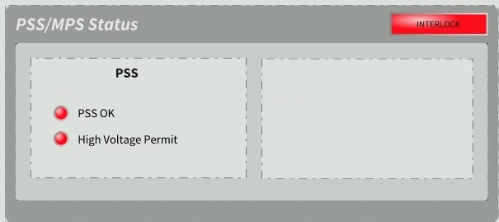
LCR
You can see the state of PSS0 in LCR as below:
The state of PSS0 permit for HV PS. (HV PS permit)
Green LED = PSS0 permit available. (i.e. PSS0 controlled area is searched and locked, Access key is returned to the box in FEB)
Red LED = PSS0 permit not available.
The state of PSS0. (PSS0 OK)
Green LED = PSS0 is OK. (i.e. There is no alarm in PSS0 system)
Red LED = acknowledgement on PSS0 racks HMI in FEB is required. If acknowledgement does not resolve the issue, contact PSS team.

Slide 26
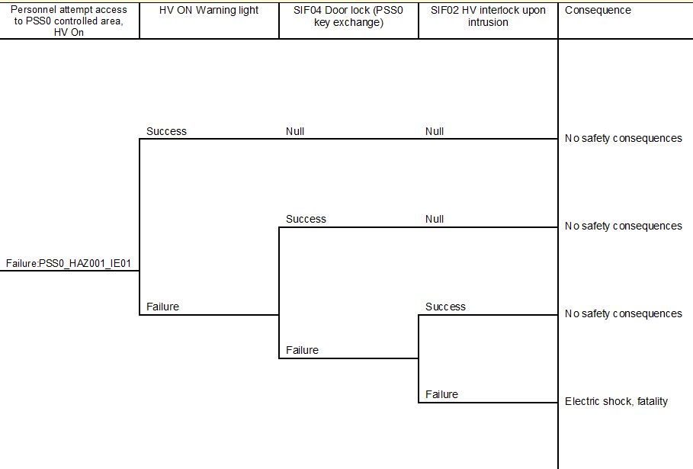
PSS0 Hazard and Risk Analysis Accident progression ETA
ESS-0229491 PSS0 Hazard Register
Figure 6: ETA for initiating event 01.

Slide 27
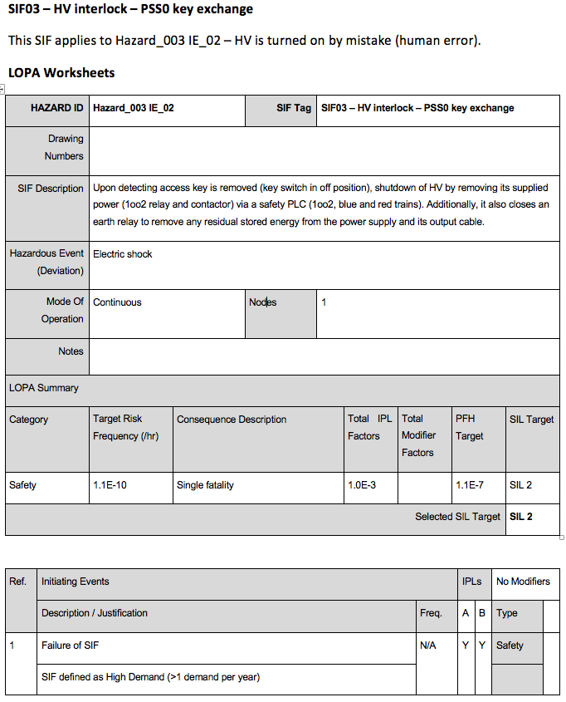
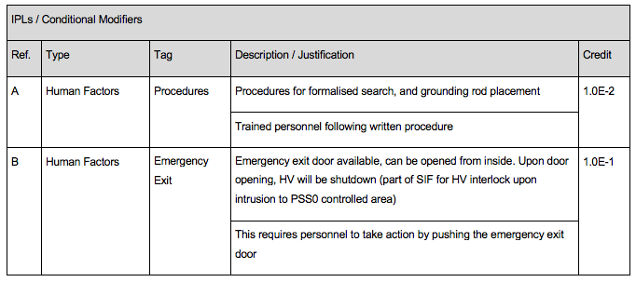
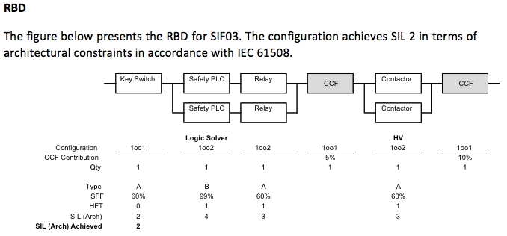
PSS0 Overall safety requirements and their allocation.

Slide 28
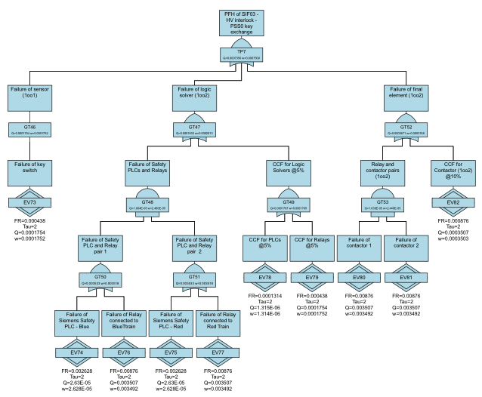
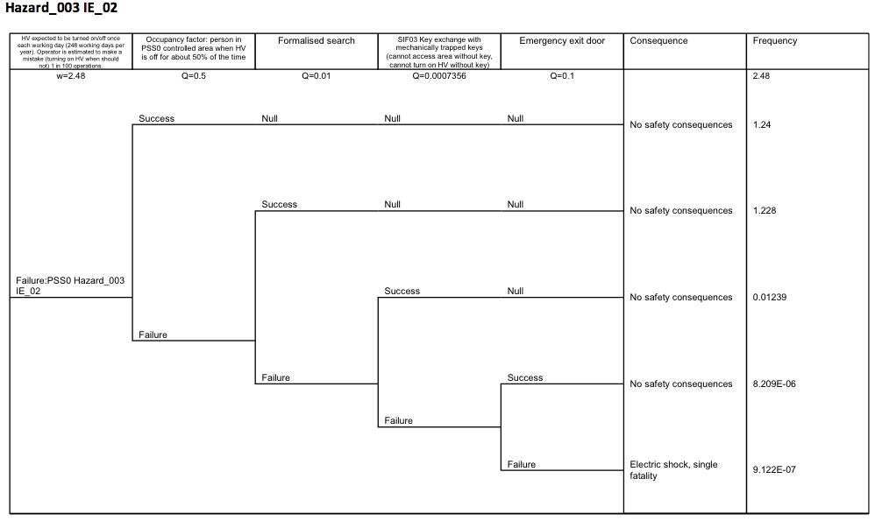
PSS0 Overall safety requirements and their allocation.

