Slide 1
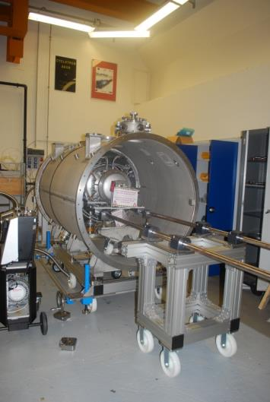
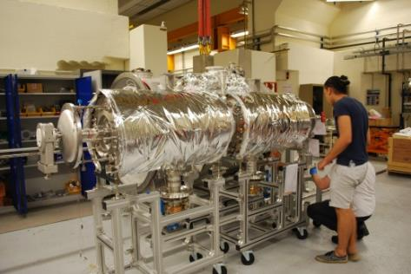
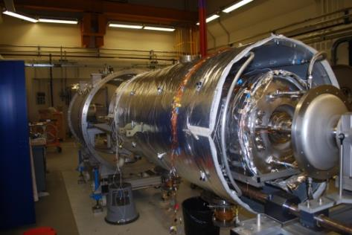
Prototype cryomodule development
The prototype cryomodule has been assembled with the two pre-series cavities (Romea and Giulietta) equipped with the two PMB pre-series couplers (conditioned at IPNO up to 420 kW in TW) and two different types of tuning systems:
1 tuning system in final config. : 72mm-long piezos + limit switches + disconnection system
1 tuning with 36x2mm-long piezos without limit swithes nor disconnection system

Slide 2
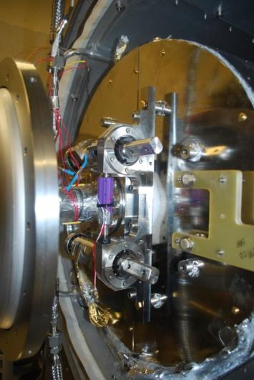
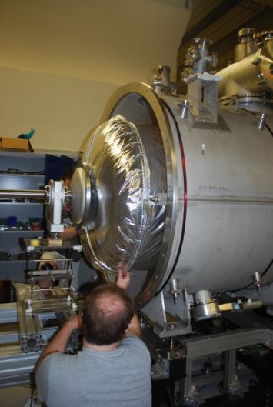
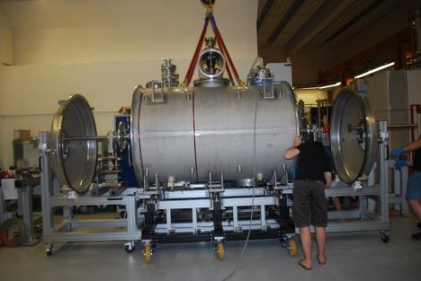
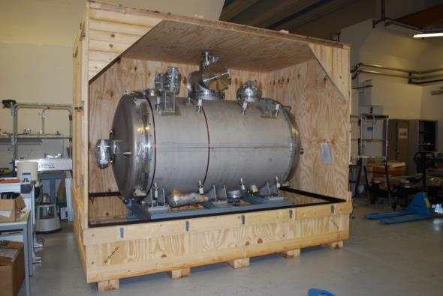
Prototype cryomodule development

Slide 3
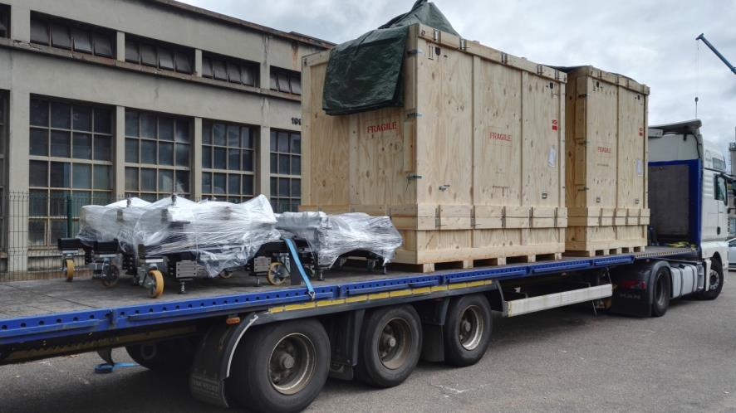
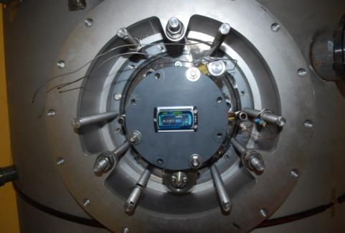
Prototype cryomodule development
Transport #1 to UU:
Cryomodule + Valve box + 2 mechanical supports + 1 doorknob
Dispatch on Monday 13 August
Arrival on Friday 17 August
Checked yesterday…we are waiting for some (good?) news.
MSR165 data logger fixed on the coupler flange

Slide 4
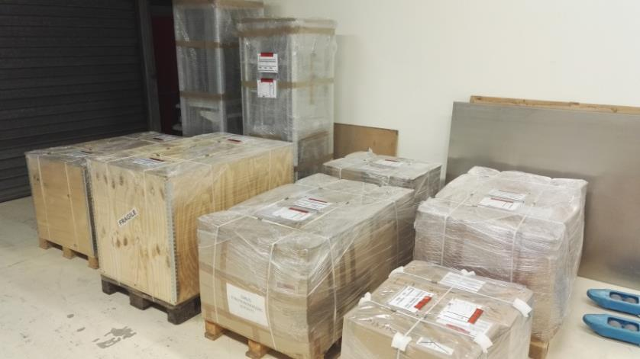
Prototype cryomodule development
Transport #2 to UU:
Remaining equipment: instrumentation cables, vacuum pumps, C&C racks…
Dispatch planned next Thursday (23/08)
Arrival before August 31.

Slide 5
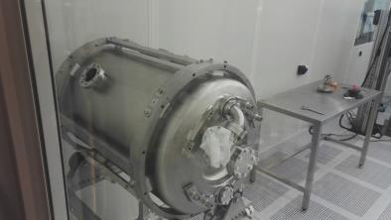
Series cavities
Cavities DSPK05 (Solbritt) and DSPK06 (Solveig)
Delivered on June 4.
DSPK05: prepared (chemistry, heat treatment, clean room
assembly): ready for testing
DSPK06: currently in the chemistry room. Should be ready for testing in W38.
W39: mounting of the 2 cavities in our VC
W40-41: vertical test
Cavities DSPK03 (Charlotte) and DSPK04 (Caroline)
Delivered on July 17.
DSPK04 will be prepared first (need to decrease the frequency by a dedicated horizontal etching process). Should be ready for testing in W39
DSPK03 should be ready in W42
W44-45: vertical test

Slide 6
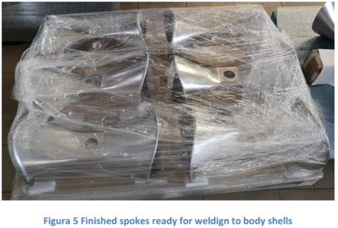
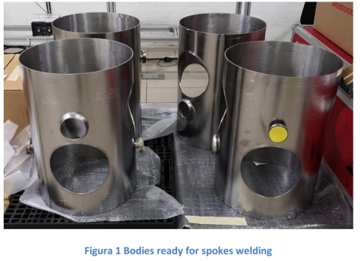
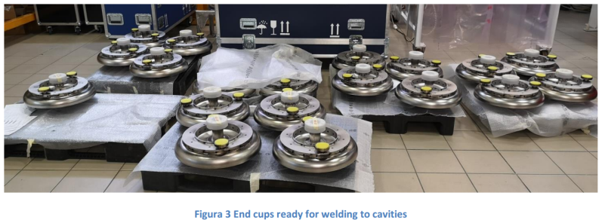
Series cavities
Cavities DSPK01 and DSPK02
Ready for the first trimming operation.
Operation on hold: wait for the cooldown of DSPK05 & 06 (beginning of October)
Remaining cavities

Slide 7
Procurements
Call for tenders
Cernox (for WP4, WP5 and WP11: order of all Cernox by CEA).
April 18 (x200): delivered on May 18. 4 sensors rejected. Calibration will start beginning of in September (sensors already mounted in the test cryostat)
May 8 (x200): delivered in mid-August: 3 sensors rejected.
July 3 (x200): postponed to end of August
August 20 (x205): postponed to mid-October
RF couplers & Double-wall tubes:
RF couplers (PMB): kick-off hold end of June. Fabrication of sub-parts started. Ceramic procurement launched. Update of the fabrication end of August.
Double-wall tubes (SDMS): fabrication started. Update of the fabrication end of August.
Vacuum vessels + cold-warm transitions: 5 offers received and rejected in July. New call is finished (yesterday!). 4 offers received. Analysis this week. Contract award before end of September.
Gate valves: fabrication in progress. Delivery planned for November.
Magnetic shields: contract award in progress. Kick-off meeting before end of August.

Slide 8
Procurements
Upcoming RFQ/Call for tender/Orders:
Tuning sytems: completed for all mechanical parts. On-going: request for quotations for the heaters and the piezos. Preparation of the order for the limit switches.
Test bench of the series couplers (SOMINEX): order done. Fabrication of the 2 new coupling cavities has started.
Cryomodules:
RF cables (HABIA): order done. Delivery is planned in September 2018 so there is no impact on the series cryomodule assembly.
MLI: request for quotation started. Deadline for the offers: September 03
Thermal shields (main parts): request for quotation started. Deadline for the offers: September 03.
Thermal shields (covers): request for quotation to be done beginning of September.
RF Couplers:
IKR070 vacuum gauge: request for quotation started. Deadline for the offers: July 20
Glass windows: request for quotation started. Deadline for the offers: August 17
Electron pick-up: request for quotation started. Deadline for the offers: August 24.
2 Pre-series doorknobs with DC-Bias: request for quotation started. Deadline for the offers: September 14.
To be done
Internal cryogenics lines
Internal cables
RF feedthroughs

Slide 9
Planning
Prototypes
CM + VB: done!
Shipment of all the material will be complete by end of August.
Series
CAVITIES
4 cavities delivered. Should be tested (and validated) in October.
7 to 8 additional cavities should be delivered till end of December.
COUPLERS
First 4 couplers should be delivered in December.
CRYOMODULES
Vacuum vessels delivery is still on the critical path (delivery planned end of July 2018). Schedule updated after the analysis of the offers which have been received yesterday.

