Slide 1
Workshop commissioning 2018-10-16 Installation Coordination at ESS
Olle Lagerblad

Slide 2
Agenda
AD installation Project (Infrastructure and Component installation)
Harmonized ways of working at ESS
Outline
The Installation Binder ”Practical Use”
The Installation Readiness Review (IRR)
The RAMS ”Practical Use”
ESS Work Orders ”Mandatory for all installation work”

Slide 3
AD Installation Project
AD will change the set up for Installation;
Current approach - Component installation and Infrastructure project
AD Will merge Infra structure project with component installation
Main purposes for the change is;
Simplify – Reduce the current amount of interfaces
Clarify – Responsibilities, one AD installation coordinator, uniform implementation of processes
Clarify – Responsibilities for planning and reporting (Own org and IK part.)
Use of resources – Improve and coordinate use of common resources
Release resources for IK delivery of components “expediting”
Clarify and align Infra project installation planning with component installation
Budget allocation, Infra project budget (WP 15/16 +CR) and WP 98

Slide 4
Introduction “Project changes over time”
The project consist of mainly 2 high level phases
Engineering phase
Construction phase
Design and planning
AD Project
WP x -------------------------- WP z
Installation & Commissioning
AD Project
Installation Commissioning
Mainly Installation and commissioning focus
Components matrixed for installation and testing
Mainly component focus
Installation & Commissioning matrixed

Slide 5
Implementation
“Daily stand up” meetings in the buildings
“Daily” meeting in “installation room”
Principal agenda
Plan/Comply or explain deviation/Issues (meetings outside)
Weekly Meetings
Installation detailed working and follow up meetings (weekly)
Detail planning and organization of installation activities
Service needs (eg. transportation, storage, tools, workshops)
Installation binder
Commissioning
Installation and commissioning meeting “Information” (Friday)
Share information
General presentations
Status updates
Safety /quality aspects
Issues solved/new

Slide 6
Harmonized ways of working at ESS

Slide 7
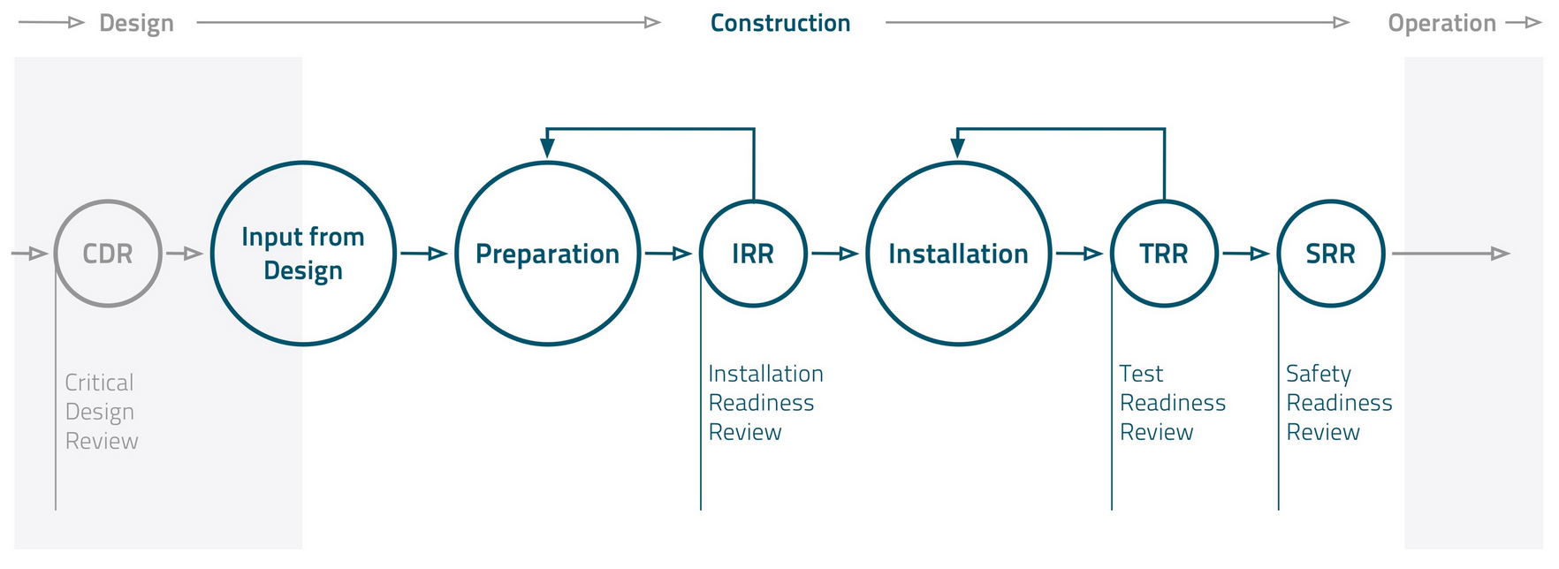
Introduction
ESS is implementing harmonized ”ways of working”
Installation binder (IB) and Installation Readiness Review (IRR)
Risk Assessment and Method Statement (RAMS)
The Work Order process (WO)
NCR (Non Conformity Report)
Services and support
Information can be found at ESS Installation web page
https://confluence.esss.lu.se/category/essinst

Slide 8
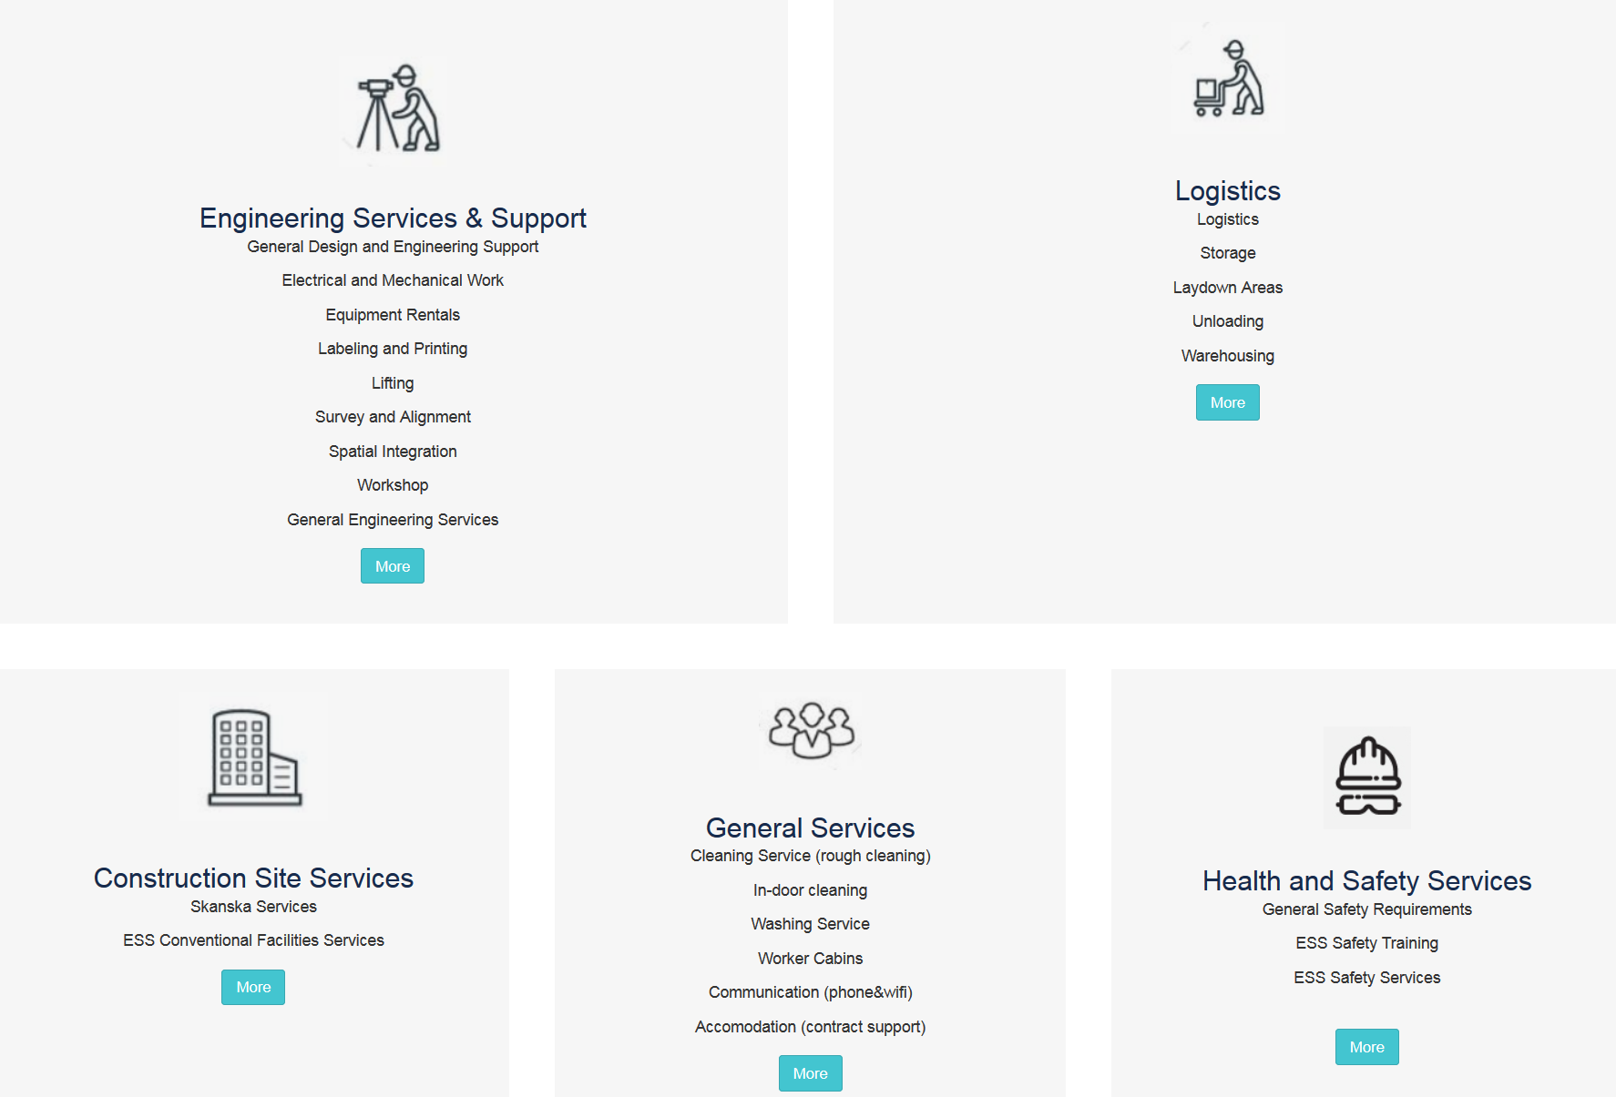
ESS Installation Services

Slide 9
Interface between In Kind, ESS WP and Installation Package lead
AD installation coordinator
IK partner
Installation package lead
AD Work package lead
AD Liaison Officers
Responsible for;
Installation binder
IRR
Work order
NCR

Slide 10
Installation Binder
Purpose
Collect all required documentation to perform site work
Gathers documentation prepared before and during installation
There is a template, if tab is not applicable N/A
The installation Scope can be split into several IB, depending on:
Time for the installation - If the installation is performed in different time periods it may be better to create separate binders
Area - If the work is done in different areas of the building it may be better to create separate binders
Disciplines / Contractors - If there are several contractors and/or disciplines involved in the installation, it may be better to do separate binders for each contractor (As electrical, mech. or piping)

Slide 11
Input from Design / Manufacturer
Input from Design
Preparation of Installation Binder
Check by:
Discipline Lead Engineer
QC Engineer
IRR

Slide 12
Preparation of Installation Documentation
Input from Design
Preparation of Installation Binder
IRR
Reviewed by:
Discipline Lead Engineer
QC Engineer

Slide 13
Purpose IRR Documentation
The purpose with Installation Readiness Review is to;
review if the necessary preparations have been performed
and the supporting documentation are in place for the upcoming installation.
Good shape – Proceed
Minor things to fix before start – Keep start date
Major things to fix before start – Reschedule installation
Part of package not ready – Split package

Slide 14
Preparation of Installation Documentation
Pre Job Briefing
Perform Installation
Test & Inspection
Installation Certificate of Compliance
TRR
SRR

Slide 15
ESS Work Orders
The Work Order (WO) control the release of work and work/safety
some aspects are:
No work shall be executed unless it is planed and organized
Synchronize the work with other parallel work (same area)
To control plant conditions and equipment
To plan and organize delimitations and tag outs
“becomes more and more important when entering in to the test and commissioning phase!”
The Work Order will mainly state:
Installation activity start and end time
Summary of the activity
Documents related to this activity (RAMS)
Any need for delimitations/tag outs
https://jira.esss.lu.se/servicedesk/customer/portal/11

Slide 16
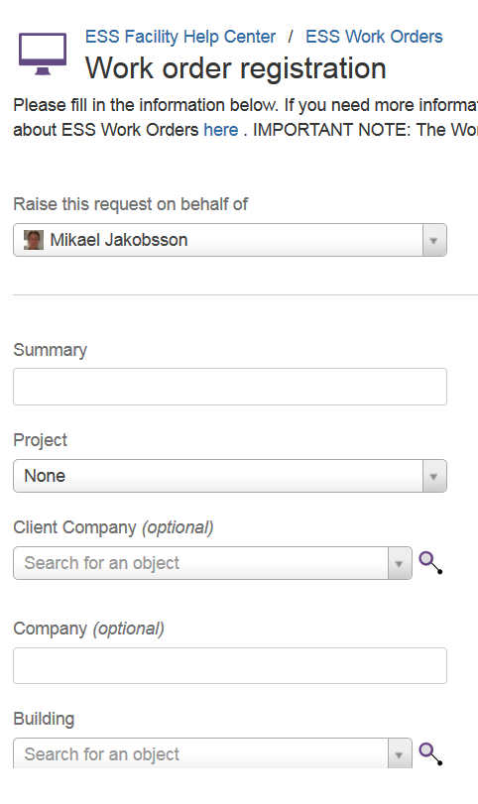
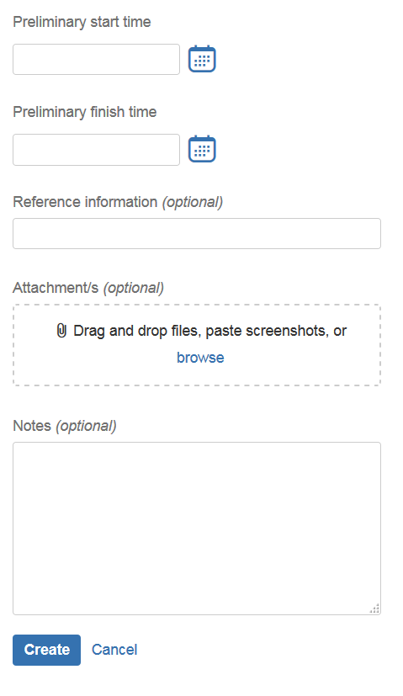
Registering WOs
Minor work
6 fields + RAMS (attached)
Normal work
6 fields + link to installation Binder

Slide 17
Risk Assessment and Method Statement (RAMS)
What’s the purpose with a RAMS?
Identify hazards and associated risks for an activity and determine if sufficient controls are in place (to reduce the risks to an acceptable level)
Who is responsible for preparing the RAMS?
Installation Package Lead for making sure it’s prepared.
What does a RAMS consist of?
The RAMS consists of two parts:
A method statement, i.e. a detailed break down/description of the work to be carried out and material to be used to perform this task
A risk assessment, i.e. identify the risks associated to the work steps detailed in the method statement. Including adjacent risk.

Slide 18
Questions?

