Slide 1
Testing Coordination at ESS
Workshop on Testing and Commissioning
Iñigo Alonso, Lead Engineer, Linac Group
www.europeanspallationsource.se
October 16, 2018

Slide 2
Outline
Strategy
Planning
Status
Lessons (being) learned
Notes:
I am responsible for planning/coordination of hardware testing, by coordinating activities in that area, and working within the schedule boundaries set by the overall project plan.

Slide 3
Strategy
Manufacturing
Installation
Commissioning
Operations
Perform FAT
Perform Installation
Test & Inspect
Perform SAT
Perform System Tests
Perform Licensing
Factory Acceptance Tests
Installation Inspections
Site Acceptance Tests
Verification & Validation Tests
IRR
TRR
SAR
ORR
SRR
The main purpose of the testing activities is to verify that the systems and components meet their requirements and operational goals, i.e. they are verification and validation activities.
Here we focus on the activities done after installation is finished and before we start producing beam.
Notes:
Fitting into the bigger picture (Installation, Testing and Commissioning Plan)
For more details on the high level reviews, see the High Level Readiness talk by John Weisend II
Installation Readiness Review (IRR)
Examines the final technical design, emphasising on interfaces between components, subsystems, controls integration, plans, staff, and tooling required for the installation work itself.
Test Readiness Review (TRR)
Ensures that the product, its test equipment, support personnel, and test procedures are ready for the verification activities.
System Acceptance Review (SAR)
Ensures that all requirements are fulfilled by: examining the facility, end products, documentation, test data as well as analysis supporting the verification activities.
Operational Readiness Review (ORR)
Ensures that facility, personnel, and procedures have reached the required maturity for hand-over to operations phase.

Slide 4
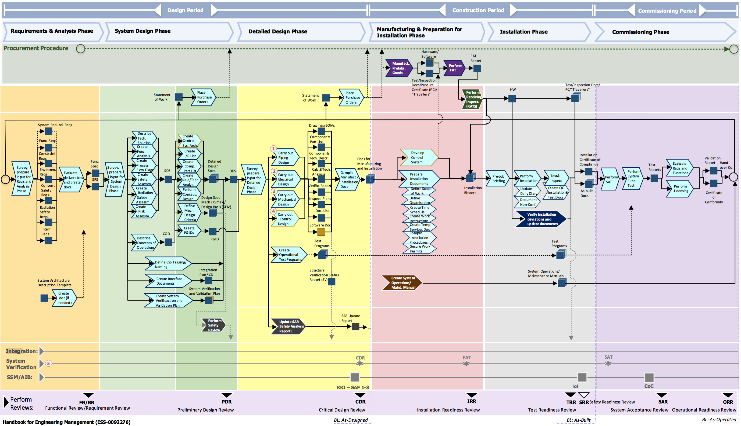
Handbook of Engineering Management

Slide 5
Commissioning vs Beam Commissioning
In the context of the Handbook for Engineering Management, “Commissioning” is used for the Verification and Validation phase of all systems, independently of the use of the proton beam.
In general, when we talk about “Commissioning”, we mean “Beam Commissioning”. But there are exceptions, like the cryoplants, which are also being “commissioned”.
To show to that the systems are ready from a safety point of view to start “Beam Commissioning” part of the accelerator, 5 separate Safety Readiness Reviews (SRR) will be held by ES&H.
ISrc+LEBT
RFQ+MEBT+DTL1
DTL2+DTL3+DTL4
DTL5+Spk+MBL+HBL+HEBT+DmpL
A2T
SRR1
SRR2
SRR3
SRR4
SRR5
Notes:
Hardware Testing / Hardware Commissioning / “Cold” Commissioning
SRR are not linked to the licensing

Slide 6
Strategy: Pragmatic approach
Centralize coordination to get some consistency, but give teams agency to use the appropriate practices for themselves.
We try to minimize disruptions to ongoing work.
It is better to adopt a good-enough approach quickly than a perfect one eventually, but it will nonetheless require an effort from everybody to adopt it.
It is challenging with the available resources.
Notes:
The experts on each system know best what and how needs to be tested.

Slide 7
Planning: Priorities
Realistic time allocation in the ITC plan
Add and link detailed activities in JIRA
Milestones linked between JIRA & P6
Key dependencies
Links to other Accelerator systems and other divisions (CF, ICS…)
Correct Gateways/Reviews (TRR, SRR…)
Additional support
Identify relevant Permits (internal, SSM…)
Ensure Safety Measures (RAMS, WSCP…)
Notes:
Reconciliation with P6 of JIRA planning monthly

Slide 8
Status: Procedures
Use of ESS procedures to coordinate plans:
Handbook for Engineering Management, ESS-0092276
Graphical Workflow, ESS-0093443
Procedure for Prepare for Installation and Installation, ESS-0102864
Procedure for Test, Verification and Commissioning, ESS-0102865
Handbook for System Verification, ESS-0117128
Accelerator System Verification Plan, ESS-0005458

Slide 9
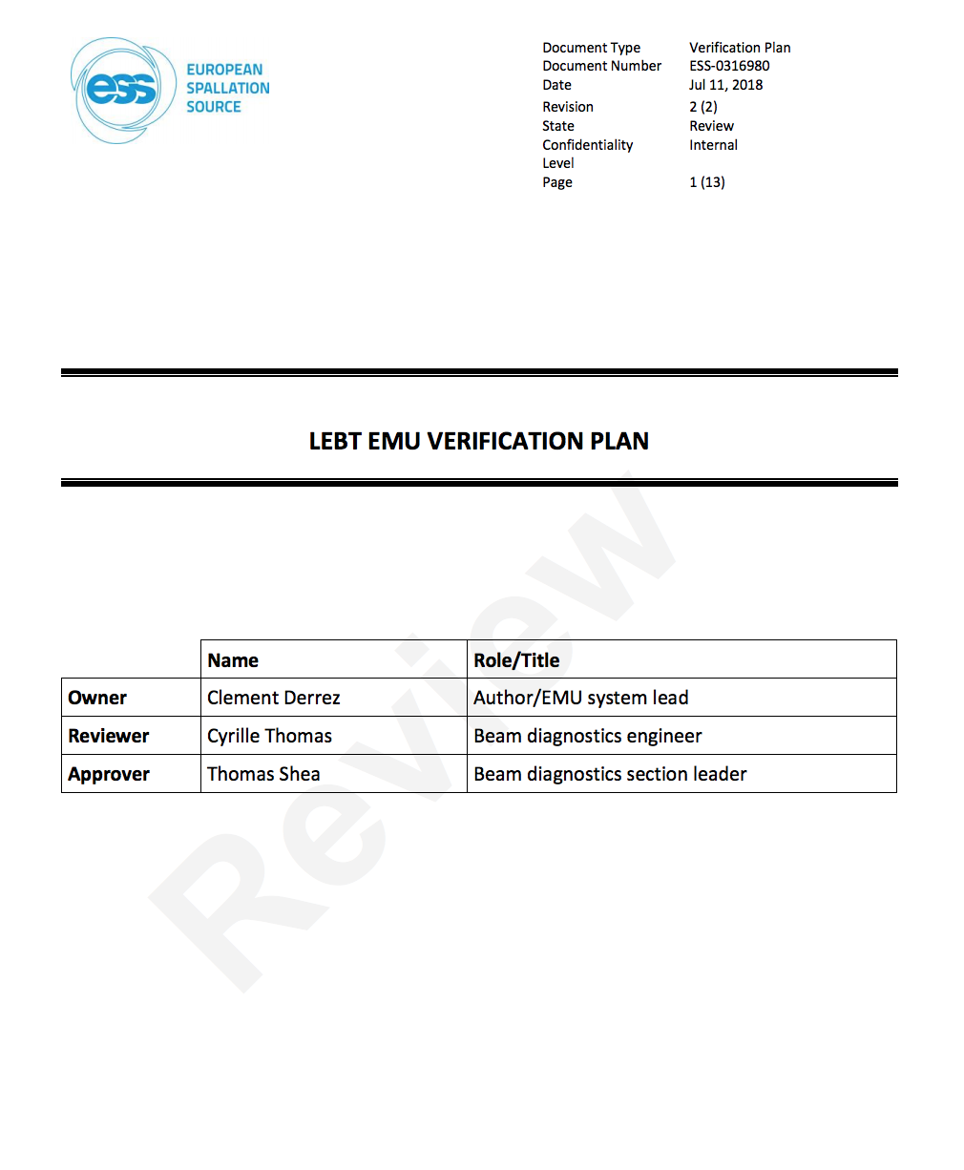
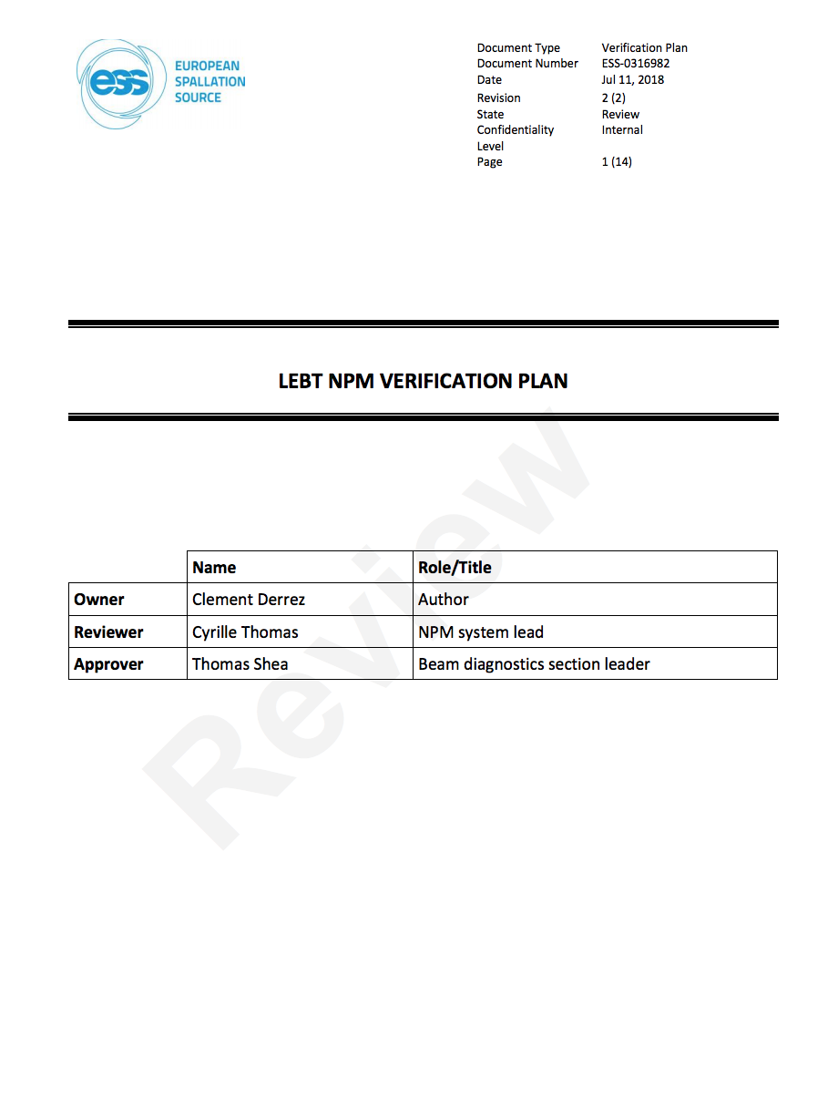
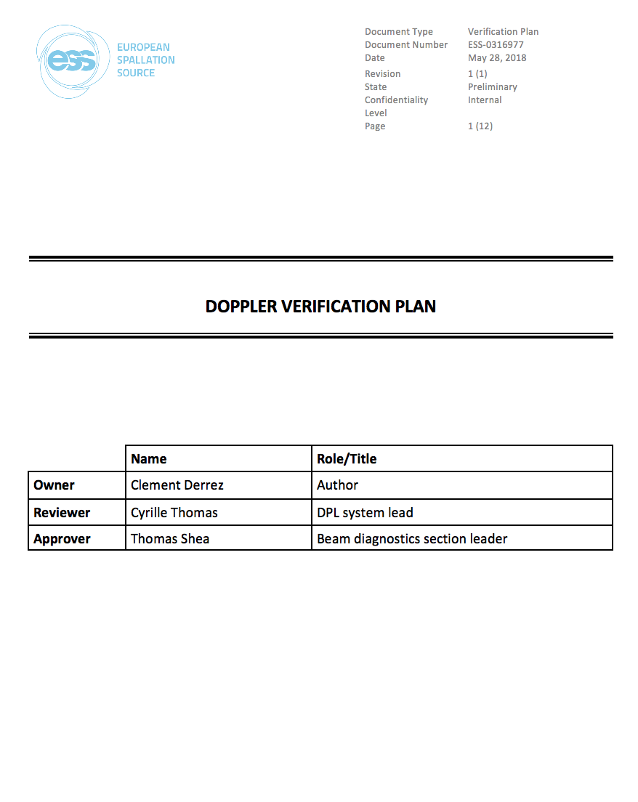
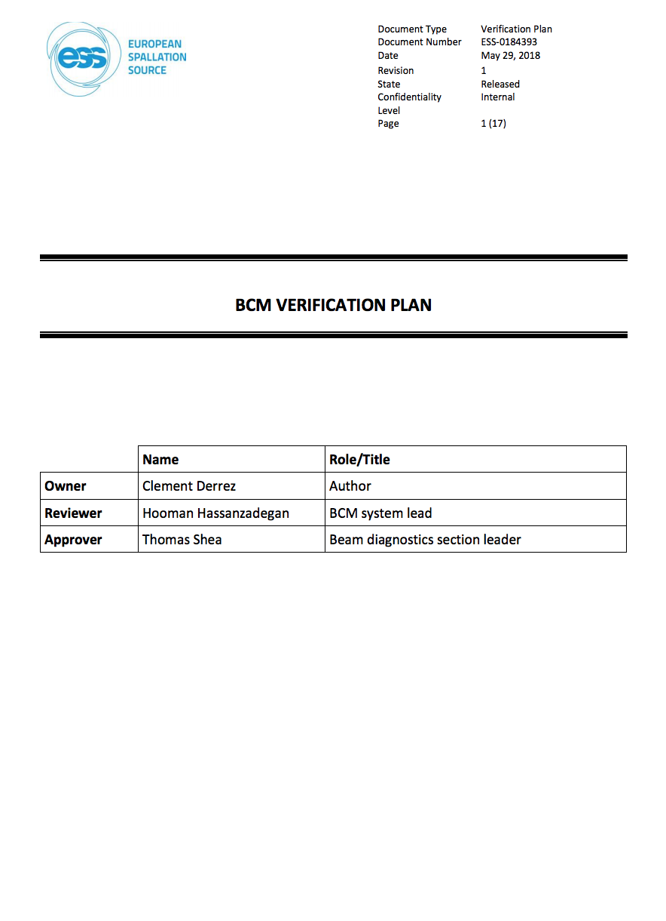
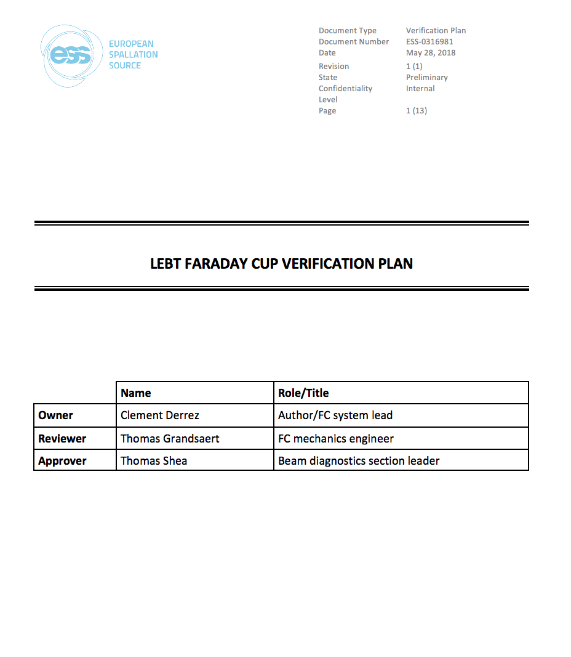
Status: Verification Plans
BCM verification plan
LEBT EMU verification plan
DPL verification plan
LEBT NPM verification plan
LEBT FC verification plan
HIPOT Testing for vacuum cables
Gamma Blockers Verification Plan
RSMS Test Procedures
…
Notes:
ESS-0184393
ESS-0316980
ESS-0316977
ESS-0316982
ESS-0316981
ESS-0306087
ESS-0127783
ESS-0092221

Slide 10
Status: Planned activities (NC Linac)
System | Local tests | Integrated tests
RFQ Cooling Water |  | PLC comm. w/ controls, Closed loop test (dry run)
RFQ Vacuum | Leak tests
RFQ EMR | RFQ tuning
RFQ |  | Test comm. w/ LLRF
MEBT Cooling Water | Manifold inst.
MEBT Vacuum | Leak tests | Integrated tests
MEBT EMR | Buncher tuning | Controls tests, Tuner comm. w/ LLRF, RF conditioning
MEBT Bilbao rack equipment | Local tests
MEBT Beam Instrumentation |  | Tests w/o beam (x9)
MEBT Magnets |  | Integrated tests
MEBT Chopper |  | Integrated tests
MEBT MPS |  | Tests
MEBT |  | Dry run
DTL EMR |  | RF conditioning 1, 2-4, 5
DTL | Local HW tests: 1, 2, 3, 4, 5 | Dry run: 1, 2, 3, 4, 5, HW verification w/ beam

Slide 11
Status: Planned activities (NC Linac)

Slide 12
ISrc & LEBT Testing and Commissioning Lessons Learned
Session held 2018/10/12
Worked well:
PSS is working great
Weekly meeting to organise the SRR was very useful
Vacuum documentation was excellent from the controls point of view
Good team building experience
Great support from technicians and Area Coordinators
To be improved:
Changing conditions lead to need for re-testing
FAT documentation lacking
Sequence of tests (PSS...) needs to be more explicit
Management disconnect, lack of engagement
Quality inspections for all installations, make no assumptions
Verification plans missing (sometimes), and they should also include integration tests
Cramming activities to meet “arbitrary” deadlines leads to inefficiencies
Infrastructure plan still under development, coordination needed
TRR was too weak
Suggestions:
Clear checklists
Clarify the safety responsibility during testing
Balance the paperwork vs hands-on work
SRR ≭ Beam RR, minimalistic and focused on safety
Dry runs
Report in preparation

Slide 13
Summary
Short term goals:
Identify missing activities and V&V plans
Update the JIRA plan with milestones linked to Primavera
Medium term goals:
Help producing the missing documentation
Support the preparation of TRRs and SRRs
Organise dry runs
Long term goals:
Make sure the commissioning team gets the hardware they need, reliably tested and on time

Slide 14
Thank you for your attention

