Slide 1
ESS Accelerator Plan
Ciprian Plostinar
Workshop on Testing and Commissioning
www.europeanspallationsource.se
16 October 2018

Slide 2
List of Acronyms
NC – Normal Conducting
SC – Superconducting
ISrc – Ion Source
LEBT – Low Energy Beam Transport Line
RFQ – Radiofrequency Quadrupole
MEBT – Medium Energy Beam Transport Line
DTL – Drift Tube Linac
SPK – Spoke Section
MBL – Medium Beta Linac
HBL – High Beta Linac
HEBT– High Energy Beam Transport Line
DMPL – Dump Line
A2T – Accelerator to Target
BOD – Beam on Dump
RBOT – Ready for Beam on Target
RFI – Ready for Installation
SSM – Strålsäkerhetsmyndigheten (Swedish Radiation Safety Authority)
PA/SSPA – Power Amplifiers/ Solid State PA
HV – High Voltage
PSS – Personal Safety System
SRR – Safety Readiness Review
CMs – Cryomodules
CDS – Cryogenic Distribution System
LWU – Linac Warm Units
PS – Power Stations
IK – In Kind
B1-3 – Buncher Cavities

Slide 3
Key Assumptions
Installation
In-Kind Model
Testing
Commissioning
Ready for Installation Dates (RFI):
Some contractual
Optimised Sequence:
Logic
Safety
Flexibility
Parallel Installation and Commissioning:
Shielding Wall
Others “best estimate”
Safety Measures
Correct Gateways
Suitable Reviews
Realistic time allocation
Relevant Permits
SSM
Hardware
Beam
Key Dependencies
Critical Parameters
Other Divisions
Coordinated Installation of Utilities/Services
Demanding Schedule
No Internal Float

Slide 4
2018 New Baseline
ISrc to Beam Dump (BOD)
8/2/2021
ISrc to LEBT
ISrc to DTL1
ISrc to DTL4
RBOT
03/9/2018
4/11/2019
27/4/2020
24/5/2021
2018
2019
2020
2021

Slide 5
Ion Source and LEBT
Beam!*

Slide 6
NC Front End
RFQ
Some manufacturing difficulties and setbacks.
RFI Date has shifted to March 2019.
MEBT
No major schedule changes announced, progress on many fronts.
Current RFI, March 2019, but can only be installed after RFQ
Infrastructure
New organisation structure
Work re-planning ongoing, follows the accelerator schedule.
Near critical path, but expected to ”catch-up”

Slide 7
NC Front End
NC RF System:
Two major milestones:
RF System Ready for RFQ/DTL1
RF System ready for the full NC Linac
Ongoing discussions on scope adjustment to reduce risk.
RFDS Support frame now to be built by ESS to allow infrastructure work to advance.
Some unresolved issues remain.
 | RF System
RFQ and DTL1 RF System Operational | Q3 2019
Full NC RF System Operational | Q1 2020

Slide 8
NC Front End: DTL
RFIs | 2018 Baseline Date | Latest Update
DTL4 | 01-Jan-2019 | 20-Mar-2019
DTL1 | 10-Feb-2019 | 05-Jun-2019
DTL3 | 15-Mar-2019 | 03-Oct-2019
DTL2 | 05-Jun-2019 | 13-Jan-2020
DTL5 | 30-Sep-2019 | 19-Mar-2020

Slide 9
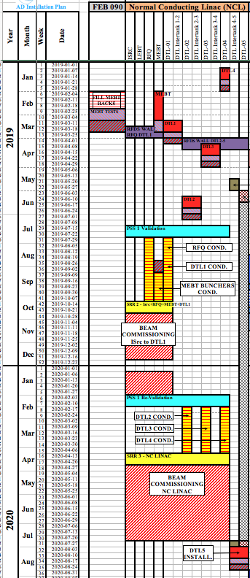
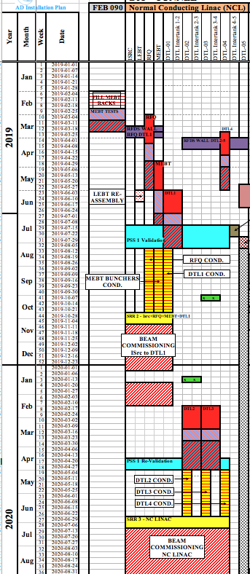
Visual Plan
Baseline
With the New Dates
Installation Window
DTL4
DTL1
DTL3
Cond/Commissioning Window
DTL2
RFI DTL3
RFI DTL2

Slide 10
NC Front End: DTL
Significant slippage, RBOT date is affected (DTL2 and DTL3 late by 6-7 months compared to the baseline.
Requires some installation sequence adjustment
The “Beam from ISrc to DTL1” milestone is largely not affected.
Near Critical Path buffer
The “Beam from ISrc to DTL4” milestone has slipped by ~2.5 months
Delay can be reduced if installation work can take place during the RF conditioning or beam commissioning windows.
(i.e. install during the day, condition in the evenings/at night).
Currently this is not an ESS strategy.

Slide 11
NC Front End Timeline
RBOT
9/8/2021
ISrc to Beam Dump (BOD)
ISrc to LEBT
ISrc to DTL1
ISrc to DTL4
26/4/2021
3/9/2018
11/11/2019
13/7/2020
2018
2019
2020
2021
Infrastructure Works
RF System (RFQ and DTL1)
RF System (Full NC Linac)
DTL4
RFQ
MEBT
DTL1
PSS1 Validation
RF Conditioning (RFQ and DTL1)
SRR2
Beam Commissioning (ISrc to DTL1)
DTL2
DTL3
PSS1 Re-Validation
RF Conditioning (DTL2,3,4)
SRR3
Beam Commissioning (ISrc to DTL4)
DTL5

Slide 12
NC Front End: Main Risks and Opportunities
Risks
RFQ and DTL deliveries
Infrastructure works late
RF System delays
Opportunities:
Schedule flexibility
Mitigating actions
Parallel NC beam commissioning/SC installation work

Slide 13
SC Linac
CDS:
For the Elliptical CDS, a delay on the start of installation was reported compared to the baseline:
December 2018 to March 2019.
A faster production and installation pace was proposed such that the commissioning date of the full CDS (Elliptical and Spoke) is maintained (November 2019).
Spoke CMs (CM1 – CM13):
Baseline RFIs: June 2019 to July 2020
Assumes 9 weeks of testing at FREIA for CM1, 6 weeks for CM2 and CM3 and 4 weeks for the rest.
Assuming 6 weeks of testing for all CMs would shift the delivery of CM13 to December 2020
A possible delay of up to 2 months was flagged up.
SC RF System:
Spoke RF Amplifiers: 3 months delays as tender was challenged.
MBL Klystron deliveries have started.
Good installation progress in the Gallery

Slide 14
SC Linac
MB CMs (CM1 – CM9):
RFIs: October 2019 to August 2020
Major changes in assembly schedule at CEA
~2 months delay on the cavities. No mitigation possible.
~4 months cumulative delay on the CM. This pushes the delivery of the last MB CM to December 2020.
Some mitigation possible (testing reshuffle, skip the installation of the 2 unpowered HB CMs to reduce the impact on RBOT).
HB CMs (CM1 - CM11):
Baseline RFIs: October 2020 to October 2021
As above. The RFI for the first HB CM is now January 2021
LWUs:
New delivery schedule for all the magnets from Elettra is now available.
Installation near Critical Path. Affected by the late access to A2T building.
Sequence updated and optimised.

Slide 15
SPK Timeline
ISrc to Beam Dump (BOD)
26/4/2021
ISrc to LEBT
ISrc to DTL1
ISrc to DTL4
RBOT
3/9/2018
11/11/2019
13/7/2020
9/8/2021
2018
2019
2020
2021
19/08/19 - 15/11/19
SPK CDS Installation
18/11/19 - 07/08/20
SPK CM Installation
22/06/20 - 25/09/20
SPK LWU Installation
08/01/18 - 18/12/20
SPK RF System
04/11/19 - 18/12/20
SPK RF Power Stations

Slide 16
MBL Timeline
ISrc to Beam Dump (BOD)
26/4/2021
ISrc to LEBT
ISrc to DTL1
ISrc to DTL4
RBOT
3/9/2018
11/11/2019
13/7/2020
9/8/2021
2018
2019
2020
2021
11/03/19 - 15/11/19
Elliptical CDS Installation
02/12/19 - 11/12/20
MBL CM Installation
17/08/20 - 29/01/21
MBL LWU
05/03/18 - 27/11/20
MBL RF System Installation/Commissioning
13/08/18 - 27/09/19
MBL Klystrons
01/07/19 - 13/03/20
MBL Modulators

Slide 17
HBL
Installation of the 11 HB CMs is now planned after RBOT, but before BOT. Currently this interval is ~12 months long.
If this “buffer time” will be used by additional delays, the HB installation will have to take place after BOT, during planned machine shutdown periods.

Slide 18
SC Linac: Main Schedule Risks and Opportunities
Risks
CM deliveries
Infrastructure works late
SPK RF System delays
Testing findings
Opportunities:
Schedule flexibility
Parallel NC beam commissioning/SC installation work

Slide 19
Critical Path – September 2018

Slide 20
Near Critical Path
ISrc to Beam Dump (BOD)
26/4/2021
ISrc to DTL1
ISrc to DTL4
RBOT
11/11/2019
13/7/2020
9/8/2021
2018
2019
2020
2021
17/12/18 - 12/07/19
RFQ + DTL 1 RF System
27/05/19 - 31/01/20
Full NC Linac RF System
04/03/19 - 15/11/19
Elliptical CDS
19/08/19 - 15/11/19
SPK CDS
18/11/19 - 28/08/20
SPK CM
18/11/19 - 27/11/20
MBL CM
01/06/20 - 07/08/20
HBL CM
05/08/19 - 20/12/19
HEBT LWU
06/01/20 - 05/06/20
HBL LWU
08/06/20 - 04/09/20
A2T LWU
24/08/20 - 16/10/20
SPK LWU
19/10/20 - 19/02/21
MBL LWU
12/08/19 - 25/09/20
SPK RF Power Stations

Slide 21
Delays on major milestones since the new baseline was approved
ISrc to RFQ/MEBT/DTL1
ISrc to Beam Dump (BOD)
4 Nov '19
8 Feb '21
ISrc to DTL4
RBOT
27 Apr '20
24 May '21
2018 Baseline
2019
2020
2021
0.3 months
Beam to RFQ/MEBT Delay
2.6 months
Beam to DTL4 Delay
2.6 months
BOD Delay
2.6 months
RBOT Delay
September 2018
2019
2020
2021
11/11/2019
13/7/2020
9/8/2021
ISrc to DTL1
ISrc to DTL4
RBOT
26/4/2021
ISrc to Beam Dump (BOD)

Slide 22
The Big Picture
Beam on Dump (BOD)
Accelerator Ready for Beam on Target (RBOT)
ISrc to DTL1
End of Construction
ISrc to LEBT
ISrc to DTL4
Beam on Target (BOT)
2018
2019
2020
2021
2022
2023
2024
2025
Start Of User Program (SOUP)

