Slide 1
MPS commissioning at ESS
Szandra Kövecses
Lead Integrator for Machine Protection
www.europeanspallationsource.se
16 October, 2018

Slide 2
Protection for the NC linac beam commissioning
In order to provide protection for the NC linac beam commissioning,
all relevant MP systems and functions MUST be completely verified and validated
Notes:
With and without beam

Slide 3
What do I mean by relevant?
The machine protection system of systems (MPSoS) is distributed along the linac, target and the neutron instruments.
The relevant ones in this case are the ones that are covering equipment in the NC linac.

Slide 4
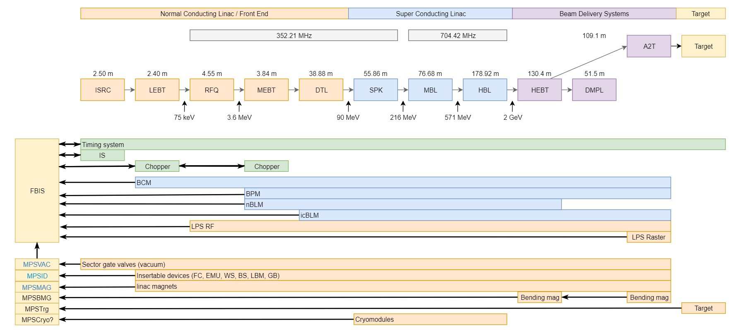
Distribution overview
Notes:
MP monitors inputs and stops the beam if a potentially damaging situation is detected

Slide 5
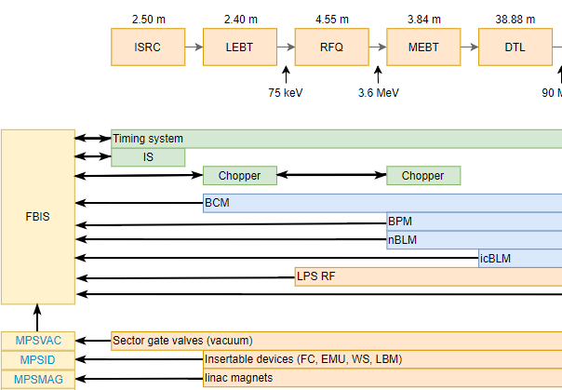
NC linac distribution overview
Notes:
Green: actuators
Blue: Beam monitoring
Orange: other

Slide 6
Dependencies of MPSID
MPSID
Insertable Devices
ID motion control
ID water cooling
NTP server
EPICS
Technical network
aso.

Slide 7
Dependencies on MPSID
ID motion control
MPSID issues a movement permit which allows movement or blocks it
The permit is an active signal which closes a NO relay
Relay has a button that forces it to closed state (ONLY for tests)
MPSID does not block ID/ID motion controller commissioning

Slide 8
NC linac distribution overview

Slide 9
Dependencies of FBIS
FBIS
Timing system
Ion Source
Choppers
BCM
BLM
BPM
LPSRF
MPSID
MPSVAC
MPSMAG
Aso.

Slide 10
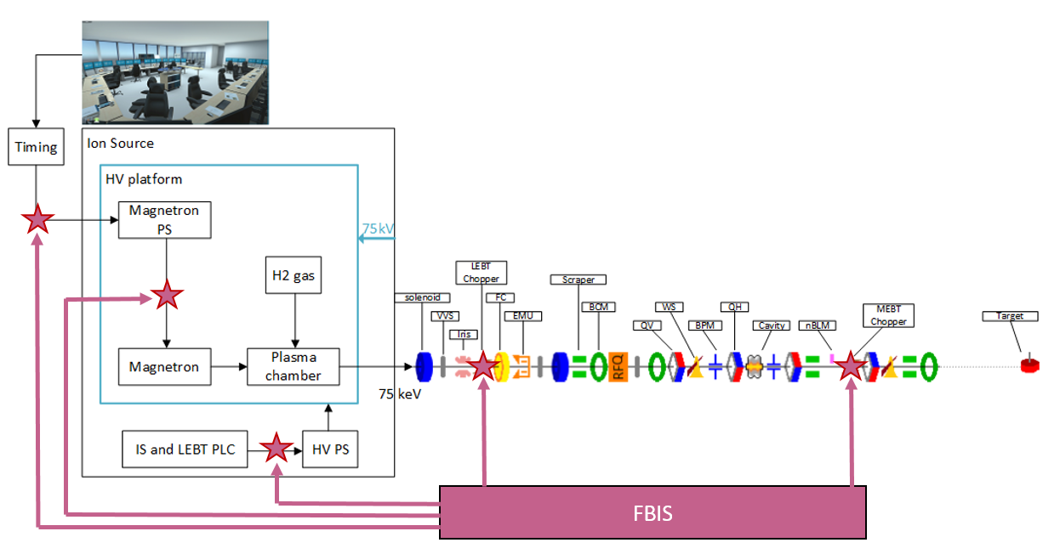
Dependencies on FBIS
Rewire
FSU
High signal
to chop
High signal
to chop
Rewire
Notes:
Timing-magnetron PS
Currently: fiber straight from TS to magnetron PS (keep it for IS+LEBT commissioning)
Final: fiber from TS to FBIS and fiber from FBIS to magnetron PS (NC commissioning), active
Magnetron PS-Magnetron
Current: HV cable from magnetron PS to magnetron
Final: FSU in between. “NO” (IS+LEBT commissioning, tested in lab, administrative work, RAMS aso)
HV interlock
Current: cable from IS and LEBT PLC to HV PS. Current loop
Final: cable from IS and LEBT PLC to FBIS and cable from FBIS to HVPS (NO open switch)
LEBT Chopper
Have to provide 5V to request chopping -> no effect on chopper commissioning
MEBT Chopper
Have to provide a high signal to chop. No effect on chopper commissioning

Slide 11
When to test MPS?
Non-beam verification and validation
Due to the many interfaces and functions performed by the interaction of systems, MP should be tested late in the hardware (non-beam) commissioning.
Beam verification and validation
The MP tests should be the first tests to be performed during the beam commissioning

Slide 12
Connect additional equipment to MPS
When the later sections of the linac are installed equipment has to be connected to existing or new MP systems.
When that is done the affected system has to be reverified and revalidated

Slide 13
Thank you
Questions?
www.europeanspallationsource.se
16 October, 2018

