Slide 1




SNS Commissioning
Mike Plum
Ring Systems manager for the Power Upgrade Project
Lund, Oct. 16-17, 2018

Slide 2
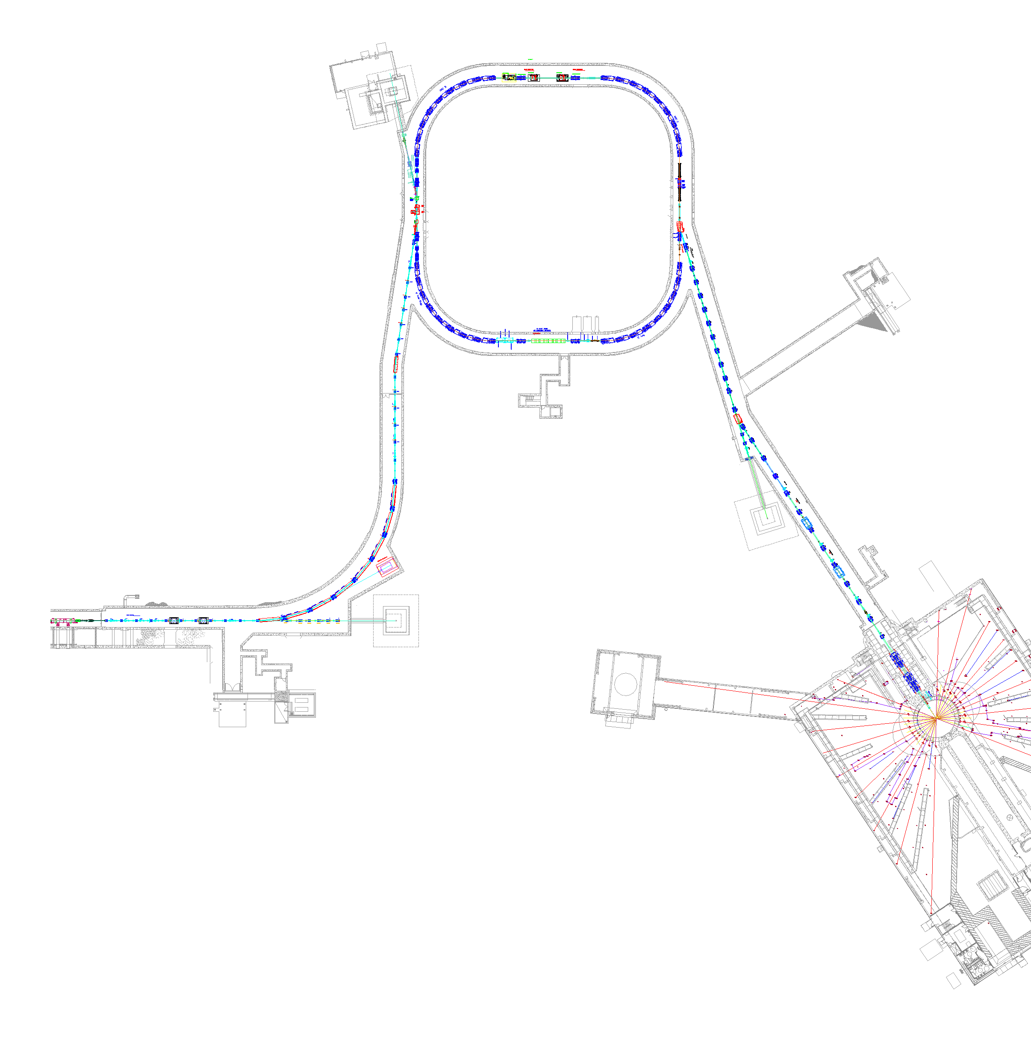
SNS Accelerator Complex
150 kW injection dump
1 GeV LINAC
Accumulator Ring: Compress 1 msec long pulse to 700 nsec
Collimators
Front-End:
Produce a 1-msec long, chopped,
H⁻ beam
Extraction
Injection
RF
2.5 MeV
87 MeV
186 MeV
387 MeV
1000 MeV
RTBT
Ion Source
7.5 kW beam dump
HEBT
RFQ
DTL
CCL
SRF, β=0.61
SRF, β=0.81
Design parameters
Kinetic Energy [GeV] | 1.0
Beam Power [MW] | 1.4
Repetition Rate [Hz] | 60
Peak Linac Current [mA] | 38
Linac pulse length [msec] | 1.0
SRF Cavities | 81
7.5 kW beam dump
Liquid Hg Target

Slide 3
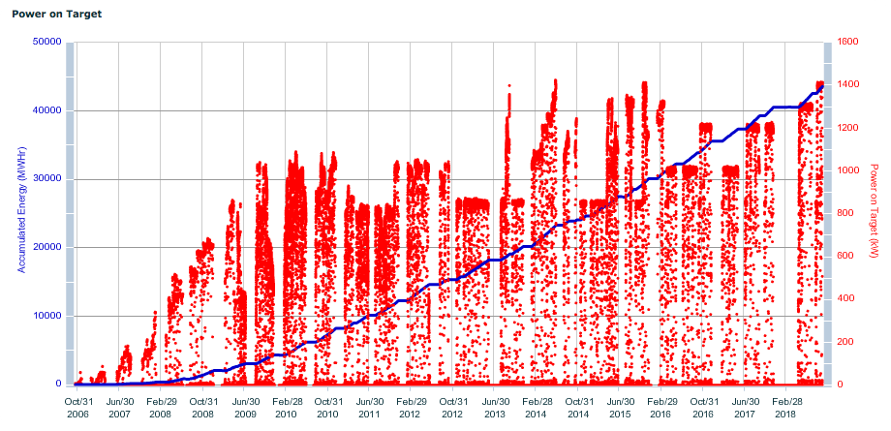
SNS beam power history
Beam power administratively limited by target most of this time
1.4 MW
~3 y to 1 MW
Availability for last fiscal year was 94.5%
Plan to operate at 1.4 MW from now until Power Upgrade Project

Slide 4
Commissioning Timeline
2002
2003
2004
2005
2006
Front-End
DTL/CCL
DTL Tank 1
SCL
DTL Tanks 1-3
Ring
Target
Total commissioning duration was about 3 years 7 months

Slide 5
How we did it
Each section of the accelerator complex had an assigned physicist (area manager)
  Responsible for the overall commissioning and performance of that section
  Four areas: Front end, warm linac, cold linac, HEBT/Ring/RTBT
  Front end later combined with warm linac to make one area
Commissioning shifts were staffed 24/7, 2 physicists per 8 hour shift
  Technical support called in as needed
Commissioned with beam in 7 stages (5 for linac, 2 for Ring and target) over ~3.5 years
Front End through CCL-3 “control room” was a few computer stations in the Front End building, hard hats and safety shoes were required

Slide 6
How we did it (cont.)
Commissioned DTL-1 (7.5 MeV output energy) with a special diagnostics beam line (D-plate) that had a high-power beam stop. We used it to demonstrate 1.0 MW equivalent power (26 mA pk, 650 us, 60 Hz) in 2003. After that did not return to 1 MW beam parameters until 2009.
After initial low intensity commissioning, large fraction of accelerator physics time was spent developing low-loss tunes for the next step in beam power

Slide 7
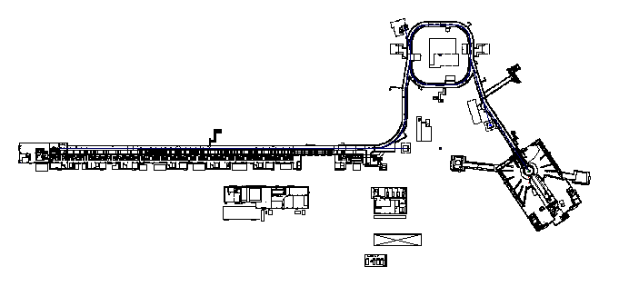
Evolution of PPS enclosures
Injection Dump 150kW
HEBT-RTBT-Target
PPS 3.0
HEBT -Ring Gate
PPS 2.0
End of Linac - HEBT Gate PPS 1.0, 1.2
Extraction Dump 7.5KW
DTL Tank 1
and
DTL Tanks 1-3
PPS 0.4/0.5
Linac Dump 7.5 KW

Slide 8
How long did it take (how much time did we spend)?
Section commissioned | days actual*
Front end | 33
DTL 1 | 47
DTL 2-3 | 12
DTL 4-6 and CCL 1-3 | 135 (incl. ~40 days of planned shutdown)
CCL 4 thru SCL | 63 (incl. ~13 days of planned shutdown)
*Some times could have been shorter. For example we spent a large amount of time studying the beam halo, and some of this work never bore fruit. On the other hand, this could be seen as time well spent gaining experience with the machine.

Slide 9
DTL and CCL warm linac commissioning
Temporary high-power (1.4 MW equivalent) beam dump for DTL-1
Temporary low-power (50 us, 1 Hz) dump for DTL 2-3
After that only internal / permanent dumps
For DTL we had two methods prepared to set cavity phases and amplitudes
  Delta-t method
  Energy degrader method
  Later developed phase scan signature method (PASTA), and today we use a variation of the PASTA method
For CCL we had one method prepared
  Delta-t method
  Today we use a variation of the PASTA method

Slide 10
SCL commissioning
Initially commissioned at 4.2 and 2.1 deg. K, but cryo-plant at
2.1 K was not stable at the time
Cavity amplitudes set to maximum stable gradients – much different than design gradients
Determining cavity phase set points was a lot easier than expected, partly due to the large acceptance of the SCL
  Had two methods prepared: Beam Induced Signal (Drifting Beam method) and Phase Scan. Phase Scan method worked great, no need to further develop Drifting Beam method.
Operated at 4.2 K from 2005 to 2007 to give time for cryoplant adjustments needed for stable 2.1 K operation, and also because 4.2 K met operations needs during that time

Slide 11
What we should have done differently
During commissioning many system adjustments and modifications were needed to get everything working together. The rapid pace did not accommodate careful reviews of the modifications. Modifications to the Machine Protection System should have been more carefully reviewed.
  Low pass filters were added to some MPS inputs to help with false trips due to noise. This ended up slowing down the response time of the MPS, which we didn’t realize at the time, and which caused some (temporary) performance degradation due to the increased beam loss.

Slide 12
What worked well for us
Having a physicist assigned to each section of the accelerator
Thorough magnet measurement program allowed “dialing-in” magnet currents and immediately transporting beam – first shot through HEBT hit view screen in ring injection section (didn’t do as well with first shot to neutron target)
Good set point reproducibility in the magnet power supplies.
Physics apps were integrated with the on-line model and the control system, and well developed before start of commissioning
Physics apps written by commissioning team members
Commissioning the machine in 7 stages
Good set of beam instrumentation (lots of beam position, beam profile, beam phase, and beam loss monitors)
General philosophy of getting low intensity beam to go as far as possible as soon as possible

Slide 13
Some lessons learned
Equipment checkout with beam takes a large fraction of the time
  Beam instrumentation
  RF & LLRF
  Control system
  Machine Protection System
The pace of the commissioning is determined by equipment issues. If all the equipment worked as designed from day one it would only take a few days to commission.
Need to closely involve hardware experts, thoroughly test hardware as much as practically possible before commissioning
Need to prioritize equipment readiness in event of limited resources (e.g. don’t need multipole corrector magnets for initial commissioning)
Low power commissioning is relatively easy. High power operations brings unexpected surprises.
Be careful with modifications to critical systems (e.g. MPS system)

Slide 14
Power ramp up (the commissioning after the initial commissioning)
Two schools of thought here:
  Keep the beam power low, get all the bugs worked out, don’t endanger beam availability, don’t activate beam line components until everything is working well
  Aggressively push beam power to identify weak components and to solve high-power problems before the users expect/demand high availability
At SNS we choose the latter, and we are glad we did
At 1 MW we paused to focus on beam availability. Budget and then target problems caused us to stay at 1 MW for longer than we had hoped.

Slide 15
Summary
The pace of commissioning and beam power ramp was determined by the hardware (RF modulators, target, RFQ, ion source, beam instrumentation)
Accelerator physics worked 24/7, with support from technical experts as needed. Sometimes this was not very efficient because equipment limited the rate of progress.

Slide 16
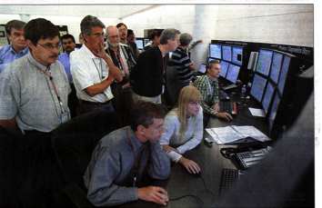
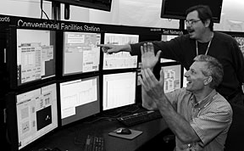
Commissioning: A Period of Ups and Downs
Beam commissioning can be extremely frustrating and is hard work (long hours)
But it is ultimately extremely rewarding
Enjoy it

Slide 17
Thank you for your attention!

Slide 18
Backup slides

Slide 19
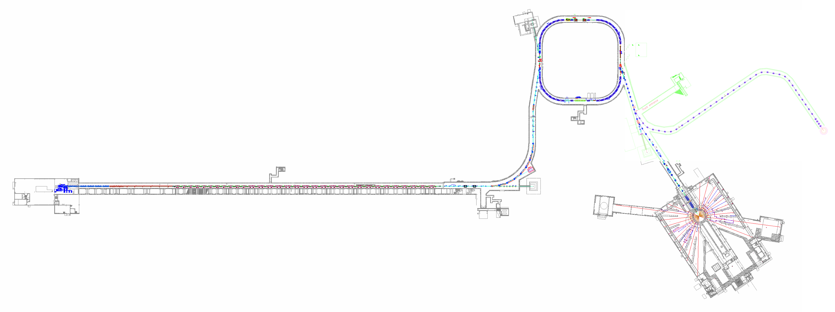
PPU system upgrades
INJECTION DUMP
Re-assess 150 kW power rating
Add view screen imaging system
RING INJECTION
Replace 2 chicane magnets
Replace inj. dump septum magnet
Upgrade 8 inj. kickers
Add quad magnet to inj. dump beam line
RING EXTRACTION
Add 2 more kickers to the existing 14 kickers.
But there is another way: to upgrade the voltage capability of the existing 14 kickers -- prototype testing is in progress.
WARM LINAC KLYSTRONS
Upgrade DTL klystrons 3, 4, and 5 from 2.5 MW to 3.0 MW
SCL
Add 7 cryomodules
(28 cavities)
Add 28 klystrons and 3 modulators
Future beam line to second target station
STS STUB
Build first part of beam tunnel to future second target
RING UTILITIES
Increase water cooling capacity
TARGET
Increase power capability from 1.4 to 2.0 MW

Slide 20
Design vs operation SCL gradients
HOM
HOM
Turned on
Conditioning
Tuner problem
Tuner
HOM+Conditioning
Design gradient
(from R. Campisi, June 2006)

