Slide 1
AWAKE Commissioning at CERN
Janet Schmidt
ESS Linac Group
www.europeanspallationsource.se
16 October, 2018

Slide 2
The AWAKE experiment
Advanced plasma WAKEfield experiment at CERN
https://awake.web.cern.ch
Accelerator R&D experiment at CERN on proof of principle of proton driven plasma wakefield acceleration
witness
beam
drive
beam
plasma
wakefield

Slide 3
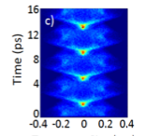
The AWAKE Facility
Electrons @
E₀=1.3 GeV
1.25e9 electrons@
10-20 MeV from PHIN
TW laser
Self-modulation
10m Rb-Plasma
N_{e}=10¹⁴⁻10¹⁵ cm⁻³
3e11 Protons @
400 GeV from SPS

Slide 4
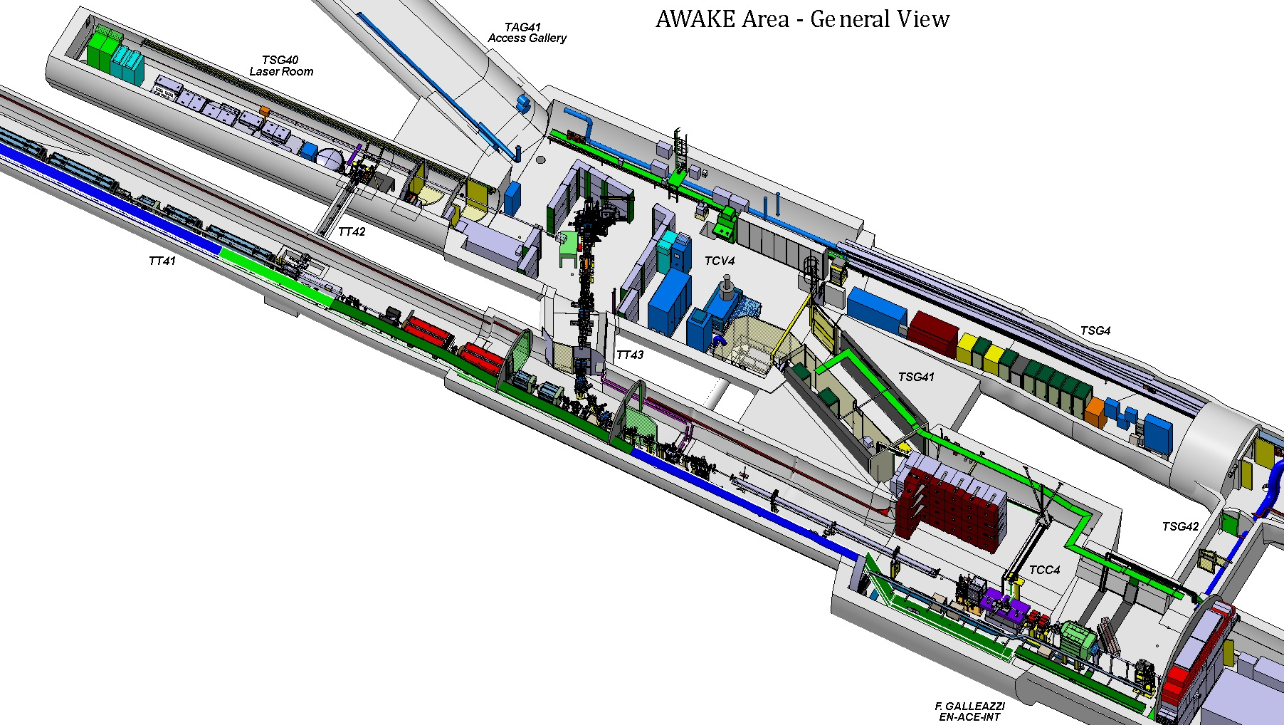
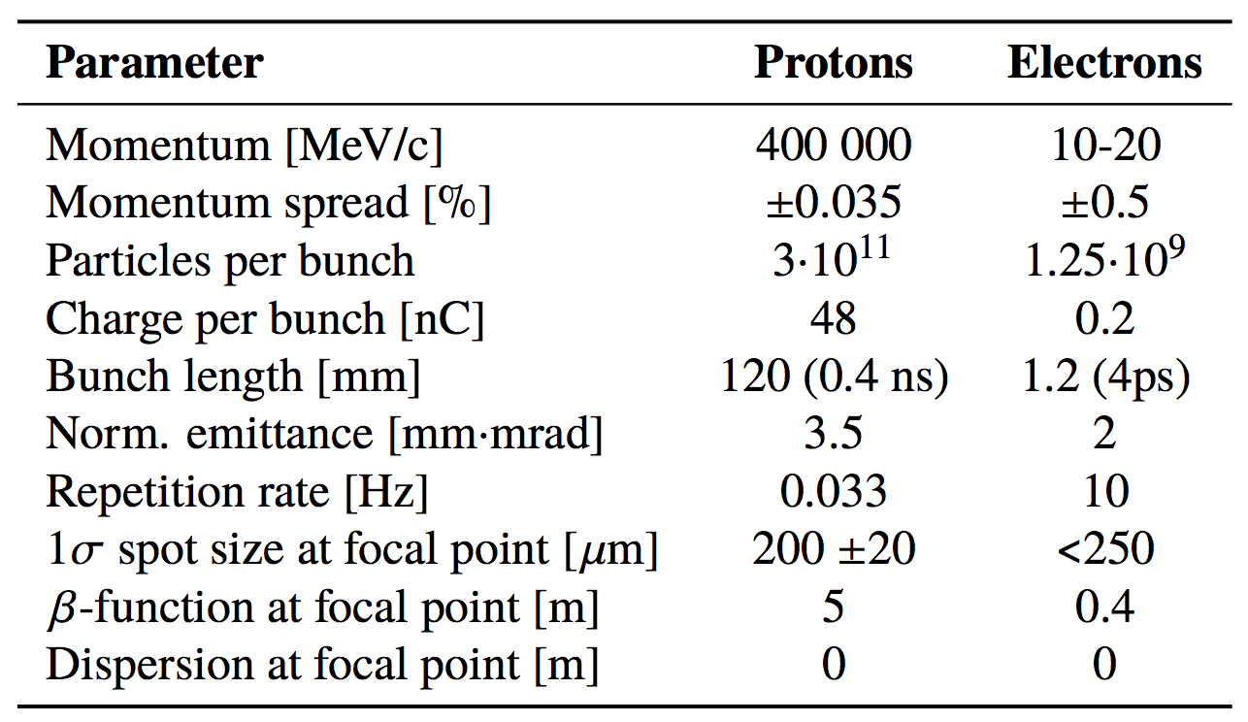
The AWAKE Facility
laser
laser merging mirror
electron source
proton beam
electron merging point
plasma cell
diagnostic

Slide 5
A project view of AWAKE
Collaboration of 18 member institutes and 3 associated partners from Novosibirsk to Vancouver
Notes:
The coordination package leader, CPL, is responsible for the design and commissioning of the proton and electron beam lines, follows up the specifications of the different equipments and services (i.e. magnets, power converters, beam instrumentation, vacuum, windows, interlock system, controls, cabling, EL). The CGL follows up its integration and installation, coordinates the related studies and activities, follows up work progress and insures that milestones are achieved according to plans.

Slide 6
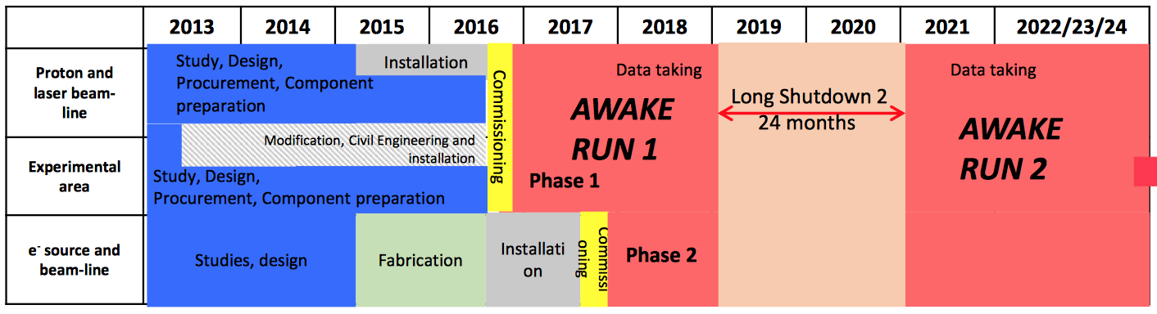
A project view of AWAKE
Collaboration of 18 member institutes and 3 associated partners from Novosibirsk to Vancouver

Slide 7
A project view of AWAKE
Collaboration of 18 member institutes and 3 associated partners from Novosibirsk to Vancouver
That’s the phase, on which I will concentrate today

Slide 8
Schedule for run1
M. Bernadini

Slide 9
Coordination phases
Activity coordination (access approvals, planning, coordination)
Handover to
Coordination Package
Handover of beam line to
operation
Installation
Hardware Commissioning
Beam Commissioning
Experimental Phase
Installation Coordinator
Coordination Package Leader
Beam Line
(in the AWKAE case: experiment and beam line very close, so commissioning with beam together)
Coordination Package Leader Experiment

Slide 10
The handover procedure ➔ permits
The permit document is the gateway to start hardware (powering permit) or beam (beam permit) commissioning.
Formal procedure:
Preparation of the document together with the safety group responsible (template available from safety group) ➔ coordination package leader with safety
Comments from required systems are collected in EDMS on the document when ➔ equipment responsible
After all system experts have given the “green light” the document is approved and released ➔ project leader and operation leader (issued by safety leader)
Comment: EDMS = CERN document management system (~ CHESS)

Slide 11
From installation to hardware commissioning ➔ the “powering permit”
Covered area
Check points to grant permit
Responsible persons to give status, review, approve
Scope of permit
Procedure for suspension of permit
Procedure for reactivation of permit
Procedure for cancellation of permit

Slide 12
Installation Coordination
Weekly project meeting covering:
  Planning coordination (short term and long term)
    Same plan (tool) for short and long term planning
    In meeting: open plan, check and update
  Integration issues
Bi-weekly coordination package meetings (sequence depending on coord. package)
Activity registration
  Approval by area coordinators (installation coordinator, project leader, beam line coordination package leader)
  No access w/o registration of person
  Key information: what, who, where, when interference with other activities
Comment: I have screenshots of the activity registration tool available, if someone is interested to take a look

Slide 13
From installation to hardware commissioning ➔ the “powering permit”

Slide 14
From installation to hardware commissioning ➔ the “powering permit”
Installation complete
Access system functional
Safety documentation complete
Protection from false beam active
Notes:
Installation completed
Everything cabled (powering and controls, including Ethernet)
Water and air-cooling active
Vacuum to operational value: 1e-7 mbar
Access system ready (starting in June 2016)
CIBU installed and ready
SPS timing ready
Controls and applications ready
All data for all equipment logged

Slide 15
From installation to hardware commissioning ➔ the “powering permit”
AWAKE internal pre-requirements:
Installation completed
Everything cabled (powering and controls, including Ethernet)
Water and air-cooling active
Vacuum to operational value
Access system ready
CIBU installed and ready
SPS timing ready
Controls and applications ready
All data for all equipment logged
Installation complete
Access system functional
Safety documentation complete
Protection from false beam active

Slide 16
Hardware commissioning
Coordination:
  Handover from installation (no installation activities in parallel, if not explicitly approved by commissioning coordinator)
  Clear list of activities defined before start
  Daily meetings in the evening:
    What has happened today,
    what is the plan for tomorrow,
    any changes needed in planning,
    test results (non-conformities)
For each activity registered
  need / no need for: vacuum, access system, timing, interlock system, controls, logging, applications
  Conflict with other activities
Tests done:
  Vacuum, beam diagnostic, beam interlock system, power converters+magnets+temp. interlock system
  Mainly: movement of parts, interlock tests, calibration, magnet testing

Slide 17
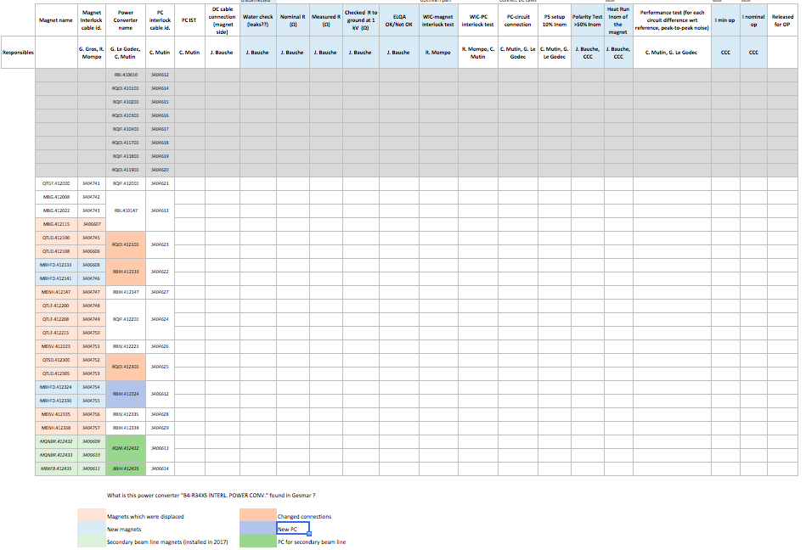
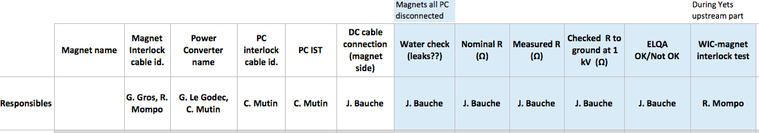
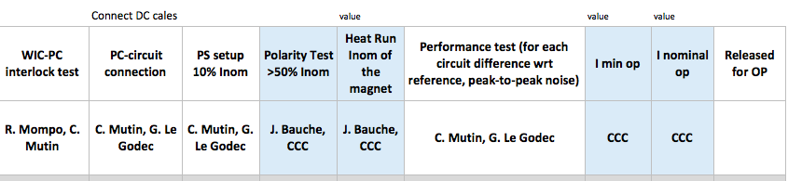
Magnet testing in detail

Slide 18
Original “Lessons Learned" slide from AWAKE HWC
keep an eye on the OP schedules (start communicating your planning early)
start contact with OP early
recheck existing beam lines in databases => consistency of databases
short meetings with few people on specific topic
  bigger overview meetings (technical boards,…) to REPORT status
use communication infrastructure provided (collaboration workspace, EDMS, calendar, task lists)
  whatever helps to keep the overview AND make people look at it
Learn french!!!
equipment experts have done an amazing job during the HWC!

Slide 19
From hardware commissioning to beam commissioning ➔ the “beam permit”
Area patrolled
Safety validation passed
RP of the area is ready for beam

Slide 20
From hardware commissioning to beam commissioning ➔ the “beam permit”
HWC finished is not mentioned here, because the approval of the permit is requested by the coordination package leader only after the testing is finished ➔ could be added in addition
Area patrolled
Safety validation passed
RP of the area is ready for beam

Slide 21
From hardware commissioning to beam commissioning ➔ the “beam permit”
AWAKE internal pre-requirements:
Installation completed (including alignment)
Everything cabled (powering and controls, including Ethernet)
Water and air-cooling active
Vacuum to operational value
Access system ready
CIBU installed and ready
SPS timing ready
Controls and applications ready
All data for all equipment logged
New optics in OP tools
Area patrolled
Safety validation passed
RP of the area is ready for beam

Slide 22
Beam commissioning
Coordination:
  Clear list of activities defined before start
  Daily meetings in the evening:
    What has happened today,
    what is the plan for tomorrow,
    any changes needed in planning,
    test results (non-conformities)
For each activity registered
  need / no need for: beam intensity, beam destination, diagnostic tools, applications
  Conflict with other activities
Tests done:
  Polarity checks, synchronisation, steering, diagnostic reaction to beam, data logging, threshold settings for interlocks, aperture measurements and beam based alignment, optics meas., stability run

Slide 23
Beam commissioning stages

Slide 24
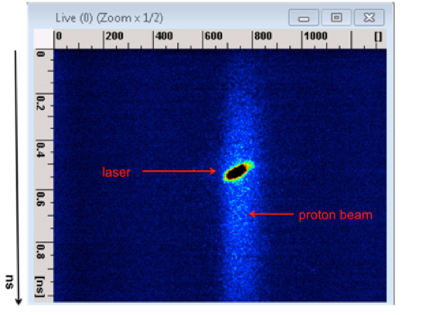
Most tricky part
Transverse alignment and synchronization of proton, laser (and electron) beams
Tight aperture restrictions from geometry of the plasma cell

Slide 25
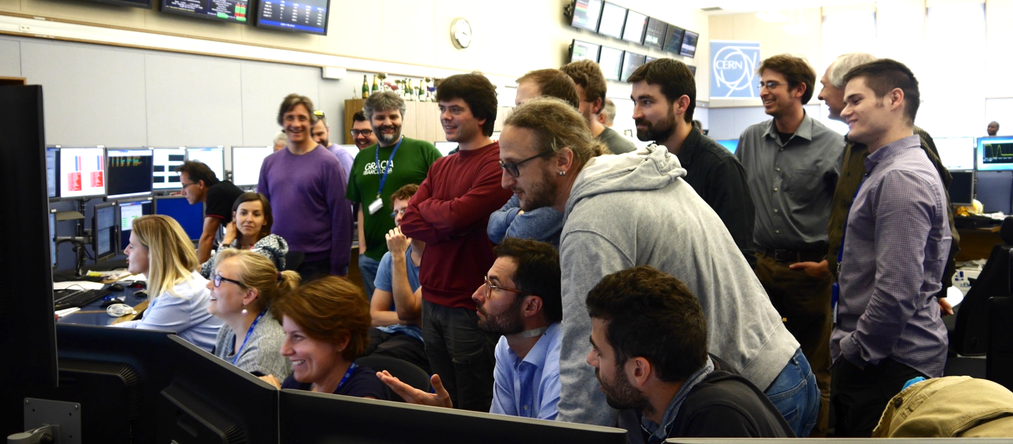
Testing & beam commissioning in summary
An exciting time
  With not a lot of sleep
  And a lot of pizza in the control room
Needs flexibility and dedication of all team members
Communication and clear responsibilities is the key!

Slide 26
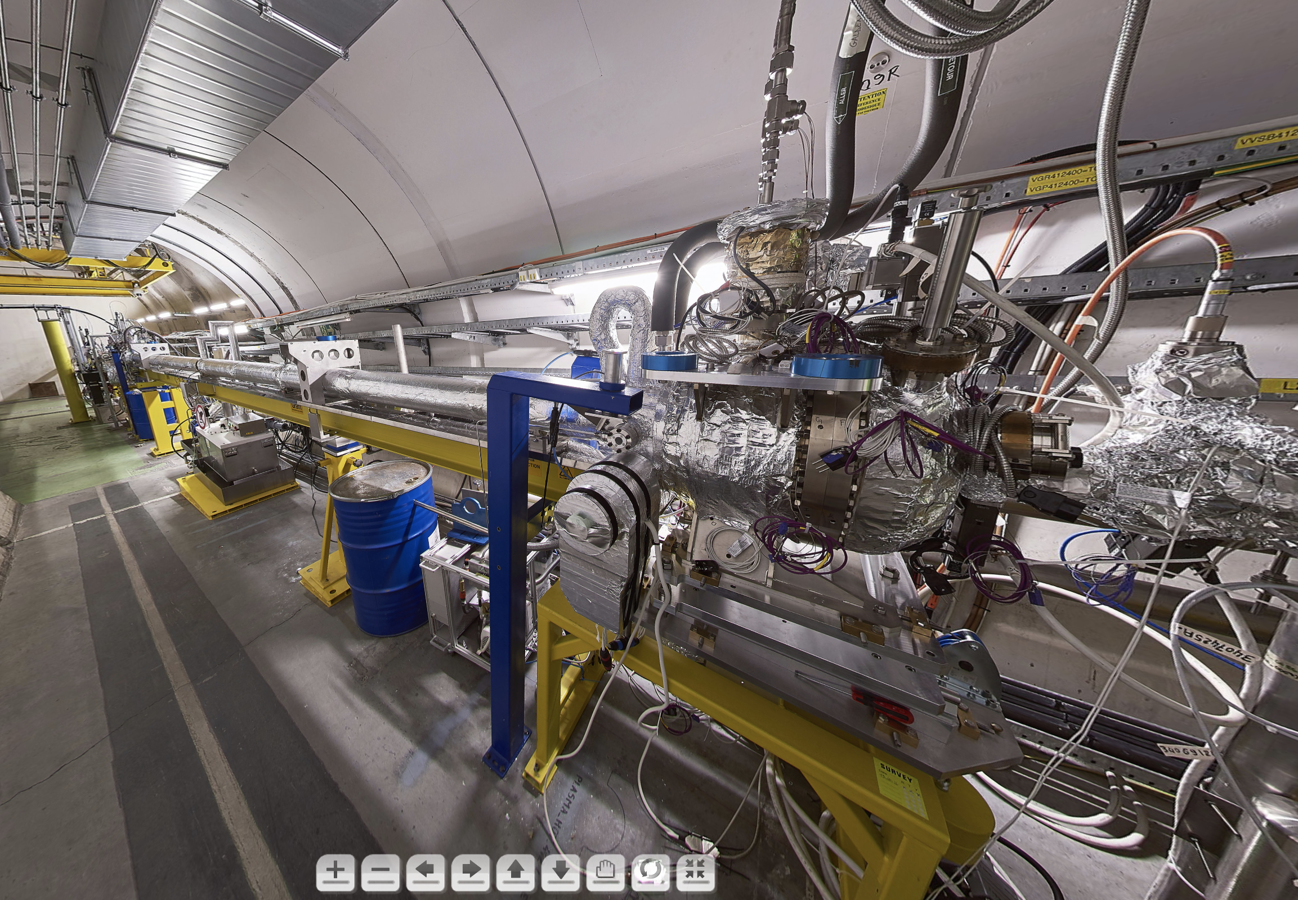
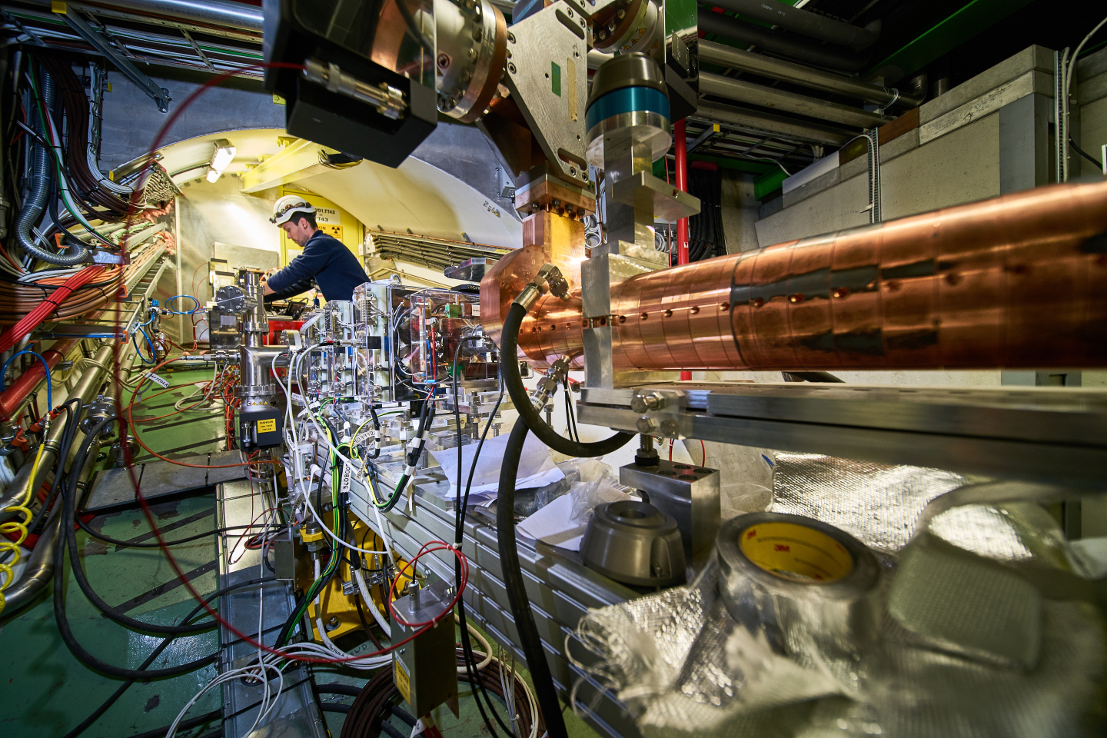
AWAKE today
https://home.cern/about/updates/2016/12/awake-making-waves-accelerator-technology
https://home.cern/about/updates/2018/08/awake-successfully-accelerates-electrons

Slide 27
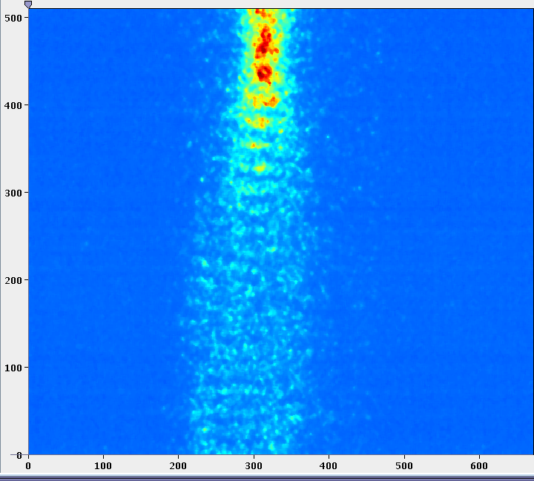
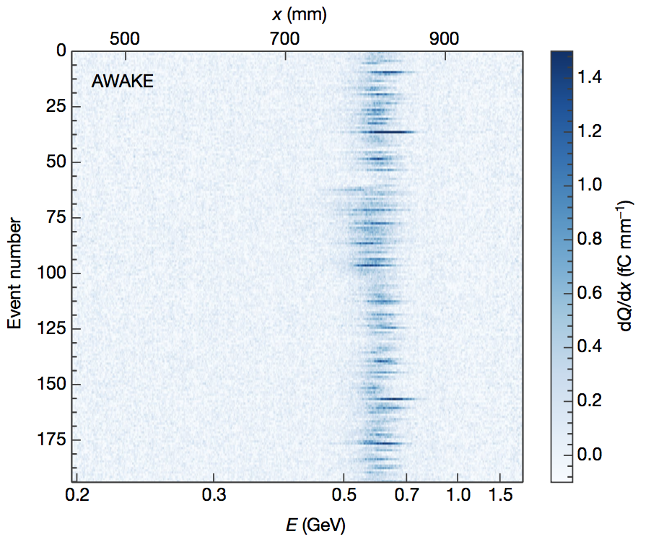
AWAKE today
Beam lines (p+, e-, laser) and major experiment diagnostics operational
Self-modulation instability of proton bunch in plasma proven
Electron acceleration in proton driven wakefield shown
Optimization of electron injection and parallel preparations for run2 ongoing
Nature volume 561, pages363–367 (2018)

