Slide 1
A few commissioning experiences from a few hadron facilities (SNS, RHIC, AGS Booster, LANL PSR)
Thomas Shea
ESS

Slide 2
Outline
Testing and commissioning overview – SNS v. ESS
Stories and Lessons, organized loosely by theme
Integration
Protection
Verification
Concurrent Development
Human performance
End game and Organization

Slide 3
Vertical Testing to interfaces then Horizontal Testing across interfaces
Accelerator Interfaces:
Machine Protection Interfaces:
Controls network
Buffering
post mortem
Timing/event
Signal Processing
device health
RF reference
configuration
Low-latency data
beam interlock
component state
Shielding
Also:
Power
Alignment
Cooling
EMI
Radiation
cabling
Beamline device

Slide 4
SNS commissioning ran in parallel with installation and testing
1
2
3
4
5
6
7
8
9
2002
2003
2004
2005
2006
Run #1: - RFQ at LBNL (2.5 MeV), Jan 25th through Feb 2002 - beam stop for design beam power
Run #2: - Front End at LBNL (2.5 MeV), Apr 4 to May 31, 2002 - beam stop for design beam power
Run #3: - Front End at ORNL (2.5 MeV), Nov 5, 2002 to Jan 31, 2003 - beam stop for design beam power
Run #4: - Front End, DTL tank 1, D-Plate (7.5 MeV), Aug 26 to Nov 17, 2003 - beam stop and radiation shield for design beam power
Run #5: - Front End & DTL tank 1,2,3 (39 MeV) Spring 2004 - Beam stop and radiation shield for reduced beam power (50us, 1Hz)
Run #6 : - Front End, DTL, CCL modules 1,2,3 (158 MeV) Fall 2004 - Beam stop and radiation shield for reduced beam power (50us, 1Hz)
Run #7 : - Front End, DTL, CCL, SCL (1 GeV), Aug 2005
Run #8 : - Front End, DTL, CCL, SCL, Ring (1 GeV), Feb 2006
Run #9 : - Front End, DTL, CCL , SCL, Ring, Target (1 GeV), April 28, 2006

Slide 5
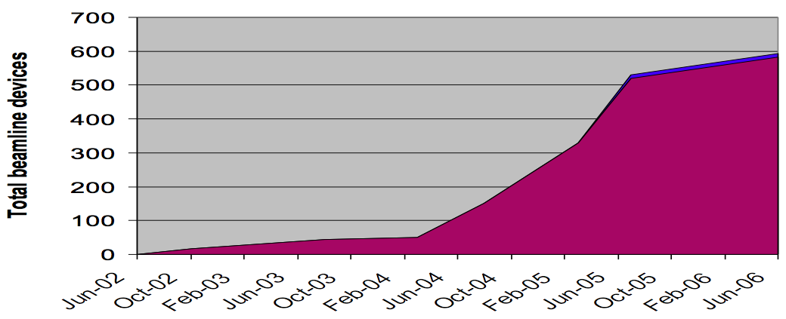
Awake at Night
Comparison
DTL5
+ Spokes
+ Medium Beta
To target
Source/LEBT at Catania
RFQ/MEBT/DTL1
Source/
LEBT
DTL 2-4
ESS
2017
2018
2019
2020
2021
2022
SNS
2002
2003
2004
2005
2006
1
2
3
4
5
6
7
8
9
MEBT
improve
DTL 1
improve
Elliptical
Deployment at scale: superconducting linac devices
In the past, ESS appeared too compressed.
Now, I think that it looks achievable and similar to RHIC and SNS.

Slide 6
Story time!
Notes:
Not compete by any measure. Just a few vignettes to highlight experiences, both good and bad.

Slide 7
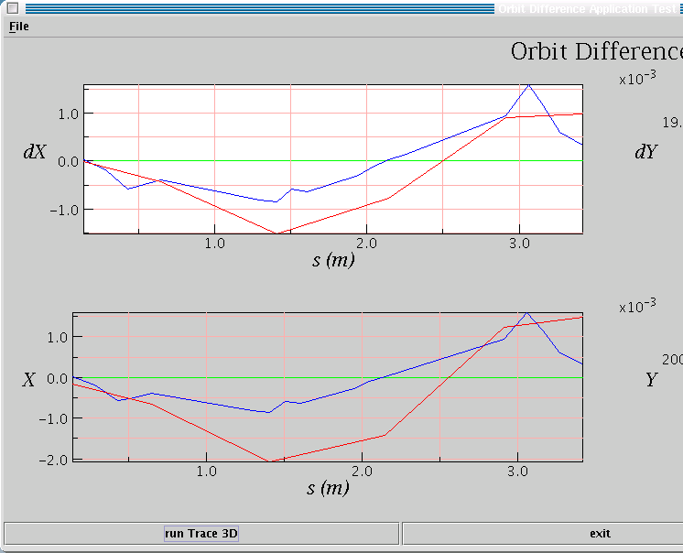
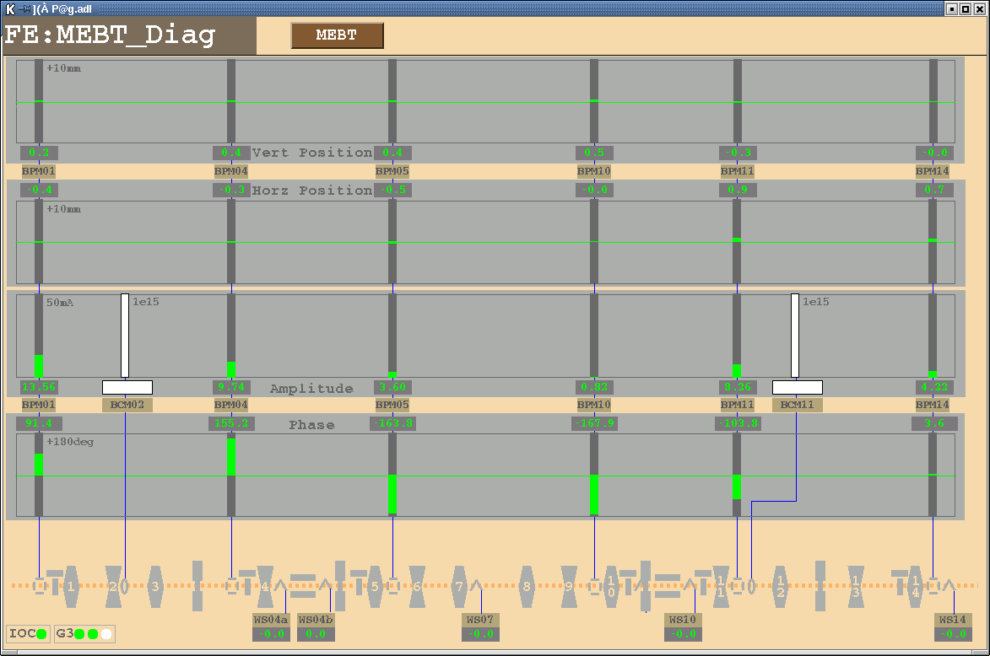
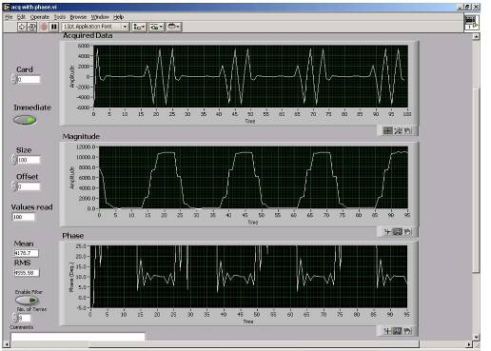
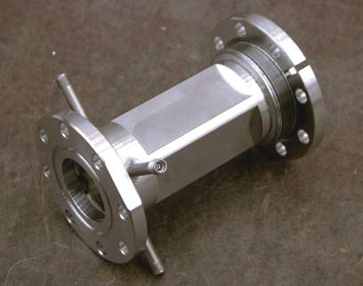
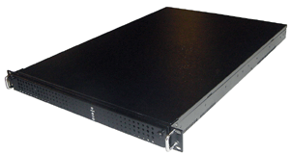
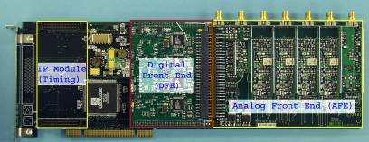
Integration: SNS @LBNL Beam Physics and Systems meet at the Application Layer
“99% complete is 100% failure” *
Network Attached Devices:
1 week to integrate all MEBT diagnostics at LBNL (from 4 labs) with timing and EPICS screens
the orbit app worked live from ORNL - simply initialize with the Process Variable names
app
EPICS screen
Channel Access
Cables & install - LBNL
Electrodes - LBNL
Electronics, NAD software - LANL
* W. Blokland, 2001

Slide 8
Integration Lessons re: Controls
Use of EPICS allowed modular deployment with a mature (but quite simple) control system toolkit
Installation and vertical integration of network-attached devices performed rapidly and independently
Minimal coordination needed (just check in at daily standup meeting)
Compared to RHIC
RHIC commissioned the controls toolkit with the systems – painful!
But RHIC controls started with some useful features that SNS lacked: triggered, continuous data acquisition; post-mortem; service-layer to manage device collections
Both:
Built-in self test was very valuable
Early availability of final timing and MPS systems was critical

Slide 9
Integration Challenges: Electromagnetic Interference @ SNS
c. 2004, In order of decreasing impact. Efforts focused on BCM and Loss systems
System | Signal level | Frequency Range | Comments on Noise
BCM | Tens of mV into 50 ohms | Few Hz to hundreds of MHz | Must heavily filter waveform and baseline subtract to reduce noise to few percent.
Loss | Hundreds of pA | < 35kHz | Noise on fast channel = 30% beam loss. Slow channel OK.
Faraday Cup/ Beam Stops | Hundreds of mV | DC – few MHz | Same issues as BCM low frequency range, but stronger signal.
Wire Scanners | microAmps | < 40 kHz | Noisy waveforms, but requirements exceeded by analysis and averaging
BPM | Ten mV into 50 ohms | Few MHz around RF (402.5 and 805 MHz) | Near 402.5 MHz RF systems, measure 805 MHz, and vise versa
Notes:
The lower frequency devices (DC through super-audio) are the most challenging. Many inductively coupled sources of interference, including switch-mode modulators.
Most BCMs could have been lower bandwidth devices with better S/N.

Slide 10
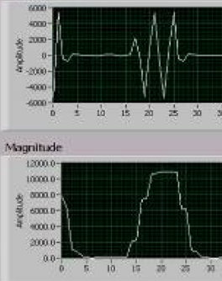
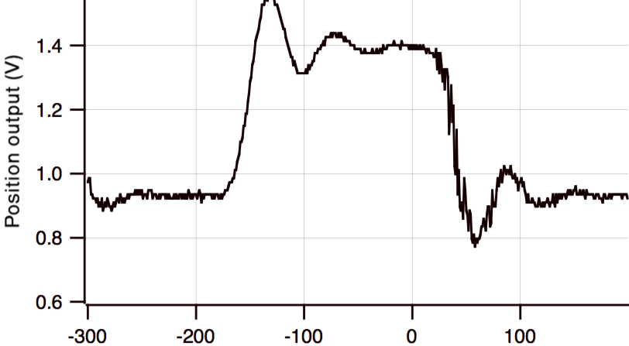
Protection: Commission with safe “probe” pulses
Specify performance with low current, short pulse (“safe”) beam such that beam can be lost most anywhere without causing damage
Bonus: Allows tuning RF without impact of beam loading
ESS probe beam will be critical for MPS commissioning
RHIC sextant, first turn: Orders of magnitude below nominal
Self triggering very helpful
SNS vector receiver < 1 µs
1990 BNL Linac to Booster position electronics
(analog processing at twice RF frequency)
200 ns pulse
Notes:
devices happed to perform OK with safe beam, but in retrospect, more emphasis on this regime might help.

Slide 11
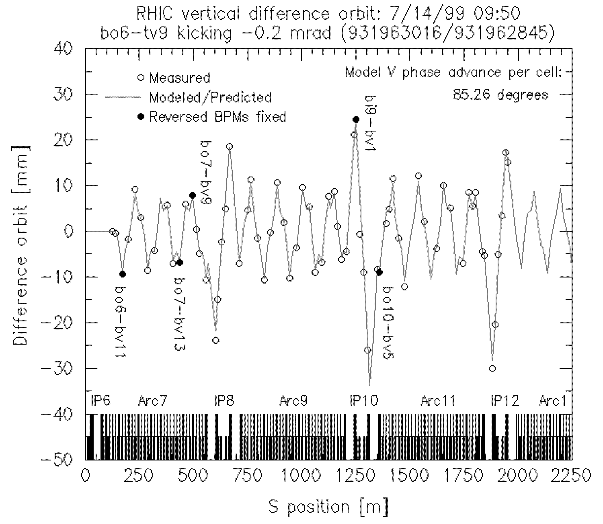
Verification with beam: Difference Orbits in RHIC
Quickly verify optics and BPMs
Difference orbit: App uses online model, live and saved BPM readbacks, kick strength is free parameter, …
Recommendation: System owners lead system commissioning with beam, supported by machine commissioning/ops team. Then handoff.
SNS verified with beam in 7 sections
RHIC rings verified with beam in virtually one go
Notes:
Similar in SNS and other machines
BNL linac to booster: orbit correction app provided similar function, nearly on day 1.

Slide 12
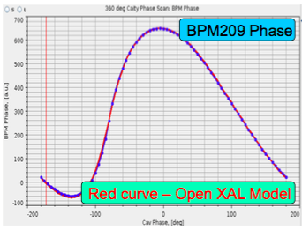
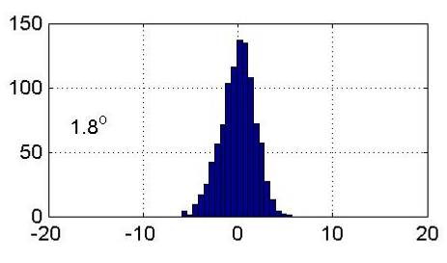
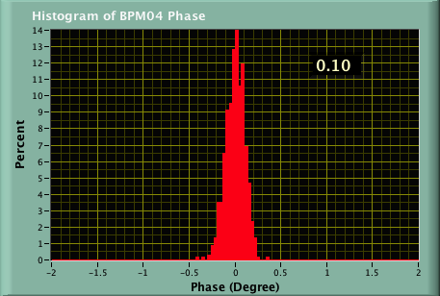
Concurrent Development: SNS BPM Position/Phase Measurement
“We know that BPMs in proton linacs don’t work”*
Worked even embedded within DTL
Measure harmonic away from RF (like @BNL Linac to Booster line)
Vector receivers (I-Q at SNS): retain phase
Results:
Scrap dedicated phase monitors
Didn’t really need measurements with energy degrader-faraday cups for DTL tuning
Diagnostics engineers helped design LLRF
With automated tuning apps, 8 hours reduced to ~30 min
0.1 deg. at ORNL, 2 years later
1.8 deg. at Berkeley, 2002
* R. Siemann, 2000
Notes:
Still kept many wire scanners and also built the energy degrader faraday cups just in case.

Slide 13
Concurrent Development: Old School
Formal procedures are necessary, but should support some use cases from the “good old days”
Allow agility where appropriate
Good asset management can help
LANL (1980s), AGS Booster (1990)
Very limited data/document management
RHIC/SNS (1990s/2000s)
Better:
Global database (required for deployment at scale),
Primitive document management
Inconsistently applied
ESS risks a step backward with lack of data-driven approach; heavy, document-driven configuration management
There, I fixed it.
Phase measurement system in a week … at LANL in the 1980s

Slide 14
Human Performance
Configuration errors
Mitigate with thorough verification before beam
Shortcuts under pressure
Noise filters on SNS machine protect inputs: now a suspected contributor to SC cavity degradation -> fixed this and also deployed differential BCM
Commission early and often, but not too often
Usually enough staff to install and integrate systems, then support operations phase
24 by 7 commissioning can add too much peak load -> burnout
RHIC commissioning, Aug 16, 1999 Owl shift summary loglook entry:
“…BPM reading in general
were difficult to interpret since some BPMS read data from other BPMs/plans/rings. We corrected the large orbit deviation at yo9-bv1… No progress, however, at the main Losses…”

Slide 15
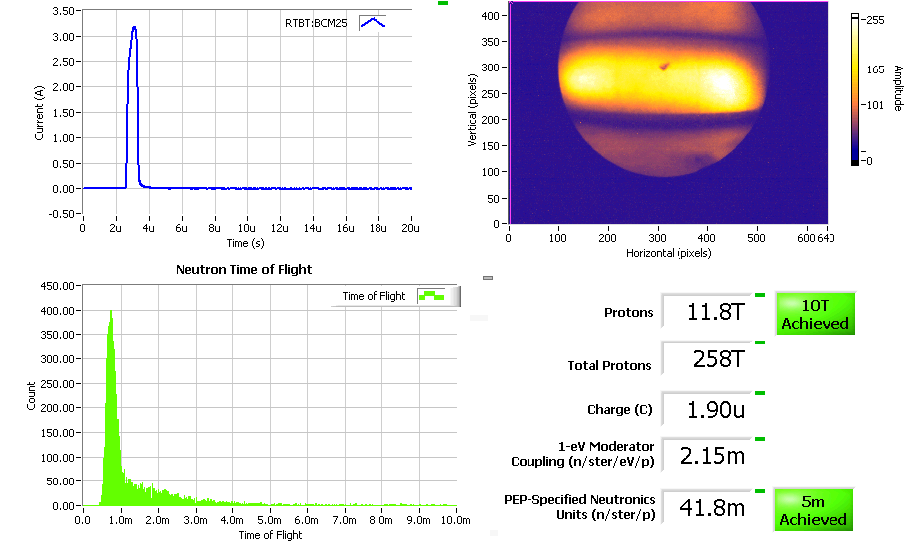
End Game: Integrated Accelerator, Target and Neutron Instruments

Slide 16
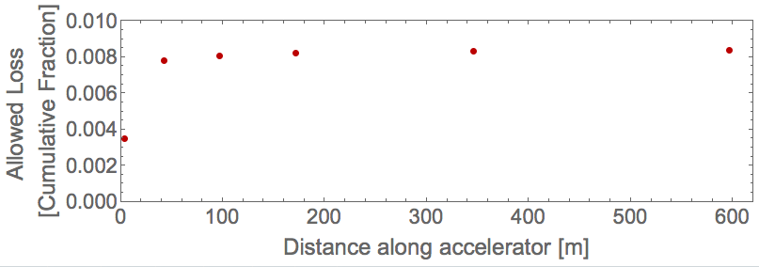
Some considerations for ESS compared to short pulse sources
Rotating target (but controls are simpler than existing chopper controls)
Long Pulse source couples machine and neutron instruments
Pulse by pulse modulation requires full timing system functionality
Two dominant causes of neutron intensity fluctuation
1. Ion Source and RFQ produces proton pulses with some current fluctuation
2. Raster System scans proton beam across target; moderator coupling is position dependent
Low loss (< 1%) acceleration and transport Low energy variation (+/-1.5 %) allowed
Accelerator and Beam Transport

Slide 17
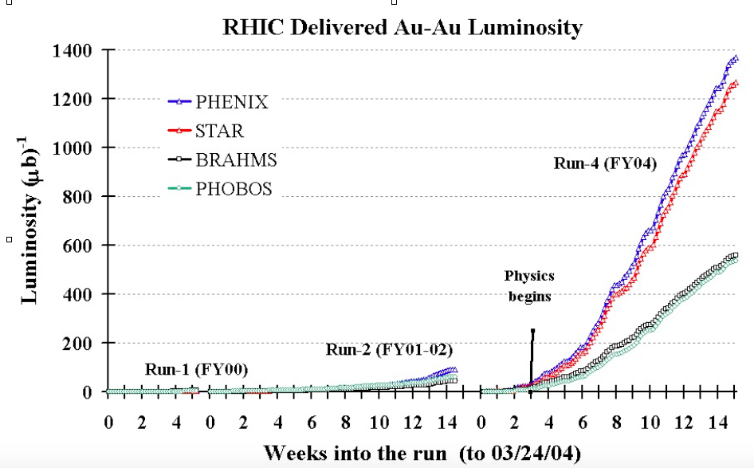
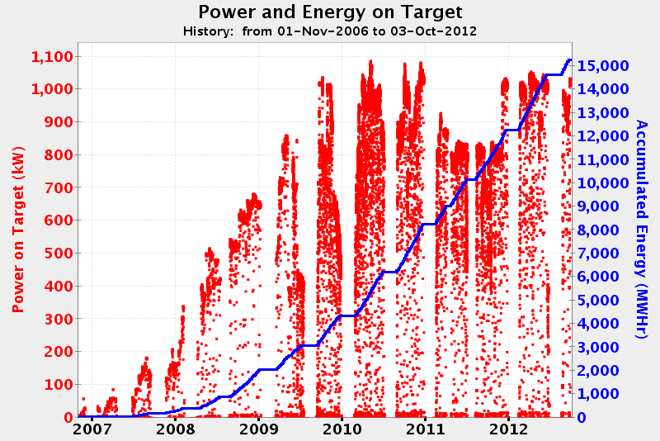
Early Operations and Performance Ramp
RHIC highest priority: gradual accumulation of integrated luminosity
SNS chose to ramp power rapidly rather than staying conservative. Shook out issues during a period when lower availability was tolerated. Only a few years of this will be tolerated by user community: work fast!
Functionality: The minimum for commissioning may not be enough for this phase and there is limited time for new development.
First proton functionality
Roadmap to full functionality, back by design work during construction phase

Slide 18
Organization
SNS had area managers, RHIC did not (topical management). Both ways worked for commissioning
All: Daily standup very important to coordinate physical work
RHIC and SNS: Weekly meeting with machine director and work package managers
Line aligned with project
Rapid decisions
Managing the end game
SNS rolled partners off too early. Partner engagement through commissioning aligns motivation with project goals
Instruments saw no need to share data with control room. User engagement may soften transition to operations
Recognize that the organization is being commissioned

Slide 19
thanks
Particular thanks to many Beam Diagnostics and Beam Physics colleagues at BNL, LANL, LBNL, and ORNL.
Input from: M. Plum, J. Galambos, A. Aleksandrov, W. Blokland, A Shishlo, A. Zhukov, T. Satogata, S. Assadi, J. Staples, A. Ratti, J. Power, A. Jason, D. Purcell, C. Deibele, T. McManamy, C. Goetz, R. Witkover

