Slide 1
Operations/Control room organization during commissioning
Lali Tchelidze
Operations Section Leader
Accelerator Division
October 16, 2018
Workshop on Testing and Commissinoing, Lund, Sweden

Slide 2
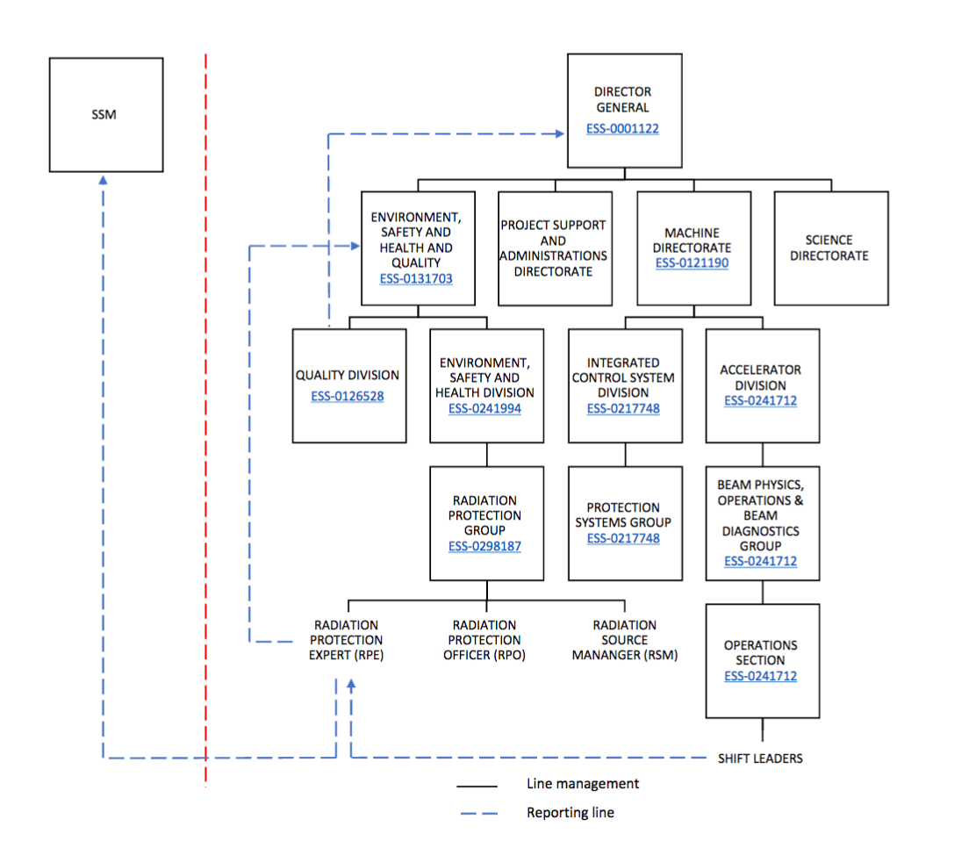
Organigram

Slide 3
Functions description
Operations Section: The operations section of the Beam Physics, Operation and Beam Diagnostics Group within the Accelerator Division is responsibly for organizing and staffing the main control room.
Operations Section Leader: The Operations Section Leader is in charge of organizing the control room staffing rotation, control room procedures, and training for Operators and Shift Leaders. He/She is responsible to make sure that all operational rules and procedures are properly documented and that the operations staff is adequately trained in these procedures.
The Operations Section Leader will also be line manager for the full time shift leaders and operators. However, for the ion source test operation, no dedicated shift leaders or operators are foreseen, so the Operations Section Leader will assign these roles to members of the accelerator division staff (with consent of their line managers).

Slide 4
Functions description
Main control room (MCR) shift leader: The MCR shift leader is responsible to ensure safe operation of the ESS neutron source (in this case the ion source) and is in charge of control room operations during the shift. A local control room will be considered as the main control room during the Ion Source and LEBT beam commissioning stage.
The MCR Shift leader shall consult with and report any inclarities/incidents with respect to radiation protection/radiation safety to the RPE.
The MCR shift leader role will be performed by appropriately trained staff from various groups of the accelerator division.

Slide 5
Functions description
Area Supervisor: The Area Supervisor (AS) will be responsible for all activities within the test stand, which includes ensuring that all safety requirements are fulfilled, that the work is performed as set out in the general safety rules, that the staff is trained and that operational procedures are followed. The AS is also responsible for any visitors to the test stand.
The Area Supervisor reports the MCR shift leader with respect to any operational aspects.

Slide 6
Functions description
The Study Leader is an Accelerator/Target Physicist or Engineer in charge of a Machine Development Study or Commissioning Activity, under the supervision of the Shift Leader.
The responsibilities of the Study Leader are:
  Keep the logbook for the studies.
  Follow the limits set by the operations envelope.
  Ensure that the plan for the study is followed.

Slide 7
Beam commissioning
1 shift per day 8h30 to 16h30
Only working days
1 Shift Leader, 1 Study Leader, as many experts as required
Currently staff from the accelerator division are trained to perform the shift leader role
Training program is generated and run by the operations section

Slide 8
Operations section
Currently 2 staff members and 1 consultant
Request to hire 2 shift leaders is currently being considered
1 qualified shift leader in control room at all times (when there is beam) – is required by the license
Qualification is based on required training – defined in ESS-0290889
  Training is coordinated by the operations section
  There is a list of documentation to read
  There are seminars and presentations to follow
  There are hands on training for some systems
  Final certification is granted after completing a shift(s) with Marc M.

Slide 9
Joint installation/commissioning on construction site
We are on construction site and we follow the rules set for the site (PPE, training, working hours, etc.)
We have a strong link with the installation team and area coordinators
  Daily morning meetings in control room (focused on commissioning, but area coordinator is present and representatives from other operational areas attend)
  Weekly installation/testing/commissioning meetings, where weekly summaries from installation and commissioning are shared

Slide 10
Main Control Room

Slide 11
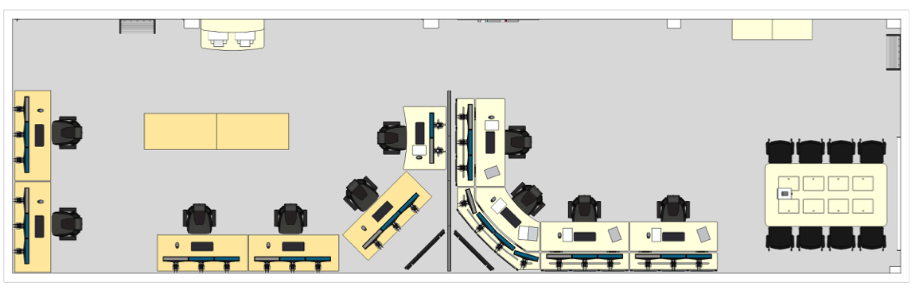
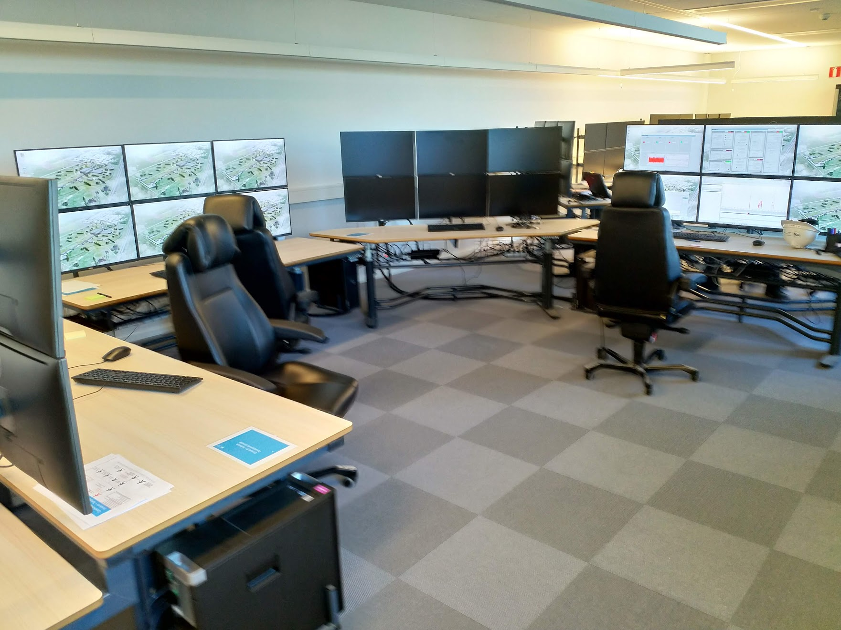
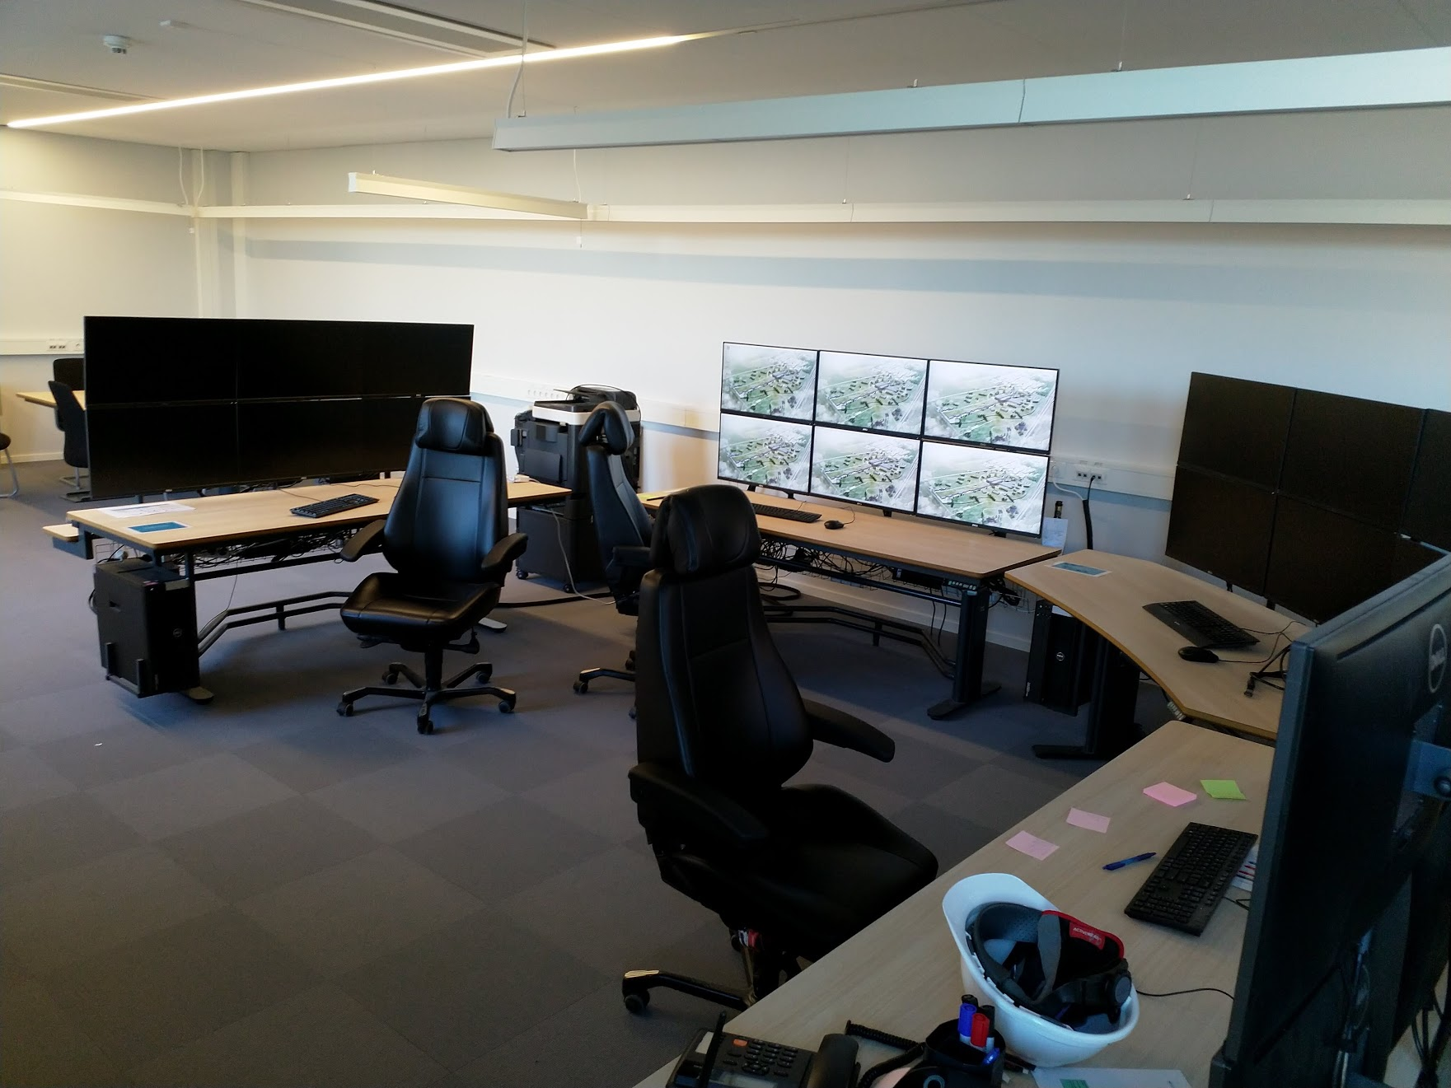
Local Control Room
Cryo+Test
Beam Commissioning

Slide 12
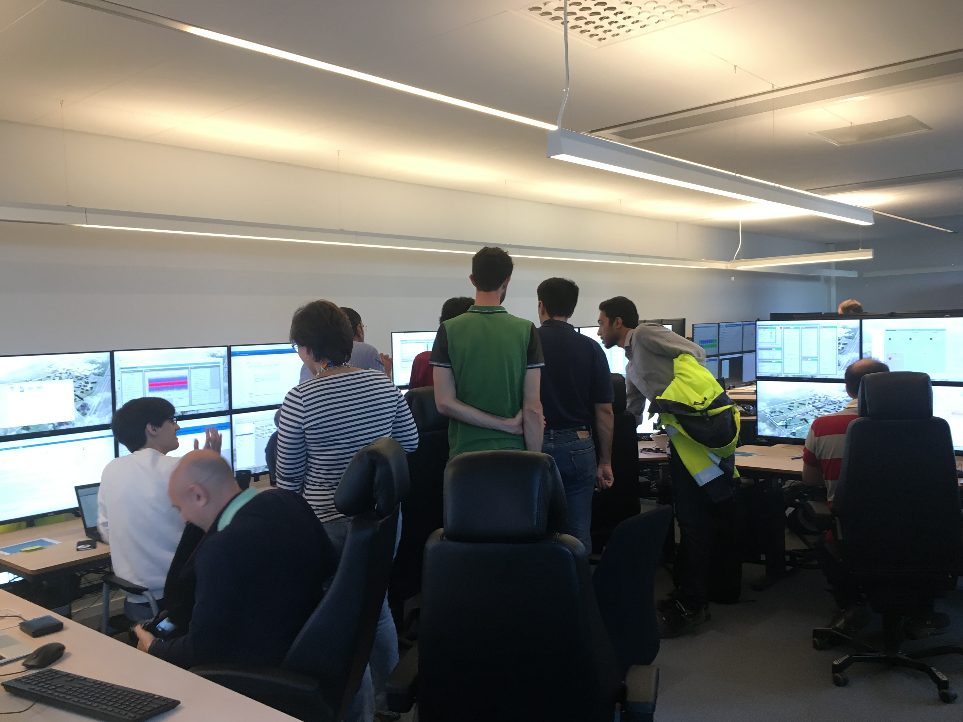
THANK YOU

