Slide 1
PSS Verification and validation
Paulina Skog
On behalf of Protection Systems Group
www.europeanspallationsource.se
16 October, 2018

Slide 2
Content
Personnel Safety Systems scope (PSS) at ESS
Verification and validation goal
Verification and validation flow

Slide 3
PSS scope at ESS
PSS0: It aims to mitigate high voltage electrical hazards for personnel arising from operating the ISrc and LEBT test stand
PSS1: It aims to mitigate hazards for personnel arising from operating the normal conducting section of the accelerator.
Accelerator PSS: It aims to mitigate hazards for personnel arising from operating the (whole) accelerator, including the super conducting and transport to target areas.
PSS for target
PSS for neutron instruments

Slide 4
Verification and validation goal
Prior to any beam operation or energisation of the systems interlocked by PSS, the PSS shall be verified and validated.
This entails all Safety Instrumented Functions (SIF) described in the safety requirements specification for PSS shall be verified and validated.
SIF01 (PSS0): If the ISrc HV OFF button is pressed, de-energise the HV PS by removing its supplied power.

Slide 5
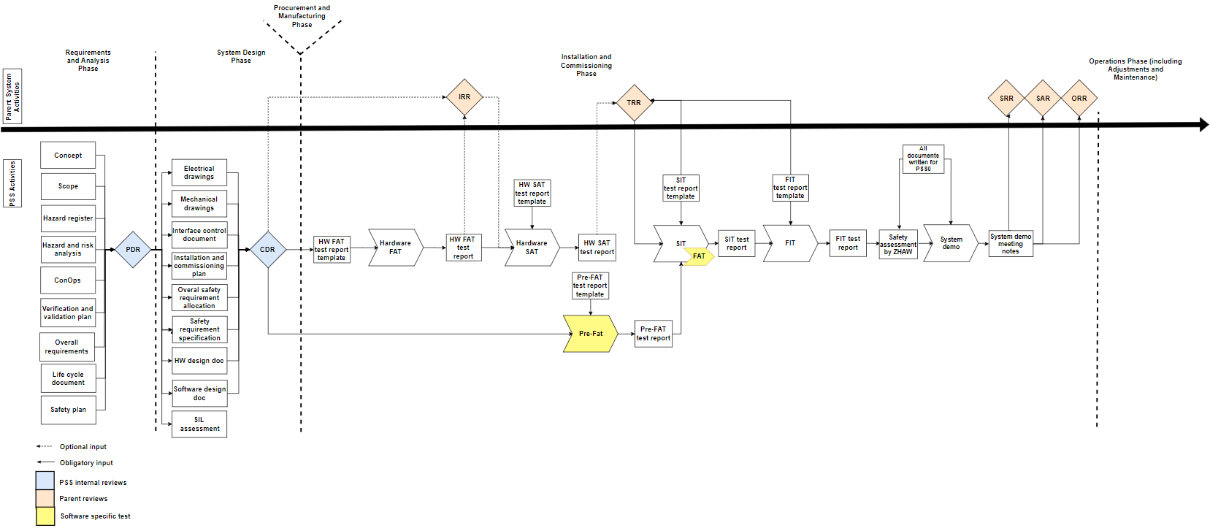
Verification and validation flow for general PSS

Slide 6
Dependencies for parent systems
If there is any hazards concerning the following:
Ionising X-ray radiation
Electrical hazards
Non-ionising radiation (radio frequency)
Magnetic fields
ODH
The parent system needs to provide their equipment before PSS can start the FIT. The FIT will always be before the SRR. This means no handover or SRR before validation!

Slide 7
Thank you
Questions?
www.europeanspallationsource.se
16 October, 2018

Slide 8
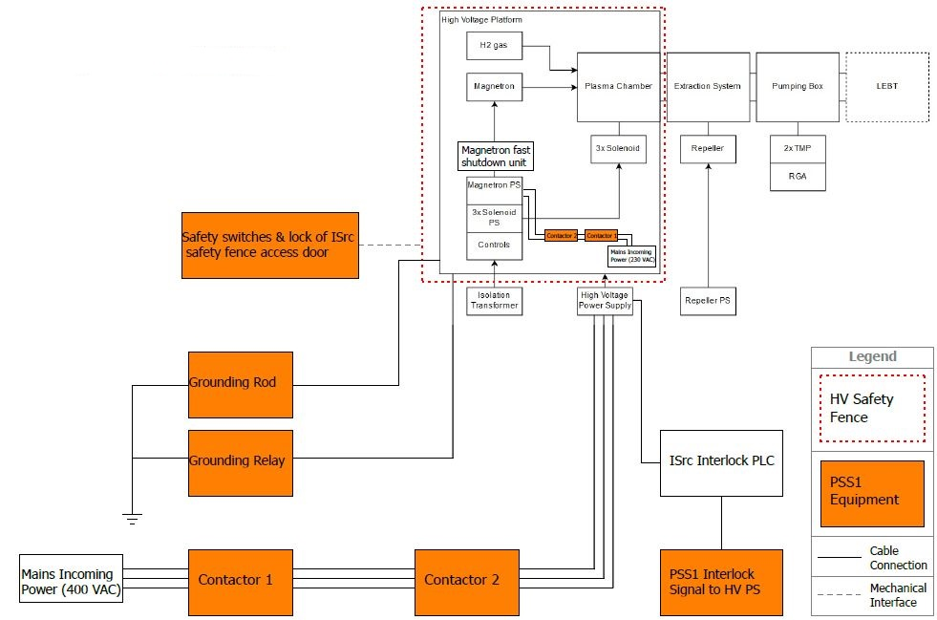
PSS1 Interfaces with ISrc

Slide 9
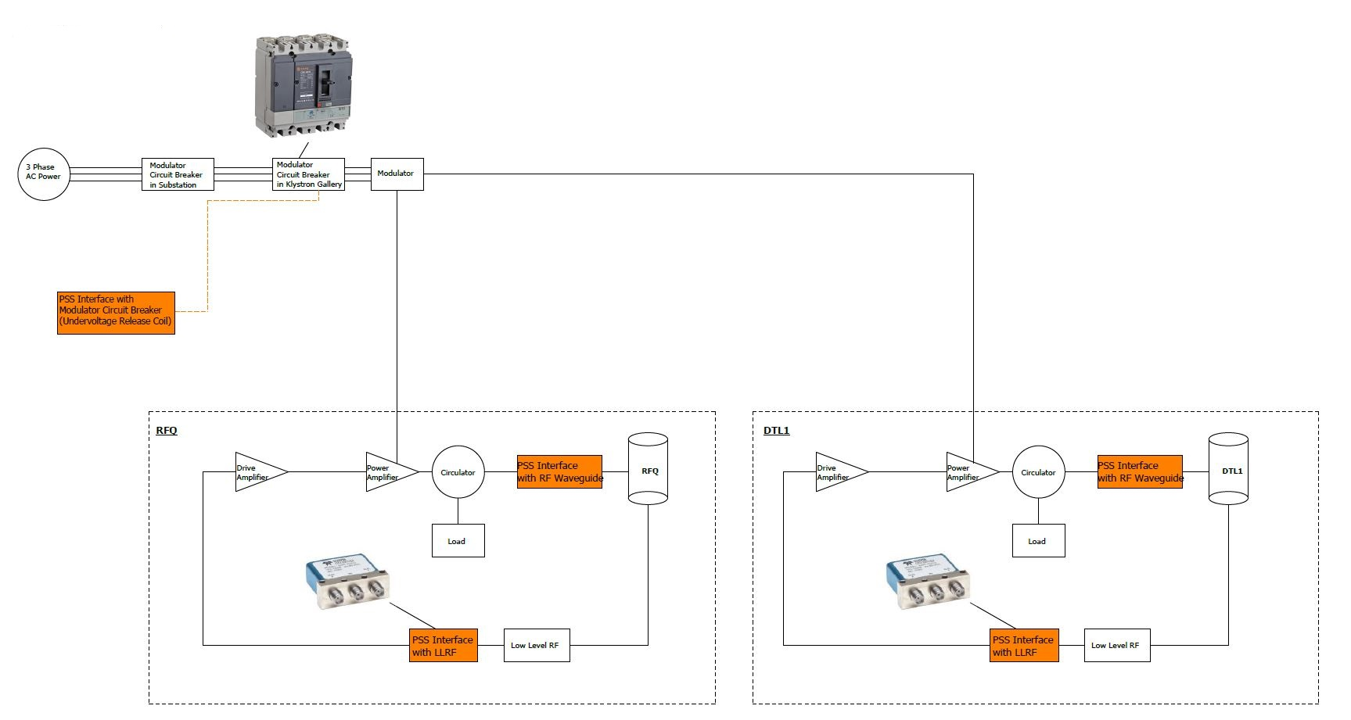
PSS1 Interfaces with RF Systems (RFQ&DTL1)
Notes:
Spoke cavities, medium beta and high beta cavities used the same interface strategy.

Slide 10
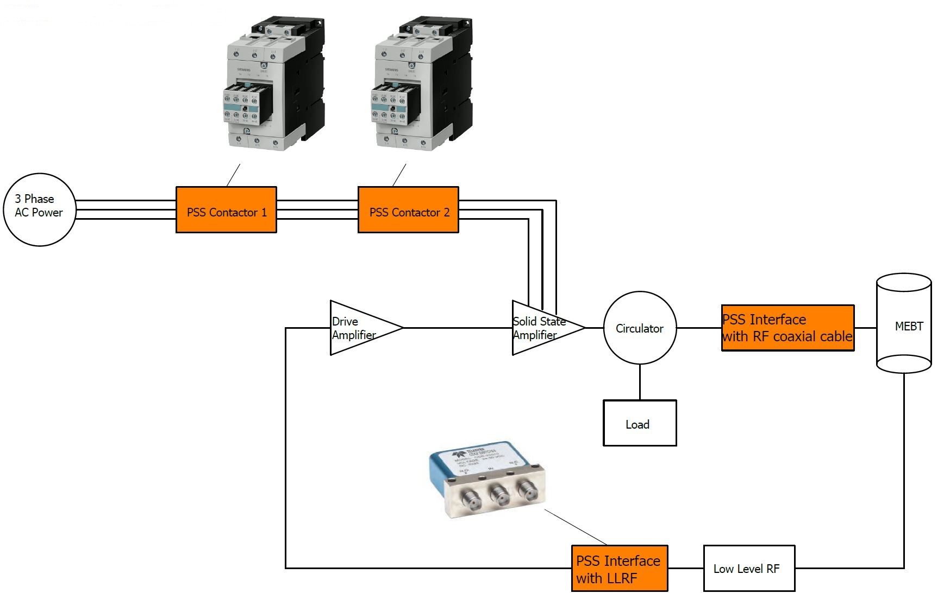
PSS1 Interfaces with RF Systems (MEBT bunchers)

Slide 11
Dependencies for PSS
Ion source:
Extraction system
HV PS
Plasma
Magnetron
RF systems:
Modulators
Remove incoming power
Removable waveguides
- To enable RF to run with no RF to tunnel
LLRF (Low Level Radio Frequency)
Co-axial switch

