Slide 1
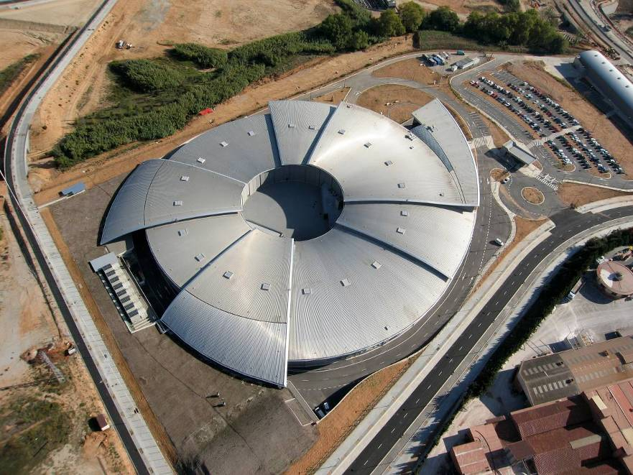
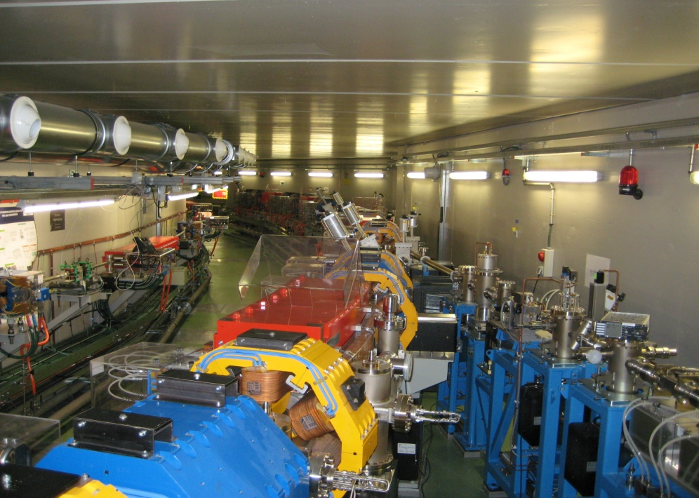
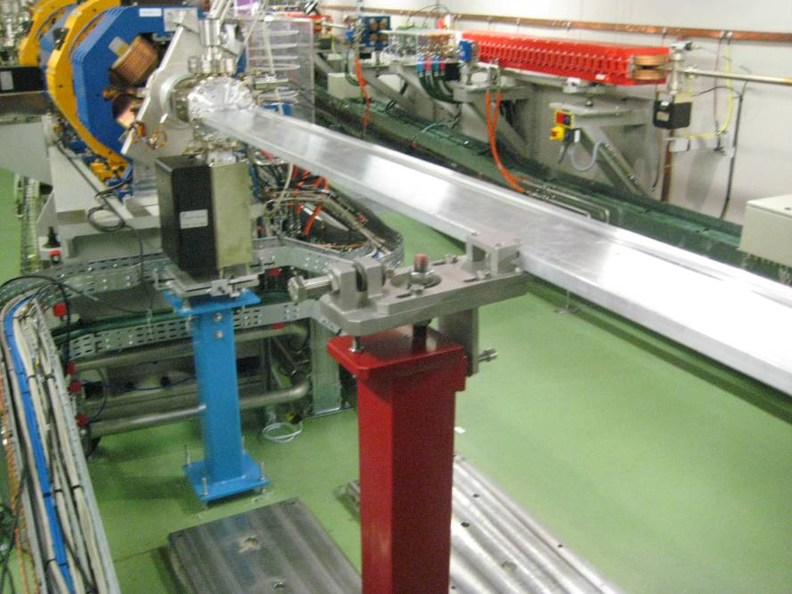
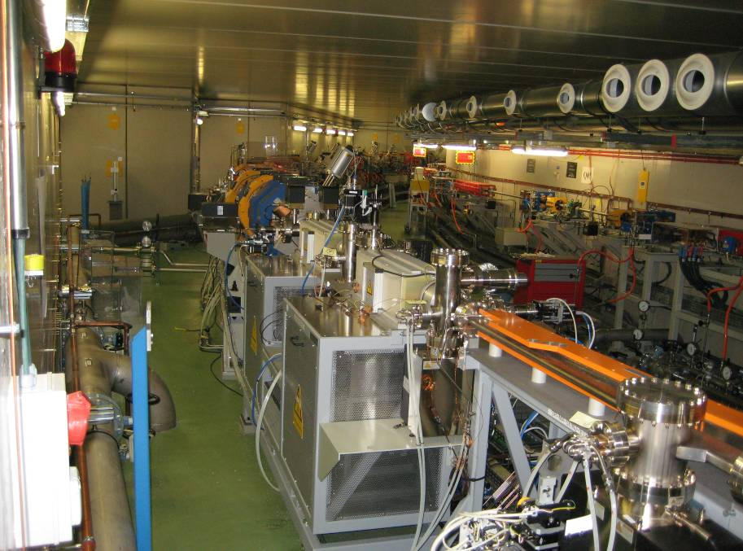

Slide 2
Overview
C=270 m
LINAC
100 Mev
Commissioned in 2008
BOOSTER
100 MeV – 3 GeV
Commissioned in 2010
STORAGE RING
3 GeV
Commissioned in 2011

Slide 3
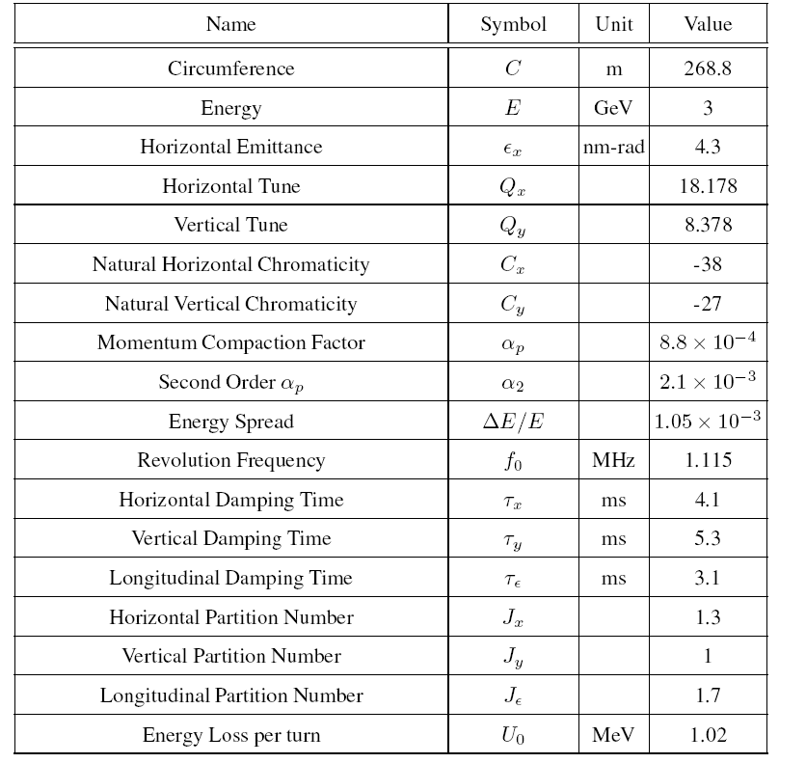
SR Summary
Parameters
Remarks:
  24 straight sections:
    4 x 8 m -> 3 free for ID
    12 x 4.3 m -> all free
    8 x 2.4 m -> RF, diagnostic
  38 % of the circumference for straight sections.

Slide 4
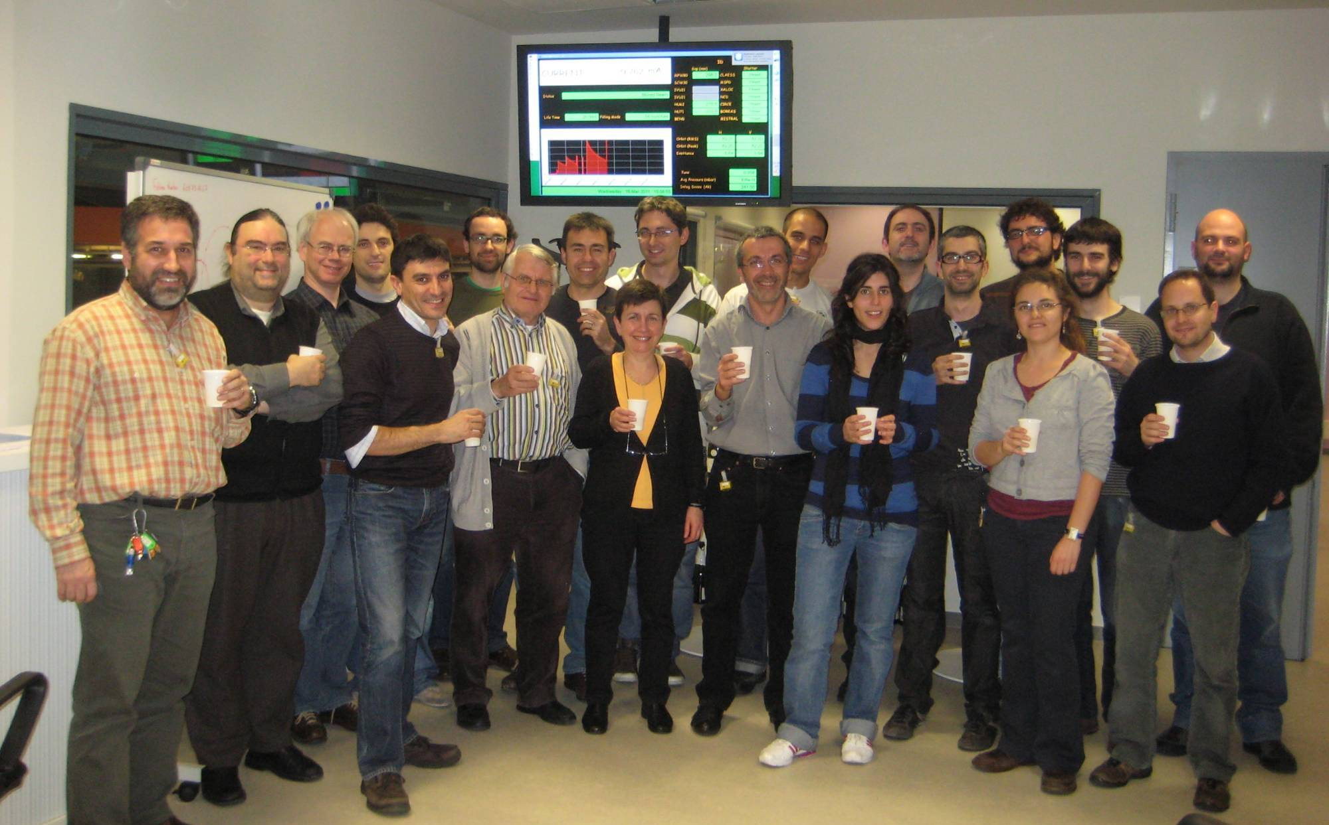
16th of March 2011:
A historical day of the ALBA – project, 20 mA stored beam
The Accelerator Division is celebrating this success.
Notes:
Bona tarda a tothom.
En primer lloc agrair al Museu, que no se si sabia que soc nascuda a Terrassa i que per tant em fa especial il.lusio se avui aqui, el que m’hagi donat l’oportunitat de venir a explicar-vos que és un sincrotró i en particular el sincrotró ALBA que s’està construint en aquests moments a Cerdanyola del Vallés.

Slide 5
SR Commissioning preparations
Commissioning plan ready nearly 1 year in advance
Training of operators and team members during this year (accelerator physics, control system, basic GUIs, basic procedures).
License for the supervisors and operators.
Pre-commissioning of subcomponents before start of the commissioning.
Booster already commissioned -> a lot of experience already with most of the Control System, Diagnostics, OPIs and Physics apps

Slide 6
Shift organization:
  1 Supervisor (we were only 3)
  1 operator
  At least one other expert
  On call support from support groups
Weekly planning with objectives
  Daily meeting to recheck planning
  Simulations for the expected settings and results
    Make everyone aware of the expectations

Slide 7
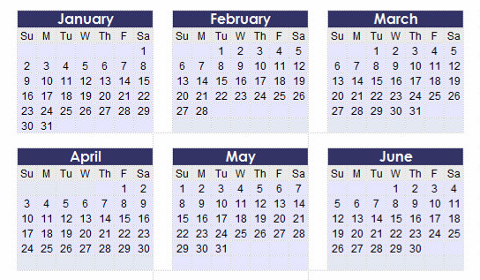
SR Commissioning plan
First try over one week-end: 4 shifts
2 intensive weeks: 2 shifts/day for 10 consecutive days
Teams of 1 operator, 1 supervisor, plus 1 accelerator team member
Normal commissioning: 9 shifts/week
Total commissioning phase I : 90 shifts (8 hours/shift): 720 h
2 shifts
1 shift

Slide 8
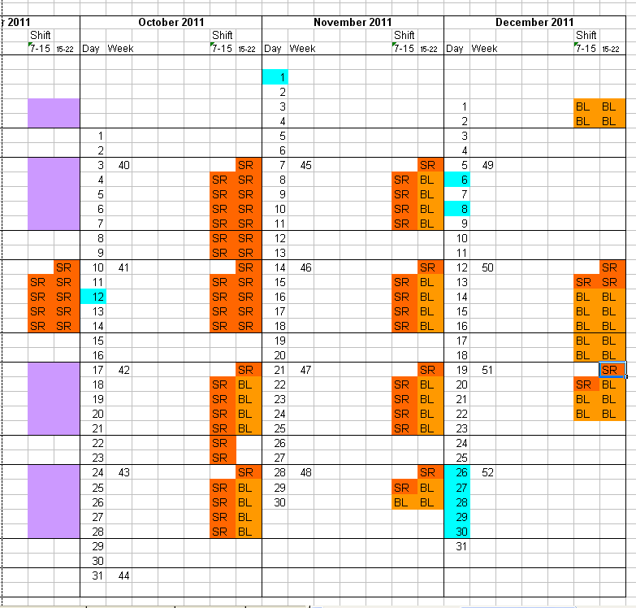
Transition to BL commissioning
TRANSITION

Slide 9
Storage Ring Commissioning
22th of November 2010: The storage ring was assembled (without ID’s) and ready for commissioning, but the CNS certificate was missing. It was decided to install the out of vacuum undulators. This means the commissioning has to be made with 3 small vacuum chambers (+/- 4 mm)
1.) Phase: Weekend 12th/13th February 2011: For this weekend we got from CNS the allowance for the storage ring injection and one turn. We realized the miss-positioning of on BTS quadrupole and had a problem with the kicker power supplies. In general no success, beam into the first bending magnet of the storage ring.
2.) Phase: March - June 2011: We got the allowance from the CNS for the commissioning of the machine at the 8th of March 2011. We commissioned the storage ring very successful until 10th of June.

Slide 10
June to September 2022: Installation of the in vacuum undulators and the SCW wiggler. Restart of the machine in the middle of September 2011
3rd Phase: September-October 2011: Commissioning of the in vacuum undulators and the SCW.
22 October 2011: Start of beamline Commissioning. In the morning shift, machine optimization and in the afternoon shift, beam line commissioning.

Slide 11
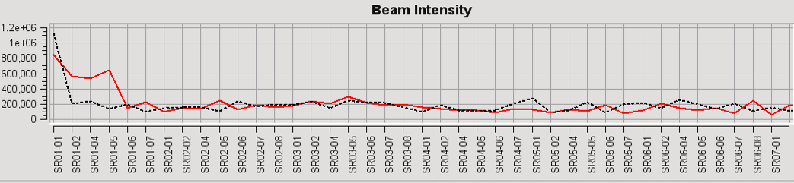
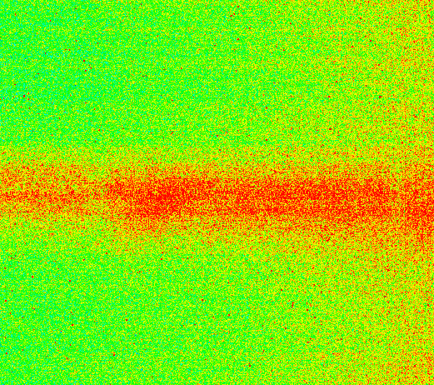
Main difficulties during commissioning
Wrong polarity in all SR quads:
  3 shifts to discover the problem, 6 hours to fix.
  After that one turn in 5 minutes
Cabling of two adjacent quadrupoles swapped:
  Right working point, but machine completely assymetrical.
  1 month to discover, 1 hour to fix.

Slide 12
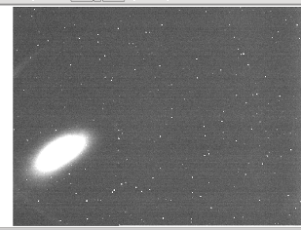
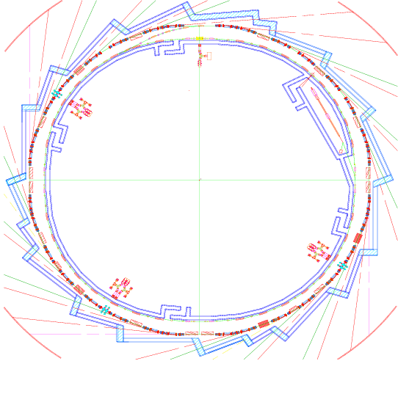
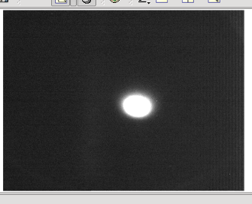
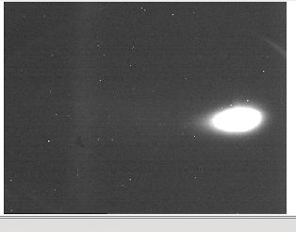
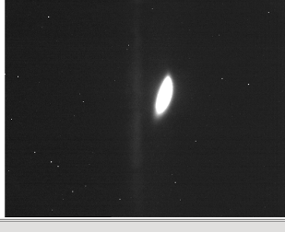
Recabling Quads:
Sectors 1&2
Quadrant 1
Almost ‘On axis’ injection
Quadrant 2
Quadrants 3&4
19h35: 1st turn !, without correctors, almost nominal quads

Slide 13
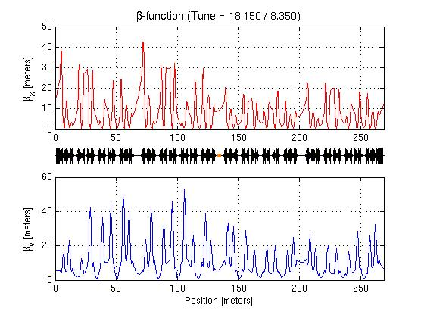
Day 1 Optics - Asymmetric
Two quadrupoles in sector 8 where swapped!

Slide 14
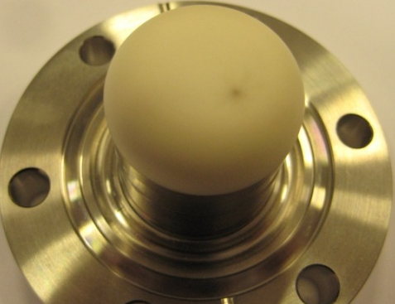
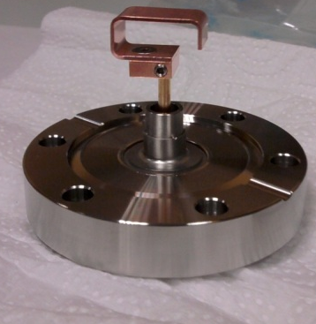
RF cavities:
  Still conditioning cavities, with reduced voltage.
  Problems with vacuum in some cavities.
  Interlocks due to waterflow in the cooling.
  Working with 4 to 6 cavities.
  All this implies a reduction of the lifetime, but very few beamtime lost due to cavities.
Orbit:
  Temperature stability in the tunnel. Orbit oscillations of ~10um with a period of 20 m. Solved by improving PID of the air conditioning.
  Problems with getting good BBA offsets
New pick-up loop

Slide 15
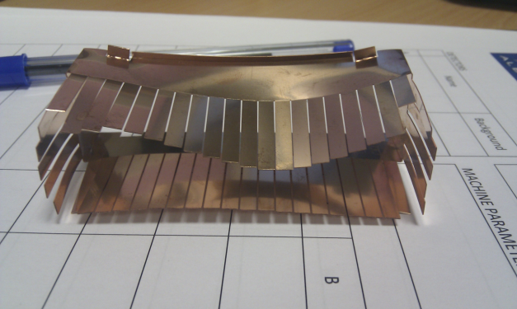
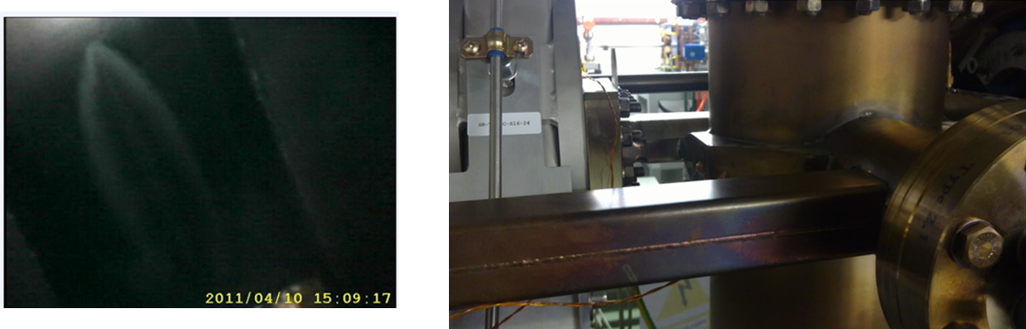
Obstacles in the vacuum chamber:
  A RF finger in one of the injection kickers deform and blcok the beam. Replaced in a few days.
Other Vacuum problems:
  Wrong design of one absorber, radiation hitting the chamber. Solved with some extra copper:

Slide 16
Some lessons
Preparation time was well spend
  For example, excellent calibration of magnets
  Good model of the machine
  Collaboration with other light sourcesb(MML, BPMs)
  Good training
  Very good alignment
Weak spots:
  Commissioning of Tango at the same time that the accelerator
  Understaffed
    In particular in RF
Sometimes we had difficulties finding what was important for the BeamLines

