Slide 1
Sample Environment for Large Scale Structures Instruments at ESS
Andrew Jackson
Deputy Head Neutron Instruments Division
LSS Instrument Class Co-ordinator
LoKI Lead Scientist
www.europeanspallationsource.se
18-11-27

Slide 2
SEE4LSS@ESS
Andrew Jackson
Deputy Head Neutron Instruments Division
LSS Instrument Class Co-ordinator
LoKI Lead Scientist
www.europeanspallationsource.se
18-11-27

Slide 3
Overview
ESS instruments and timeline
Project lingo
Purpose of the workshop
Introductions (round table)

Slide 4
ESS Instruments
Current baseline:
8 instruments by end of 2024
15 chosen now - operational in 2026
> 22 instruments to be built in total
https://europeanspallationsource.se/feature-series-ess-instrument-suite

Slide 5

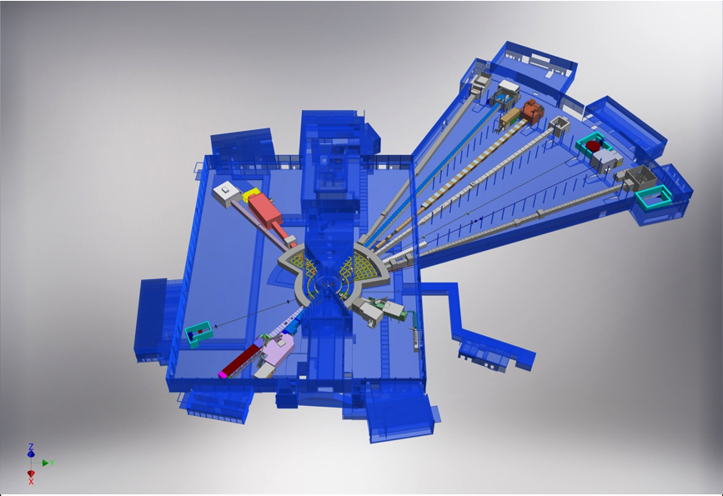











ESS Instruments
ESS Lead Partners for instrument construction
+
Nuclear Physics Institute
NMX
BEER
+
C-SPEC
BIFROST
MIRACLES
MAGIC
ODIN
T-REX
DREAM
HEIMDAL
LoKI
VESPA
FREIA
SKADI
ESTIA
+
ESS In-Kind Partners also collaborate on sample environment, data management systems etc.
ESS Instrument Layout (December 2016)

Slide 6
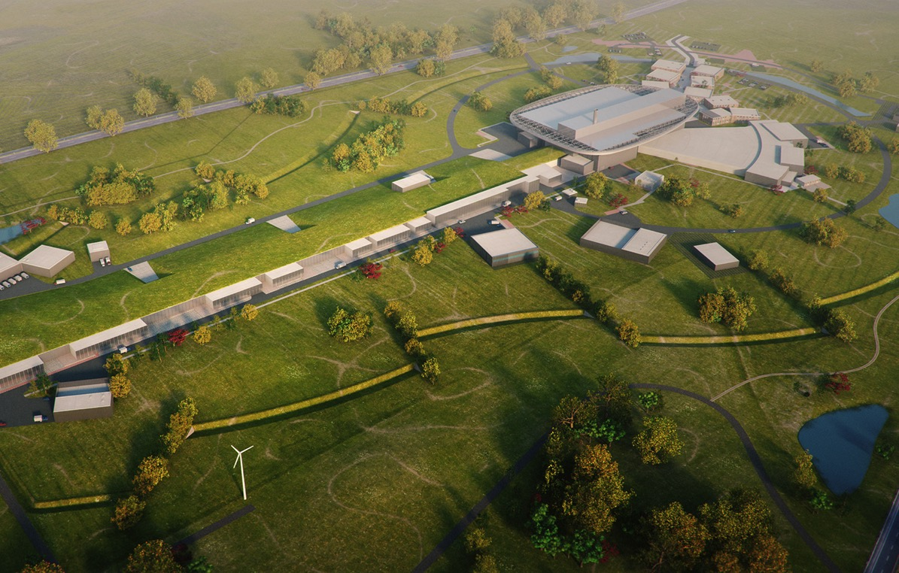
Timeline
2025
ESS Construction Phase Complete
2022
Instrument Hot Commissioning Starts
2014
Construction Starts on Green Field Site
2023
ESS Starts
User Program
2009
Decision to Site ESS in Lund
2022
1st Beam on Target
2012
ESS Design Update Phase Complete
2003
European Design of ESS Completed

Slide 7
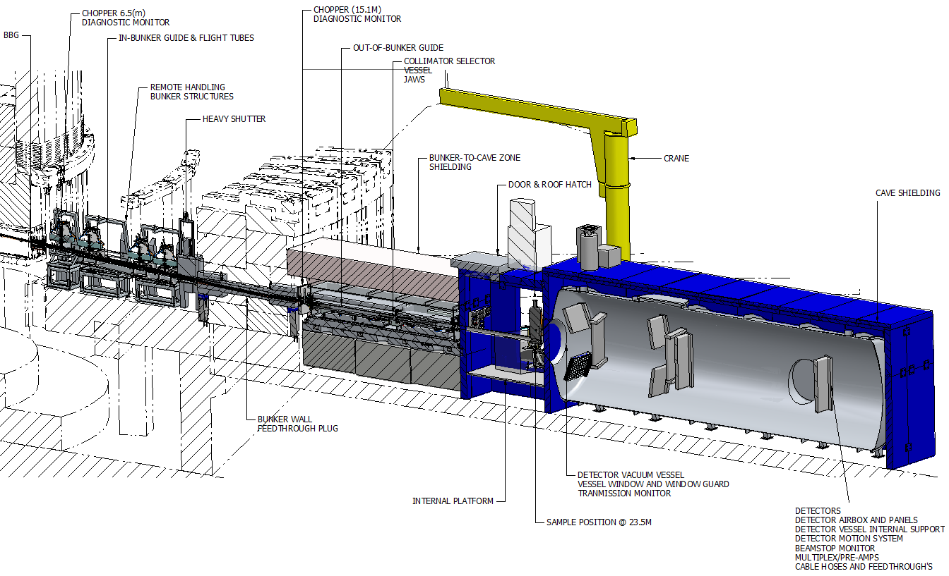
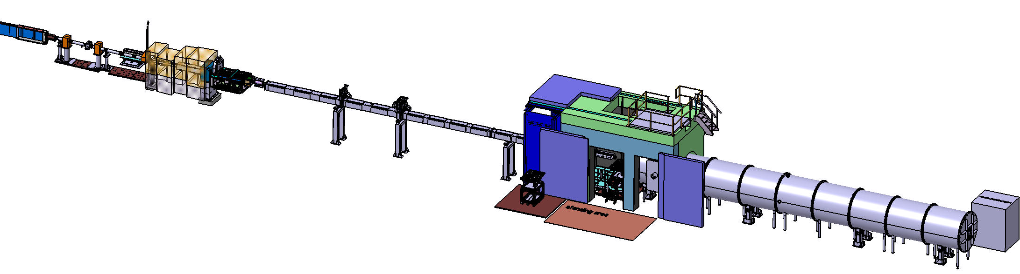
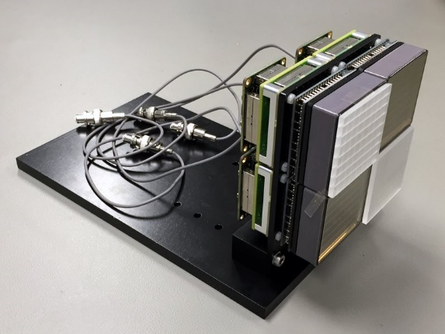
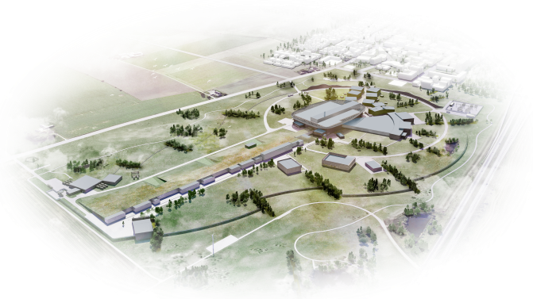

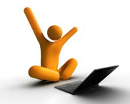
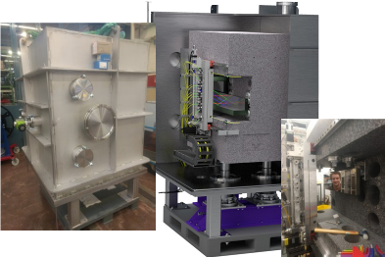
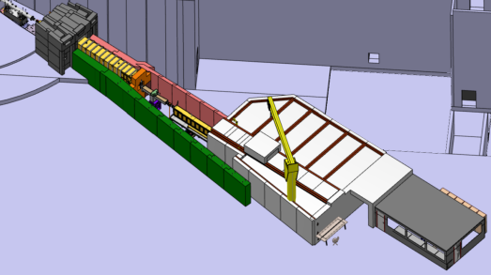
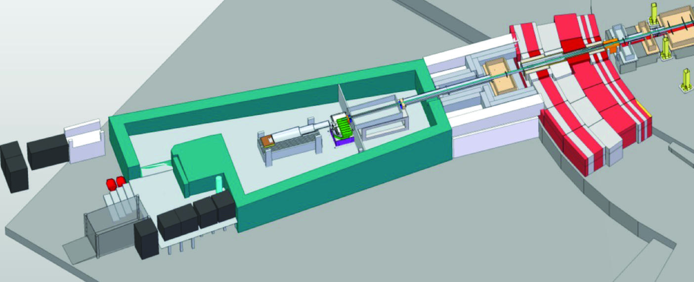
Timeline
SoNDE Detector
Project Complete
2019
LoKI user
operation 2023
SKADI user
operation 2025
LoKI Installation
2021
SKADI Installation
2022-24
ESS first beam
on Target 2022
Estia Installation
2021
Freia Installation
2023-24
Selene demonstrator
2018
Estia user
operation 2023
Freia user
operation 2025

Slide 8
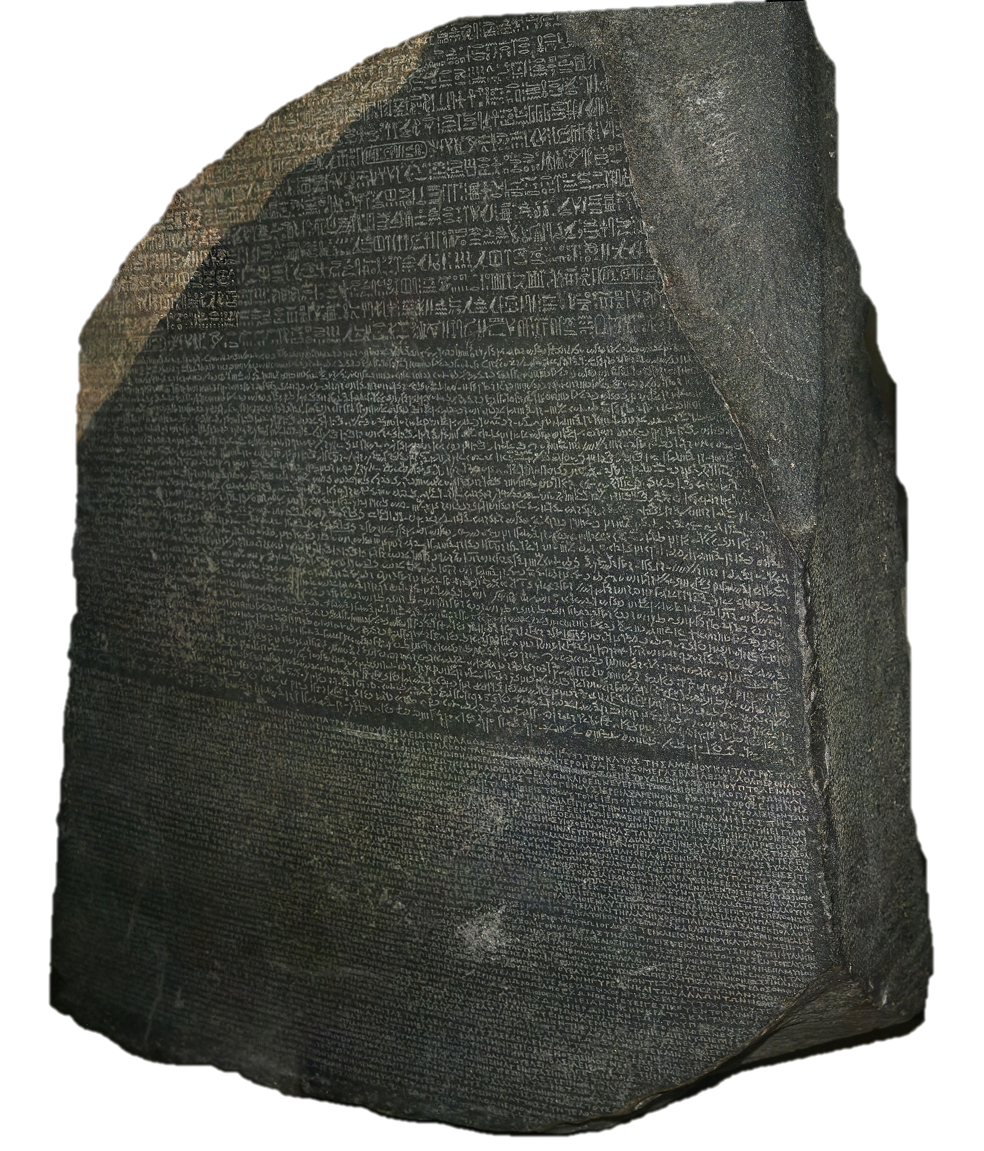
Project Lingo
ESS: European Spallation Source
NSS : Neutron Scattering Systems
SSS : Science Support Systems
SAD : Scientific Activities Division
NID : Neutron Instruments Division
LSS : Large Scale Structures (SANS + Reflectometry)
SEE : Sample Environment Equipment
SES : Sample Environment System
FLUCO : Fluids including gasses, vapour and complex fluids
PREMP : High pressure and mechanical processing
TEFI : Temperature, magnetic and other fields
MESI : Mechatronics and software integration
SULF : Sample handling and user labs
DEMAX : Deuteration and macromolecular crystallisation
SCUO : Scientific coordination and user office
Attribution: © Hans Hillewaert
CC BY-SA 4.0

Slide 9
Delivering on the Sample Environment Reference Suite
https://1drv.ms/x/s!AuCQb_HPf3b9g8g2HHqvybpQKix-Lg
Sample Environment Reference Suite based on instrument needs. Timelines determined by instrument construction schedule and lead time.
NSS construction budget covers needs of first 8 instruments #1-#8. Additional budget provision for instruments #9-#15 in initial operation.
Cross-check regularly Sample Env. Reference Suite and Laboratory Requests; at least during each (sub-) TG3 jointly between SAD and instr. Team.
Each SES follows its own project plan incl. integration and safety assessment; e.g. SES are not part of the instrument TG3 process itself
Notes:
5 regular crosscheck the Sample Env. Suite and the laboratory requests at each sub-TG3 with the instrument teams again using checklist. To keep aligned with instrument construction, we will aim to adjust the project plans for each sample environment system. Each sample env equipment follows its own project plans incl. integration and safety assessment e.g. sample environment is NOT part of the instrument TG3 process itself.

Slide 10
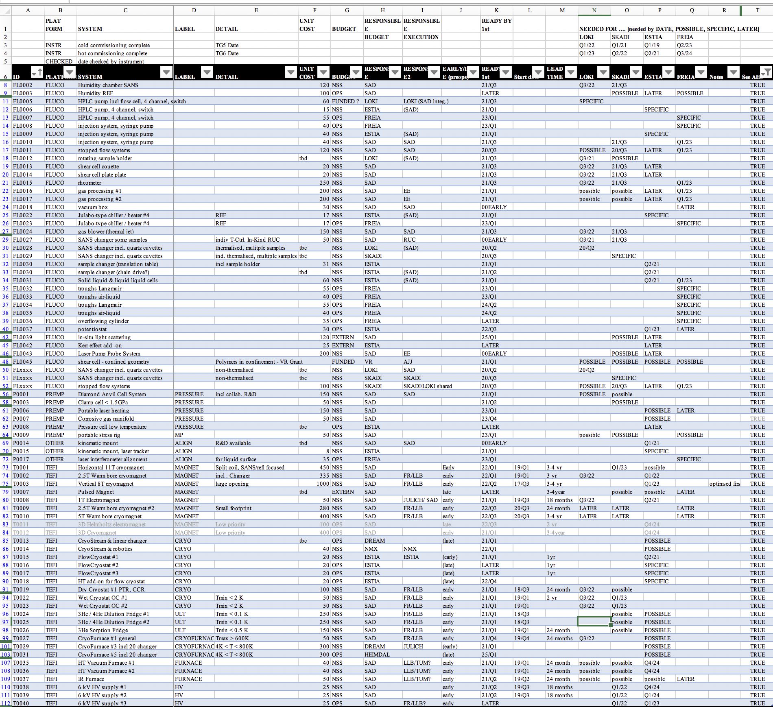
Sample Environment Reference Suite for LSS

Slide 11
Science Support 4 Instruments
(driven by 1st #1-8, #9-15 invited observers)
MESI is involved for all sample env. integration | LSS Estia, Loki Freia, Skadi | ENG Beer, Odin | DIF Dream, Magic Heimdal, NMX | SPEC CSPEC, Bifrost TREX, Vespa, Mir
FLUCO Harald | YES | MAYBE | YES | YES
TEFI Alex | YES | MAYBE | YES | YES
PREMP Malcolm | YES | YES | YES | YES
SULF Monika | YES | YES | YES | YES
DEMAX Zoë | YES | NO | NMX only | YES
SES 4 LSS
(autumn)
SES 4 ENG
FLUCO 4 DIF & SPEC
(w/o Bifrost, Magic, NMX)
TEFI & PREMP 4 DIF & SPEC
Labs 4 Instruments D Hall
Labs 4 Instruments E Hall
DEMAX 4 LSS, NMX, SPEC (w/o Bifrost)

Slide 12
Objectives
Why: Revisit Needs, Requirements and Prioritisation
Discuss SES needs and requirements related to instrument science case
Motivate in respect to (early) science commissioning / experiments / success
Consider operational aspect including sharing SES between instruments
Identify need for development of new equipment
What: Scope and Specifications for each Sample Environment System
Define (top-level) specifications for (Day-1) Sample Environment Systems
Investigate communalities, portability, modular structures, multiple copies
Develop delivery plans incl. integration and safety aspects
Evaluate in respect to costbook values / available budget.

Slide 13





Towards an integrated ESS:
Science Support Systems in Operations
Equipment
Availability
Safety, Robustness, Reliability, Ease-of-use
Maintenance, Workflow, Cost, Schedule
  Maximal range
  Multiple parameters
  Precision, accuracy
  Stability, control speed
  Total range sweep
  Return to ‘off’
Equipment
Change-over
Parameters
Mobility
Modularity
Rapidity
Reproducibility
Work flow
Sample Change
Positioning precision
Reliability, speediness
Labs
  Prepare and characterize
  Align, condition, mount
  Register, tag, store, ship, dispose
Sample Environment Suite = Pool equipment + Instrument Specific Devices
Laboratory Suite = General User Labs + Instrument Labs and Prep. Areas

Slide 14
Objectives
How and Who: Execution and Budget Responsibilities
Establish top-level work breakdown structure considering synergies
Share developmental efforts, integration tasks, safety evaluation
Define / Revise execution responsibilities and identify budget leverage
Prepare request for consideration in (initial) ops budget for additional SES
When: Schedule alignment, Milestones, Tollgate Review
Align SES delivery schedule to instrument (commissioning) plans
Define Milestones and Tollgate Reviews based on instrument timelines
Identify critical path and decision points incl. in-kind scenarios / constraints

Slide 15
Role of “Convenors”
Introduce the topic area
Lead/manage the discussion with a view to the goals of the meeting
Lead/guide the writing of the report section for the topic area on Thursday morning
”Official Scribes” : ESS SAD team members will take notes, but everyone please keep some notes that can contribute towards the writing on Thursday and pass them on to the session/topic convenors.

Slide 16

Introductions …
Time for the SEE4ESS@LSS RTI …

