Slide 1


LoKI
Science Case and SEE Priorities
A Jackson^{1,2}, R Heenan², W Halcrow², D Turner², C Lopez¹, J Houston¹, K Kanaki¹, A Orszulik², J Cooper², K Andersen¹ and S Langridge²
¹European Spallation Source, Lund, Sweden
²ISIS Neutron and Muon Source, STFC, Rutherford Appleton Laboratory, Didcot, UK

Slide 2
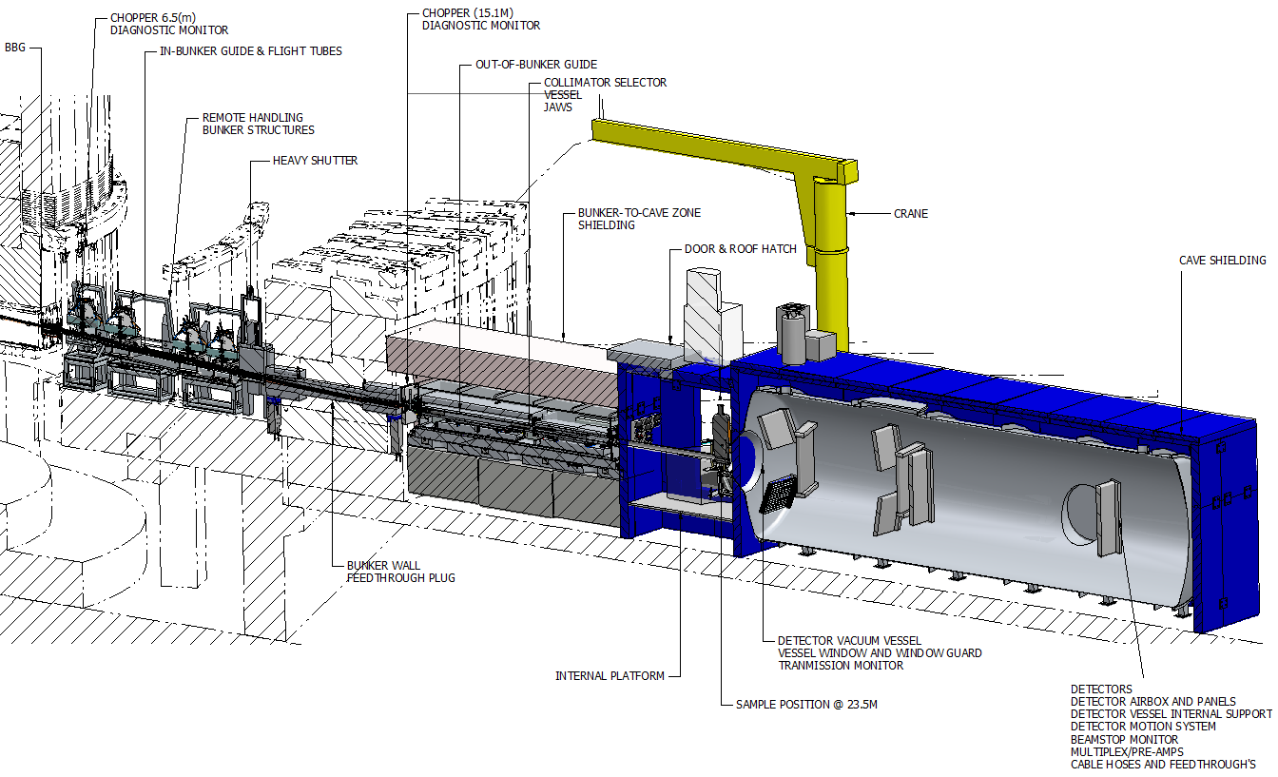
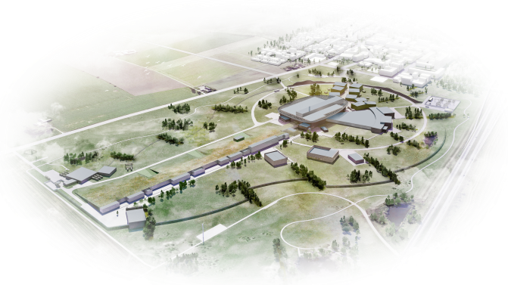
LoKI Project & Schedule
LoKI will have high flux, wide simultaneous size range, low background, and a flexible sample area.
LoKI will enable the use of small beams, making scanning experiments & microfluidics routine.
LoKI aims to provide the ability to perform “single-shot” kinetic measurements on sub-second time scales
ESS first beam
on Target 2022
LoKI
Installation
2021-22
LoKI user
operation 2023

Slide 3
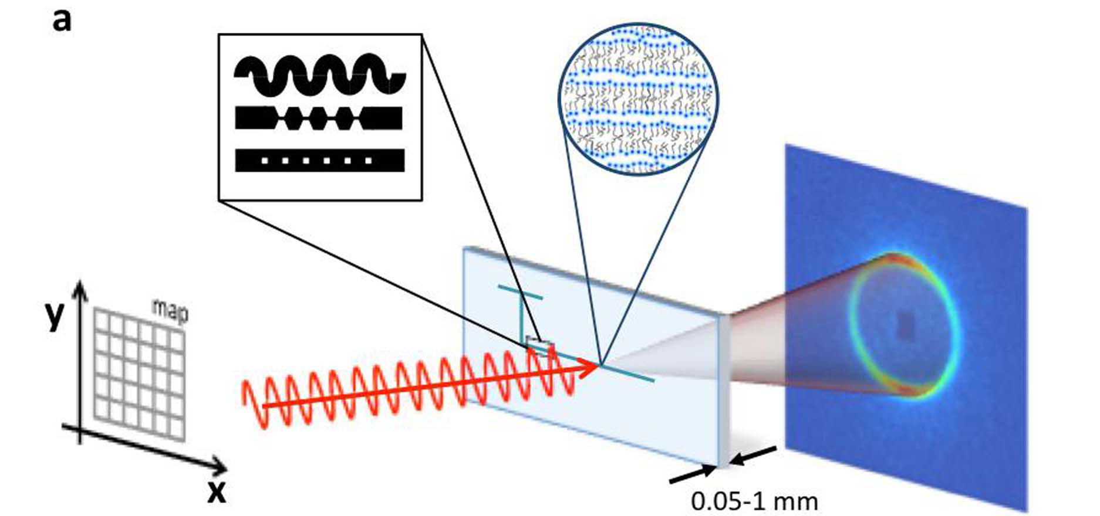
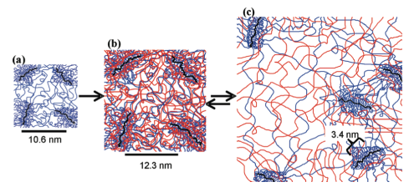
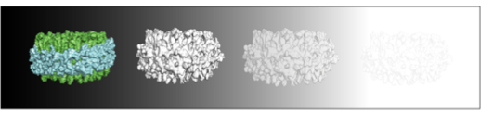
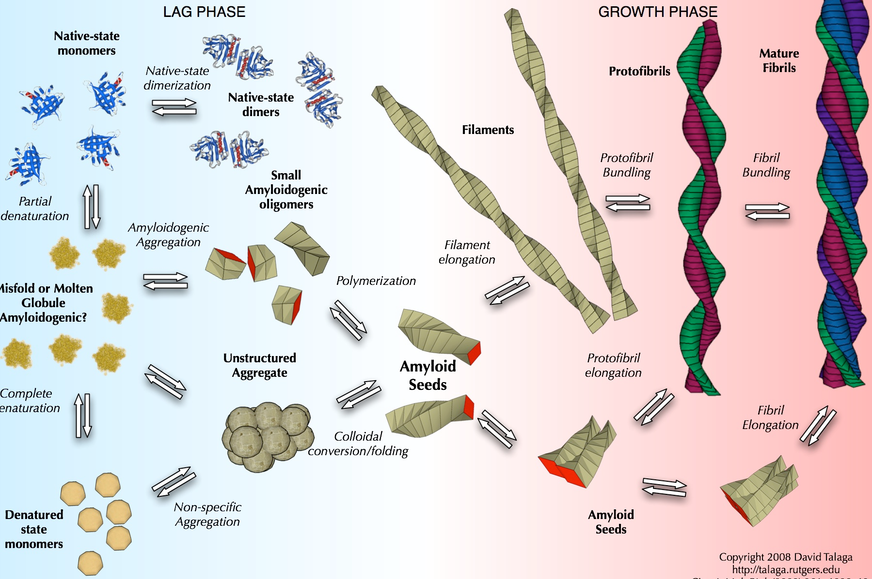
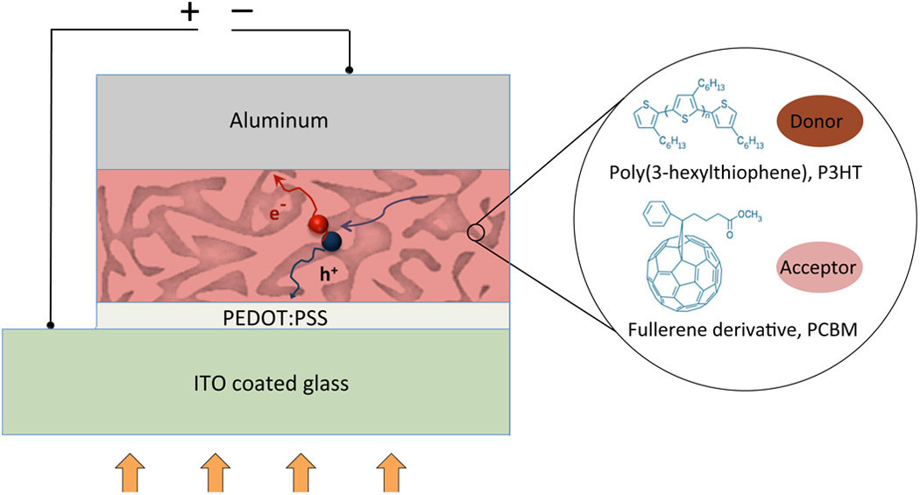
LoKI Science Case
SANS for Soft Matter, Materials and Bioscience
The flow of complex fluids through complex geometries is relevant to many industrial processes. There is a need to understand structural effects of flow. The use of microfluidic devices enables high throughput studies of these types of system.
FLOW
KINETICS
Gel structure forms over multiple length scales. Kinetics of gelation can be rapid needing sub-second time resolution. Fast exchange and growth kinetics in surfactant micelles or lipid systems can be studied.
Swelling of a double network hydrogel designed for use as a cornea replacement. (Frank Group, Stanford)
MULTI
SCALE
Amyloid fibril formation and growth is a multi-length scale problem and to understand methods of formation and inhibition the structural evolution must be observed.
DEVICES
Organic Solar Cells promise to provide cheap and accessible solar energy. The lifespan and efficiency of the devices depends on the nano-structure of the polymer mixture. Understanding the structural evolution under operation guides development of new devices.
BIOLOGY
Membrane proteins are key drug targets and cannot easily be crystallised for study by macromolecular crystallography. Examining such proteins in their native environment is vital to understanding their function.

Slide 4
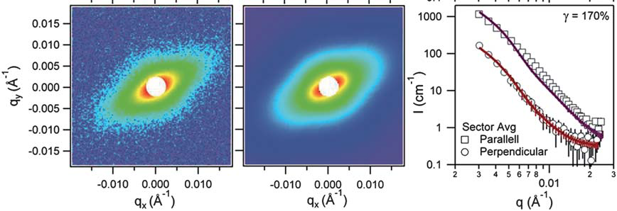
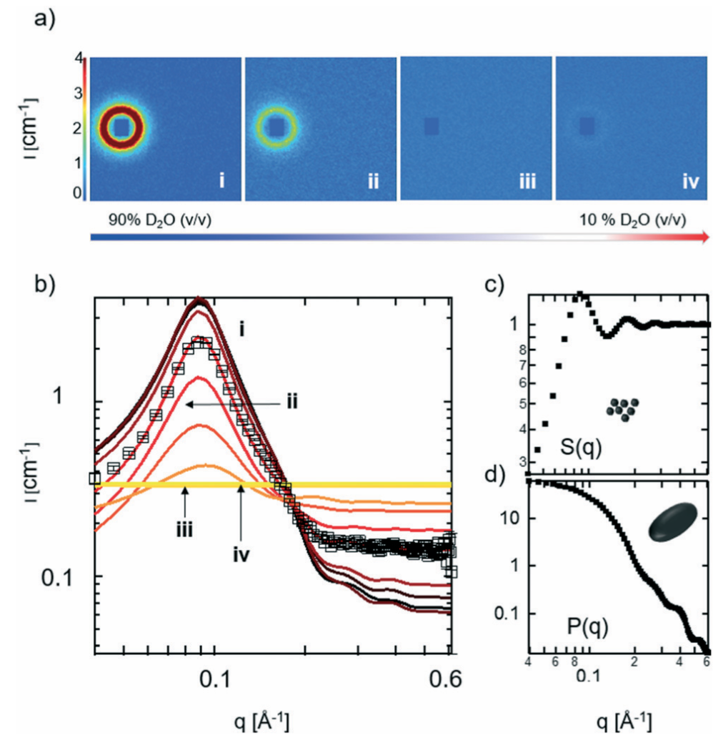
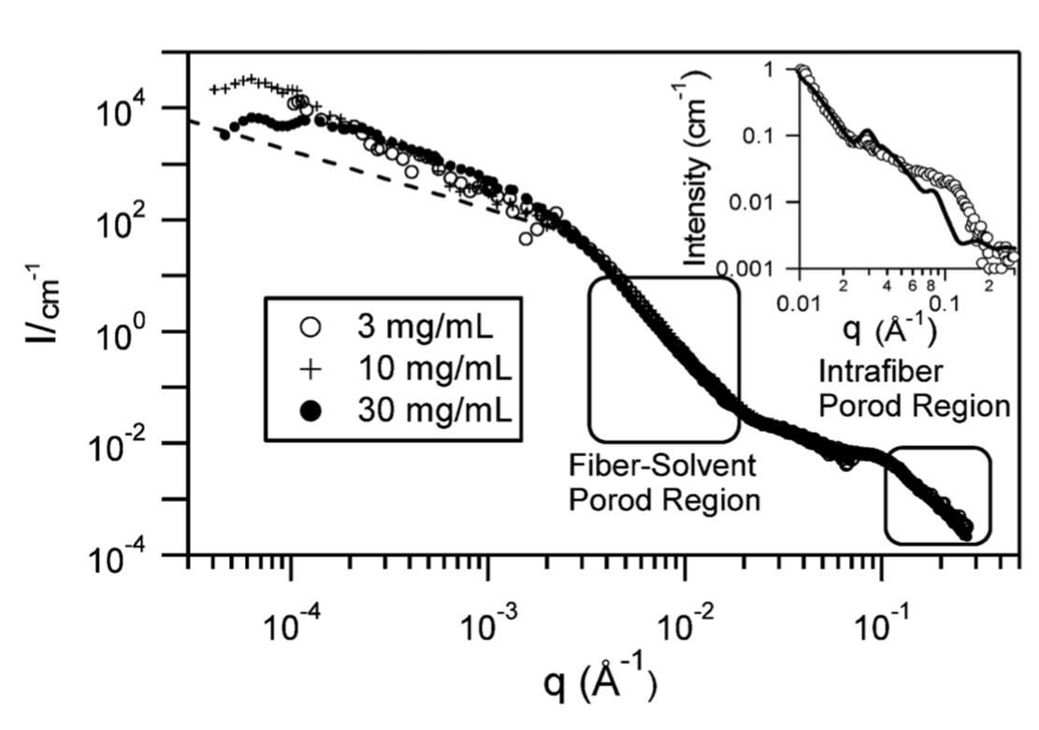
LoKI Science Case: Fluid Flow
Microfluidics and Rheology
Microfluidic devices e.g. for chemical and pharmaceutical discovery, production and processing.
Rheology e.g. structures of gels under shear
2D Scattering
2D Fit
1D Scattering
high-throughput mixing & tailored flow geometry
@LoKI: high throughput, large parameter space
@LoKI: wider simultaneous Q-range. Probe structural effects of shear over wider size range
Adamo et al., Lab Chip, 2017, 17, 1559
Weigandt, Porcar and Pozzo, Soft Matter, 2011, 7, 9992

Slide 5
LoKI Science Case: Non-Equilibrium Studies
Stopped-flow SANS: Self-assembly and Exchange Kinetics
Disc to vesicle transition: 50-100ms shots repeated 10-25 times
Neutron contrast (deuteration) to detect lipid transfer between nanodiscs
@LoKI: fewer repeats needed / less material / more samples
@LoKI: better time resolution / faster exchange kinetics
Bressel et al., Colloid Polym Sci, 2010, 288, 827
Arenas et al., Scientific Reports, 2017, 7, 45875

Slide 6
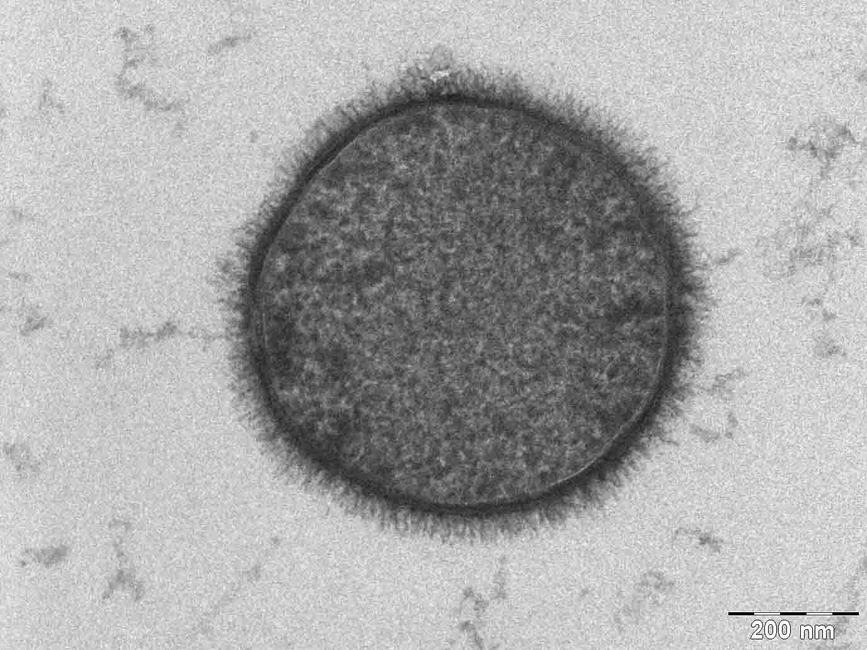
LoKI Science Case
Weakly scattering biological samples
e.g. SANS from perdeuterated living cells with hydrogen labelled cell membrane
→ 4h on BioSANS (ORNL) @ 5mg/ml cells
@LoKI: shorter counting times / higher throughput and low background

Slide 7
Early Science
LoKI is the first of the 15 instruments, so potentially not super high flux, we can take advantage of large simultaneous q-range and low background
Early science experiments are likely to involve:
- Experiments that use flow e.g. rheology & microfluidics
- Kinetic experiments requiring short time resolutions
- In situ experiments
- Work-horse measurements - standard samples but with high throughput
Day 1 Performance (2 MW):
  Approx. 5x compared to D22 (LoKI at 14 Hz)
  Approx. 20x SANS2D (LoKI at 7 Hz)

Slide 8
Sample Environments
Required for Hot Commissioning (2022)
Sample changer for quartz cuvettes, T = -10 to 120 ºC, 50+ (ESS)
Rotating/tumbler cell holders, temperature controlled, 3 or 4 (ESS)
Quartz cells of varying dimensions, 200+ (ESS)
Flow-through cell with syringe and HPLC pumps (ESS)
Required Sample Environments
Notes:
Rotating cells for powdered calibration standards

Slide 9
Sample Environments
Required for Early Science
Rheometer (ESS)
Stopped-flow cell (ESS)
Goniometer (ESS)
In situ techniques, e.g. DLS, spectroscopies, as attachments to the flow-through cell (LoKI team)
Dismountable ‘sandwich’-style cells (ESS)
Stress/stretching rig (ESS)

Slide 10
Sample Environments
Long Term Additions*
Humidity cell / chamber (ESS)
High pressure cell (ESS)
Linkam temperature stage (ESS)
Radioactive sample cool-down area (ESS)
Couette shear cell (ESS)
Sample changer robot (ESS)
Electric field cell (ESS)
Larger pool equipment
Furnace (ESS)
Cryostat (ESS)
3 or 7 Telsa magnet (ESS)
1 Tesla electromagnet (ESS)
*developed/added following needs of the user community

Slide 11
Sample Area (Preliminary Design)
Sliding roof for top access to sample area
External SEE staging area
Limited space for turning
Equipment lift

Slide 12
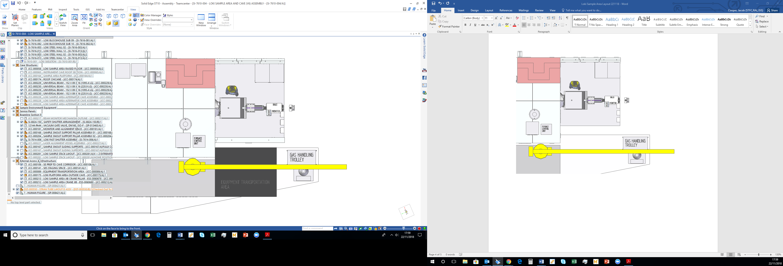
Sample Area (Preliminary Design)
Space for water baths/ancillary equipment
Sliding roof for top access to sample area
Top view
External SEE staging area
Limited space for turning
Equipment lift

Slide 13
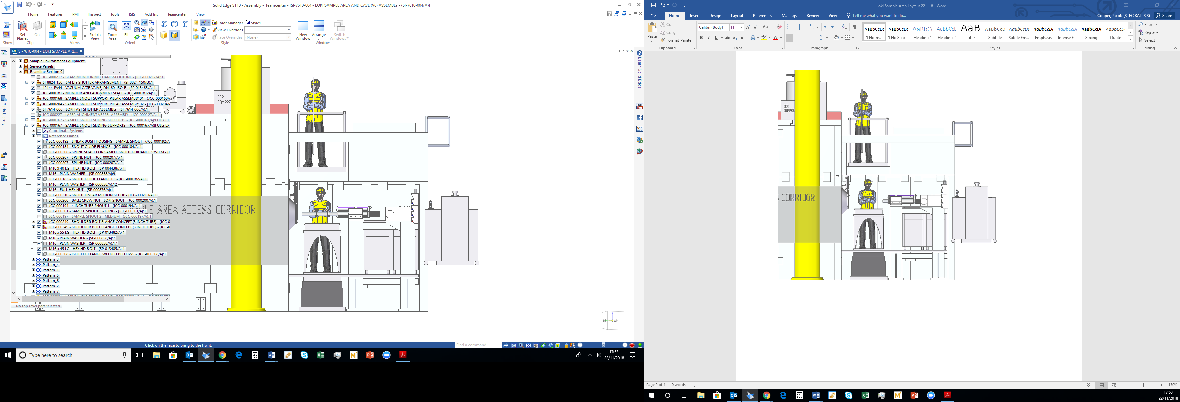
Sample Stack & Snout
Sample stack:
Stack will include Z-translation and x-translation (in the direction of the beam)
Y-translations will be incorporated in the SEE
2000 mm
L3
L2
1300 mm
level “0” - platform
790 mm
Z- & X-translation table
(under the platform?)

Slide 14
Sample Stack & Snout
Sample stack:
Stack will include Z-translation and x-translation (in the direction of the beam)
Y-translations will be incorporated in the SEE
2000 mm
Pre-sample snout:
Length is manually adjusted by (1) an extendable position attached to bellows and (2) pipes of fixed lengths
Pipe sections can be custom built for specific sample environments
L3
L2
1300 mm
level “0” - platform
790 mm
Z- & X-translation table
(under the platform?)
Multiple fixed-length tubes
Extendable position
(200 mm travel)

Slide 15
Thanks for listening, any questions?

