Slide 1
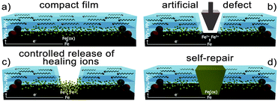
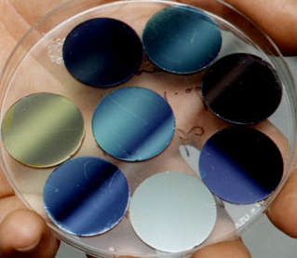
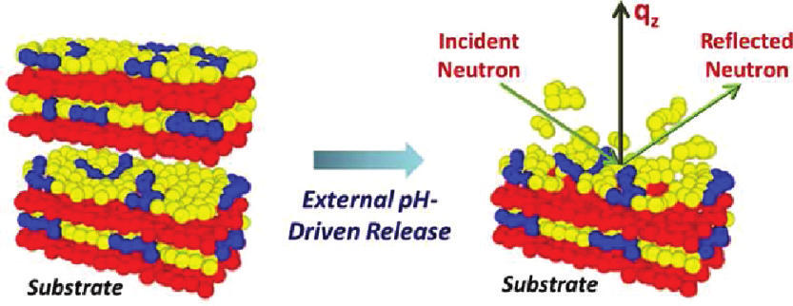
Structure
FREIA Science Case
In-situ time-resolved reflectometry for soft condensed matter, life science and functional materials
Instrument needed:
Dynamics
Horizontal sample geometry
Flexible collimation
Variable resolution
Broad simultaneous Q
No sample movement
Applications
deposition, structure and phase behavior
adsorption, self-assembly and reactions
gas/liquid/solid interfaces
Design
response to external stimuli
in situ and in operando
complex sample environments
Function

Slide 2
FREIA Fast Measurements
Time-resolved and high-throughput reflectometry to match ESS long pulse performance
ESS allows fast measurements over a wide Q-range:
The long-pulse length and 14Hz frequency is ideal for fast kinetics using a broad λ band
FREIA is optimised for time-resolved and high throughput studies:
Wide vertical divergence - avoids movement of sample or configuration changes
Extended simultaneous Q range with fast shutters
High flux mode: dλ/λ = 3-17%
FREIA is a flexible instrument for broad science coverage
Downward orientation for liquid interfaces
Flexible Collimation options
High resolution mode: dλ/λ < 3%

Slide 3
Three slit system
Three pairs of precision slits + fast shutter mechanism to select open slit as function of time
High-flux mode:
FIGARO@ILL: R = 10⁻⁶ – 1-2min.
FREIA @2MW: 3.75s
FREIA @ 5MW: 1.5s
High-res mode:
FIGARO: R =10⁻⁷ ~ 8h
FREIA @ 2MW = 15 min.
FREIA @ 5MW: 6 min.
split guide prevents cross-talk
3 angles cover a wide Q-range

Slide 4
Project Schedule
Phase 1 Preliminary design: Complete by end 2018
Phase 2 Detailed design & start procurement
Installation begins is 2023
Hot commissioning in 2024-25
Operations begin 2025-26
Project scope DOES NOT INCLUDE SAMPLE ENVIRONMENT – ESS responsible for all SEE.
Design
Construction:
ISIS Pre-build
Construction:
ESS
Operations
Decommis-sioning
2014
2018
2021
2022
2023
2025-26
2065?
TG1
TG2
TG3.1
TG3.2
TG4
TG5
PDR
CDR
CDR
TRR
SAR
ORR
Preliminary design
Detailed design
Construction & Installation
Commissioning + Upgrades
Operations + Upgrades
Operations
Decommissioning
Upgrades to full scope and further modernisation

Slide 5
Early Science
Freia is nominally the last of the 15 Instruments
The highest impact early science is likely to be related to high speed measurements
  Probably not from the fast slit system
  Would try to reproduce Figaro or D17 measurements but with improved time resolution
Experiments that can use in-situ techniques and correlate changes with high time resolution
Work-horse measurements also needed which would use standard samples but with high through-put

Slide 6
Sample Environments
Required for Hot Commissioning (2024)
Sample Changers!!!!
  Solid-liquid cells
  Air-liquid simple troughs
  Langmuir troughs
Appropriate temperature / humidity / HPLC / Langmuir trough controls
Gas handling (including ozone generation)
1 in-situ technique (e.g. FTIR)
Some kind of auto-alignment
AV table & alignment laser (Not really SEE)
Requires significant development work

Slide 7
The need for sample changers
Current sample changers have space for 3-4 solid-liquid cells or 6-7 liquid troughs.
Langmuir trough changes limited to surface pressure and temperature
So a standard solid-liquid experiment
  2 clean contrast changes, 3-4 bilayer contrasts, some sample addition + 1-2 contrasts
  8 runs * 4 samples * 15 mins = 8hours for high-resolution
  8 runs * 4 samples * 2 mins = 1hour for low-resolution
Simple Langmuir trough experiment
  Nominally 10 surface pressure complete in 2.5 hours for high-resolution
Air-liquid troughs
  7 samples without contrast changes complete in < 2hours for high-resolution

Slide 8
Sample Environments
Required for Early Science 2025-2027
1-2 more In-situ techniques
  Shear cells / Rheometer, Electrochemistry / Potentiostat, Ellipsometry / BAM, in line QCM
Liquid-liquid cells with sample changing capacity
Improvement on number of samples that can be changed
Smaller volume cells & troughs
Radioactive sample cool-down capacity???
Capacity for pool equipment (Cryostats & Magnets)
Offline preparation facilities
  Langmuir Schaffer
  Large scale substrate cleaning (Piranha etc)
Offline Lab Equipment

Slide 9
Sample Environments
Long term additions
Further in-situ equipment development
  e.g. spin coater?
  Anything missing from previous list
Improved sample changing capacity
  Automatic monolayer spreading & cleaning?
High pressure cells
Over-flowing cylinder?

Slide 10
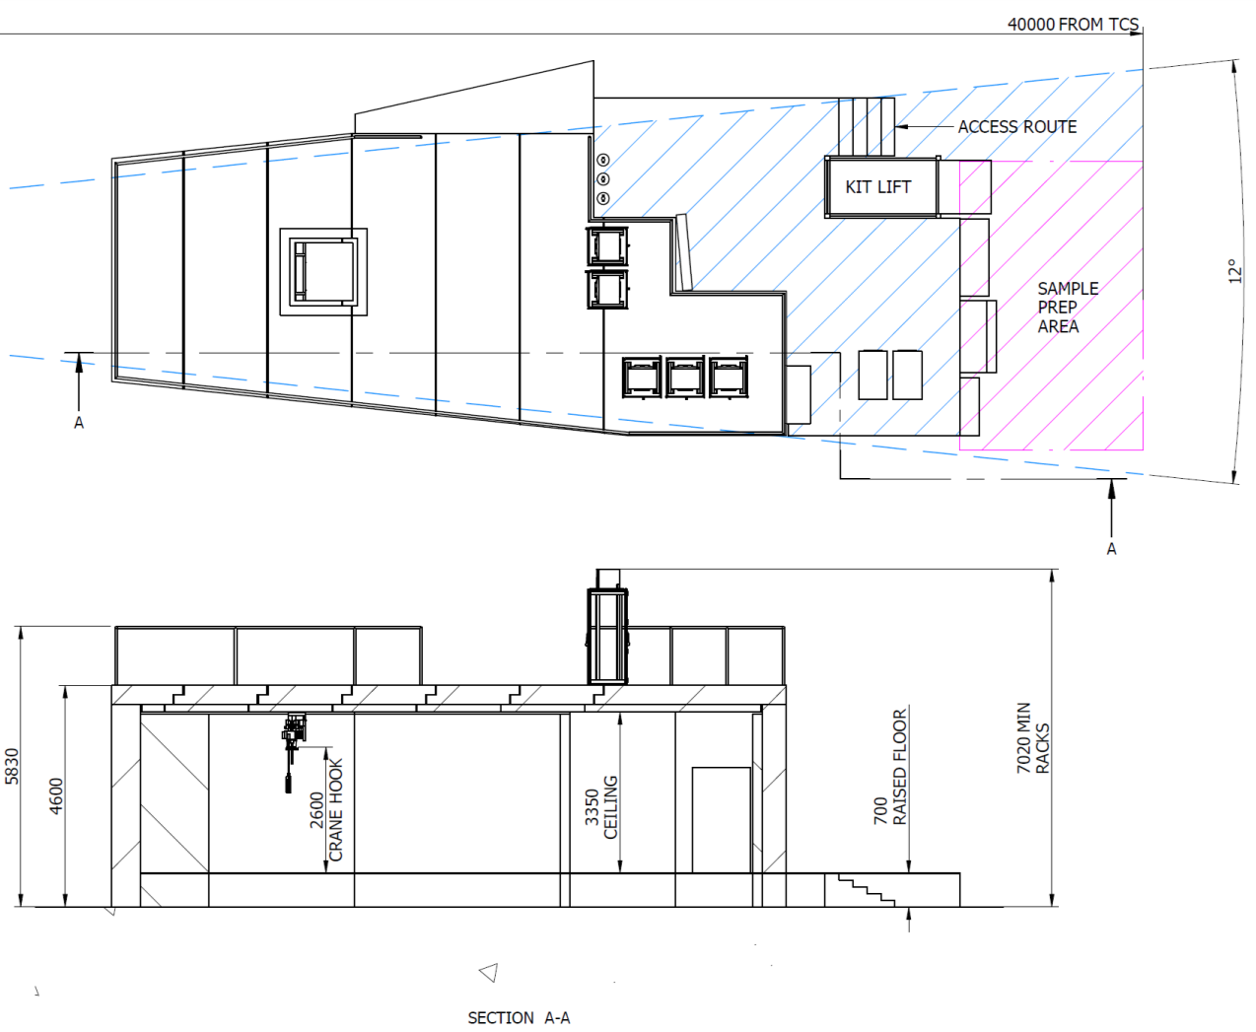
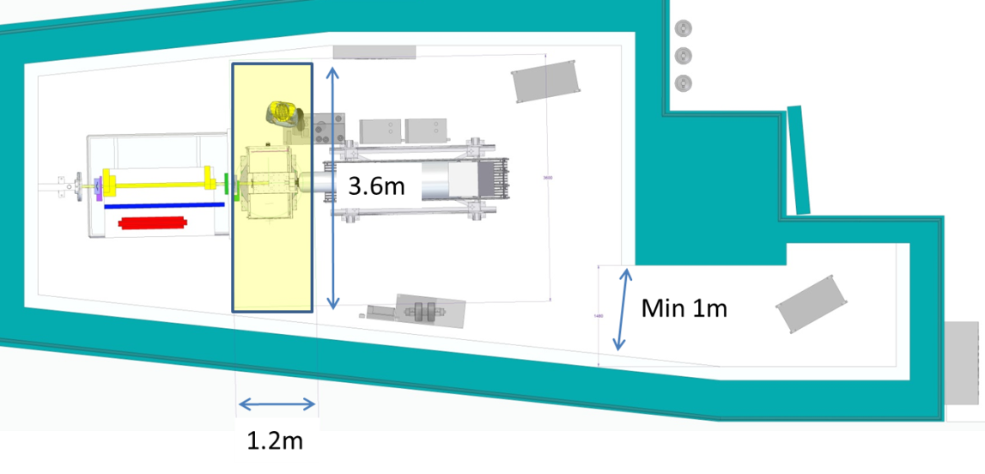
FREIA Experiment Ergonomics
General principle to allow as much space as possible
This allows flexibility and good user access from both sides

Slide 11
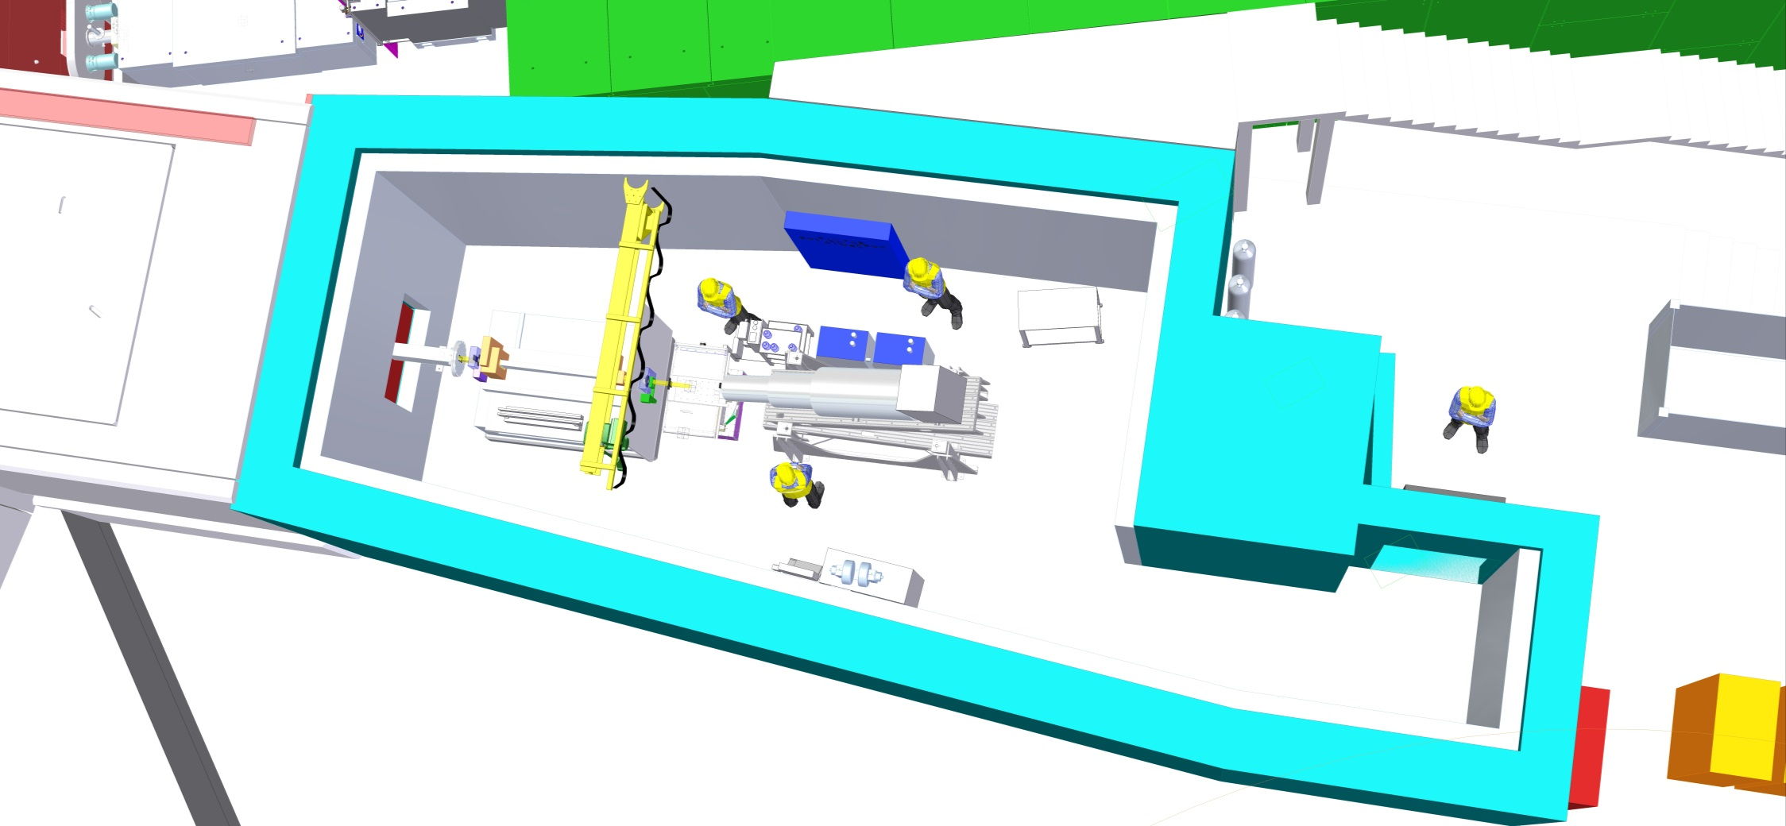
FREIA Experiment Ergonomics
1T crane
Standard panel for water, compressed air, standard gasses, etc
Unusual sample gas supplies.
Also not shown plans for COSHH extraction

Slide 12
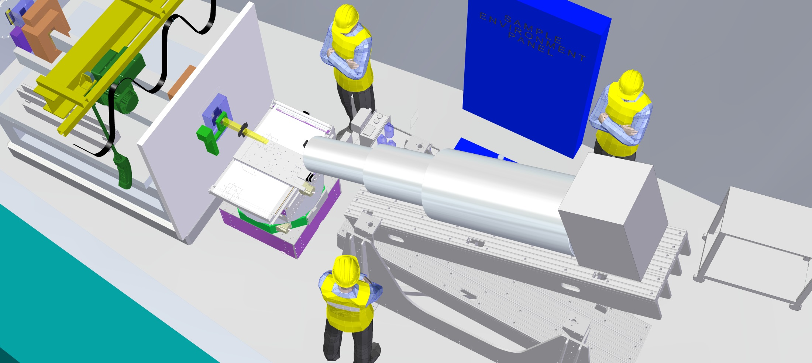
FREIA Experiment Ergonomics
Sample height ~1m
Sample stack will include anti-vibration system and there is space above it for alignment laser

Slide 13
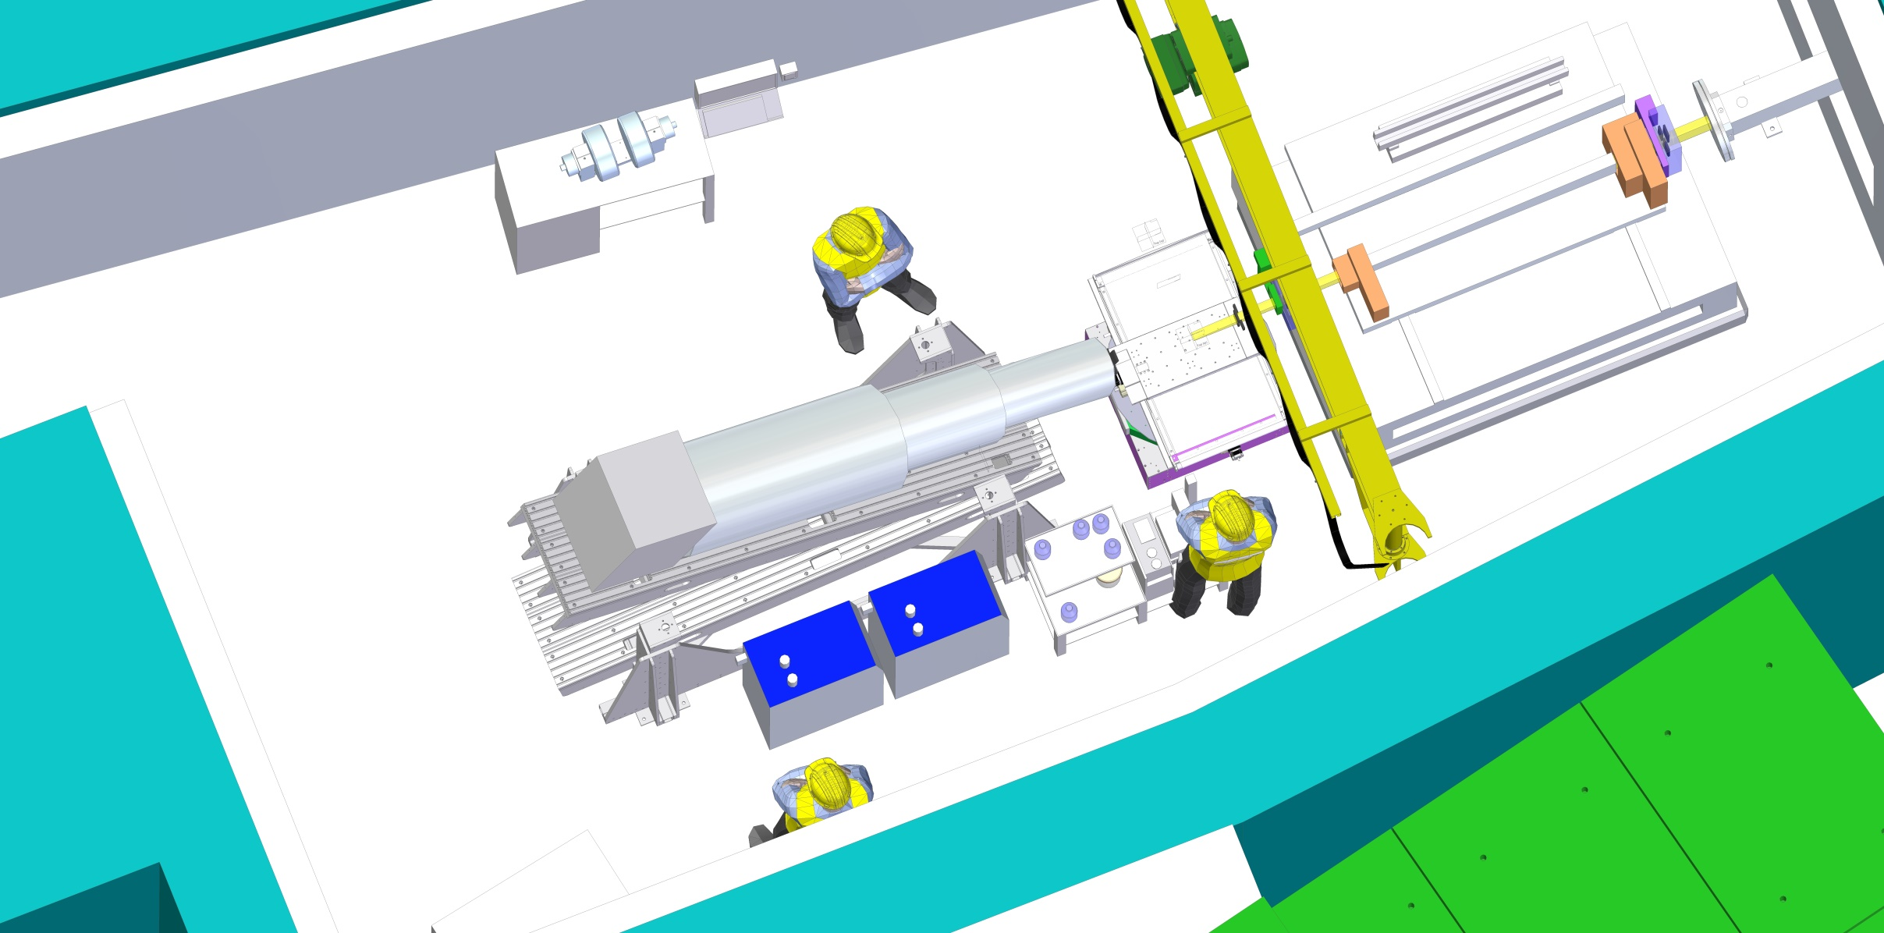
FREIA Experiment Ergonomics
Space for ancillary equipment & sample/waste bottles

