Slide 1
Near Ambient Temperature Control & Humidity Control
www.europeanspallationsource.se
18-11-27

Slide 2
What is “near ambient”
~ -10 C to 150 C
~ 0.1 C control precision & readout accuracy
Applies to *any* SE that needs this control, but mainly thinking of “sample changers” for SANS – i.e. multiple cuvettes mounted in thermostatted holders.
Reflectometry – need T control in this range for Solid-Liquid / Air-Liquid / Liquid-Liquid cells
Needs temp feedback/control from both thermostatting block and ”sample”
Independent control of each sample is sometimes needed for SANS and always for reflectometry
Traditionally done by contact heating from metal block with channels for flow of cooling/heating fluid and inserts for cartridge heaters.
Peltier devices can be used in some circumstances
Humidity control needed to go below dewpoint!

Slide 3
Sample Environment Reference Suite for LSS

Slide 4
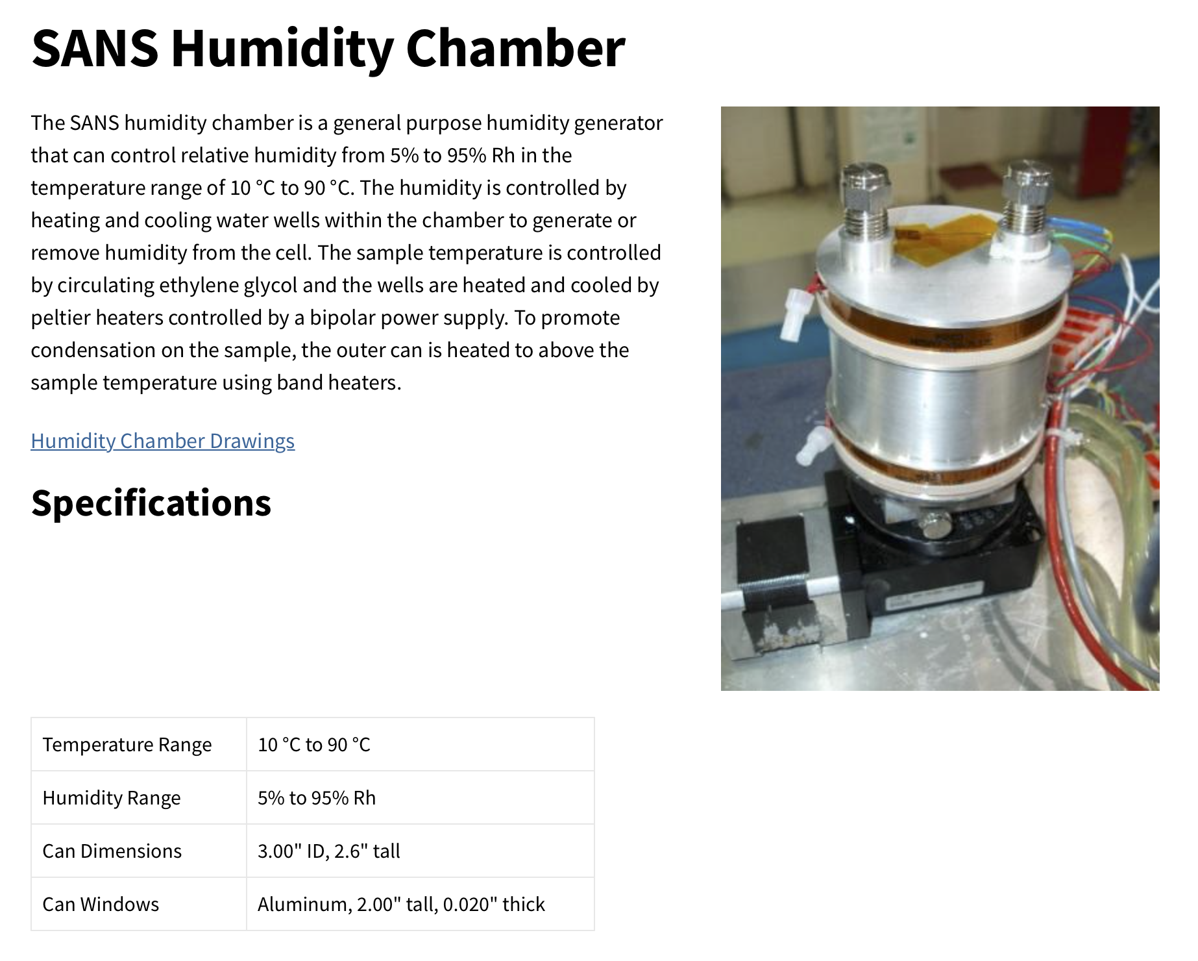
Humidity chambers
What spec do we need?
T range?
RH range?
Sample types?
Other vapours than water?
Principles of operation:
Salt Solution
T controlled water troughs
Gas flow/dewpoint generator
Problems:
T control of all surfaces
T control of sample
T control of vapour
Measurement of RH
Condensation (T control)
NCNR

Slide 5
Humidity Chambers
What spec do we need?
T range?
RH range?
Sample types?
Other vapours than water?
Principles of operation:
Salt Solution
T controlled water troughs
Gas flow/dewpoint generator
Problems:
T control of all surfaces
T control of sample
T control of vapour
Measurement of RH
Condensation (T control)
HZB - ILL

Slide 6
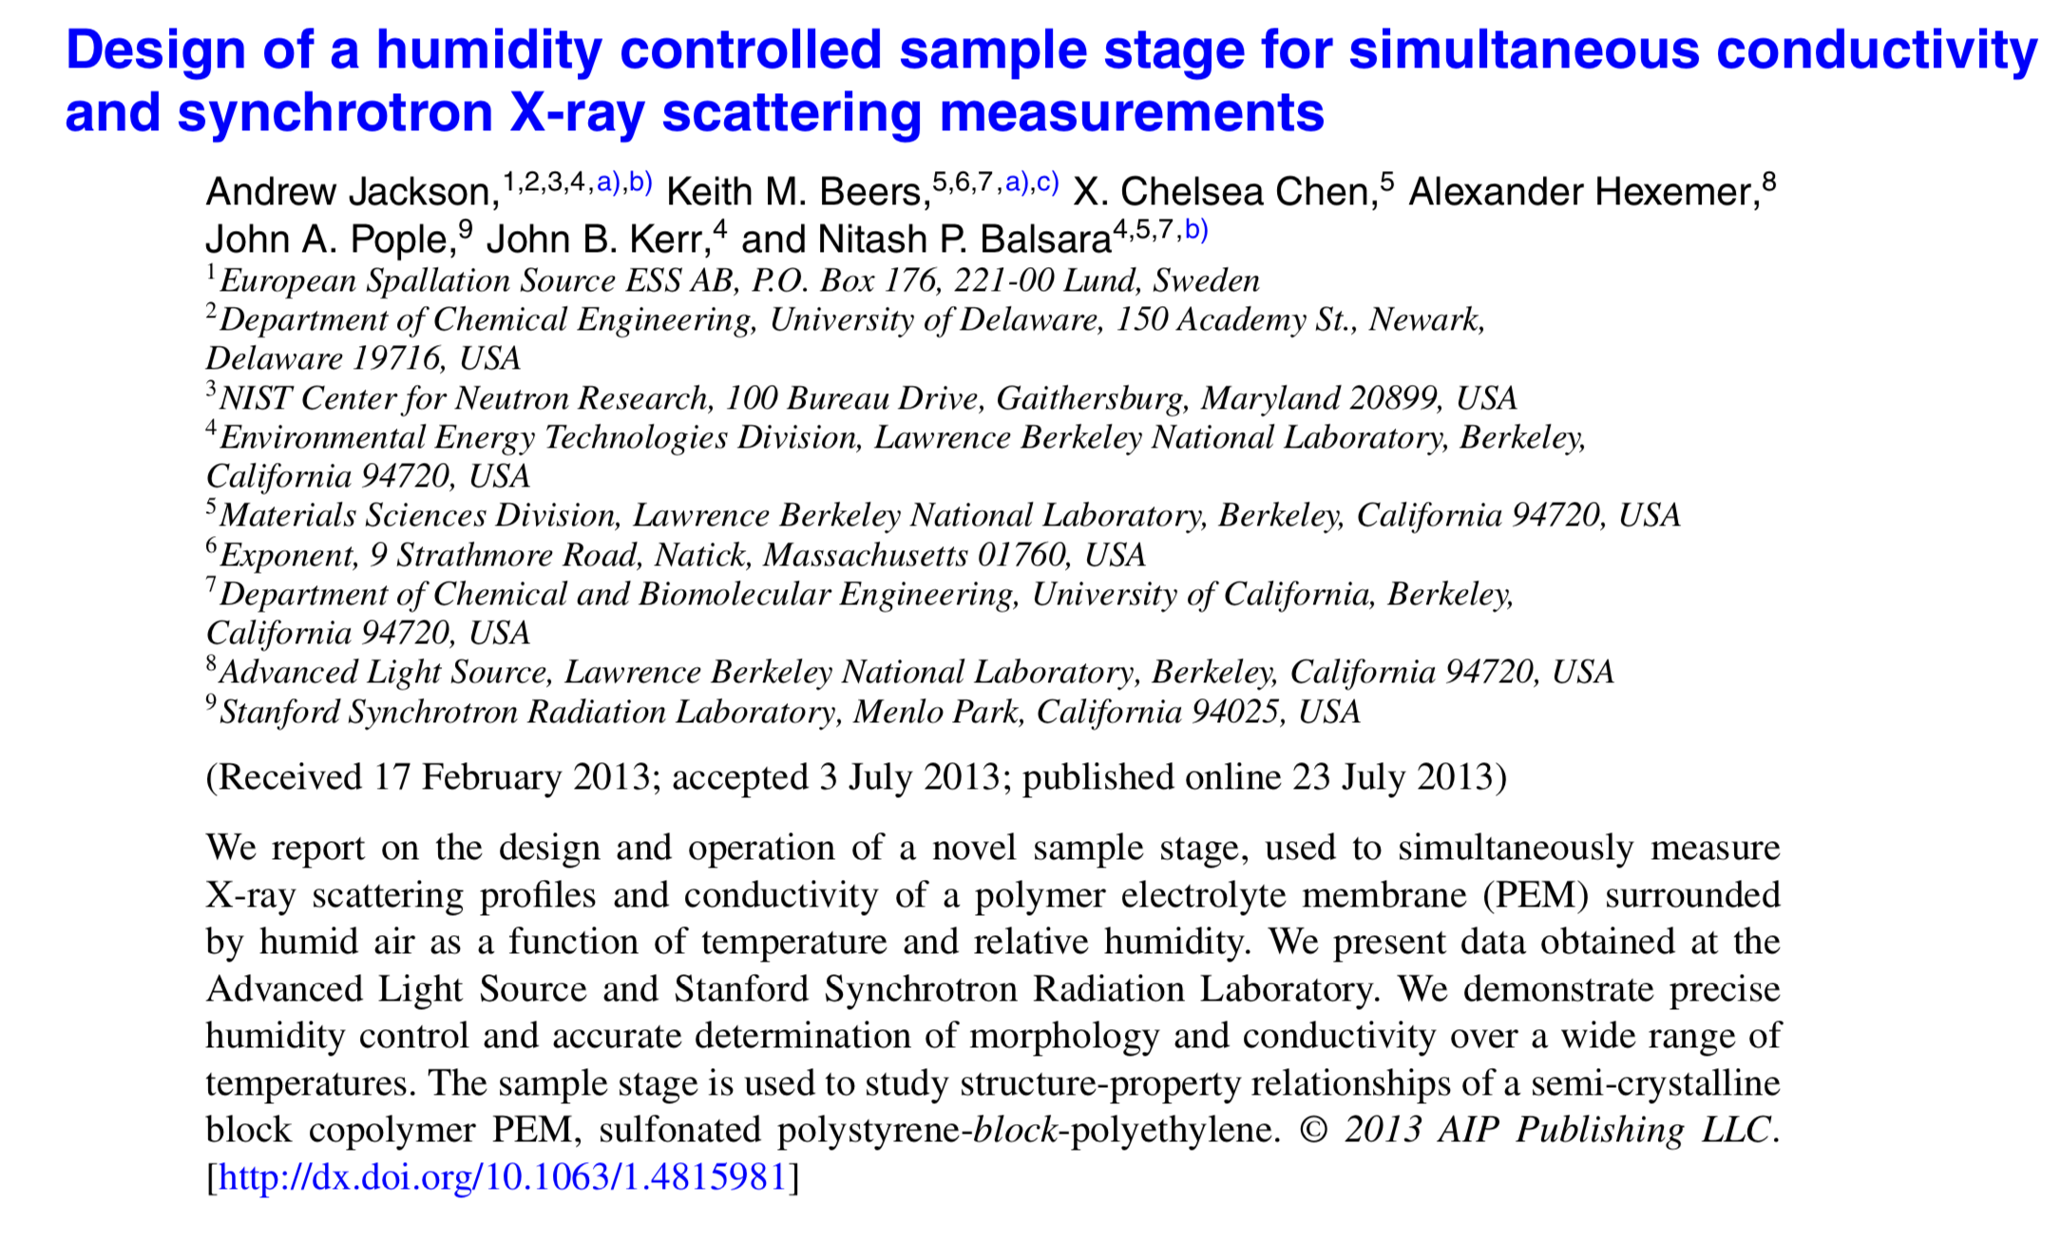
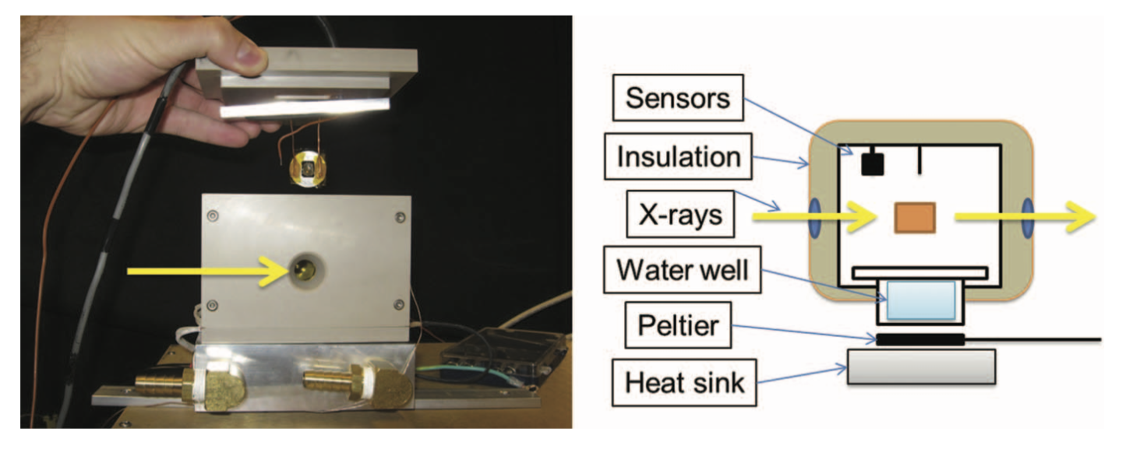
Humidity chambers
What spec do we need?
T range?
RH range?
Sample types?
Other vapours than water?
Principles of operation:
Salt Solution
T controlled water troughs
Gas flow/dewpoint generator
Problems:
T control of all surfaces
T control of sample
T control of vapour
Measurement of RH
Condensation (T control)

Slide 7
Sample Environment Reference Suite for LSS

