Slide 1
Solid-liquid and flow cells
Tom Arnold
FREIA Instrument Scientist
www.europeanspallationsource.se
27 November, 2018

Slide 2
SANS

Slide 3
Liquid handling for SANS
Off the shelf items
Stop-flow / flow-through cells
Microfluidics
HPLC & syringe pump
Integration with a sample changer?
Anything else needed?

Slide 4
Reflectometry

Slide 5
Sample Changers
Current Solid-Liquid Sample changing on INTER
Simple translation stage

Slide 6
Standard Solid – Liquid cells
The standard solid-liquid cell looks quite simple
Substrate clamped onto a Teflon trough

Slide 7
Variations
Some sophisticated designs exist
Modular
Kinematic mounting
Different orientations and materials
Flow & mixing appropriate to application and orientation

Slide 8
Variations
Adaptations to allow parallel techniques
Different constraints on substrate & trough materials, windows etc

Slide 9
Microfluidics? Small volumes
New opportunities for measurements on small samples
Increases capacity for a sample changer

Slide 10
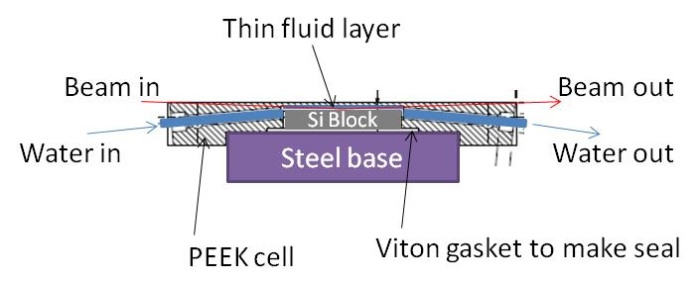
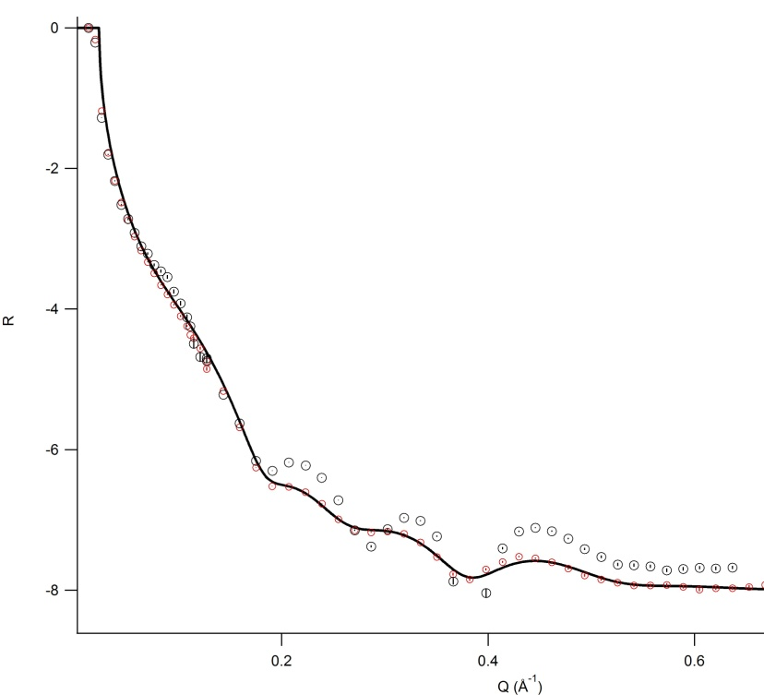
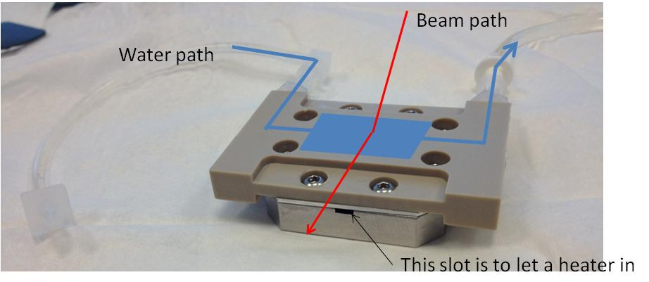
X-ray compatibility? Collaboration with Max IV?
Lipids at Silicon-water interface
with a small volume flow cell (1-2cc max)
1:1 DPPC/DOPC bilayer at Silicon-Water
(with and without NaCl)

Slide 11
Sample Changer Considerations
Orientation & mounting?
Number of cells required
Space constraints
HPLC / syringe pumps / switches
Supply / Drains / Hazardous waste
Volume
Chemical resistance / fumes / activation
Auto-alignment & scripting to avoid human error
Adaptations for complementary techniques
Interface with other kit?

Slide 12
Solid-Liquid Cell Considerations
What should ESS provide & what should users provide?
Orientation & mounting?
Footprint / Volume?
Fluid flow & exchange?
Shielding & Activation?
Materials? Substrates?
Adaptations for complementary techniques
Stirring / mixing
Electrical contacts
UV/visible/IR
High liquid pressure?
In-line analysis (QCM etc)
X-ray reflectometry?

