Slide 1
Sample Environment for Large Scale Structures instruments at ESS

Slide 2
ESS Air-Liquid and Liquid-Liquid cells
Sample environments
28th November 2018
The goal of our session is:
1) To determine the required pieces of equipment
2) To develop some top level requirements for each piece of equipment
or identify where development work is needed
3) To identify who is responsible for delivering the equipment
or doing the development work
4) To determine if the current plans of SAD align with the instrument
requirements and timelines

Slide 3
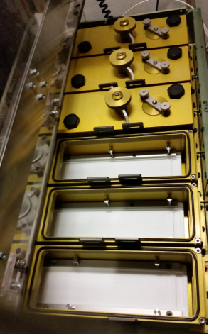
ESS Air-Liquid and Liquid-Liquid cells
Sample environments
28th November 2018
1) To determine the required pieces of equipment
A. Standard troughs design and commissiong
Multi troughs > 80 automatic syringes and washing
Temperature control below and above RT
Vapour control

Slide 4
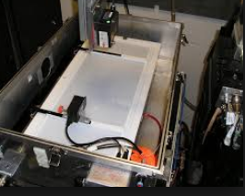
ESS Air-Liquid and Liquid-Liquid cells
Sample environments
28th November 2018
Smart multi Langmuir troughs
Vapour controlled environments
Above and below room temperature
Vapour control
Automatic syringe injection

Slide 5
ESS Reflectometry project
Air-Liquid and Liquid-Liquid cells
Of interest to physicists, chemists, biologists...
Capillary waves, bending rigidity
Phase-transfer catalysis, separation science etc.
Electrochemistry: transport phenomena
Surfactants and polymers at oil-water interfaces
Stabilisation of emulsions
Drug delivery
Proteins at oil-water interfaces
membranes and membrane transport

Slide 6
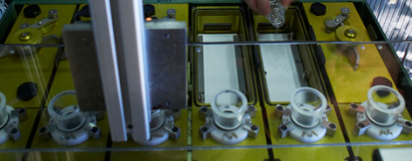
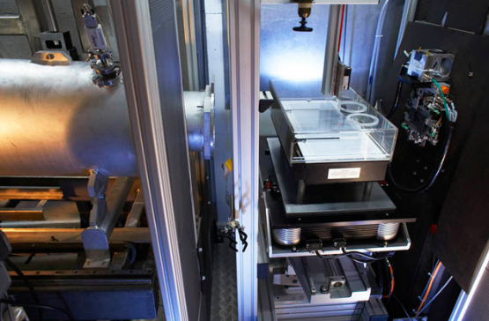
ESS Air-Liquid and Liquid-Liquid cells
Sample environments
28th November 2018
Temperature controlled Air-Liquid multi troughs

Slide 7
Neutron
(entry) window
8 troughs
Automatic syringe filling
Automatic washer
Notes:
For me

Slide 8
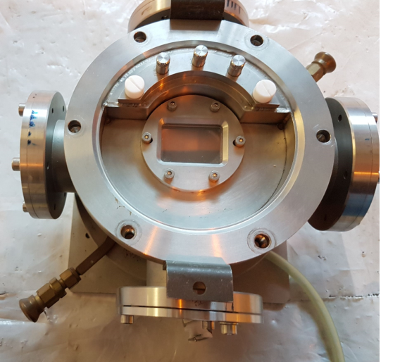
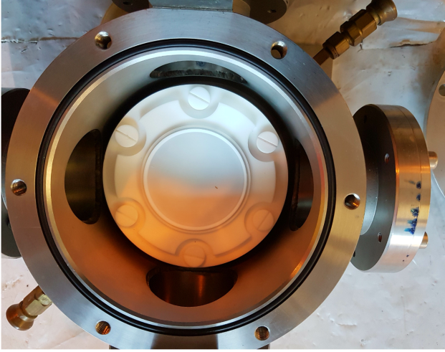
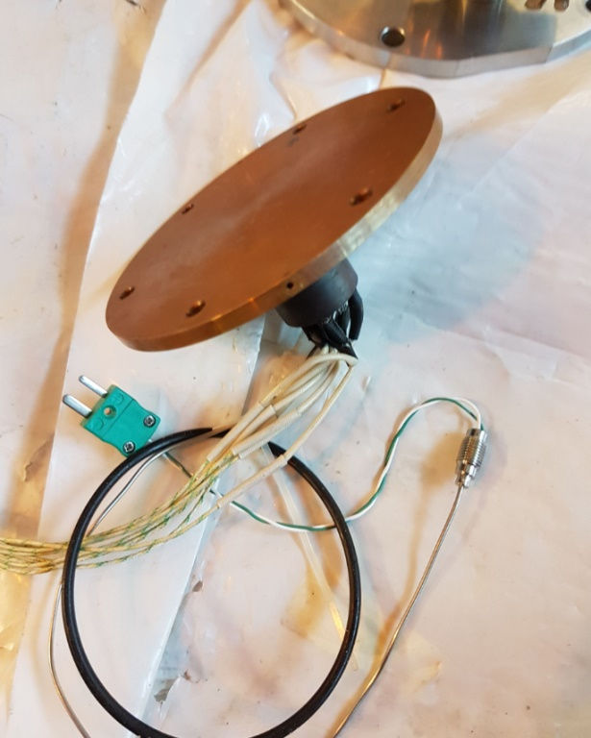
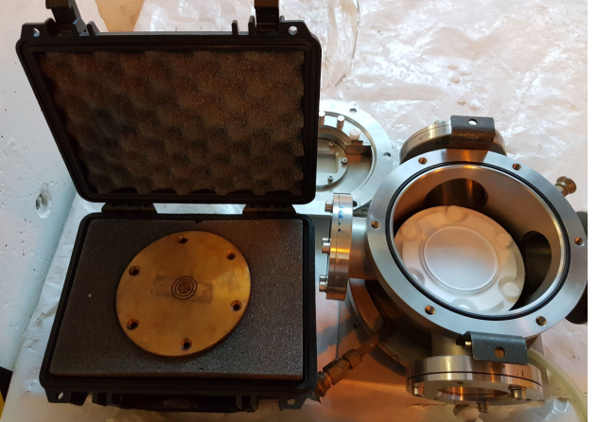
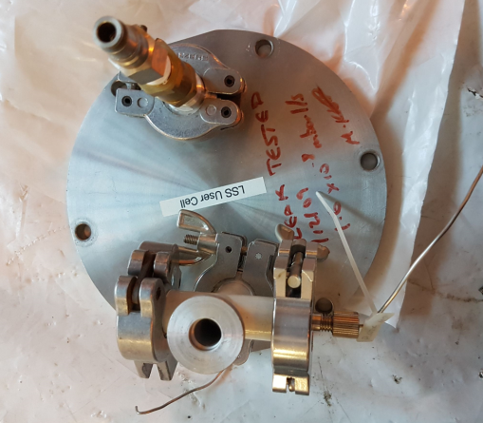
ESS Air-Liquid and Liquid-Liquid cells
Sample environments
28th November 2018

Slide 9
ESS Air-Liquid and Liquid-Liquid cells
Sample environments
28th November 2018
Neutron reflectivity from bulk oil- water interface
Pressure balance
Quartz windows
Protonated Biological system – Using a high Nb substrate
Reduced sample size and increased sensitivity; liquid/liquid interfaces:

