Slide 1
Mounting & Movement Stages, Motion Stacks & ESS Requirements

Slide 2
Mounting and Movement
Motion Stacks
Translations in the sample area:
Z-translation stage (up/down)
X-translation stage (in the direction of the neutron beam)
Y-translation (perpendicular to the neutron beam) – incorporated into the SEE
Other may also need:
Pitch?
Roll?
Yaw?
i.e. rotations around each of the axis
Need to consider:
→ Weight capacities, sizes
→ Hexapods vs. stacks
→ Additional space requirements, e.g. for plumbing

Slide 3
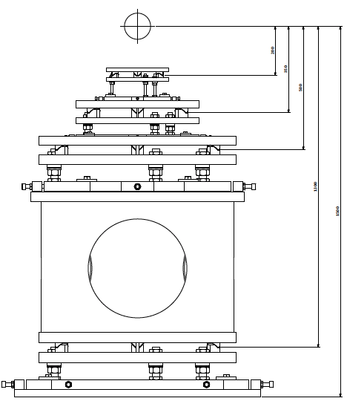
Mounting and Movement
Stages and Mounting Levels
Mounting levels provided by Malcolm Guthrie
200 mm
Kinematic mounts for easy installation of SEE between different instruments - no need for bolting/unbolting each time
Level 3
350 mm
Level 2
500 mm
Level 1
1300 mm
1500 mm
Level 0
200 mm

Slide 4
Mounting and Movement
Stages and Mounting Levels
Mounting levels provided by Malcolm Guthrie
200 mm
Kinematic mounts for easy installation of SEE between different instruments - no need for bolting/unbolting each time
Level 3
350 mm
Level 2
500 mm
Level 1
1300 mm
1500 mm
Level 0
200 mm

Slide 5
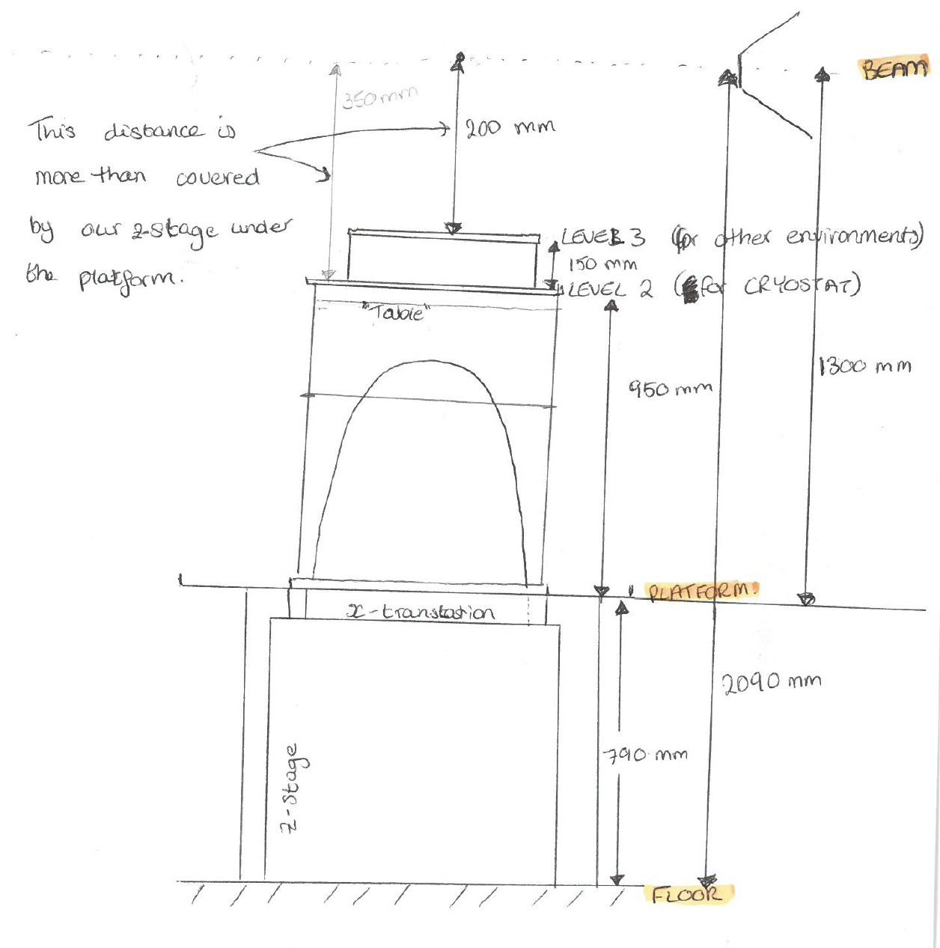
Motion Stacks
Current Design for LoKI
2000 mm
L3
L2
1300 mm
level “0” - platform
790 mm
The top of these stages (with Harald’s kinematic mount design?) will be lowered flush to the platform, i.e. “level 0”. Ideally allowing simple “tables” mounted with cumbersome SEE to be wheeled in and installed without each needing their own z- and x-translation tables
Z- & X-translation table
(under the platform?)

Slide 6
Mounting and Movement
Stages, Motion Stacks and ESS Requirements
Things to consider:
The height (z-translation) of the standard SANS (and NR?) sample holders
Evaluation of the SAD mounting stack prototype (probably haven’t had a chance to test yet though)
Plan for building a prototype “level 0” kinematic mounting system:
Build and see how it works at ISIS?
Can it fit feasibility within the available turning areas?

