Slide 1
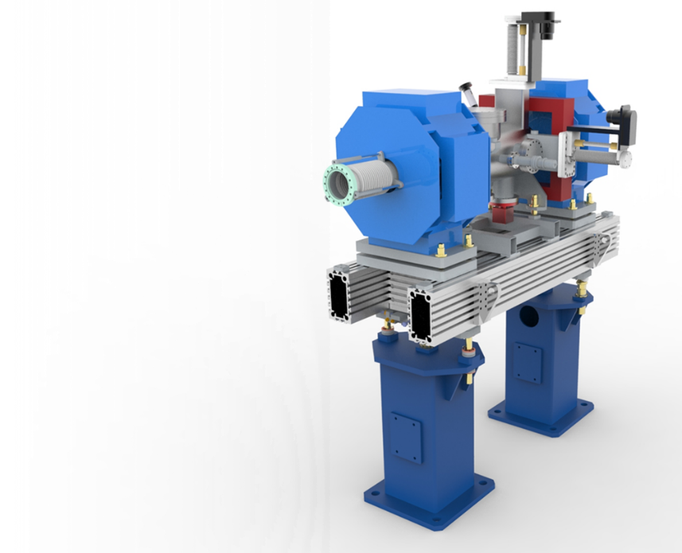
Linac Warm Units - Update
(Beam Transport Modules)
Richard Smith
STFC Daresbury Laboratory
November 2018

Slide 2
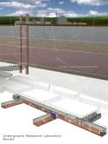
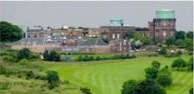
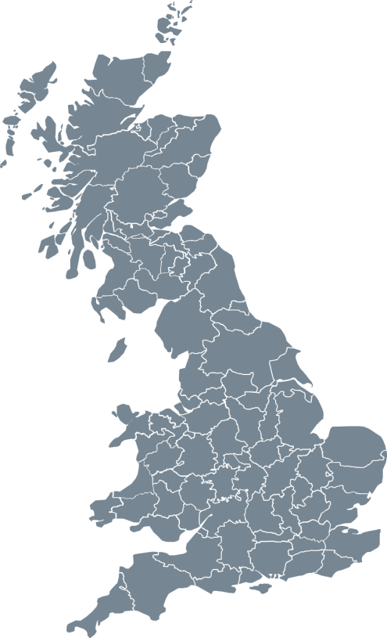
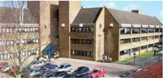
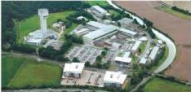

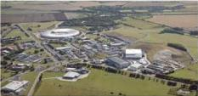
STFC
UK Astronomy Technology Centre
Edinburgh, Scotland
Boulby Underground
Laboratory
North Yorkshire
Polaris House
Swindon, Wiltshire
Daresbury Laboratory
Sci-Tech Daresbury Warrington, Cheshire
Chilbolton Observatory
Stockbridge, Hampshire
Rutherford Appleton Laboratory
Harwell Didcot, Oxfordshire
Notes:
The science and technology facilities council are one of Europe's largest research organisations. Employs 1934 staff mostly based across the six sites in the UK.

Slide 3

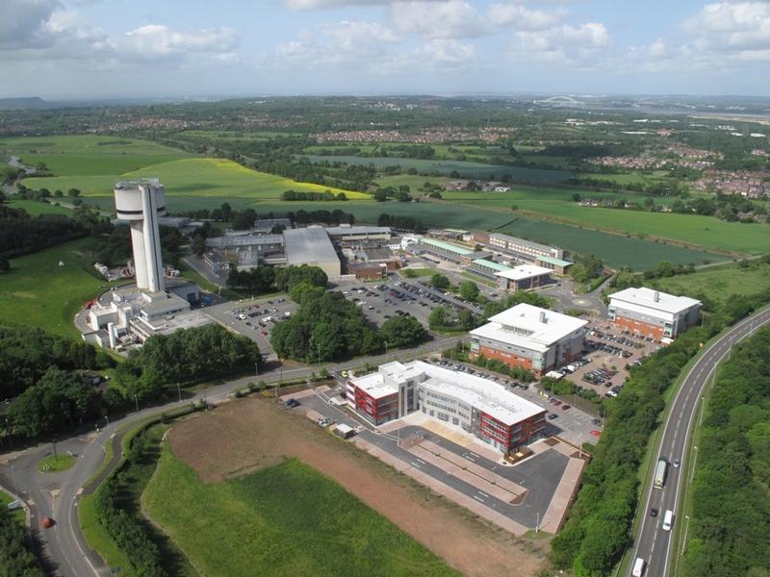
STFC, Daresbury Laboratory
Notes:
At Daresbury Laboratory there are approximately 700 employees working with over 120 different research organisations.

Slide 4
Project Team

Slide 5
Core Project Team
Paul Aden
  Project manager
Keith Middleman
  Deputy PM, Vacuum Work Package Manager
Neil Geddes
  Project Sponsor
Richard Smith
  Project Engineer
Olly Poyntz-Wright
  Mechanical Engineer
Danish Naeem
  Quality & Mechanical Engineer
Alan Muir, Philip Craine, Ken Davies,
  Mechanical Design Engineers
George Miller, Luke Bayden, Tom Cornes, Dave Coleman, Ninad Pattalwar, Stuart Wildes
  Core Technicians
Notes:
The team is expanding to cope with the work and the processing that is required

Slide 6
Overview of the scope

Slide 7

BTM WP Scope
To design, procurement and assemble;
  2 Prototypes
  52 Beam pipe modules
  74 Linac Warm Units
  3 Differential pumping systems
  4 mobile installation cleanrooms
Notes:
Over the next four years we have been asked to delivery …

Slide 8
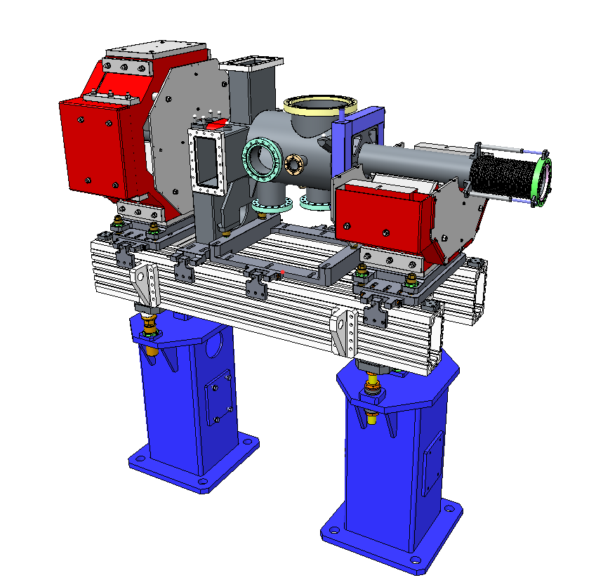
Typical LWU Design
Quadrupole Magnets
Low Particulate Chamber
- ISO 5 or better
BPM on entrance or exit
Aluminium slotted girder
Fiducials, laser tracker alignment
-100µm Accuracy
Semi–kinematic
girder adjustment
Built in lifting points
Pedestals

Slide 9
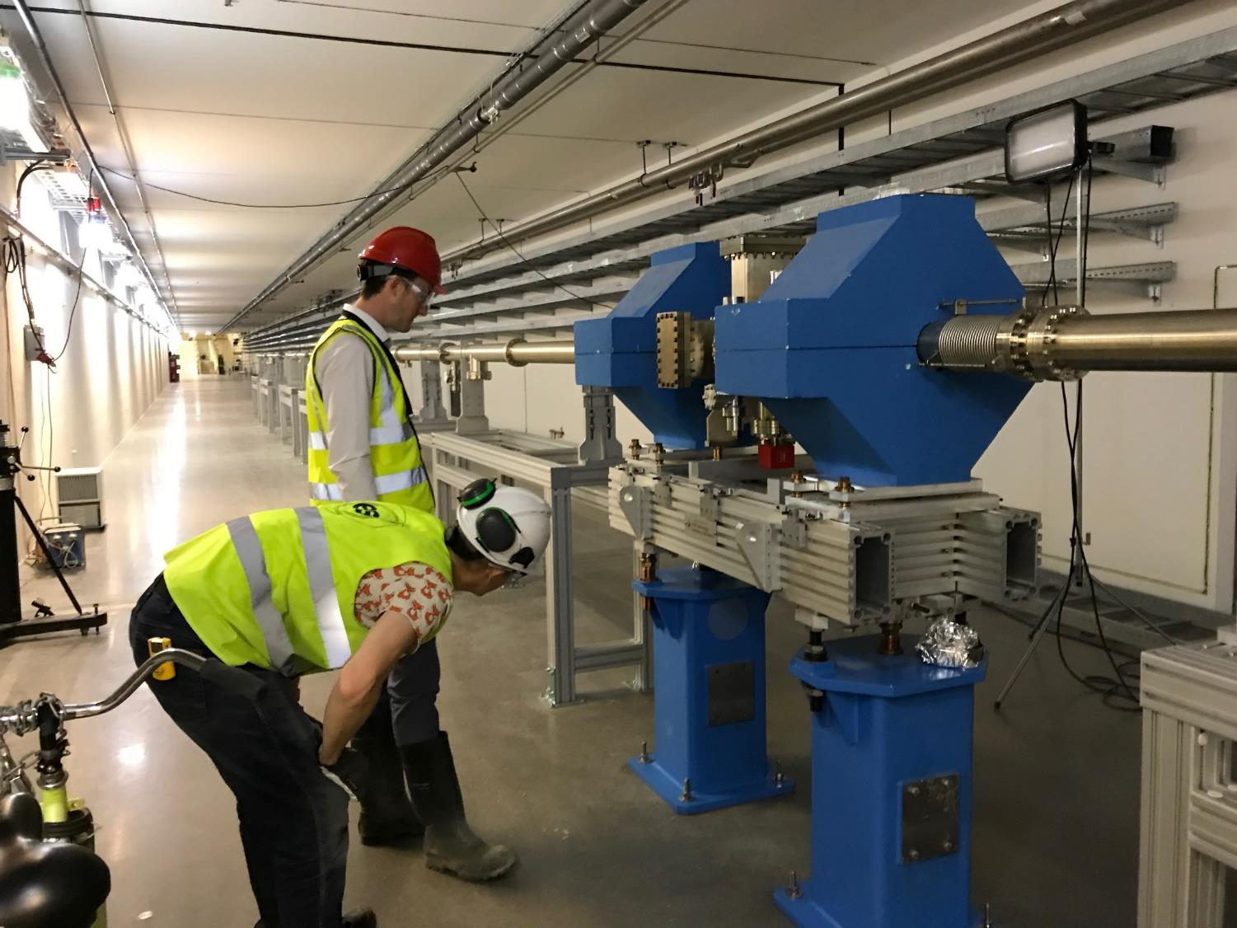
2 LWU Prototypes delivered
Notes:
One unit in the tunnel and one at the RATS storage facility

Slide 10

BTM WP Scope
To design, procurement and assemble;
  2 Prototypes
  52 Dummy Cryo Modules
  74 Linac Warm Units
  3 Differential pumping systems
  4 mobile installation cleanrooms
Notes:
Over the next four years we have been asked to delivery …

Slide 11
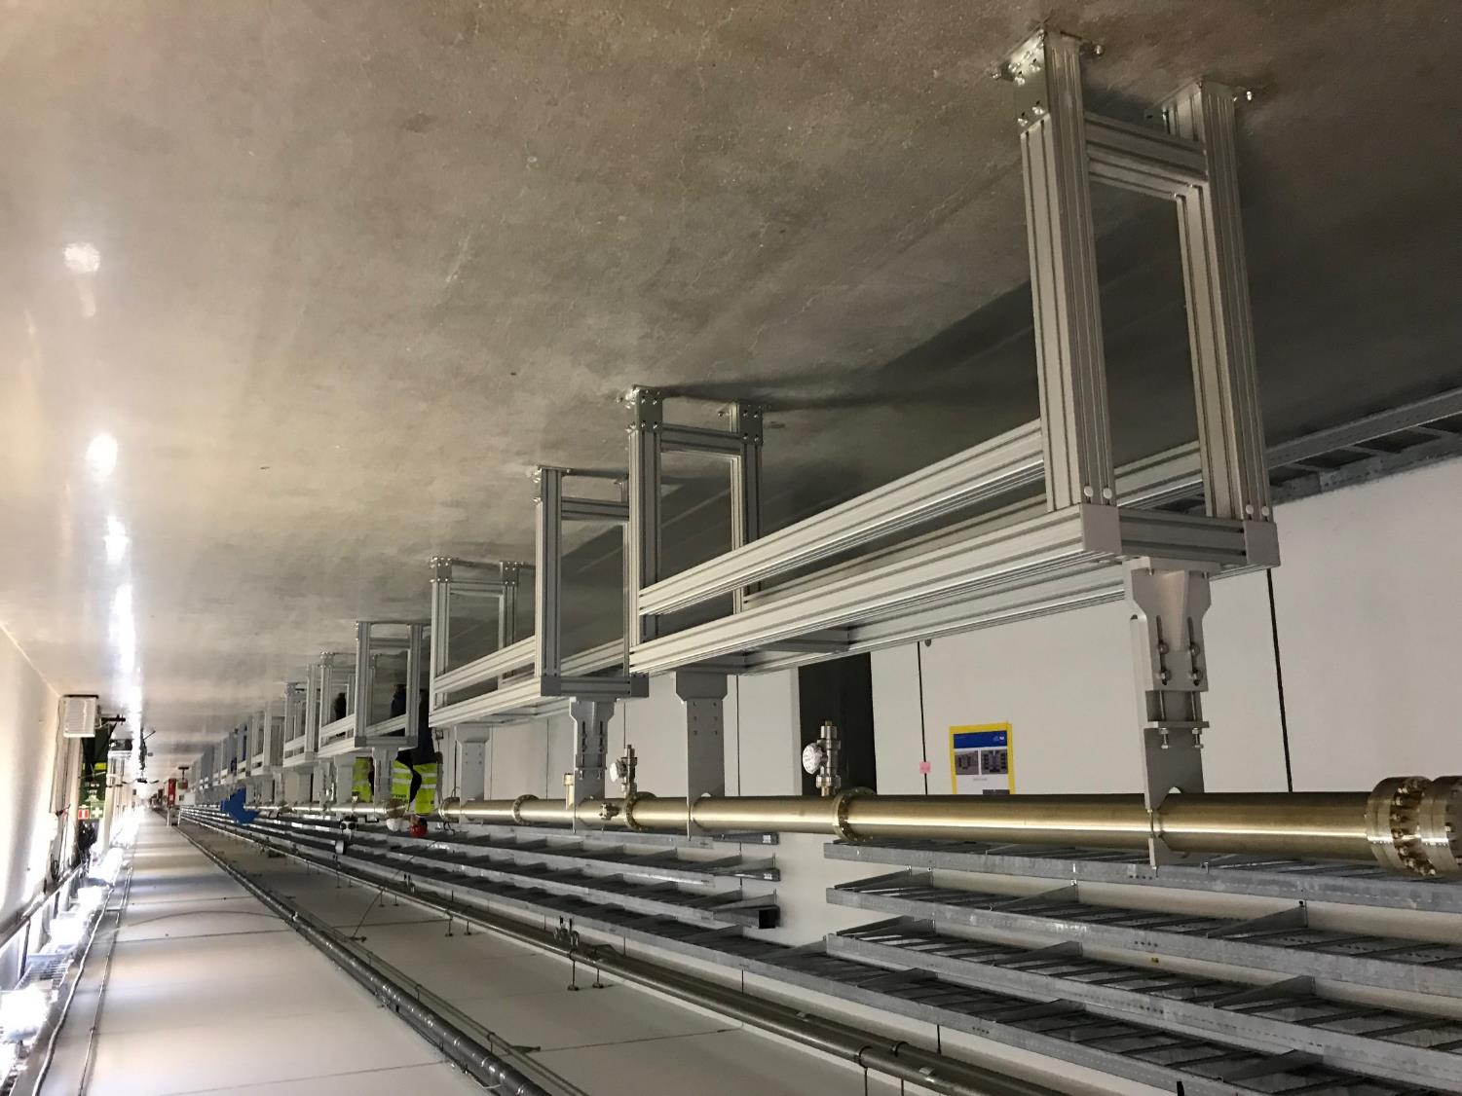
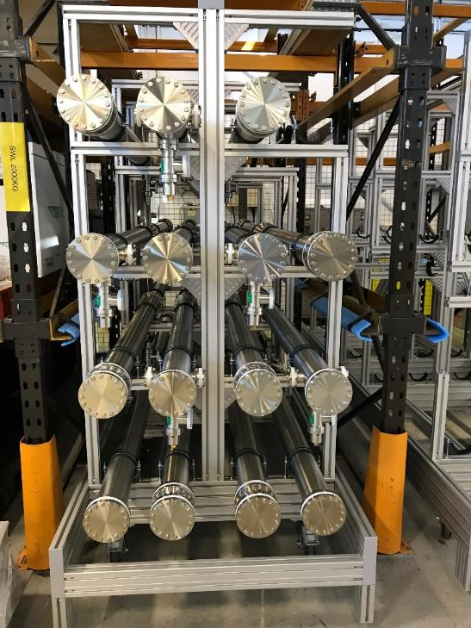
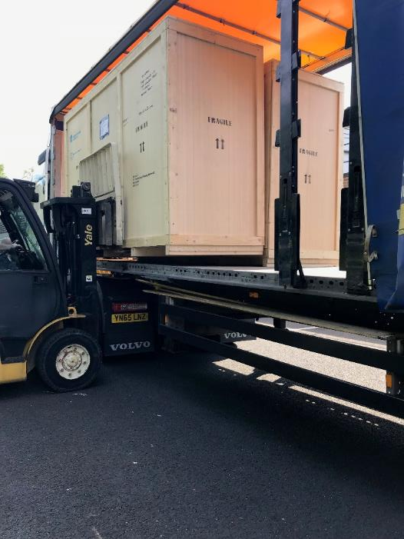
22 DCM (6 metre) + all stands delivered
Notes:
All stands for the tunnel have been delivered

Slide 12
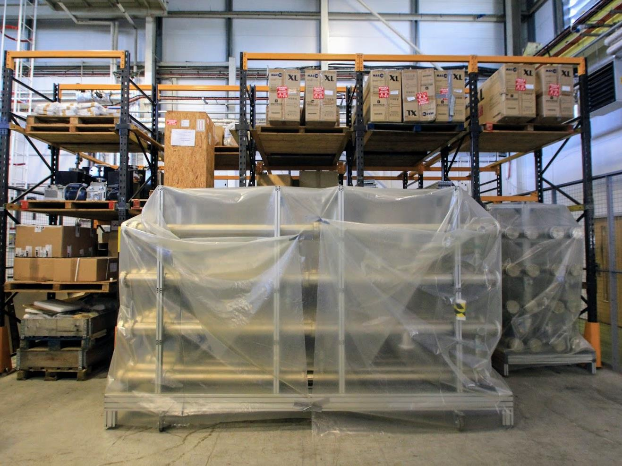
12 more DCM ready to ship

Slide 13
BTM WP Scope
To design, procurement and assemble;
  2 Prototypes
  52 Dummy Cryo Modules
  74 Linac Warm Units
  3 Differential pumping systems
  4 mobile installation cleanrooms
Notes:
Over the next four years we have been asked to delivery …

Slide 14
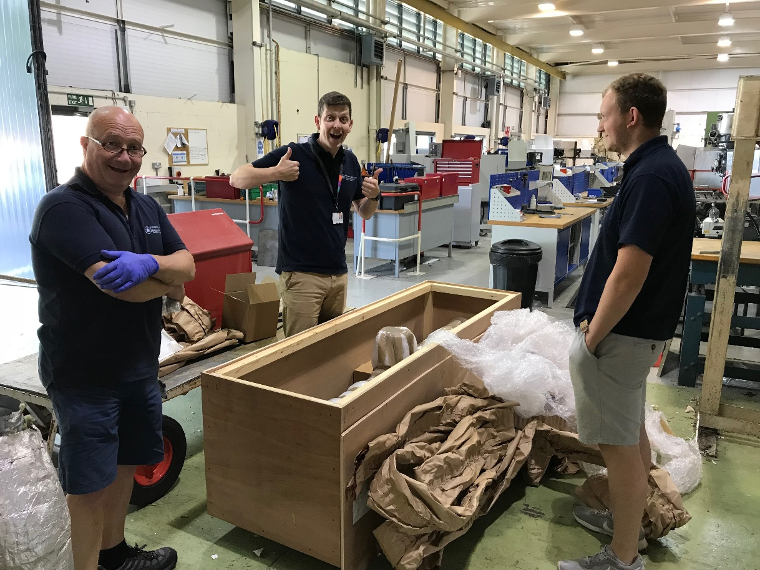
First elliptical vessels received at STFC…
Notes:
Vessels from two different suppliers, ITL and Kurt J Lesker

Slide 15
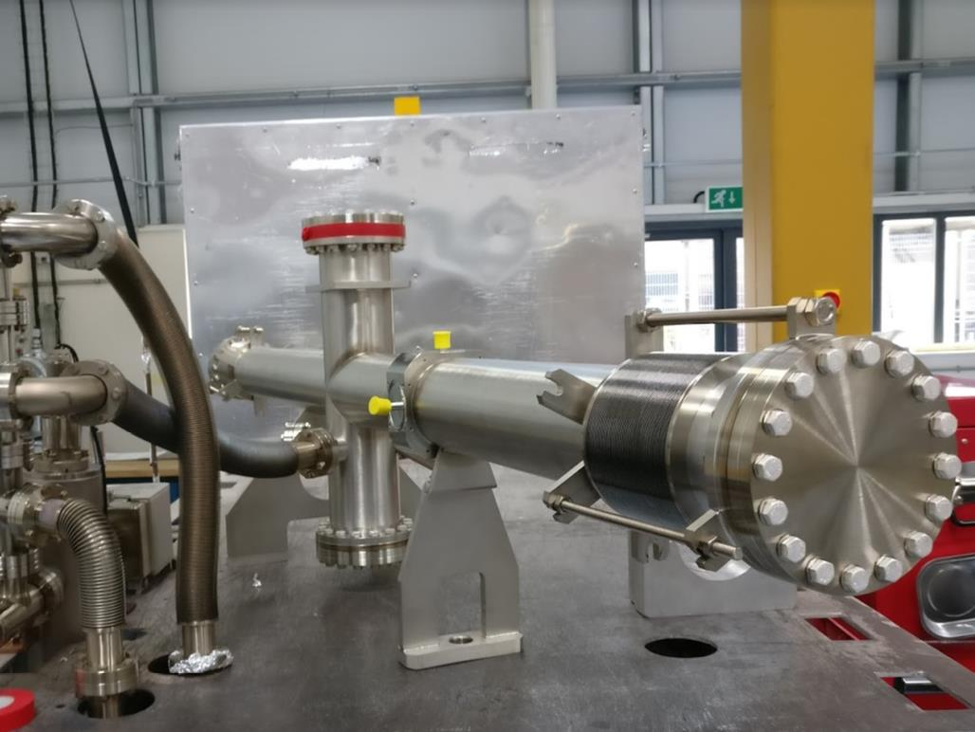
…cleaned, baked and vacuum tested…
… to discover they leaked!

Slide 16
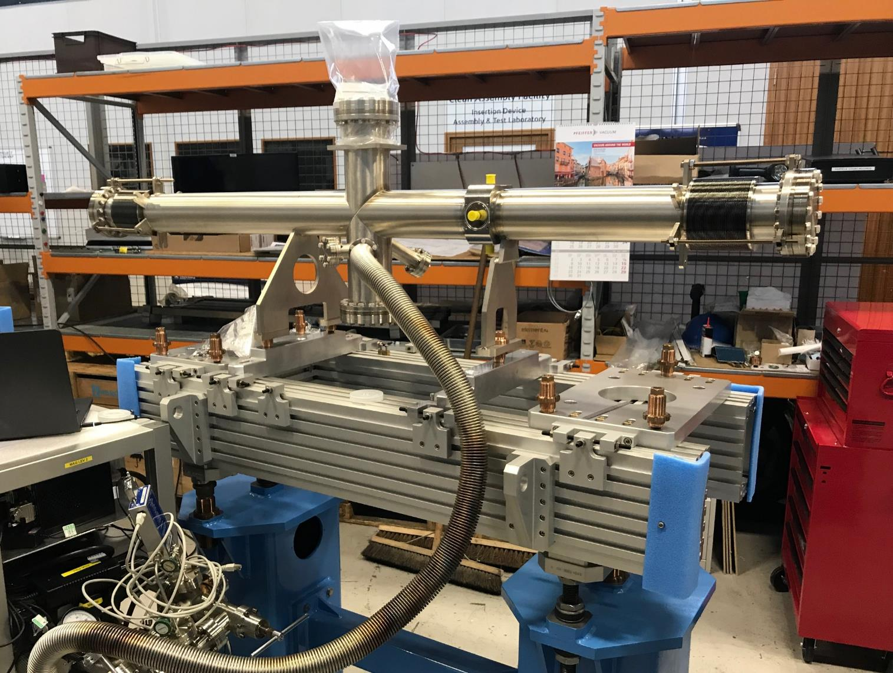
However, not at the BPM region
(Issues are identifiable and fixable)
Notes:
Leaks discovered on the upper flange weld on one vessel…. And bellows on another. This was due to poor bracing on the bellows during transit (lessons learned).

Slide 17
BTM WP Scope
LWU Milestones
Date | LWUs
26/01/2019 | 1
25/07/2019 | 30
21/01/2020 | 27
19/07/2020 | 16
First Magnet pair not due until Jan
Notes:
Over the next four years we have been asked to delivery …

Slide 18
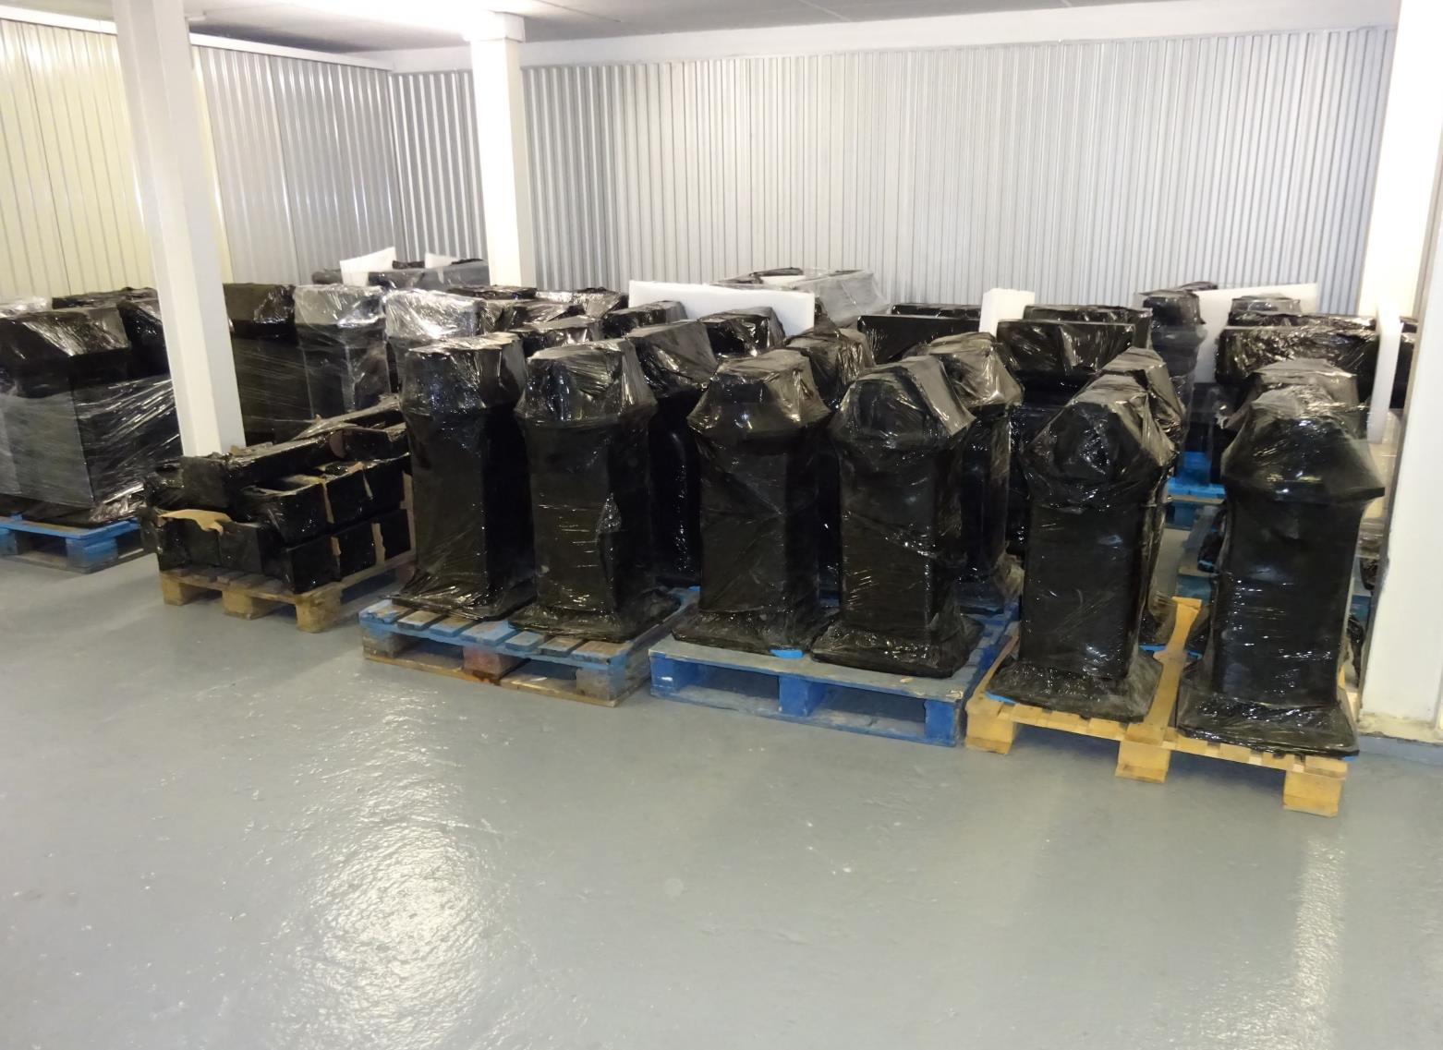
However, not at the BPM region
(lessons to be learned!)
All LWU pedestals manufactured
Notes:
Ready to be shipped, to be delivered Jan/Feb

Slide 19
BTM WP Scope
To design, procurement and assemble;
  2 Prototypes
  52 Dummy Cryo Modules
  74 Linac Warm Units
  3 Differential pumping systems
  4 mobile installation cleanrooms
Notes:
Over the next four years we have been asked to delivery …

Slide 20
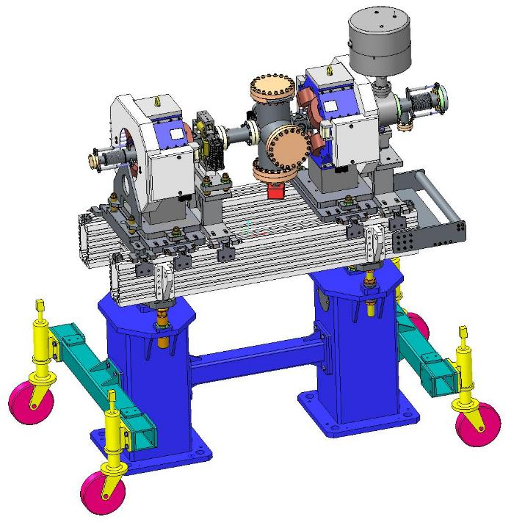
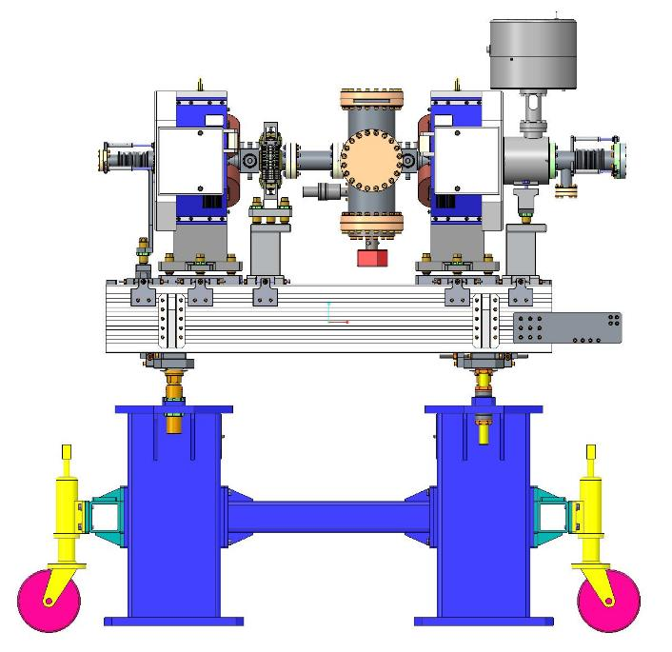
Differential Pumping Sections
Low energy pumping system
Notes:
Designs for the differential pumping stations are complete and ready to order

Slide 21
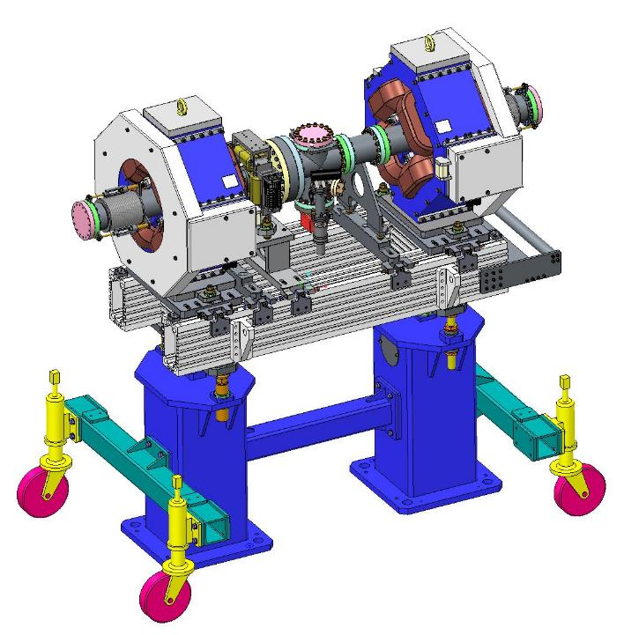
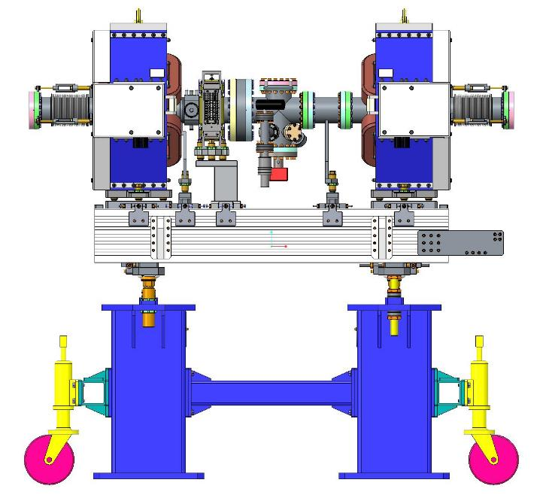
Differential Pumping Sections
High energy pumping system
Notes:
Designs for the differential pumping stations are complete and ready to order

Slide 22
BTM WP Scope
To design, procurement and assemble;
  2 Prototypes
  52 Dummy Cryo Modules
  74 Linac Warm Units
  3 Differential pumping systems
  4 mobile installation cleanrooms

Slide 23
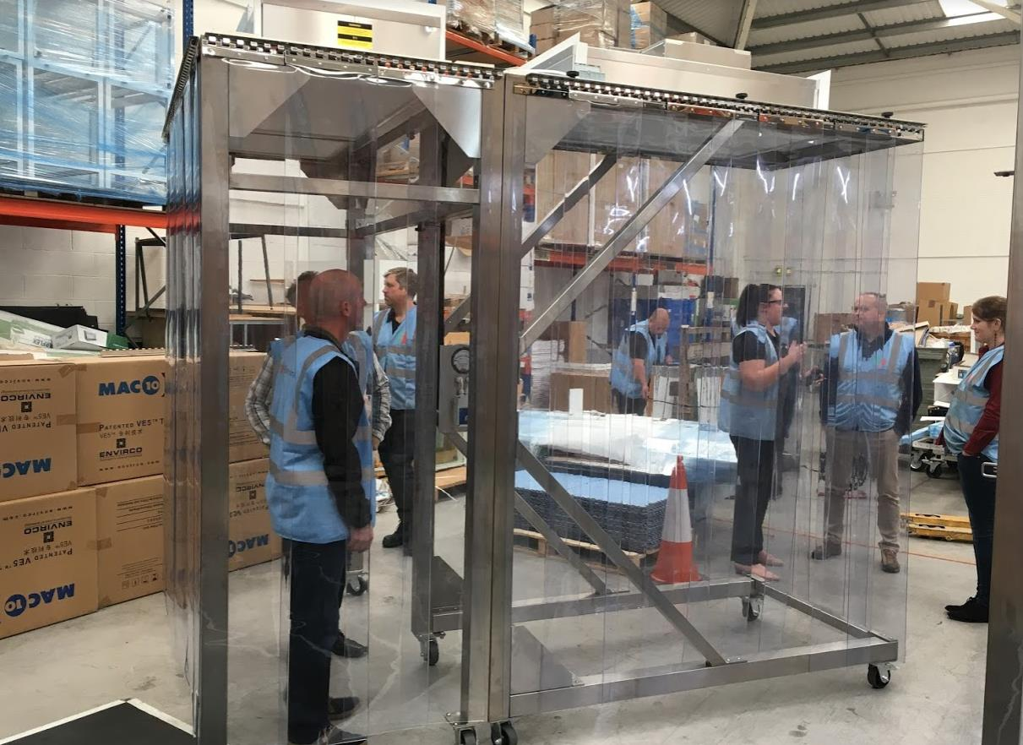
2 Mobile cleanrooms delivered…
…2 more before year end
However, not at the BPM region
(lessons to be learned!)
All LWU pedestals manufactured
Notes:
Two clean rooms have been delivered.. One is at the RATS storage facility and one is ready to be unboxed and signed off this week

Slide 24
Schedule

Slide 25
Schedule
2015 | 2016 | 2017 | 2018 | 2019 | 2020
BTM Design
Tunnel available (May 2017)
Prototype 1
LWU by
March 2020
Prototype 2
CDR
CDR 2
Magnet Deliveries
BPM Deliveries
BTM Assembly
BP Assembly
LWU Assembly
Installation Cleanrooms
Prototype Cleanrooms

Slide 26
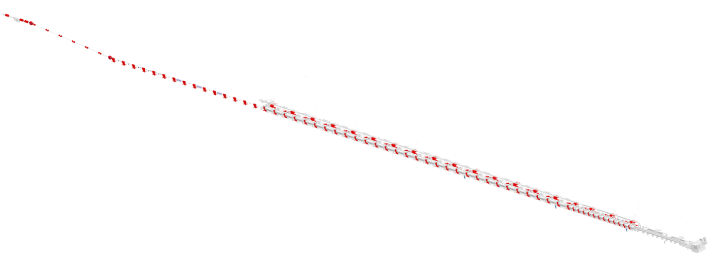
Overview
Differential Pumping System
Beam Pipe
LWUs & Beam Pipe
LWUs & Beam Pipe
LWUs & Beam Pipe
Differential Pumping System
LWUs
LWUs
Notes:
What STFC are delivering

Slide 27
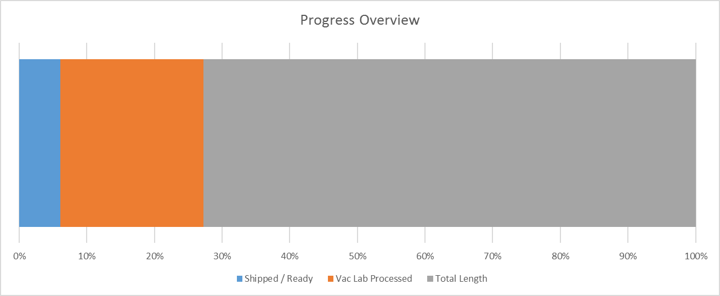
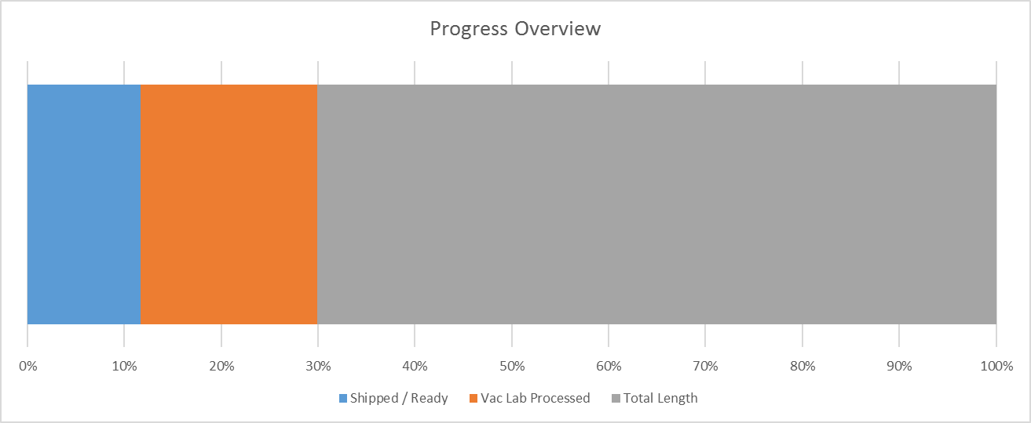
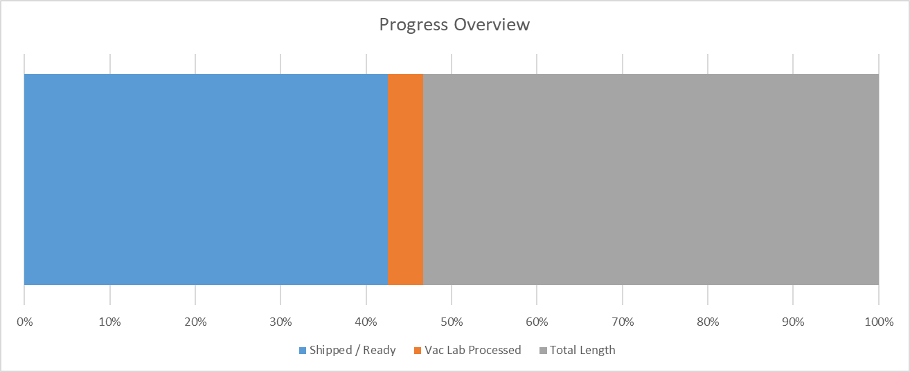
Progress
Total length to process 480m
Total shipped 204m (42.5%)
Notes:
Progress by length

Slide 28
Milestones in TA
Deliverables | Final Delivery Deadline
ESS Vacuum Laboratory consisting of (see Chapter 2.1): [PTF] Particle Test Facility [GCF] Gauge Calibration Facility [OGF] Outgassing Facility [VIF] Vacuum Integration Facility technical data as specified in [PTF], [GCF], [OGF], [VIF] | 01 July 2015
Relevant Technical data package for PDR. See 4.4.2.1 | 2015 (Pre-PDR)
Qty 3 x Dummy Test Chambers | March 2016
Qty 1 x 1st Prototype | June 2016
Qty 1 x 2nd Prototype | August 2016
Technical data package as specified for 1st CDR. See 4.4.2.2 | CDR, June 2016
Technical data package as specified for 2st CDR. See 4.4.2.2 | CDR, July 2018
Qty 3 x Mobile Clean Rooms | July 2018
Qty 57 x Beam Pipe Units | July 2019
Qty 71 x LWUs | April 2020
Qty 2 x Differential Pumping Systems | April 2020
Qty 2 x Dipole Chambers | April 2020
Technical data package as specified for SAR. See 4.4.3.2. | SAR, minus 5 weeks
Delivery of Final Report and documentation package for Supply. See 4.4.5 and 4.4.6 | 31 December 2020
Vacuum Technician Support during installation at STFC site. See 4.1.2.1.6 | 2018-2019, dates to be agreed

Slide 29
ESS visit
Notes:
In September we welcomed some of the ESS vacuum group for 3 weeks

Slide 30
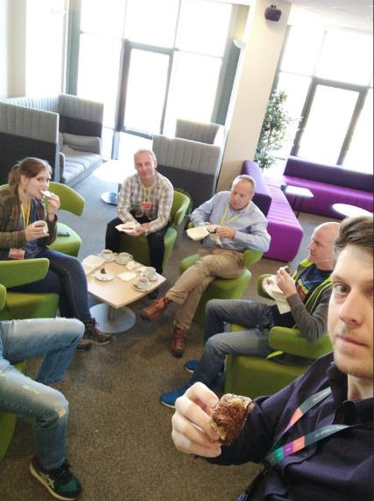
ESS Visit - Deliverable
Extremely productive three weeks:
  Design reviews
  Mobile Cleanroom sign off
  Vacuum assembly work
  Mechanical Assembly work
  Cleanroom operation
  Flange assembly discussions
  Plus some rather enjoyable social events

Slide 31
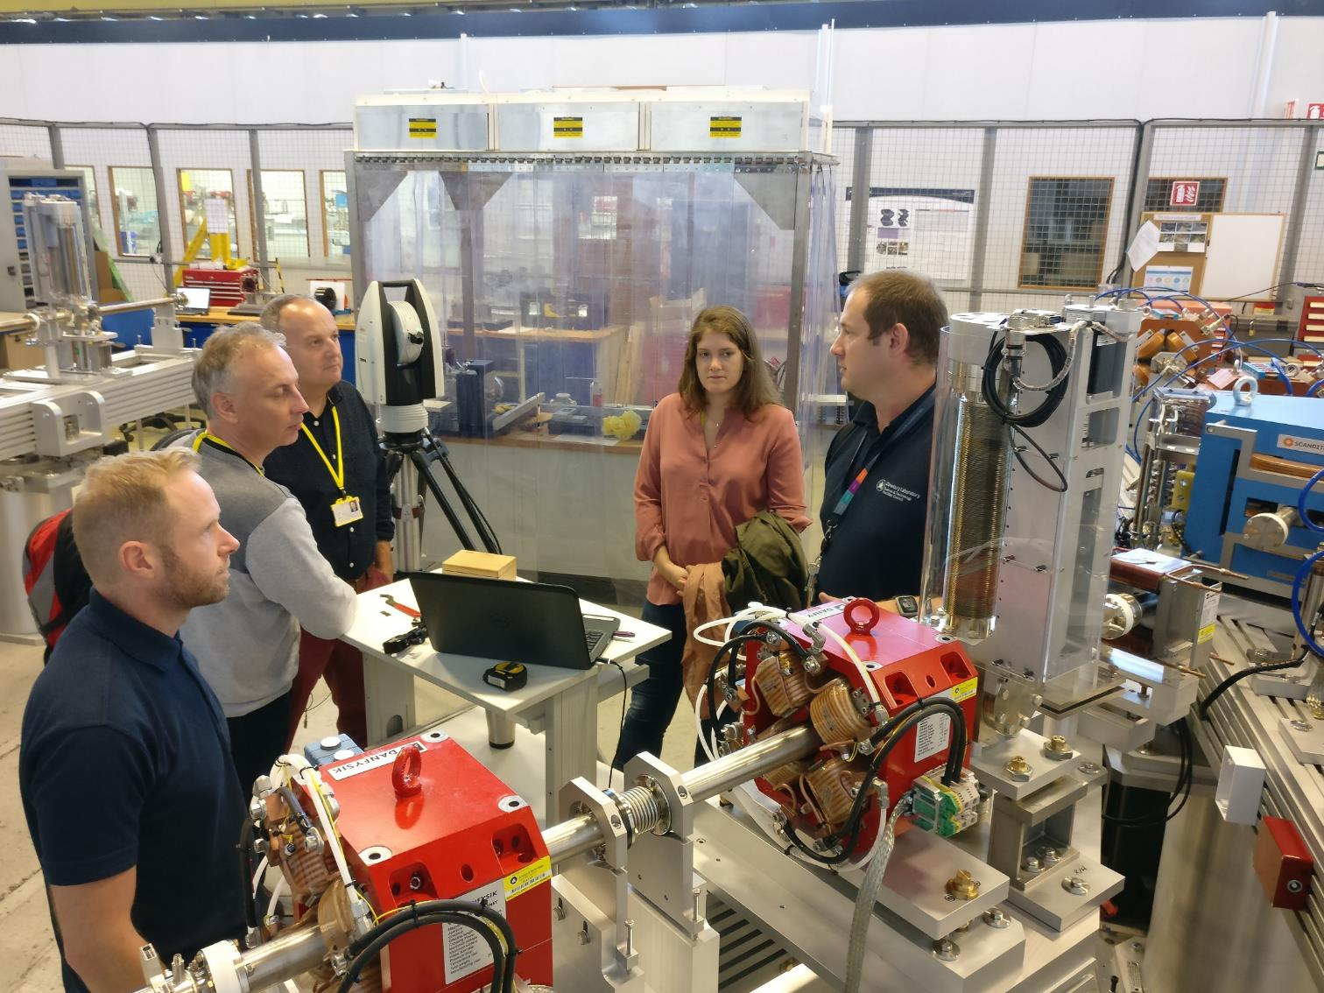
ESS Visit to STFC
Notes:
Fabio, Kristell and Ralf from ESS vacuum group discussing survey and alignment of the magnets and LWU’s with Ryan. Using a module from Daresbury’s compact linear accelerator as an example.

Slide 32
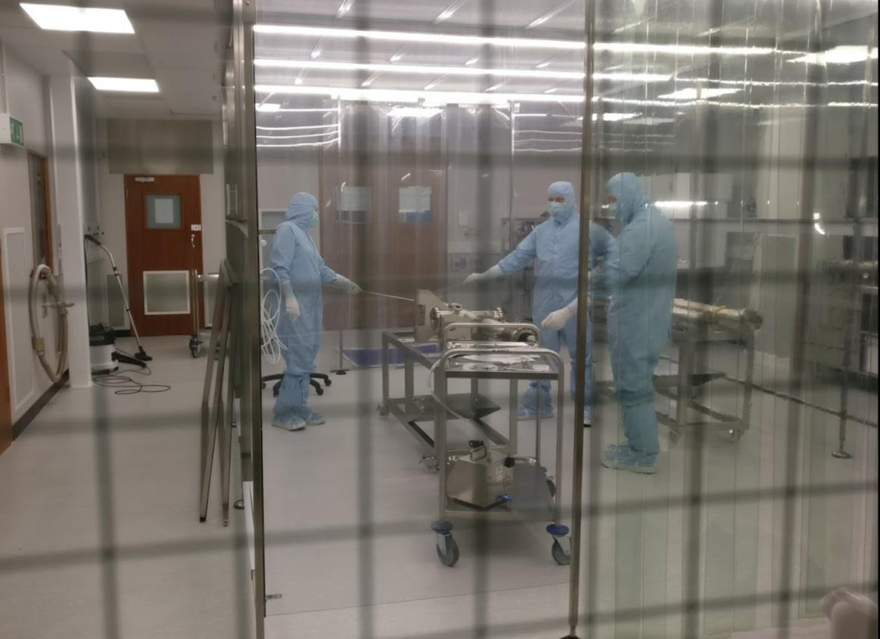
ESS Vacuum Group in the STFC Cleanrooms
Notes:
The team from ESS was shown the procedure for cleaning and particle counting the vessels in the clean room. Operates at ISO 3 class (static) Kristell is using a lance to blow filtered nitrogen into the vessel and Tom is positioning the counter head near the exit.

Slide 33
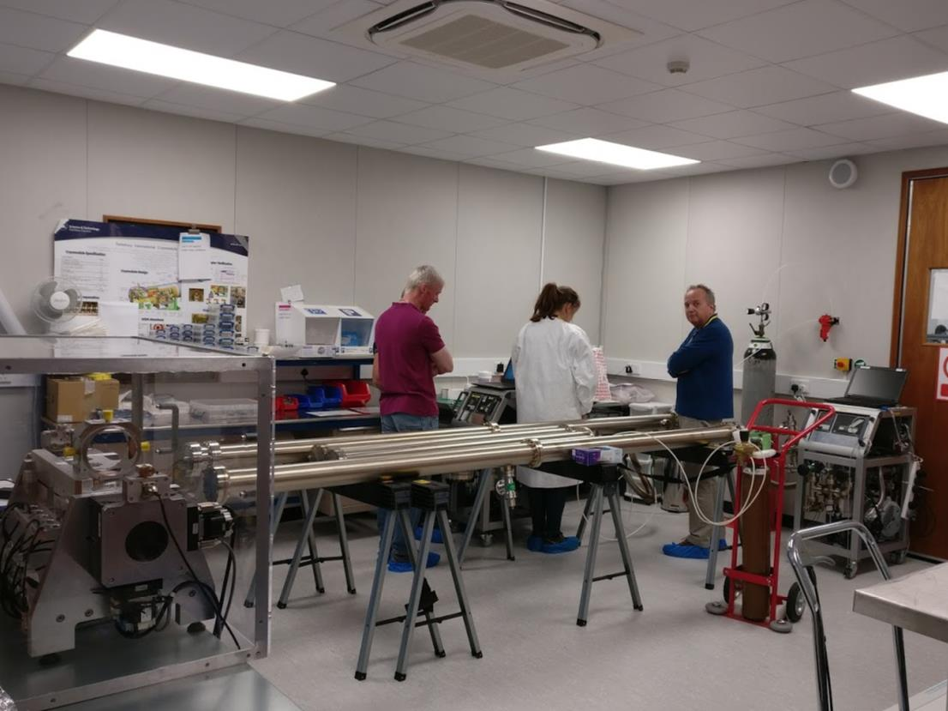
Vacuum Group in the clean assembly area
Notes:
Assembly procedures

Slide 34
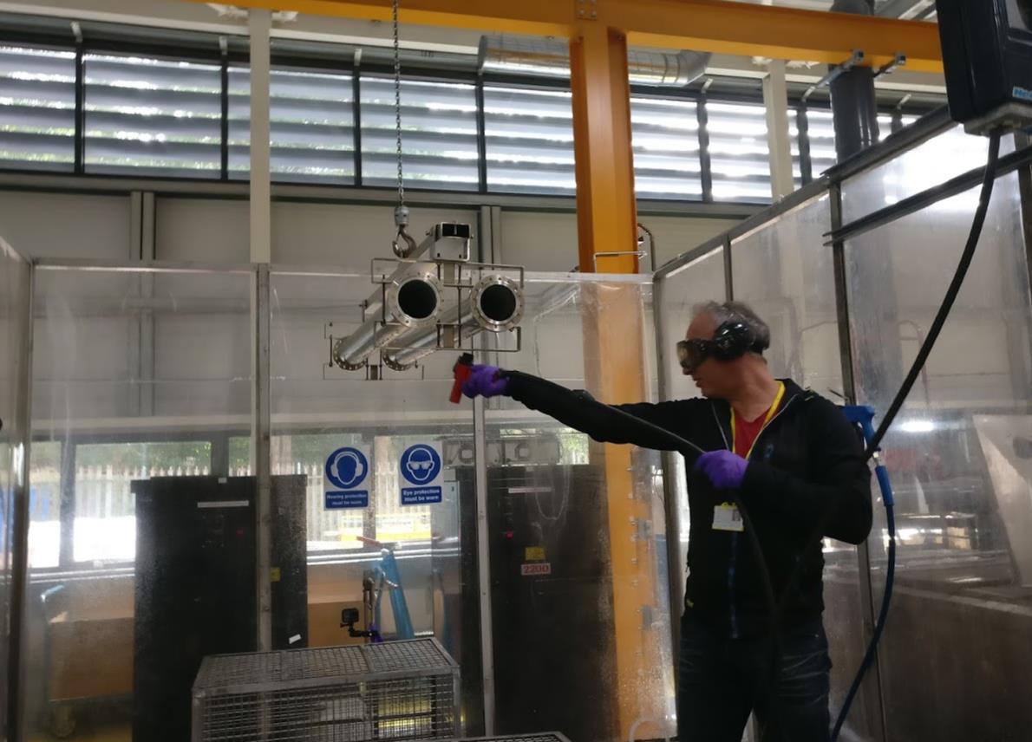
Vac Lab Processing procedures
Notes:
Initial cleaning phase once the vessels are received from the manufacturer. Years of vacuum cleaning expertise at Daresbury has enabled the process to be refined.

Slide 35
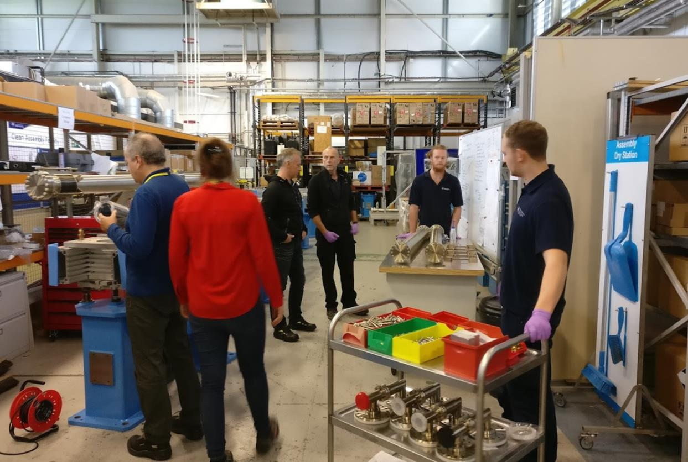
ETC LWU Mechanical Build
Notes:
The vacuum team from ESS were shown how to assemble a complete LWU from the ground up.

Slide 36
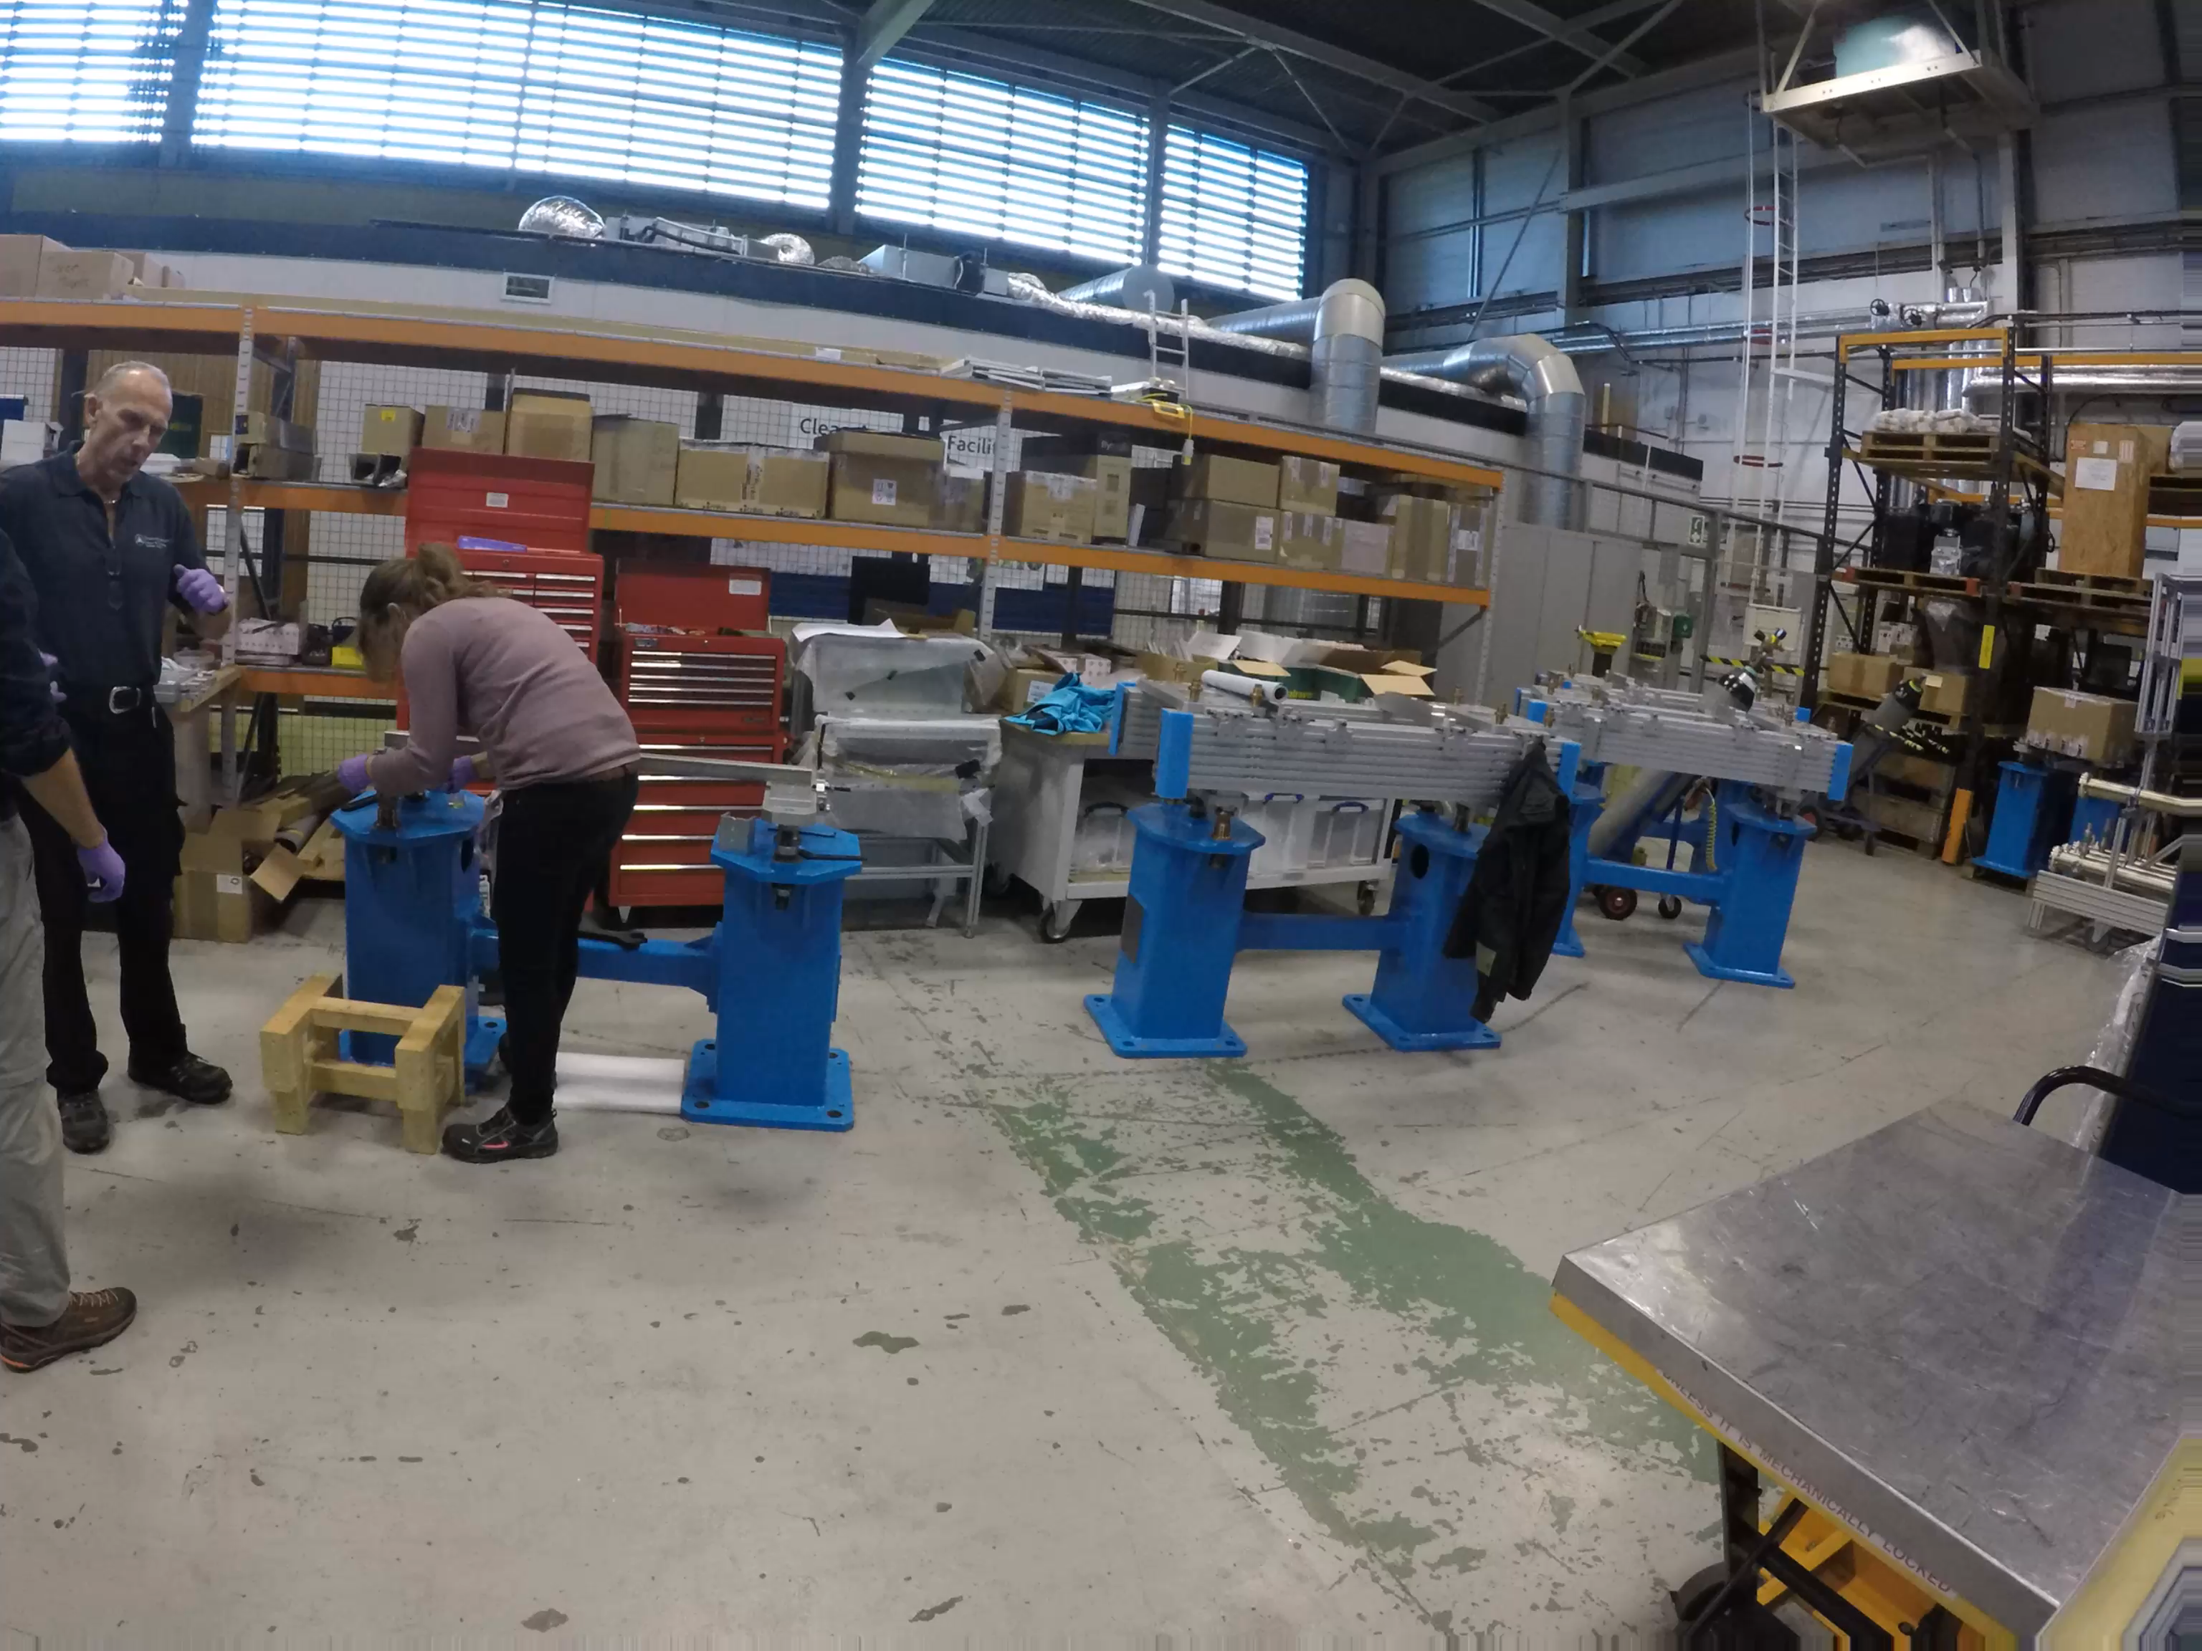
Notes:
Snapshot of Fabio and Kristell assembling the support structure for the LWU and preparing an LWU for processing.

Slide 37
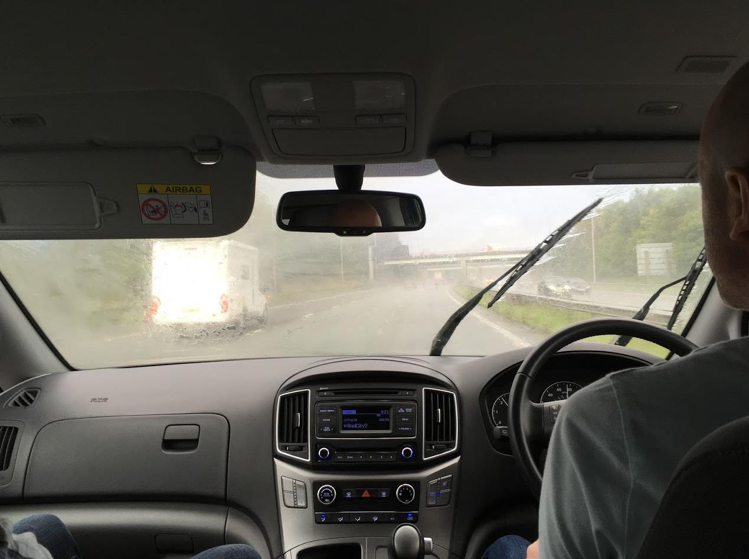

Sampled the Great British Weather
Notes:
No trip to the UK is complete without sampling the fine British weather.

Slide 38
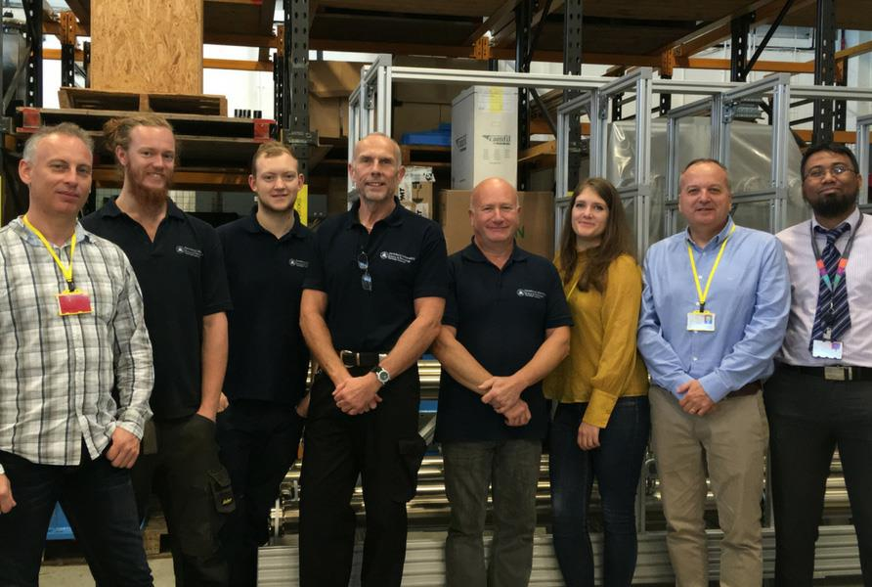
Knowledge transfer between teams
Notes:
The Daresbury technicians are going to spend time with ESS vacuum group at ESS

Slide 39
LWU to cryo-module connection

Slide 40
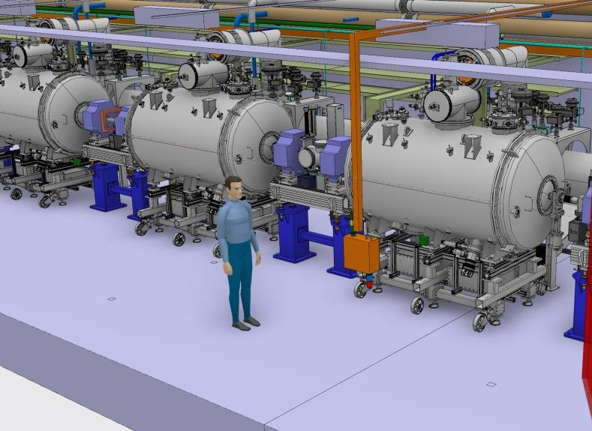
LWU to Cryo-module bellows connection
Notes:
STFC have put a lot of though into finding the optimal method of connecting the two modules that limits particulate generation that could contaminate the accelerator.

Slide 41
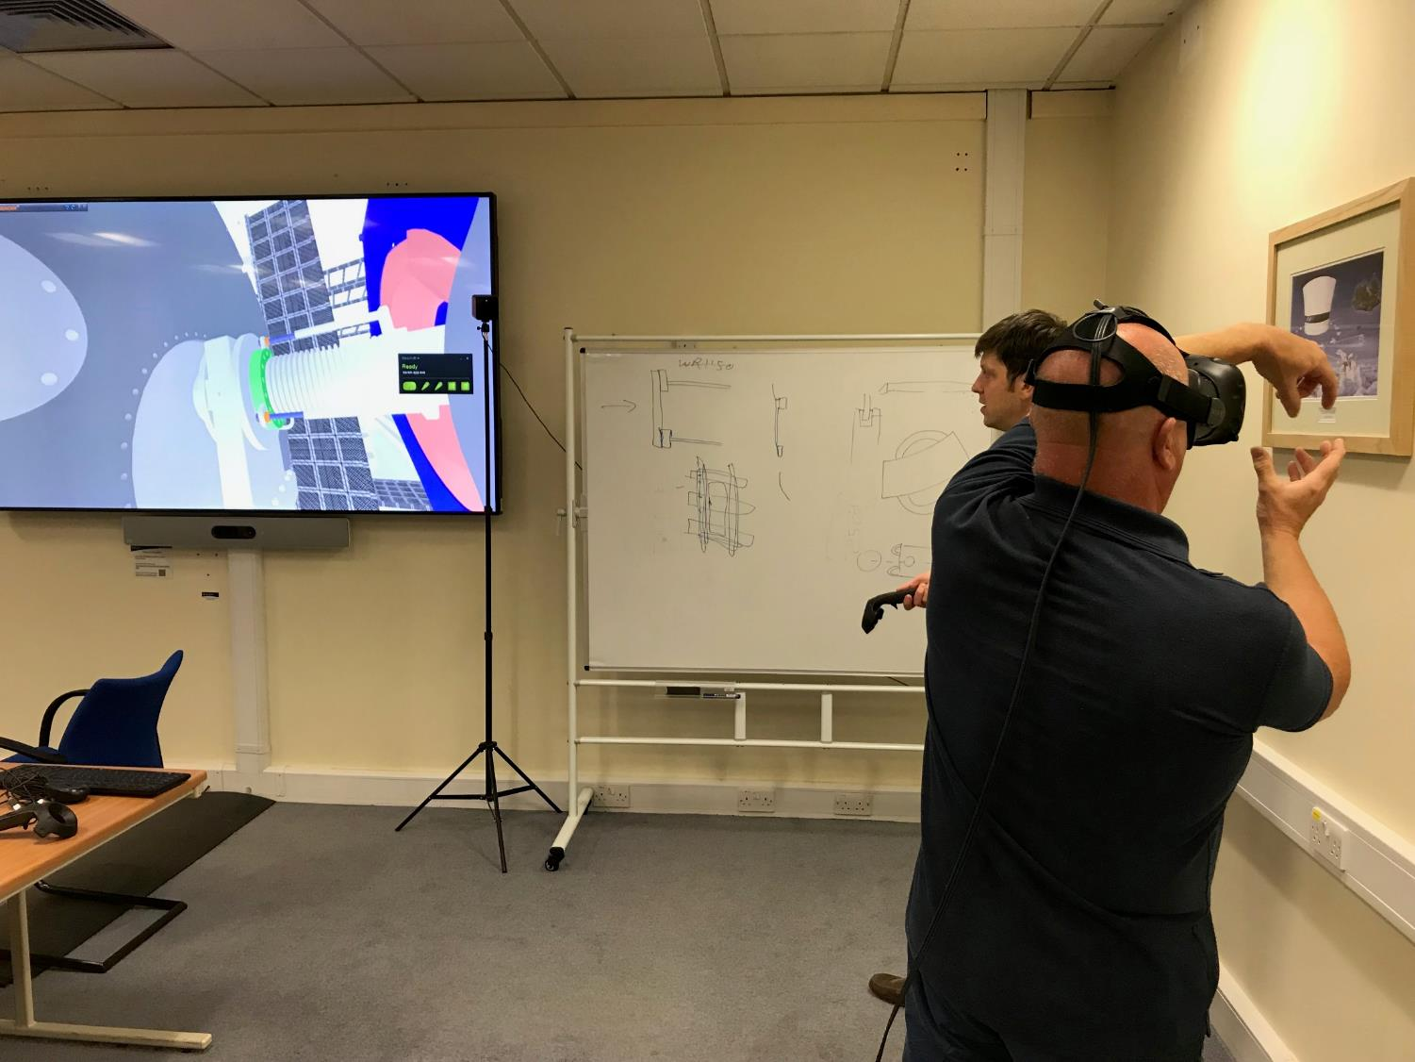
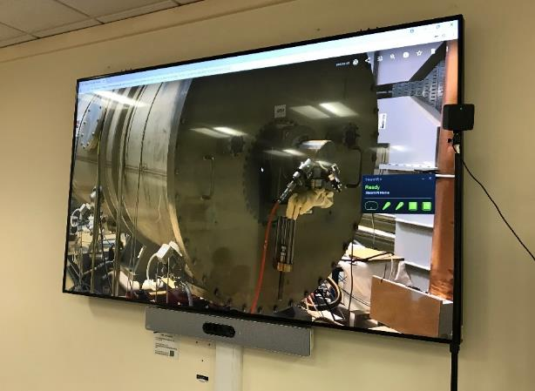
Using VR to view LWU to Cryo-module
Notes:
STFC technicians visualising the bellows to cryo-module connection in VR and the limited room to manoeuvre

Slide 42
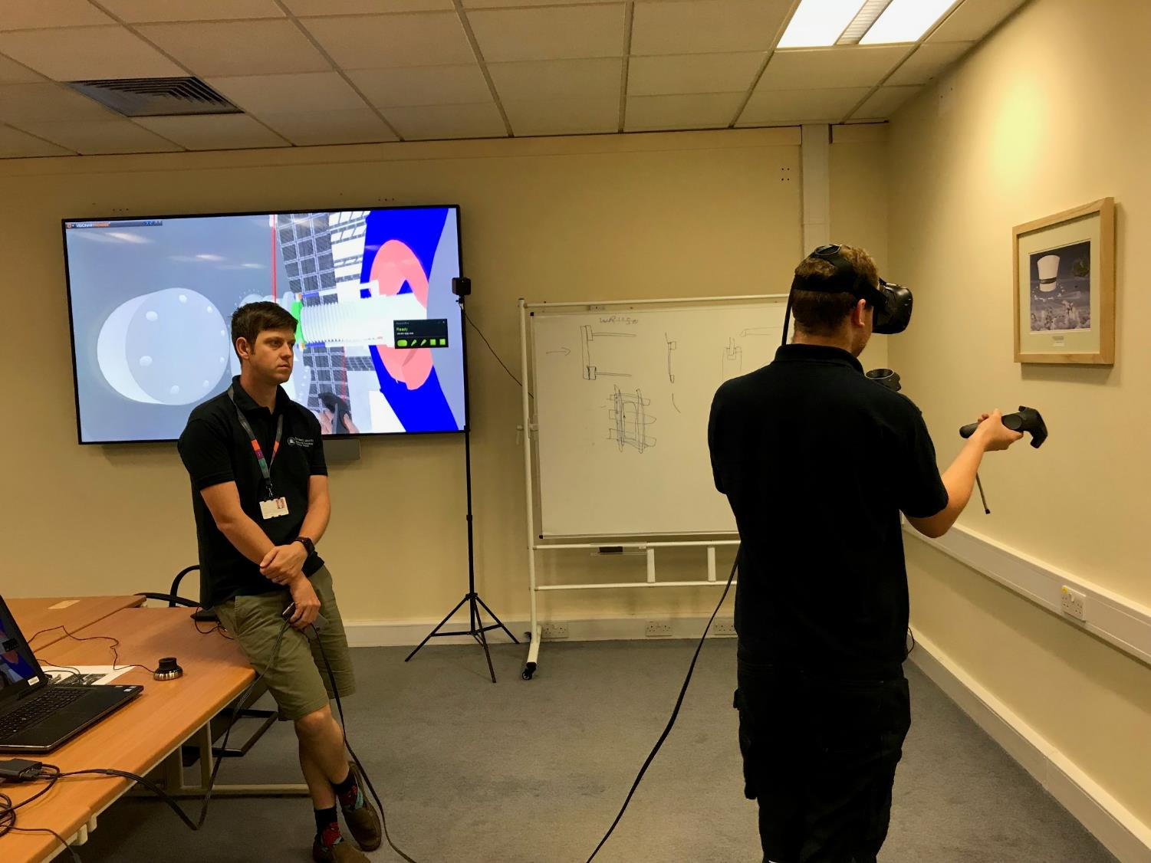
Using VR to view LWU to Cryo-module

Slide 43
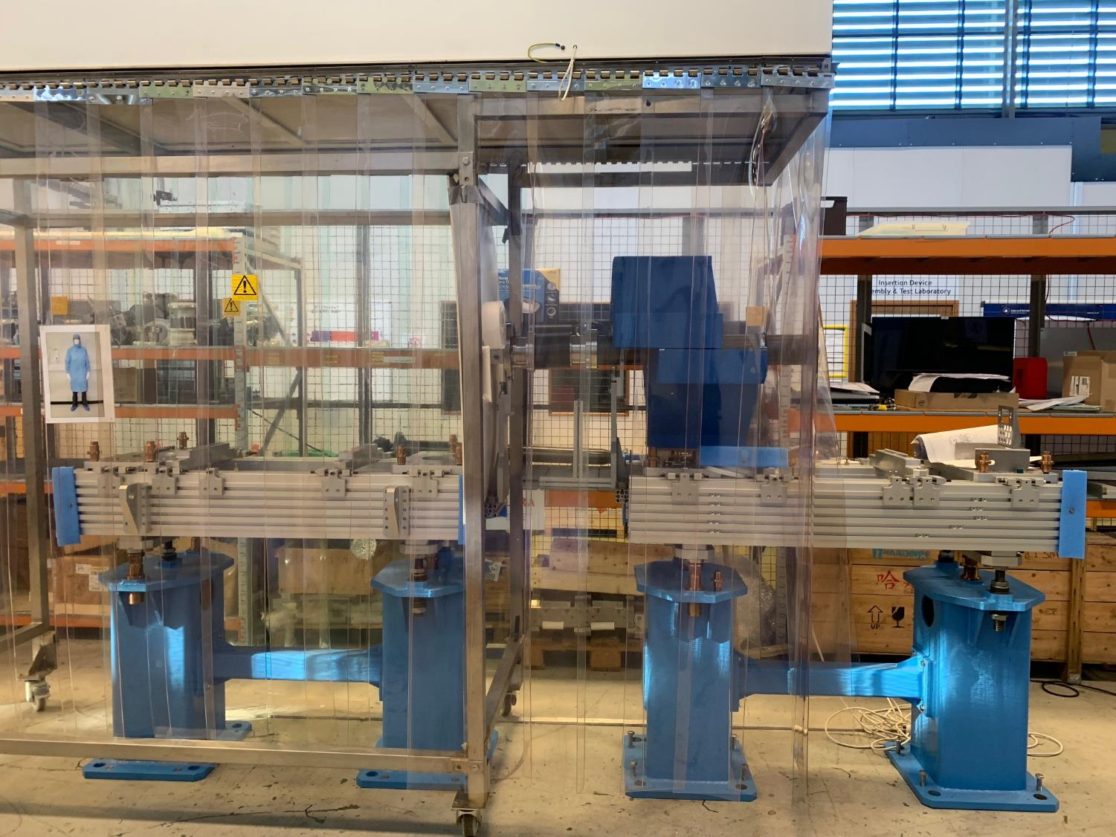
LWU to Cryo-module mock-up
Notes:
We created a physical mock-up of the connection to allow us to trial different methods and tooling that would help create a low particulate vacuum connection

Slide 44
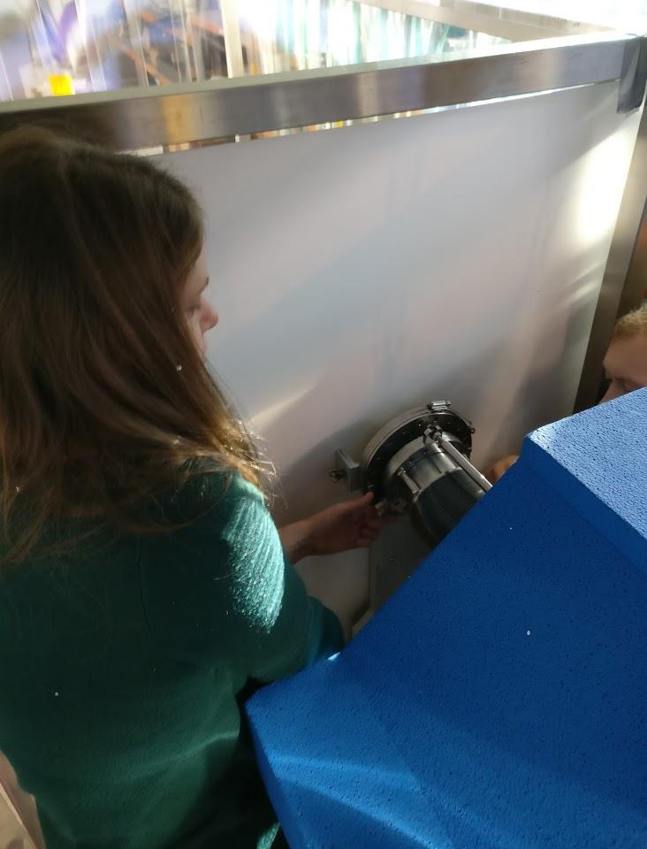
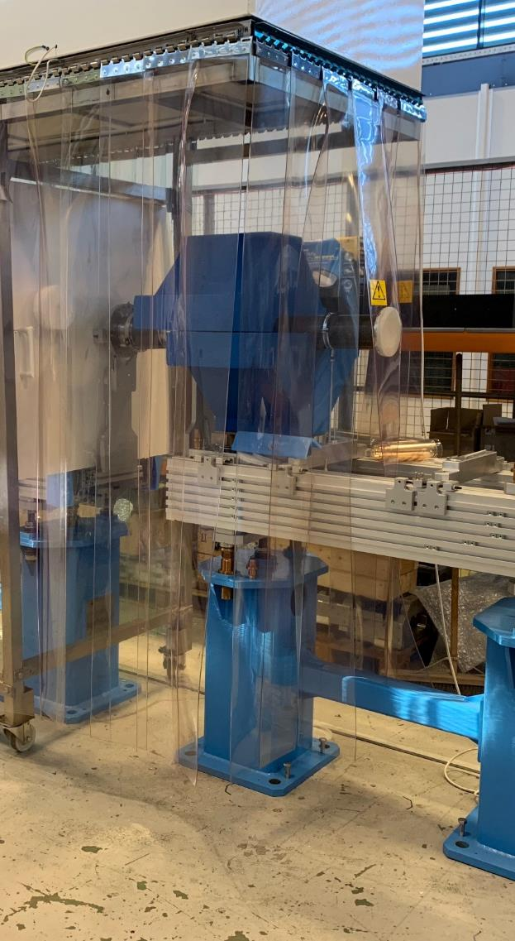
LWU to Cryo-module - tests ongoing
Notes:
The vacuum team from ESS also took part in some of the trials… this work is ongoing (XYZ table to be tested soon)

Slide 45
Shock and vibration accelerometer logger

Slide 46
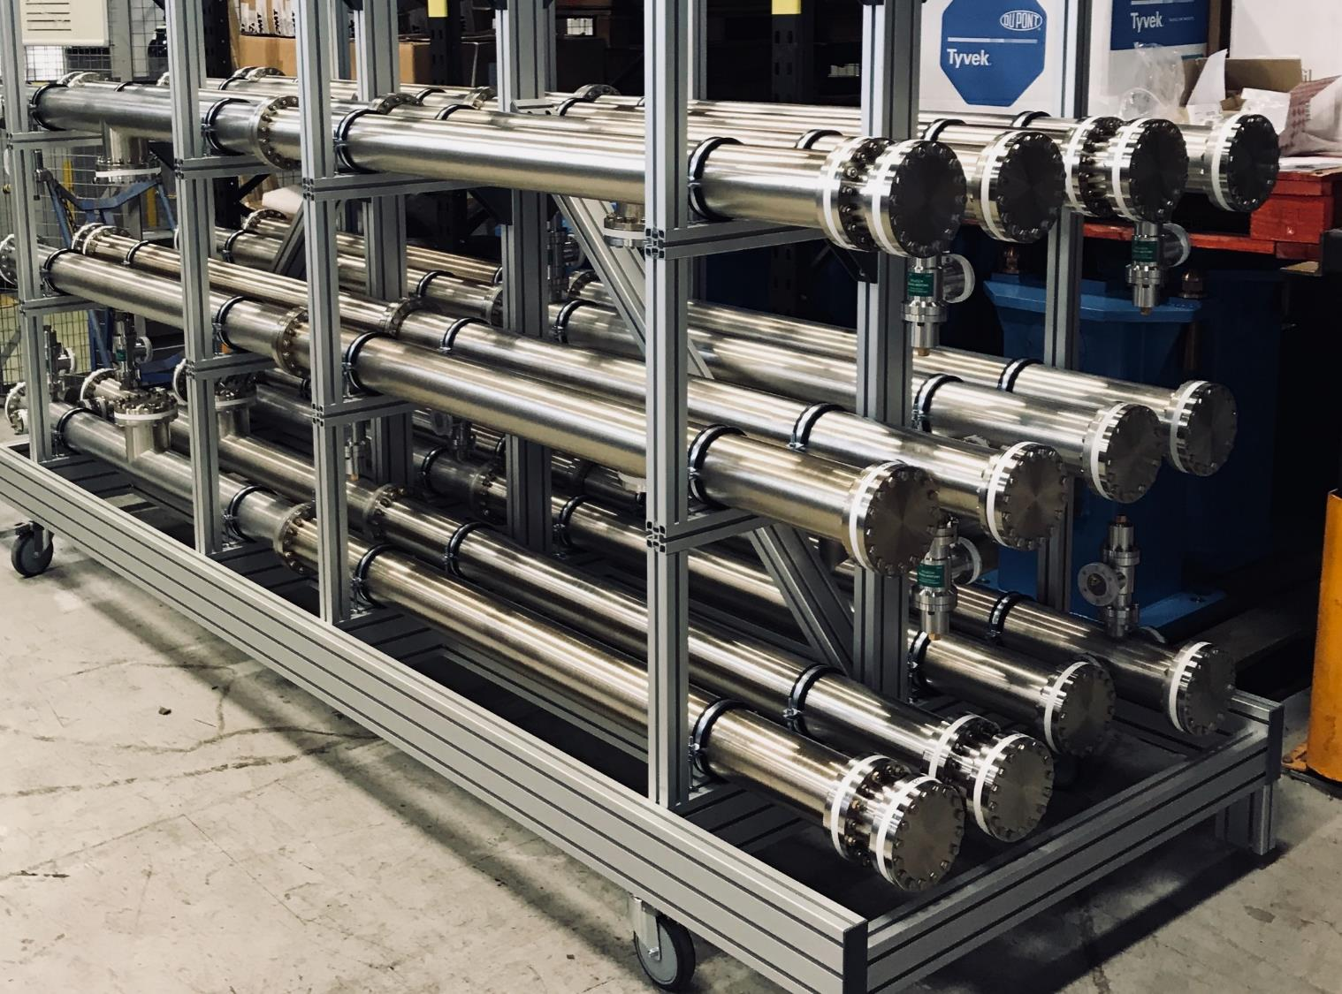
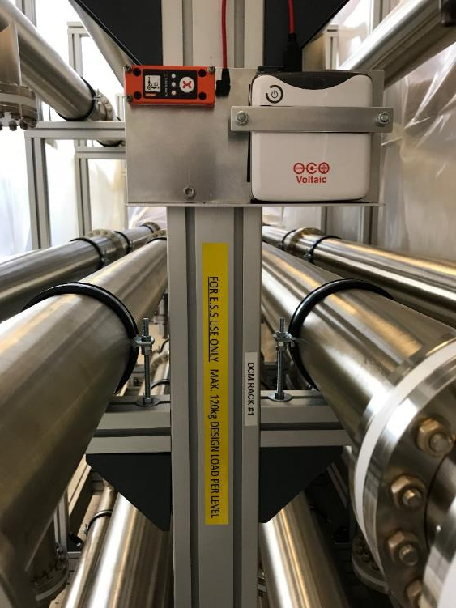
Shock and vibration accelerometer logger
Notes:
We fitted a SLAM stick on one of the dummy cryo-module racks before it was shipped to ESS and recorded the shock and vibration data during its journey. This helps us determine what conditions to expect when shipping more sensitive equipment that may be on the LWU’s and provide additional bracing to potentially unstable loads (magnets)

Slide 47
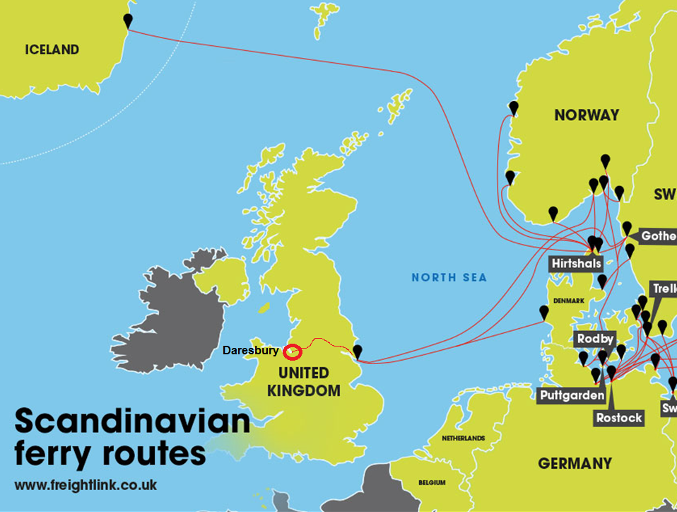
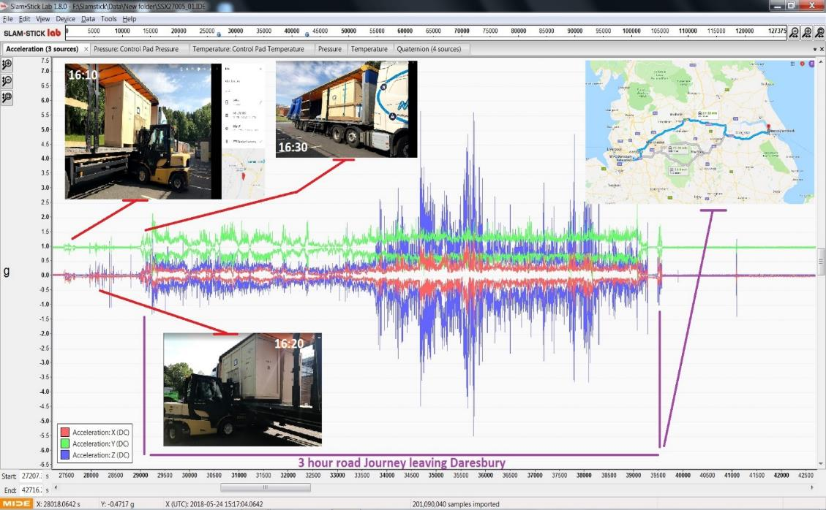
Notes:
Events in the first 3 hours of its journey from Daresbury laboratory.. Loading, smooth motorways and smaller windy roads before waiting at the port in Hull

Slide 48
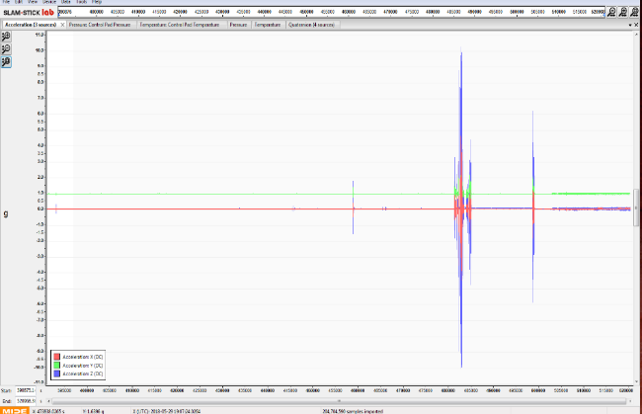
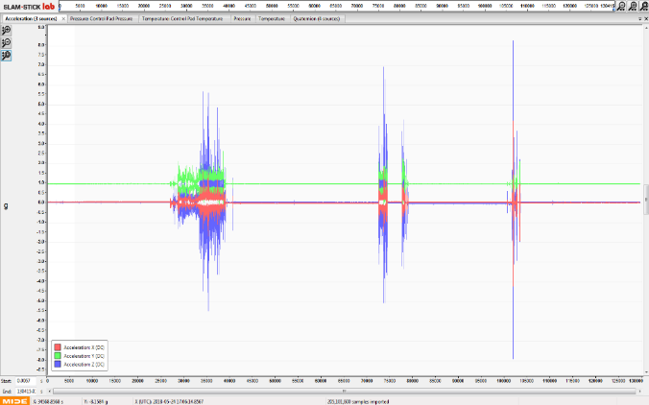
Shock and vibration during transport
Initial observations show some 10G+ shock events.
Possible causes:
  Poor road surface (pot holes)?
  Crates sliding on the trailer bed (insufficient strapping)?
  Handled with limited care at the ports (loading/unloading)?
Notes:
Run the test again with the next batch of DCM’s but utilising a dedicated air ride trailer. No switching to another trailer during transit which doubles the handling and potential chances for damages.

Slide 49
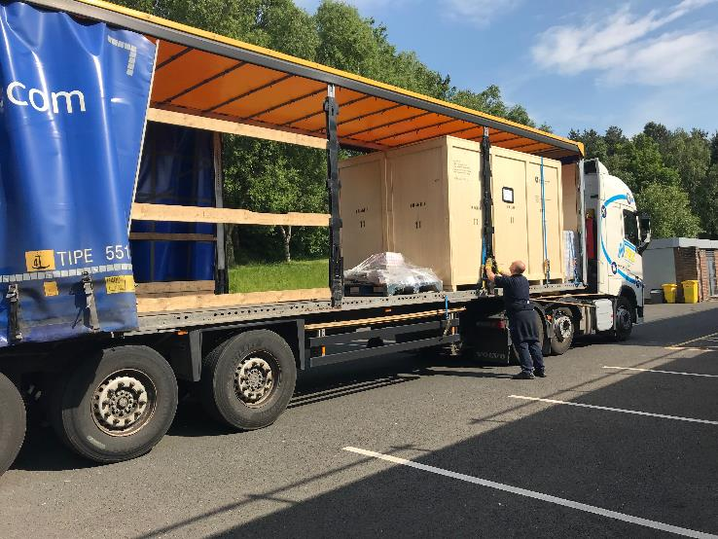

Shock and vibration during transport
Actions and potential solutions
  Re-run the test using ‘air ride’ suspension trailer (DCM’s)
  Same trailer from Daresbury to Lund
  Design temporary bracing (magnets) for transport
Notes:
Run the test again with the next batch of DCM’s but utilising a dedicated air ride trailer. No switching to another trailer during transit which doubles the handling and potential chances for damages. Cavoflex springs successfully used to safely transport accelerator modules from Daresbury to Romania.

Slide 50


Shock and vibration during transport
Damping system in the crate (Cavoflex)
Notes:
Run the test again with the next batch of DCM’s but utilising a dedicated air ride trailer. No switching to another trailer during transit which doubles the handling and potential chances for damages. Cavoflex springs successfully used to safely transport accelerator modules from Daresbury to Romania.

Slide 51

Final summary
Progressing well
First LWU due to be delivered early 2019 (30 to follow)
Pedestals and remaining DCM delivered early 2019
All mobile clean rooms signed off by end of this year
Spending time at IK partners facility highly advisable
Help refine bellows to Cryomodule connection
  *Likewise.. installation methods of interfacing BI?
Transport method to be optimised
240m vessels remain to be processed
A lot of work still to do - busy 2019
Notes:
Run the test again with the next batch of DCM’s but utilising a dedicated air ride trailer. No switching to another trailer during transit which doubles the handling and potential chances for damages.

Slide 52



