Slide 1
Beam Imaging at the
Tuning Dump
Greyson Christoforo
University of Oslo
BI Forum, ESS Lund Sweden
21 November 2018

Slide 2
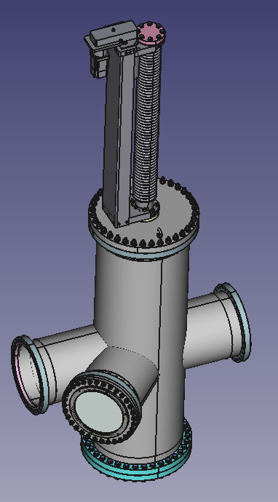
System Overview
4
Purpose: Image the beam just before the tuning dump
  Beam input pipe
  Beam output pipe
  View pipe
  Linear actuator (moves scintillating screens)
1
2
3
1
2
4
3

Slide 3
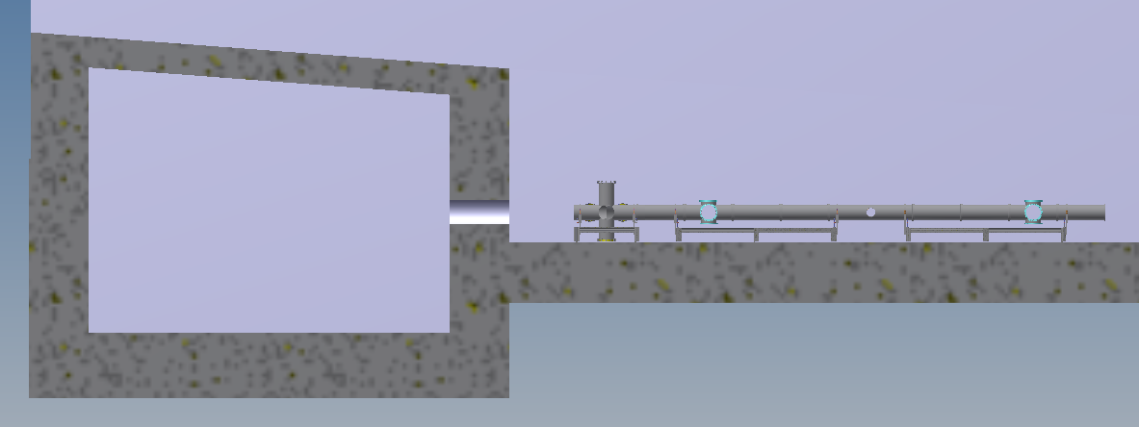
System Overview: Where Will It Go?
Quantity 2 (for now)—
One just before the gamma blocker
One ~2m upstream of the first
3157.5mm
4 way Tee crosses
1240mm
1
2
3
Tuning dump area
Gamma blocker sits here

Slide 4
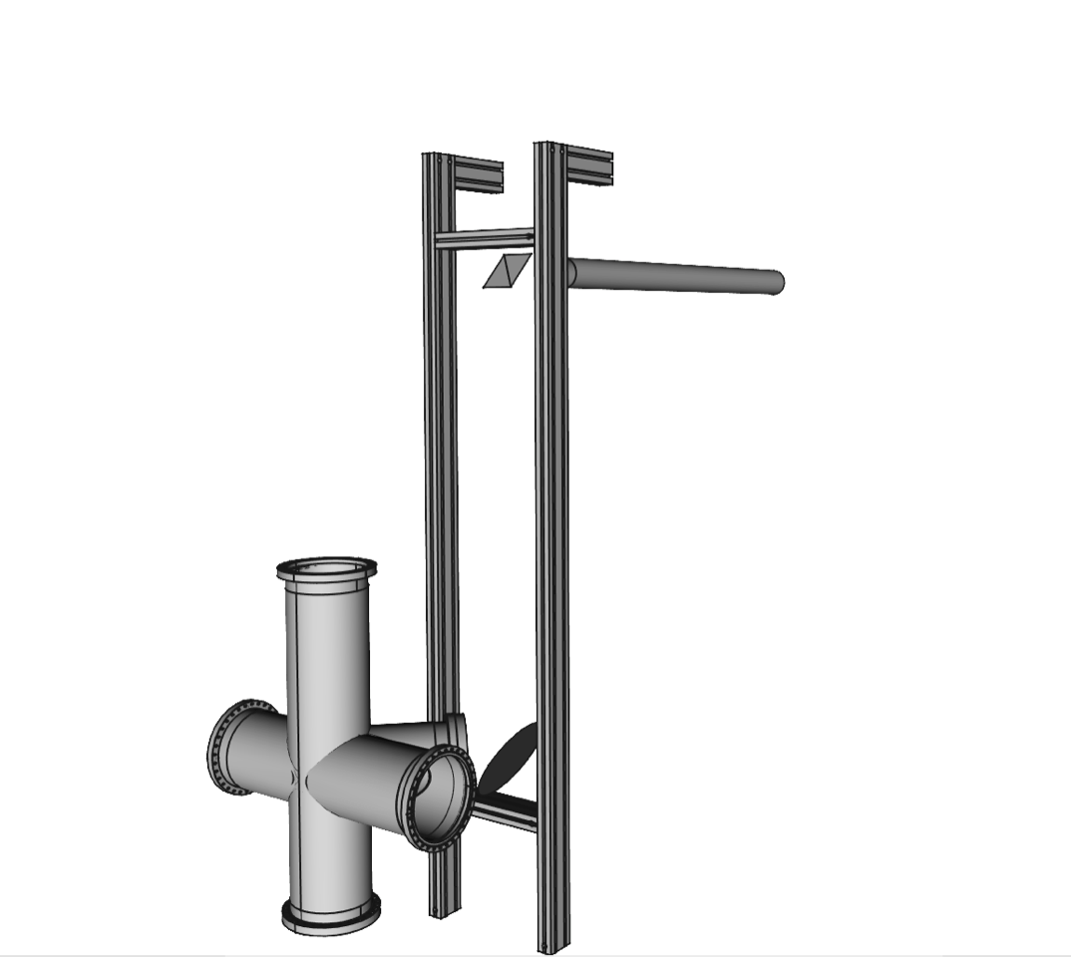
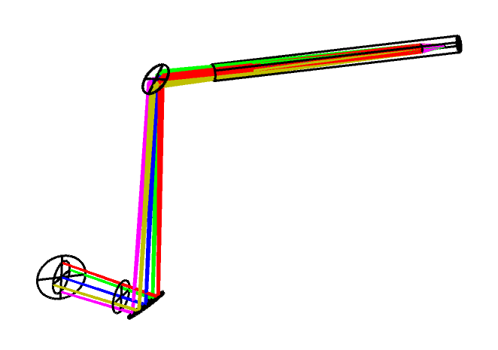
System Overview: Camera, Mirrors, Optics
light path
mirrors and support structure

Slide 5
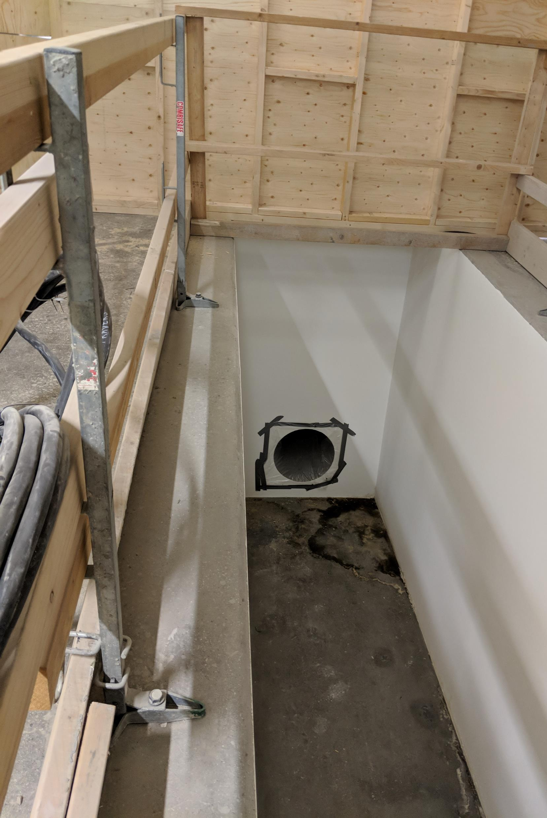
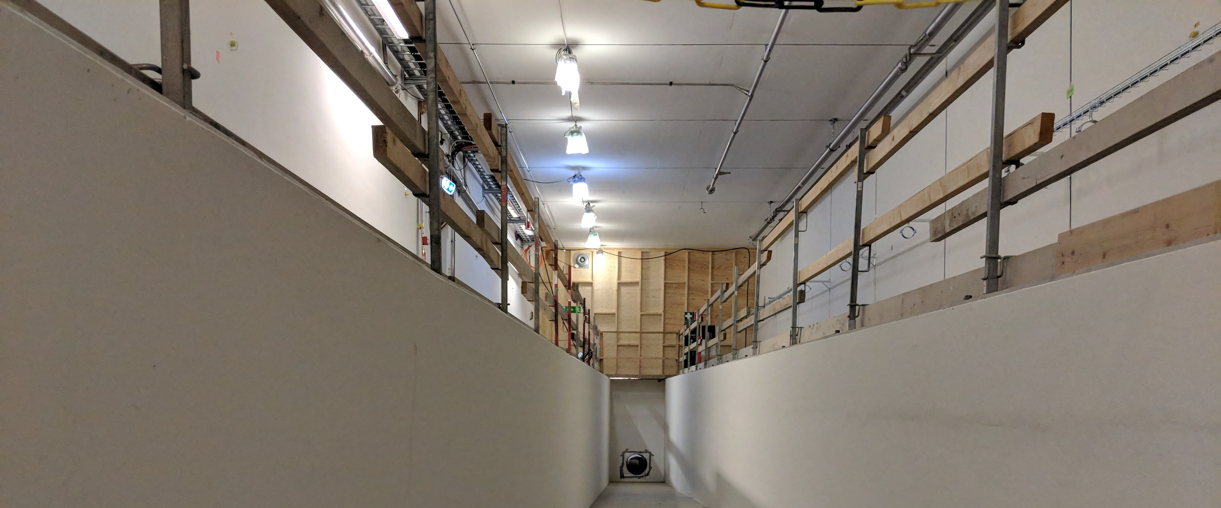
System Overview: Where Will It Go?
Camera Hole
Another Camera Hole

Slide 6
Recent Updates
Dump chamber CDR passed two weeks ago
  Design tweaked based on feedback here
    Move screen holder hardware away from beam
    Increase imaging area
  Screens rotated to be normal to beam
  Screens enlarged from 230x230mm to 230x320mm
    Chamber enlarged accordingly
      250mm inner diameter vertical pipe → 350mm

Slide 7
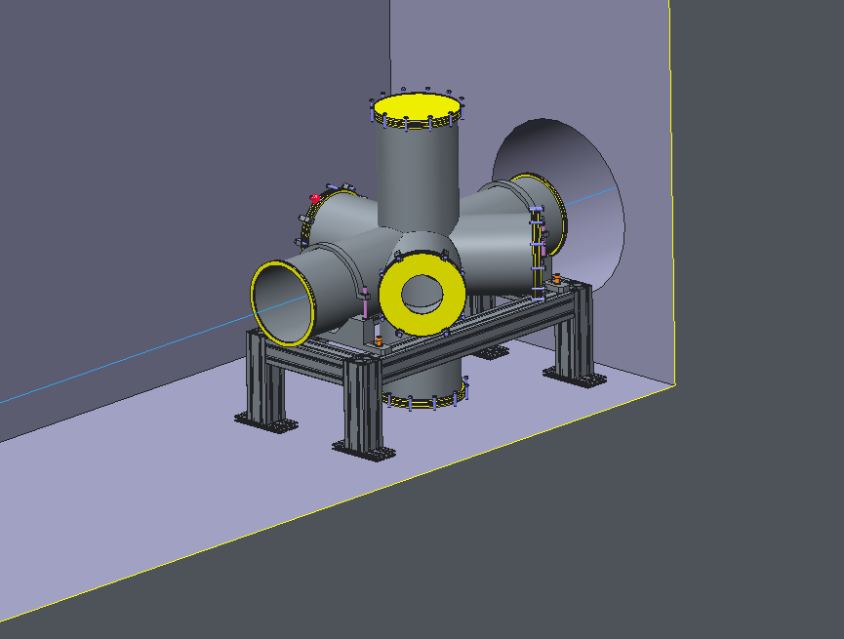
Early Design
Waaaay back in April 2018

Slide 8
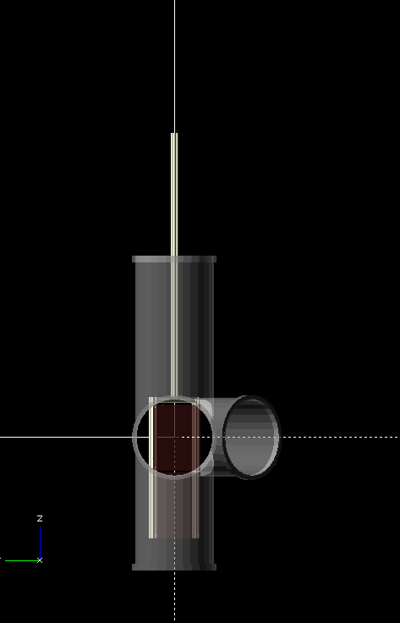
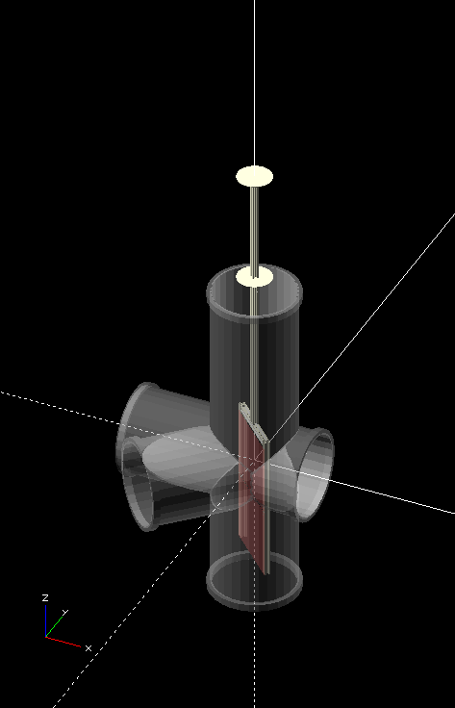
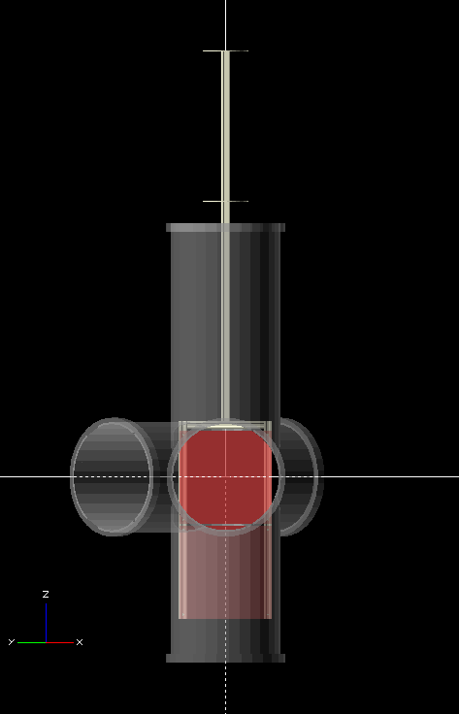
Previous Design
Beam view
Camera view
Back in eaaaarly November 2018

Slide 9
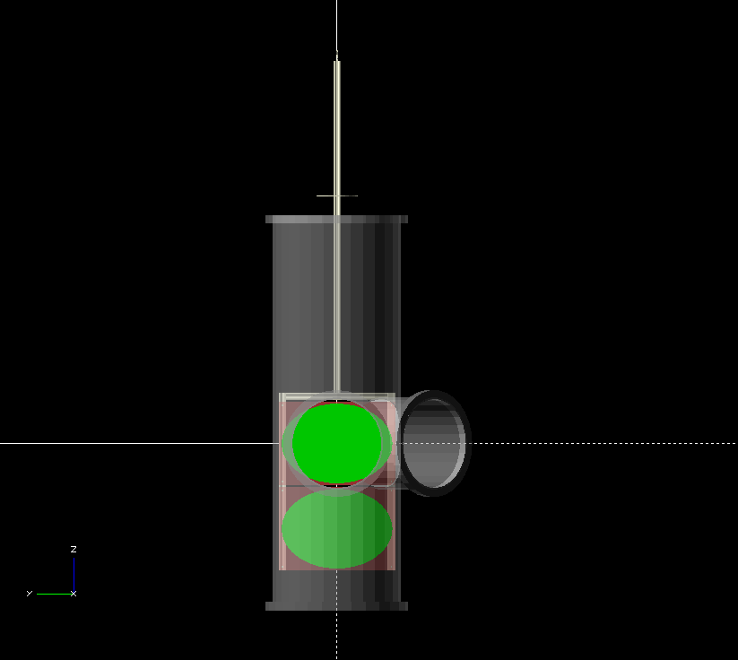
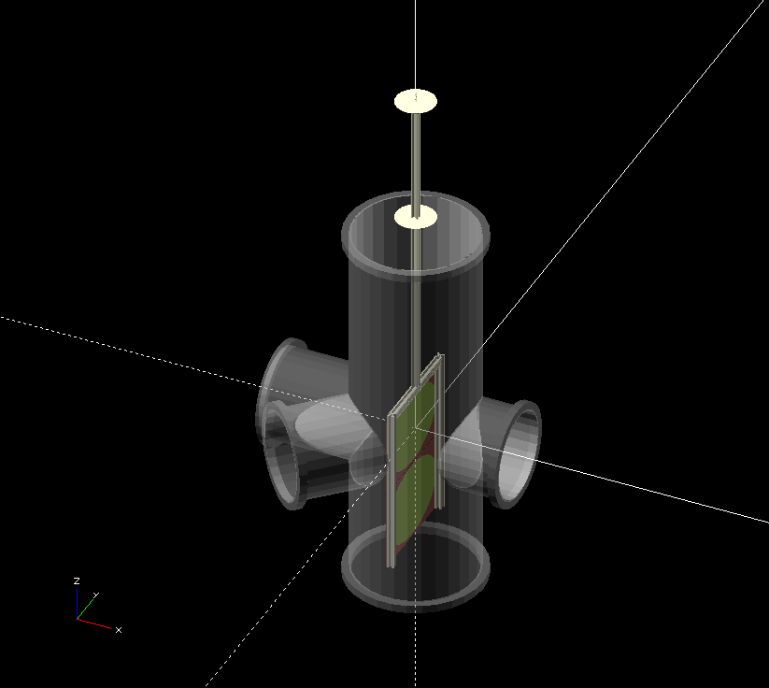
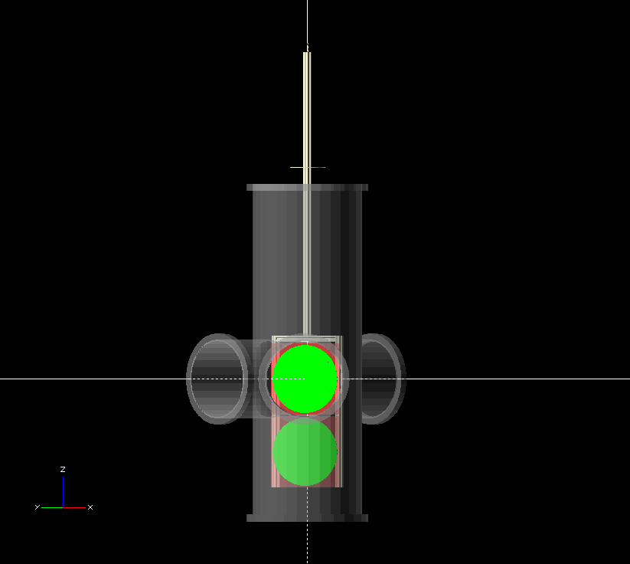
New Design
Beam view
Camera view

Slide 10
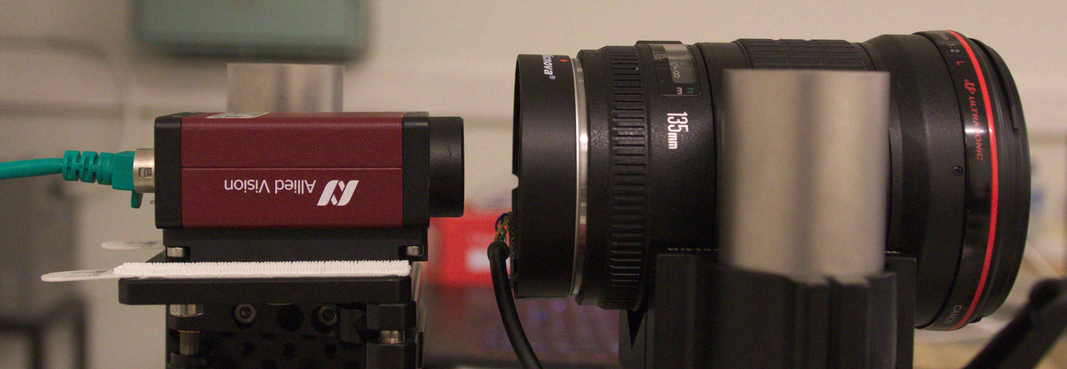
Depth of field tricks
The scintillating screen is now angled (45 degrees) relative to the camera field of view
  The camera’s focal plane no longer corresponds to the screen surface
We can tilt the camera sensor (~2 degrees) to compensate for this
~2°

Slide 11
Scintillating Screens
Dimensions: 230x320mm
Screen A
  Same as what is used in LHC dump lines: “Chromox”
  Purchased from Ceraquest (of France) at ~5k EUR each
Screen B
  Experimental sprayed coatings developed in partnership with University West, Trollhättan, Sweden

Slide 12
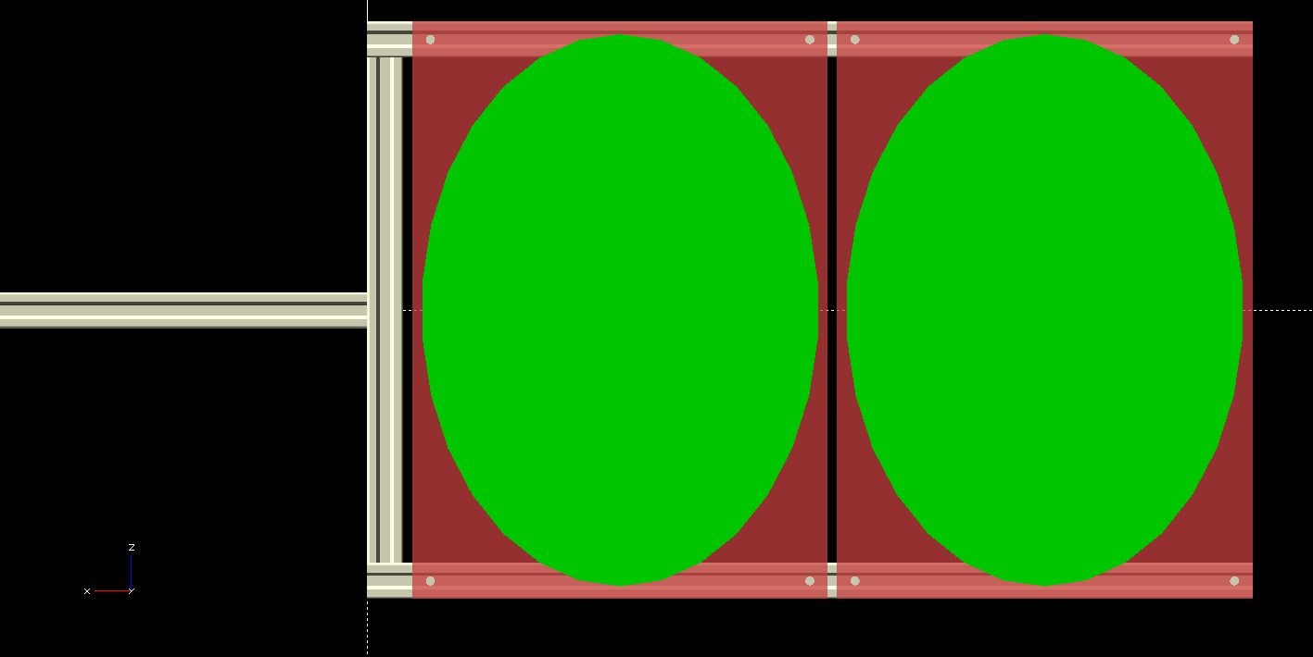
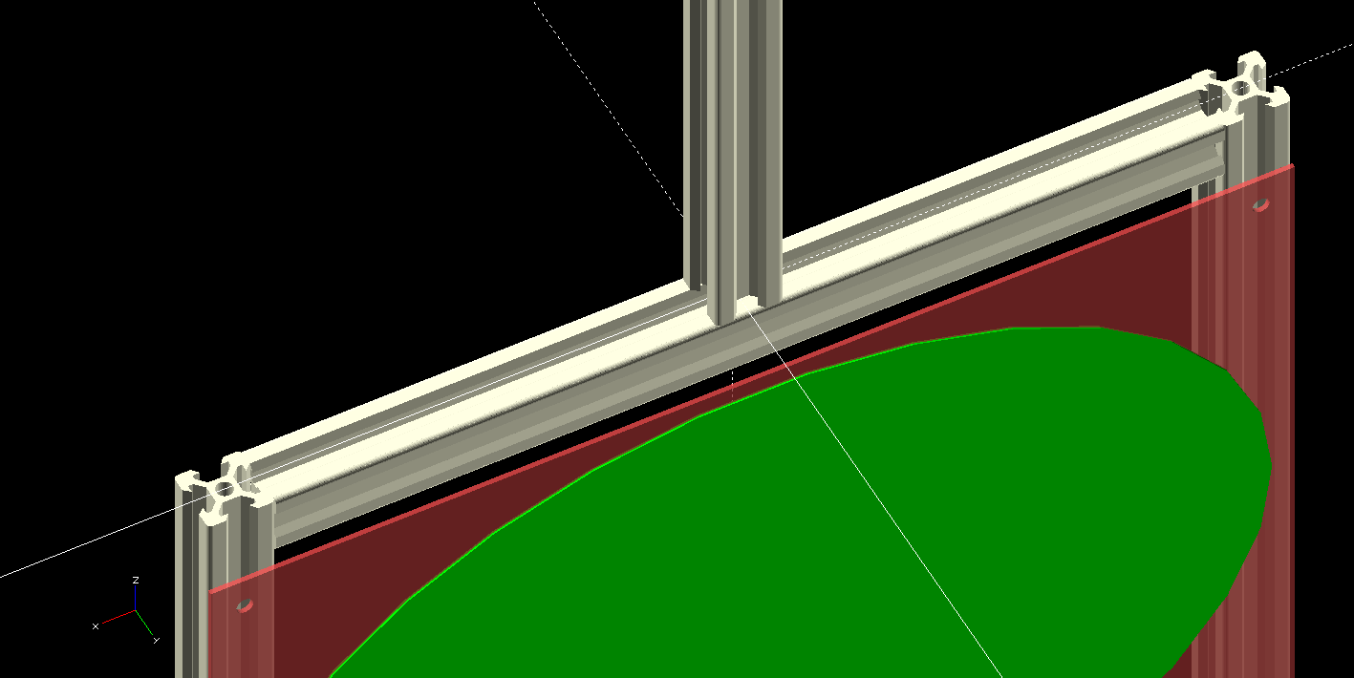
Screen Holder Design
Four pieces of 2x2cm Aluminum framing

Slide 13
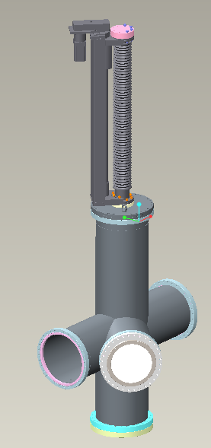
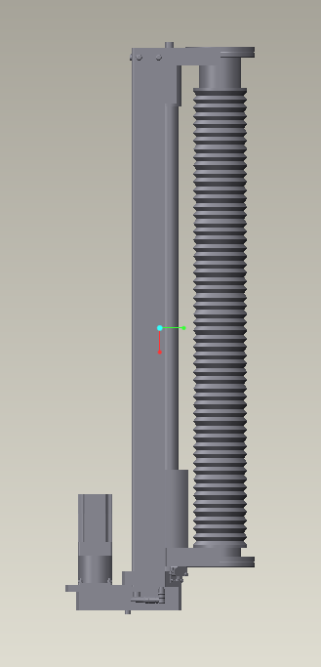
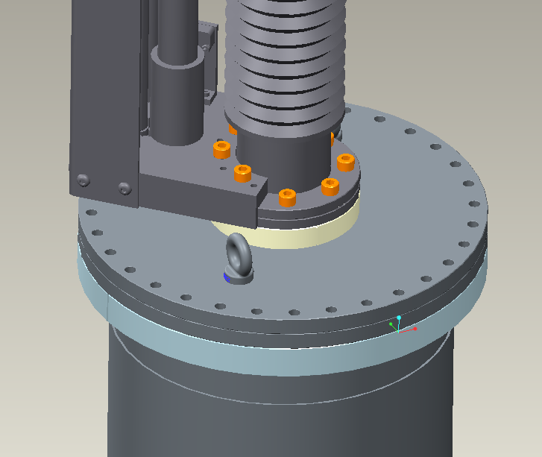
Motion Control
Screens moved by a stepper motor driven linear actuator
Using standard EtherCAT motion control components (BECKHOFF), recommended by the ESS motion control group
860mm
Bolted as shown
Top and bottom

Slide 14
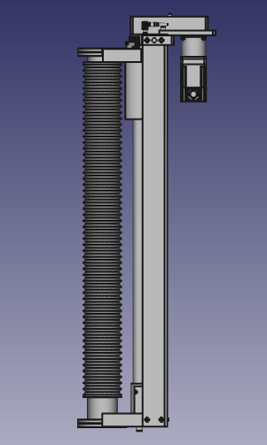
Motion Control
No position encoder
Five limit/position switches
  Top limit switch
  Screens removed position switch
  Bottom screen installed position switch
  Top screen installed position switch
  Bottom limit switch
Motion is slow (10s of seconds between positions)
1
2
1
3
2
600mm
3
4
4
5
5

Slide 15
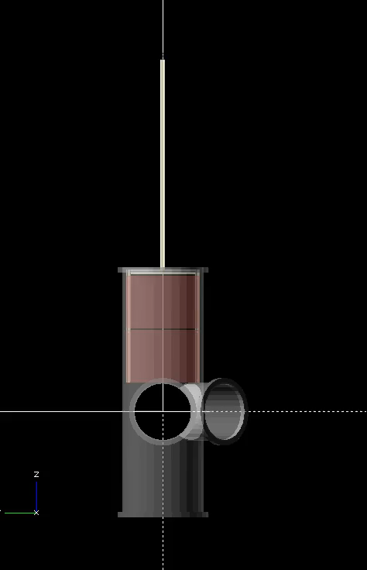
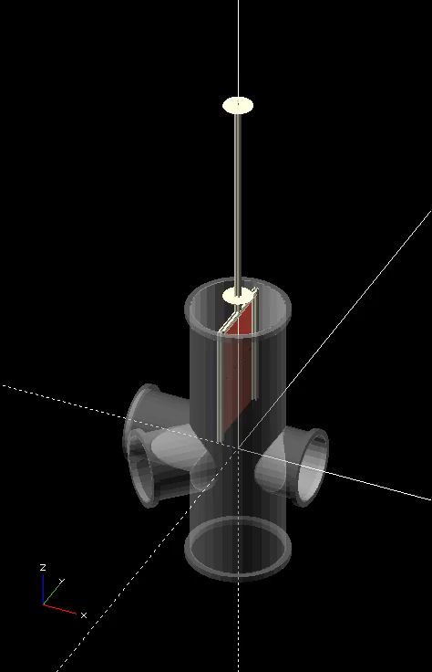
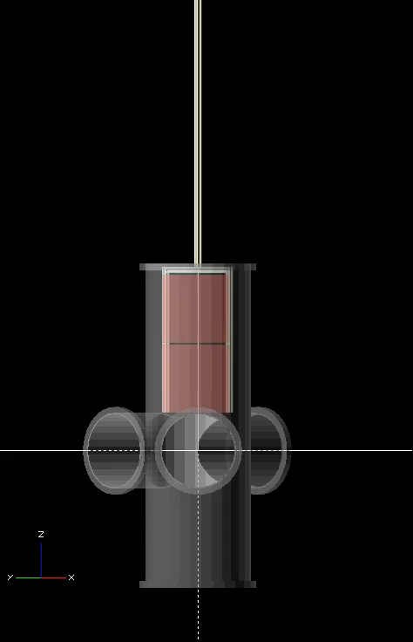
Motion Control
Beam view
Camera view

Slide 16
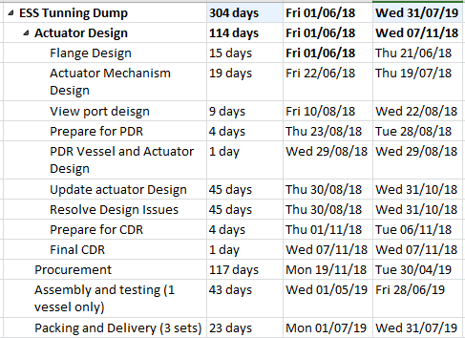
Schedule

Slide 17
Questions?
Thanks for listening!

Slide 18
Danger: Backup Slides Below

Slide 19


ESS Tuning Dump Imaging System
Input to the Vacuum Vessel CDR
Prof. Erik Adli
Department of Physics, University of Oslo, Norway
Cockcroft Institute, November 6, 2018

Slide 20
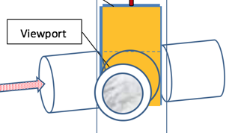
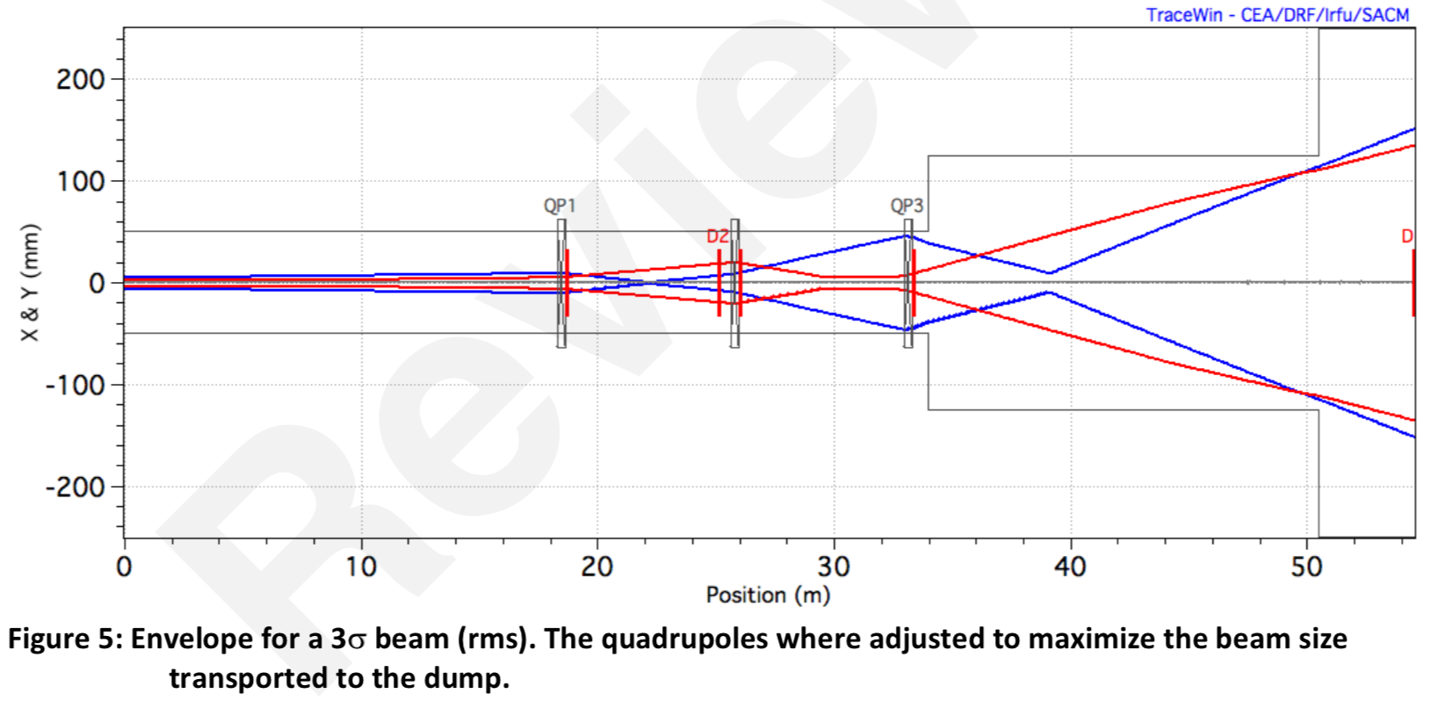
Some overall requirements of Im. Sys.
For the tuning dump, the overall limit is the 12kW.
Full pulse are allowed a low frequency to stay below the 12kW limit overall (around 1 pulse/30 sec).
If we send one full pulse we will be quite sure that the transversal optics is accurate so the beam size will be close to the nominal design.
Although the nominal beam size is not larger than 1x1 mm² at the dump, during beam tune up, the dump line optics allows for very large beam sizes at the dump and at the imaging systems.
250 mm
Imaging systems, including optical system and screen designed to maximalize FOV in the beam plane, while at the same providing a resolution of sub. 1 mm.
Key challenges for system related to:
large screens, long travel
large FOV
radiation environment
ESS-0191105
Beam Size Range on the Dump During Transverse Tuning

Slide 21
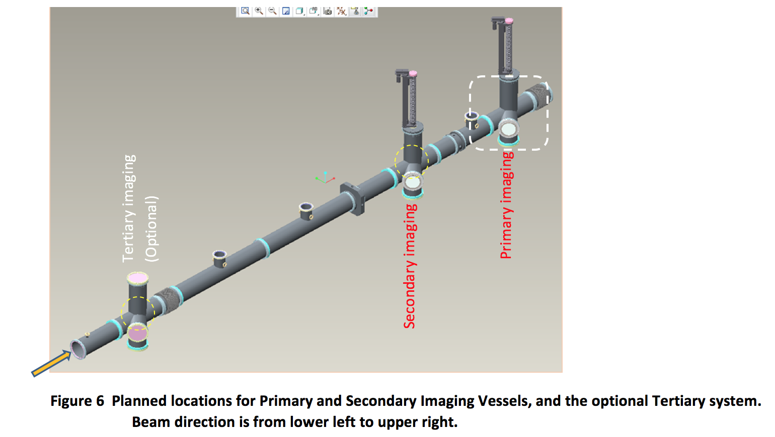
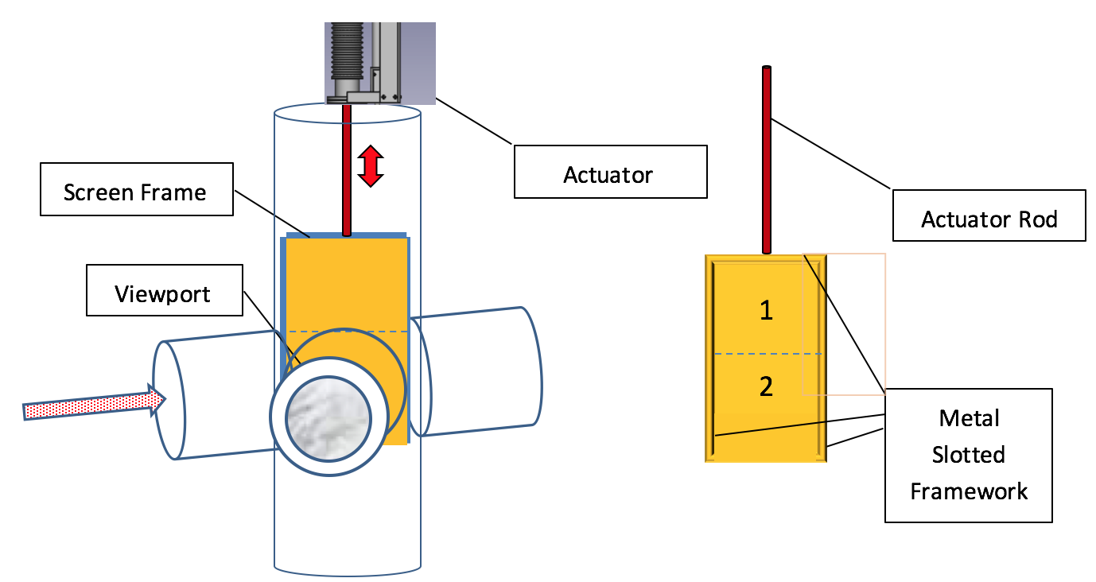
Two imaging systems
Two imaging systems are required to measure both spot size and divergence.
A third imaging system was discussed, but will not be installed due to cost.
Each imaging system will be equipped with two screens. The two screens gives redundancy, or, the possibility to test different materials/coatings (test beam for target coatings).
(details in talks from
Mark and Grey)

Slide 22
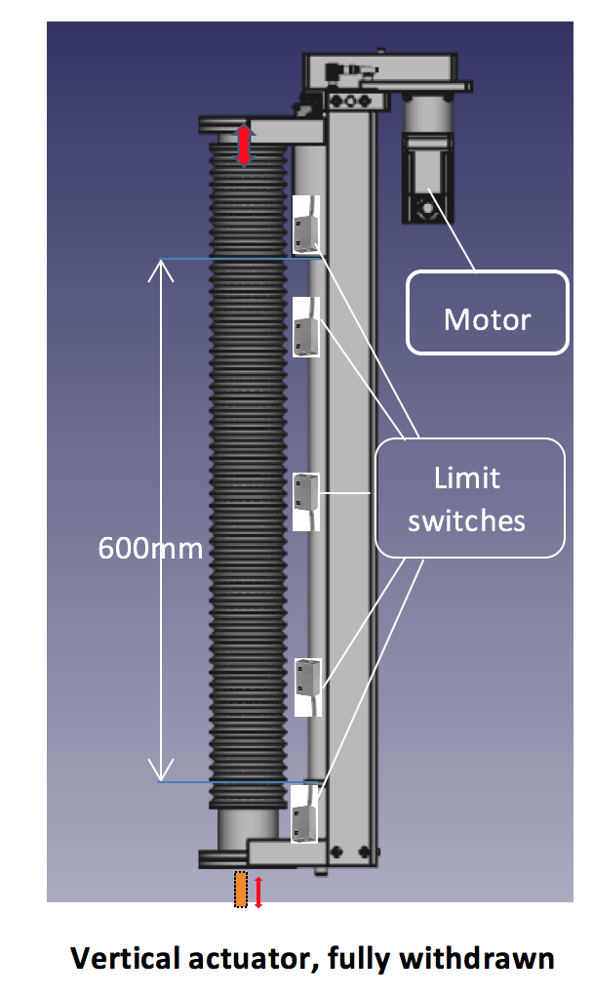
Interfaces imaging system and vacuum vessel
The imaging systems themselves passed their CDR in Oslo, 25-27 October 2017, with update to simplified system ESS-0331227.
Interfaces to vacuum vessel was not discussed at this time, but was discussed later at a meeting at Daresbury March 2018, and around the vacuum vessel PDR in August 2018.
Gray zones and interfaces (know from the PDR and previously) seems to have been sorted out by now :
The main mechanical interface imaging system and vacuum is the linear actuator. The actuator has been chosen in agreement with ESS, STFC and Oslo, and will be procured and integrated by STFC.
The screen holders, screens, motor control will be provided by Oslo.

Slide 23
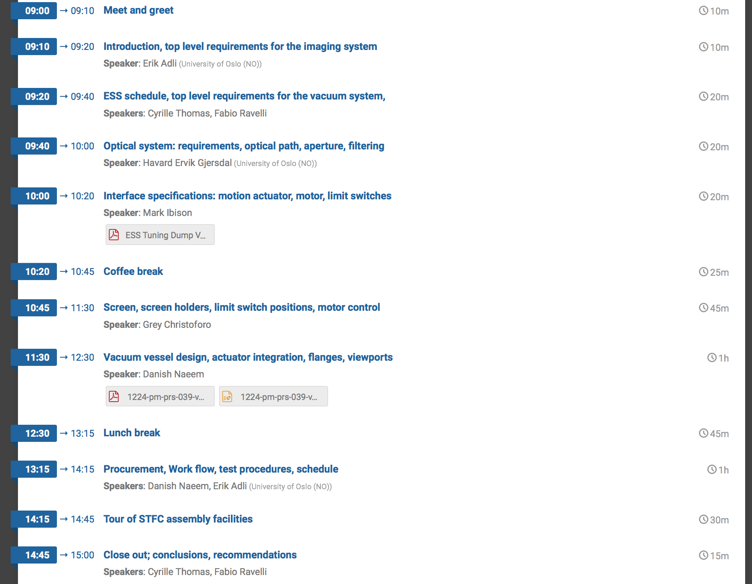
Agenda
Present all interfacing systems to the vacuum vessel
Present vacuum vessel design
Way forward

Slide 24
ESS Tuning Dump
Vessel Actuator Design
CDR
Danish Naeem
07th Nov 2018

Slide 25
Attendees:
Danish Naeem (STFC Daresbury Lab)
Mark Ibison (University of Liverpool)
Erik Adli (Oslo)
Greyson Christoforo (Oslo)
Håvard Gjersdal (Oslo, Optional)
Cyrille Thomas (ESS, Optional)
Thomas Shea (ESS, Optional)
Fabio Ravelli (ESS, Optional)

Slide 26
Scope:
Procurement of Actuators with motors
Design and Procurement of mating flanges for vessel
Design and Procurement of mating flanges for Actuators
Procurement of Limit Switches
Procurement of view ports
Assembly and testing of above
Packing and Delivery to Oslo / ESS Sweden
Design and Procurement of vessel for Tuning Dump is covered by ESS BTM WP12.

Slide 27
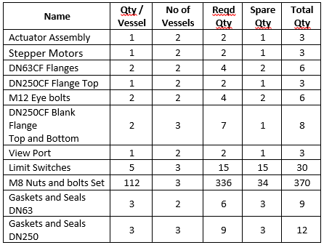
Quantities to Deliver:

Slide 28
CDR Objective:
To get approval for vessel manufacture.
To get approval for procurement of Actuator and view port.
To get approval for rest of the items.

Slide 29
Vessel Design

Slide 30
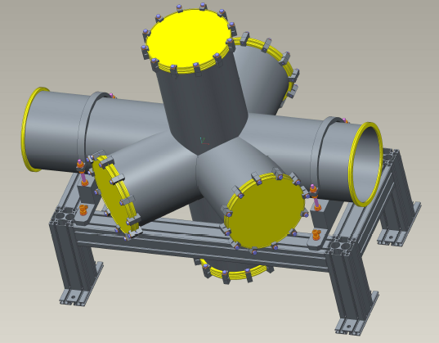
Original Design:
Only 1 vessel
Location: At the end of dump line
before Gamma blocker
Vacuum Vessel

Slide 31
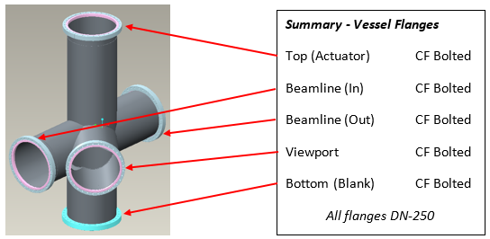
Final Design:
Length significantly reduced
Angular ports removed
Rotatable flanges except Bottom flange.
Location changed
Qty increased
Top & View port flange is 2 piece rotatable.

Slide 32
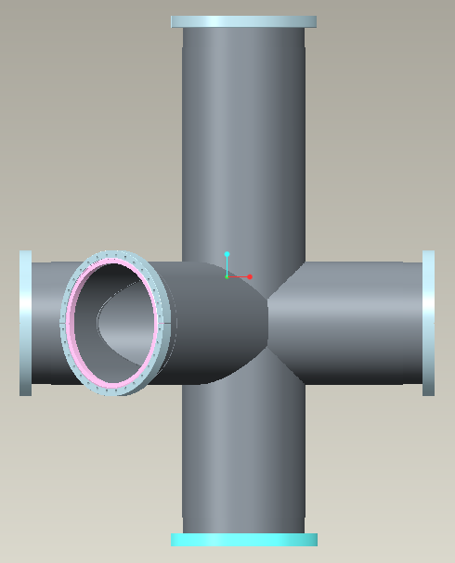
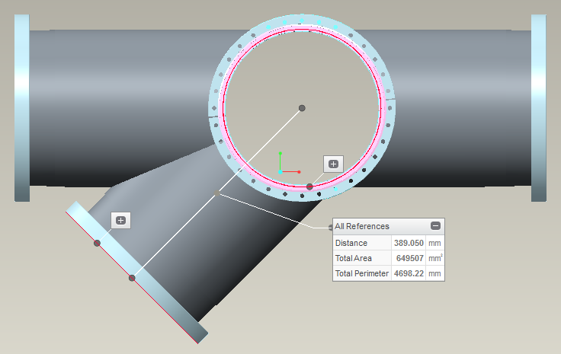
Dimensions (New Design):
All ports are DN 250 size dia.
860.6mm
Top View
1102.3mm
45º

Slide 33
Location of New vessel:
The vessel quantity in dump line has been increased from 1 to 3. Where 2 vessels closure to the dump will be fully equipped with screen imaging system while 3rd vessel will work as beam pipe and future upgrade for ESS. The location for 2 new vessel has been chosen as to replace the 4-way tee crosses which exist earlier in the dump line. This will be done at 2 different locations in the dump line as shown below. This decision has been made by Oslo and Uni. Of Liverpool jointly but requires ESS approval.
3157.5mm
4 way Tee crosses
1240mm
1
2
3

Slide 34
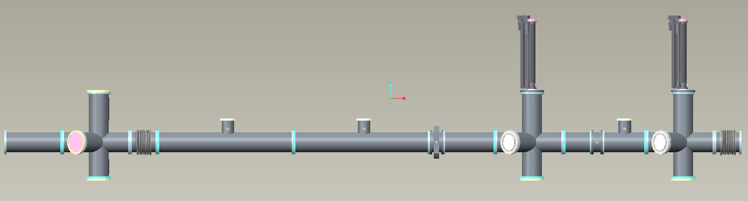
After replacement of Tee crosses with new vessel
Vacuum Vessel
Dump
End
Beam
End
5497.5mm
The length of new vessel is same as the length of Tee crosses replaced here.
The vertical height of new vessel is determined based on travel and size required for screens.

Slide 35
Actuator Design

Slide 36
Actuator design is provided by UHV motion.
Travel is 600mm based on screen travel required.
Phytron Stepper motor with limit and home switch included.
Mounted on top of the vessel via transition flange.
Size DN63
860mm
Bolted as shown
Top and bottom

Slide 37
Vessel Mounting Flanges

Slide 38
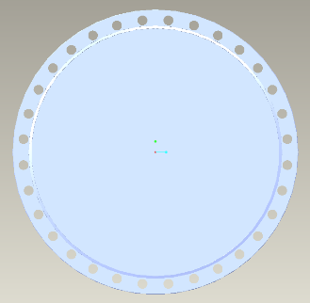
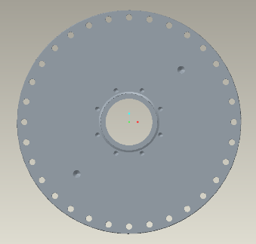
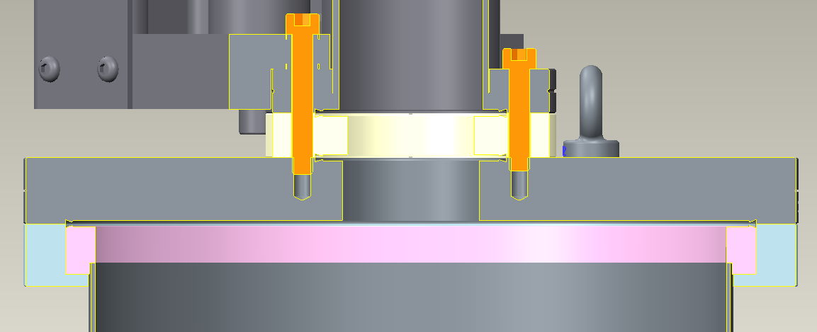
The vessel vertical port will be equipped with 2 flanges. Both flanges will be DN250CF bolted with knife edge.
The bottom flange will be a standard CF bolted blank flange.
The top flange will be a standard CF bolted flange with modification i.e. a bore in centre to suit central rod passing through and a bolt pattern holes to suit DN63 flange bolt holes.
Top flange will have knife edge on both faces to provide vacuum seal.
Top flange will have blind threaded holes to provide lifting aid.
Both flanges will mate with vessel welded rotatable flanges using bolts.
Bottom Blank
Flange
Top Bored Flange
With bolt holes
Top Flange connection with vessel and DN63 Flange

Slide 39
Actuator Mounting Flanges

Slide 40
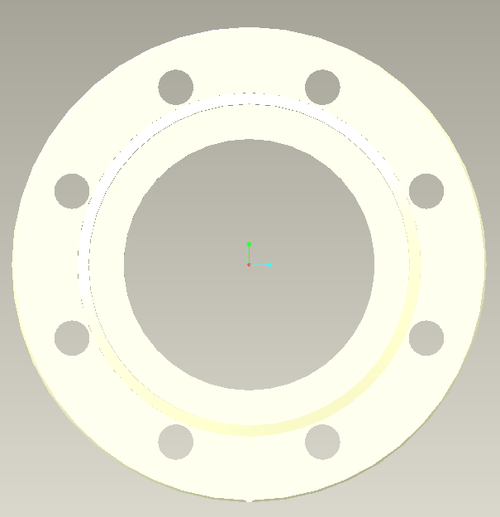
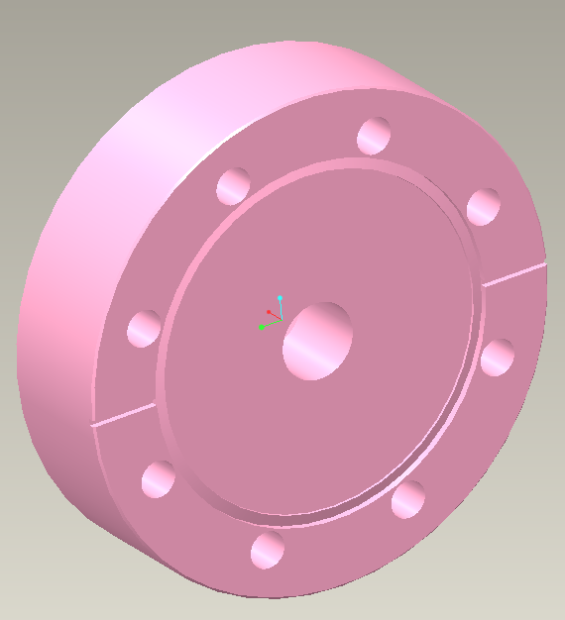
The actuator will be equipped with 2 flanges at top and bottom. Both flanges will be DN63CF with knife edge.
The bottom flange will sandwiched between actuator and vessel DN250CF flange.
Bottom Flange will have knife edge on both faces to provide vacuum seal.
The top flange will be a standard CF blank flange with modification i.e. a blind tapped hole in centre to suit central rod and a bolt pattern holes to suit DN63 flange bolt holes.
Both flanges will be held in place using cap head screws.
Bottom Flange
Top Bored Flange
With bolt holes

Slide 41
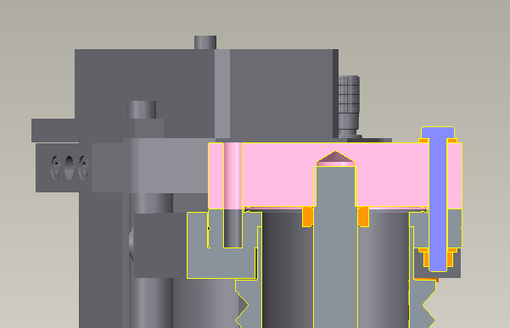
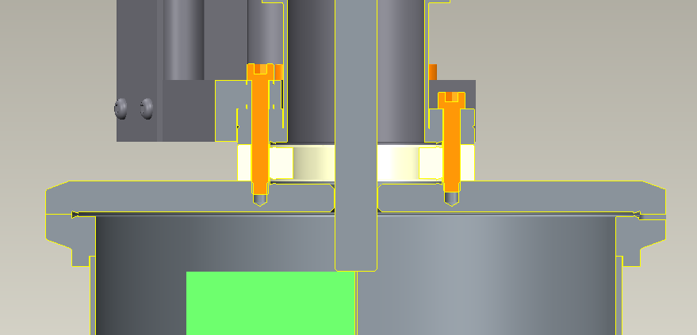
Top Flange connection with Actuator
Bottom Flange connection with vessel Flange and Actuator

Slide 42
Limit Switches Design

Slide 43
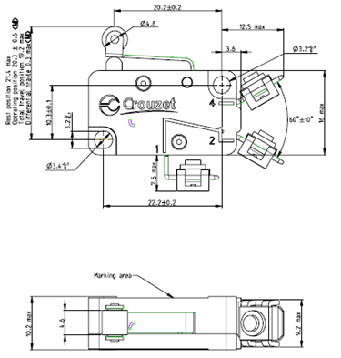
Limit Switches :
All limit switches will be procured from Crouzet 83160 family.
Full designation is SF133210_B 83160154.
All limit switches are roller type with special contacts.
Actuator supplier need to be informed on limit switch positions as the actuator support needs to be modified to allow installation of these switches onto actuator.

Slide 44

Location of Limit Switches (TBC)
Limit switches
600mm

Slide 45
Testing

Slide 46
A detailed test procedure document will be written by STFC at the time due for testing.
Major tests are as follows
  Visual and dimensional inspection of all incoming items i.e. purchased items
  All items will go through vacuum cleaning process
  Independent Actuator test before assembling onto the vessel to ensure its working. Oslo to conduct this.
  Electronics, motion controller, wiring tests to be conducted by Oslo.
  Vacuum vessel cleaning, RGA scan, pumping and any other vacuum tests to be conducted by STFC. All these tests for vacuum vessel are covered in ESS BTM WP12.
  After assembly tests of actuator, screen positioning, location and working of limit switches to be done by both STFC and Oslo.

Slide 47
Schedule

Slide 49
Costs

Slide 50
A formal quotation has been issued to Oslo for the STFC works on this work package.
Quotation is under review with Oslo and will be signed shortly.
STFC will not proceed with any order until formal quotation has been signed and agreed.
All prices in quotation are based on current valid quotation from different supplier but final prices will be determined at the time of placement of order.
Quotation price of actuator has already gone up from supplier due to phytron motors and crouzet limit switches.
Any changes in prices will be reflected in final invoice to Oslo unless those changes are already covered.

Slide 51
Approvals

Slide 52
Do STFC have approval for vessel manufacture?
Do STFC have approval for Actuator order placement?
Do STFC have approval for View port order placement?
Please note that despite the client approvals, STFC will still have to go through internal approval process and acquiring 3 quotations for each item purchased.

Slide 53
Tuning dump optical
system
Håvard Gjersdal
2018-11-07
University of Oslo
1

Slide 54
Imaging system
• Goal:Image light from scintillating screen onto a camera.
• To minimize dose, camera placed 1.5m inside concrete wall.
• Optical
path:
through viewport, two flat mirrors and into hole in wall.
2

Slide 55
Requirements
• Should be able to measure very small
test pulses, as well
as full
ESS pulse.
• Field of view:
as large as possible
• Better than 1 mm resolution across field of view
• Camera and all
other parts must be able to survive in environment without
maintenance
3

Slide 56
Parts
• Mirrors
• Limiting apertures
• Camera, lens
• Filtering
• Illumination
4

Slide 57
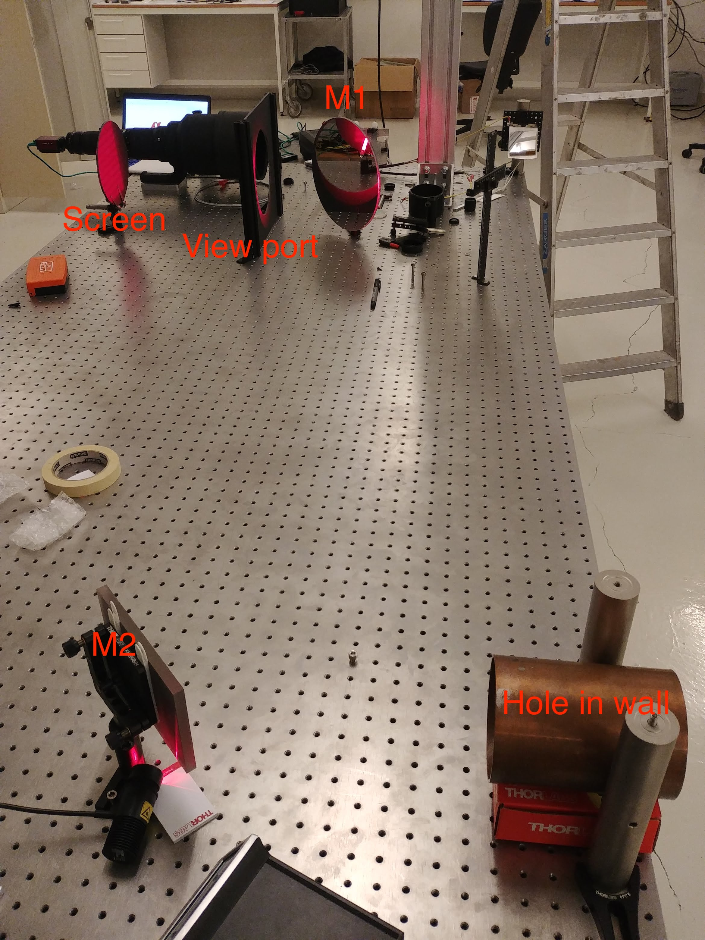
Mirrors
M1:
• Borosilicate
• 1λ over 25 mm
• 290mm diameter
• Centered on viewport
M2:
• Fused silica
• λ/4 over surface
• 110mm × 150mm
• Centered hole in wall
Exact position of hole in wall
is not known yet.
Mirrors should remain centered on
apertures, angles adjusted.
5

Slide 58
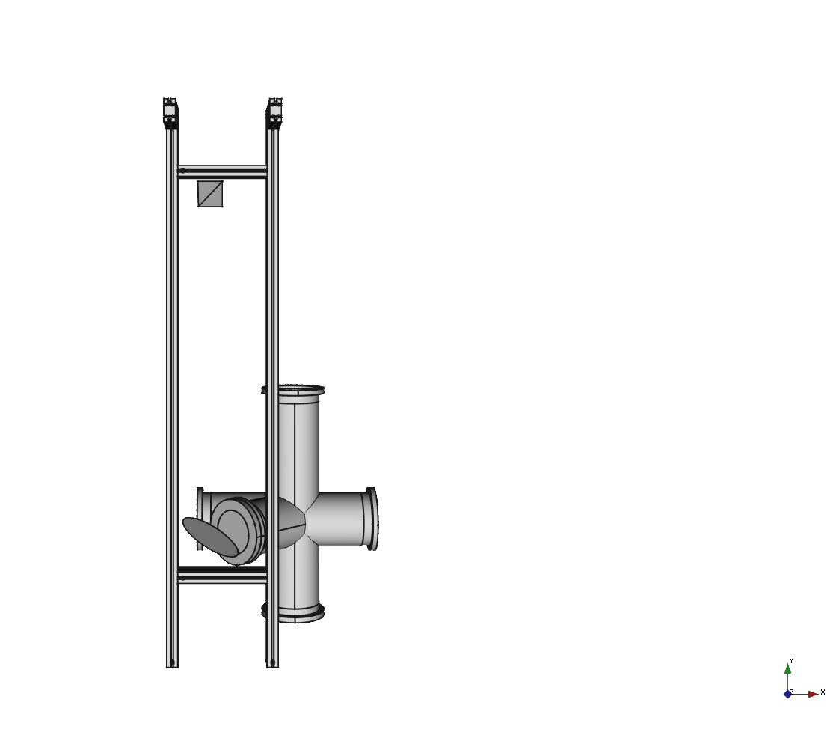
Mirror support
• Mirrors will
be mounted to the Bendamount, allowing precise adjustment of three
angles, one translation.
• Design of support for the mounted mirrors is not fixed.
One option is a sturdy
strut profile frame, bolted to the wall
and the floor.
6

Slide 59
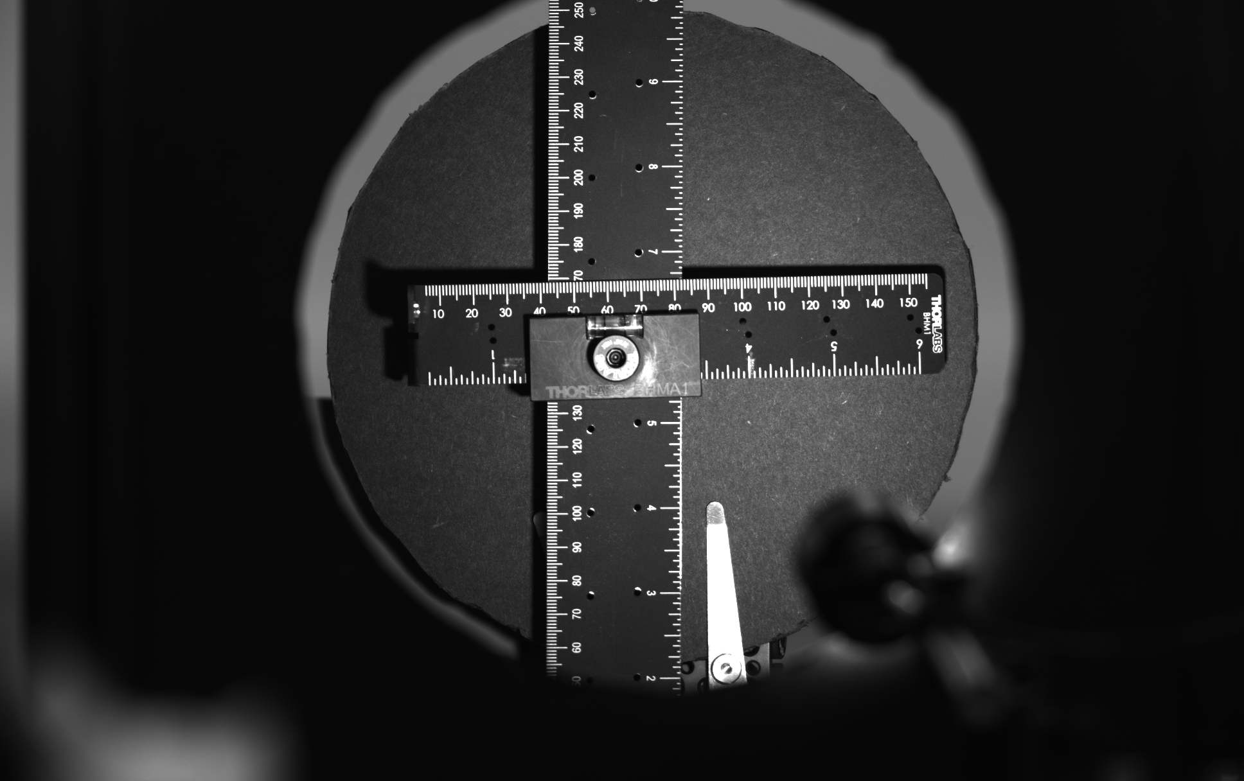
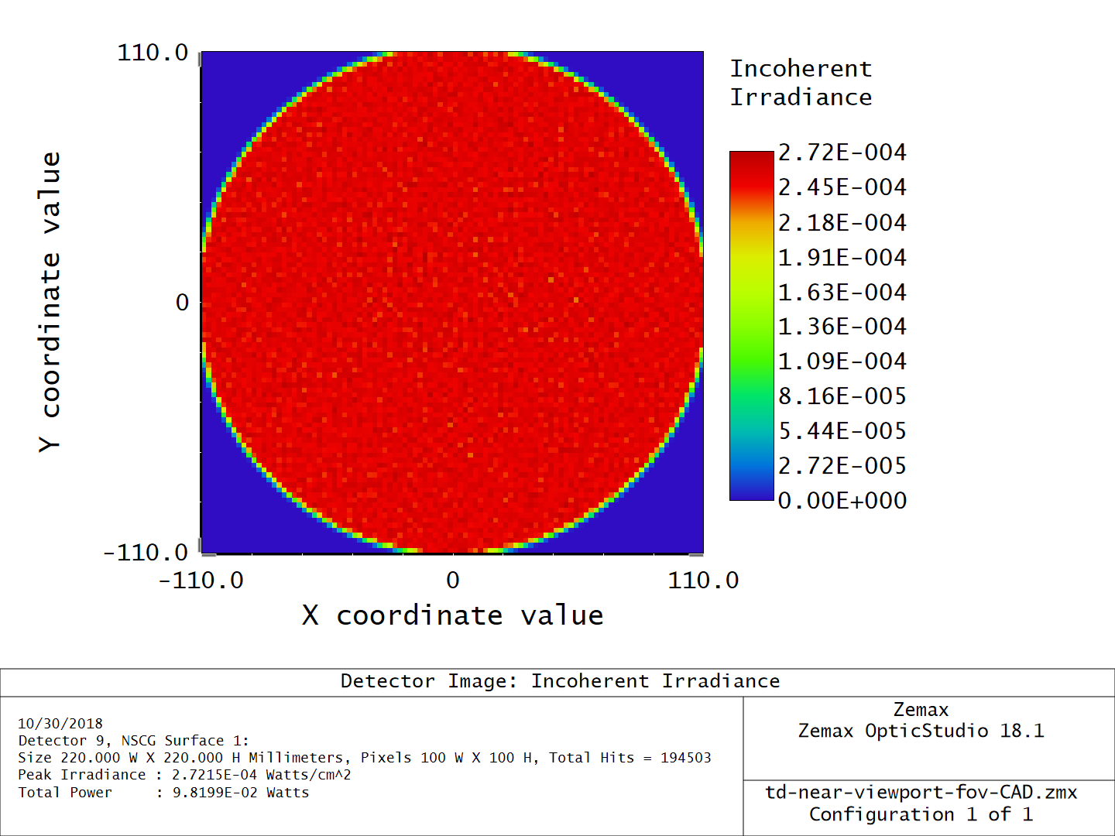
Limiting apertures
The viewport limits the field of view.
Field of view is very close to 220mm in screen coordinate system.
Elliptical
in beam
√
orthogonal
system, minor axis 220/
2
7

Slide 60
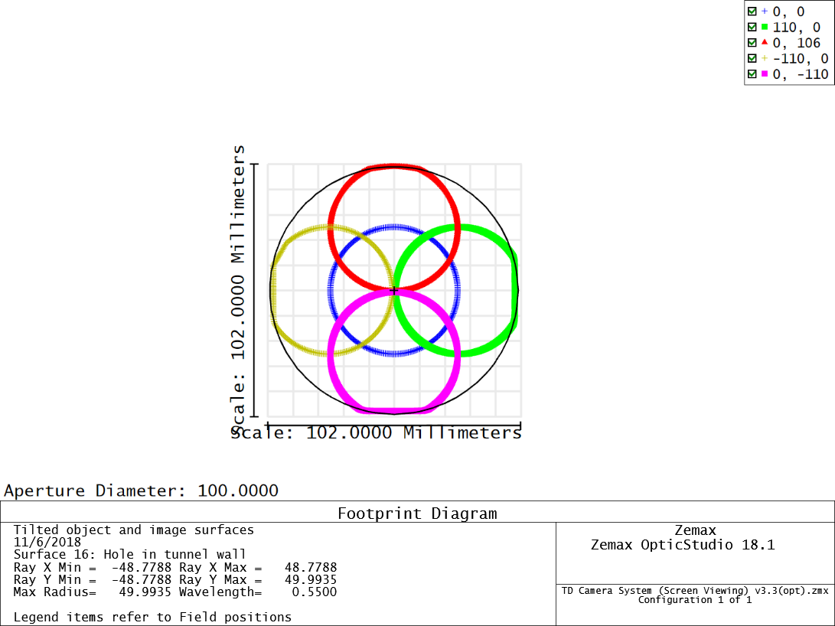
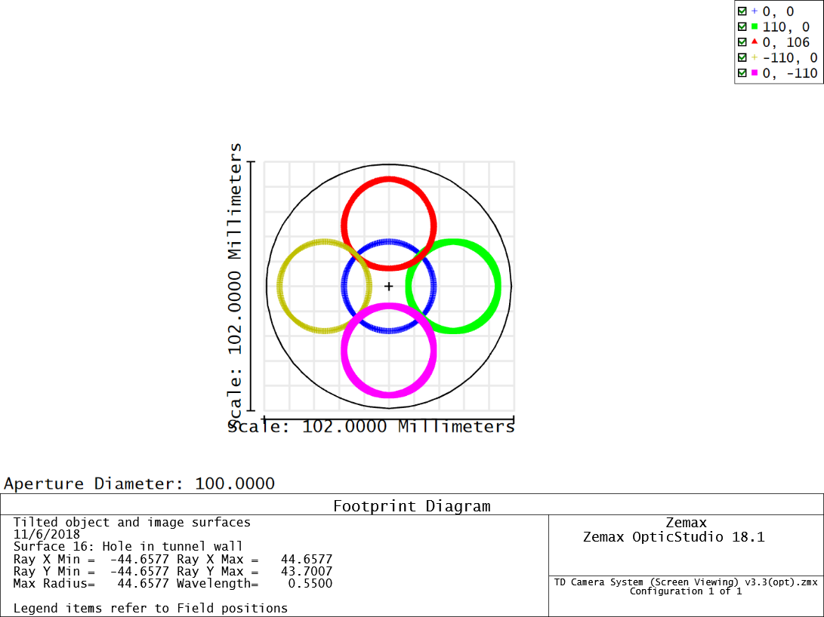
Limiting apertures
Hole in wall
limits entrance pupil
size.
Entrance pupil:
135mm/2
Entrance pupil:
135mm/2.8
This lets us use a 135mm lens operated at f/2.8 without vignetting.
f/2 will
brighten
the center, but some darkening near the edges of the FoV.
8

Slide 61

Camera and lens
Canon 135mm f/2L
• Fast lens, large entrance pupil
• Lens has internal
motors to adjust focus, aperture.
Possible to remote control.
• Telephoto lens allows for large sensor, high sensitivity, high resolution.
9

Slide 62
Camera
• 1 inch sensor (11mm × 11mm), for example Manta G-419B
• GigE camera, power over ethernet
• Camera, lens, controllers will
be mounted in a tube, aligned in a lab, inserted and
fixed in the wall
10

Slide 63


Filtering
• Large dynamic range:
must be able to see first test pulses, as well
as a full
ESS
pulse.
• Camera will
saturate even at f/32, ND filters needed
• Options are small
filters inside the hole in the wall, or large filters outside.
11

Slide 64

Illumination
• We need illumination for debugging
• Thorlabs LED lamp (LIUCWHA) mounted between M1 and the viewport
• 24V, supplied by EtherCAT module
• Lamp will
obscure part of screen
12

Slide 65
Conclusions
A simple optical
system.
• Performance tested in simulations and prototype
• Final
mirrors ordered, mirror quality tested in prototype
• Work remaining on control
of filters and lens, mechanical
support of mirrors and
camera.
13

Slide 66




ESS Tuning Dump Imaging Systems
CDR Review for Vacuum Vessel
Specification: Motion Control System
Dr Mark Ibison
University of Liverpool
Attached to the University of Oslo team
23/10/2017
M G Ibison
1

Slide 67
Outline of Presentation
•
Requirements for Motion Control
•
Selection of Actuator
•
Actuator Details
•
Motor Selection Criteria
•
Motor Drive Details
•
Limit Switch Functions
•
Limit Switch Selection
•
Conclusions
29/10/2017
M G Ibison
2

Slide 68
Requirements – Motion Control
•
UHV Compatible
•
Large Multiple Screens -> Long Travel
•
Radiation Environment
•
Access & Maintainability
•
Machine Protection Interface
•
ESS Standards (MCAG)
23/10/2017
M G Ibison
3

Slide 69


Selection of Actuator
1
2
Criteria
Actuator Flange
•
Led by STFC Project experience
Viewport
•
Supplier options limited due to
length of travel required
4
3
e.g. UHV Design, Vacgen (UK)
Final Specification:
•
Single actuator, vertical motion only
•
Long Travel Linear Shift Mechanism
•
Mechanical, driven by lead-screw
•
Edge-welded bellows (replaceable)
•
CF vacuum flange seals
23/10/2017
M G Ibison
4

Slide 70

Actuator Details
Moving
UHV Design
HLSML64-20895-002
flange
Long travel Linear Shift Mechanism mounted on
CF63 (4 1/2” OD CF) flanges.
Fixed flange with metric clearance bolt-holes and
travelling flange with metric tapped bolt holes.
600mm stroke. 65mm clear bore.
Demountable bellows assembly.
Lifetime of Bellows (expected)
10,000 operations
Fixed
Maintenance (routine)
Greasing of screw
flange
Total Mass (excl. motor)
26 kg
Motor Mass
1 kg
23/10/2017
M G Ibison
5

Slide 71

Motors - Selection Criteria
Feature
Property
Advantage
Motor type
Standard ESS ‘harsh environments’
includes high-radiation
stepper motor
Torque > 2 Nm at lead-screw
Gearbox ratios
for screen-change time ≤ 2 min
600 mm travel
linear speed 5 mm/sec
extends lifetimes, avoids
risk of lead-screws’
lubrication breakdown
Transmission
Flexibility in motor mounting
Option to reduce overall
length, if necessary
Type:
Phytron VSS 57.200.2.5
Flange: NEMA 23
23/10/2017
M G Ibison
6

Slide 72


Motor Drive Details
•
Gearbox
–
Preference for ‘direct’ drive, BUT …
–
Motor holding torque only 0.84 Nm
–
Other motor options require significant
mounting modifications
→
Retain gearbox
•
Transmission
–
Belt drive offered as standard, BUT …
Motor
–
Implications for radiation hardness
–
Alternative ‘in-line’ option accepted
→ Height increase manageable ~ 70mm
Gearbox Type: Phytron VGPL52
Ratio: 16:1
23/10/2017
M G Ibison
7

Slide 73
Limit Switches - Requirements
•
Feed back screen position for Motor Control
–
Indicate screen disposition to operator
•
Protect screens and actuator from possible
over-travel damage
•
Must be highly reliable
•
Precision to ± 1mm adequate, as screen
alignment is not critical
23/10/2017
M G Ibison
8

Slide 74

Limit Switches - Functions
Mechanically-operated limit switches on actuator frames
― linked to motion control module (encoders not used)
Position Indication
1.
Upper End-of-travel (Top Limit)
2.
Screens Out Position
3.
Screen 2 Position (mid-way)
4.
Screen 1 Position
5.
Lower End-of-Travel (Bottom Limit)
Limit
600mm
switches
Other Requirements
Optical sensing not approved
Radiation resistance mandated (ESS Standard)
23/10/2017
M G Ibison
9

Slide 75

Limit Switch Selection
Switch Type
Le Crouzet SF133210_B 83160154
–
Special, limited availability
–
Contacts gold plated; body plastic
–
Qualified for ‘nuclear’ use
–
Dimensionally as Cat. No. 83160
–
Compatible with actuator supplier
suggested type V3FN (unavailable)
–
Roller actuated; same type for all 5
positions
23/10/2017
M G Ibison
10

Slide 76
Conclusion
Next Steps
•
Finalise Specification Document
–
Vessel, Actuators + Motors, Switches
•
Discussions with Vessel Manufacturers
•
Procurement action by STFC
–
Quotes (x 3) requested from suppliers
•
Place orders for vessel, actuators and motors
–
Order limit switches for fitting by actuator supplier
23/10/2017
M G Ibison
11

Slide 77
Standards
Vacuum
ESS Vacuum Handbook Parts 1 and 2
•
Materials, Flanges, …
Motion Control (MCAG)
•
ESS Motion Control Components Standard
•
EtherCAT Motion Control System
23/10/2017
M G Ibison
12

Slide 78
ESS Tuning Dump Imaging Systems Vessel CDR
Grey Christoforo
Researcher, University of Oslo
Nov 7, 2018
at Daresbury Laboratory, UK

Slide 79
Outline
Imaging screen design
Screen holder design
Limit and position switch locations
Motion control electronics

Slide 80

Quick System Overview

Slide 81

Quick System Overview

Slide 82

Quick System Overview

Slide 83
Imaging Screen Mechanical Design Rules
Screens should be as large as possible
Must be remountable/changeable in case they must be replaced

Slide 84


Slide 85


Screen details
¹ see backup for chromux details
The chromux¹ screens are 230x230x1mm
Has four holes for M5 screws to fit through in corners 1cm from edges
Simple mounting hardware

Slide 86


Screen Holder
Made of four pieces of Aluminum framing
20x20mm cross-section
Not anodized
1405mm total height
230mm total width
M5 tapped hole for connection...
1
4
2
1
Long Vertical Bar (915mm)
2
Cross bar (190mm)
3
3
4
Side bars (490mm)
Simple connection hardware:

Slide 87

Screen Holder Connection to Moving Flange
Standard M5 0.8mm pitch
machine screw into moving flange plate

Slide 88




More Screen Holder Views
Top
Back
Right Side
Back Isometric

Slide 89
Screen Holder Design Rules
Must not crash into or otherwise interfere with the chamber
Must hold two screens centered on the beam & angled for the 45° viewport
Must be made of vacuum compatible material
Should have robust and easy/semi-easy screen mounting mechanism
Must never interfere with the beam
Must be possible to completely remove both screens from beam

Slide 90
Screen Positioner Location Feedback Switches
Electromechanical switches installed by UHV Design on their actuator will tell the control system where the positioner is
There will be five total switches
  Two limit switches (these should never be reached)
    Screen extraction end of travel limit [LT]
    Screen insertion end of travel limit [LB]
  Three position switches:
    Screens fully withdrawn [SA]
    Bottom screen centered on the beam [SB]
    Top screen centered on the beam [SC]

Slide 91


Linear Actuator

Slide 92


Actuator Travel Limits

Slide 93

LT Limit Switch
Location = 860mm
Prevents actuator from over extending
and the screen holder from crashing into the top of the chamber

Slide 94


SA Position Switch
Location = 850mm
Both screens are removed from beam

Slide 95


SB Position Switch
Location = 607.55mm
Bottom screen is centered in beam

Slide 96


SC Position Switch
Location = 372.55mm
Top screen is centered in beam

Slide 97


LB Limit Switch
Location = 352.55mm
Prevents screen holder from being
inserted too far into the chamber

Slide 98
Screen Holder Animations

Slide 99

Motion Control Electronics
Following standard EtherCAT recommendations from the ESS Motion Control and Automation Group
All from Beckhoff
  One EtherCAT coupler
  One digital input terminal
  One digital output terminal
  One stepper motor driver terminal
Power supplies
  One 24V DC ~300W (for electronics, lights, switches)
  One 50V DC ~200W (for stepper motor)

Slide 100

EtherCAT coupler
Beckhoff EK1100
Allows for computer ↔ EtherCAT communication

Slide 101

Digital Input Terminal
16-channel digital input terminal 24 V DC, filter 3.0 ms
Beckhoff EL1809
Reads limit and position switches

Slide 102

Digital Output Terminal
16-channel digital output terminal 24 V DC, 0.5 A
Beckhoff EL2819
Powers sample illumination lights and actuator switches

Slide 103

Stepper Motor Driver Terminal
Stepper motor terminal without incremental
encoder, 2 x 50 V DC, 5 A
Beckhoff EL7041-0052
Drives the stepper motor that moves the screen holder

Slide 104

The Stepper Motor
70

Slide 105

Screen View From Camera

Slide 106

Screen View From Beam

Slide 107
Backup

Slide 108
Chromux screens
Several decades of research on ceramic phosphors at CERN [3] and at other laboratories has led to the almost exclusive use of doped alumina ceramic screens, i.e., Al2O3:Cr3+, for accelerator beam observation. Alumina (type AF995 [4]) is doped with 0.5% chrome sesquioxide and at room temperature two principal lines of luminescence at 692.9 and 694.3 nm are generated with a decay time of 3.4ms [5]. These screens are also compatible with ultrahigh vacuum systems, they exhibit good response linearity, and their radiation resistance is high. For example, in tests made at CERN, screens have withstood integrated relativistic proton fluxes of up to 1020 protons/cm2."
http://epaper.kek.jp/d07/papers/tupb28.pdf

