Slide 1
Rack and Interconnect Design in E-plan
Krystian BEC
WUT
22 November 2018 , BI forum

Slide 2
Scope of Work
1. Design and preparation of infrastructure documentation and rack cabling for BD:
- 3D rack occupation designs of ~ 50 BD racks,
- all cables connections between devices and modules inside racks,
- list of all cables types and connectors in each rack.
2. Design and production of BD racks patch panels.
3. Help with BD racks installation.
4. Laboratory works: devices testing, lab organization, etc.

Slide 3
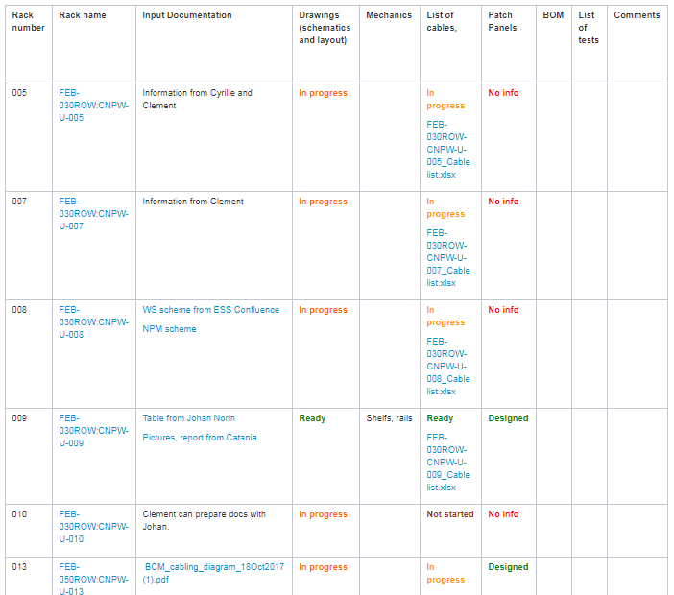
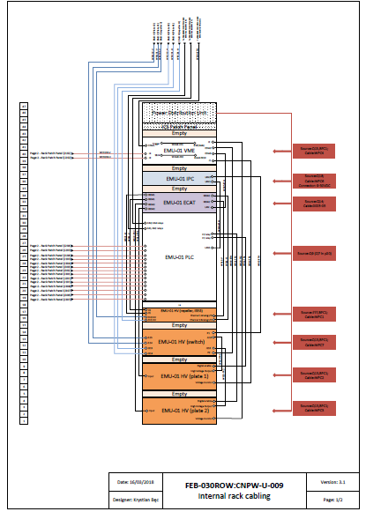
Ongoing Work
Preparation of documentation for few racks ( mainly from FEB building) – 2D draft layouts.
https://confluence.esss.lu.se/display/BIG/Beam+Diagnostics+WUT+racks+layout%2C+installation+work+and+patch+panels+designs

Slide 4
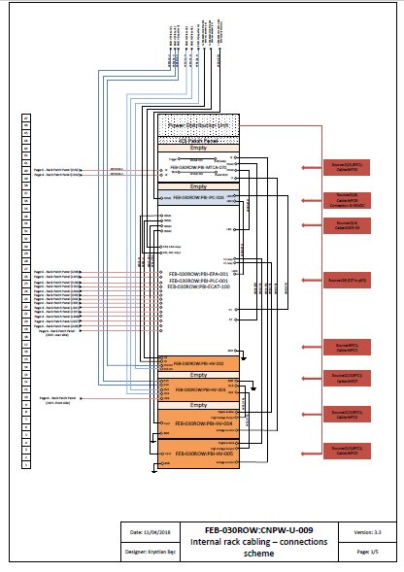
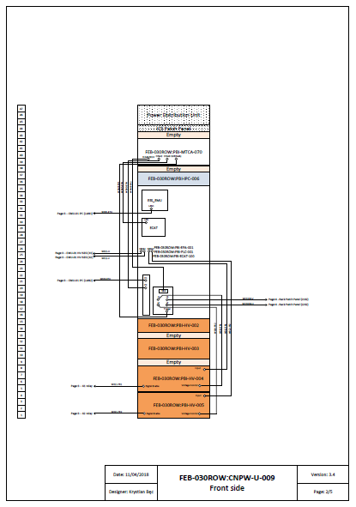
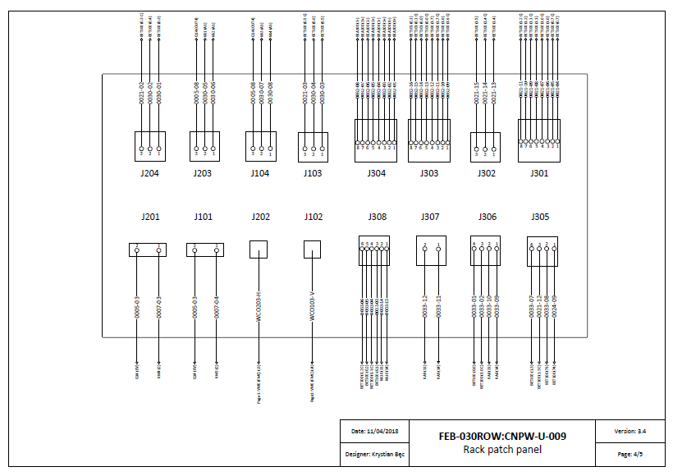
Ongoing Work
Based on 2D drawing they will be drawn in 3D in E-Plan Pro Panel.

Slide 5
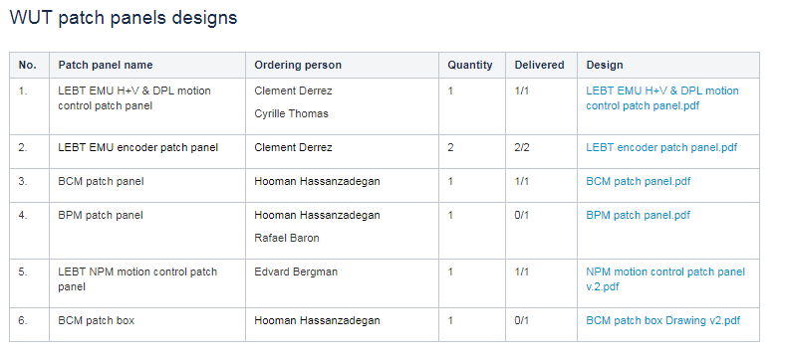
Ongoing Work
Designs and production patch panels for BD systems by WUT.
List of patch panels designed and produced for BD systems until Nov. 2018.

Slide 6
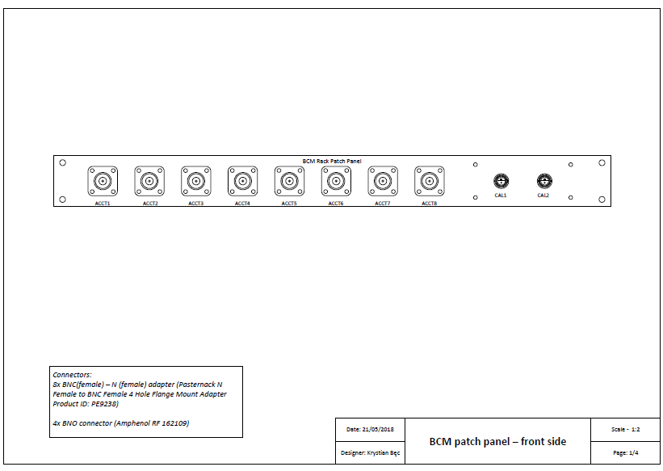
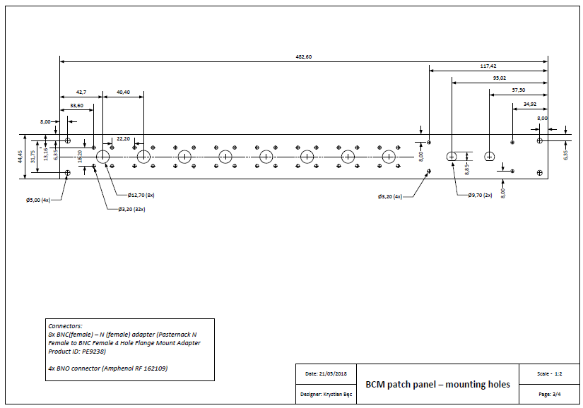
Ongoing Work
Designs and production patch panels for BD systems by WUT

Slide 7
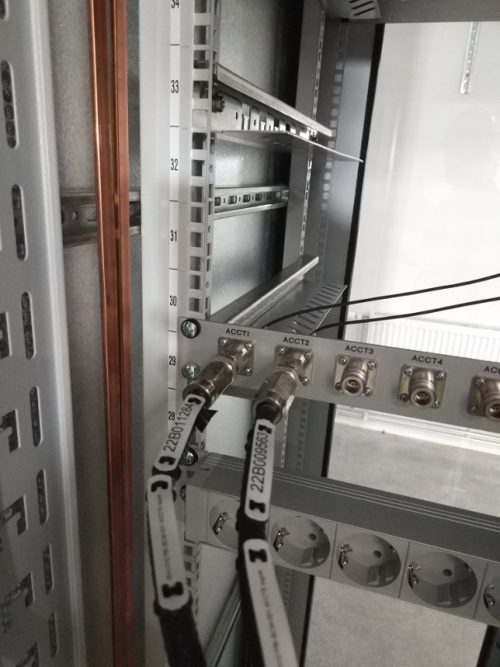
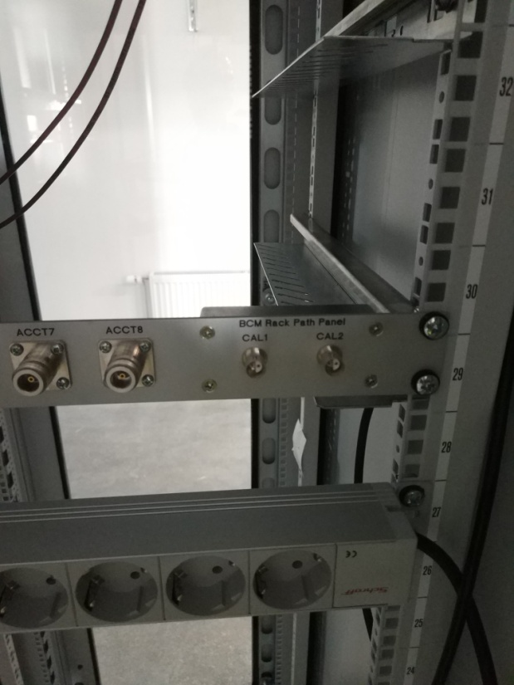
Ongoing Work
Designs and production patch panels for BD systems by WUT.
BCM patch panel from rack no. FEB-050ROW:CNPW-U-013

Slide 8
Issues
Main problems: poor or incomplete documentation necessary for work
(mainly internal rack connections, cables, connectors ect.)
Effects: can’t fulfill tasks in 100% - significant delays.
To effectively perform tasks WUT team needs a full documentation of diagnostics systems placed
in racks including:
cable connections,
types of cables,
types of connectors,
types of commercialy available devices and links to 3D drawings (to be implemented in E-Plan),
3D drawings of non commercial devices (to be implemented in E-Plan);
available at the latest first week of February 2019 to fulfill schedule.
More precise description of laboratory works is also missing.

Slide 9
E-Plan Pro Panel
Thoughts and experiences with E-Plan Pro Panel
Main problem right now is lack of training for the E-Plan Pro Panel software.
Polish team attended a course of E-Plan Electric P8 (only for 2D).
2. Is there any database where we could get all 3D models (racks electronics, components, devices etc. ?)
Data Portal (helpful E-Plan database – unavailable for use!)
3. Problem with stability (lags, network speed) during work through remote computer.

Slide 10
Thanks for your attention!

