Slide 1
BSM
S. Grishin (installation manager),
I. Dolenc Kittelmann (BSM system lead)
BI Forum, ESS, Lund, Sweden, 20-22/11/2018

Slide 2
BSMs @ ESS
Longitudinal Bunch Shape Monitoring (LBM)
  Originally foreseen 4 LBM devices along the ESS linac
  LBM1: MEBT
  LBM2: End of DTL (LEDP)
  LBM3 & LBM4: After Frequency jump (MB), at the end of HB – now both cancelled
MEBT & DTL LBM: Bunch Shape Monitor (BSM) – “Feschenko device”
  2 year contract with INR, Moscow (S. Feschenko, S. Gavrilov)
  Design and production of 2 BSMs
  Modernize RF deflector design
  Resolution improved from 1º to 0.7º

Slide 3
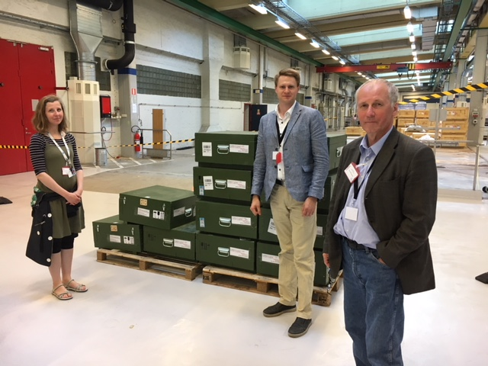
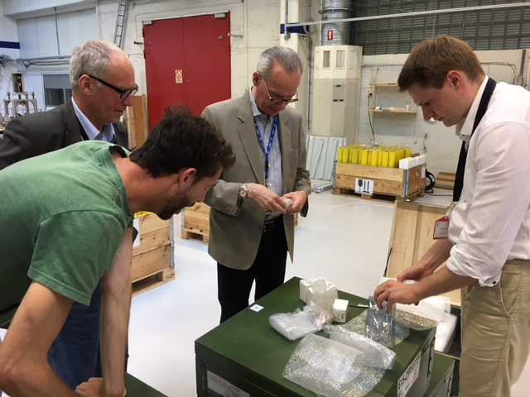
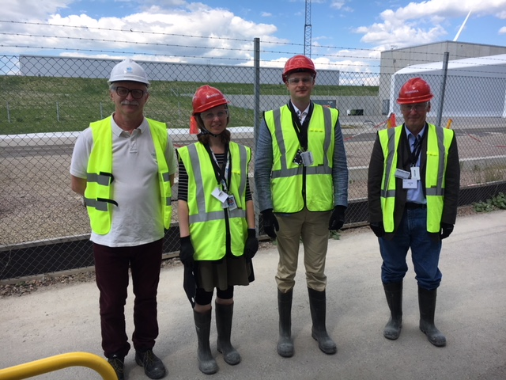
BSMs @ ESS
April 2018:
  2 BSM devices arrive to ESS: MEBT & DTL BSM
  On schedule
"On Monday, 23. April, 2018, two Bunch Shape Monitor (BSM) devices arrived to ESS, following a 2 year long design and fabrication period without any delay. The BSMs were designed and fabricated by a team of experts from INR, Moscow, Russia, lead by S. Gavrilov and A. Feschenko. The two devices, which were prior to shipment disassembled and packed in 11 boxes, are currently stored in the RATS space in Lund. They will be installed in the MEBT and LEDP sections of the ESS linac and will provide valuable information about the average time structure of the proton bunch as measured during the commissioning and start-up periods of the ESS linac.”
May 2018:
  Working meeting with S. Feschenko and S. Gavrilov
  Discussing installation plans, commissioning, DAQ

Slide 4
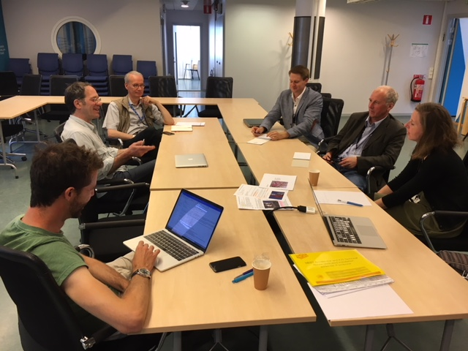
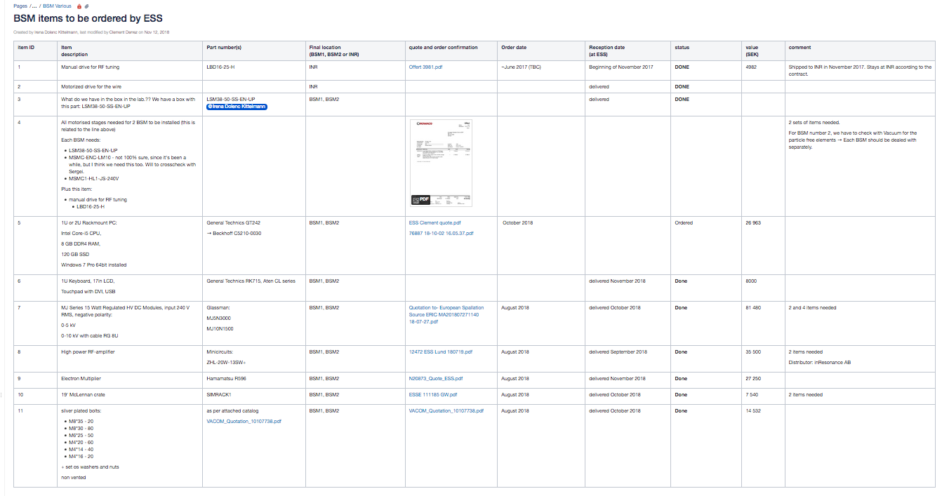
List of additional equipment
According to the contract with INR
Certain items provided by ESS
Procurement close to final (Clement)
  Orders: all in place
  Received: all items apart from one (rack mountable PC)

Slide 5
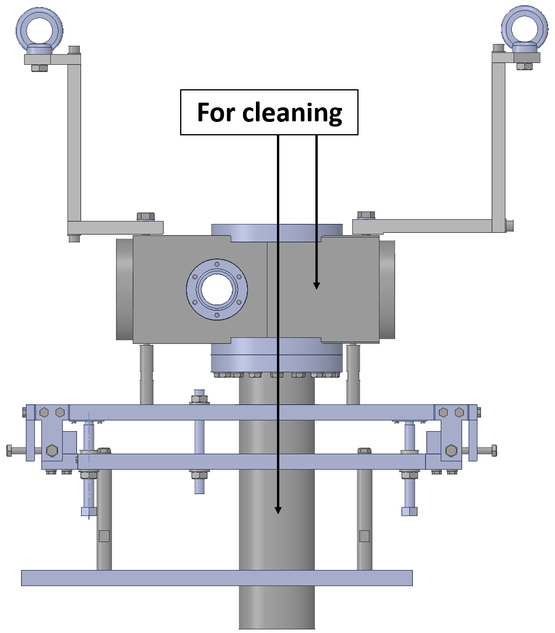
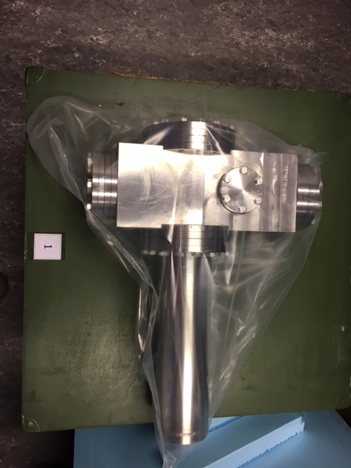
BSM cleaning (MEBT)
    BSM cleaning: necessary minimum to cross-check BSM-MEBT mechanical integration at Bilbao
Done
INR: ”ESS can open Box#1 (number one) to clean vacuum parts.
You will need to disassemble them, because it was packed as one part ready for installation”.

Slide 6
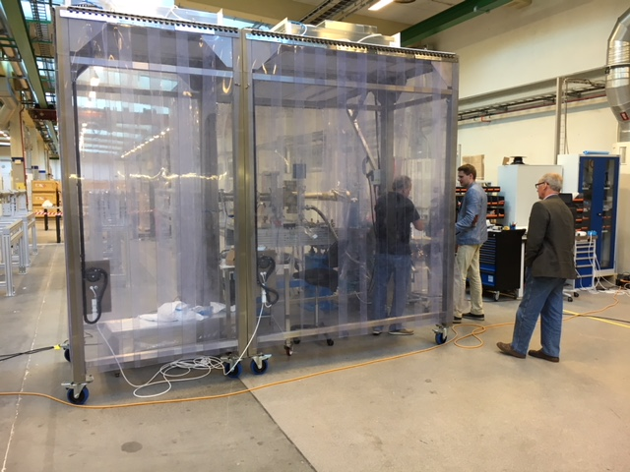
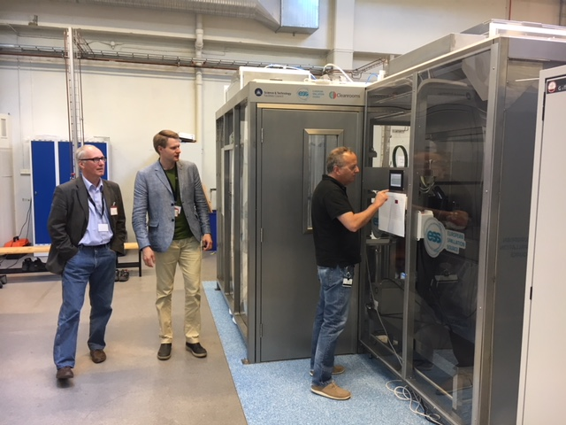
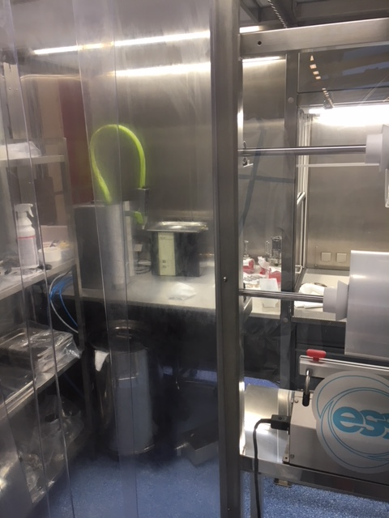
BSM cleaning at ESS vacuum facility

Slide 7
"big" BSM parts for UHV-cleaning

Slide 8
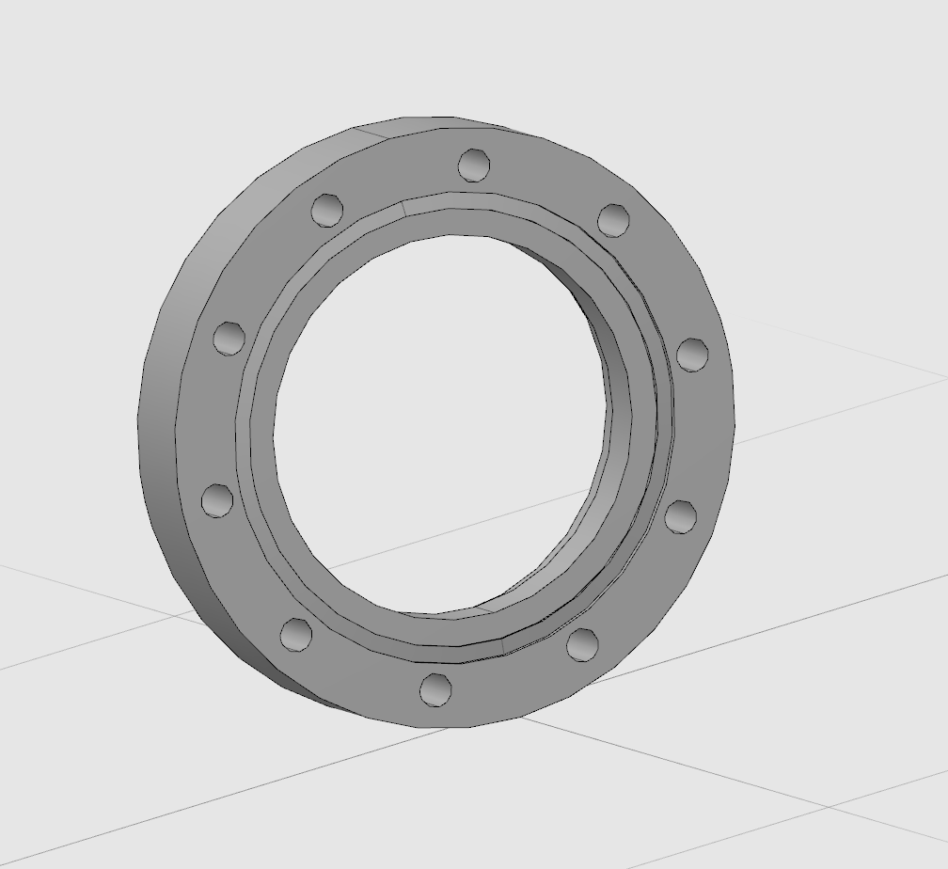
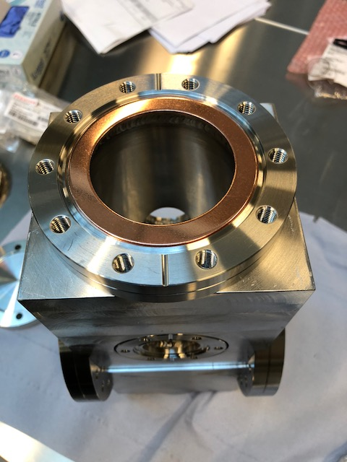
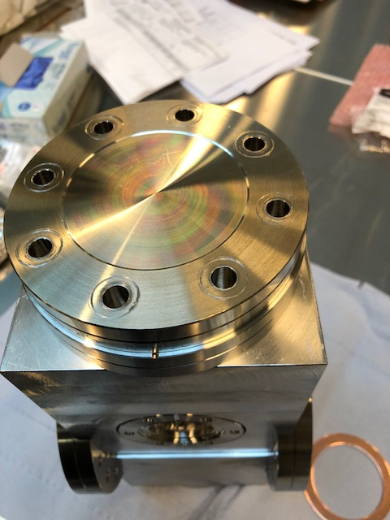
BSM cleaning : small lesson
After UHV cleaning, the next step was a leak check.
Assembling the BSM-MEBT with UHV blank flanges on one DN 63 CF flange – it doesn’t fit
It is a standard DN75CF (4.625" OD) flange (and gasket)

Slide 9
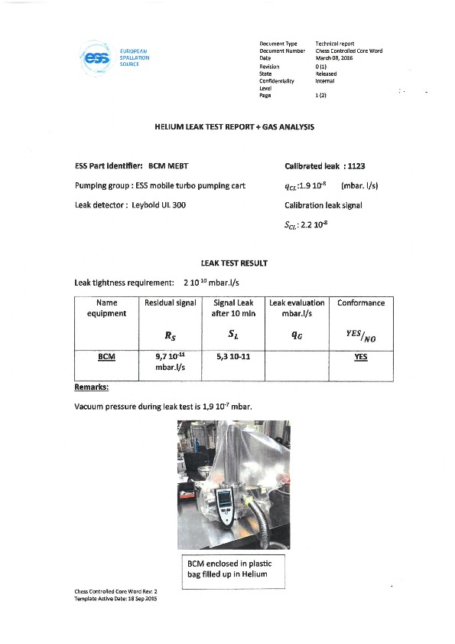
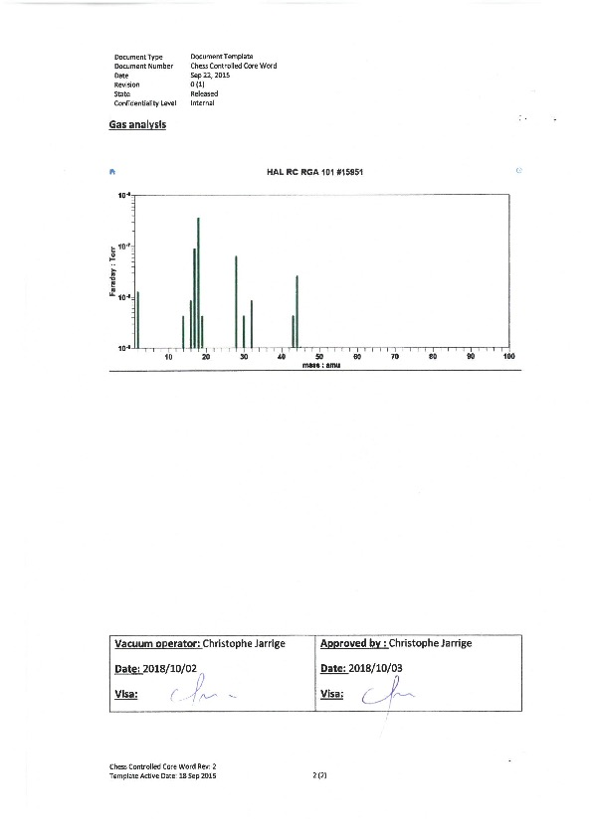
Leak test

