Slide 1
Infrastructure Project and Component Installation Accelerator Project
Olle Lagerblad
Installation Lead Infrastructure Project
Dep. Installation Coordinator Accelerator Project
European Spallation Source ERIC
2018-11-20

Slide 2
Overview
Agenda
Background
Vision and Strategy
In the pipeline
Scope of Work
Organization
Ways of Communicating
Ways of Working
Overview, IB
WO
RAMS, I-NCR
The goal
Summary

Slide 3
Background
The Infra Project started with the Front End Building (FEB) installation, a lessons learned (LL) on the work was performed. The outcome gave the need to improve:
design and installation documents
EIS project handbook/installation support function/build ability review
material definition and management
Plan for early procurement and definition of needed material “BOM”
Use more of the same “standardized”, Use relevant material in required functions
control and follow-up (design and project)
Installation room/follow-up matrixes/ reports to stakeholders/ planning and coordination's meetings/ meeting structure
management involvement and support
Trough steering comity and cross functional working group
better defined roles, responsibilities and processes
Role and responsibility descriptions in the project

Slide 4
Vision and Strategy
The Vision
Contribute to, and use ESS “harmonized” way off working
Identify key resources to relevant tasks, build competence for ESS
Develop concepts and requirements within ESS and use ext. contractors for time critical bulk work
Develop and refine processes “usability”
Work across the divisions to improve communication and cooperation
Use the power in the organization – if we work together
The Strategy
Use Skanska org for installation of Mech. Infra structure
Project Baseline design hand-over to Detail design NCF/ SPOKE, completed
Detailed design through external contractor - for Piping and Raceways, started
The work is done in a phased approach to support AD component installation
The target is to mobilize the installation contractors at 7 Jan, start installation at 14 Jan

Slide 5
In the Pipeline
Design for G01 & G02
Cable trays and pipes
Cable routing and termination (NCL and SPOKE)
All grounding design (components not included)
Power distribution
Baseline M-beta and H-beta Piping and raceways
Installation
STUB cable conduits and Waveguides
All cable trays and pipes in G01 and G02
Cable pulling and termination NCL
Gas pipe installation for BI

Slide 6
Scope of Work for Installation
The Scope of Work for Installation
Harmonized ways of working at ESS
Supervise and coordinate all installation activities
Planning, short term on site and long term
Execution and follow up on Division or Main project level
Coordinate and manage support activities
Interface between: In-Kind – ESS WP – Installation Package Lead
AD installation coordinator
IK partner
Installation package lead
AD Work package lead
AD Liaison Officers
Responsible for
Installation binder
Installation Readiness Review
Work order
Installation Non-Conformity Reports

Slide 7
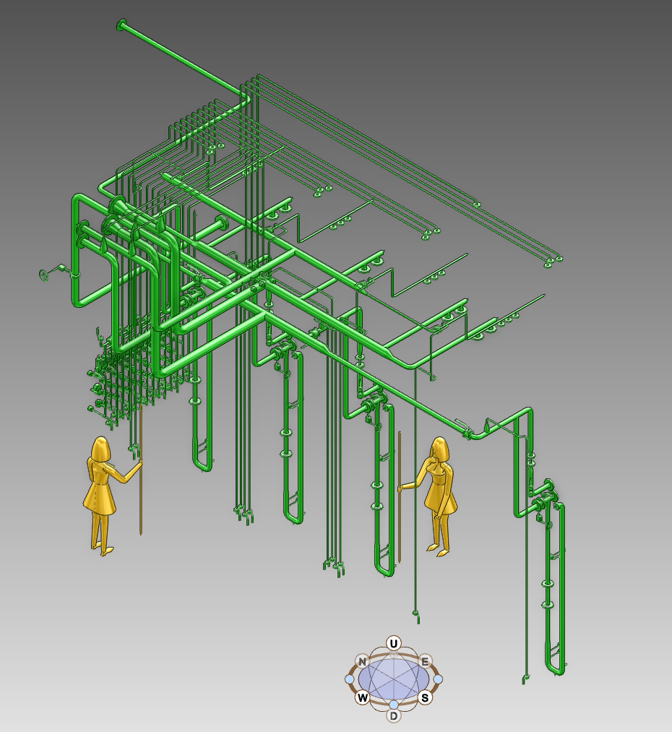
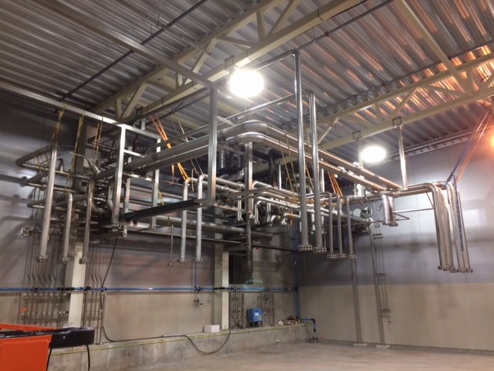
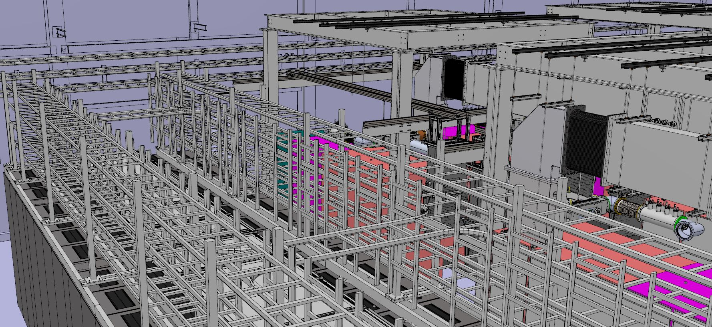
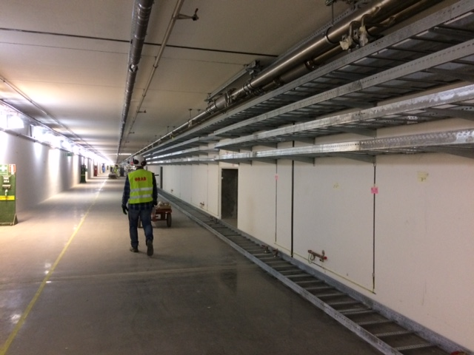
Scope of Work for Installation
The Scope of Work for the Installation of Infrastructure project
Components Installation Packages
WP3, 4, 5, 6, 7, 8, 10, 11, 12
Installation Package Lead (IPL) assigned by Work Package
IPL supported by Installation Organization
Infrastructure Installation Packages
Process and Piping
Cooling water and Drainage Systems
Pressurized Air
Gas Systems
Electrical
Cable Raceways and Conduits,
Electrical Power Distribution and Grounding
Racks and Rack cooling,
Cable coordination, Pulling Termination and verification
Assign Installation Package Leads

Slide 8
Installation Organization at Infrastructure and Accelerator
PM
Peo Gustavsson
PA/PC/Admin.
Ciprian/Fredrik
Design
Anton L
Installation
Olle L
Testing (SAT1)
Inigo A
QA/QC
Björn R
Electrical DD
High V / Low V
Jonas W
Electrical IPL TBD
Process & Pipe IPL TBD
CM/DM/Change mgt
Patrik W
Civil
CF Pre Ops
Civil IPL TBD
Electrical
TBD
Cabel DB
Design, installation and test follow up
Process&Pipe DD
Piero V
Process
Anton L
OSH
Nic E
System Design Owner
Frithiof J
System Design Owner
Anton L
Mechanical
Machanical IPL TBD
Component IPL Kristifer Falkland
Installation
Components IPL
Technicians
Service and Technical Support
Transportation
Lifting, Scaffolding
Rigging
Storage
Laydown Areas
Procurement
Boring &Drilling
Temporary services, H₂O, Power, Comp air.
Alignment
Work Shop
Integration
Electrical IPL
Area Coordinators
Civil IPL
Process & Pipes IPL
Mechanical IPL
Steering comity
John H
Roland G
Ken
Ralf T
Mikael J

Slide 9
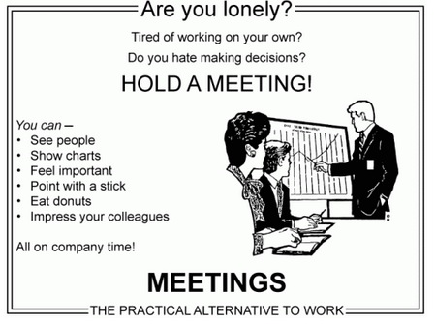
Ways of Communicating
Daily
War room meetings
Plan
Comply or explain deviations
Issues
Stand up meeting on site
Weekly
Installation detailed working and follow up meetings
Detail planning and organization of installation activities
Service needs (eg. transportation, storage, tools, workshops)
Installation binder
Commissioning
Installation and commissioning meeting “Information”
Share information
General presentations
Status updates
Safety /quality aspects
Issues solved/new
Once
Preliminary Design Review
Critical Design Review
Installation Readiness Reviews
Design Data
Time plan and installation sequence
Temporary Services
Safety
Quality
Feedback from Manufacturer
Test Reediness Review

Slide 10
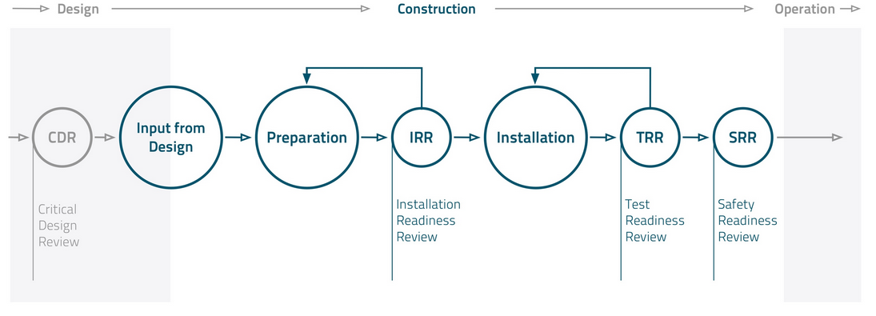
Ways of Working with Installation
“The project are here to supervise and coordinate all installation activities, planning, execution and follow up, on Division or Main project level”
Preparation and Planning
Installation Binder
Risk Assessment and Method Statement (RAMS)
Work Order
Installation Readiness Review
Installation (Perform your Work)
Pre-Job
Test Readiness Review
Documentation handover
Close down site activities
Work Review
Safety Readiness Review
*Detailed information to be found on: https://confluence.esss.lu.se/category/essinst
Chess document “ESS-0102864 - ESS Procedure for Preparation for Installation and Installation”
Input from Design
Preparation of IB
IRR
Installation
Test and Inspection
TRR
SRR

Slide 11
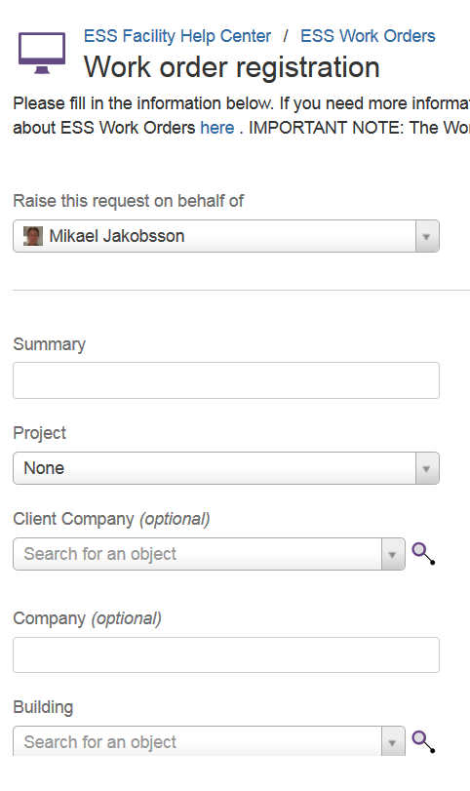
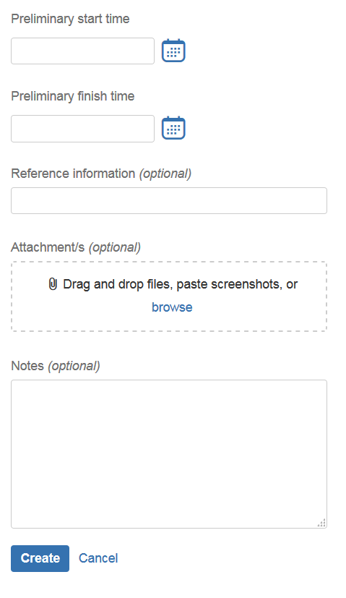
Ways of Working with Installation
The Work Order (WO) control the release of work and work/safety:
What/Who/How/Where/When
No work shall be executed unless it is planed and organized
Synchronize the work with other parallel work (same area)
To control plant conditions and equipment
To plan and organize delimitations and tag outs
The Work Order will mainly state:
Installation activity start and end time
Summary of the activity
Documents related to this activity (RAMS)
Any need for delimitations/tag outs
https://jira.esss.lu.se/servicedesk/customer/portal/11

Slide 12
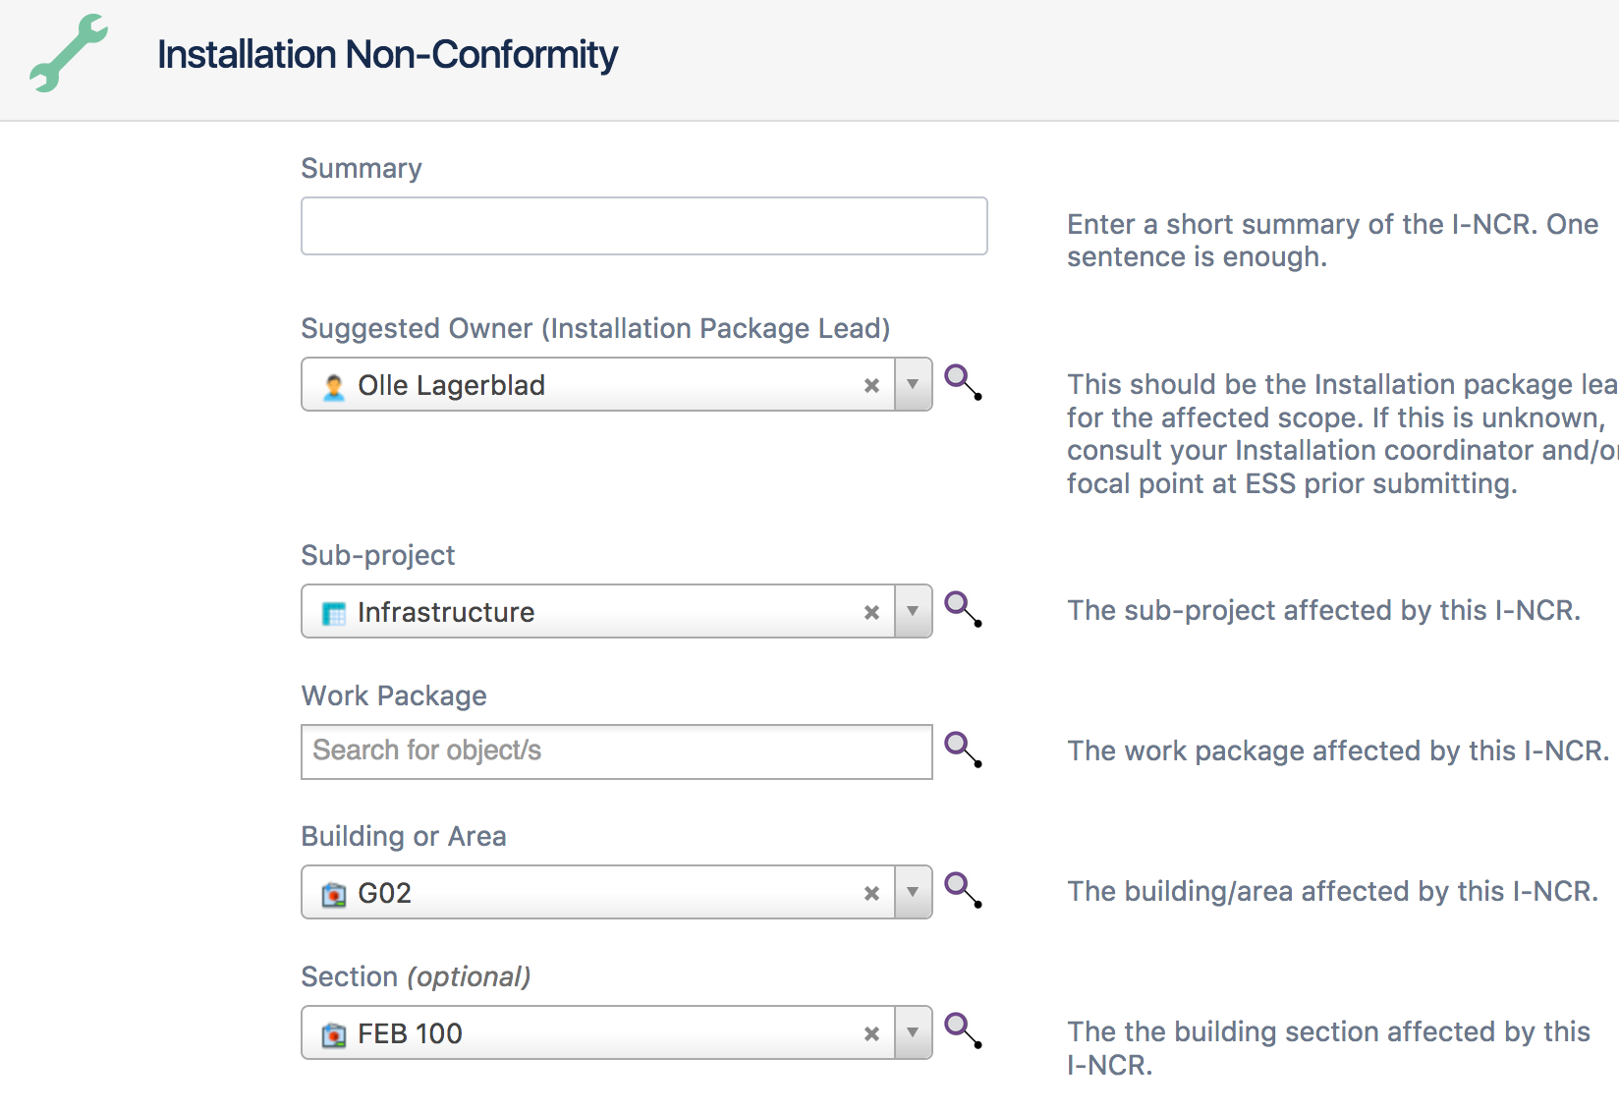
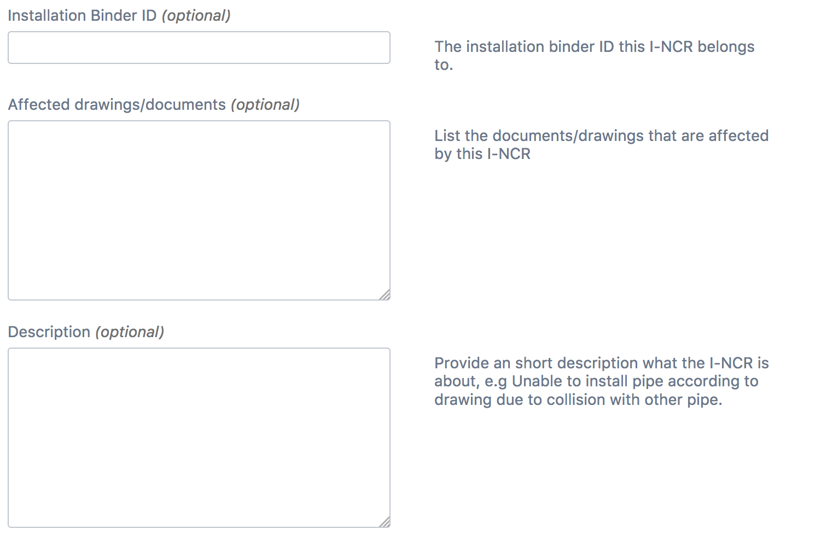
Ways of Working with Installation
Risk Assessment and Method Statement (RAMS)
What’s the purpose with a RAMS?
Identify hazards and associated risks for an activity and determine if sufficient controls are in place (to reduce the risks to an acceptable level)
Who is responsible for preparing the RAMS?
Installation Package Lead for making sure it’s prepared
Help and support from Safety and Installation Orgnization
What does a RAMS consist of?
The RAMS consists of two parts:
A method statement, i.e. a detailed break down/description of the work to be carried out and material to be used to perform this task
A risk assessment, i.e. identify the risks associated to the work steps detailed in the method statement. Including adjacent risk.
Installation Non-Conformity
RAMS: https://confluence.esss.lu.se/pages/viewpage.action?pageId=265308713
I-NCR: https://confluence.esss.lu.se/display/QUAL

Slide 13
The goal
High level ESS Objectives 2019
RFQ, MEBT and DTL 1 installed in the tunnel
Conditioning and commissioning of the RFQ, MEBT and DTL1 started
There are 3 critical paths, which feeds SRR 3 & 4;
RFQ – DTL 4 Beam on temporary dump, “Warm Linac”, 2020 June/July
DTL5 – Beam on Dump “Cold Linac”, 2021 April/May
Dump to Target, 2021 July/Aug RBOT, (2022 June BOT)

Slide 14
Summary
The project covers the infrastructure and accelerator components installation
The project are here to supervise and coordinate all installation activities, planning, execution and follow up, on Division or Main project level
Organization staring to form and being put into place
Ways of working “harmonized” with installation at ESS being established
There will be a lot of installations starting to happened in the coming 6 months

